Slide 1
Sept 2, 2009
Today’s Lecture
How to use the online syllabus
Mankiw’s 10 basic principles of economics (start)

Slide 2
Syllabus at
http://www.uvm.edu/~awoolf/

Slide 3
1. People Face Tradeoffs, or You Can’t Always Get What You Want

Slide 4


Tradeoffs: Which To Use?

Slide 5

Or This?

Slide 6
10 Principles of Economics
The Cost of Something is What You Give Up To Get It: Opportunity Cost
Rational People Think at the Margin—a little bit more, or a little bit less—and consider costs and benefits
People Respond to Incentives—Price is a Powerful Incentive

Slide 7
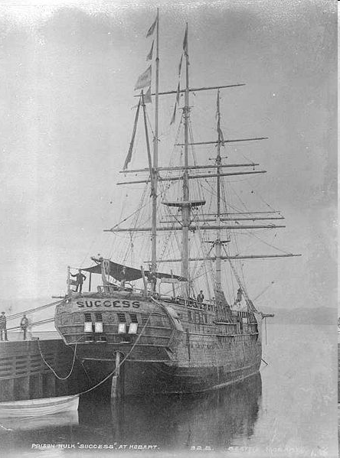
Incentives
Shipping Convicts to Australia, Late 1700s

Slide 8
Australian Baby Bonus
May 11, 2004 announce $2,000 (US) Baby Bonus starting July 1, 2004
June 30, 2004 500 babies born
July 1, 2004 1005 babies born
July 2, 2004 928 babies born
Babies born in early July are heavier than those born in late June

