Slide 1
Children and Race

Slide 2
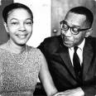
Kenneth and Mamie Clark

Slide 3
Background on Research on
Childhood and Race
Since 1930s
Few studies of young children
Traditional views
Piaget
Egocentric
Neglects social worlds

Slide 4
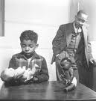
Doll Experiments

Slide 5

Kiri Davis

Slide 6


Davis’s Doll Experiment

Slide 7
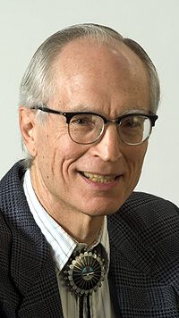
Joe Feagin

Slide 8
New Research
Van Ausdale and Feagin Study
Challenges Piaget
Children ages 3-5
Field Observations
11 Month Period

Slide 9
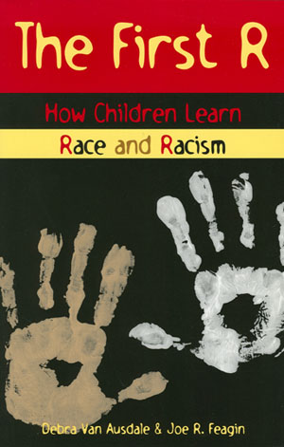
Van Ausdale and Feagin

Slide 10
Van Ausdale and Feagin Findings
Using Racial and Ethnic Concepts to:
  Exclude
  Include
  Define Oneself
  Define Others
  Control
Adult Misperceptions

Slide 11
Talking to kids about race
2006 University of Texas study
  Parents unable to discuss race with children
  Children had views on race
2007 study: Nonwhites less able to talk with their children

Slide 12
Katz Study
Tested children for 1st six years
Color-blindness did not exist
This period of children’s lives (when parents think it is important NOT to talk about race) is the very time when children’s minds are forming conclusions about race.

Slide 14
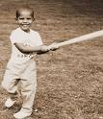
Biracial Children

Slide 15

Obama with his mother

Slide 16
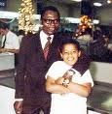
Obama with his father

Slide 17
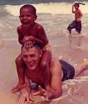
Obama and his grandfather

Slide 18

Obama at school

Slide 19
Questions
What was unique about Obama’s childhood experience with race?
In what ways were his experiences typical or common for American children?

Slide 20
Children and Biracial Experience
Interracial Unions
Mixed-Race marriages Illegal
Ruled unconstitutional in 1967
Mixed Race in U.S.
2000 Census
7 Million Americans
Half under the age of 18
Self Concept
Racial Ambiguity
“What are you?” Questions
Group Identity

Slide 21
Children and Biracial Experience
Interracial Unions
  Mixed–race marriages illegal
  Ruled unconstitutional in 1967
  Loving v. Virginia

Slide 22
Mixed Race in the U.S.
2000 Census
7 Million Americans
Half under the age of 18

Slide 23
Self Concept
Racial Ambiguity
“What are you?” Questions
Group Identity
“Racial Moments”

Slide 24
Recent Research on Children and Biracial Identity
Coping Strategies
Complex Identities
“Racial Moments”
Obama’s Experience

