Slide 1
Examining Instances of Embezzlement in Vermont Tyler Miles Barbara Arel Ph.D. University of Vermont Grossman School of Business
Notes:
Talk about how this was an undergrad honors thesis, interested in the topic because I am a Vermonter. Mention that this is a descriptive study

Slide 2
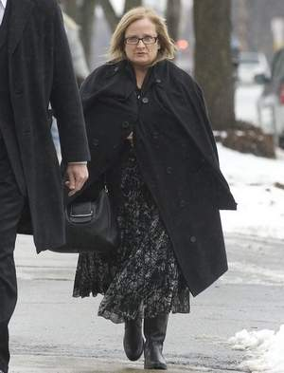
Agenda
Background
Research Questions
Results
Conclusions

Slide 3
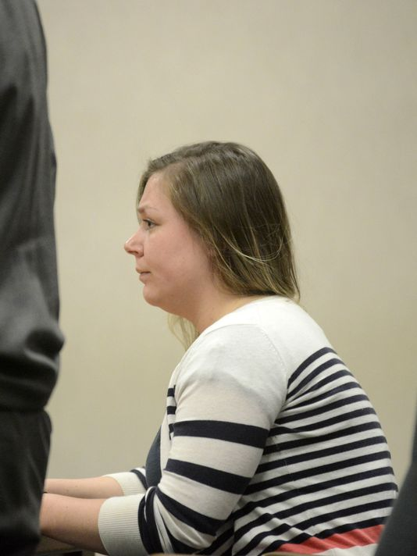
Introduction
Kiana Donegan case
Pinewood Development LLC and Tempo Home Furnishings victimized
Second embezzlement perpetrated to cover restitution for first
Five year deferred sentence
Agri-Mark case
Notes:
Kiana stole from Pinewood to pay her restitution due to Tempo. Pinewood unaware of previous embezzlement. Received five year deferred sentence. Agri-Mark just last week it was revealed that Ronald Rup (Head Technology Officer) was buying It equipment and selling it for cash

Slide 4
Background
Burlington Free Press Embezzlement Epidemic series (2011)
Marquet Report
Three Types of Fraud from ACFE 2014 Report
Corruption – ex. FIFA, Wal-Mart
Financial Statement Fraud - Enron
Asset Misappropriation – Rita Crundwell, renowned quarter house horse breeder, Dixon, IL over $50 million stolen
Notes:
Front page of Marquet Report, ACFE logo as well

Slide 5
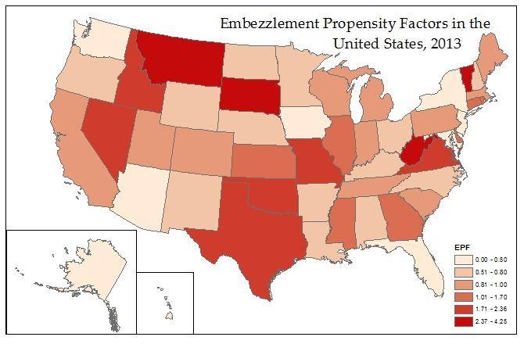
2013 Report Marquet
Notes:
Base on Marquet’s Propensity factor highest this year and has been the highest three of the six years this has been measured top 12 in 5 of 6 yrs

Slide 6
Research Questions
How does embezzlement occur in Vermont?
What can be done to curtail embezzlement in Vermont in the future?
Notes:
State of Vermont picture play with size of font

Slide 7
Methodology
Descriptive study
Timeframe: 2002 – 2014
Greater than $20,000 in losses
Searched databases of BFP and FBI records, etc.
Collected data about perpetrator’s age, industry of victim entity, losses, sentence length, scheme used, etc.
Notes:
Font larger, note the kinds of data collected, since SarbOX

Slide 8
Results
40 instances of embezzlement meeting the criteria were identified
39 different perpetrators
Total estimated losses upwards of $13,000,000
Average loss of about $333,000
Notes:
Mention that one person committed two crimes, losses by amount (band)

Slide 9
Ten Largest Cases
Alleged Main Perpetrator | Victim Organization | Losses ($)
Kenneth MacKay | Willis Management | 5,300,000
Joyce Bellavance | Hardwick Electric Department | 1,400,000
Debra Kinney | Border Lodge Credit Union | 633,702
Gisele Adams | Brault’s Mobile Homes | 567,000
Katy Lantagne | Vermont Department of Children and Families | 490,471
Karen Brisson | Town of Weybridge | 476,480
Sarah Sanville | Radiantec | 417,000
Manon Cote | DeLaBruere’s Auto Sales | 400,000
Donald Hewitt | Town of Ira | 350,000
Tonnie Sullivan | Rhino Foods | 311,000

Slide 10
Kinds of Schemes Used
From the Marquet Report
Credit card/account fraud
Forged/unauthorized checks
Fraudulent reimbursement schemes
Inventory/equipment theft
Payroll shenanigans
Theft/conversion of cash receipt
Unauthorized electronic funds transfers
Vendor fraud
Notes:
Get rid of definitions, explain four or five most relevant ones for Vermont
Explain: credit card, forged checks, vendor fraud (creating a bogus vendor), payroll shenanigans (improper reporting of time)

Slide 12
Losses By Scheme
Embezzlement Scheme | Vermont Losses | % | Nationwide (2013) | %
Forged/Unauthorized Checks | $6,511,193 | 49% | $139,118,000 | 23%
Vendor Fraud | $5,300,000 | 40% | $47,919,000 | 8%
Theft/Conversion of Cash Receipts | $866,651 | 7% | $79,088,000 | 13%
Credit Card / Account Abuse | $301,000 | 2% | $23,097,000 | 4%
Payroll Shenanigans | $296,726 | 2% | $166,260,000 | 28%
Other | 0 | 0% | $139,146,000 | 23%
Total | $13,322,320 | 100% | $594,628,000 | 100%
Notes:
Take all at 0% for Vermont and make into an other row, so it adds up to 100%, increase font, make % columns narrower

Slide 13
Characteristics of Perpetrators

Slide 16
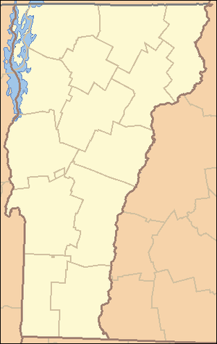
Embezzlements by County
8%
5%
8%
0%
5%
23%
8%
Chittenden - 25% population
13%
5%
0%
Washington - 10% population
Bennington - 6% population
5%
8%
Grand Isle - 1% population
10%
5%

Slide 18
Research Question #2
Segregation of duties
Approximately 80% of cases
Authorization, Recording, Custody
VT State Auditor recommendations
Forced vacations
Tone at the top
Code of ethics
Engaged management
Notes:
Hard to always determine where the failure was in the controls, in the majority of cases seg of duties, go through and check what percentage seg of duties was an issue, in vt with smaller businesses and towns there isn’t always enough folks, tone at the top can help with seg issues. Seg of duties PDF with recommendations for a two person set up custody, recording, authorization

Slide 19
Conclusion
Perpetrators tend to be middle aged women
Men steal more on average than women
Perpetrators usually held a position with some relation to accounting or finance
Usually organizations had lax internal controls in place and lacked the staff to properly segregate duties
Most embezzlement occurred through the perpetrator forging/tampering with checks
Notes:
Bullet, pick out key phrases,

Slide 20
Image Credits
https://en.wikipedia.org/wiki/List_of_counties_in_Vermont
http://www.clipartpanda.com/categories/handcuff-20clipart
http://archive.burlingtonfreepress.com/article/20120117/NEWS02/120117020/Joyce-Bellavance-sentenced-3-5-years-1-6M-embezzlement
https://www.sircon.com/stateInformationCenter/vermont.jsp

