Slide 1

Welcome…

Slide 2

…to the
Grossman School of Business
Orientation 2017

Slide 3

Agenda
About Grossman
Advising
Resources
Laws
Taking Classes
To Do List
Tomorrow’s Plan
Questions

Slide 4
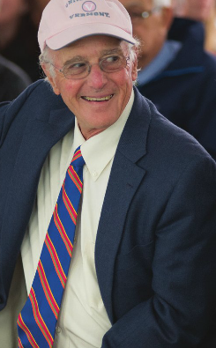
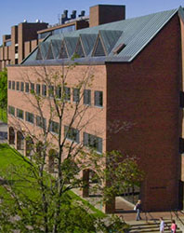
Grossman School of Business
Steve Grossman
Kalkin Hall

Slide 5

Advising
First and Second Years
  Jennifer Fath, Director
  Academic Advisors
  (Stephanie, David, Travis, and Lisa)
  Kalkin 101 – By appointment and Drop-in Office Hours
  What do we do?
Third and Fourth Years
  Assigned Faculty Advisor in your area of study
Notes:
What do we do? Support you on your journey. We walk with you – not in front of you, not behind you – but with you. We show you the tools and resources you’ll need to be successful. This is your journey, this is your degree. We are here by choice, just as you are, and we both have expectations and responsibilities. How do we support you? Course selection, Study Abroad, connecting you to resources on campus.

Slide 6

Resources
Center for Academic Success
The Tutoring Center
  Subject Area Tutoring (one hour per week, per class is free!)
  Study Skills
Student Accessibility Services
  Advising for students with learning and physical disabilities
  Exam Proctoring Center
  Students with IEP or 504
The Writing Center
Notes:
Tutoring Center: In Living and Learning. Online scheduling for most classes and you can arrange to meet your tutor at a convenient place on campus
The Writing Center: Located in the Bailey Howe Library. Schedule an appointment to work on variety of different writing assignments; research papers, labs, resumes, essays. Appointments can be made online at the Writing Center website.

Slide 7
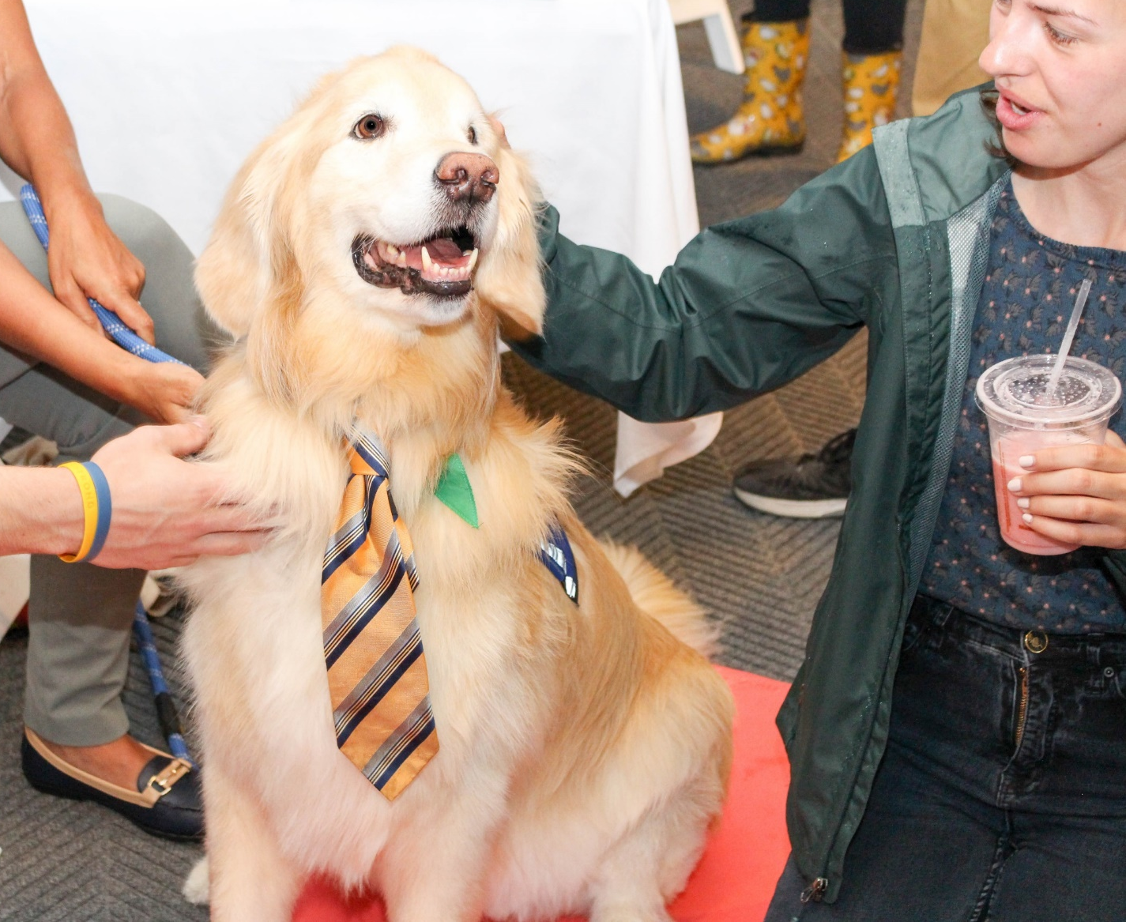
Resources
Counseling and Psychiatric Services (CAPS)
Student Health Services
GSB Peer Mentors
IT Support
  Free printing
  Hardware and Software support
Notes:
PM’s – Website with bios and you can select who you’d like to meet with. Peer mentors are available to meet with students individually or in groups. You can also meet with more than one peer mentor throughout the year.

Slide 8
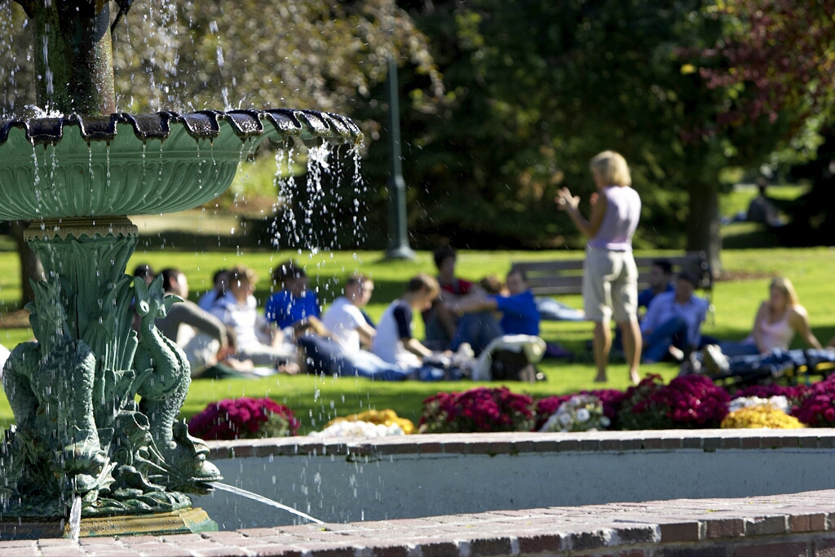
Resources
Academic Advisors
Faculty Members
Connect with campus resources
Most important point…
You are NOT alone!
Notes:
Students should save the email with links to all of the campus resources we talked about! This should arrive in your email about a week before classes begin.

Slide 9
Family Education Rights and Privacy Act
FERPA
  Federal Law
  What does it mean to you?
  We cannot discuss any information about you or your academic records to anyone outside of UVM.
  We require your permission to do so.
  Waivers are available at Student Services.
  Alcohol and Drug violations are not protected by FERPA.
  Talk to your parents about the law!
Notes:
More info on gray sheet in your folder.

Slide 10

Taking Classes at UVM
Read the syllabus
  Mark due dates on your calendar
  Purchase all books and materials
  Schedule homework/study time
Ask for help and/or guidance
Be respectful of peers and faculty

Slide 11

Taking Classes at UVM
Be familiar with the Academic Integrity Policy
  If it is not yours, cite it.
  All your work, assignments,
  tests, etc., must be done by you.
Attend class!

Slide 12
Four Year Plan for Career Success
FIRST YEAR: EXPLORE
Join a club Catamount Job Link
College resume Career Workshop
SECOND YEAR: EXPERIENCE
Study Abroad Leadership Opportunities Alumni Connections
98 % of GSB graduates are employed or continuing their education
within one year of graduation.
THIRD YEAR: FOCUS
Internships Job Shadow
Practice interviews LinkedIn
FOURTH YEAR: ACHIEVE
Request recommendations
Join Professional Associations
Career Fairs Elevator Pitch

Slide 13


Summer Reading

Slide 14
To Do List
Complete Summer Reading
Complete BSAD 010 readings
Send final HS transcript to UVM Admissions
AP Credits from College Board to Transfer Affairs
Purchase Laptop
Look for Student Staff paid positions (Federal Financial Aid)
Check your UVM email every day
Buy textbooks early
Contact Student Services with any questions/concerns

Slide 15

For tomorrow…
Advising
  Appointment times on your advising cards
Registration
  Registration is at Bailey-Howe Library
  Check-in 15 minutes early
  Be on time!

Slide 16
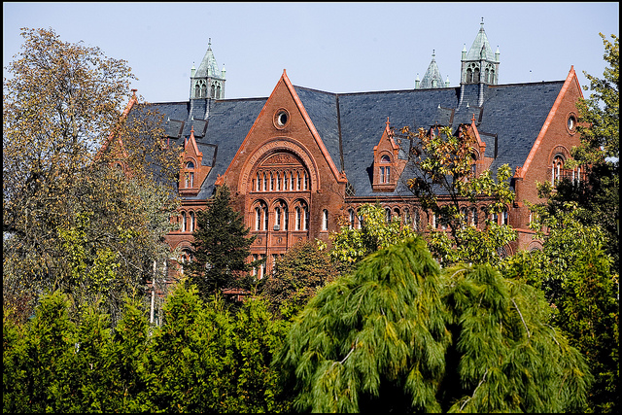
Questions?

