Slide 1
Family Orientation 2017
Jennifer K. Fath, M.Ed., Director of Student Services
Amy M. Tomas, Ph.D., Director of Undergraduate Programs
Notes:
JENNIFER

Slide 2
Agenda
Business Core & Field Requirements
Business Concentrations & Themes
General Education & University Requirements
Minors
Grade Point Average (GPA)
Advising & Student Services
Federal Laws (FERPA)
Support
Campus & Grossman Resources
Four Year Plan for Career Success
Summer To Do List
Questions
Steve Grossman
Notes:
JENNIFER

Slide 3
Basic Business Core Requirements
BSAD 010: The Business Enterprise
BSAD 015: Business Communications
BSAD 025: Sustainable Business Strategies
BSAD 030: Decision Analysis
BSAD 040: Information Technology & Management
EC 011: Macroeconomics
EC 012: Microeconomics
MATH 019 or 021: Calculus (MRT Placement)
BSAD 060: Financial Accounting
BSAD 061: Managerial Accounting
STAT 141: Basic Statistical Methods
Ifshin Hall opens fall 2018
Notes:
JENNIFER

Slide 4
Basic Business Core Requirements, cont.
No grade lower than a C-
Overall GPA of 2.25 or higher
Core classes must be completed by the end of sophomore year or 75 earned credits
Semester 1
BSAD 010
EC 011
MATH 019
(2) Gen Ed/Minor
Semester 2
BSAD 015
EC 012
BSAD 040
(2) Gen Ed/Minor
Semester 3
BSAD 025
BSAD 060
STAT 141
(2) Gen Ed/Minor
Semester 4
BSAD 030
BSAD 061
(3) Gen Ed/Minor
BSAD 002
Notes:
JENNIFER

Slide 5
Business Field Requirements
BSAD 120: Leadership & Organizational Behavior
BSAD 141: Information, Technology, & Business Systems
BSAD 150: Marketing Management
BSAD 173: Operations Management
BSAD 180: Managerial Finance
* Overall 2.00 GPA or higher
Notes:
AMY

Slide 6
Business Discipline Concentrations
Accounting
Business Analytics
Finance
Marketing
Each concentration requires:
Five 3-credit Business courses above the 100 level
Overall 2.00 GPA or higher
Notes:
Students declare a concentration by end of sophomore year
Students can double-dip one theme course to their selected concentration
Notes:
AMY

Slide 7
Business Strategic Interdisciplinary Themes
Entrepreneurship
Global Business
Sustainable Business
Each theme requires:
Four 3-credit Business courses above the 100 level, including capstone course
Overall 2.00 GPA or higher
Notes:
Students declare a theme by end of sophomore year
Students can double-dip one theme course to their selected concentration
Notes:
AMY

Slide 8
General Education & University Requirements
General Education Requirements
English Writing
Social Science
Natural Science (lab optional)
Humanities
University Requirements
Foundational Writing & Information Literacy
SU: Sustainability
D1: Race & Racism in the U.S.
D2: Human & Societal Diversity
QR: Quantitative Reasoning
Notes:
AMY

Slide 9
Minors
Students are required to complete a minor outside of Business with a 2.00 GPA or higher
Most minors average six courses, 18 credit hours
Sample list of popular minors for Business majors is provided below
Languages
CHIN
FREN
GERM
JAPN
SPAN
RUSS
ITAL
Social Sciences
ANTH
EC
ENVS
GEOG
POLS
PSYS
SOC
Applied
Applied Design
Green Building
NFS
PRT
Computer Science
MATH
STAT
SMGT
Coaching
Humanities
ENG
HST
MUS
PHIL
REL
THE
Notes:
AMY

Slide 10
Grade Point Average (GPA)
Final grades carry a corresponding point value. The quality point value and the credit hour value determine a student’s semester grade point average (GPA). The cumulative grade point average is the student’s total quality points for all semesters divided by his/her total credit hours.
Quality Points by Letter Grade
Computation of Grade Point Average (GPA)
To calculate the total quality points, multiply the quality points for each grade by the number of credits earned for the course.
BSAD 010 A 3 credits x 4.00 = 12.00
MATH 021 B 4 credits x 3.00 = 12.00
EC 011 A- 3 credits x 3.67 = 11.01
SOC 019 B+ 3 credits x 3.33 = 9.99
ENGS 001 A- 3 credits x 3.67 = 11.01
Total: 16 credits and 56.01 quality points
56.01quality points/16 credits = 3.50 GPA
A+ | A | A- | B+ | B | B- | C+ | C | C- | D+ | D | D- | F
4.0 | 4.0 | 3.67 | 3.33 | 3.0 | 2.67 | 2.33 | 2.0 | 1.67 | 1.33 | 1.0 | .67 | 0
Notes:
JENNIFER

Slide 11
Advising
First and Second Year Students
Jennifer Fath, Director
Academic Advisors
(Stephanie, David, Travis, and Lisa)
Kalkin 101 – By appointment and Drop-in Hours
Third and Fourth Year Students
Assigned Grossman faculty advisor in student’s area of student (align with declared concentration or theme)
Notes:
JENNIFER

Slide 12
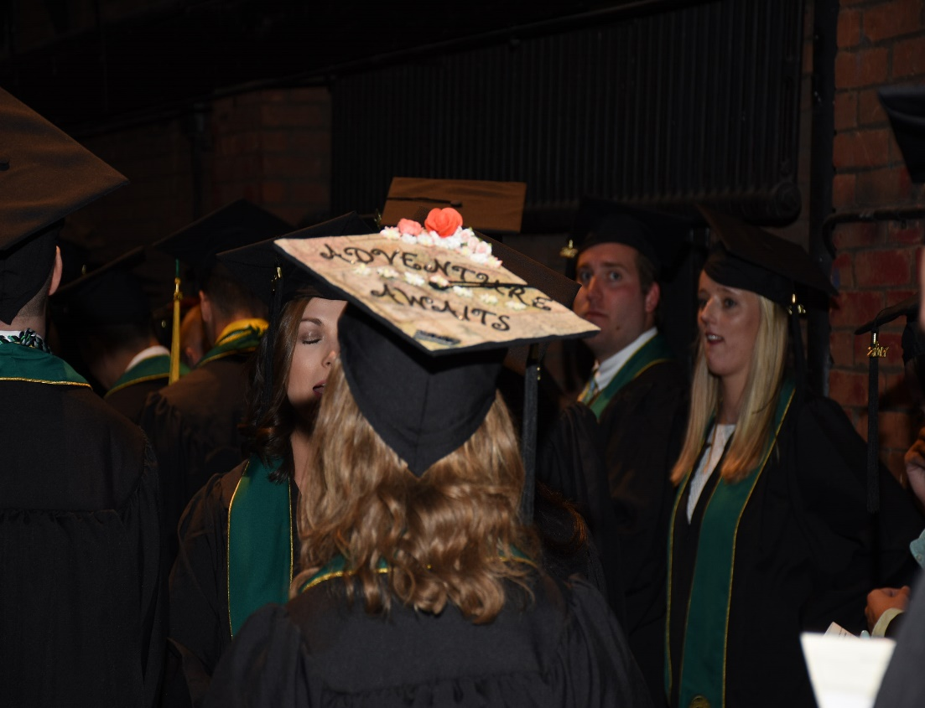
Grossman Student Services
Questions about dual-degrees, majors and minors
Connecting with faculty members
Referrals to campus resources
Manage GPA requirements
Engagement opportunities
Honors Day & BGS
Study abroad advising
NCAA compliance
Commencement
Notes:
JENNIFER

Slide 13
Family Educational Rights and Privacy Act (FERPA)
Family Educational Rights and Privacy Act
Federal law that protects the privacy of student education records. The law applies to all schools that receive funds under an applicable program for the U.S. Department of Education.
Rights to academic information transfer to the student when s/he reaches the age of 18 or attends a school beyond high school.
Alcohol and drug violations are not protected by FERPA!
PLEASE TALK TO YOUR STUDENTS! Students can opt to sign a waiver, but collaboration is key.
Notes:
AMY

Slide 14
How to Support Your College Student
Questions to Ask:
What is your favorite class?
What is your least favorite class?
Do you understand your syllabi?
Have you had any exams recently?
Have you found a good place to study?
Have you received any academic alert notices?
How are you figuring out your current grade in each course?
Have you contacted your advisor?
Are you getting involved? ~ Clubs, Sports, Greek Life, TREK, VIA, Study Abroad
When to contact Student Services:
Any emergency!
You suspect something is wrong academically or personally with your student.
There is a family issue which affects the well-being of your student.
Basic curriculum/university policy questions.
Notes:
AMY

Slide 15
Campus Resources
Center for Academic Success
Tutoring
Study Skills
Advising Hub
Writing Center
Career Center
Residential Learning Communities
Counseling & Psychiatric Services (CAPS)
Student Health Services
Student Accessibility Services
Notes:
AMY

Slide 16
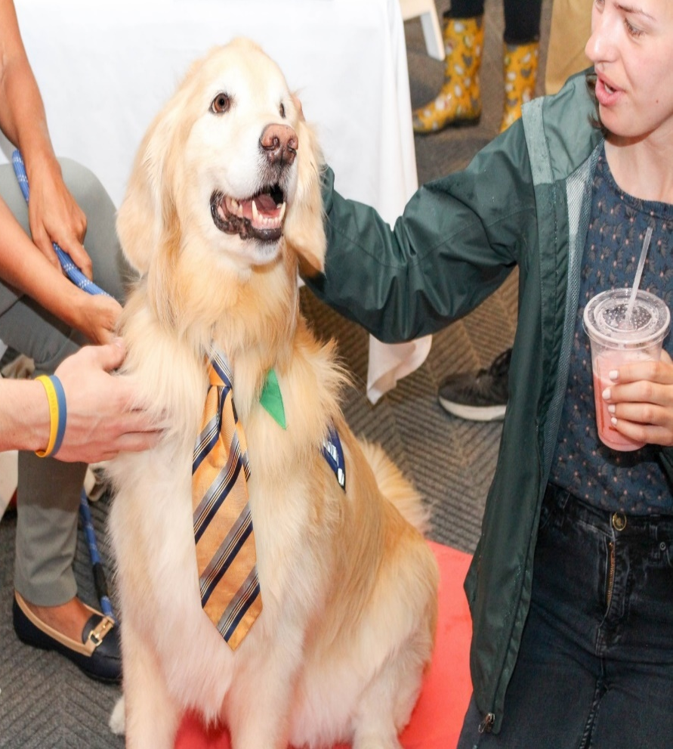
Grossman Resources
Academic Advisors
Career Advisors
Peer Mentors
Faculty Members
Degree Audit, Handbook, Catalogue
IT Services
Free printing
Hardware & Software support
Notes:
AMY

Slide 17
Four Year Plan for Career Success
FIRST YEAR: EXPLORE
Join a club Catamount Job Link
College resume Career Workshop
SECOND YEAR: EXPERIENCE
Study Abroad Leadership Opportunities Alumni Connections
98% of GSB graduates are employed or continuing their education
within one year of graduation.
THIRD YEAR: FOCUS
Internships Job Shadow
Practice interviews LinkedIn
FOURTH YEAR: ACHIEVE
Request recommendations
Join Professional Associations
Career Fairs Elevator Pitch
Notes:
AMY

Slide 18
Summer To Do List
UVM summer reading & complete BSAD 010 reading and reflection activities: books on sale at UVM Bookstore during orientation for a 20% discount
Send final high school transcript to UVM’s Admissions Office
Send AP credits directly from College Board and official college level transcripts to UVM’s Transfer Affairs Office - (Questions? transfer@uvm.edu)
Purchase Laptop Computer (Questions? help@bsad.uvm.edu)
Contact Student Services (studentservices@bsad.uvm.edu) regarding any changes to fall course schedule
Research work-study positions
Student Services has office positions available (pick up an application at orientation)
Check UVM email regularly. E-mail is the MAIN METHOD of all formal UVM communications!
Text book information will be available in early August through the UVM bookstore website
Notes:
JENNIFER

Slide 19
Summer Reading…
University Summer Reading
BSAD 010 Summer Reading
Notes:
JENNIFER

Slide 20
Questions?
Notes:
JENNIFER

