Slide 1
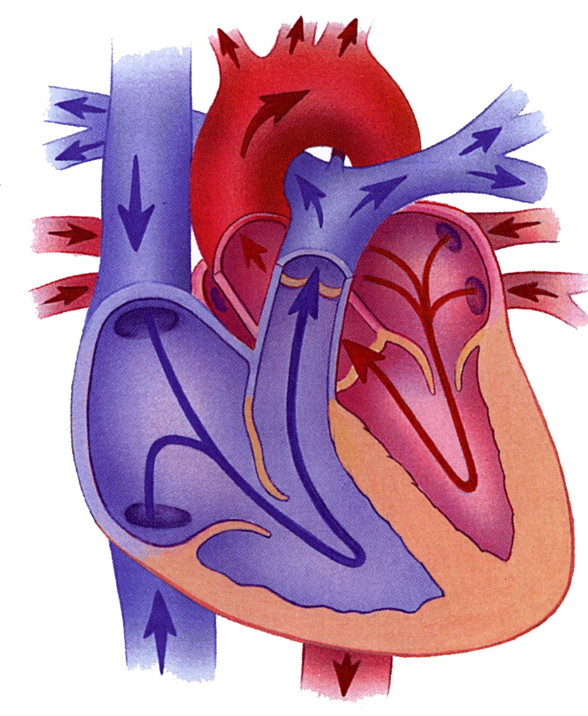
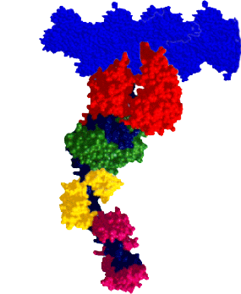
Heart Failure:
Genetic Defects in the Molecular Motors that Power the Heart
David M. Warshaw, Ph.D.
Molecular Physiology & Biophysics
Myosin Molecular Motor
Notes:
Myosin is 5,000 times smaller than the diameter of a human hair.

Slide 2

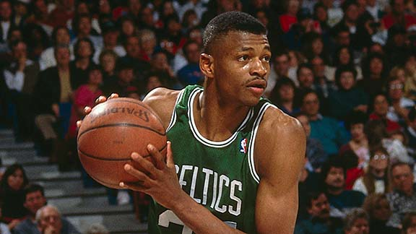
Genetic Defects in Myosin Motor
Hank Gathers
Reggie Lewis
Leading cause of sudden death in young adults.
1 in 200 people have genetic defect (3,100 Vermonters)

Slide 3
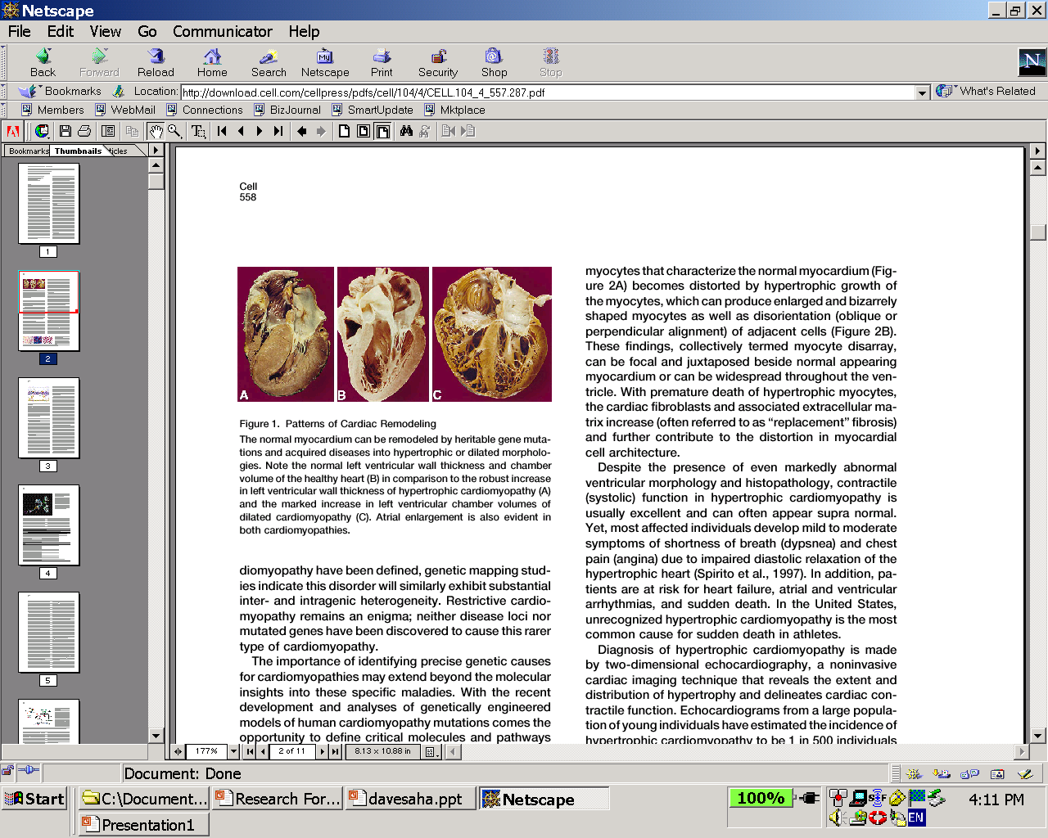
Familial
Hypertrophic
Cardiomyopathy
(FHC)
Dilated
Cardiomyopathy
(DCM)
Normal
Seidman and Seidman Cell (2001)
Notes:
Notice how thick the hearts muscle is compared to the normal heart for FHC and how thin the wall is for the dilated cardiomyopathy

Slide 4
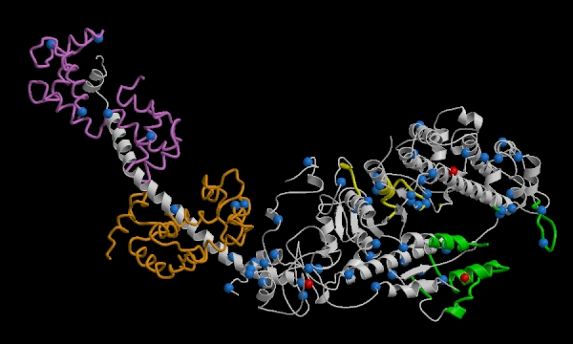
Myosin Genetic Mutations
R403Q
2000 amino acids
S532P
Hypertrophic
Dilated
http://genetics.med.harvard.edu/~seidman/cg3/HCM_DCM_myosin_jpg.html
Notes:
This is the atomic structure of the myosin molecule. The myosin molecule is made up of 2000 amino acids these are the nuts and bolts and all it takes is a mutation to one of these nuts and bolts to result in cardiomyopathy. The question is how do mutations that appear to be next to each other result in such different effects on the heart. Most widely accepted view of the mutation’s effects is that it would compromise mechanical performance.

Slide 5
Power = Force x Velocity
Myosin Molecular Motor
Notes:
Impaired power might lead to cardiomyopathies
5000 X smaller than the diameter of a human hair.

Slide 6
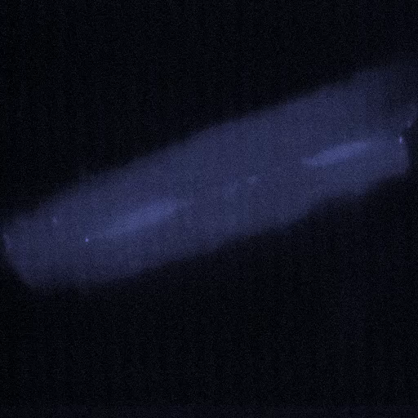
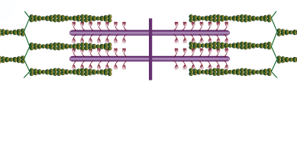
Heart
Cell
Sarcomere
Actin
Myosin
Notes:
150 Million Myosin molecules in a cardiac cell.
Myosin is the motor and actin is the rope that myosin pulls on.

Slide 7
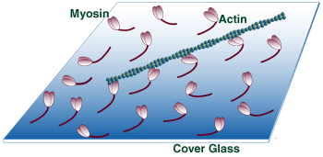
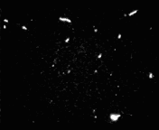
Motility Assay
http://motility.york.ac.uk/
Actin Filament Velocity ~ Muscle Velocity
Notes:
To measure the molecular force and motion generation we get samples of human heart muscle that allows us to extract the myosin motors and the actin ropes. We can then attach the myosin to a microscope slide and add actin filaments or ropes and myosin will do what it always does and that is to grab onto the actin and move it.
However to measure the power that a single myosin motor generates we had to develop a way of grabbing onto a single actin filament, shown in the next slide.

Slide 8
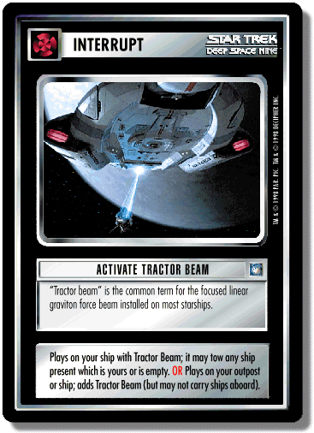
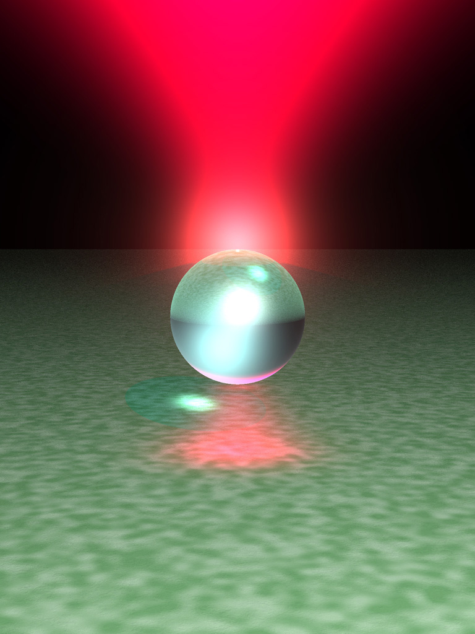
Star Trek Tractor Beam
Laser Trap

Slide 9
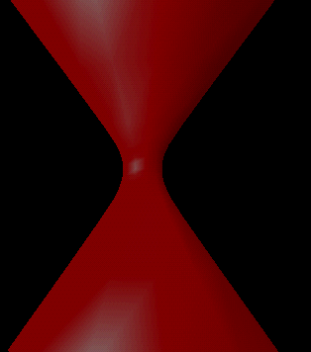
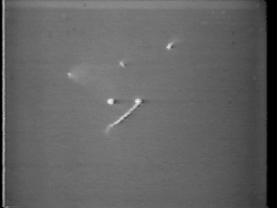
Single Molecule Laser Trap Assay
Notes:
So what we do is use this laser trap technology to trap dielectric spheres roughly a micron in diameter. In this picture you can see two beads trapped in two different laser traps. Attached to the bead on the right is a fluorescently labeled actin filament. What I’m going to show you now is how we attach the other end of the actin filament to the other bead.
Actin is 10,000 thinner than human hair.

Slide 10
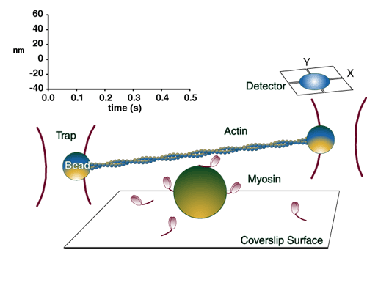
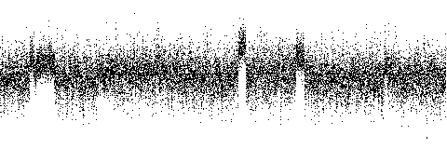
Laser Trap Assay
Y
X
Detector
Actin
Trap
Myosin
Coverslip Surface

Slide 11
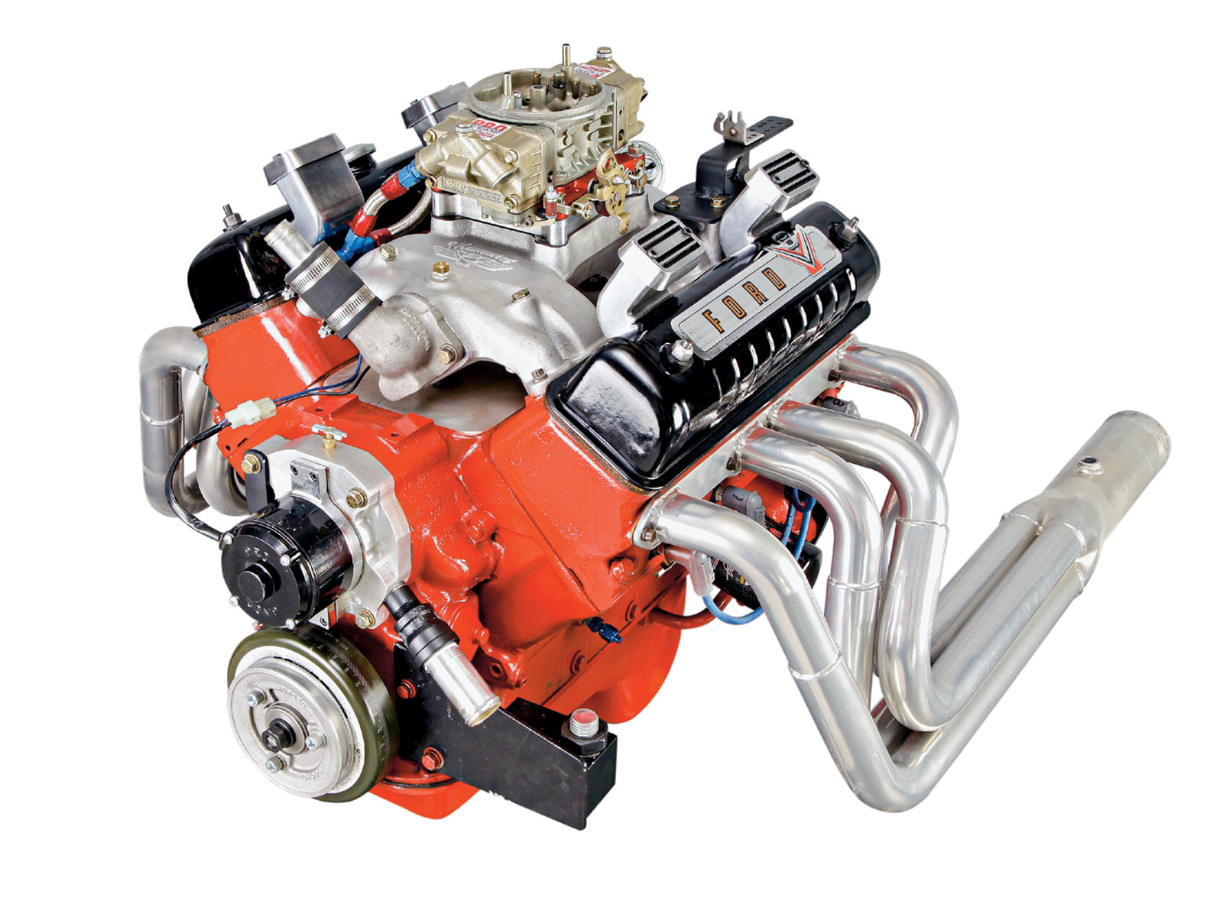
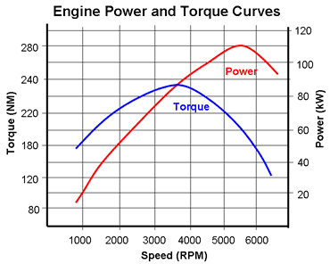
Heart is the Ultimate Power Generator!
450 Million
Revolutions
3 Billion Beats

Slide 12
Power vs. Force Relation
P_{max}
Normal
0.0
0.5
1.0
Notes:
Prevailing view was that FHC resulted in diminished motor power generation and thus the hypertrophy but in fact the opposite was true. Our lab discovered this.

Slide 13
Depressed
Motor
Function
Enhanced
Motor
Function
-
+
Function
DCM
FHC

Slide 14
Cardiomyopathies:
Defects in the Molecular Motors that Power the Heart
Future Perspectives
Genetic Testing or Simple EKGs
Precision and Individual Therapeutics:
Enhance Myosin Power in Dilated Cardiomyopathy
Reduce Myosin Power in Hypertrophic Cardiomyopathy

Slide 15
University of Vermont

