Slide 1



Huron kickoff
University of vermont
February 20, 2018
© 2016 HURON CONSULTING GROUP INC. AND AFFILIATES. ALL RIGHTS RESERVED.

Slide 2

Team introductions the huron team

Slide 3
Introductions
Project Team
Huron
Jared Eicher | Project Manager (Albany, NY) Main Contact | jeicher@huronconsultinggroup.com | (312) 515-0853 | Core Team
Tony Haber | Delivery Director (Portland, OR) Account Manager & Escalation Contact. | thaber@huronconsultinggroup.com | (503) 748-3926 | Steering Team
Jonathan Hunter | Manager (Houston, TX) Focusing on IRB Regulations and HRPP Evaluation and Accreditation | jhunter@huronconsultinggroup.com | (202) 821-5997 | Advisor as needed
Philip Infurna | Managing Director (Boston, MA) Highest Escalation Contact. Provides high level oversight. | pinfurna@huronconsultinggroup.com | (617) 959-7962 | Advisor

Slide 4
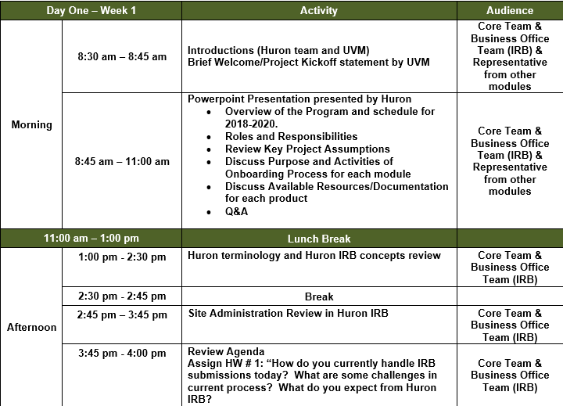
Today’s agenda

Slide 5
Program review scope & criteria
Review of SOW goals, scope, criteria and goals/expectations.
Footnote goes here, delete if not needed
Footnote goes here, delete if not needed

Slide 6
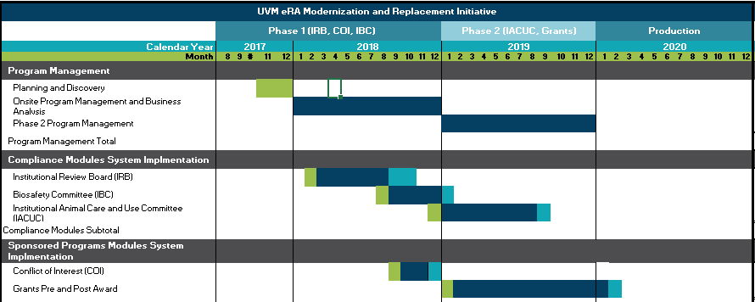
Program schedule
2018-2020

Slide 7
GOALS/objectives as per sow
  Improve Investigator Satisfaction
  Improve Staff Satisfaction and Productivity
  Increase Transparency and Access to Data
  Improve Data Quality
  Modernize Technology
  Strengthen Compliance
  Support Growth
  Enhancement Reporting

Slide 8
SUCCESS METRICS
Project will go-live within allocated budget and timeline
All IRB submissions completed in Huron IRB starting by X
Completion of all critical & high priority tasks/issues prior to go-live
Sunset sub systems and shadow systems in core offices
% of people that have attended training and feedback rating
Complete periodic feedback sessions during iteration with both research administrators and researchers
What metrics does your office currently have that will allow an “apples to apples” comparison?

Slide 9
Managing scope should always ask the following
Does the feature support our project objectives?
What are the risks of adding the feature?
How does the feature affect the future upgrade path?
Do we have an estimate for the feature?
What impact on timeline and testing will the feature have?
Does the feature follow best practice considerations?

Slide 10
Roles/responsibilities
Role | Description | Name(s)
Executive Sponsors | Provides organizational support for the project and team members and act as an advisor and ultimate decision maker if necessary | Dr. Richard Galbraith Brian Prindle
Project Manager/Business Analyst | Develop project plan, manage project deliverables and tasks, communicate project status, manage risks, escalating issues to project sponsor as necessary, ensure project is completed in budget, on time, and within scope | Lynn Tracy (UVM) Jared Eicher (Huron)
Business Office Team | Provide UVM input into the decision making for business process, system configurations, and general requirements. Direct change management activities and communications across the research community and stakeholders. | Donna Silver (IRB, IACUC, IBC) Sonja Stern (Grants) Victoria Jones (COI)

Slide 11
Roles/responsibilities
Role | Description | Name(s)
Technical Lead | Provide technical expertise in all phases of system development, ensure technical standards are followed, and develop interfaces, customizations, and reports as needed. | Huron Resource
Technical Resource | Conduct system configurations, data loads, data conversions and unit testing. | Huron Resource
Technical Integration and Data Conversion Support | Provide expertise necessary to produce data files for integration between InfoEd and Huron as well as data files for the data conversion of legacy modules into Huron. | UVM Resources
Trainer | Develop end-user training materials, provide initial end-user training, and continue to provide training as needed. | UVM and Huron

Slide 12
Deliverables/major tasks
Project Schedule
Training Strategy
Testing Plan
Communication Strategy
Updated business documentation
Data Conversion Strategy
Post Production Support Plan

Slide 13
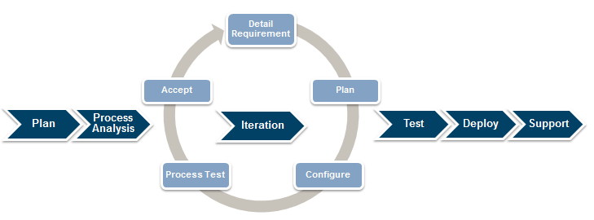
methodology

Slide 14
Why onboarding?
Purpose, activities & audience
Footnote goes here, delete if not needed
Footnote goes here, delete if not needed

Slide 15
Why onboarding? purpose
The purpose of onboarding is for those who will be shaping the design of the system to fully understand how Huron IRB works and what changes to the site would cause additional maintenance to keep the implementation on the upgrade path.
  Out of onboarding the core team will:
    Be trained on the Huron IRB solution
    Be able to communicate the value of the project to the institution
    Identify the strategy for Protocols/Modifications/Continuing Reviews/RNIs into Huron
    Identify desired changes to be made to the site in time for go live
    Identify business processes to be updated to support the new system

Slide 16
why onboarding?
Key activities
Key activities during onboarding include:
  Demos
  Hands on simulations: Taking institutional examples of protocols and driving them through the solution to further identify strengths and gaps within the system.
  Fit gap analysis
  Project schedule
  Responsibility matrix
  Communication Plan

Slide 17
why onboarding?
Who needs to be involved?
Key roles and responsibilities:
Core team: Attend all sessions, ask questions and identify necessary technical and business process changes
Business Office Team: Attend sessions, ask questions and provide feedback
Huron Implementation Team: Guide the core team in requirements collection, collect information required to complete planning for implementation

Slide 18
Onboarding plan weekly agenda
Week-to-week review of the plan/milestones during onboarding.
Footnote goes here, delete if not needed
Footnote goes here, delete if not needed

Slide 19
The 5-week plan
1 | Intros & Overview IRB 8.1 Demo | 4 | Requirements Analysis
2 | Core Team Simulations | 5 | Creation of Deliverables
3 | Client Artifacts

Slide 20
Intros, overview & demo week 1
Introduce the Huron team and get acquainted with the UVM team
Review responsibilities
Set expectations, goals, and review SOW
Introduce basic concepts in Huron (definitions, roles, terminology, design concept, workflow overview, etc.)
Begin gap analysis deliverable
IRB 8.1 walk-through demo
Assign Week 1 Homework to UVM team

Slide 21
Core team simulations week 2
Review Week 1 homework; discuss concepts/solutions
Core team leads demo sessions with client-specific data
Discussion data conversion strategy
Identify individuals (“Champions”) who can have some involvement in project
Provide overview of rollout plan
Ensure proper communication is instilled with core team regarding SOW expectations, goals, success metrics, etc.
Assign Week 2 homework

Slide 22
Client artifacts week 3
Review Week 2 homework; discuss concepts/solutions
User role mapping analysis (mapping UVM roles to Huron roles)
  Identifying bottlenecks and isolating unique roles for Huron
Develop strategy for managing master list data, settings, and review plan for customizations
Create communication plan and review with core team
Assign 2-3 homework assignments to the core team based on business office team session agenda

Slide 23
Requirements analysis week 4
Detailed walkthrough of IRB for Requirements Analysis
Review the requirements planned for implementation based on Business Office Team feedback and what is configurable vs customizable, and what have workarounds
Map Legacy Data to Huron IRB
Determine Client Values for IRB Data Lists
Identify Standard Reports

Slide 24
Creating deliverables week 5
Identify Huron IRB standard configuration tasks
Establish criteria for formal change control process
Finalize conversion strategy
Finalize implementation project schedule
Determine success criteria for this project (both at go-live and at steady state)

Slide 25
Documentation/resources
Click.huronsoftware.com – Documentation for each release, future release dates, submit customer support issues, etc.
Huron Training Lab – online videos and exercises for core project team
Engage site (Engage.clickcommerce.com/engage) – site to assign tasks for work, re-assign when work completed and ready for testing
Huron ListServes – Huron and clients will post to listserve with updates and/or questions to the community. Important to have at least a couple people on each listserve.
Monthly Community Calls – monthly calls for each product to discuss enhancements, issues or other items impacting the direction of the product
Annual User Group Meeting – Spring of each year.
Annual Developer Conference – varies but typically in later summer/Fall

Slide 26

Thank you

