Slide 1
In Situ Remediation Strategies for Transformation of Perfluoroalkyl Substances (PFASs)
Raju Badireddy
Assistant Professor
Water Treatment & Environmental Nanotechnology (WTEN) Laboratory
Civil and Environmental Engineering

Slide 2
PFAS are Ubiquitous
YEAR OF BIRTH: 1940s
STAIN-Repellants
https://www.linkedin.com/company/caras/

Slide 3
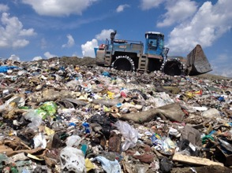
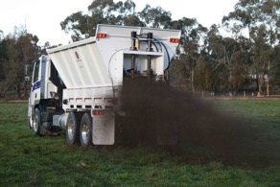
Environmental Contamination by PFASs Increased since early 2000s
May 25, 2016: FIVE MILLION U.S. Citizens woke up to learn that their drinking water contained PFOA and PFOS at concentrations exceeding the revised health advisory levels of the US EPA (70 parts per trillion, life time exposure)
Hoosick Falls, NY
North Bennington, VT
Private drinking water wells:
40 to 2,880 parts per TRILLION!!!
PFAS
PFAS
PFAS
Groundwater clean up cost at military installations = $2 Billion (US DoD)

Slide 4
Environmental Contamination by PFASs Increased since early 2000s
PFAS pose great risk to the Environment and the Human Health (300 plus peer-reviewed publications)
Regulatory Agencies Response:
Past: Voluntary Compliance (benefited manufacturers)
Need: Enforceable drinking water standards (PFAS)
Current Status and Prospect:
Minimize exposure and remove PFAS from environment
Few, unsustainable, engineered treatment processes exist
Need better detection and cost-effective remediation approaches

Slide 5
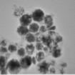
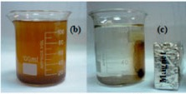
Break PFOA with Radicals (Hydroxyl)
Remediation Strategies
Capture and Separate PFOA with Magnetic Fatty Acids
Iron oxide/Iron Nanoparticles
( 1 GRAM of material covers the entire area of a Football Field )
PFOA
Magnetic Liposomal Iron oxide Nanoparticles

