Slide 1
how the Irb functions & Obtaining protocol approval
Melanie Locher, B.S., CIP
Assistant Director of Monitoring and Education,
UVM Research Protections Office
Notes:
NOTE:
To change the image on this slide, select the picture and delete it. Then click the Pictures icon in the placeholder to insert your own image.

Slide 2
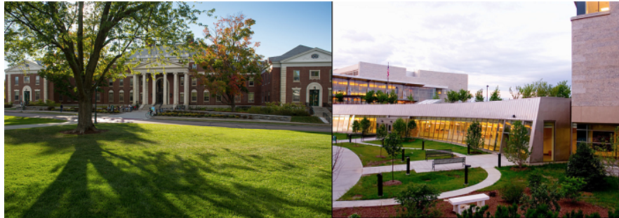
Aims of today’s presentation
Detail the steps for a PI to obtain IRB approval
Describe the different risk classification (minimal vs. greater than minimal risk)
Summarize the criteria by which research is approved, applying 45 CFR 46.111
Outline what occurs during a convened IRB meeting
Describe obstacles to IRB approval

Slide 3
Obtaining UVM IRB Approval
Step 4 Training
Step 5 Approval Process
Step 6 After Approval
Step 3 Submit a Protocol for Review
Step 2 Determine level of review.
Step 1 Determine if activity needs review.

Slide 4
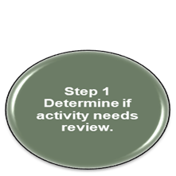
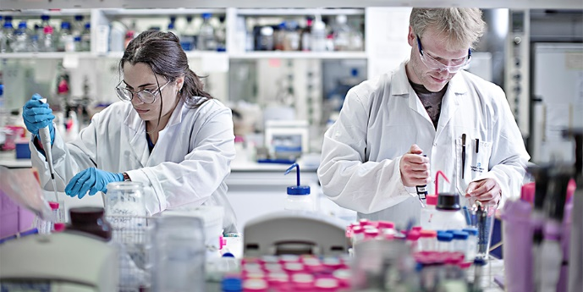
Types of Research Reviewed by the IRB
Clinical Trials
Phase I, II, III and IV (more than minimal risk)
High risk protocols
compassionate use
gene therapy
Expedited (minimal risk)
Health Record reviews
Blood collection protocols
Data/Tissue repositories
Qualitative Protocols
Ethnography
Field research

Slide 5
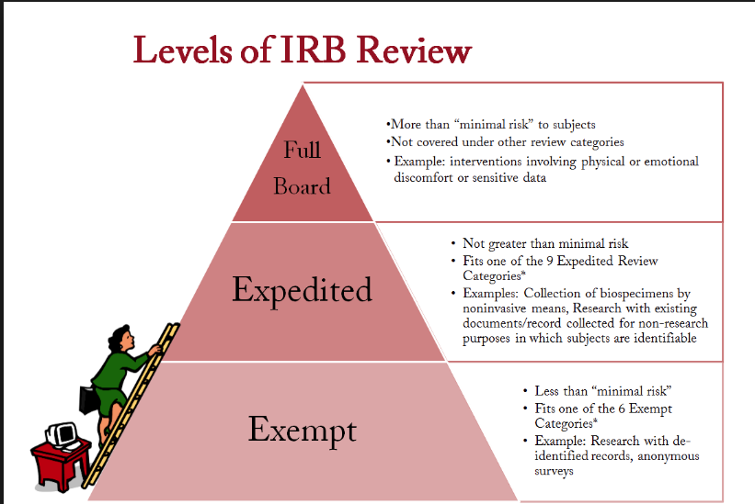
Step 2 Determine level of review.

Slide 6
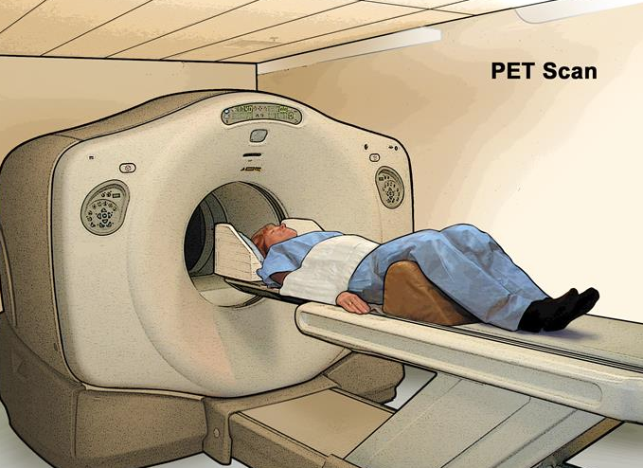
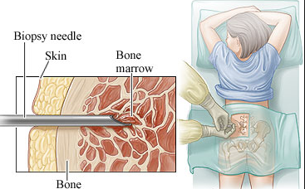
the probability and magnitude of harm or discomfort anticipated in the research are not greater in and of themselves than those ordinarily encountered in daily life of the general population or during the performance of routine physical or psychological examinations or tests
What defines minimal risk research interventions?

Slide 7
Is it an “Expedited” IRB Review? – Minimal Risk
Step 4 Training
Step 5 Approval Process
Step 6 After Approval
Step 3 Submit a Protocol for Review
Step 2 Determine level of review.
Step 1 Determine if activity needs review.
IRB Chair and RPO analyst review
Collection of blood samples by finger stick, heel stick, ear stick, or venipuncture only when very specific criteria are met
Prospective collection of biological specimens for research purposes by noninvasive means (urine, sputum, blood)
Collection of data through noninvasive procedures (not involving general anesthesia or sedation) routinely employed in clinical practice, excluding procedures involving x-rays or microwaves (ultrasound, EKG)
Research involving materials (data, documents, records, or specimens) that have been collected, or will be collected solely for non-research purposes (such as medical treatment or diagnosis)
Collection of data from voice, video, digital, or image recordings made for research purposes
Research on individual or group characteristics or behavior or research employing survey, interview, oral history, focus group, program evaluation, human factors evaluation, or quality assurance methodologies

Slide 8
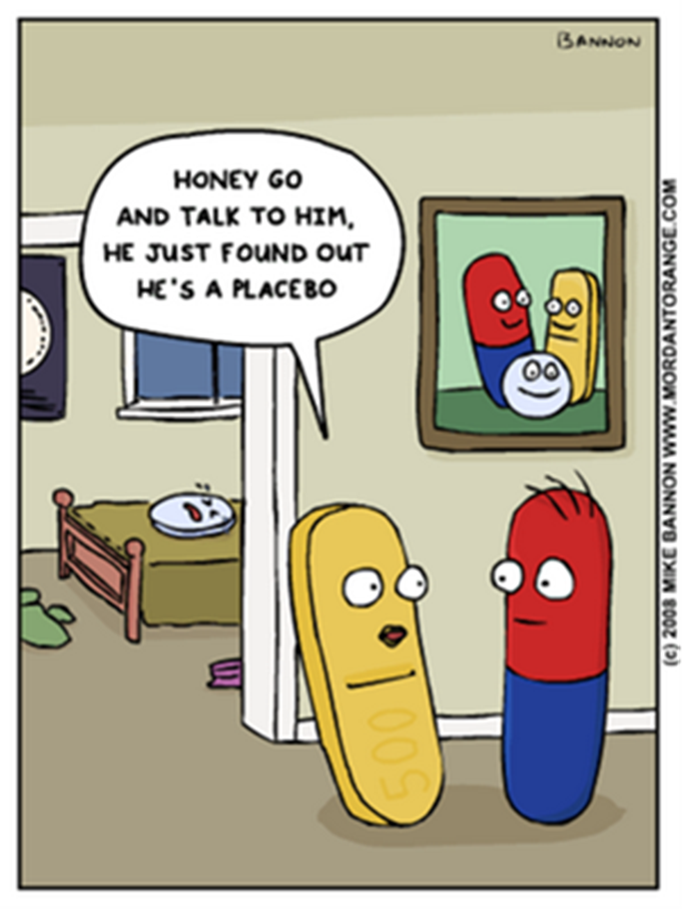
Is it an “Full Committee” IRB Review?
Step 4 Training
Step 5 Approval Process
Step 6 After Approval
Step 3 Submit a Protocol for Review
Step 2 Determine level of review.
Step 1 Determine if activity needs review.
Two IRB Members and RPO analyst review
Randomized placebo controlled trials
IND studies
IDE studies
Randomized trials between two known treatments
Studies involving more than minimal risk research procedures

Slide 9
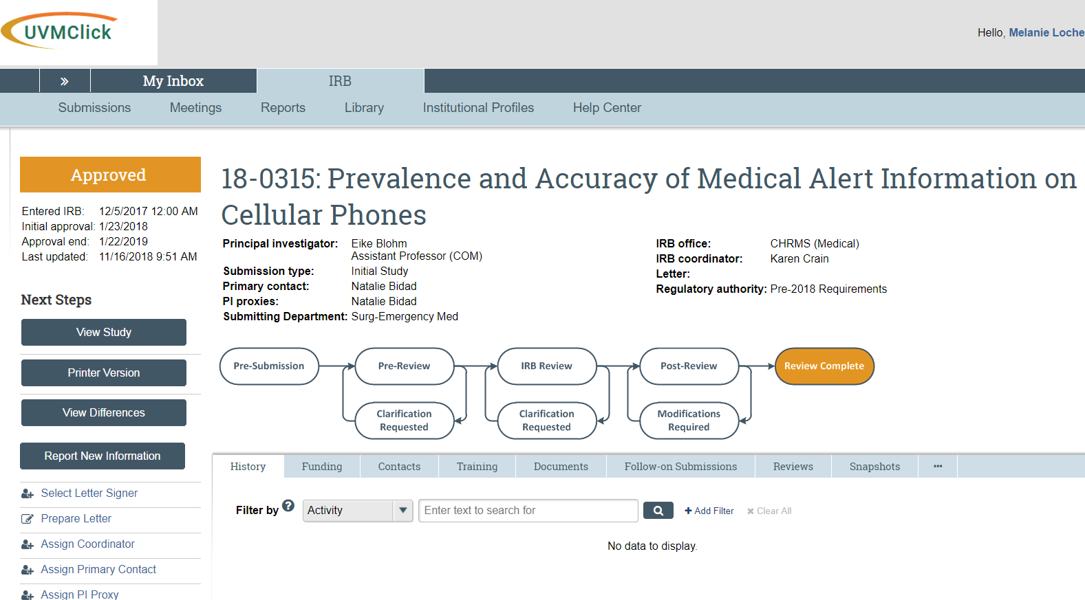
Step 4 Training
Step 5 Approval Process
Step 6 After Approval
Step 3 Submit a Protocol for Review
Step 2 Determine level of review.
Step 1 Determine if activity needs review.
PI must write a protocol, consent, recruitment materials etc.
Forms are submitted to the IRB through the UVMClick system

Slide 10
Step 4 Training
Step 5 Approval Process
Step 6 After Approval
Step 3 Submit a Protocol for Review
Step 2 Determine level of review.
Step 1 Determine if activity needs review.
Take one of the following to meet the training requirements for Human Subjects Research:
Medical researchers should take Biomedical Research
Social or Behavioral researchers should take Social Behavioral Education Sciences

Slide 11
Once Risk Level of the Research is Determined… How Does the IRB Function?
Step 5 Approval Process

Slide 12
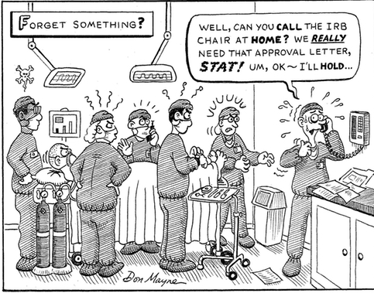
Intuitional Authority
As a voting Committee the IRB has the authority to:
Approve
Require modifications
Disapprove
Suspend
Terminate
The IRB reviews all research activities that fall within its jurisdiction as specified by federal regulations, state law, and institutional policy.

Slide 13
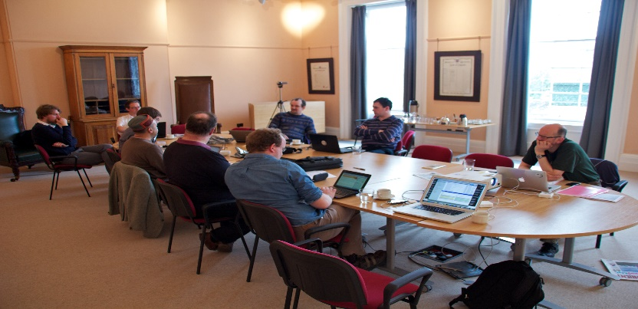
Who sits on the board?
The board must be minimally comprised of:
At least 5 members
At least 1 member must have a scientific background
At least 1 must be a non-scientist (1 non-scientist must attend every meeting to achieve quorum)
At least 1 non-affiliated member (not affiliated with UVM/UVMMC)

Slide 14
Over 60 IRB members dedicated to the rights and welfare of human subjects participating in research
Physicians representing 10 different sub-specialties
Ph.D.'s
Pharmacists
Nurses
Lawyers
Statisticians
Community members

Slide 15
UVM Committee members expertise
Bioinformatics member - Hindu translated consent form was not factually correct. He was able to assist the PI with a more accurate translation
Research Pharmacist – noted newly missing black box warning label risks were not included on the consent form.
IT Director – consistently identifies potential data breaches and gaps within a protocol and works with the PI to rectify.
Dedicated Community Members – Found a newly released FDA drug risks omitted from the consent & protocol. Brings the perspective of the subject to the committee members with regard to lay language.

Slide 16
45 CFR 46.111 Criteria for IRB approval of research
IRB Members must ensure all of the following requirements are satisfied:
Risks to subjects are minimized
Risks to subjects are reasonable in relation to anticipated benefits
Selection of subjects is equitable
Informed consent will be sought from each prospective subject or the subject's legally authorized representative
Informed consent will be appropriately documented
When appropriate, the research plan makes adequate provision for monitoring the data collected to ensure the safety of subjects
When appropriate, there are adequate provisions to protect the privacy of subjects and to maintain the confidentiality of data. Additional safeguards have been included in the study to protect the rights and welfare of vulnerable subjects.

Slide 17
Additionally the IRB must Consider………….

Slide 18
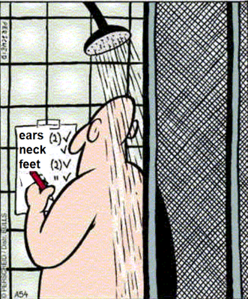
IRB Member Review Process
CHECKLISTS
ANALYSTS PRE-REVIEW
COMMITTEE MEMBER PRE-REVIEW FORM
ACCESS TO OUR LOCAL RESEARCH POLICY AND PROCEDURES MANUAL
ACCESS TO FEDERAL REGULATIONS

Slide 19
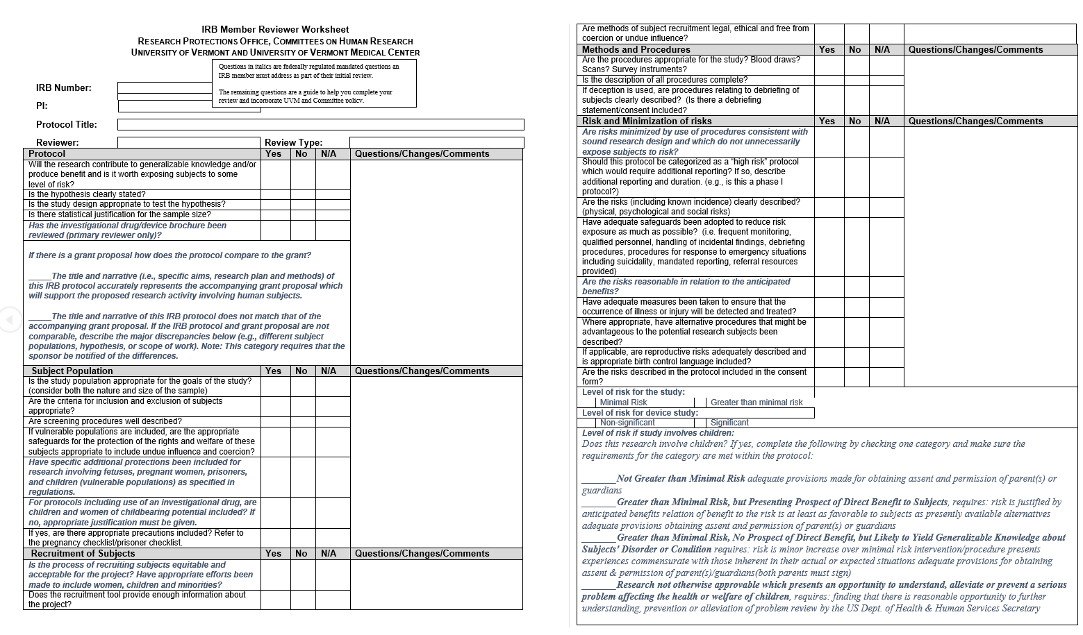

Slide 20
Convened Meetings
Step 5 Approval Process
2 to 4 hours
two members present
Additional members input
Creation of a formal letter back to the PI detailing the questions, clarifications, and edits needed prior to final approval

Slide 21
Possible Outcomes
Approved
Approved with Minor Modifications
Approved with Major Modifications
Deferred
Disapproved

Slide 22
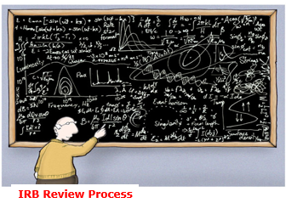
Obstacles to IRB Approval
Not recognizing and explaining common risks and overstating benefits to participants in the consent form.
Studies propose participant materials written at a reading level much higher than the national average (7th-8thgrade)
Discrepancies between the IRB application form, consent form and other study documents.

Slide 23
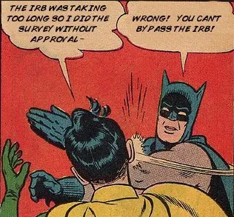
Obstacles to IRB Approval
Consent forms missing required elements of informed consent
IRB application uses jargon, highly technical or discipline/field-specific language, unexplained acronyms or lacks clarity.
Not proofreading – typographical errors, disorganized information and lack of attention to detail.

Slide 24
After the Convened Meeting
Step 6 After Approval
PI must formally respond to the Committee’s concerns with a point by point memo addressing all inquiries.
The response must be submitted through the UVMClick system
All documents must be revised with tracked changes to show edits have been made
Research analysts ensure the changes have been made and forward response to the IRB Committee Chair for the final review and approval
Once approved the consent forms, protocol, informational sheets etc. are IRB stamped and finalized with an approval date
The UVMClick system is updated to reflect protocol approval for the PI and research staff to verify. This is now the system of record for the federal regulators to audit and ensure compliance with the FDA, OHRP and local state and local agencies.

Slide 25
A local example of why we need irb review
“Propofol Requirements for LMA Supreme vs Oral Airway”
PI initiated study from Anesthesiology
Intent was to compare a new gastric access device used for airway management during surgeries to the standard of care mask currently being used
Subjects would receive each device while receiving propofol and then rate their discomfort during and after insertion of the device and the physicians will rate the ease of use and their satisfaction with the placement of the devices.

Slide 26
Proposed Protocol
Criteria for irb approval for research
Irb determination - disapproved
Normal healthy volunteers
Medical students were the targeted population
Endpoints were to determine pain and discomfort levels
No statistical section provided, PI indicated there was no need for a “stopping rule”
a. Risks to subjects are minimized.
b. Risks to subjects are reasonable in relation to anticipated benefits
When appropriate, the research plan makes adequate provision for monitoring the data collected to ensure the safety of subjects
Additional safeguards have been included in the study to protect the rights and welfare of vulnerable subjects.
Benefits are not substantial enough to outweigh the risks in this population because they are not already scheduled for surgery
PI did not have a plan to assess pain and relieve discomfort when participants awoke and many would be unable to speak.
Potential for coercion.
Safety stop measures must be in place while propofol is being administered

Slide 27
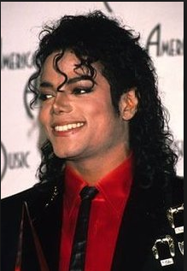
IRB review can disapprove a protocol to protect subjects
The UVM Committee reviewed and disapproved the protocol in August of 2009
2 months (June 2009) after Michael Jackson died of acute propofol and benzodiazepine intoxication
The use of propofol outside the setting of surgery has risks that far outweigh the benefits of sedation and research

Slide 28
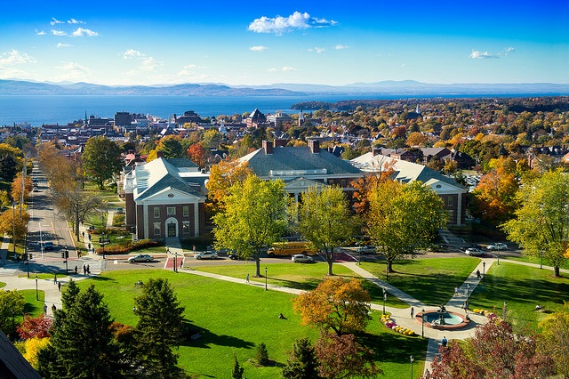
Questions?
Melanie Locher, B.S., CIP
Assistant Director of Monitoring and Education
UVM Research Protections Office
211F Waterman Building
Burlington, VT 05401
P: (802) 656-5040
F: (802) 656-8604
E: Melanie.Locher@uvm.edu

