Slide 1
Oh! The Places You’ll Go! A Career in Research Development
UVM Postdoctoral Association
Career Mobility Talk, February 21st 2019
Gagan Bajaj, PhD
Grant Proposal Manager
Pre-Award Office, Department of Medicine

Slide 2
PI has an Idea!!

Slide 3
In a nutshell: I help researchers with their grants.

Slide 4
But….

Slide 5
….there is a lot more to it

Slide 6
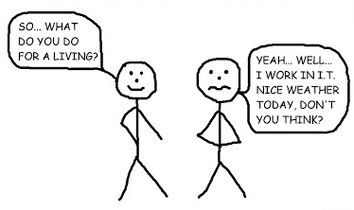
What is Research Development?
R.D.

Slide 7
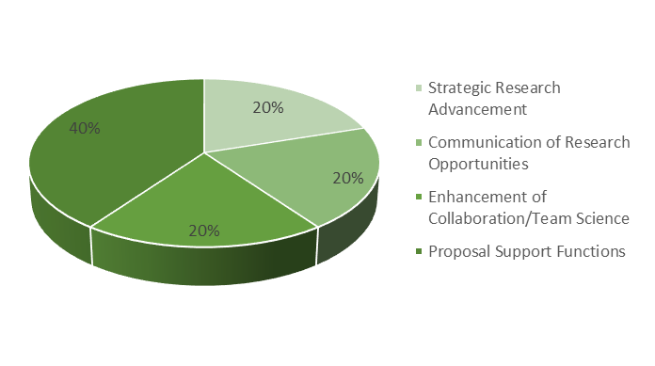
Research Development professionals serve as "rainmakers" who catalyze and facilitate team science in response to the external funding landscape.

Slide 8
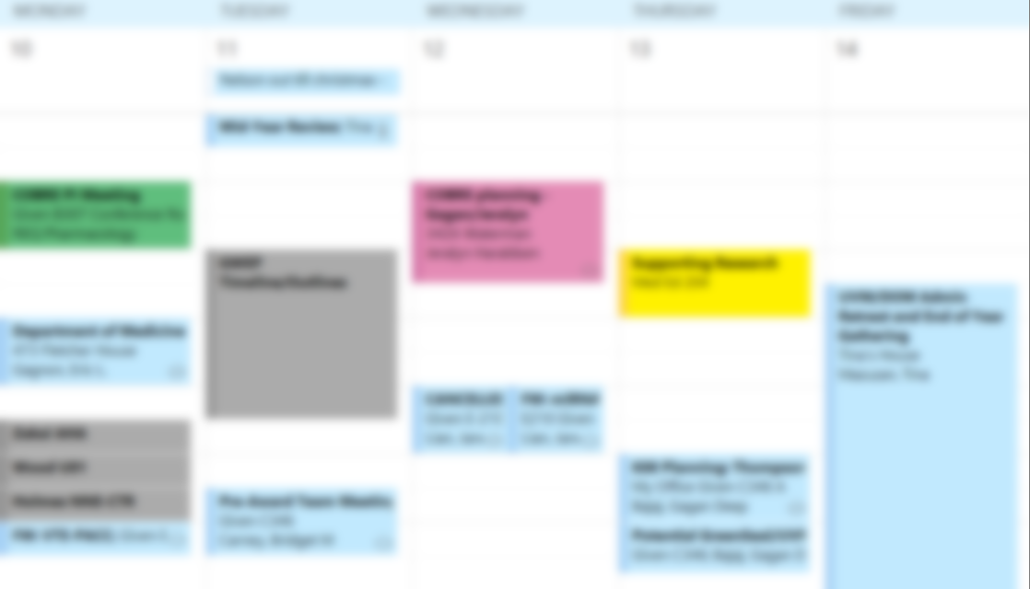
In a typical week..
Projects:
Working on several projects
In various stages of development
Proposal development
Manage a submission
Meetings:
With research teams to identify new opportunities
Meet with new teams/individual researchers to plan grant submission roadmaps
Attend Department level meetings to identify new strategies to increase faculty competitiveness
Attend trainings/webinars
Scheduled call with an NIH program officer and DoM Research team to discuss programmatic relevance of proposal…..

Slide 9
That sounds great! But is this a job or a career?
Is it viable?
Is it intellectually satisfying?
Is there opportunity for growth?
Is it right for me?

Slide 10
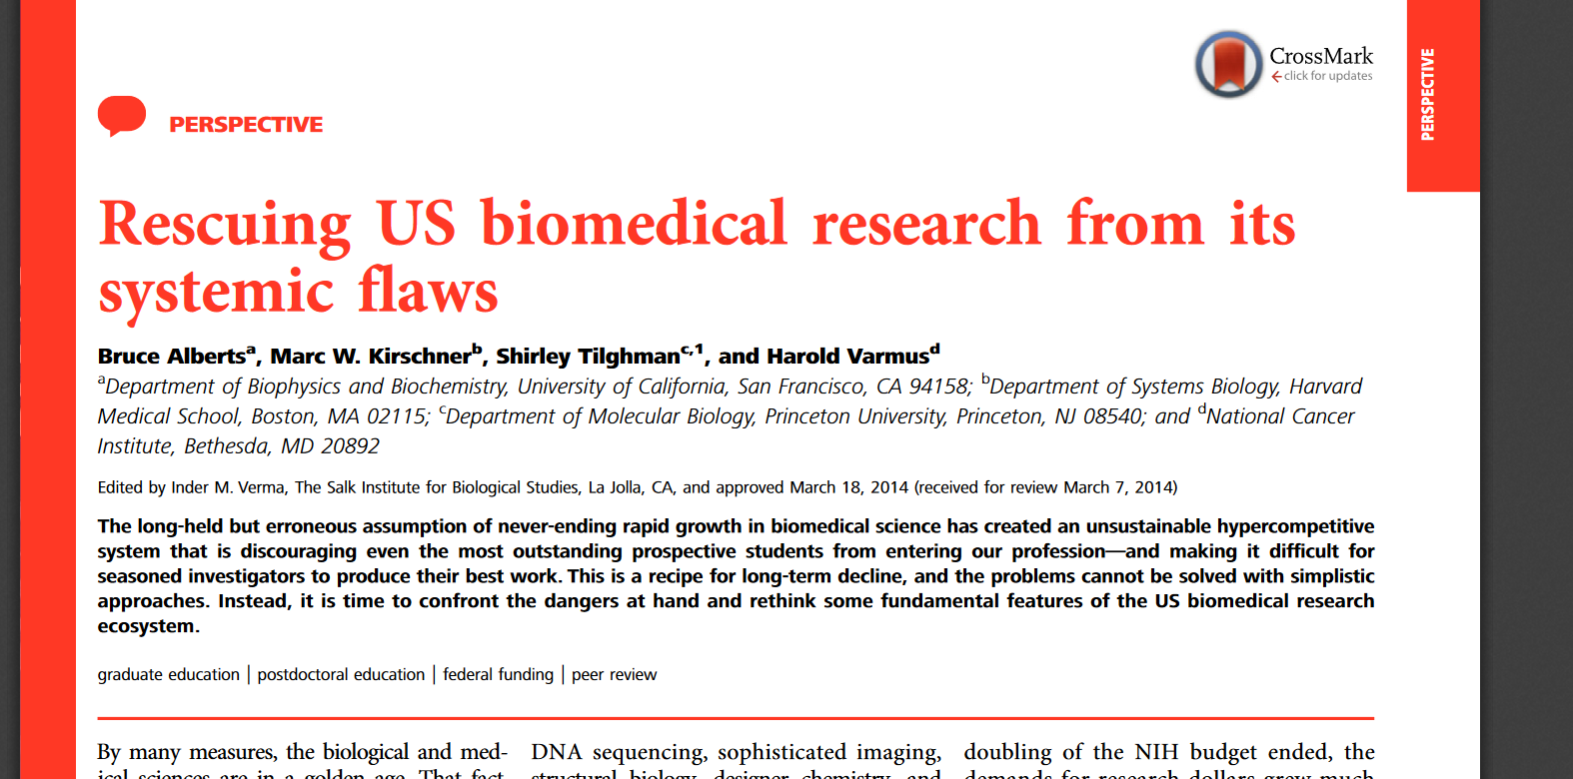
Relevance The US Biomedical Research Enterprise is stretched to its limit…

Slide 11
…while Research $$ are stagnant or declining …which means that Universities are trying harder to obtain funding, and are willing to invest in resources that give them a competitive edge….
Research Development encompasses a set of strategic, proactive, catalytic, and capacity-building activities designed to facilitate individual faculty members, teams of researchers, and central research administrations in attracting extramural research funding, creating relationships, and developing and implementing strategies that increase institutional competitiveness.

Slide 12
Relevance, continued……
“Why NIH switched to electronic applications. This photo, which also appeared in our 2001 article, shows the loading dock at NIH on the day of a grant-application deadline. Since the photo was taken, the number of applications NIH receives has more than doubled.”
The increasing time required for grant writing, manuscript revisions and mandatory administrative tasks associated with research are overwhelming and distract researchers from critically thinking about their science.
-Bruce Alberts, Judith Kimble, Shirley Tilghman, Harold Varmus http://rescuingbiomedicalresearch.org/the-problem/

Slide 13
Paperwork, much??

Slide 14
Your friendly RD to the rescue….
Research Development includes a broad spectrum of activities that vary by institution, including: funding opportunity identification and targeted dissemination; grant/contract proposal development; research team building; interaction with funding agencies and institutional research administration and leadership; interaction with institutional federal relations; and outreach activities and training.

Slide 15
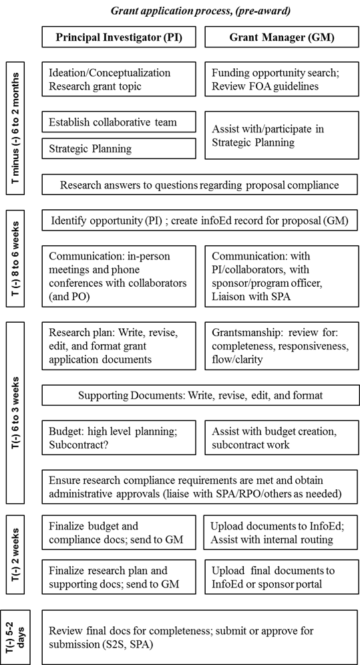
Adapted from: Kulage KM, et. al. Time and costs of preparing and submitting an NIH grant application at a school of nursing. Nurs Outlook. 2015 Nov-Dec;63(6):639-49. doi: 10.1016/j.outlook.2015.09.003. PubMed PMID: 26566959.

Slide 16
Is it intellectually challenging?
“I get to be part of enabling that, and that’s very rewarding.”
“I probably had more impact on science doing research development than I ever would have had if I had stayed in bench research.”
In one word: YES!
Gretchen Kiser, PhD
Director Research Development
UCSF
Peg AtKisson, Ph.D.
President, AtKisson Training Group

Slide 17
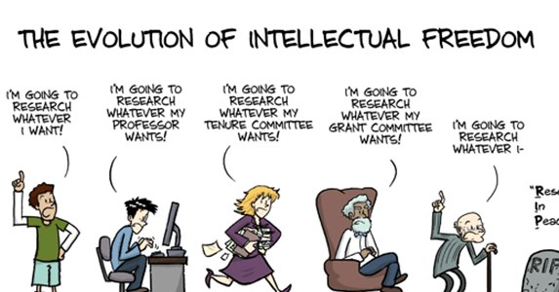
Is it right for me?
http://phdcomics.com/

Slide 18
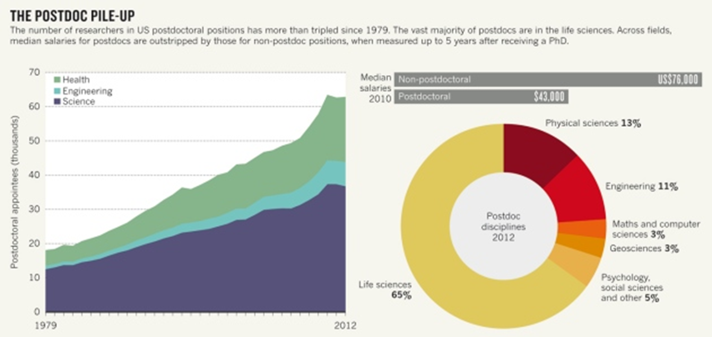
Source: Powell K. 2015. The future of the postdoc. Nature 520 (7546): 144–147.

Slide 19
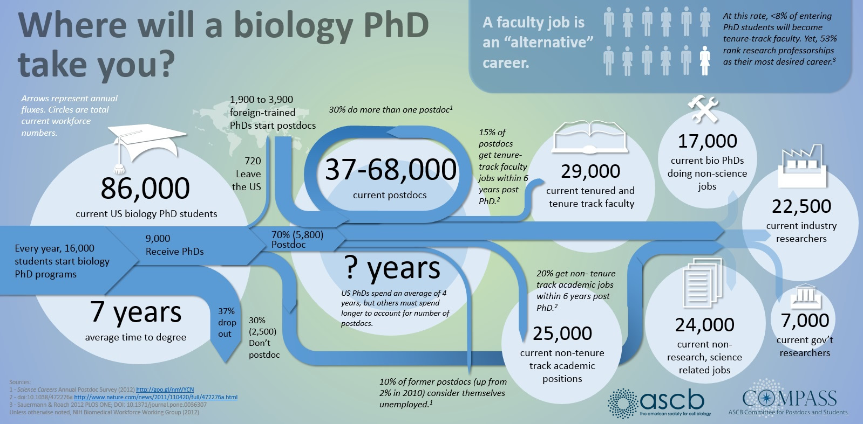
Source: Where Will A Biology PhD Take You? https://www.ascb.org/compass/compass-points/where-will-a-biology-phd-take-you/
By Jessica Polka | April 11, 2014 | The American Society for Cell Biology

Slide 20
Points to Consider:
Transferrable skills
Fit
Culture

Slide 21
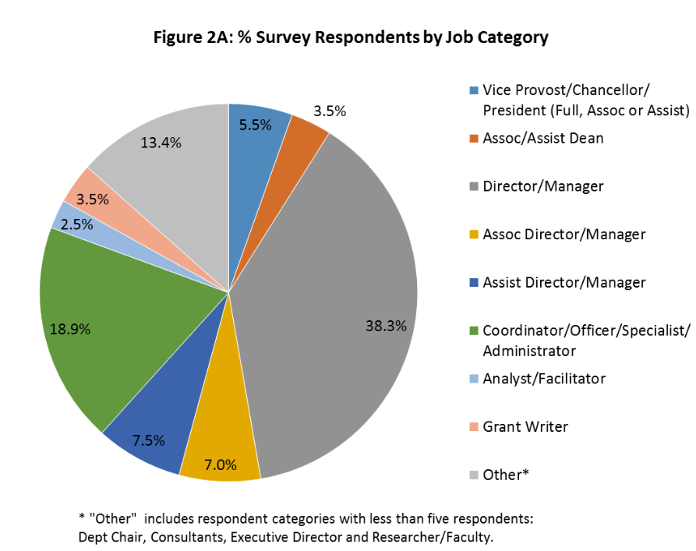
Opportunities for Growth?
Source: NORDP Salary Survey, 2015

Slide 22
Specializations
Strategic Research Advancement Collaborate to identify areas of institutional research priorities • Strategic Planning Support (information to leadership about opportunities/strengths/weaknesses) • Serve as institutional representative to university community and external visitors • Manage or contribute to decisions regarding internal funding • • Interactions with political leaders related to research initiatives at your institution • Liaison with institutional federal relations • Industry collaboration and partnerships • Liaison with funding agencies about direction of future research funding initiatives • Bringing Program Managers/Agency representatives to Campus or taking/introducing Faculty to them • Facilitating Sponsor Site visits • Coordinating/Managing the limited submission process. | Proposal Support Functions Assisting faculty to find funding opportunities • Newsletters/Listserv announcements of funding opportunities • Proposal Development Support for individual investigator awards or large, complex awards • Proposal Development Project Management (coordinating milestones, internal deadlines, meetings, e-mail reminders, etc.) • Grant Writing of Technical/Scientific, Evaluation, Resources, Administrative, Timeline, Communications, Budgets, and Outreach portions of proposals • Suggesting collaborating scientists for a proposal • Providing strategic advice on making proposal competitive • Editing proposal drafts • Coordinating pre-submission peer reviews of proposal drafts • Manage “Red Team” reviewers or external review process • Analyze proposal reviews and provide feedback.
Communication of Research and Research Opportunities Manage marketing of research, e.g. annual reports, research magazine, web page development/coordination, identifying institutional priorities • Raise profile of university strengths that add to visibility or impact of university with external funding sources • Providing proposal/award information related metrics to internal constituents • Website support e.g. grant opportunities and proposal development • Collect and disseminate funding information to faculty and administrators • Conducting Grant Writing Workshops on your campus or regionally | Enhancement of Collaboration/Team Science Convene and coordinate multi-disciplinary interest groups • Catalyze new cross-disciplinary research initiatives • Sponsoring catalytic research events, e.g. research mini-symposia • Develop and/or coordinate resources and tools to promote collaboration • Provide guidance and expertise for building and fostering connections and teams • Maintain faculty expertise database and other collaboration web tools • Facilitating collaborations between investigators at your own institution • Facilitating collaborations between investigators at other institutions • Provide guidance on the identification of and manage the institution’s Research Networking Tools
Adapted from the NORDP webpages

Slide 24
Resources

Slide 25
Questions?

Slide 26
Further Reading:
NORDP website
Research Development: A Career for the Planners, Strategists, and Figure-it-Out-ers (Source: National Postdoc Association, October 2017)
Being the Enabler by Maggie Kuo, Science, Oct. 17, 2016
Science Careers (Tip: subscribe to the weekly newsletter if interested in exploring career options with a PhD)
Science Careers also links out to some career development tools
Interactive Simulation Exercises for Career Transitions (InterSECT) is an online platform that allows PhD-level scientists and humanists, regardless of professional stage, to explore future career options. This Link takes you to simulations for Research Development professionals.
The Malthusian Dilemma: Biomedical Research in the Post-NIH Budget Doubling Era
Rescuing US biomedical research from its systemic flaws: Alberts B, Kirschner MW, Tilghman S, Varmus H.. Proc Natl Acad Sci U S A. 2014 Apr 22;111(16):5773-7. doi: 10.1073/pnas.1404402111. Epub 2014 Apr 14. PubMed PMID: 24733905; PubMed Central PMCID: PMC4000813
The future of the postdoc (Nature News Feature)

