Slide 1
water
uvm
november 13th 2017
brendan fisher

Slide 2
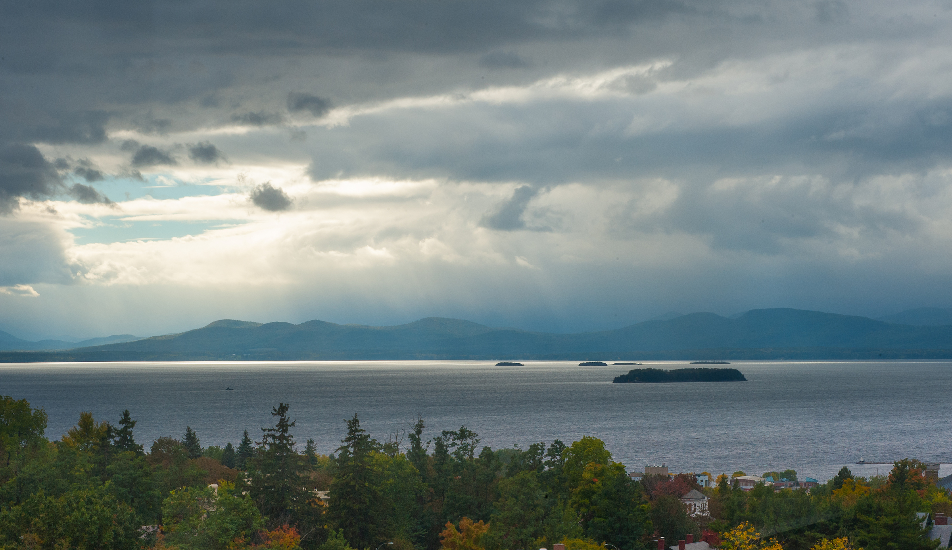
How we affect….
….affects human and ecological welfare
|-----------------groundwater contamination ----------------------|
|------------------------------ algal blooms------------------------------|
|----------------------- Lake Champlain -------------------------------|
© Sally McCay UVM photo

Slide 3
How we affect….
….affects human and ecological welfare

Slide 4
Drones and remote sensing techniques delivering time critical response data
Expert science climate effects on floods, drought, extreme events
How extreme events affect lake and river water quality and nutrient loads
How to design infrastructure and systems to best deal with such events

Slide 5
Development across the state affects nutrient and sediment loads in rivers and lakes
Pharmaceuticals wind up in our water supply
How human behavior on the landscape may couple with climate change to make our freshwater systems more sensitive
How we affect…

Slide 6
Lake water quality affects property values and employment
Ecosystems (e.g. wetlands) protect cities and towns from flooding
Water quality affects fish, human exposure to toxins, and behavioral responses to engagement with water quality issues
….affects human and ecological welfare

Slide 7
thanks

