Slide 1
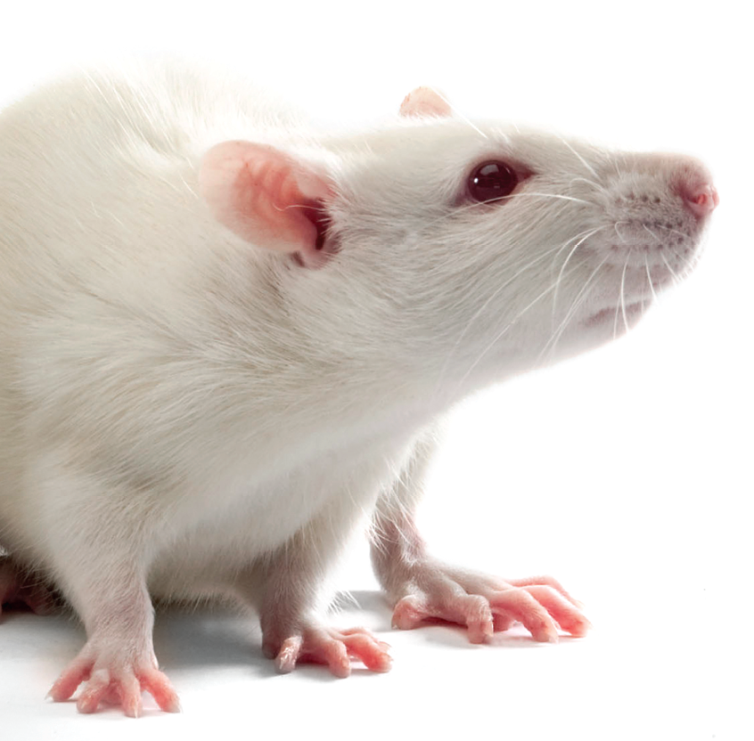
Institutional Animal Care and Use Committee

Slide 2
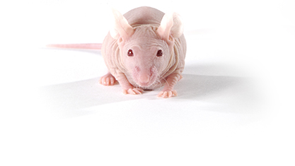
Basic Differences Between IACUC and IRB
No Consent forms
No “expedited” review method
No “exempt” category

Slide 3
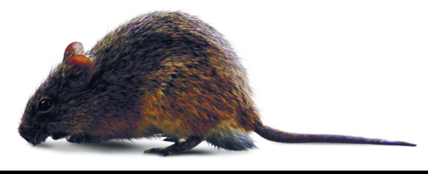
The Basics
At UVM, >97% of the animals used in research are rats and mice.
Members of the IACUC are appointed by UVM’s Vice President for Research
IACUC must review and approve ALL animal use in teaching and research prior to any work with animals.
The IACUC Committee at UVM consists of scientists, non-scientists, biosafety experts, statisticians, community members, and a veterinarian.

Slide 4
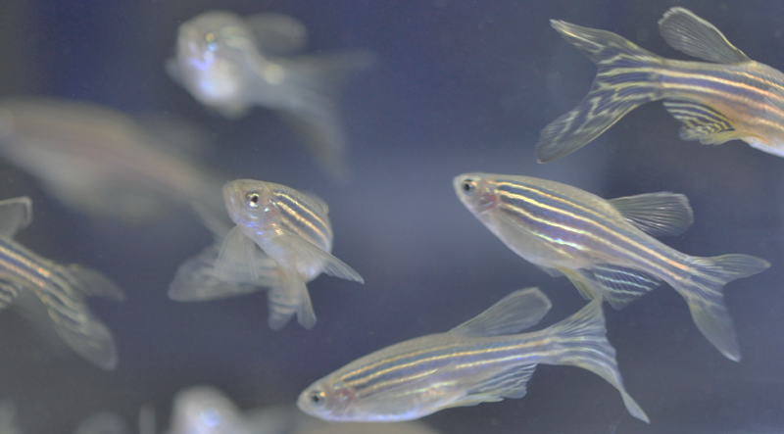
The Three Rs in Animal Research
Reduction
Refinement
Replacement

Slide 5
Animal Welfare Act (AWA)
Sets minimal standards for housing, feeding, handling, veterinary care.
Excluded: rats, mice, and birds bred for research, fish, reptiles, amphibians, farm animals for agricultural use.
Public Health Service (PHS)
Provides oversight of all federally funded research projects
(NIH, CDC, FDA).
Covers all species
USDA/APHIS
Enforces AWA
Conducts yearly inspections on facilities that use animals covered in the AWA.
OLAW
Administration and coordination of the PHS Policy/oversight of all PHS supported animal research projects.
IACUC
Oversee and evaluate the institution's animal care and use program.
Ensure compliance with AWA and PHS
AAALAC
Voluntary accreditation
Ensures excellence in animal care.

Slide 6
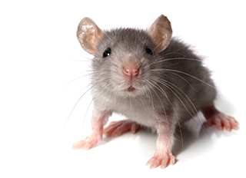
IACUC Purpose and Responsibilities
Oversight of every aspect of animal use for research and teaching at the institution
Maintain and review UVM, state, and government policies regarding use of animals at UVM
Conduct inspections to ensure that all UVM facilities involved in animal use are maintained adequately.

Slide 7
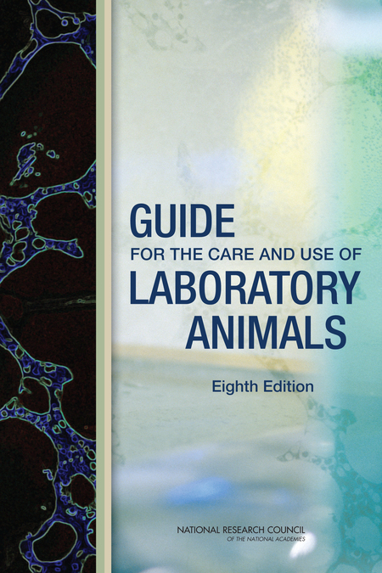
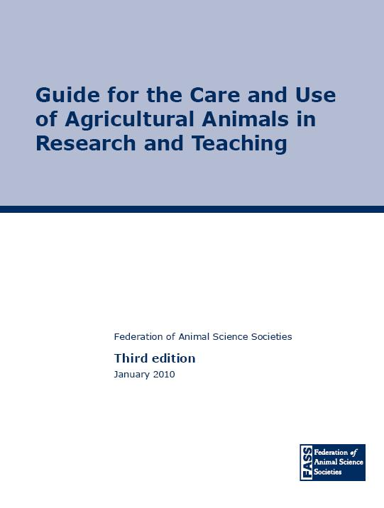

Slide 8
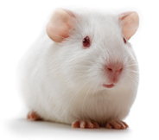
What does the IACUC do?
Meet monthly
Inspect (semiannually) all UVM animal facilities
Review animal welfare concerns
Review and approve all animal use in teaching and research prior to any work being done with animals.
Review each animal use protocol annually to ensure all work is conducted appropriately.
Review the entire UVM animal care program on a semiannual basis

Slide 9
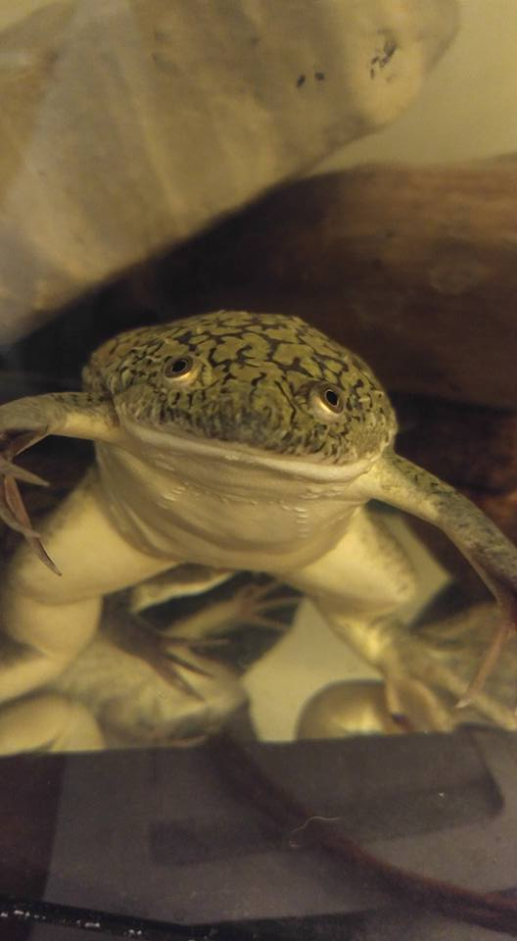
Animal Use Protocol
Document detailing all aspects of the work involving animals
Justification for animal use
Describes species, strains, and numbers of animals to be used
Detailed explanation of procedures
Explains housing, treatment, medications, and care of animals
Details surgery, anesthesia, restraint and euthanasia

Slide 10
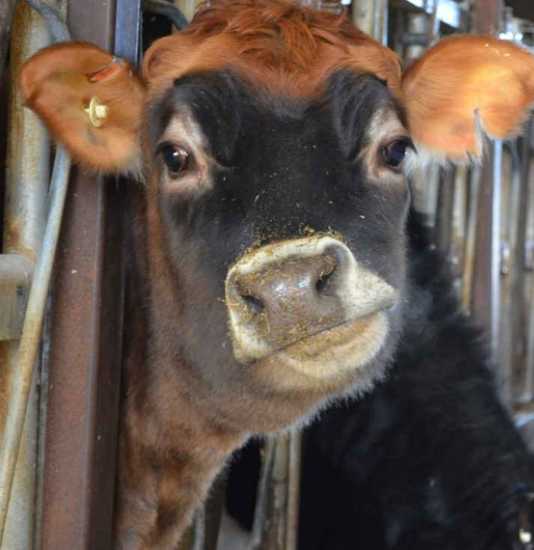
USDA Pain Levels
The USDA has designated pain levels that are used to classify the level of potential pain or distress in an animal use protocol
Level B
Breeding only, no pain or distress anticipated
Level C
Not more than momentary pain/distress
Level D
More than momentary pain/distress, relieved by drugs or other
methods of analgesia
Level E
More than momentary or slight pain/distress, not relieved by
drugs or other methods of analgesia.
Pain levels determine the level of review required.

Slide 11
Protocol Submission Process
Initial Veterinary Review
A draft protocol is initially sent to the University Veterinarian for review and approval.
Return to Investigator for modifications
The draft protocol is returned to the investigator with a written review and a copy of
the protocol with tracked changes. The veterinarian must sign the protocol.
Final Submission to IACUC
After revisions are made, a final document is submitted to the IACUC for review. A grant,
If applicable, must be submitted as well
Assigned a review or placed on agenda
A pre-review by a research analyst is conducted and the protocol and supporting
Documents are uploaded into the system and assigned to reviewers or added to the
Next available agenda.

Slide 12
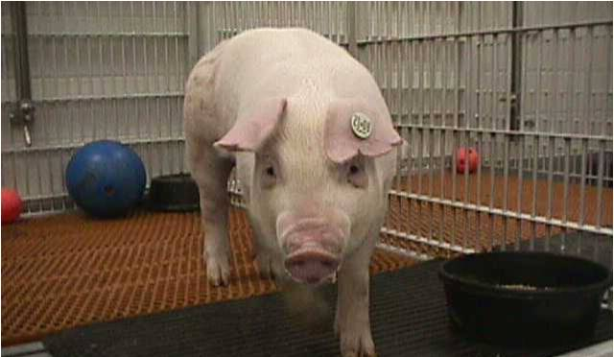
Designated Review Process (pain level B or C)
Approved
Submit protocol at any time, these are reviewed on a rolling basis
Protocol and supporting documents are sent out to the entire committee for 5 business days
Protocol is assigned to one or two members for review (depending on pain level)
Submit revised documents for review
A memo is issued to the Investigator that outlines required clarifications or modifications

Slide 13
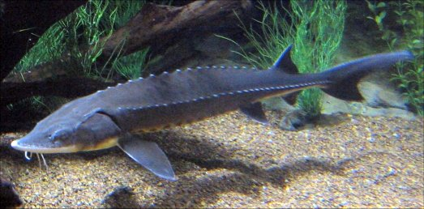
Full Committee Review Process (pain level D or E)
Approved
Protocol is added to an agenda and assigned to 2 members for review
Protocol is discussed at convened meeting and a determination is made
Submit protocol on or before deadline
Submit revised documents for review
A memo is issued to the Investigator that outlines required clarifications or modifications

Slide 14
Training Requirements
Training requirements are offered through the Office of Animal Care Management blackboard webpage.
Required Training:
Optional Training:
Other Requirements:
General
Euthanasia
Surgical/Anesthesia
Controlled Drug *
Hands-on Training
Rodent Analgesia
Census Training
Statistical Justification
Total Body Irradiation of Mice
Managing Aggressive Male Mice
Occupational Health
Coming in 2017, new online CITI training modules and training requirements!

Slide 15
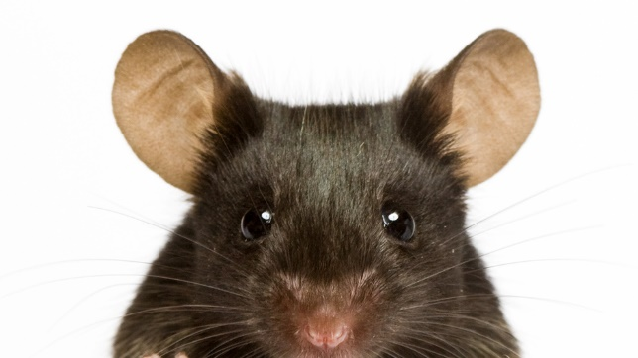
Protocol Maintenance
IACUC protocols require a basic annual review with a more in depth review triennially.
Any change to the protocol must be submitted on an amendment form to the IACUC for approval before those changes are implemented. An updated/revised protocol must accompany each amendment form.
Key personnel rosters must be kept up to date. Personnel additions to the roster must be submitted and approved by the Committee before those individuals can work in the lab.

Slide 16
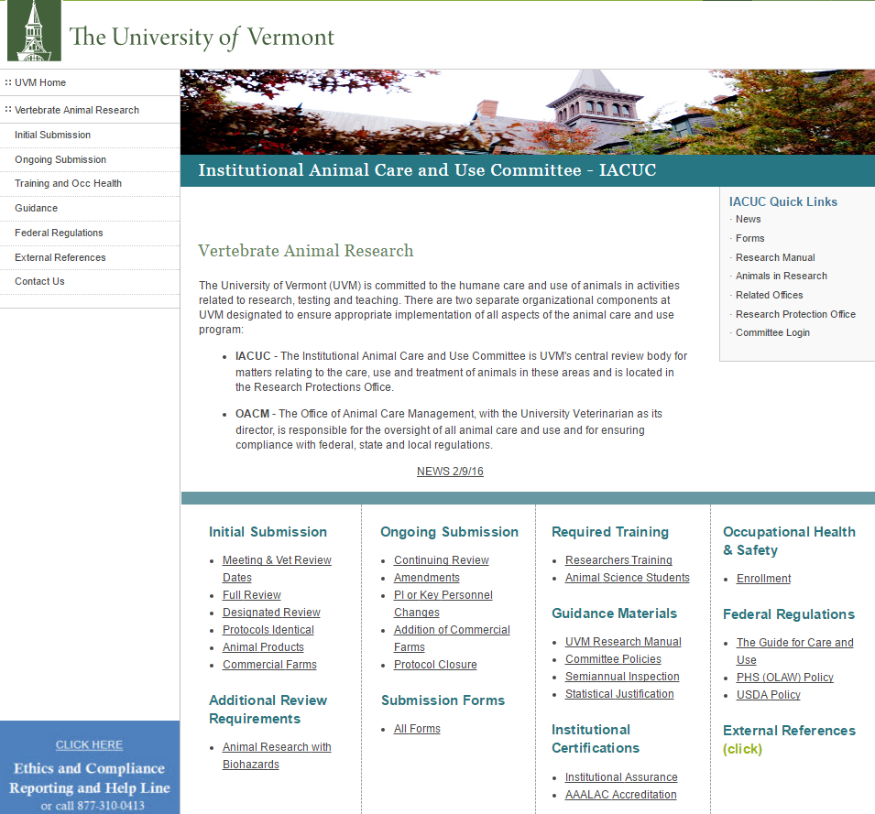
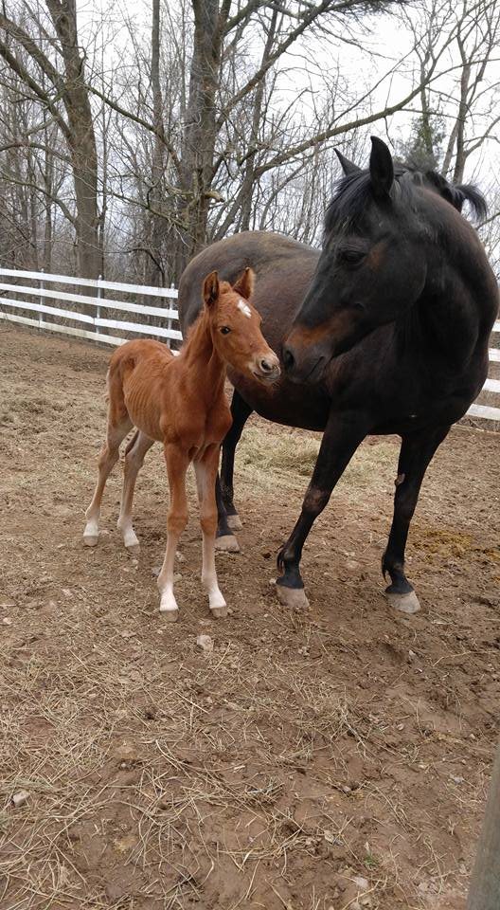
WWW.uvm.edu/rpo/
Additional information, forms,
and contact information is
available on the RPO website:
Abbey Peterson
656-8805
IACUC@uvm.edu

