Slide 1
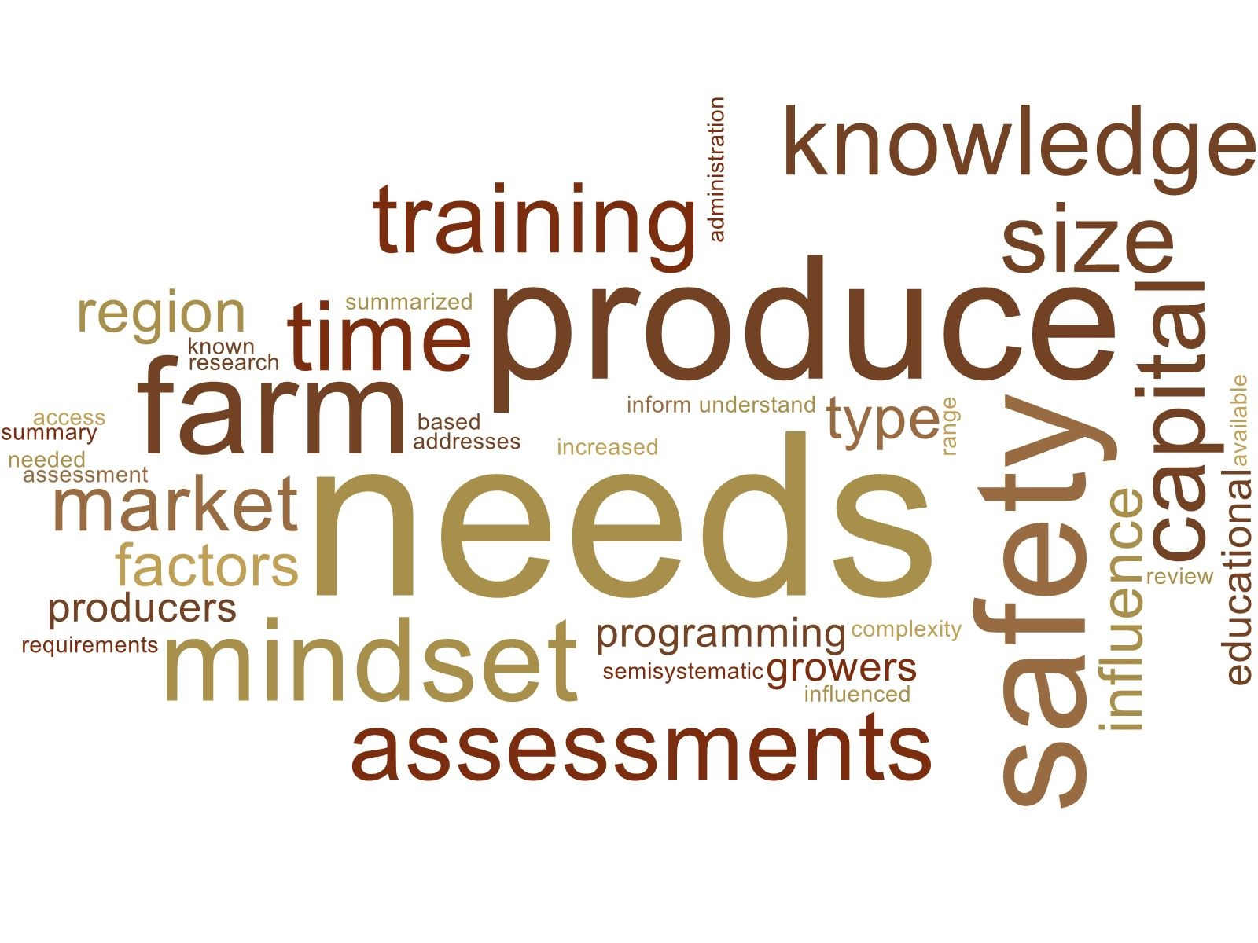
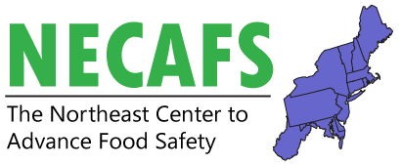
On-Farm Produce Safety: A Review of Needs Assessments of Small- and Medium-Sized Growers in the United States
Hannah Doyle, Chris Callahan, & Elizabeth Newbold
Funding for this work was provided by the Food Safety Outreach Program (USDA-NIFA-FSMA-2018-70020-28878).

Slide 2
RESEARCH QUESTION: What are the known produce safety needs among small- and medium-sized producers in the United States?
Notes:
IN OTHER WORDS: What has been done already, to find out what growers in the Northeast need when it comes to fresh produce safety?

Slide 3
Goal for the Work
Avoid duplication of what’s already been done
A summary of all available needs assessment research is needed to inform educational programming that addresses the complexity and range of produce safety requirements based on farm size and market access

Slide 4
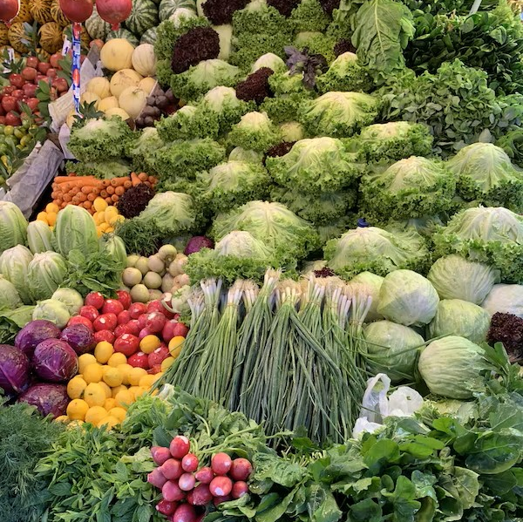
Overview of Project
Conducted a national semi-systematic review of produce safety needs assessments that:
Considered data from 2005 - 2020
Included only published literature
Reviewed 34 needs assessments
Presented findings at NECAFS in Philly, 2020
Published in Food Protection Trends Jan/Feb 2023 issue
Notes:
INTRODUCE MYSELF – SMALL FARMER IN VERMONT, PART-TIME EMPLOYEE OF NECAFS. ASKED TO DO THIS PROJECT
BROUGHT FRESH EYES TO WORLD OF FOOD SAFETY REGS AND NEEDS ASSESSMENTS, newcomer, outsider perspective
*REMOVED PROCESSORS FROM THIS LIT REVIEW, FRESH PRODUCE SAFETY *FOCUSED ON NORTHEAST, BUT INCLUDED NATIONAL NEEDS ASSESSMENTS TOO
Between working group phone call and now: brief search to see what happened in 2019 (USDA report by Astill et al. 2019 / LFSC self-published, Betsy and Laura), revisions, slightly revised draft sent as PDF to attendees

Slide 5
Needs Assessment Defined to Include: A wide variety of sampling techniques was used in order to gauge current practices / knowledge / needs
Surveys (mailed or emailed)
Phone interviews
Pre- and post-event surveys / evaluations
In-person interviews / on-farm visits
Notes:
Self-reporting practices (gaps in best practices → barriers to compliance) In some cases, follow-up interviews validated questionnaire answers, in some cases self-reported info was found to be less-than-accurate

Slide 6
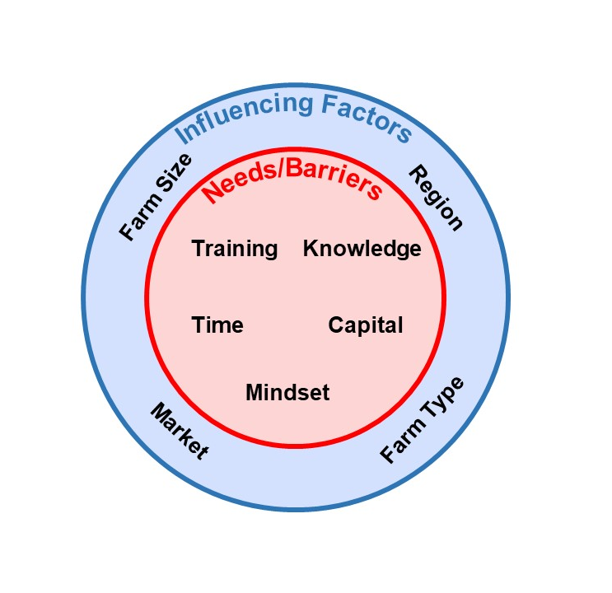
TWO EMERGING DIMENSIONS or FRAMEWORKS
Needs
Training
Knowledge
Time
Capital
Mindset
Factors that Influence Needs
Farm Size
Farm Type
Region
Market
Notes:
(left the text on LEFT for now, but this can be removed if we want)

Slide 7
NEEDS
KNOWLEDGE
Lack of information (but this isn’t the only barrier)
Regulatory confusion
Inconsistent information
Science behind recommendations
(pathways of contamination, etc.)
Notes:
Discuss NEED v. BARRIERS/BURDENS OF COMPLIANCE
Knowledge models
Train-the-trainer / expert model
Assumes and tries to remedy a knowledge deficit
(Delphi method gathers a consensus about existing knowledge gaps and preferred methods of communication)
Mental models
Address how individuals/groups define problems Identify problem areas; refine outreach based on need
Behavioral intervention
Cognition/intention → new behavior

Slide 8
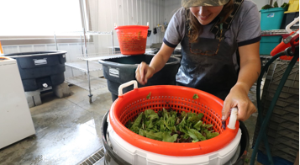
NEEDS
TRAINING
Specific technical training
On-the-ground assistance
Technical skills for management
Those not covered also want food safety training
Notes:
Discuss NEED v. BARRIERS/BURDENS OF COMPLIANCE
Knowledge models
Train-the-trainer / expert model
Assumes and tries to remedy a knowledge deficit
(Delphi method gathers a consensus about existing knowledge gaps and preferred methods of communication)
Mental models
Address how individuals/groups define problems Identify problem areas; refine outreach based on need
Behavioral intervention
Cognition/intention → new behavior

Slide 9
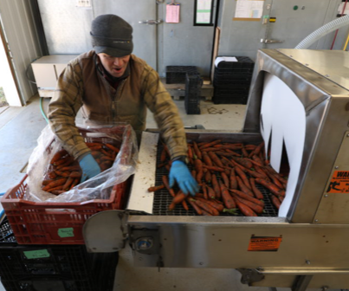
NEEDS
CAPITAL
High cost of compliance
Infrastructure + equipment (access, sourcing, etc.)
Cost of labor (training and implementation)
Maintaining or gaining market access
Notes:
Discuss NEED v. BARRIERS/BURDENS OF COMPLIANCE
Knowledge models
Train-the-trainer / expert model
Assumes and tries to remedy a knowledge deficit
(Delphi method gathers a consensus about existing knowledge gaps and preferred methods of communication)
Mental models
Address how individuals/groups define problems Identify problem areas; refine outreach based on need
Behavioral intervention
Cognition/intention → new behavior

Slide 10
NEEDS
Time
Farmers - never enough time!
Time for record keeping
Time for improving practices (including lack of labor)
Notes:
Discuss NEED v. BARRIERS/BURDENS OF COMPLIANCE
Knowledge models
Train-the-trainer / expert model
Assumes and tries to remedy a knowledge deficit
(Delphi method gathers a consensus about existing knowledge gaps and preferred methods of communication)
Mental models
Address how individuals/groups define problems Identify problem areas; refine outreach based on need
Behavioral intervention
Cognition/intention → new behavior

Slide 11
NEEDS
MINDSET (motivation, perspective, and confidence)
Provide the big picture motivation for food safety behavioral changes (although recent outbreak information reduces confidence)
Motivation comes from buyers, regs, and opportunities for mutual benefits
Foster confidence in the process by making it realistic and attainable
Notes:
Discuss NEED v. BARRIERS/BURDENS OF COMPLIANCE
Knowledge models
Train-the-trainer / expert model
Assumes and tries to remedy a knowledge deficit
(Delphi method gathers a consensus about existing knowledge gaps and preferred methods of communication)
Mental models
Address how individuals/groups define problems Identify problem areas; refine outreach based on need
Behavioral intervention
Cognition/intention → new behavior

Slide 12
TWO EMERGING DIMENSIONS or FRAMEWORKS
Needs
Training
Knowledge
Time
Capital
Mindset
Factors that Influence Needs
Farm Size
Farm Type
Region
Market
FACTORS THAT INFLUENCE NEED
REGION
SIZE
TYPE
MARKET
NEEDS
KNOWLEDGE
TRAINING
CAPITAL
TIME
MINDSET
Notes:
(left the text on LEFT for now, but this can be removed if we want)

Slide 13
FACTORS THAT INFLUENCE NEED
Geographical REGION
Practices vary by region
Public perceptions of food safety
Cultural differences amongst growers
Farm SIZE
Scale, methods of production
Regulations vary by annual sales (size)
Farm TYPE
Organic v. conventional
Crop mix
MARKET for products
Wholesale, retail, direct-to-consumer, etc.
Buyer requirements
Notes:
THE WAY I ORGANIZED MY FINDINGS : what the needs depend on, and what the needs are (matrix)
For all of these, you can say Practices vary by ___, so it’s logical that Needs vary by ___ as well.
Requirements of the farm vary _____ Burden of compliance is disproportionate.

Slide 14
HOW BEST CAN WE MEET STAKEHOLDER NEEDS? Unique to stakeholder group
WHAT (the 5 needs, sensitive to the 4 factors)
&
HOW (ASK stakeholders: what would be most helpful? How do you want it?)

Slide 15
Tailor Outreach and Education
Consider both CONTENT and DELIVERY
Content
Credible (experienced) sources
Respondents often favored ag service providers (extension professionals, researchers), NOT federal agencies
DELIVERY
Format: Online? Handouts? On-farm workshops? Know your audience
Consider literacy, numeracy and language barriers
Creative solutions to produce growers’ problems
Conclusions
Educators who can foster confidence by understanding the outside factors influencing the needs of their target audience and tailor programming to address those specific needs will have greater success in changing behaviors.
Notes:
No unpublished needs assessments included here
REFORMAT for publication
How can we help?

