Slide 1
Produce Safety Alliance Update
NECAFS Annual Conference
January 18, 2023
Hartford, CT

Slide 2
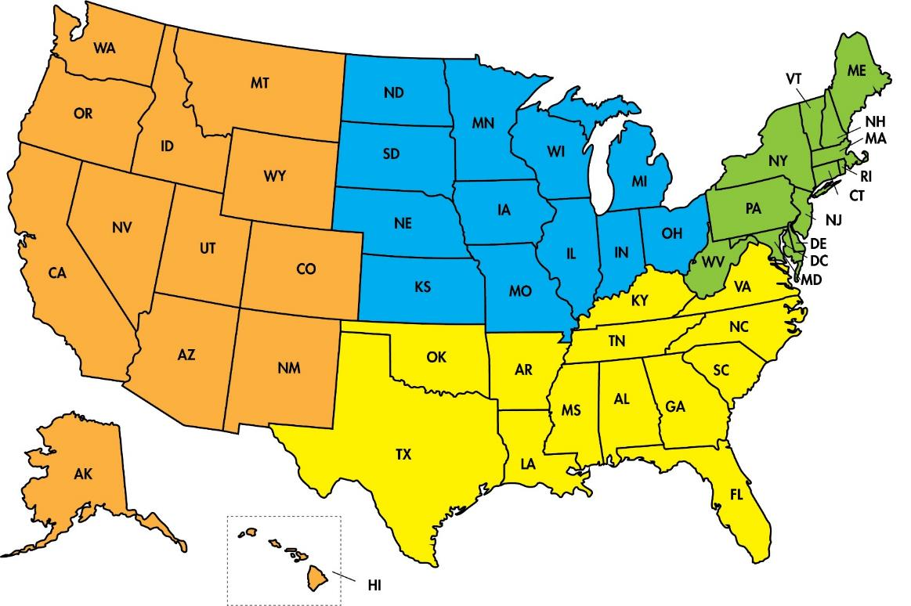

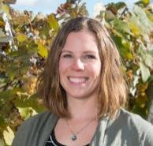
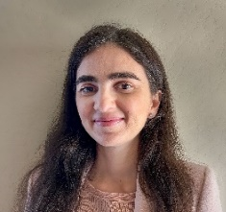
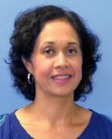

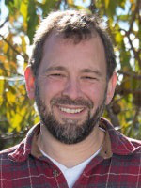
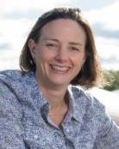
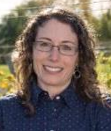


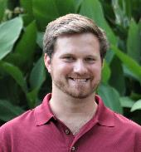
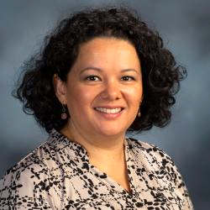
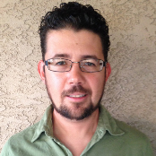
Produce Safety Alliance Team
PSA Coordinator &
Northeast EA
Donna Clements, M.S.
Spanish-Language EA
Laura Acuña-Maldonado, Ph.D.
Northwest EA
Collins Bugingo, Ph.D.
Southwest EA
Thaís Ramos, Ph.D.
Midwest EA
Laurie George, Ph.D.
EA
Don Stoeckel, Ph.D.
Cornell AgriTech
Betsy Bihn, Ph.D., Director
Michele Humiston, Ext Supp Spec
Rob Way, Database Mgr.
Toria Melville, Ext Aide
Spanish-Language EA
Mariana Villarreal D.V.M., Ph.D.
Davis Blasini, Ph.D.
Southeast EA
Tommy Saunders, M.S.

Slide 3

PSA Team Updates
New PSA Team members!
  Mariana Villarreal, Spanish-Language Extension Associate
  Collins Bugingo, NW Regional Extension Associate
  Thais Ramos, SW Regional Extension Associate
Reviewing applications for
new Spanish-language Extension Associate

Slide 4
PSA Training Accomplishments
September 2016 – September 30, 2022
3,742
Grower Trainings
122
Train-the-Trainer Courses
79,707
GT Participants
3,486
TTT Participants
Total PSA Trainers: 2,925 (2,070 domestic US)
Total PSA Lead Trainers: 505 (281 domestic US)
Remember: Trainers can update their affiliation and contact
preferences on the Trainer Directory page
Notes:
The data on this slide shows training numbers from September 2016 to September 30, 2022. This information is shared in our quarterly training reports available on the PSA Training Reports page (https://producesafetyalliance.cornell.edu/training/training-reports/).
More than 3,486 individuals have attended the TTT course and become PSA Trainers; 505 later became Lead Trainers. (updated 9-30-22)
Together, we have trained almost 80,000 people in six years
We would like to thanks all PSA trainers and Lead trainers for their continued effort to keep training and collaborating even under special circumstances like this COVID-19 pandemic. To make my point, we have trained almost 20,000 growers since January 2020.

Slide 5

2023 PSA Updates
Expanding into International Training
  New objectives to conduct 15 trainings in Mexico with specific commodity groups (onion, mango, and melon)
  Will impact domestic Spanish-language outreach
New website
  Please remember to update your bookmarks!
Funding remains a big concern
  Full funding through
  September 2023
  Partial funding through
  June 2024

Slide 6

Subpart E (Agricultural Water) Efforts
Supplemental training slides on proposed Subpart E requirements
Current priority is on harvest/postharvest water requirements
  Updating PSA required records templates (water system inspection)
  Updating sanitizer resources
Upcoming produce Safety Educators’ Call series on harvest/postharvest water

Slide 7

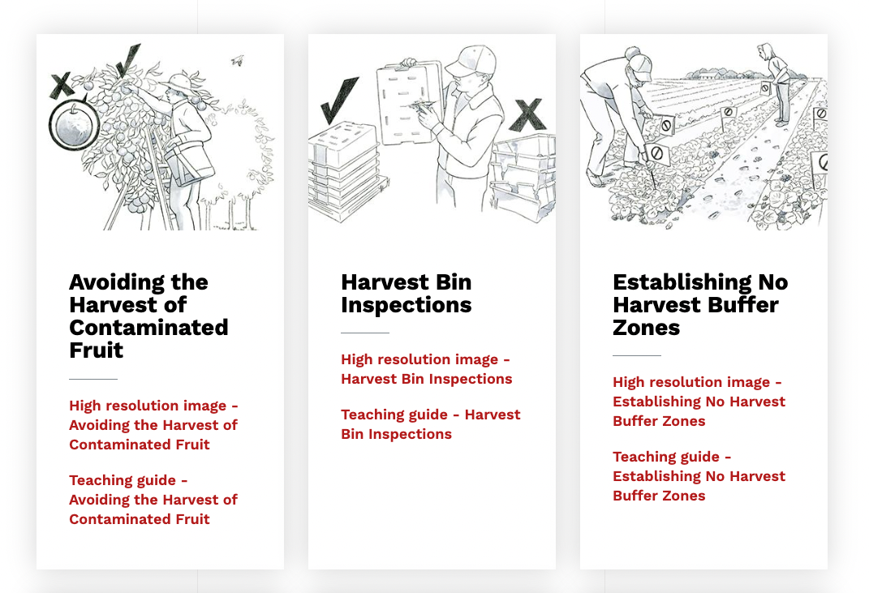
New Educational Materials
Traceability Supplemental Slides
More than Words Illustrations
PSA Grower Training
Manual Translations
Educators’ Groups (English & Spanish) going strong!
Notes:
Mention V1 of the traceability slides

Slide 8
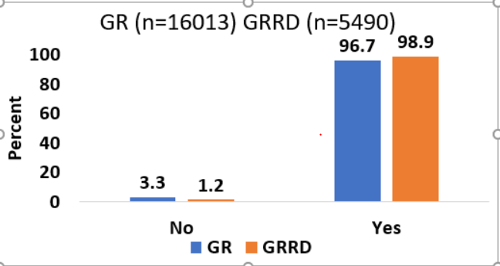
Additional Updates
Settling into a new COVID normal
  Optimizing training schedules, assessing needs, and prioritizing objectives
Analyzing PSA Grower Training evaluations to evaluate the temporary remote training policy
  Comparing differences between training modalities
  Developing recommendations for effective remote trainings

Slide 9
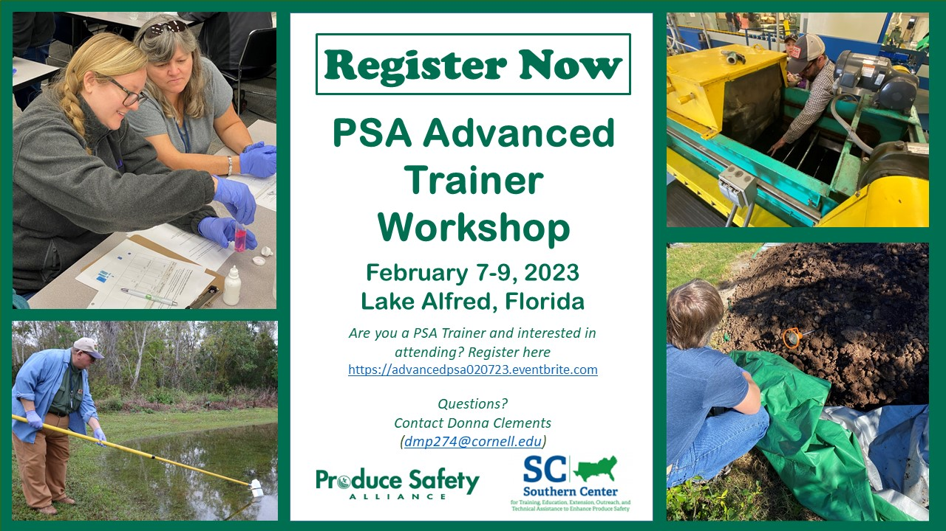

PSA Advanced Trainer Workshop
Notes:
https://www.eventbrite.com/e/psa-advanced-training-lake-alfred-registration-479534108427

Slide 10


The PSA (Migrated) Website
English: producesafetyalliance.cornell.edu
Spanish: es.producesafetyalliance.cornell.edu
Notes:
Has animation

