Slide 1
NECAFS Annual Conference and Meeting
January 18 & 19
Hartford, CT

Slide 2
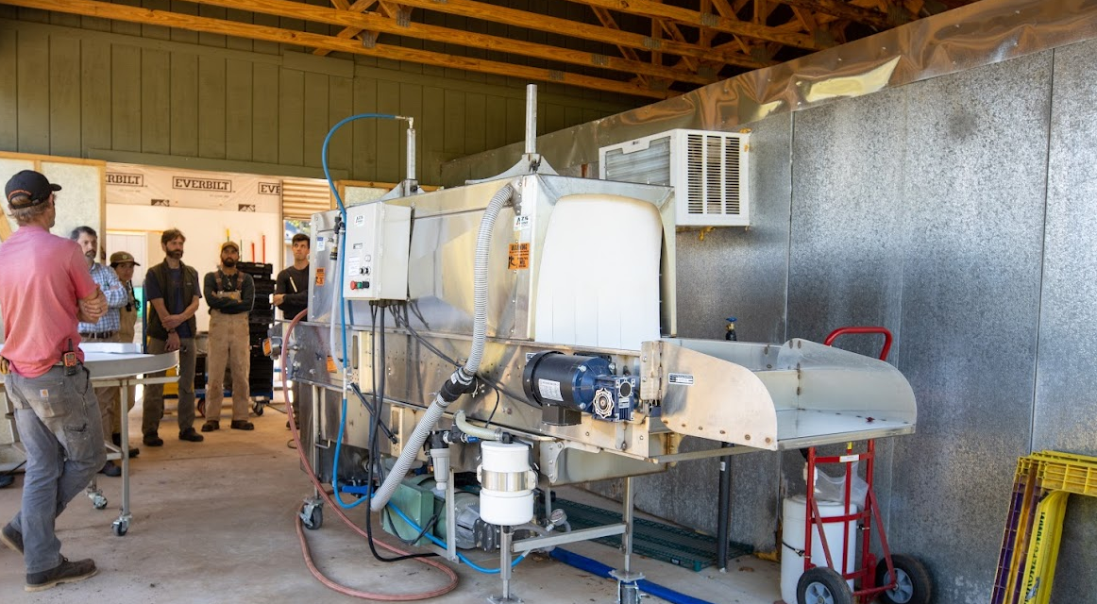
Welcome and NECAFS Background

Slide 3
Enhance produce safety and preventive controls

Slide 4
Enhance produce safety and preventive controls training, education, and outreach

Slide 5
Enhance produce safety and preventive controls training, education, and outreach among small and medium sized farms and small processors

Slide 6
Enhance produce safety and preventive controls training, education, and outreach among small and medium sized farms and small processors in the Northeast.

Slide 7
Enhance produce safety and preventive controls training, education, and outreach among small and medium sized farms and small processors in the Northeast.

Slide 8
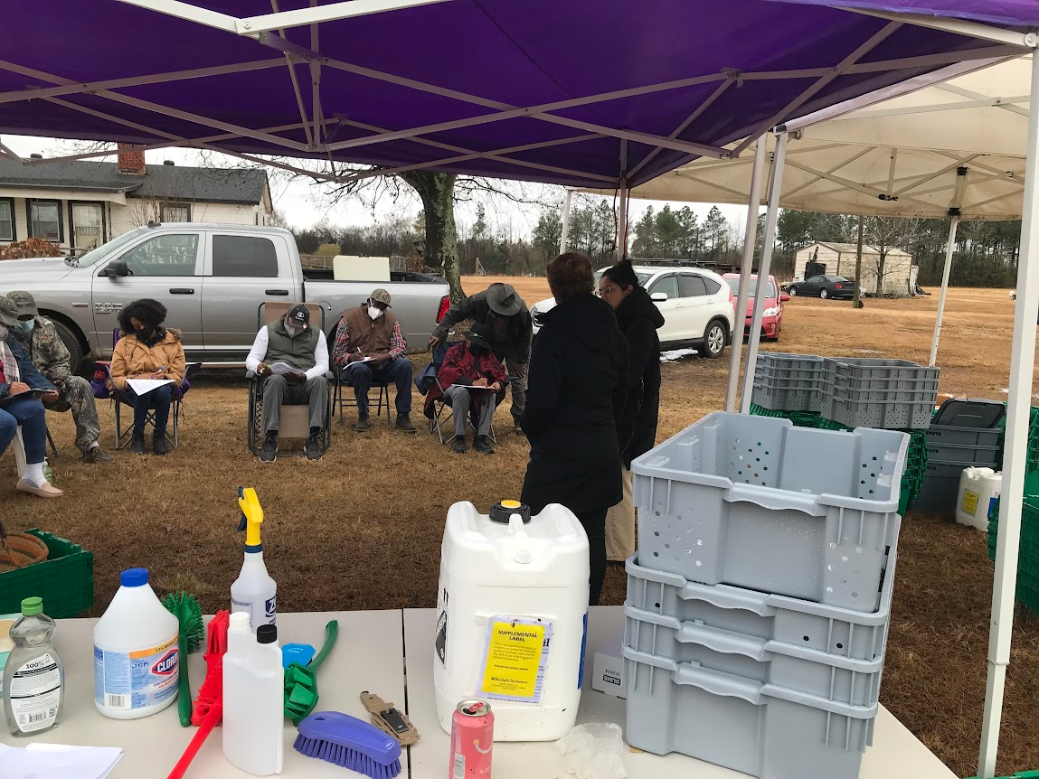
Who:
University researchers, educators and extension specialists
State regulatory and enforcement agency partners
Local food and farming organizations, NFP’s
Consultants & Industry associations
Small and medium sized producers, small processors, buyers
Other regional centers and initiatives, national center, USDA/FDA
Goal:
Enhance produce safety and preventive controls training, education, and outreach among small and medium sized farms and small processors in the Northeast.
Objectives:
1. Establish Foundational Network Structure
2. Build Capacity, Competency, and Collaboration
3. Develop and Deliver Educational Programs
4. Evaluate and Assess Progress and Impact
5. Sustain Good Work

Slide 9
NECAFS started with NE-PHRESH
(Northeast Center to Advance Food Safety)
(Northeast Postharvest Research and Extension Service Hub)
Disparate opinion, accuracy and location of knowledge. Overlapping and non-coordinated effort in region.
Based on field experiences. Shared by peers.
Lacking regional relevance and research base.
NEED/NERA* Planning Grant ($4k) to focus on postharvest research and educational needs. Together.
Jan 2015
Amherst, MA
* Northeast Extension Directors / Northeastern Regional Association of State Agricultural Experiment Station Directors

Slide 10
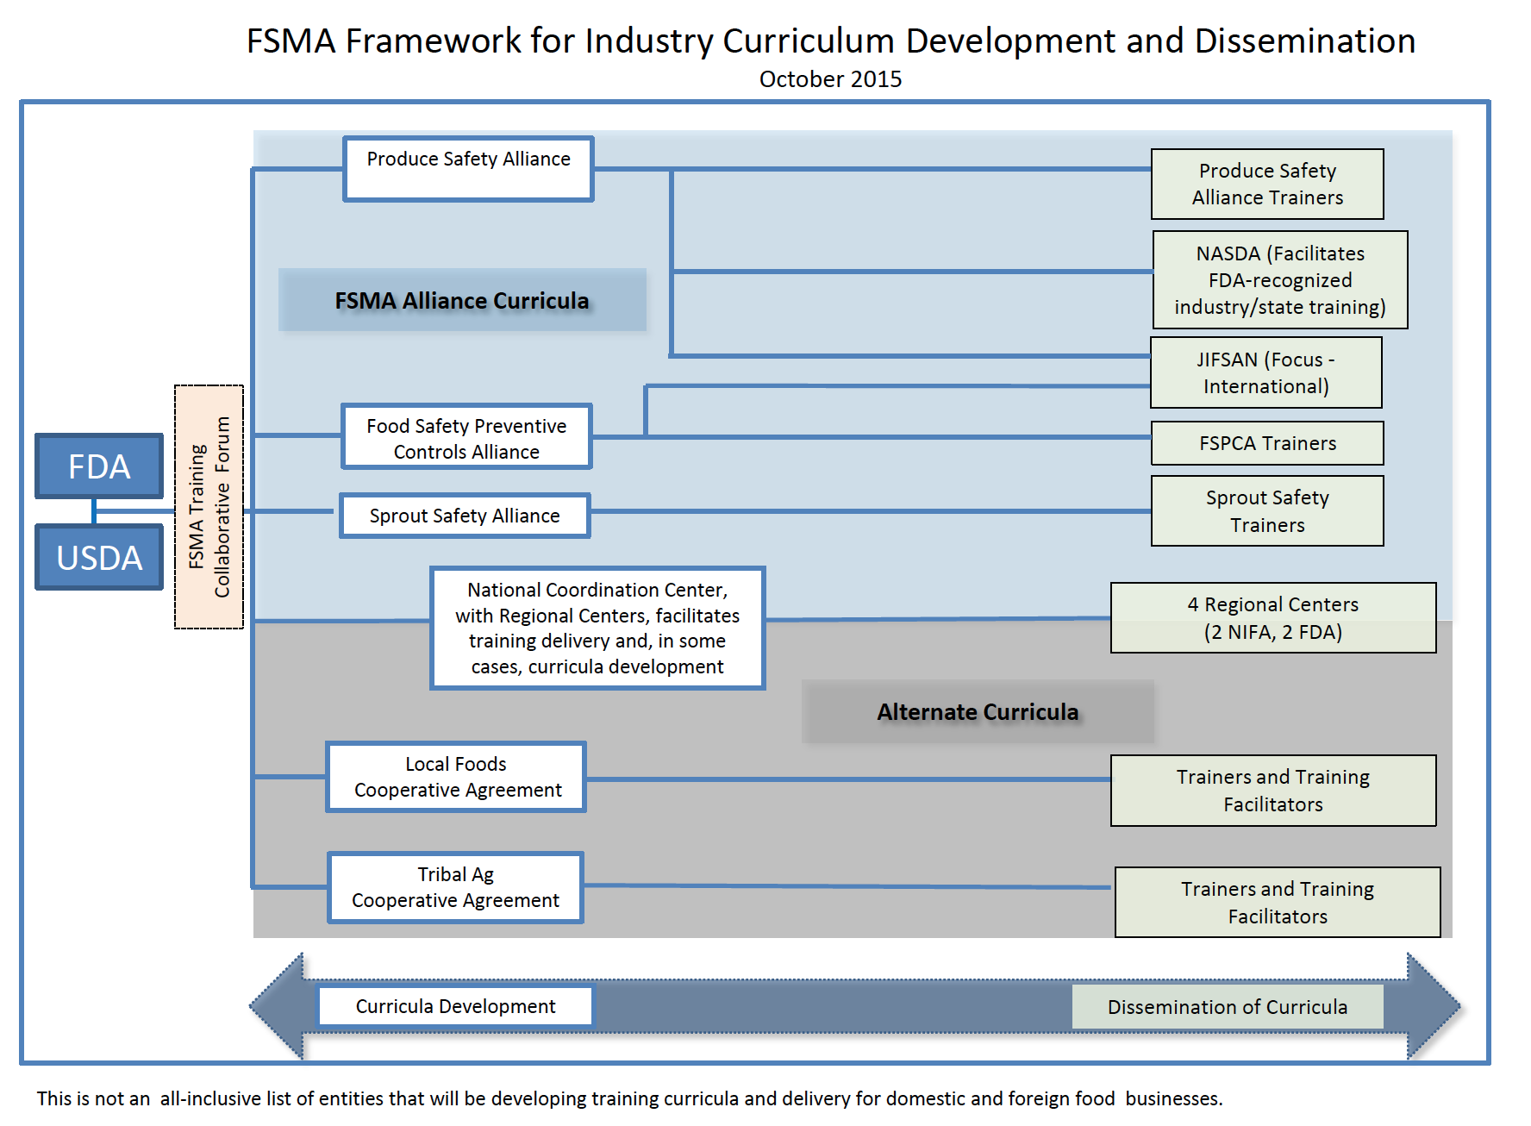
What Came from this?
Expressed need for consolidated resources – sharing work
Expressed desire for collaborative research and educational programming – e.g. drafted collective research questions
Concerns about how to “train up” to “train up” for anticipated FSMA rules (PCHF and PSR) (this was Jan ’15)
Concerns about maintaining regional relevance of information, educational programs and best practice
Sustained, nascent network with willingness to collaborate

Slide 11
Enhance produce safety and preventive controls training, education, and outreach among small and medium sized farms and small processors in the Northeast.

Slide 12
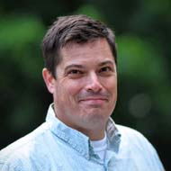
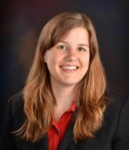
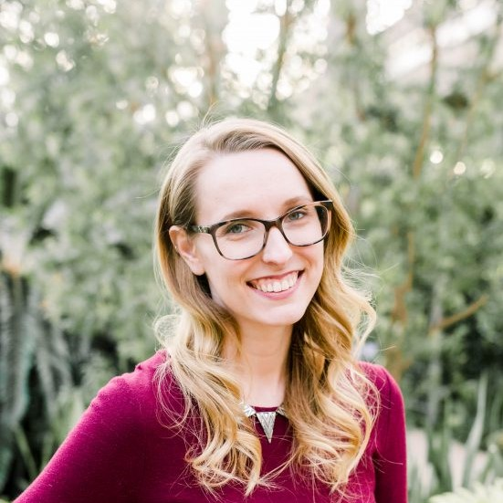
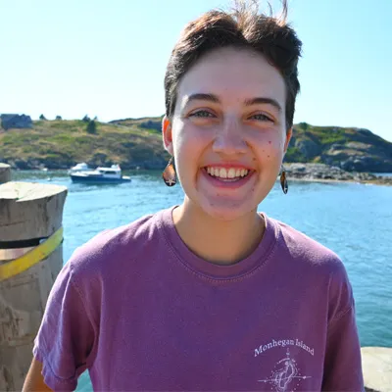
NECAFS Team
Chris Callahan
Elizabeth Newbold
Annie Fitzgerald
Sean Fogarty
Anna Loewald

Slide 13
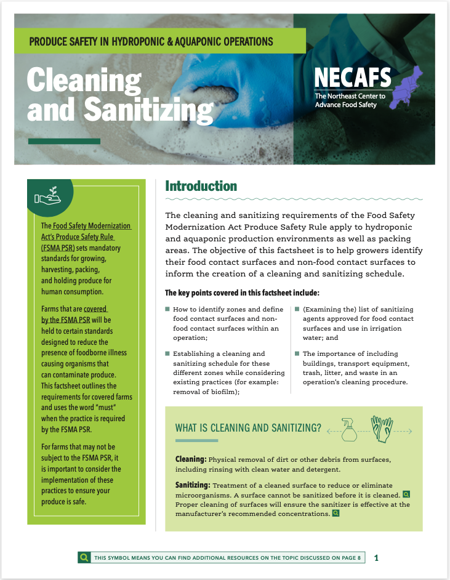
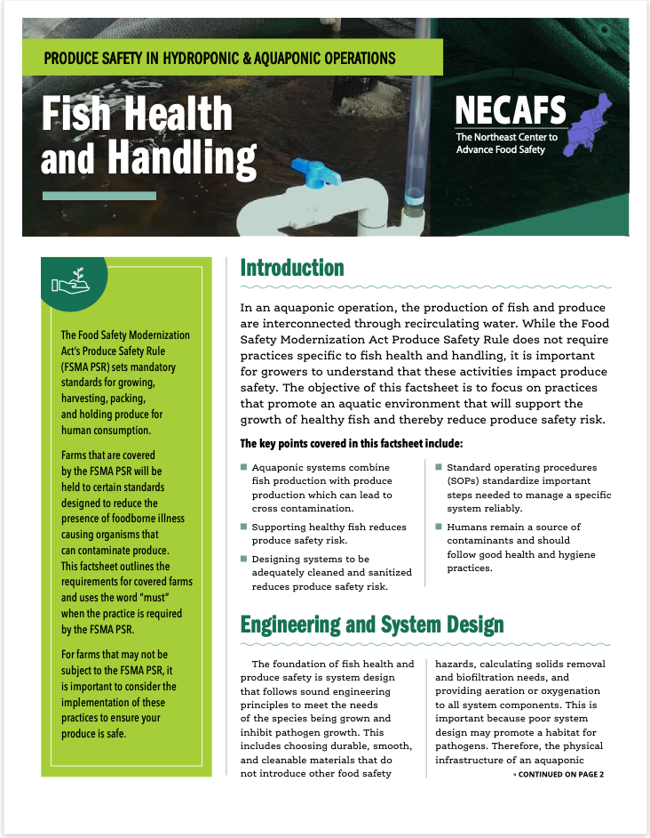
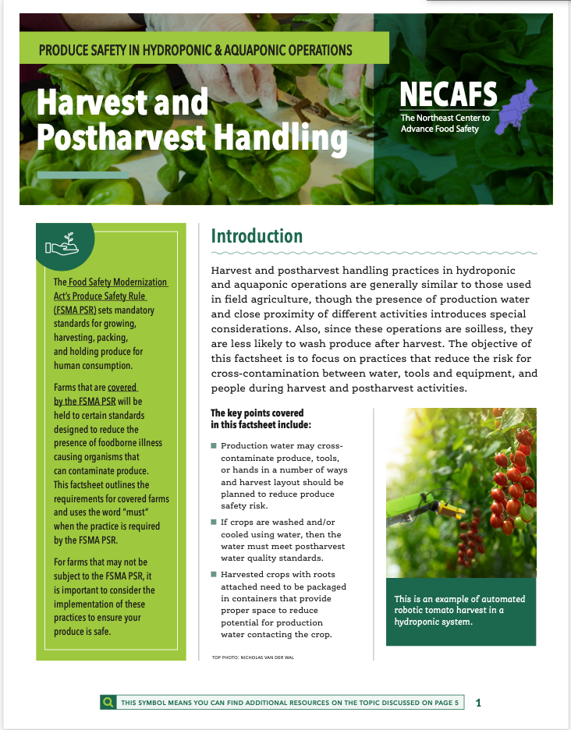
Produce Safety in Hydroponic and Aquaponic Operations
Topic-Based Factsheets:
Cleaning and Sanitizing
Fish Health and Handling
Harvest and Postharvest Handling
Personal Health and Hygiene
Wildlife and Domesticated Animals
In revision following advisory group feedback
First release expected February 2023!
Notes:
at the 2019 Annual Meeting a need was expressed for educational resources regarding produce safety in HP/AP. NECAFS acted upon this need by developing a set of factsheets that guide the reader through produce safety considerations specific to these types of systems.

Slide 14
Understanding and Addressing Needs for On-Farm
Produce Safety Education in Hydroponics and Aquaponics
2022 FSOP Grant
PROBLEM STATEMENT: The HP/AP industry is growing and is under-served by produce safety educational resources and learning events, while produce safety educators and regulators lack knowledge about HP/AP operations.
PLANNED IMPACTS
Aquaponic and hydroponic growers improve produce safety practices leading to reduced risk.
Produce safety educators and regulators improve knowledge and understanding of aquaponic and hydroponic operations leading to improved support of the industry.
GOAL: The overall goal of this project is to facilitate coordinated development of produce safety educational resources and experiences for aquaponic and hydroponic stakeholders across the nation to support increased understanding and reduced risk.
OBJECTIVES:
ADVISORY GROUP - Form a nation-wide hydroponic and aquaponic produce safety advisory group that informs project outputs at multiple steps.
NEEDS ASSESSMENT - Determine produce safety educational needs/gaps specific to hydroponics and aquaponics.
ED DEVELOPMENT - Develop educational curricula, programs, and resources for diverse audiences.
ED DELIVERY & EVALUATION - Deliver educational resources and programs to target audiences and evaluate outcomes and impact.
COORDINATE RESEARCH - Coordinate research efforts to address knowledge gaps.
TL;DR: NECAFS will continue to organize collaborative work in on-farm soilless produce safety over the next 3 years.
Contact Sean to join the fun!
Notes:
And NECAFS will continue to work on resources and programming in this area over the next 3 years. Please contact me if you want to become involved in this project.

Slide 15
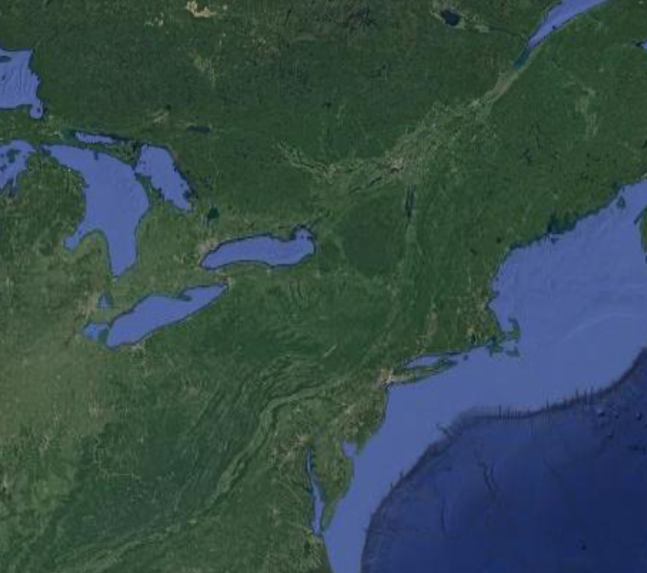
Northeast Produce Safety Research Consortium
FDA CFSAN OARSA (Center for Food Safety and Applied Nutrition, Office of Applied Research and Safety Assessment) requested a proposal from NECAFS for a collaborative regional project.
Aim: Establish a Northeast regional produce safety research consortium that coordinates sampling of produce production and handling environments to better understand human pathogen risks in the food system.

Slide 16
Northeast Produce Research Consortium Organizational Chart – Year 1 (2022)
Updates, Results
NECAFS
FDA CFSAN OARSA
Funding, Project goals
Methodology
Anonymized data
Feedback from field
Funding
Project activities
Pathogen isolate DNA + metadata
Farm Partners
Wild blueberry
Apple
Ohio vegetables
More to come…
University Partners
U of Maine
U of Delaware
The Ohio State U *
Results, Outreach
Samples, Metadata
* The Ohio State University has its own FDA funding.

Slide 17
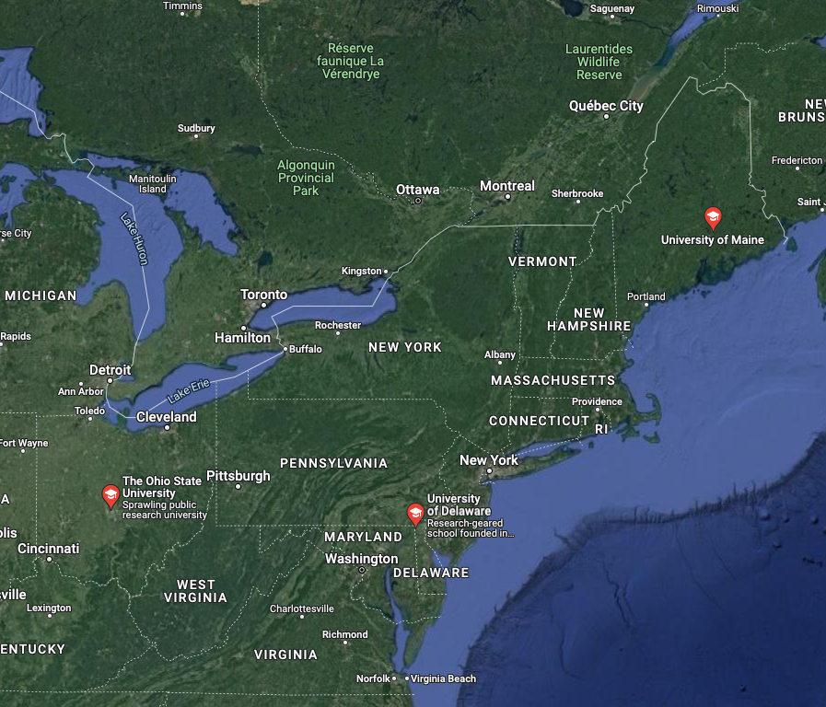
Northeast Produce Safety Research Consortium
Year 1 Organisms of Interest
FDA-Requested Pathogens
Shiga toxin-producing E. coli (STEC)
Salmonella spp.
Listeria monocytogenes
Cyclospora spp.
Hepatitis A virus
Norovirus GI
Norovirus GII
Indicators Determined by Investigators
Total coliforms
Generic E. coli
Aerobic plate count
Fungi (yeast and mold)
Pepper mild mottle virus (PMMoV)

Slide 18
Northeast Produce Safety Research Consortium
Year 1 Sample Collection
Maine – Wild Blueberries
Delaware – Apples
Sample aliquots were sent from ME and OH to DE for digital PCR virus and protozoan analysis
Ohio – Variety of Produce
Farms | Weeks | Sample types | Total samples
5 | 6 | 5 | 230
Farms | Weeks | Sample types | Total samples
2 | 4 | 2 | 48
Farms | Weeks | Sample types | Total samples
2-4 | TBD | TBD | TBD

Slide 19
Northeast Produce Safety Research Consortium
Year 2 Planning
Maine – More Wild Blueberries + Apples?
Delaware – More Apples?
Ohio – Add Apples?
Change target organisms based on results?

Slide 20
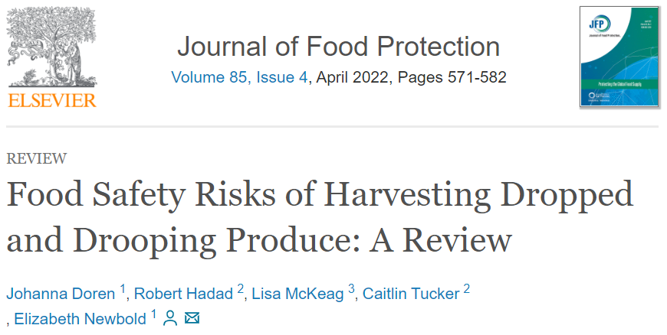
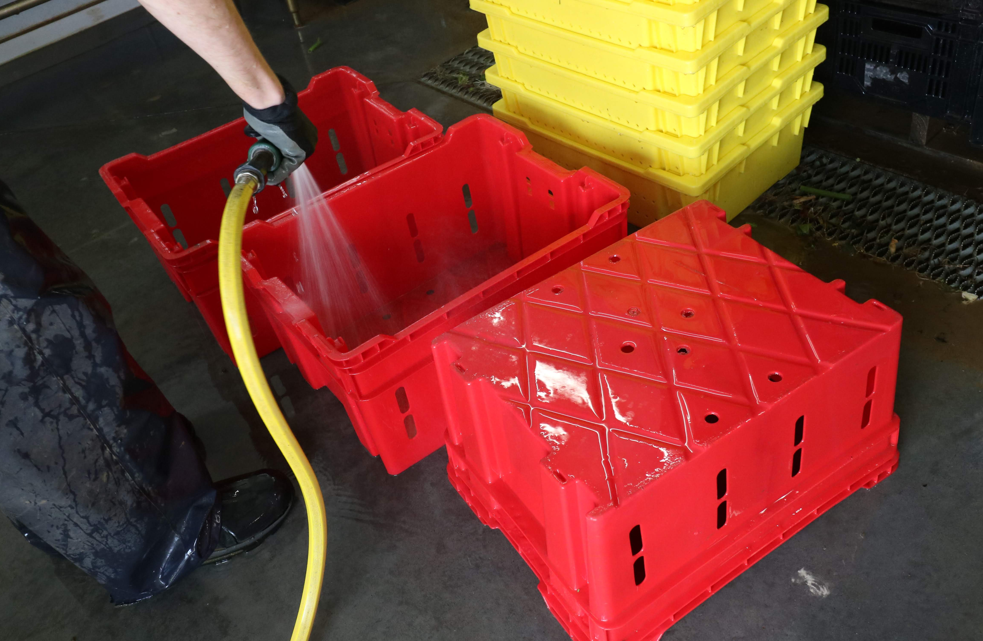
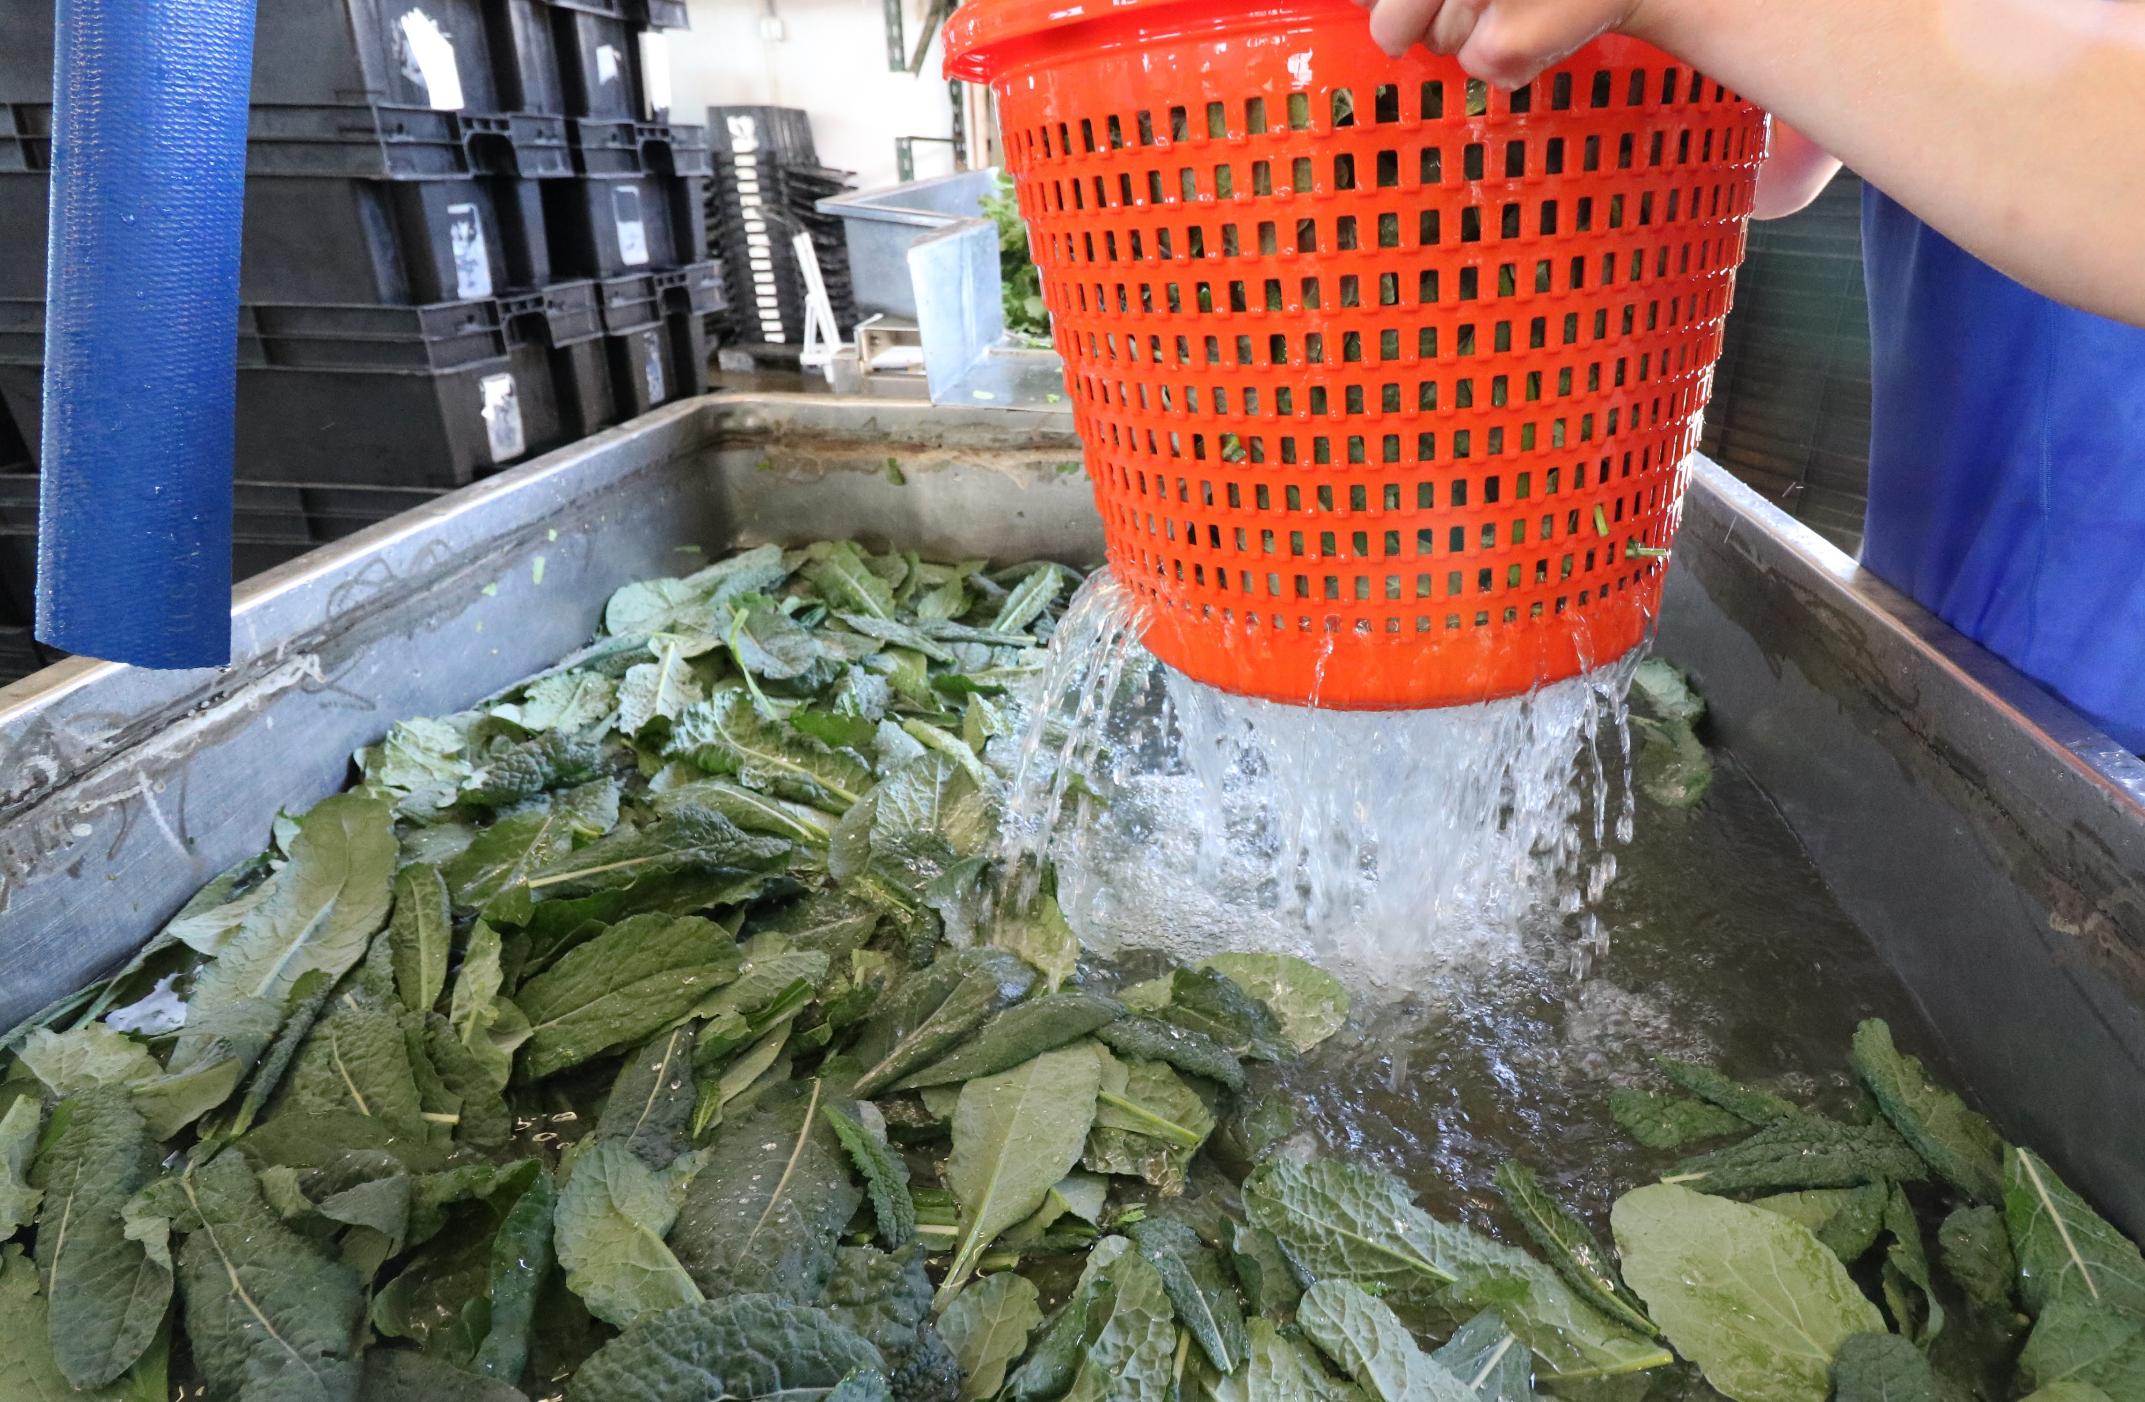
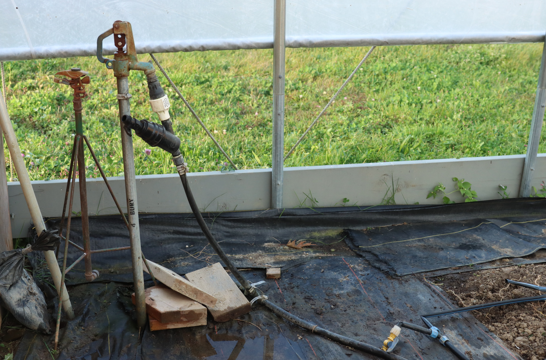
Existing Produce Safety Research
Objective: Articulate critical research questions and conduct extensive review of existing research related to FSMA PSR topics
Goal: Summarize and share existing produce safety research in an approachable way
How: Literature reviews and digestible outputs (e.g., table summaries, decision flowcharts)
Dropped and Drooping Produce
Animal Damage
Surfaces and Pathogen Survival
Wash Water
Water Systems

Slide 21
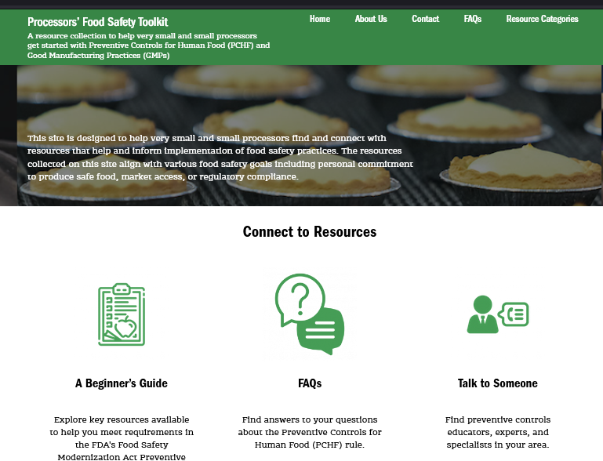
Preventive Controls Workgroup: Leveraging the shared needs, skills, and outputs of Food Safety Communicators in the Northeast
Resources
Designed and built a one-stop-shop for small and very small processors to learn about the PCHF rule
Launched in July 2022
Awareness
Build awareness and collaboration among food safety communicators of our shared goals and tools
Build awareness among small and very small processors of the Processors Food Safety Toolkit
Evaluation
Developed a regional evaluation tool for the FSPCA PCHF curriculum to identify trends and additional technical support needs of those impacted by the
Launched in November 2022
Needs Assessment
Developed and conducted a needs assessment to understand food safety communicator’s observations of small and very small processors’ food safety needs
Group members
Elizabeth Demmings, Ph.D., Institute for Food Safety at Cornell University Coordinator
Andrea Gilbert-Eckman, Graduate Assistant, University of Maryland
Luke LaBorde, Ph.D., Professor of Food Science, Penn State University
Amanda Kinchla, Extension Associate Professor, University of Massachusetts Amherst
Nicole Richard, Research Associate/Food Safety Education Specialist, University of Rhode Island
Dave Seddon, MBA, RD, LD, Food Safety Specialist/Auditor, FoodReady.ai & Maine Farm and Sea Cooperative

Slide 22
Food Safety Resource Clearinghouse Analytics
LAST YEAR
7,482 USERS VISITED
THE CLEARINGHOUSE
11,400 TIMES
AND SPENT
14 DAYS 13 HOURS
AND 34 MINUTES
LOOKING AT
23,552 PAGES

Slide 23
Food Safety Resource Clearinghouse Analytics
How do people find what they need and what aren’t they finding?
Search Term | Total Searches | % Selected Result | Most popular resource from the search
Water | 62 | 31% | Managing Water Quality: Water Testing, Remediation, & Post Harvest Water, Food Safety Fridays
Handwashing | 45 | 73% | FSMA PSR Handwashing Poster
Food Safety Plan | 36 | 50% | Food Safety Plan Builder

Slide 24
Food Safety Resource Clearinghouse Analytics
How can we improve to meet user needs?
Peer review tool
Leverage the data: how do we point people to what they’re looking for?
How to do we improve site design and accessibility?
Create new resources
Most clicked on resources per page view
Food Safety Resources for Food Hubs - Sample Standard Operating Procedures (SOPs)
Overlaps in Quality Assurance Programs and FSMA Preventive Controls for Human Food Rule Requirements Training Series
Soil Amendment Activity
Farm Food Safety Posters
PSA Training Pre and Post Test Evaluation (English and Spanish Versions)
Farm Innovation Activity Resources
UT, NCSU, UGA and WSU Food Safety Posters
Worker Specific Training in Spanish
Video Series: Using Sanitizers in Washwater
Fruits, Vegetables, and Food Safety: Health and Hygiene on the Farm

Slide 25
Produce Safety Handbook for Buyers
Goals of site -
Summarize of the Northeast produce food safety landscape
Give an overview of produce production
Help buyers understand and navigate each state’s audit and inspection information
Launching Feb/March 2023
Team included Wes Kline, Jenn Matthews, Hans Estrin, buyers and state partner review

Slide 26
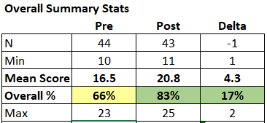
Other Ongoing Activities
Training Support Stipend Program
Funding is available to support
the development of PSA, PC, Sprout trainers
the delivery of PSA, PC, Sprout trainings
National Water Lab Map
607 maps
27,209 views
Pre- and Post-Test for PSA Grower Trainings

Slide 27
Upcoming Work
National long term look back survey in partnership with the Produce Safety Alliance
Will assess:
Behavior Change (what have people done since attending training)
Confidence (what do they need help with doing next)
Continuing Need (what other obstacles prevent them from implementing next steps)
Costs
Survey will open February/March 2023 and remain open for 8 weeks

Slide 28
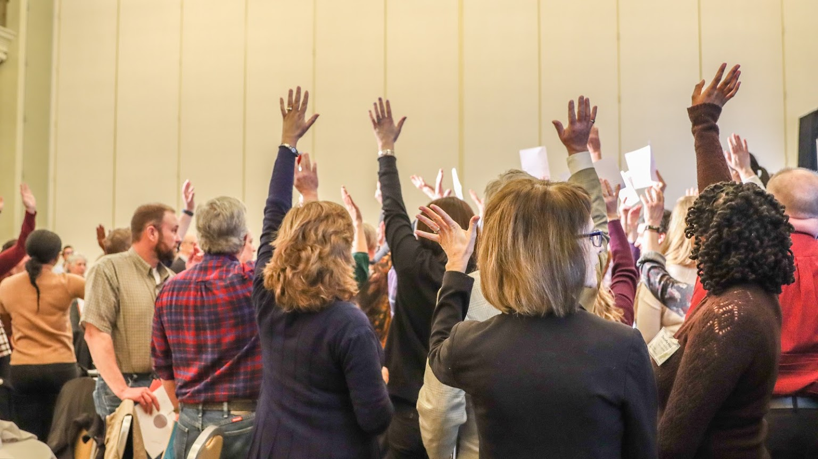
What to Expect in this Meeting

Slide 29
Situational Assessment
Planning for Change
Collaborative Activity
Change in Practice
Last Year
Day One – Situational Assessment
Day Two – Planning for Change
Now
(You are here!)
Summary of Inspectional Findings
(PSR Topic)
Regulatory Group
Inspectional and Observational Findings
Regulatory Panel
Plans & Teams for a handful of feasible and important actions and projects
Joint Breakout Groups to Facilitate Change
Summary of Educational Needs (Barriers)
Educational Group
Learning Barriers
Educational Panel
Cont’d Planning as Needed
Collaborative Activity
Change in Practice
Coming Year
Rinse, Repeat… always follow the label!

Slide 30
NECAFS Meeting Guiding Principles
Respect and trust each other enough to challenge and grow together.
Everybody is an expert… and nobody is an expert.
Step forward… and step back.
Celebrate and share successes… and be candid about challenges that remain.
Take breaks and take care of yourself!
What others would you like to share?

Slide 31
Thank You To our funder
USDA NIFA

Slide 32
Thank You NECAFS Team
Betsy Bihn, Cornell University
Chris Callahan, UVM
Annie Fitzgerald, UVM
Sean Fogarty, UVM
Amanda Kinchla, UMass
Luke LaBorde, Penn State
Anna Loewald, UVM

Slide 33
Thank You Regulator One-Day Meeting Planning Committee
Liz Stiles, NJ
Ananda Fraser, RI
Aaron Finley, NY
Michael Botelho, MA
Kristina Sweet, VT

Slide 34
Thank You Preventive Controls Workgroup Leads and Members
Beth Demmings, Cornell University
Amanda Kinchla, UMass
Luke LaBorde, Penn State
Nicole Richard, URI
Andrea Gilbert, UMD
Dave Seddon, PeakCore

Slide 35
Thank you!
Break out group facilitators
Student volunteers
Our colleagues who are retiring!

