Slide 1


State Inspectional Observations
Presented by Kristina Sweet, Vermont Agency of Agriculture, Food & Markets
Produce Safety Regulator & Program Staff Meeting | NECAFS Annual Conference
January 18 & 19, 2023

Slide 2
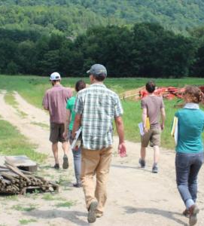
Context & Background
Follow-up to NECAFS 2021 & 2022 presentations
Most common misunderstandings, noncompliance issues, and technical assistance needs
Persistent misunderstandings and areas of noncompliance
Looking ahead
  Agricultural water compliance
  Traceability
Notes:
Follow-up to last year’s presentation and the 2021 presentation by Leah Cook, then of the Maine Department of Agriculture, Conservation and Forestry
Qualitative analysis of information provided by inspectors across the region of the most common misunderstandings, noncompliance issues, and technical assistance needs they’ve identified over the past year of inspections.
The regional context here is that inspectors conducted a mix of initial and routine Produce Safety Rule inspections this year on covered farms of all sizes.
What we’ll see today are some persistent misunderstandings and noncompliance issues across the region and that folks are looking ahead to revised agricultural water requirements as well as the proposed rule on traceability.
Thank you to Elizabeth Newbold for collecting data from all of our Northeast states. Thank you to everyone participating today for their commitment to both public health and making sure growers have the resources they need to successfully implement the Produce Safety Rule. That’s what this presentation is really all about.

Slide 3
Questions
What common misunderstandings did farms have about either food safety or PSR regulatory requirements during inspections in 2022?
What were the most common noncompliance observations or issues you observed on farms during inspections in 2022?
What types of technical assistance do you need in your state?
Are there specific knowledge areas or delivery formats you’ve identified as a need for in your state?
Notes:
We asked the same three questions of inspectors this year.

Slide 4
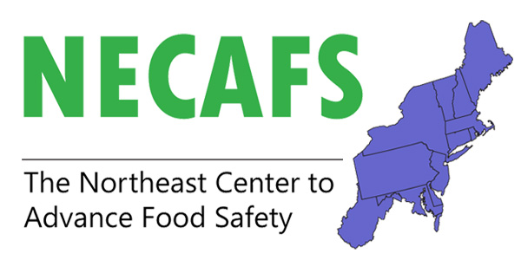
Participants
Connecticut
Delaware
Massachusetts
Maine
Maryland
New Hampshire
New Jersey
New York
Pennsylvania
Rhode Island
Vermont
West Virginia
Notes:
Thank you to inspectors who have been conducting inspections on farms during a global pandemic and generously took the time to provide data on common misunderstandings, noncompliance issues, and technical assistance needs.

Slide 5




2022 Topic Summary Table
TOPIC | MISUNDERSTANDINGS | COMPLIANCE ISSUES | TA NEEDS
Cleaning & Sanitizing
Worker Training
Agricultural Water
PSR Coverage & Audits vs. Inspection
Records
Equipment, Tools & Buildings
Hand Washing & Worker Hygiene
Animal Intrusion
BSAAOs
Dropped Covered Produce
Visitors
Traceability
General Compliance Issues
Notes:
Here is a summary of topics that arose this year. Many are the same as last year, but a few, like animal intrusion and visitors, were not topics highlighted last year.

Slide 6
Common Misunderstandings
Cleaning & Sanitizing
Worker Training
Agricultural Water Requirements
Produce Safety Rule Coverage, Audits & Inspections
Records

Slide 7
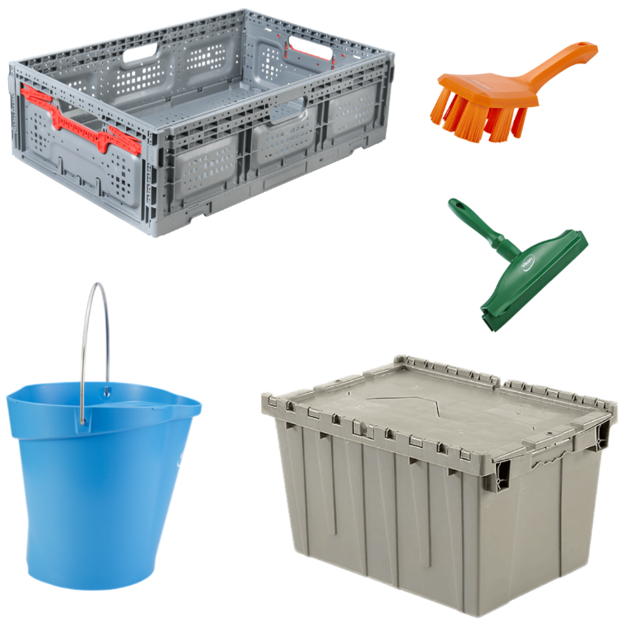
Misunderstandings:
Cleaning & Sanitizing
What to clean and sanitize
How to clean and sanitize
Items that cannot be cleaned or sanitized
Risks associated with lack of cleaning and sanitizing
What to include on cleaning logs
Notes:
Persistent misunderstandings about the difference between cleaning and sanitizing and the difference between detergents and sanitizers as well as identifying food contact surfaces. Some of the other topics that came up were workers taking knives and totes home and bringing them back to the farm without cleaning, insufficient cleaning of floors and drains, and reusing waxed or cardboard boxes that cannot be cleaned.
Difference between detergents and sanitizers
Using appropriate detergents and sanitizers
Identifying food contact surfaces
Workers taking knives and totes home
Insufficient cleaning of floors and rains
Reusing waxed or cardboard boxes

Slide 8

Misunderstandings: Worker Training
Understanding training requirements
Not understanding the need for annual training
Resistance to annual retraining
Reluctance to retrain employees to change behavior
Farm manager not modeling food safety practices

Slide 9
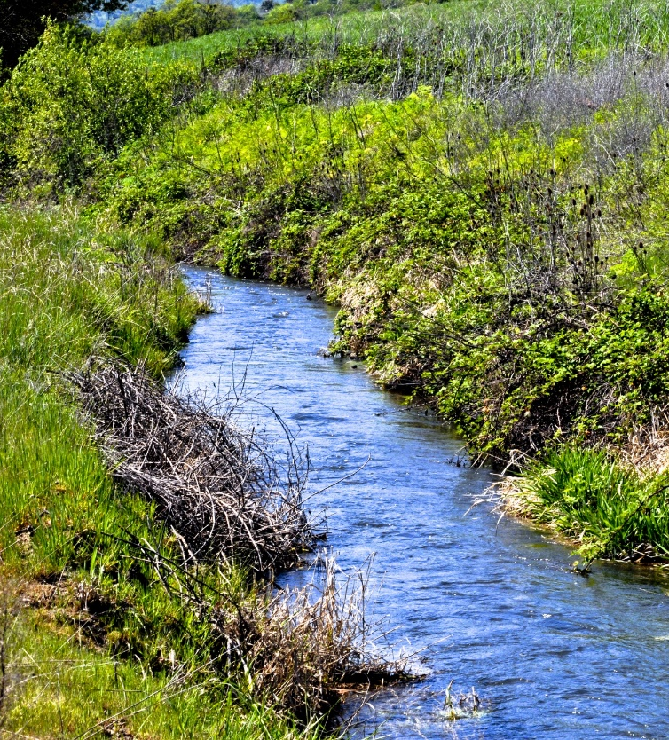
Misunderstandings: Water
Definition of agricultural water
The idea that because of the status of Subpart E, paying attention to water is not important
Annual inspection of agricultural water systems
What to test for and how often to test
How to monitor and maintain postharvest water treatment systems (e.g., UV treatment)
How to monitor re-circulated postharvest water and when to change water

Slide 10
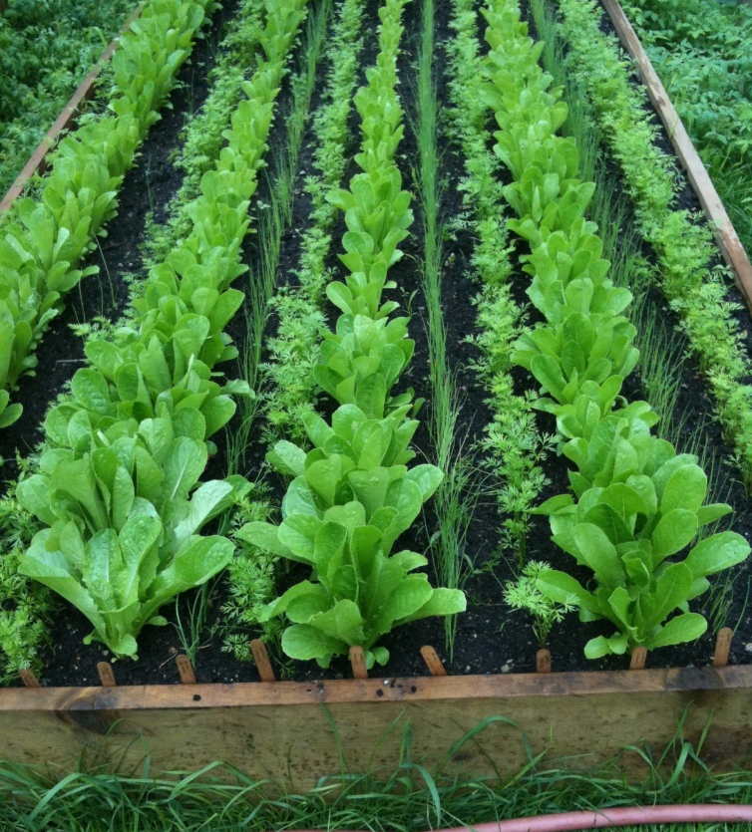
Misunderstandings:
PSR Coverage, Audits & Inspections
Growers not knowing whether they are covered by the rule, qualified exempt, or not covered
Some growers do not understand why they need both a USDA GAP and a Produce Safety Rule (PSR) inspection.
Some growers think if they are GAP certified, they don't need a PSR inspection. Others think the GAP audit is the PSR inspection.
Some growers are confused or forget that they must include commodities and covered activities (under the PSR) that have not been part of their audit.
Notes:
Inspectors faced continued confusion about PSR coverage as well as audits vs. inspections this year.

Slide 11

Misunderstandings: Records
General record requirements and components
What to include on cleaning and sanitizing logs
Minor recordkeeping issues

Slide 12

Additional Misunderstandings
Animal intrusion: assessing significant evidence of potential contamination
Identifying biological soil amendments of animal origin (BSAOO) beyond manure
Poor pest management in buildings
When to wash hands and maintaining hand washing stations
Listeria m. and risks associated with drip, condensate, and pooled water
Notes:
Assessing evidence of animal intrusion and what actions to take
What constitutes BSAAO (fish meal, bone meal, blood meal, dried chicken pellets)
Farms that have UV water treatment systems (for postharvest water) often do not have a regular maintenance schedule, records, or a plan if things go wrong.

Slide 13
Common Noncompliance Issues
Cleaning & Sanitizing
Equipment, Tools & Buildings
Records
Worker Training
Hand Washing / Worker Hygiene

Slide 14

Noncompliance:
Cleaning & Sanitizing
Cleaning vs. sanitizing
Lack of cleaning and sanitizing
Documenting cleaning and sanitizing
Cleaning and sanitizing equipment
Sanitizers not labeled for the purpose
Managing condensate
Use of sanitizer test strips

Slide 15
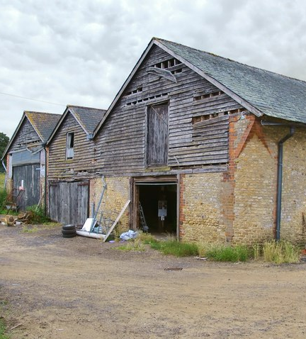
Noncompliance:
Equipment, Tools & Buildings
Equipment or tools that cannot be adequately cleaned
  Design, construction, or workmanship
  Damage or inadequate maintenance
Contamination from buildings and storage
  Lack of pest control in buildings
  Lack of adequate drainage or prevention of contamination through floors, walls, and ceilings
  Drip or condensate on or near produce
This Photo by Unknown Author is licensed under CC BY-SA
Notes:
Lack of understanding of risks of associated with drip, condensation, and pooled water in packing areas (esp. coolers). Lack of knowledge about Listeria m. as a risk in these conditions. This topic also relates to poor condition of floors and insufficient cleaning practices (e.g. of drains).
Poor pest management in buildings. Farms may have traps or bait stations, but no maintenance schedule, maps or records, or staff who are responsible for checking them.

Slide 16
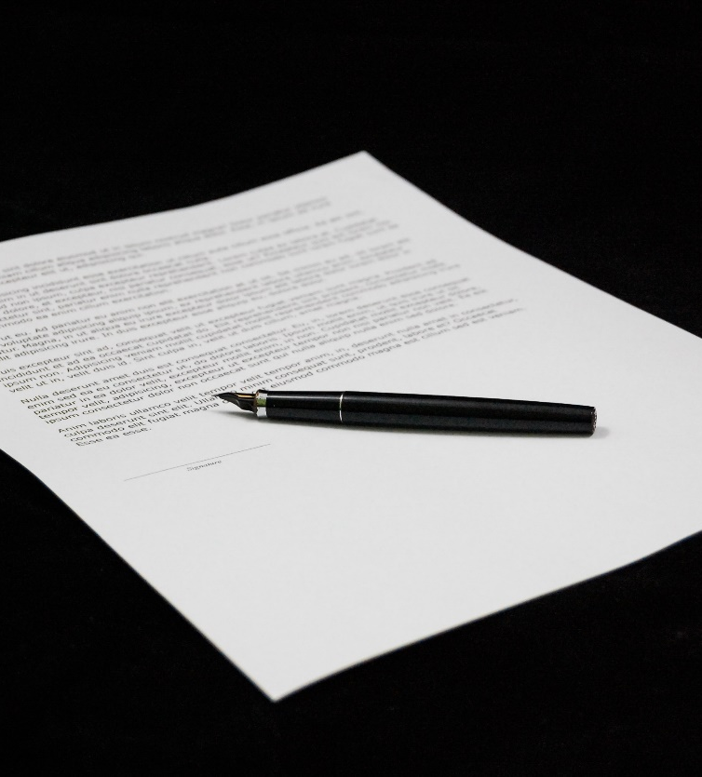
Noncompliance: Records
General record requirements and components
Cleaning and sanitizing records
Training
  Worker training in food safety, health and hygiene
  Produce Safety Alliance (PSA) Grower Training certificates
Water
  Water system inspection
  Water treatment monitoring
  Municipal water
  Water used for ice and hand washing

Slide 17
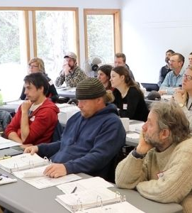
Noncompliance: Worker Training
Lack of worker training
Documentation of worker training
Worker training did not include required food safety or health and hygiene topics
PSA Grower Training certificate
Monitoring and maintenance of reusable gloves
Lack of hand washing
Inadequate hand washing

Slide 18
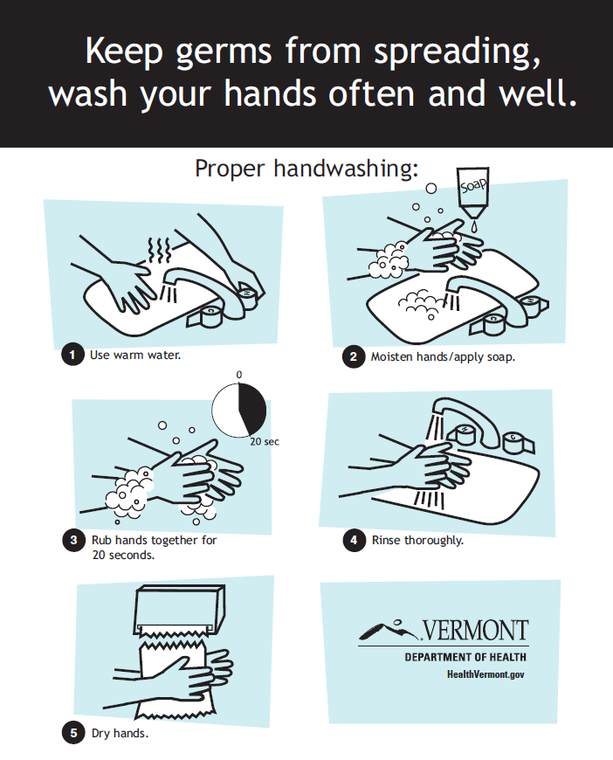
Noncompliance:
Hand Washing & Hygiene
Employees not washing hands before starting work or before putting on gloves
Farm manager not modeling best practices
Hand washing facilities lacking soap, running water, and/or a drying device
Hand washing facilities aren’t easy to use or well located
Notes:
Farms not fully understanding how often workers must wash their hands while handling produce (harvest and post-harvest). Farms may have accessible hand washing stations but they are not used as frequently as necessary, or aren't kept stocked with supplies, or aren't easy to use. In some cases the farm manager doesn't model good hand washing practices which has an impact on the hand washing culture on the farm.

Slide 19

Technical Assistance Needs
Agricultural Water Requirements
Cleaning & Sanitizing
Worker Training
Produce Safety Rule Coverage, Audits & Inspections
Traceability & Recalls
Recordkeeping

Slide 20
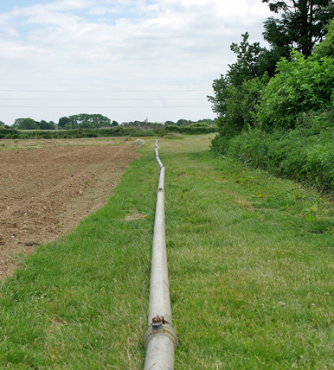
Technical Assistance: Water
Distinguishing between pre-harvest, harvest and post-harvest requirements
How to do an annual ag water system inspection
How to monitor recirculated/batch water
Which crops are particularly sensitive to infiltration and under what conditions
How to maintain wells and protect systems from back siphonage
Resources on treating agricultural water
Education, outreach and technical assistance for pre-harvest agricultural water requirements
This Photo by Unknown Author is licensed under CC BY-SA

Slide 21
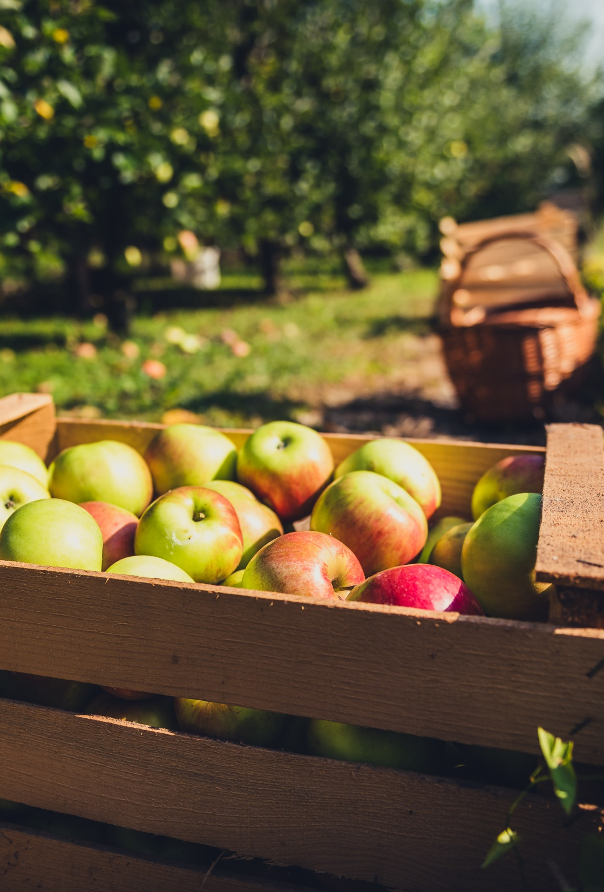
Technical Assistance Needs
More hands-on workshops for growers to see proper cleaning and sanitizing procedures
Resources focusing on appropriate methods and which products to use
Growers need access to a worker training program that they don't have to build
New PSA Health & Hygiene on the Farm worker training video

Slide 22

Technical Assistance: General Outreach
Get the word out about PSR, inspections, OFRR, and registration
A fact sheet specific to produce auctions describing various scenarios or a flowchart to determine farm coverage and best practices

Slide 23
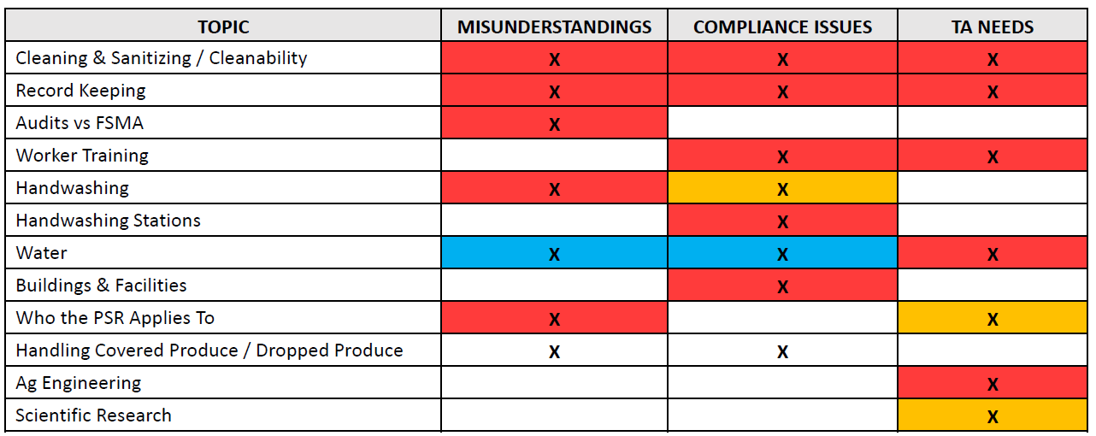
2020 Topic Summary Table

Slide 24
2021 Topic Summary Table
TOPIC | MISUNDERSTANDINGS | COMPLIANCE ISSUES | TA NEEDS
PSR Coverage & QE
Audits vs. Inspection
Cleaning & Sanitizing
Records
Agricultural Water
Equipment, Tools & Buildings
Worker Training
Hand-Washing
Traceability
Translation

Slide 25
2022 Topic Summary Table
TOPIC | MISUNDERSTANDINGS | COMPLIANCE ISSUES | TA NEEDS
Cleaning & Sanitizing
Worker Training
Agricultural Water
PSR Coverage & Audits vs. Inspection
Records
Equipment, Tools & Buildings
Hand Washing & Worker Hygiene
Animal Intrusion
BSAAOs
Dropped Covered Produce
Visitors
Traceability
General Compliance Issues

Slide 26
Summary
Persistent misunderstandings and noncompliance issues across the region
Growers would benefit from technical assistance in several areas
Cleaning & Sanitizing
Recordkeeping
Worker Training
Agricultural Water
Notes:
Not a comprehensive study.
Growers need to understand WHAT to do, HOW to do it, and WHY. This is what drives behavior change.

Slide 27
Key Quotes
/
“Growers are still overwhelmed with the rule and the need for costly/capital improvements. This sometimes causes them to overlook simple changes that can have significant benefit.”
“Growers had an assumption that PSR inspections would be more frequent. Upon completion of an inspection, growers are usually shocked that the next inspection will not be for 3–5 years.”
Notes:
two quotes from this year’s data provide important takeaways. We’ve had inspections for several years now, but this rule is still new. We still have a lot of work to do to implement this rule and help growers achieve the minimum standard for on-farm food safety that the Produce Safety Rule represents. Thank you again for sharing your insights this year, and I look forward to hearing from inspectors in the upcoming panel.

Slide 28



Contact Vermont
agriculture.vermont.gov/produce
802-522-7811
AGR.Produce@vermont.gov

Slide 29
Vermont Produce Program:
Mission & Vision
The Vermont Produce Program works with fruit and vegetable farms to enhance produce safety and promote public health.
Our vision is a safe, local, and thriving Vermont produce industry.

Slide 30
