Slide 1
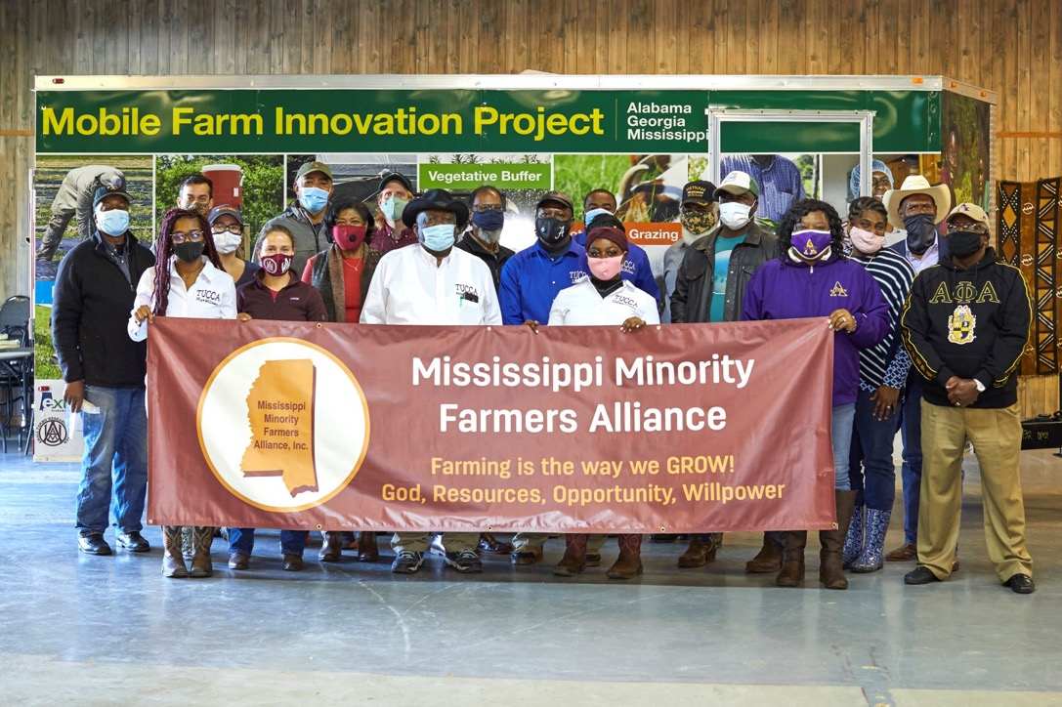
Mobile Farm Innovation Units in Mississippi, Alabama, and Georgia
This work is supported by Food Safety Outreach Program [grant no. 2019-70020-30349] from the USDA National Institute of Food and Agriculture
Notes:
Good morning, First of all I want to thank
for the opportunity to talk about a small piece of the impactful work happening in the southern region. I’m going to spend a few minutes talking specifically about a NIFA Food Safety Outreach Program funded project that we call the Farm Innovation project.

Slide 2
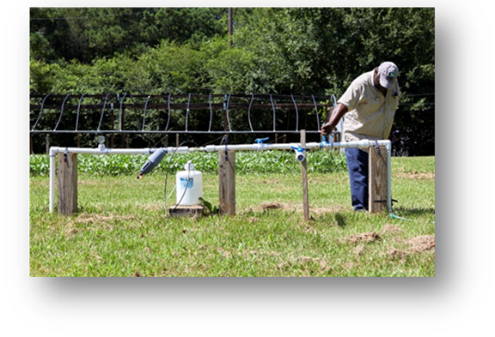
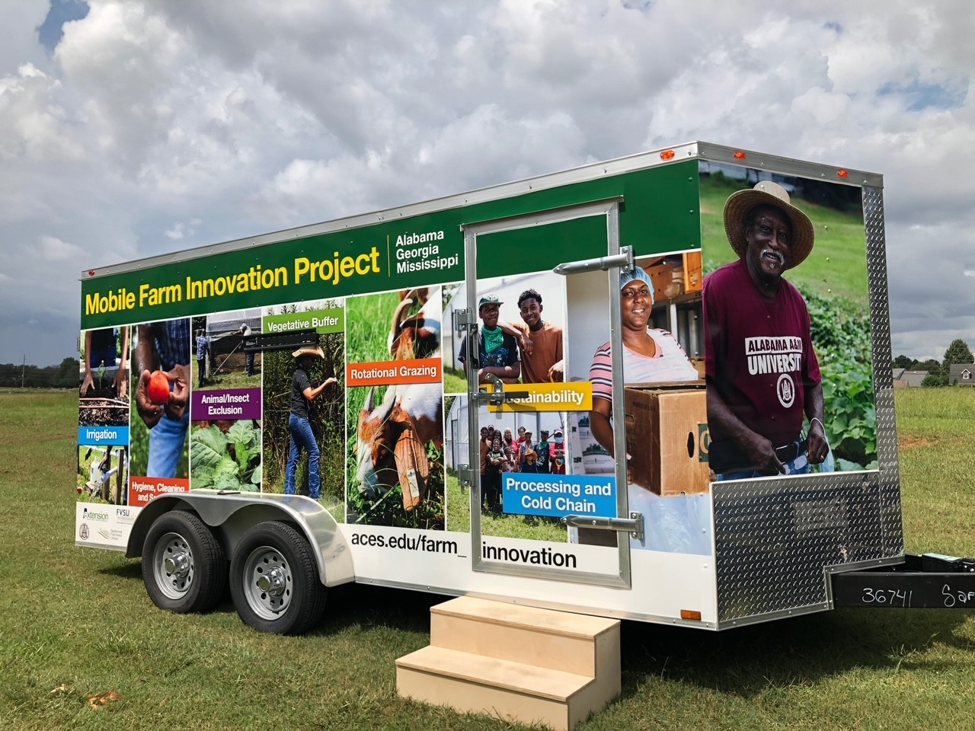
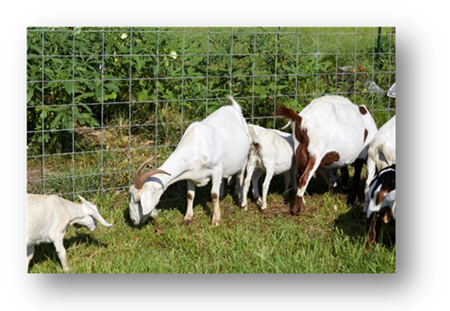
Objectives
Mobile Farm Innovation trailers
Small acreage, limited resource growers
Hands-on training that balances food safety and conservation
Notes:
For the FI project, our project objectives are to:
Design and construct three Mobile Farm Innovation trailers to meet the learning needs of limited resource growers with small acreage
Second, Develop and implement a multimodal and modular training program that balances farmers food safety and conservation needs. The training program we have developed takes a holistic approach to meeting farmers needs which means that we not only help farmers improve their technical knowledge and skills, but we also address financial sustainability by helping them find funding to implement practices.
Our third objective is to conduct outreach in Mississippi, Alabama, and Georgia
And lastly, of course, design and conduct a comprehensive evaluation of impact and I will share some preliminary results today.

Slide 3
Notes:
The next few slides depict the trailers in use.
In this photo you can see the technology station. We have a Tv mounted on the outside for technology based activities
And a quiet generator is available when we are in locations that lack electricity.

Slide 4
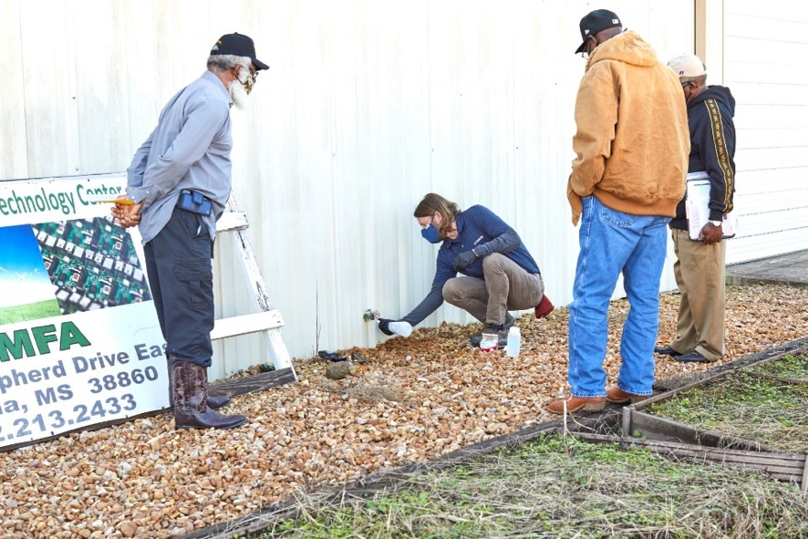
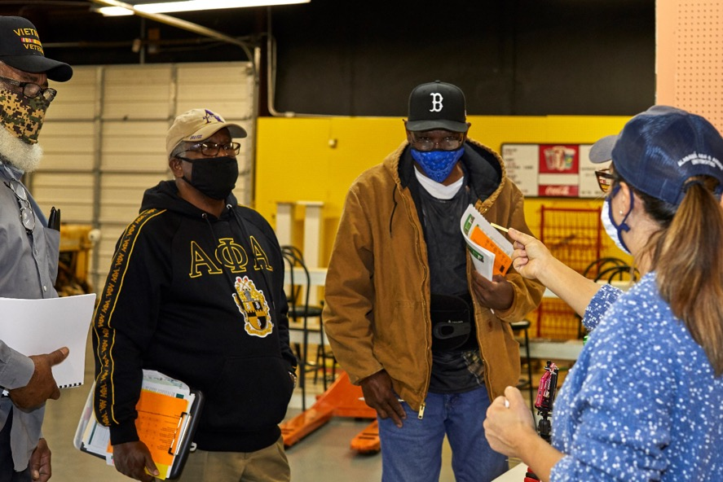
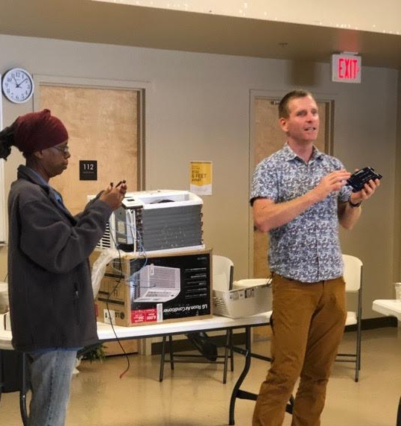
Water Sampling
Using Sanitizers
Cold Storage
Notes:
Here we see different small groups developing skills to collect an aseptic water sample, install a coolbot to improve produce quality – we also talk to farmers about the hazard presented by condensation and the financial benefits of reducing produce waste; on the right farmers are participating in a sanitizer activity where they lear to use the pesticide product labeling system and correctly mix and monitor sanitizer according to the label instructions.

Slide 5
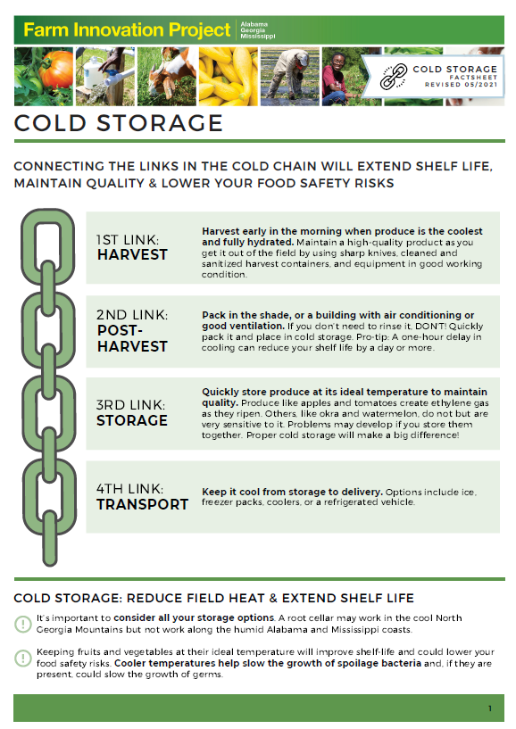
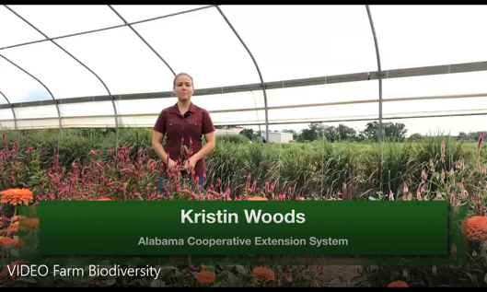
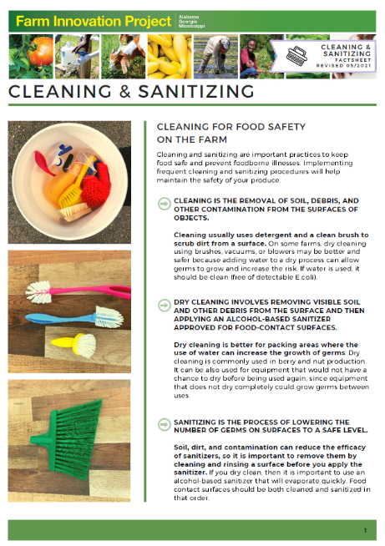
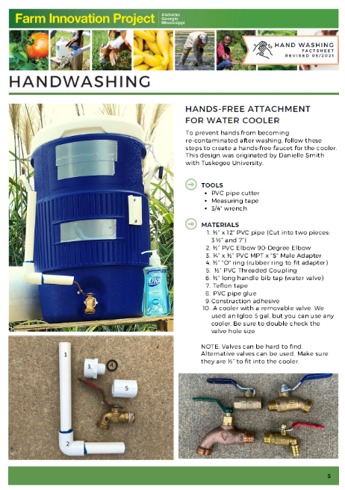
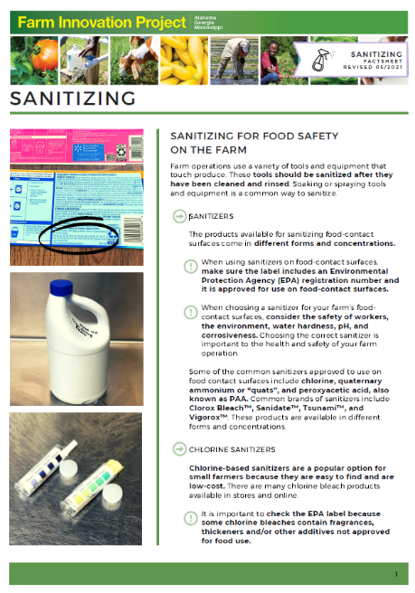
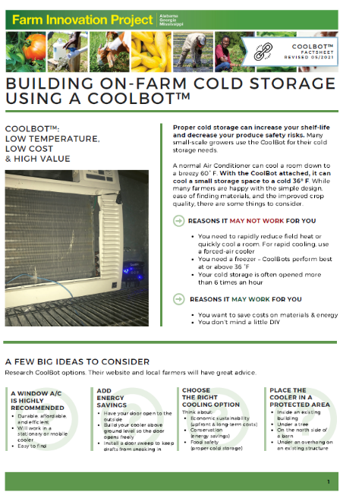
Videos, Fact Sheets, and Guides
Notes:
We have thus far developed 15 factsheets and activity facilitator guides to make project replication easier.
Facilitator guides include step by step guidance for educators and a supply list.
I’m happy to report that I have heard from folks outside of our immediate project group that the activities are in use.

Slide 6
Hands-on activities improve awareness, confidence, and intent to implement practices.
The benefit of a practice may be influenced by other factors.
Community based education creates space for conversation and collaboration.

