Slide 1
State Produce Safety Program Updates

Slide 2
PATH/Jurisdictional Authority/Statute
MASSACHUSETTS
PATH C State Authority M.G.L. c 128 s 124
Program Personnel
Inspectors
Educational Partner-CAP Funds
UMASS Agricultural Extension
6
4
Total Farm Registry
Verified Farm Registry
Large Covered Farms
894
578
72
Number of Inspections -2022
Number of For-Cause Inspections
Number of Educational Visits
79
0
105
1. Supported an investigation in the jurisdiction in 2022 Salmonella Mississippi- Tomatoes suspect vehicle.
2. Will amend CMR 330 34:00 in 2023.
3. Will launch a formal registration for all produce farms in the Commonwealth in 2023.
4. Continue to support the Commonwealth Quality Program for Produce- Compliance Vehicle.

Slide 3
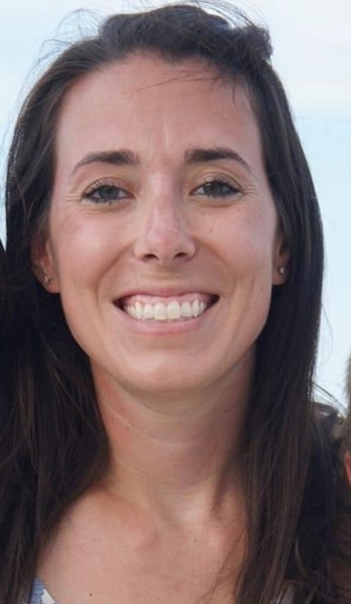
PATH/Jurisdictional Authority/Statute
MARYLAND
PATH C State Authority
Program Personnel
Inspectors
Educational Partner-CAP Funds
University of Maryland Plant Sciences/Extension
ALEI (Agricultural Law Education Initiative)
3
2
Total Farm Registry
Verified Farm Registry
Large Covered Farms
808
145
33
Number of Inspections -2022
Number of For-Cause Inspections
Number of Educational Visits
13
0
21
1. Hosting a BSAAO workshop this Spring.
2. Challenges with keeping and hiring staff (reason why we couldn’t make it to the Conference)
Looking into making Registration mandatory.
Molly Gillingham Laura Iacona Devin Melancon
Program Manager/PI Inspector Inspector

Slide 4
PATH/Jurisdictional Authority/Statute
NEW HAMPSHIRE
PATH C State Authority M.G.L. c 128 s 124
Program Personnel
Inspectors
Educational Partner-CAP Funds
UNH Cooperative Extension
4
2
Total Farm Registry
Verified Farm Registry
Large Covered Farms
143
211
24
Number of Inspections -2022
Number of For-Cause Inspections
Number of Educational Visits
8
16
1. New Program Assistant hired –started 1/13/23 - will facilitate program development and reporting activities.
2. Farm Inventory data retrieval and verification activities on-going; farmer responses still slow to receive.
3. MOU between DAMF & NH state Lab in review and approval stage; lab analysis of suspect produce.

Slide 5
PATH/Jurisdictional Authority/Statute
RHODE ISLAND
PATH C / State Authority / 250-RICR-40-00-2
Program Personnel
Inspectors
Educational Partner-CAP Funds
URI Cooperative Extension
4
2
Total Farm Registry
Verified Farm Registry
Large Covered Farms
439
199
14
Number of Inspections
Number of For-Cause Inspections
Number of Educational Visits
28 (2022)
0
77
1. Formal Produce Farm Registration – annual requirement with common date of February 28th.
2. Agricultural Water Quality testing program – will expand to incorporate changing Ag water requirements
3. Mini-grant program in 2021 and 2022 to assist with produce safety improvements.
4. Continue to support the RI GAP Program for Produce – Technical Assistance & Compliance Vehicle.

Slide 6
PATH/Jurisdictional Authority/Statute
NEW YORK
PATH C State Authority 1 NYCRR Part 273
Program Personnel
Inspectors
Educational Partner-CAP Funds
Cornell University & Cornell Coop. Ext.
8
5
Total Farm Registry
Verified Farm Registry
Large Covered Farms
1,503
1,503
236
Number of Inspections -2022
Number of For-Cause Inspections
Number of Educational Visits
121
0
134 (including 8 OFRRs)
Successes:
1. Number of inspections conducted exceeded our goals, despite losing an inspector in April and July.
2. Our Produce Safety compliance program has been easily and effectively retrofitted into our Division’s compliance program.
Challenges:
1. Inventory – challenges with both inter- and intra-Division cooperation 2. Lack of inspection software

Slide 7
PATH/Jurisdictional Authority/Statute
CONNECTICUT
PATH C State Authority CT General Statute 22-39g
Program Personnel
Inspectors
Educational Partner-CAP Funds
UConn Extension
7
5
Total Farm Registered in E-License
Verified Farm Registry
Large Covered Farms
202
386
20
Number of Inspections -2022
Number of For-Cause Inspections
Number of Educational Visits
7
0
2 OFRRS
1. Voluntary Registration and All Inspections are completed online through our E-License System.
2. We have all new staff working in our program, all inspectors currently have less than 2 years of experience with Produce Safety however, we are all cross-trained and have responsibilities in other commodities within our agency.

Slide 8
PATH/Jurisdictional Authority/Statute
MAINE
PATH B FDA Authority
Program Personnel
Inspectors
Educational Partner-CAP Funds
UMaine Cooperative Extension
1
3 trained
Total Farm Registry
Verified Farm Registry
Large Covered Farms
1985
872
22
Number of Inspections -2022
Number of For-Cause Inspections
Number of Educational Visits
19
2
12 OFRRs
1. As of last week testing of the new database / major fixes seem to be winding down.
2. CPI position (PSR Specialist) re-posted for the 4th time.
3. Caught up with meeting minimum requirements / clearer plan of future work.
4. Wild blueberry commercial processing (freezing) status.

Slide 9
PATH/Jurisdictional Authority/Statute
Delaware
PATH B FDA State Authority
Produce Safety Regulations 302 Del. Code. § 3.0
Program Personnel
Inspectors
Educational Partner-CAP Funds
University of Delaware, Cooperative Extension
4
1, but the manager can also
Total Farm Registry
Verified Farm Registry
Large Covered Farms
155
110
14
Number of Inspections -2022
Number of For-Cause Inspections
Number of Educational Visits
20
1
9
1. State Regulations for mandatory registration for produce farms growing, harvesting, packing and/or holding.
2. Small program, Four people
3. Online portal for registrations, and exemptions.

Slide 10
PATH/Jurisdictional Authority/Statute
PENNSYLVANIA
PATH B FDA Authority
Program Personnel
Inspectors
Educational Partner-CAP Funds
Penn State Extension
9
8
Total Farm Inventory
Verified Covered Farms
Large Covered Farms
1643
762
150
Number of Inspections -2022
Number of 4056s issued with observations
Total Number of OFRRs
119
3
507
1. Completed 2 FDA Calibration Inspections
2. Developed 4 SOPs

Slide 11
PATH/Jurisdictional Authority/Statute
West Virginia
PATH B FDA Authority
Program Personnel
Inspectors- 3 credentialed,
Educational Partner-CAP Funds
West Virginia University
West Virginia State University
9, 3 of which are 100% Produce
1- actively inspecting
Total Farm Registry
Verified Farm Registry
Large Covered Farms
Produce- 2365
1256
7, 1 small
Number of Inspections -2022
Number of For-Cause Inspections
Number of Educational Visits
8
0
118
1. 100% of covered farms inspected annually
2. WV Farm Assessor forms utilized to compile state farm inventory data, identify produce growers/farms
3. Produce Safety Training Trailer for agricultural outreach events

Slide 12
PATH/Jurisdictional Authority/Statute
New Jersey
PATH B: FDA Jurisdiction No Registry
Program Personnel
Inspectors
Educational Partner-CAP Funds
Rutgers Cooperative Extension
7
6
Total Covered Farms
Total IE & QE Farms
Total Verified Produce Farms
231
416
887
Number of 2022 Inspections
Number of For-Cause Inspections
Number of Follow Up Inspections
55
1
1
1. 51 Farms Received Technical Assistance
2. 282 Inspections Completed 2019-2022
3. 233 Initial Inspections
4. 49 Routine Inspections

Slide 13
PATH/Jurisdictional Authority/Statute
VERMONT
PATH C State Authority 6 V.S.A. Chp. 66
Program Personnel
Inspectors
Educational Partner-CAP Funds
7 (20–82% CAP funded)
1
UVM Extension
Total Produce Farm Inventory
Verified Produce Farm Inventory
Covered Farms
612
612
17 large, 6 small, 7 very small
Total Inspections - 2022
For-Cause Inspections - 2022
Number of Educational Visits - 2022
20
2
1 OFRR
1. Completed FDA inspector calibration in 2022.
2. Voluntary farm registration. QE farms are encouraged to re-verify annually.
3. 33 OFRRs and 57 non-OFRR educational farm visits conducted to date.
4. 8 PSA grower trainings delivered to date with 176 growers trained from 131 farms.

