Slide 1
Cost Transfers on Sponsored Projects
Presented by
Tiffany Stewart &
Dawn Caffrey
11/16/2022

Slide 2
Agenda
Welcome and introductions
Presentation guidelines
Compliance & Administration
Roles & Responsibilities
Cost Transfer Form
Educational resources available
Notes:
Introduce – co-presentor from Financial & Cost Accounting Services, Dawn Caffrey. Dawn is the expert on payroll cost transfers so she will be addressing payroll related guidance in this presentation.
Ask everyone to “mute” themselves at this time.
We are going to present a lot of information. Some of it may be new to you and you may have questions. We encourage you to use the “chat” feature in Teams to ask your questions. We will either answer them at the time you ask them, or we will circle back around later as the question may be addressed later in the presentation.
Also, this presentation will be out on SPA’s Ed & learning website page. As we go through today’s training, there are several very important slides you may want to print off or familiarize yourself with. I will be mentioning those during this presentation. Please download a copy of this presentation for your future use as I know it will come in handy for you when you do a CT.
So, During this presentation we will be addressing
=➔ compliance and administration of cost transfers
== Roles and responsibilities for different positions in the process
==Cost Transfer form which is the vehicle for describing the reason for the cost transfer
==and at the end, the educational resources available.

Slide 3
Purpose of the Presentation
Understand when a cost transfer is appropriate on a sponsored project and the importance of timely transfers.
Overall Objectives: Overview of the process flow around processing a cost transfer on a sponsored project.
Learn about the roles and responsibilities involved in processing a cost transfer
Identify required backup for each type of cost transfer
Learn some helpful tips for filling out the cost transfer forms
Notes:
Objective is to provide you with an overview of the process for both operating and payroll cost transfer.
And, to provide you with an understanding for ….
=>what is appropriate for a cost transfer
== Discuss the importance of timely transfers
And, provide an overview of the process flow of a cost transfer
=== which includes learning the roles and responsibilities of those individuals involved int heprocess.
=== identify the backup documents required for each type of cost transfer
=== then we will give specific examples of CTF and provide some helpful tips.

Slide 4
SPA EDU Offerings
Notes:
But before we get to that, here is a Listing of some of SPA’s educational offerings.
Upcoming sessions include:
Cost Sharing on a sponsored project
Personnel Effort on Sponsored projects
Award Acceptance for Sponsored Agreements & Establishment of Advance Accounts
I encourage you to sign up if these can be are of interest to you.

Slide 5
UVM Sponsored Project Life Cycle
Award receipt
Award acceptance
Set up notification
Subawards issuance
Scope performed
Budget revisions
Budget projections
Project changes
Award
Manage
Award
Manage
Find opportunities
Application forms
Budget development
Proposal routing
Submission
Apply
Apply
Report
Technical reports
Effort & cost sharing
Acct. payable (subs)
Report
Close
Close
Budget closeout
Final project, and property reports
Patent report
Notes:
And, speaking of SPA, here is a wonderful graphic illustrating the life cycle of a sponsored project here at UVM.
Starts with apply…..
It is during the Manage phase that cost transfers may be needed.

Slide 6
UVM Research Community
300+ Active Principal Investigators (PIs)
100+ Departments with Sponsored Projects from 300+ Sponsors
$200M+ annual volume of awards on 700+/- award actions
300+ subawards issued annually
Office of Vice President for Research
Many supporting departments
Notes:
Sponsored Projects at UVM is ever growing….
Work in cooperation with many supporting departments.

Slide 7
UVM Units That Support Sponsored Projects Indirectly
Purchasing
Purchase Orders and Requisitions
Disbursement Center
Check requests and purcards
Travel advances and reimbursements
University Financial and Cost Accounting Services
Effort Reporting
Space and Equipment Inventory
Indirect and Fringe Rate Negotiations
Human Resources
Personnel Actions and Position Management
Payroll Services
Payroll-related Actions
Graduate College
Graduate Research Assistants
Tuition on Sponsored Projects
Enterprise Application Services
PI Portal

Slide 8
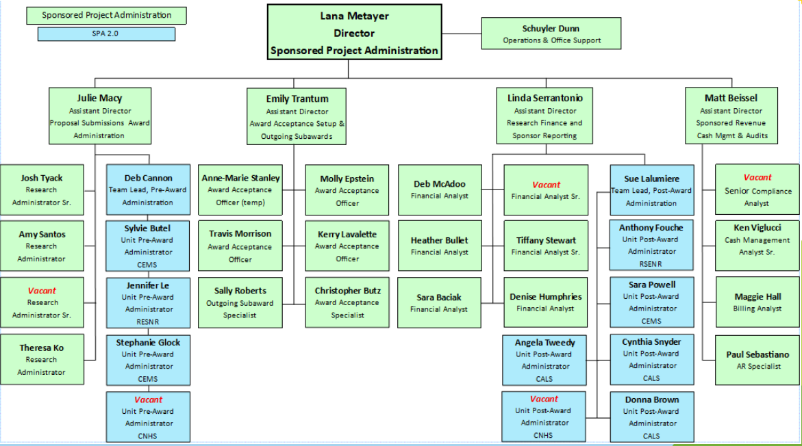
UVM Sponsored Project Administration Organization
Notes:
Here is our org chart. You may not be able to see this well, but the slide shows we have:
Four Research Analysts who cover pre-award.
Five people on the setup team.
Six financial analyst positions to help you with your transfers
Three billing specialists and Senior Compliance Analyst is now part of the billing team
Plus management and other administrative personnel.
We all report to Lana Metayer and Brian Prindle is our Executive Director

Slide 9
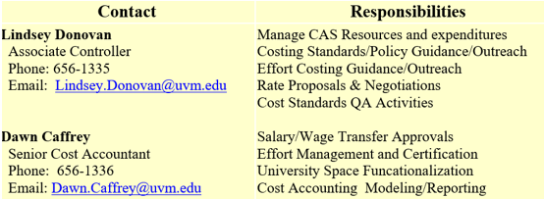
UVM Financial & Cost Accounting Services Contacts

Slide 10
Definition of Cost Transfer
Sponsored project cost transfers include both payroll and non-payroll reallocations and redistributions both to and from sponsored projects for direct and cost share expenditures.
A payroll cost transfer is any reallocation or redistribution of a previously charged expenditure involving sponsored project chartstrings.*
A nonpayroll cost transfer is the reallocation or redistribution of a previously charged expenditure onto or off from a sponsored project or a reallocation or redistribution between two sponsored project awards.
.
Notes:
NOTE 1: We will discuss the new cost transfer exclusion for certain payroll changes that went into effect in FY21 later in the presentation.
Note 2: Cost share changes are treated just like Fund 300 changes. Same rules apply. So, be sure Cost share expenditures are sent with a cost transfer form, just like Fund 300 transfers would.
Note 3: The main difference between the two is that nonpayroll cost transfers between projects on the same award are NOT considered a cost transfers, but for payroll cost transfers they are considered cost transfers due to more complexity in identifying effort by award.

Slide 11
Payroll changes not considered cost transfers
Timely Salary Distribution & Additional Payment (eAPFS) Changes
Salary distributions and additional payment forms are initially made based on estimated effort over an extended period of time.
In accordance with UVM's Effort Management Policy effort must be reviewed on a quarterly basis. Timely corrections to reflect actual effort made within 90 days of the original accounting date is not a cost transfer.
The initiator must include an additional departmental approver in the workflow when sponsored project chartstrings are being corrected.
Notes:
DAWN’s Note 1: All payroll transactions between projects, or on or off of sponsored projects over 90 days is considered a cost transfers.
DAWN’s Note 2: All wage transfers are considered a cost transfer since hours are entered when they are worked and allocated directly to a specific combocode.
When making this change in FY21 an analysis was done and I had approved 1100 timely salary distribution in the first 7 months of the fiscal year (and it picks up as the year goes on). I had only denied 4 for allowability/clarification. Katrina had denied 107 for being incomplete (missing questions 1&2 or second approver). Due to the plan confirmation approach and the quarterly effort reviews, it has felt as though there was no value in this central review or the planned vs. actual cost transfer write ups.
We reviewed the cost transfer policies of 22 research universities to guide our decision and confirmed with KPMG auditors before moving forward. This allows the salary distributions to move through the system much faster and only has to be touched by Katrina/Payroll once in most cases instead of 2-3 times.

Slide 12
Department Initiated Journal entries not considered cost transfers
It is not a nonpayroll cost transfer when transferring expenditures between projects on the same award.
Interdepartmental charges (IC journals)
Purchasing card purchases;
Chartfield value changes;
Notes:
As Dawn mentioned, For payroll, between projects on the same award, it is considered a cost transfer.
But for nonpayroll cost transfers, when transferring between projects on the same award, it is NOT considered a cost transfer.
Other transfers not considered a cost transfer are:
IC Journals
Pcards
Changes to the chartstring

Slide 13
Compliance & Administration
Proper administration and approval of cost transfers are required to ensure compliance with federal requirements as defined by Uniform Guidance Subpart E - Cost Principles and to ensure compliance with related University policies.
Cost transfers are closely scrutinized for indications of cost misallocation or non-compliance.
Notes:
Like most things in life, there are rules around cost transfers. We are governed by the federal requirements in Uniform Guidance – Subpart E – Cost Principles. Therefore, the University’s Cost Transfer policy ensures compliance with that as well as other generally accepted accounting principles.
All cost transfers are highly scrutinized as they can be construed as an indication of cost misallocation or non-compliance. Therefore, we ask questions when a cost transfer is done to ensure there is no misallocation or non-compliance. We try to ensure cost transfers are not frequent and that there are corrective actions in place to prevent repeating the same mistake. And, numerous or inappropriate cost transfers can result in Audit Findings for the University. As such, they need to be reviewed carefully.

Slide 14
Compliance & Administration Continued
Cost transfers to or from sponsored projects should be:
Initiated promptly, after recognition of posting to incorrect chartstring;
Supported by required documentation justifying the transfer;
Approved by the receiving PI(s) or responsible official for transfers greater than 90 days.
Notes:
Therefore, it is important that cost transfers, whether adding funds to a sponsored project or removing funds from a sponsored project, are done quickly, within 90 days of the original posting.
Documentation will need to be submitted to substantiate the transfer.
And, the transfer may need approval by Pis or other responsible officials

Slide 15
Cost Transfer Principles/Expectations
Cost transfers must be completed in accordance with the University policy and Uniform Guidance cost principles to ensure:
Allowable
Reasonable
Allocable
Treated Consistently
Timely
Cost transfers over 90 days should be avoided. They raise concerns with reliability of the institution’s accounting system, internal controls and management capabilities.
Notes:
Remember those slides that I mentioned would be handy to have a copy of, well, this is one of them. I encourage you to make a note to view the slide, #13 with the red ! as it contains important information.
You need to understand when is a cost transfer allowed…..
The following describes the cost principles that are integral to all cost transfers.
==Allowable on the grant for the completion of the scope of work and preferably described in the documentation provided to the sponsor.
==Reasonable, in other words, a common and appropriate expense to be charged to the grant. This includes the appropriate type of expense and the appropriateness of the cost of the expense.
==Allocable to the sponsored project if it benefits the project and is necessary to overall operation of the project. And, if the expense is being split between multiple projects, there must be a clear and fair method for splitting the costs so that the portion charged to a sponsored project is fair and consistent.
==consistent and speaking of consistent, all transfers must be handled in a consistent manner, hence the reason for a Cost Transfer form and other processes.
==timely, cost transfers should be prepared and submitted as soon as the need to do so is identified, preferably no later than 90 days after the original posting.
== if over 90 days, these types of transfers raise red flags and can signal concerns for an auditor about our account system, internal controls and the management of the award. So, they should be avoided.

Slide 16
Expenditure Review & Management
The Principal Investigator or their delegate officials should monthly:
Retrieve and review grant reports
Verify that posted charges are allowable, allocable and appropriate
Identify any additions or deletions
Initiate prompt transfers for errors/corrections
The PI or delegate should review personnel effort quarterly (key and non-key personnel)
Notes:
Part of managing an award is the frequent review of expenses. To do this, the PI or their designee should monthly,
== Retrieve and review grant reports. That can be payroll reports, monthly budget reports or even department expense reports, to ensure that
=== the posted expenses are allowable, allocable and appropriate (the principles we discussed earlier).
== Identify any expenses that need to be added to the project or removed.
== and initiate prompt cost transfers to fix those expenses that need to be moved.
For payroll expenses, personnel effort should be reviewed quarterly.

Slide 17
Cost Transfers < 90 days and >90 days
Cost Transfers are categorized into two categories and require different processing depending on when the original transaction posted:
Transfers of expenses originally posted 90 days or less
Transfers of expenses originally posted more than 90 days – Also called Untimely/Late Cost Transfers
Notes:
And, why is it important that they be reviewed monthly or quarterly for payroll expenses….
Because cost transfers=====

Slide 18
Transfers less than or equal to 90 days
Transfers requested within 90 days from the original transaction date are allowable.
A Cost Transfer Form (questions #1 & #2 only) must be completed in the Journal Entry or Payroll Retro Request.
Notes:
Transfer requests within 90 days from the original transaction posting date are allowable.
There is a cost transfer justification tab in PeopleSoft that needs to be completed in the journal or the Payroll Retro Request that must be completed. We will be going into more detail about the CTF. But for now, be aware that two questions on the CTF must be filled out for transfers <90 days.

Slide 19
Transfers over 90 days (untimely(late) cost transfers)
Only allowable under extenuating circumstances which consist of:
Moving expenses off from a sponsored project onto departmental funds
Other circumstances outside of the departmental control
Sponsor delays
Setup delays
A Cost Transfer Justification (questions #1 - #4) must be completed in the Journal Entry or Payroll Retro Request.
NOTE: Absence of PI or cognizant administrator, lack of experience of the staff administering the award, or competing priorities are not a valid extenuating circumstance.
Notes:
For cost transfers > 90 days from the original posting transactions, these are highly scrutinized.
Only allowed under extenuating circumstances such as:
==Moving an expense OFF from a sponsored project
==Moving due to circumstances outside of the dept control.
==or As a result of sponsor delays, we all know that sometimes the sponsor is slow in finalizing their award documents.
==or As a result of SPA setup delays, unfortunately, sometimes this happens as well. With either the sponsor or SPA delays, this will need to be corroborated with specific dates in your cost transfer form.
And, speaking of cost transfer form, questions 1-4 will need to be completed on the form…more info to follow on this.
Finally, because this last NOTE on this slide is so important, I do want to point out that absence of PI or cognizant administrator or staff is not an allowable extenuating circumstance and transfers because of this cannot be performed

Slide 20
Transfers over 90 days (untimely(late) cost transfers)
Things to consider:
Expenses over 90 days that are being moved off from sponsored projects do not require PI approval. A second departmental approval is still required.
If there are multiple sponsored agreements receiving a late cost transfer charge, with multiple PIs, then all PIs must approve of the cost transfer.
Notes:
For both payroll and nonpayroll….

Slide 21
Allowable and Appropriate Cost Transfers can include:
Transfers due to a clerical or data processing error;
University internal billing (IC journals and expenses such as telephone, publications or photocopying expenses, etc);
Transfers for expenses incurred before the project start date only if pre-award costs are approved by the sponsor;
Actual effort worked on the project differs from what was originally planned and distributed on salary distribution forms.
Notes:
So, what can be considered an allowable and appropriate cost transfer…. Well, remember slide #13 earlier that described the cost transfer principles that I asked you to make sure you printed that slide or familiarized yourself with that slide? The next three slides (with the icons in the bottom right corner), are just as important. Please make a note of these slides for your future reference.
So, what is allowable, here are some examples of what is an allowable and appropriate cost transfer following those cost principles in we discussed earlier
===

Slide 22
Allowable and Appropriate Cost Transfers Continued
Transfers from departmental discretionary account to sponsored project account when an Advance Account was not established;
Best practice should be to establish an Advance Account when appropriate.
Bulk purchases of lab supplies charged to departmental or other non-sponsored accounts, then allocated to the appropriate research project.
Notes:
Also allowed…
During this last example, how the expense was allocated to the sponsored project must be documented by the department and documentation retained by the department in case an auditor asks you to prove that it was appropriate, fair and consistently charged to the sponsored project.

Slide 23
Unallowable Cost Transfers
Transfers from a sponsored project in deficit to another sponsored project for the sole purpose of eliminating the deficit;
Transfers to a project having unexpended balance for the purpose of expending the remaining balance;
Transfers where the sponsored project was being used as a “holding” fund to redistribute expenses to other projects;
Transfers of expenses onto a sponsored project that were incurred before the project start date if pre-award costs have not been approved by the sponsor;
Transfers of expenses due to an absence of PI or cognizant administrator, lack of experience of the staff administering the award, or competing priorities.
Notes:
Watch for these….these are not allowed
===== In other words, removing an expense from an award with little or no remaining funds for the purpose of having more funds available to spend and transferring that expense to another award that has funds to spent. This is not allowed.
===== This is known as Spending Down the award and can lead an auditor to believe the expense is not really necessary for the performance of the work.
====== This is known as Parking and is never allowed. Expenses should never be charged to an award that is purposefully not the appropriate place for the expense.
===== Not within approved project period and the expense is not allowed.
===== As mentioned before, Lack of Staffing is never an allowable cost transfer reason. This is clearly stated in UVM’s Cost Transfer UOP and there is a hyperlink at the end of this presentation for this procedure.

Slide 24
Roles & Responsibilities
Roles and responsibilities for the PI, Unit Administrator, Department Administrator, SPA, Financial & Cost Accounting Services and Payroll Services can be different depending on whether they are for:
Non-payroll transfers
Payroll transfers
Notes:
OK. So, you’ve now learned what is allowable and not allowable for a cost transfer.
We are now going to go over who does what -- specifically what their roles and responsibilities are.
There are many players involved in a cost transfer:
PI
Unit or Dept Administrator
SPA
And Cost Accounting and Payroll Services
What they do can differ depending on whether it is a non-payroll transfer or a payroll transfer.

Slide 25
Roles & Responsibilities for all cost transfers
Principal Investigator:
Responsible for identifying the need for a cost transfer.
Payroll expenses. This includes quarterly review of effort commitments and actual effort applied for key and non-key personnel to identify any needed payroll cost transfers.
Non-payroll expenses. Includes a monthly review for all non-payroll expenses.
Reviews award balances and transactions on a consistent basis to validate expenses posted to the award;
Identifies expenses posted to the project in error;
Works with the Unit Administrator to initiate the expense transfer and provide justification when necessary;
Approves late cost transfer form when applicable.
Notes:
For all cost transfers though, the PI ====
====
By reviewing non-payroll expenses at least monthly, this avoids the need for a late cost transfer which we have discerned comes with much more scrutiny than those < 90 days from the original posting date.
In most cases the late cost transfer form is approved either through Peoplesoft in the JE or Salary Retro workflow. For wage transfers and add’l pay transfers, the cost transfer form can be signed and emailed along with the other required documentation to retro@uvm.edu. Dawn will go over that process in more detail later on.

Slide 26
Roles & Responsibilities for non-payroll cost transfers
Unit Administrator:
Assists PI in the review of the project expenses on a consistent basis (preferably monthly) to identify charges posted in error;
Primarily responsible for preparing and completing all cost transfers;
Assists PI in collecting and providing necessary justification required to accompany the cost transfer request;
Assists PI in identifying the appropriate destination chart string for the cost transfer;
Notes:
Unit Administrator’s role for NON-payroll cost transfers are to:
Assists PI in the review of the project expenses on a consistent basis (preferably monthly) to identify charges posted in error;
Primarily responsible for preparing and completing all cost transfers in the form of the JE or through the payroll workflow.
Assists PI in collecting and providing necessary justification required to accompany the cost transfer request;
Assists PI in identifying the appropriate destinated chart string for the cost transfer;
And, there are more….next slide

Slide 27
Roles & Responsibilities for non-payroll cost transfers
Unit Administrator (continued):
Reviews cost transfers for compliance with the University Operating Procedure on Cost Transfers;
Creates and submit the journal entry in PeopleSoft (including attaching the appropriate backup documentation showing the original transaction posting information and completing the cost transfer form);
Monitors the progress of the cost transfer to ensure the journal gets posted in a timely manner.
Notes:
The Unit Administrator also
==
=== We will go into more information about the appropriate backup documentation and completing the cost transfer form later
===

Slide 28
Roles & Responsibilities for all cost transfers
Department Approver:
Reviews and approves the cost transfer form electronically within the journal entry or salary distribution change.
Reviews and approves the PDF cost transfer form for hourly wage cost transfers and additional payment cost transfers.
Notes:
Cost transfers also require the department approver to,
I do want to mention that the non-payroll cost transfer form is part of the journal entry’s electronic workflow process, which is new as the form is now built into the workflow and no longer needs to be attached.
I also want to mention that Dawn will talk more about the payroll approvals later on in the training.

Slide 29
Roles & Responsibilities for non-payroll cost transfers
SPA:
SPA Financial Analyst (FA) reviews and approves cost transfers once submitted ensuring the appropriate backup documentation is attached and the Cost Transfer Form is completed appropriately.
SPA FA adds a department approver and PI approver, when applicable, in the JE workflow for all cost transfers.
SPA Team Lead approves for posting all cost transfers.
After the department approver and PI, when applicable, have approved the cost transfer, then the JE is automatically posted.
SPA FA works with Unit Administrator if any changes to the cost transfer are needed.
Notes:
Of course, SPA is involved in cost transfers. For non-payroll cost transfers.
===
===
===
They will get an automated message from PeopleSoft indicating what needs to be changed and sometimes it is followed up with an email from the FA with more specific information.

Slide 30
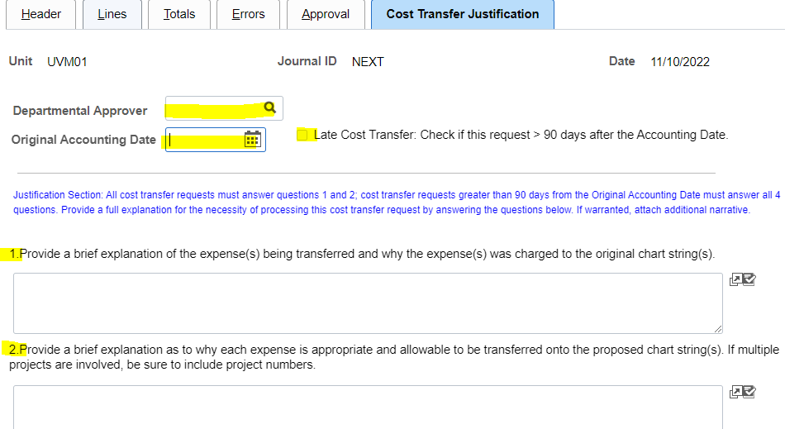
Example of a complete non-payroll cost transfer entry

Slide 31
Roles & Responsibilities for payroll cost transfers
Unit Administrator:
Assists PI in the review of the effort commitments and payroll charges on a quarterly basis to identify required salary or wage transfers;
Primarily responsible for preparing and completing all cost transfers;
Assists PI in collecting and providing necessary justification required to accompany the cost transfer request;
Assists PI in identifying the appropriate destination chart string for the cost transfer;
Notes:
DAWN

Slide 32
Roles & Responsibilities for payroll cost transfers
Unit Administrator (continued):
Reviews cost transfers for compliance with the University Operating Procedure on Cost Transfers;
Creates and submits changes to salary distributions and initiates approval workflow;
Creates additional payments and bi-weekly wage transfers along with the appropriate backup documentation;
Monitors the progress of the cost transfer to ensure department approver(s) and required PI approvals are completed in a timely manner;
Recommendation: monthly monitoring of department suspense to help avoid payroll cost transfers over 90 days past the accounting date.
Notes:
DAWN
Reminder: We discussed earlier that salary distributions and eAPFs within 90 days of the ACCOUNTING DATE are no longer considered a cost transfer and DO NOT NEED questions 1-2 completed.

Slide 33
Roles & Responsibilities for payroll cost transfers
Payroll:
Payroll confirms that all requests are complete:
Two approvers for cost transfers involving sponsored projects (PI can be the second approver);
Appropriate questions answered on the cost transfer form depending on lateness of the transfer;
PI approval for cost transfers past 90 days from the accounting date;
Hourly wage certification signature obtained
Notes:
Dawn

Slide 34
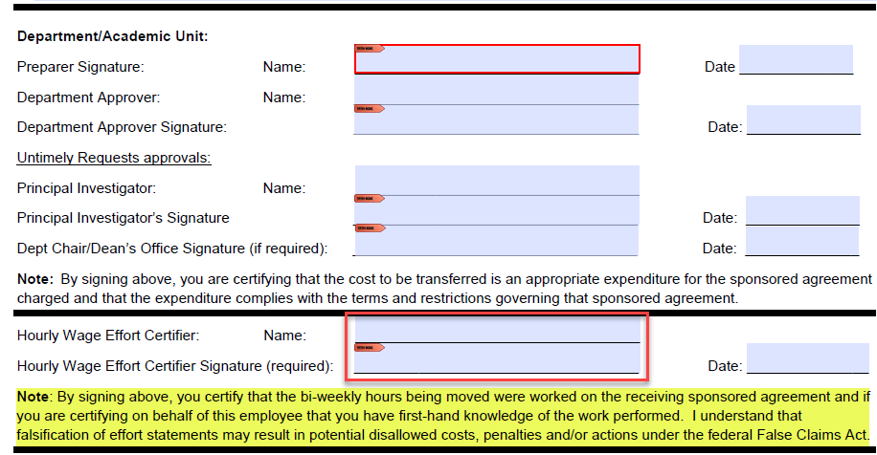
Example of Hourly Wage Effort Certification
Notes:
Dawn
1). MUST be signed for ALL hourly wage cost transfers. In the past, a certifying statement was included on the excel file that included the details for where to transfer the effort. This was very inconsistent across the university, increased audit risk with statements and signatures and people really weren’t clear on what they were certifying to. The statement on the cost transfer form is directly out of PeopleSoft so that it is the same language that the employee certifies to when submitting their hours.
2). The hourly certifier can be the second approver if the department does not have their own standards on who to include as the second approver.
3). If over 90 days and the PI is the hourly wage effort certifier the PI is required to sign in both places as they are acknowledging both responsibilities in the late cost transfer.
4). RECOMMENDATION: Download the form and save it in order to have the electronic signature fields work properly. Just look for SPANews announcements if this form is ever updated.

Slide 35
Roles & Responsibilities for payroll cost transfers Cont.
Payroll:
Adds Financial & Cost Accounting Services to the approval workflow for all payroll cost transfers (excludes chartstring changes w/in the same project);
Adds the Associate Controller to the approval workflow for all payroll cost transfer requests over 90 days from the accounting date;
Adds SPA Financial Administrator to the approval workflow if the project is ending within 30 days or has already ended;
Processes the cost transfer once all approvals have been obtained;
Notes:
Dawn
1). Again, salary distributions and eAPF changes w/in 90 days of accounting date are an exception to the cost transfers and no longer need to be seen by F&CAS and can simply be processed the first time Katrina touches majority of the time. But she does add me to ones over 90 days and all hourly wage transfers.

Slide 36
Roles & Responsibilities for payroll cost transfers
Financial & Cost Accounting Services:
F&CAS will double check that requests are complete, contain two approvals, hourly wage certification approval and includes the PI approval if the transfer onto or between sponsored projects is past 90 days from the accounting date of the original payroll charges.
F&CAS approves all cost transfers in a timely manner once submitted with all appropriate backup documentation attached;
F&CAS works with Unit Administrator if corrective action is insufficient, the reason for the cost transfer is not considered a valid extenuating circumstance or if any other question regarding the cost transfer needs to be addressed.
Notes:
Dawn

Slide 37
Roles & Responsibilities for payroll cost transfers Cont.
SPA - For transfers involving a project that is ending within 30 days or has ended:
SPA FA reviews if there are available funds for the transfer and approves cost transfers in a timely manner once submitted.
SPA FA works with Unit Administrator if the cost transfer is denied due to insufficient funding or if any changes to the cost transfer are needed.
Notes:
Dawn

Slide 38
What is a Cost Transfer Justification Form?
The Cost Transfer Justification Form:
Describes why the expense was charged where it was originally.
Why it needs to be moved.
If a late cost (>90 days), it also:
Explains the extenuating circumstances that caused the delay.
Describes what is being done to prevent the circumstances from happening again.
Notes:
Now we’ll walk through the different processes for completing a cost transfer form and the required back depending on the type of transaction you plan to transfer.
the answers filled into the cost transfer form
===

Slide 39
Cost Transfer Justification Form for non-payroll transfers
When creating the journal entry to perform a non-payroll cost transfer, the journal class entered will drive whether the Cost Transfer Justification form needs to be completed (if CSTTR>90 or CSTTR <90 is selected, it will be need to be completed) .
Once the Journal Class is filled in, the Cost Transfer Justification tab will display and will need to be completed. Note that Questions #3 and #4 are answered only when it is a late cost transfer (>90 days):
Notes:
The submission of the cost transfer justification form is different depending on whether it is a non-payroll transfer or a payroll transfer.
For non-payroll transfers…
===

Slide 40
Backup required for all non-payroll cost transfers
Monthly Budget Report (MBR) showing the original transaction posted.
Main Menu > UVM Reports > Budget Reports > Monthly Budget Rpt – Projects
OR
Operating Budget Report if transferring from a department chartstring.
Notes:
In addition to the cost Transfer Justification Form, there also needs to be a pdf showing the original transaction posted.
This document is attached at the Header form of the JE.
It can be a MBR or an Operating Bud Report

Slide 41
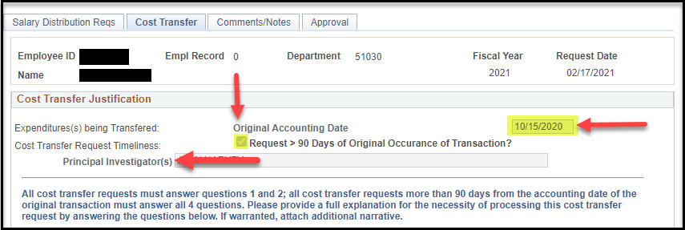
Cost Transfer Justification Form for electronic payroll cost transfers
When creating a retroactive salary distribution change involving sponsored projects (direct and cost share) the Cost Transfer tab will need to be completed for untimely changes. Fill out the original accounting date (payroll date) of the effort being transferred. If it is over 90 days check the box noted below and list all PIs of projects receiving the transferred cost in the text box and add them to the approval workflow.
Notes:
Dawn

Slide 42
Backup required for payroll cost transfers
Salary Distribution Changes:
These changes are entered in PeopleSoft HR, which includes tabs for the cost transfer form and the electronic workflow to include the second approver and PI (if required).
No additional backup documentation required.
See the user guide for steps on creating and submitting the salary distribution changes in PeopleSoft.
Notes:
Dawn

Slide 43
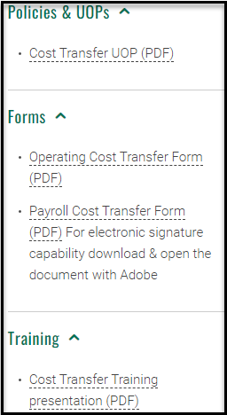
Cost Transfer Justification Form for manual payroll cost transfers
When submitting an hourly wage or additional pay cost transfer you will need to use the PDF cost transfer form found on the Division of Finance & Administration Cost Transfer website or the SPA Forms Library.
Note: Download and save the form to allow the text boxes and signature fields to work properly.
Notes:
Dawn-Cost Transfer Form has four questions.
It is important that you answer the question thoroughly, addressing what is asked.

Slide 44
Backup required for payroll cost transfers continued
Electronic Additional Pay Form (eAPR) Changes:
Make a copy of the eAPR and mark it as “Revision Only to Combo Code” and the correct chartstring written below the old chartstring.
Re-sign and date the form.
Attach the completed payroll cost transfer form and submit all paperwork to retro@uvm.edu
See the user guide for more details on submitting Additional Pay Form changes.
Notes:
Dawn

Slide 45
Backup required for payroll cost transfers continued
Wage Transfers:
The hours to be moved need to be downloaded to Excel from uv_tl_payable_time_detail query (see user guide for more details on running a query, on documentation formatting, calculating and noting the hours and/or dollar amount to be moved and more).
Must include a signature in the Hourly Wage Effort Certifier section.
The employee or the appropriate department personnel who has first-hand knowledge of the reasonableness of the effort revision must sign the certifying statement.
Attach the completed payroll cost transfer form and submit all paperwork to retro@uvm.edu
Notes:
Dawn

Slide 46
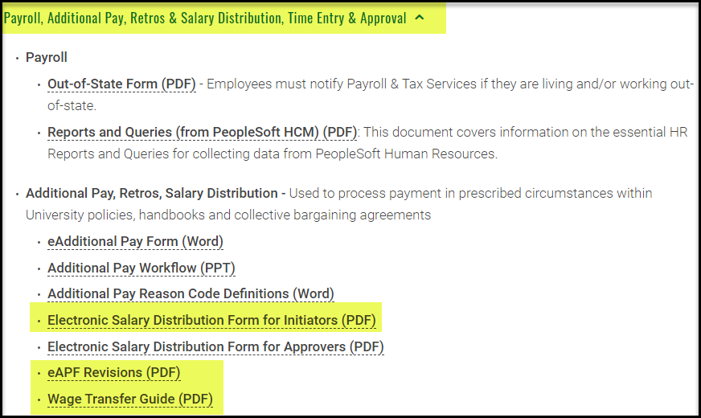
Backup required for payroll cost transfers continued
https://www.uvm.edu/finance/user-guides
Notes:
Dawn

Slide 47
Cost Transfer Form Questions and Appropriate Answers
Notes:
Now lets delve into the Cost Transfer Form’s questions and how best to answer them.
Accurately answering the questions posed on the cost transfer form requires careful thought to ensure each question is addressed appropriately and completely to ensure compliance with the Cost Transfer Principles described earlier. We will go over each question and explain the components of an appropriate response. Then we will show an example and you get to decide whether it is an appropriate response or not.

Slide 48
Cost transfer form – helpful tips
Keys to assist in completing the Cost Transfer Justification:
Familiarize yourself with the types of transfers allowable.
Read the questions carefully and be sure your responses address the questions.
Refrain from extraneous information.
Ensure responses are clear so that someone not familiar with the circumstances will understand the responses.
Never use acronyms without identifying them.
When referencing multiple projects, reference by project number, not name.
Notes:
But first, I want to give you some helpful hints to completing the form.
=== Pull out your copy of the slides discussed earlier, or your notes, to review what is allowable as well as what isn’t.
==== Read the question carefully. I know this sounds redundant, but answer just the question asked. Make sure your answer addresses the question that was asked.
==== Do not provide information that is not needed to answer the question.
=== When answering questions on the cost transfer form, responses should be easily understood by anyone reviewing the journal and provide enough detail to inform approvers and auditors about the action taken. Think, "if I leave, will an auditor be able to understand this two years from now?" it should answer: who, what, where, when, and why. Or if a friend or family member were to read your response, would they know what you are talking about? If not, revise your answer.
==== Saying the ABC grant is not acceptable. Instead say project 012345.
if you win the lottery and are not at UVM two years from now, will someone who does not know the ins/outs of why this JE was necessary, understand what you are saying.

Slide 49
Cost transfer form – helpful tips
Question 1: Provide a brief explanation of the expense(s) being transferred and why the expense(s) was charged to the original chart string(s).
The response should provide sufficient detail so that an independent reviewer can ascertain why the corrective action will satisfactorily address the reason for the error. A statement needs to be included that elaborates why the error was made, rather than just stating “to correct an error” or “to transfer to the correct account”.
Notes:
So, thinking back to earlier slides on Cost Transfer Principles/Expectations and the slides on Allowable and Appropriate Cost Transfers, remember those slides with the icons in the bottom right corner, lets look at the questions on the form.
Read Q1 ===
Enough, but not too much, information that a reviewing will know why the cost transfer is needed. Simply stating that it is to correct an error isn’t adequate.
Examples of elaboration could be that the two project numbers were very similar and there was a transposition of numbers.
Or, the PI wrote illegibly and read the project number wrong.
Here is another example…..

Slide 50
Acceptable or not?
Question 1: Provide a brief explanation of the expense(s) being transferred and why the expense(s) was charged to the original chart string(s).
Answer: They were charged to current project while awaiting setup of new funding period.
This would not be an acceptable answer, as a sponsored project cannot be used as a holding account while awaiting future funding or setup. In this case it should have been charged to a departmental chart string or had an advance account established.
Notes:
Q1 and Answer Once again…PAUSE TO LET THE ANSWER SINK IN.
TWO CLICKS ON THIS SLIDE….
Remember this is one of the unallowable examples given previously… Transfers where the sponsored project was being used as a “holding” fund to redistribute expenses to other projects. This is known as Parking and is not allowed.

Slide 51
Cost transfer form – helpful tips
Question 2: Provide a brief explanation as to why each expense is appropriate and allowable to be transferred onto the proposed chart string(s). If multiple projects are involved, be sure to include project numbers.
The response should provide sufficient detail to address the four guiding principles of allowability, allocability, reasonableness, and consistency. It needs to clearly explain why this expense is allowable and should be moved to the proposed chart string(s).
Notes:
Let’s now look at Question #2.
===
We’ve discussed these principles earlier.

Slide 52
Acceptable or not:
Question 2: Provide a brief explanation as to why each expense is appropriate and allowable to be transferred onto the proposed chart string(s). If multiple projects are involved, be sure to include project numbers.
Answer: To correct lab supplies charged due to a clerical error. The technician wrote down the wrong project number (034566) causing the supplies to be allocated to the wrong grant. This transfer corrects the error. These lab supplies are needed for the scope of project 034577 and have been approved by the sponsor in the proposal and are appropriate and allowable charge on the proposed chart string.
This justification would be acceptable. It states why and how the clerical error occurred and that it is considered an allowable expense on the proposed chart string.
Notes:
===
Two clicks on this slide…..
It also includes project numbers (rather than project names).
Re-iterates the cost transfer principle of the expense being allowable and appropriate and that it was stated in the proposal.
Note that the question asks specifically WHY each expense is appropriate and allowable. So be sure your answer clearly says WHY it is appropriate and allowable, not just that it is to be charged to the project.

Slide 53
Acceptable or not:
Question 2: Provide a brief explanation as to why each expense is appropriate and allowable to be transferred onto the proposed chart string(s). If multiple projects are involved, be sure to include project numbers.
Answer: Moving expenses from department onto grant.
This justification would not be acceptable. The description should be expanded to explain how the charge benefits the grant being charged and why the charge was not originally posted to the grant.
An acceptable response would be:
The start date of the grant is December 1. However, the chart string was not established in PeopleSoft until December 31st. The PI needed to purchase some materials to begin work as appropriate and allowable on the project in December, thus they were charged to the department until the chart string was established.
Notes:
THREE CLICKS ON THIS SLIDE…
==
Does not explain WHY it is appropriate and allowable (remember those cost transfer principles again)….. Hint, read the question carefully and ensure you answered each question asked.
CLICK FOR ACCEPTABLE RESPONSE:
The acceptable response provides more detail as to WHY the expense is being transferred.

Slide 54
Cost transfer form – helpful tips
Question 3: For cost transfers > 90 days, select the extenuating circumstance from the dropdown box and explain the extenuating situation that caused the delay.
The response should provide sufficient detail on what extenuating circumstances warrant approval of the cost transfer request. It should also clearly explain the reason it was not able to be completed within the 90 days.
(Note: There is no dropdown box for electronic payroll cost transfer forms)
Notes:
The next two questions are for those cost transfers that are >90 days.
The third question…
There is a drop down box on the non-payroll cost transfer form to indicate:
Setup Delay
Sponsor Delay
Move to Department Funds
Other

Slide 55
Acceptable or not?
Question 3: For cost transfers > 90 days, select the extenuating circumstance from the dropdown box and explain the extenuating situation that caused the delay.
Answer: Due to other competing deadlines, expenses were not reviewed during the last quarter. During this quarterly review, the PI noted this expense was allocated incorrectly and should be charged to his other R01 grant.
This would not be an acceptable response, as it is not considered an extenuating circumstance that is outside of the departments control. Best practice is to review all grants at a minimum bi-monthly to catch any errors before they are over 90 days.
Notes:
TWO CLICKS ON THIS SLIDE
Remember the slide of unallowable cost transfers… competing priorities, just like lack of staffing or PI, is not an allowable reason for a transfer.

Slide 56
Acceptable or not?
Question 3: Why is this cost transfer being requested more than 90 days after the accounting date of the original transaction and what extenuating circumstances justify this expense transfer?
Answer: The delay was due to ongoing negotiations between UVM and the sponsor. The grant start date was July 1st, but the agreement was not signed until October 10th. Once fully signed, we initiated the transfer of effort from the departmental chart string.
This would be an acceptable response, as it is clearly an extenuating circumstance that was beyond departmental control.
Setting up an Advanced Account request would be an example of a corrective action for this scenario when answering question 4, otherwise it would be important to explain why an advanced account was not appropriate in this particular case.
Notes:
Dawn. HERE IS ANOTHER EXAMPLE – THIS TIME PAYROLL
THREE CLICKS.

Slide 57
Cost transfer form – helpful tips
Question #4. For cost transfers > 90 days, describe the corrective action taken that will assist in preventing the extenuation circumstance as outlined in your response to question #3 from recurring in the future.
The response should provide sufficient detail on what systematic corrective action has been instituted within the department/academic unit’s business practice to prevent this type of error from occurring in the future. The corrective action should address the issue described in your answer to question 3.
If the award is set up months after the start date there should be a mention of why an advanced account was not appropriate for that particular award if effort was being applied to the award.
Notes:
And, finally question #4, once again for those transfers >90 days,
The key to success with this answer is to be sure that your corrective action aligns with the reasoning you gave in Q3 for the lateness.
And ensure the corrective action is substantive and specific.
And, be sure to do this corrective action. Do not say you are going to do the corrective action and then not do it.

Slide 58
Acceptable or not?
Question #4. For cost transfers > 90 days, describe the corrective action taken that will assist in preventing the extenuation circumstance as outlined in your response to question #3 from recurring in the future.
Response: We now have a process to review grants in a more timely manner going forward.
This would not be an acceptable corrective action. It does not state how frequent or what type of review will be conducted. The response needs to clearly define what is being done to prevent this from re-occurring.
Notes:
TWO CLICKS.

Slide 59
Acceptable or not?
Question #4. For cost transfers > 90 days, describe the corrective action taken that will assist in preventing the extenuation circumstance as outlined in your response to question #3 from recurring in the future.
Answer: The PI and Unit Administrator plan to meet on a monthly basis instead of quarterly to review all expenses. This will give the PI and Unit Administrator time to process the transfer within 90 days if an error is discovered in the future. In addition, the administrative staff who process expenditures have been notified to verify with the PI or UA before processing future shipping charges.
This would be an acceptable corrective action. It clearly states the frequency of the review and how it will eliminate this error in the future. It also adds additional training to staff who are posting expenses against the grant.
Notes:
Here is a good example as to how to address that issue with #4:
Word of caution, you cannot use this reasoning again for a future cost transfer. Whatever you say you are going to do for corrective action, you must do it. So, if we see the same reasoning used multiple times, the transfer will be denied.

Slide 60
Questions?
Notes:
ANY IN THE CHAT?
Dawn, anything to add?

Slide 61
Resources for Answering Questions
Sponsor Guidelines
University Operating Procedures: https://www.uvm.edu/policies/grants/costtrans.pdf
SPA Non-Payroll Cost Transfer Procedure: https://www.uvm.edu/sites/default/files/Sponsored-Project-Administration/spa_non-payroll_cost_transfer_procedure.pdf
Financial & Cost Accounting Services: https://www.uvm.edu/finance/costtransfers
Non-Payroll Cost Transfer Form: https://www.uvm.edu/spa/forms-library
Payroll Cost Transfer Form (use Microsoft Edge): https://www.uvm.edu/sites/default/files/Division-of-Finance/Forms/cost_transfer_form.pdf
Payroll User Guides: https://www.uvm.edu/finance/user-guides
NIH: 7.5 Cost Transfers, Overruns, and Accelerated and Delayed Expenditures
Uniform Guidance: Subpart E - Cost Principles
Notes:
A pdf of this powerpoint will be posted on SPA’s website.
Here is the link to the UOP and Uniform Guidance that I mentioned earlier.
Plus, here are a lot of other “good reads” for you.
Access to these links can be accessed via that document.

Slide 62
Educational Resources Available - NCURA
The National Council of University Research Administrators (NCURA) strives to make advances in the field of research administration through professional development, the sharing of knowledge, and by fostering a sense of community via multiple venues:
https://onlinelearning.ncura.edu/ Tutorials, on-line publications, magazine, industry news are available to NCURA members
http://www.ncura.edu/travelingworkshops/Home.aspx These workshops are taught by experienced leaders in the areas of compliance, department research administration, global research management, post-award administration and pre-award administration; the expertise depends on the workshop.
https://onlinelearning.ncura.edu/free-resources Education available to the public at no cost, NCURA membership is not required

Slide 63
Educational Resources Available - RACC
Research Administrators Certification Council (RACC) is an independent non-profit organization composed of active certified research administrators whose role is to certify that an individual, through experience and testing, has the fundamental knowledge necessary to be a professional research or sponsored programs administrator.
http://www.cra-cert.org/

Slide 64
Educational Resources Available – Federal
Federal Demonstration Partnership (FDP) is a cooperative initiative among 10 federal agencies and 154 institutional recipients of federal funds and is a program convened by the Government-University-Industry Research Roundtable of the National Academies. Its purpose is to reduce the administrative burdens associated with research grants and contracts. Many institutions utilize FDP’s templates, including one for outgoing subawards http://thefdp.org/default/subaward-forms/
National Institute of Health publishes YouTube videos which cover all sorts of information relevant to NIH grants https://www.youtube.com/user/nihgrants

Slide 65
Educational Resources Available - Other
Some universities have developed educational videos on various aspects of sponsored research administration, which they make accessible to the public. Vanderbilt University offers a “Getting Started in Sponsored Research” series of webinars at no cost. http://www.vanderbiltlinkages.org/gssr-1/
Notes:
HI Deb, I noticed this link is no longer working. I’m not sure what one to use, but perhaps this one: https://www.vanderbilt.edu/sponsoredprograms/spa_training_materials.php However, after poking around I couldn’t access any recorded trainings.

Slide 66
Thank you for attending!
Notes:
Dawn, anything to add?
Any other questions?
Thank you for attending and best wishes with your future cost transfers.

