Slide 1
Controlled Substance in Research at UVM
Aubrie Clas, IACUC/IBC/CSC Director

Slide 2
Topics
Purpose
What is a Controlled Substance (CS)?
CS Schedules
How CSs are used at UVM
Examples of CSs used at UVM
Who can use a CS?
Security
Purchasing Requirements
What is a CS diversion?
What if I suspect a diversion?
UVM Compliance Helpline
Q&A

Slide 3
Purpose
Create awareness around potential harm associated with CS use
Do our parts to keep our research community safe (faculty, staff, students)
Promote an environment where we feel safe to say something if we see something that doesn’t seem right
Inform CS users and administrative personnel about diversion reporting mechanisms
Keep UVM out of trouble!

Slide 4
What is a Controlled Substance (CS)?
A drug or other substance that is tightly controlled by the government because it may be abused or cause addiction. The control applies to the way the substance is made, used, handled, stored, and distributed. Controlled substances include opioids, stimulants, depressants, hallucinogens, and steroids.

Slide 5
Schedules
Controlled drug substances are scheduled based on medical use in treatment, potential for abuse, and dependence caused if abused— the lower the control schedule the more potential for abuse.
Examples:
Schedule I: heroin
Schedule II: cocaine, fentanyl, oxycodone
Schedule III: ketamine, testosterone
Schedule IV: Ambien, Valium, Ativan
Schedule V: Cough suppressants

Slide 6
Who Can Use a CS at UVM?
Registrant - a PI who obtains a DEA Registration and approval from the UVM Controlled Substances Committee (CSC)
Authorized Users - designated by a registrant to access CSs
Registrants and Authorized Users undergo specific training and background checks.

Slide 7
Controlled Substances Committee
The Vice President for Research appoints the Controlled Substance Committee (CSC) with authority to authorize researchers’ use of controlled substances at UVM, and to review researcher activities for compliance with safety and security requirements.
Composed of researchers, and representatives from EH&S, RPO, and OVPR
Meets quarterly
Inspects at least annually

Slide 8
How Are CSs Used for Research at UVM?
Anesthesia and post-operative care for animals
Humane euthanasia (animals)
Experimental purposes (humans and animals)
Fungi identification (Plant and Soil Sciences)

Slide 9
Examples of CSs Used at UVM
Ketamine (Ketaset)
Pentobarbital (Nembutal, Euthasol)
Buprenorphine (Buprenex)
Fentanyl
Oxycodone
Chloral Hydrate
Diazepam
Cocaine

Slide 10
Security
When not in use, all CSs should be secured in a double-locked cabinet that has been approved by the DEA.
CSs should never be left unattended
DEA registrations are location specific! CSs should not be transported to locations that are not approved on the registration
CSs must not be shared between PIs
Usage must be logged on applicable log sheets

Slide 11
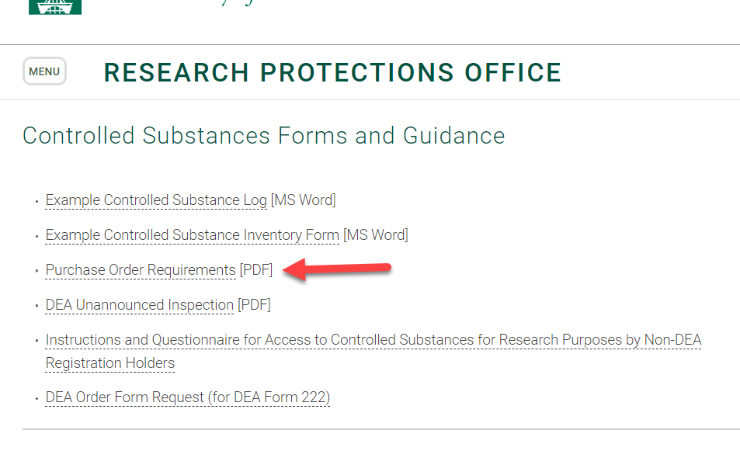
Purchasing Requirements
A single-use PO must be generated each time you need to purchase a CS
You cannot use a UVM Purcard to purchase CSs!
UVM Purchasing Services work with the CSC to allow CS orders based on required documentation
PO requirement guidance can be found on the CSC website

Slide 12
Diversion
Controlled substance diversion is the illegal distribution or abuse of controlled substances or their use for purposes not intended by the prescriber
CS diversion in research universities can lead to serious safety issues to others, harm to the diverter, and significant liability risk to the organization.

Slide 13
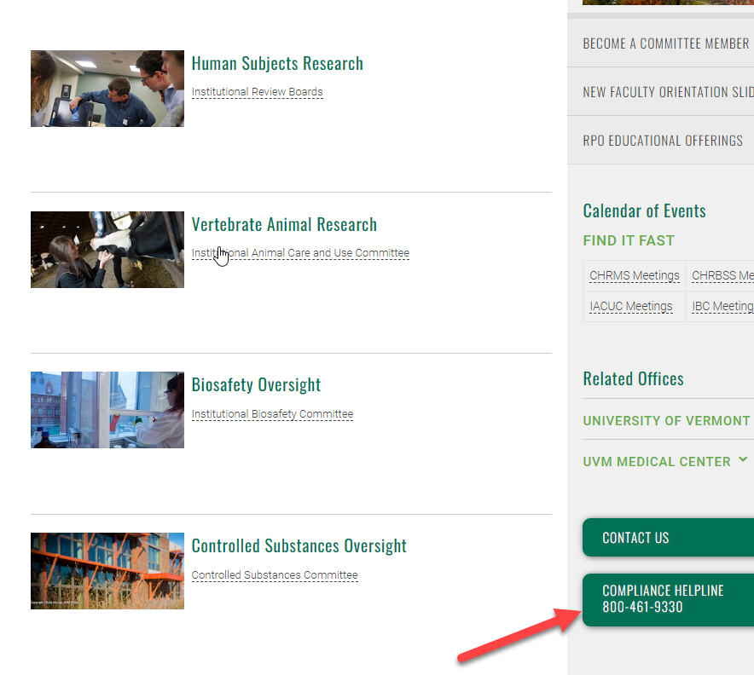
What if You Become Aware of a Diversion or there is Suspicious Activity?
If you are aware of a diversion or suspect that a diversion has occurred or is occurring, you are obligated as a UVM employee to tell someone who can review the situation. Please immediately:
Contact the Controlled Substance Committee or
UVM Police or
File an anonymous report through the UVM Compliance Helpline

Slide 14
Resources for Registrants and Non-Registrants
CSC Website: https://www.uvm.edu/rpo/controlled-substances
CSC Policies and Procedures Manual: https://www.uvm.edu/rpo/controlled-substances-policies-and-procedures
Controlled Substances Act for Researchers Manual: https://www.deadiversion.usdoj.gov/GDP/(DEA-DC-057)(EO-DEA217)_Researchers_Manual_Final_signed.pdf
DEA Website: https://www.deadiversion.usdoj.gov/
Local Diversion Officer: Chris Paquette: christopher.l.paquette@dea.gov

Slide 15
Q&A

