Slide 1
Office of Audit, Compliance & Privacy Services Records Retention: To Keep or Not To Keep
Office of Privacy Services
privacy@uvm.edu

Slide 2
Overview
Why is Records Management Important?
Who is Responsible for Records Management?
What is a “Record?”
Sources of Rules and about Preservation and Destruction
Review of Policy, Schedule and Guidelines
Common Records In Units
Duty to Secure Sensitive Information
Duty to Destroy
Privacy Program & Records Retention Intersect
Special Considerations
Conclusion

Slide 3
Why is Records Management Important?
Records are an information asset and hold value for UVM
UVM has a duty to stakeholders to manage records effectively
UVM must comply with regulatory retention requirements
Some records contain protected, proprietary or sensitive information that must be safeguarded… some by regulation, some because it’s the right thing to do.

Slide 4
Who is Responsible for Records Management?

Slide 5
Who is Responsible for Records Management?
Every employee that creates, accesses, uses or discloses University records plays an important role in records management.
Every employee has a responsibility to only create that which is necessary and part of their job duties.
Every employee has a responsibility to only access, use or disclose records in accordance with UVM policy and within the scope of their job duties.
Every employee has a responsibility to dispose of records for which they are responsible in accordance with University policy.
Each employee needs to know the policy and know how to access the records retention schedule… or where to go for help when a record isn’t listed.

Slide 6
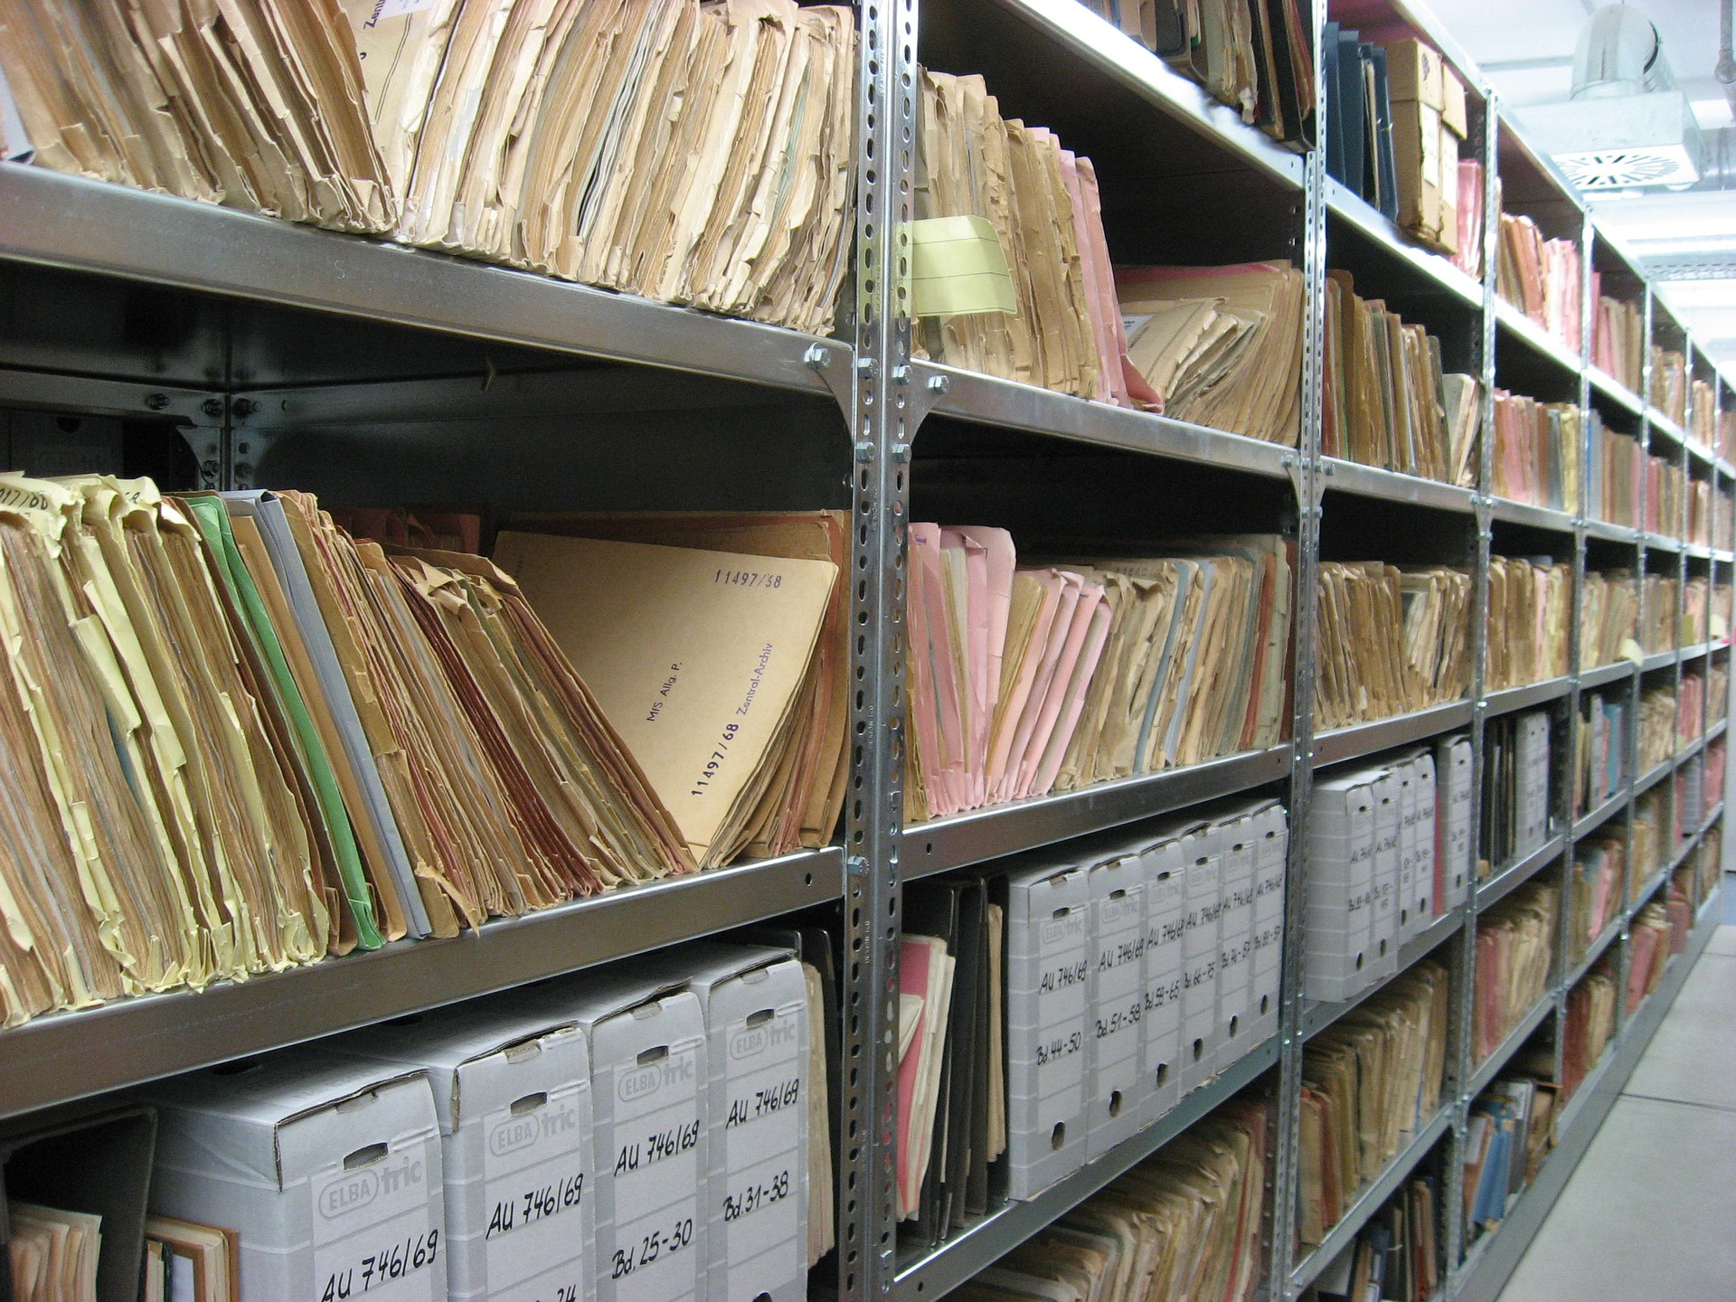
What is a Record?
Records are the evidence of what an organization does.
Records capture the business activities and transactions, correspondence, student files, employee files, financial records, so on and so forth.
Under VT law, most records are “public” records but not all records are “official” or need to be preserved.

Slide 7
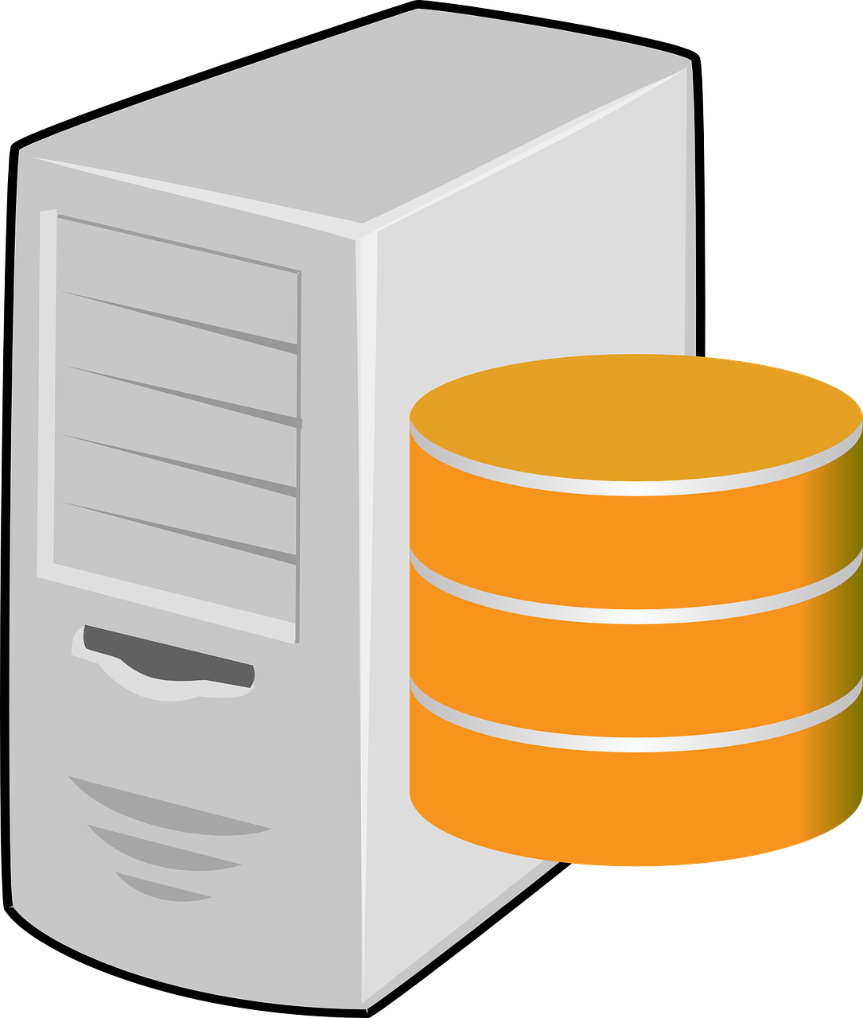
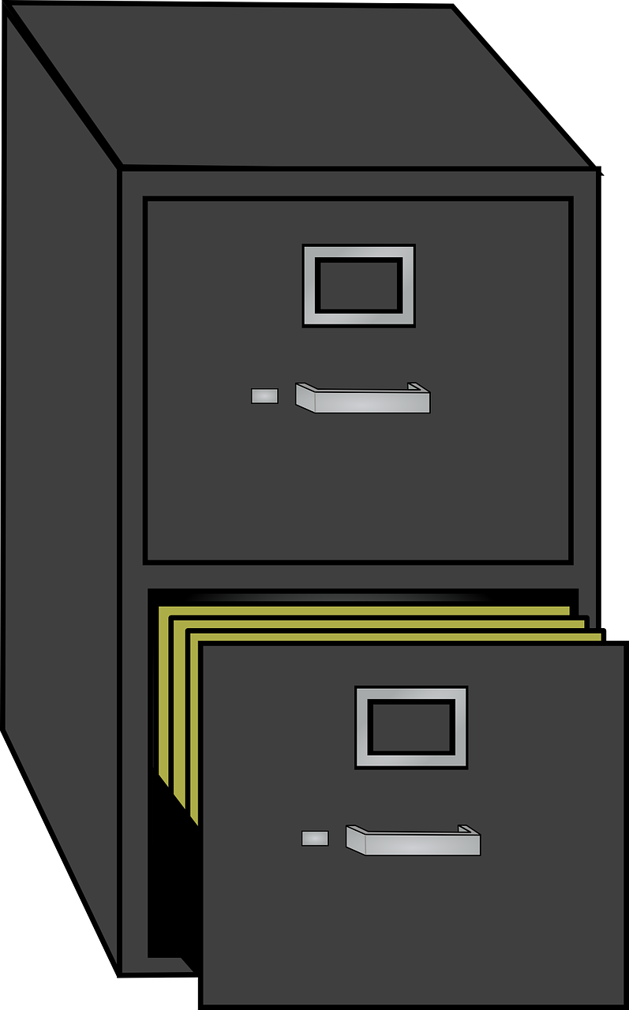
What is a Record?
.
.
Records are electronic, paper, video and recorded.
Records can be in email, portable devices such as smartphones, portable storage such as external hard drives and thumb drives, laptops, desktops, servers.
Records can be in file cabinets, storage boxes, third party storage facilities, campus facilities - attics and basements.
.
.
.

Slide 8
What is a Record?
According to UVM Policy:
Records means any and all written or recorded information produced or acquired in the course of University business, including without limitation all papers, documents, e-mail messages, machine-readable materials, and any other written or recorded matters, regardless of their physical form or characteristics.

Slide 9
Sources of Rules about Preservation and Destruction
Rules imposed upon us by law or other authority.
Vermont state laws, federal and international laws.
Rules UVM fashions and imposes on ourselves.
UVM Policies, UOPs, Guidelines
Whether a regulatory requirement or an institutional requirement, all employees are required to comply.

Slide 10
Review of Policy, Schedule and Guidelines
UVM Records Retention Policy: https://www.uvm.edu/sites/default/files/UVM-Policies/policies/recordretention.pdf
”Four Bucket” policy statement:
Create
Maintain
Safeguard
Destroy
Create
Maintain
Safeguard
Destroy

Slide 11
Review of Policy, Schedule and Guidelines
Create – once it’s created, it’s a record.
Maintain – once a record has been created in the course of University business, we have an obligation to maintain it.
Create
Maintain
Safeguard
Destroy

Slide 12
Review of Policy, Schedule and Guidelines
Safeguard – protect and otherwise secure sensitive, protected, non-public personal, confidential or proprietary information contained in University records.
Destroy – ensure that records that are no longer needed or have no value are discarded/destroyed at the appropriate time.
Create
Maintain
Safeguard
Destroy

Slide 13
Review of Policy, Schedule and Guidelines
UVM’s Record Retention Schedule sets forth retention periods for University Records.
https://www.uvm.edu/compliance/compliance/record_retention_schedule
We determine retention periods based on federal or state regulatory requirements, professional association guidance and management/operational needs.
Schedule is updated as requirements change so always look to the online version for the most up to date.

Slide 14
Review of Policy, Schedule and Guidelines
Terminology For Retention Periods Listed on Schedule:
ACT = Active, employed or enrolled
LIFE = Life of the record
AFYE = After fiscal year end
Other self-explanatory listings:
# Years
Permanent
Lifetime of License
Etc…….

Slide 15
Review of Policy, Schedule and Guidelines
UVM developed guidelines to help units make decisions for records not listed in the schedule.
https://www.uvm.edu/sites/default/files/media/recordretention_guidlines_0.pdf
RESPONSIBILITIES:
Chief Privacy Officer Responsible for policy and providing guidance.
Archivist Responsible for managing archives and identifying records to be preserved.
Individual unit leaders responsible for the records management for their units and assigning a Records Coordinator.

Slide 16
Review of Policy, Schedule and Guidelines
Records Coordinators responsible for:
Identification and awareness of unit records
Managing the records lifecycle (creation, maintenance, disposition) of unit records
Knowledge of retention requirements listed on schedule
Creation of a schedule/program for unit records as needed
Familiarity with recordkeeping practices and standards in the guidelines

Slide 17
Common Records Under Unit Responsibility
Common unit-level records:
Employment files not otherwise transferred to Human Resources;
Conflict of Interest Disclosure Forms and Conflict Management Plans (for non-officers)
Timesheets and supporting documentation (not otherwise kept in PeopleSoft or Kronos)
Employment Applications, Interview Notes, Reference Notes
Contracts
Financial Records and Backup Documentation
Training & Education Records, Certification & Licensure Records
Research Data
Email

Slide 18
Duty to Secure Sensitive Information
Records containing protected personal data or sensitive university information require additional measures to safeguard the info from unauthorized disclosure.
Unauthorized disclosure, depending on the information disclosed, may impose further reporting obligations as well as put those whose information has been compromised at risk.
Increased federal, state and now international laws that impose heavy fines and penalties for breaches. Increased regulatory enforcement.

Slide 19
Duty to Secure Sensitive Information
Records containing personal information must be secured (physical, administrative, technical) to prevent unauthorized disclosure.
Accidental public disclosure of personal information requires reporting and disclosure in accordance with state, federal and international laws.
More requirements for information such as social security numbers, credit card/bank/financial account numbers, driver’s license numbers, health records, student record data.

Slide 20
Duty to Secure Sensitive Information
FERPA: Protects Student Record Data
HIPAA: Protects Protected Health Information (PHI) – Covered Components
GLBA: Protects Non-Public Personal Information (NPPI) – Covered Areas
GDPR: Protects Personal Data on EU Data Subjects – All areas that collect/process covered data
Genetic Information Nondiscrimination Act (GINA)

Slide 21
Duty to Secure Sensitive Information
Vermont Protection of Personal Information (62V.S.A. § 2430)
Vermont Library Patron Records Act (22 VSA 171 et. seq.)
Vermont Disclosure of Information Statute (18 V.S.A.§ 7103)
Vermont Security Breach Notice Act (9 V.S.A. § 2435)
Vermont Document Safe Destruction Act (9 V.S.A. § 2445)

Slide 22
Duty to Secure Sensitive Information
Suspected privacy violations can be reported using the HelpLine or reported to the Chief Privacy Officer (privacy@uvm.edu) or the Information Security Officer (iso@uvm.edu)

Slide 23
Duty to Destroy
When records have reached the end of their retention period,
they should be discarded (if it’s not personal, confidential,
sensitive or protected) or destroyed (if it is.)
Destroy does not mean just discard. Destroy means shred,
Erase, or otherwise make it unreadable or indecipherable.
Risks of keeping records longer than necessary:
Storage costs
Potential legal discovery during legal proceedings or
regulatory audits/investigations
Once it’s begun, relevant records can not be destroyed even
if the retention period has been exceeded

Slide 24
Duty to Destroy
UVM has a preferred pricing agreement for paper and tape destruction:
SecureShred, aka Shred This!
https://www.uvm.edu/finance/supplier-contracts-agreements
Special consideration for computers, laptops and other technology… CD’s, DVD’s, thumb/flash drives, smartphones, tablets, other personal devices.
Resources:
https://www.uvm.edu/it/kb/article/secure-erase/
Part of UVM’s information security and privacy program.

Slide 25
Privacy Program and Records Retention Intersect
Think about your needs before collection.
If you don’t need it, don’t collect it.
If you don’t collect it, you can’t lose it, it can’t be breached, there can’t be unauthorized access or inappropriate disclosure.
If you need it but it’s reached it’s retention period and you destroy it, you can’t lose it, it can’t be breached, there can’t be unauthorized access or inappropriate disclosure.

Slide 26
Privacy Program and Records Retention Intersect
Breach Notification – example:
< 150 individuals = 60+ Hours
GDPR – requirement to only keep personal data for as long as needed for the purpose for which it was collected (and in compliance with federal/state law).
If you collect personal data on EU data subject employees and it has reached the end of the retention period and you don’t destroy it, and it gets compromised, GDPR can impose HUGE fines and penalties.

Slide 27
Special Consideration for Electronic Records
Electronic records are considered records and retention requirements apply equally to them.
Much more difficult to manage – but proper management is critically important.
Special Considerations include (not limited to):
Access electronic records for the duration of their life – sometimes those records are maintained using obsolete technology – if they have a permanent retention requirement, they may need to be converted as technology changes.
Access controls and integrity monitors must be implemented to prevent alterations, unauthorized access, use and disclosure.
Information security controls – physical, administrative and technical – to prevent misuse or breaches.
Ability to destroy records when they reach the end of the retention period. Easy to just let them sit there but they need to be destroyed just like paper.

Slide 28
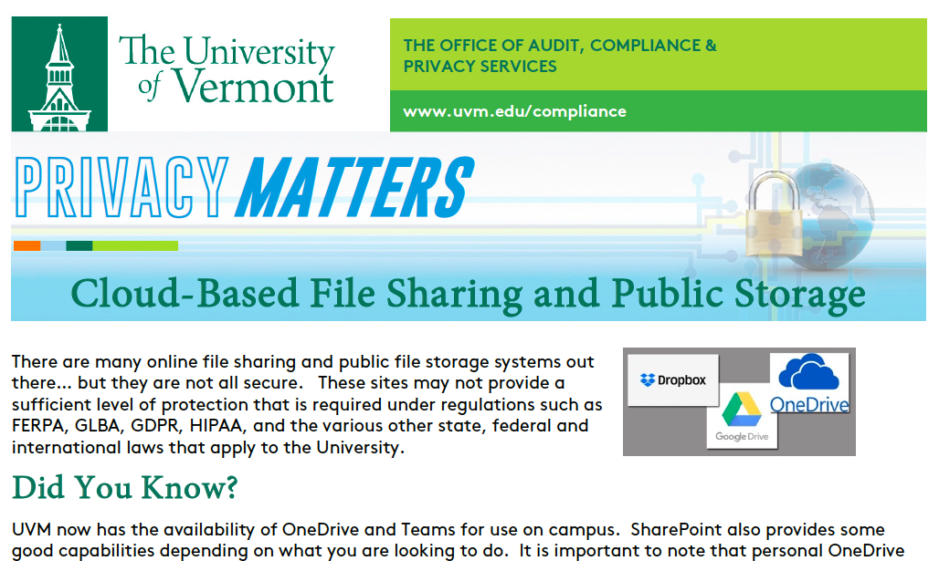
Special Consideration for Electronic Records
This applies to electronic records regardless of where they are stored.
Shared Drives
Software Applications (PeopleSoft, Banner, etc.)
File Management Systems (Webxtender)
File Sharing Locations (OneDrive, Sharepoint)
Restrictions… PRIVACY MATTERS

Slide 29
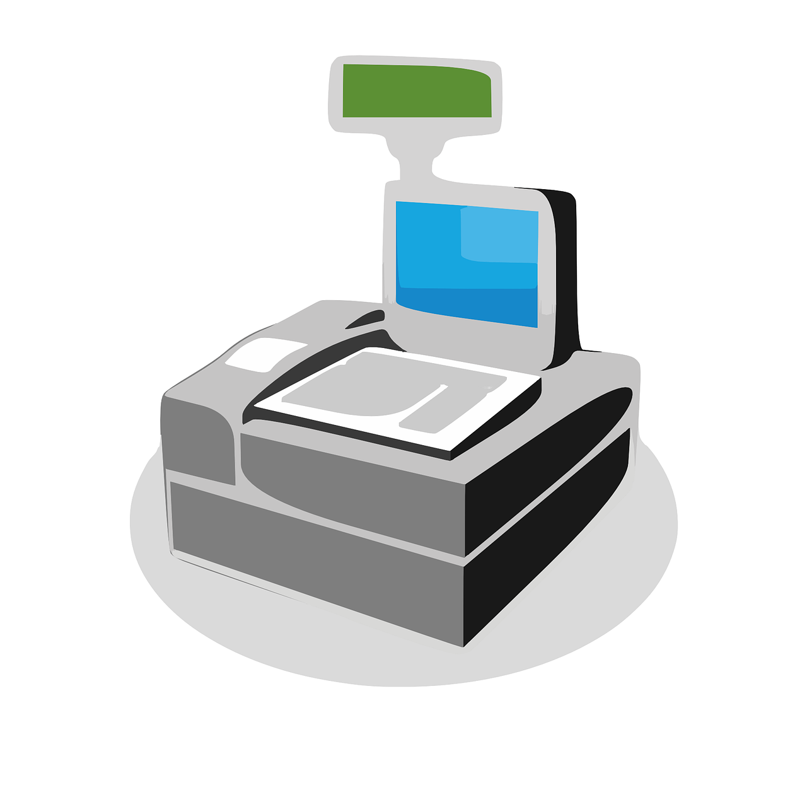
Special Consideration for Electronic Records
Scanning is ok BUT….
Paper records can be scanned, saved electronically and the paper can be destroyed only:
The paper record is not required to be retained in its original form
The paper record contains ”wet signatures” and those signatures are required under a regulation or university policy
There isn’t a regulation that prohibits it
There is a quality control system in place to ensure that the scanned document is legible
The scanned version is retrievable and reproduceable if needed

Slide 30
Special Consideration for Email
Email is a record – retention requirements apply.
They can be kept in email format as long as all the other retention, privacy and security requirement are met.
Email that is not required to be kept should be deleted when no longer needed for administrative purposes.
DO NOT transmit protected or regulated data using email. Use secure file transfer.
https://filetransfer.uvm.edu/send/
If you don’t need to download attachments that contain protected or regulated data, don’t.
If you need to download these, make sure they are (1) safeguarded and (2) saved in such a manner that they can be deleted when they reach the end of their retention period.

Slide 31
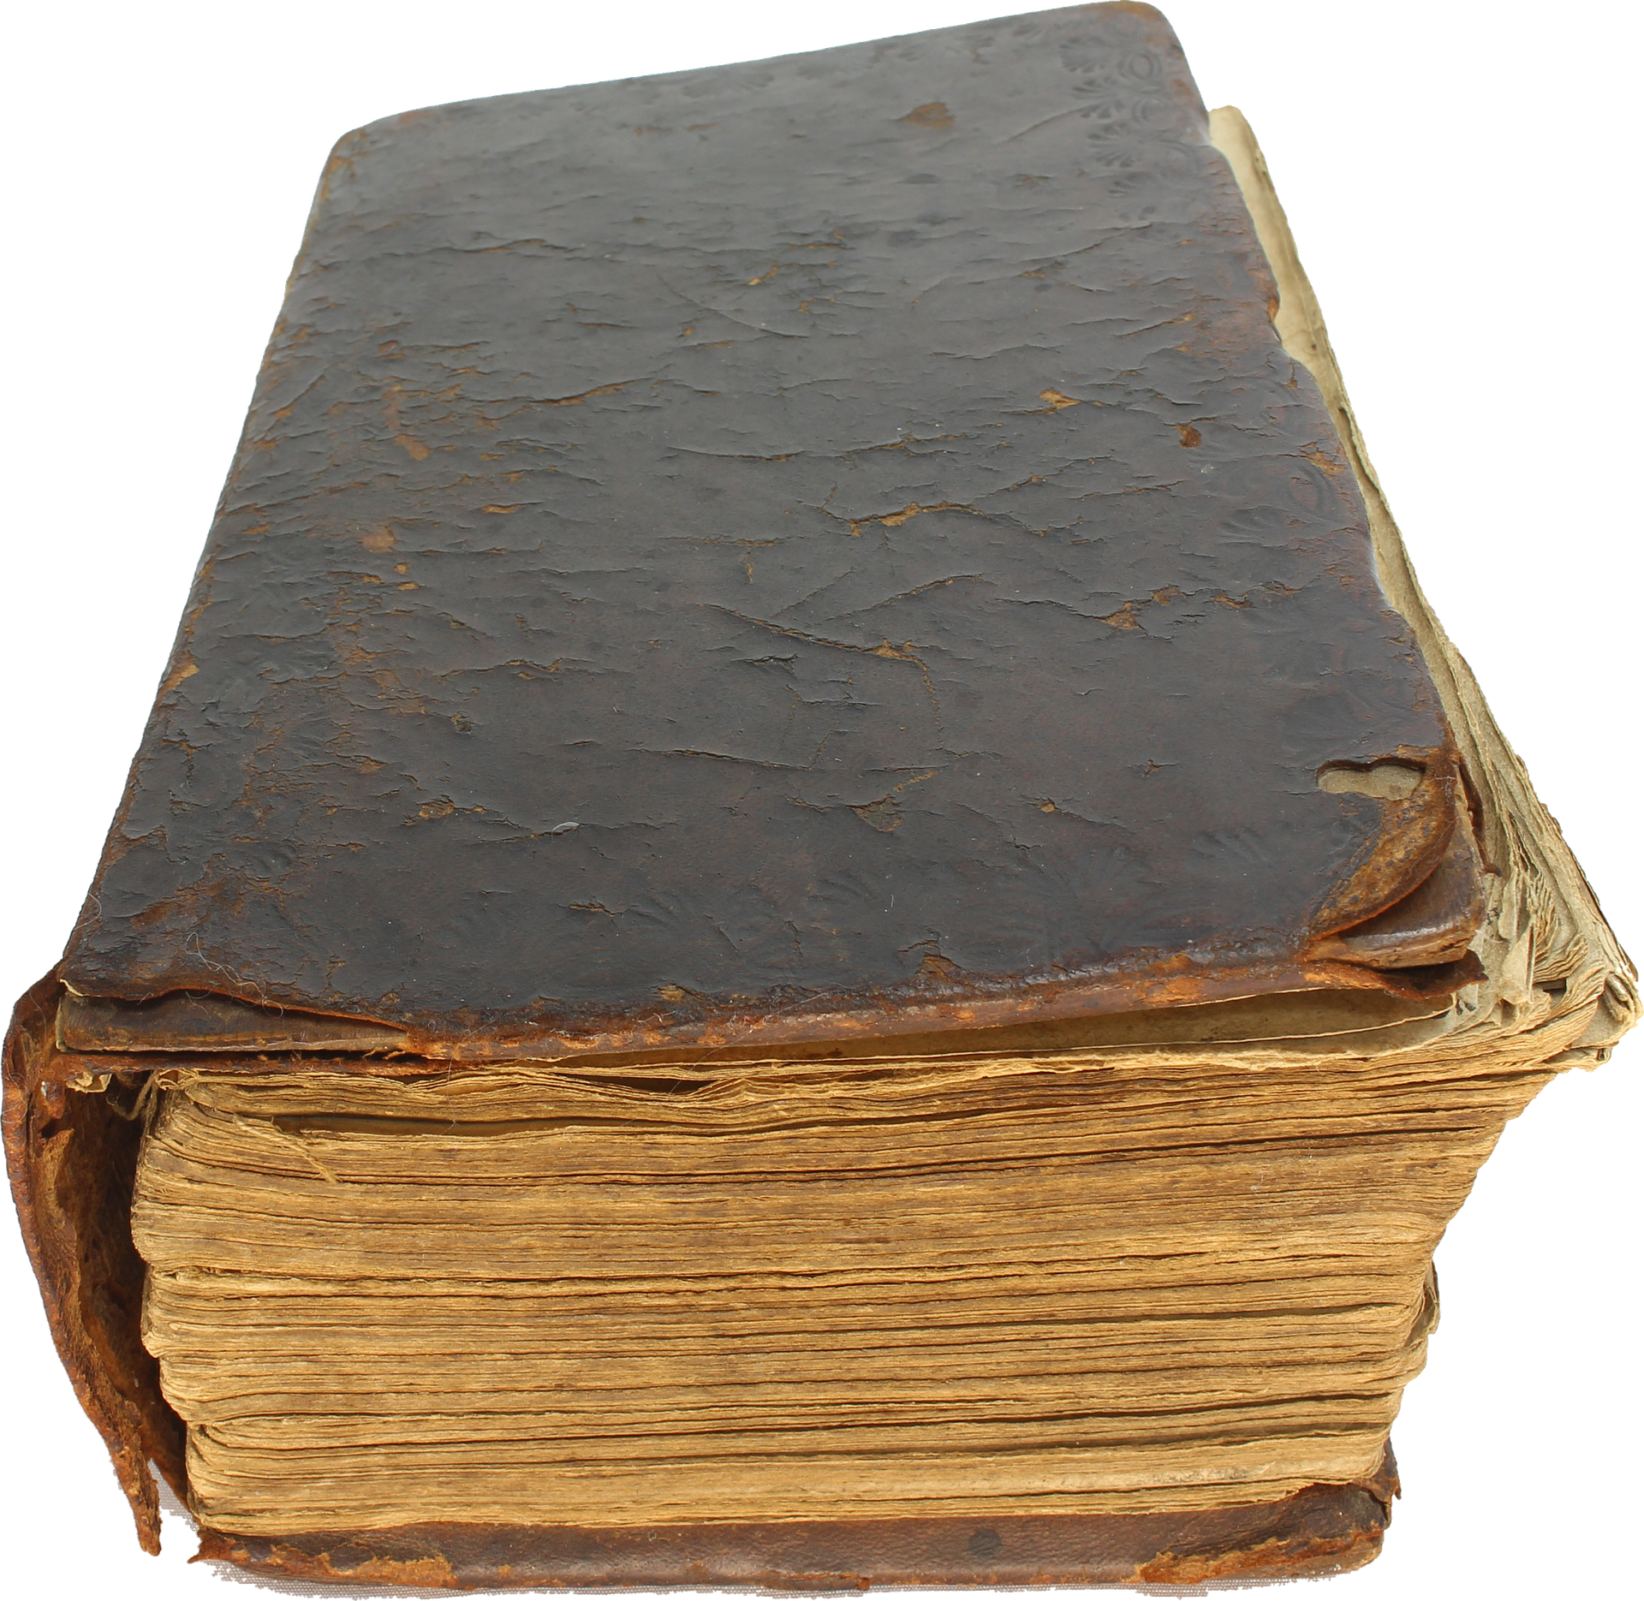
Special Consideration for Archival Records
Records documenting UVM’s history strategic decisions, organizational changes as well as some official publications may be archival records.
If you feel a unique record may hold archival value, contact the University Archivist prior to disposing.
https://specialcollections.uvm.edu/collections/archives

Slide 32
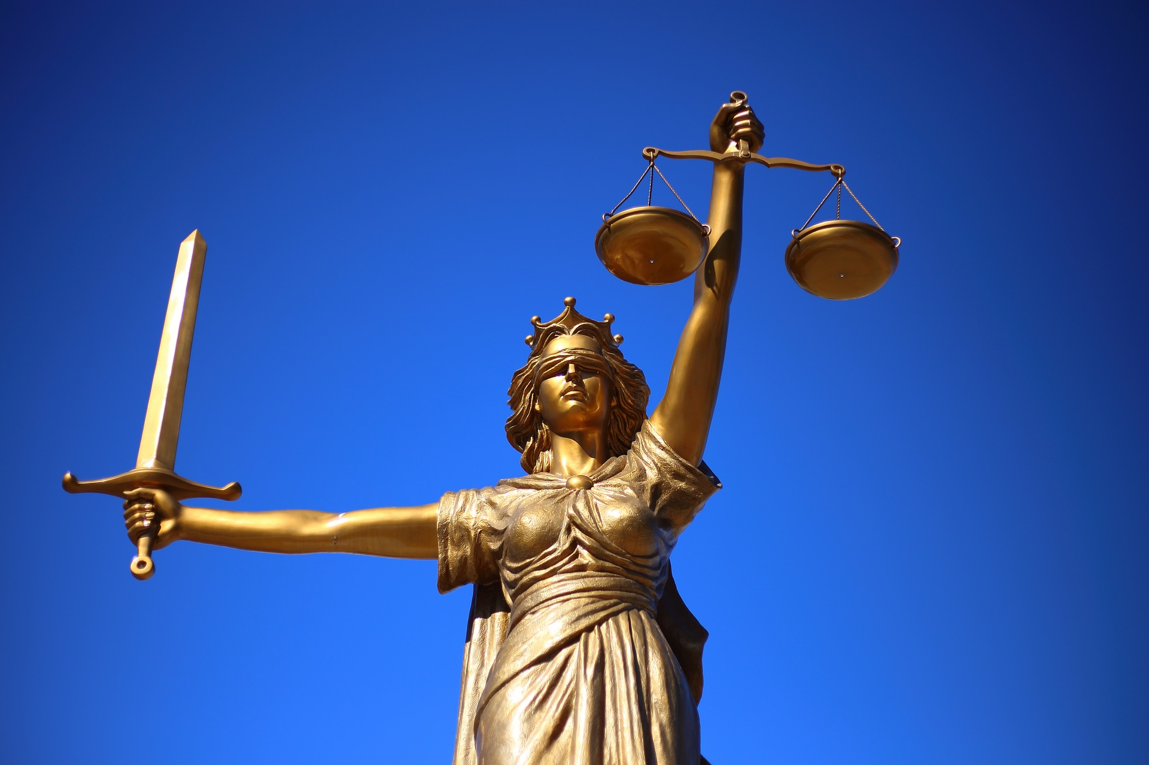
Special Consideration for Litigation Holds
WHEN NOT TO DESTROY…
Pending anticipated litigation
External investigation
Internal audit or investigation
Attorney/Client Privileged Compliance Investigation/Review
Pending request to see a record
OGC will send notification for litigation holds but units are required to ensure that records are not destroyed until the hold has been lifted.
Check with OGC if any of the above occur but you have not received a litigation hold request.

Slide 33
Special Consideration for Public Records Requests
All requests follow the Records and Documents Request Policy
Time considerations apply under the Vermont Public Records Act so prompt response is needed.
Requests must be made in writing.
All requests go through VP of Executive Operations.

Slide 34
Conclusion
Remember the four buckets
Create
Maintain
Safeguard
Destroy

Slide 35
Conclusion
.
.
Apply retention requirements to all records regardless
of format
Paper, Electronic, Recorded
Only collect personal and regulated data if necessary and authorized. If collected, SAFEGUARD it.
.
.
.

Slide 36
Conclusion
Know when to destroy and when not to destroy.
Know how to respond to a request for information.

Slide 37
Office of Audit, Compliance & Privacy Services
Office of Privacy Services
802-656-3086
privacy@uvm.edu
HelpLine: (800)-461-9330

