Slide 1
WELCOME

Slide 2
Agenda & Objectives
Meet the Center for Student Success Team & Current Students
Learn components of your Business Administration major
Understand degree requirements for both GSB and UVM
Recognize opportunities for involvement at GSB
Review next steps
Questions

Slide 3
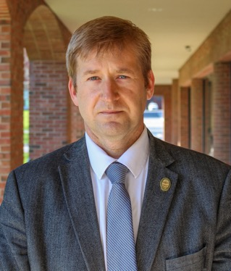
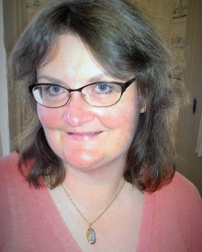
GSB Directors
Thomas Chittenden, M.B.A.
Senior Lecturer & Interim Director
of Undergraduate Programs
Amy Tomas, Ph.D.,
Senior Lecturer & Director of Undergraduate Programs

Slide 4
Center for Student Success

Slide 5
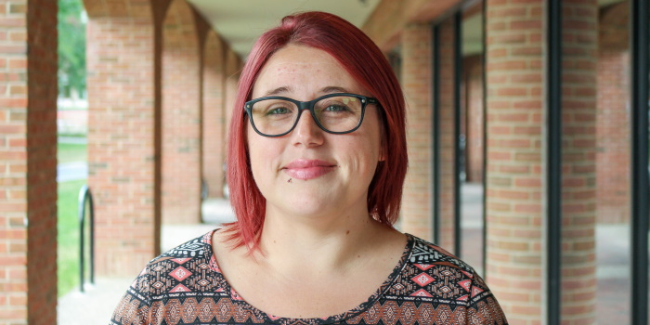
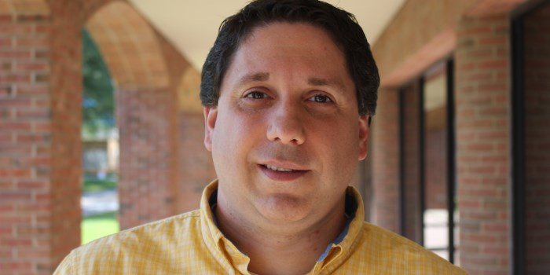
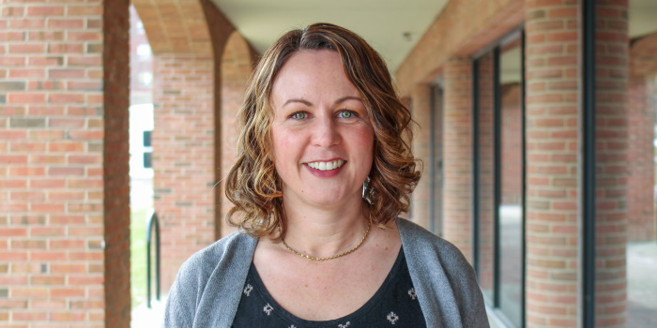
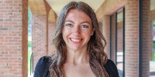
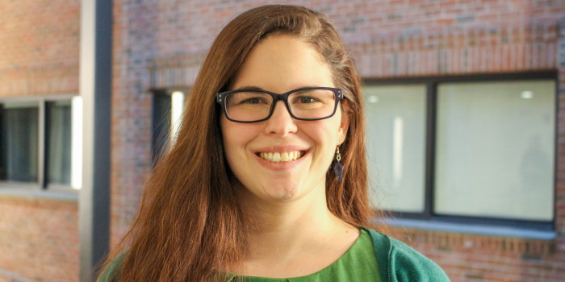
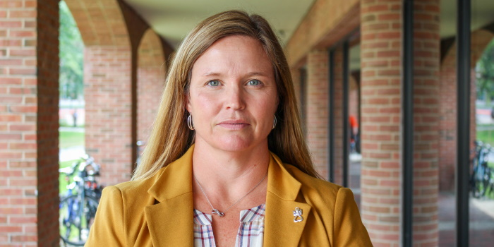
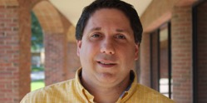
Center for Student Success Team
Samantha Williams (she/her) Director of Academic Services | Travis Perry (he/him) Student Success Advisor & Systems Liaison | Angela Erdmann (she/her) Student Success Advisor
Lindsey Bouzan (she/her) Student Success Advisor & Experiential Learning Specialist | Madison Berry (she/her) Student Success Advisor & Employer Engagement Liaison | Cyndi Dowling (she/her) Administrative Assistant

Slide 6
Bachelor of Science in Business Administration

Slide 8
Basic Business Core Requirements
BSAD 010 Business Enterprise I
BSAD 015 Business Communications
BSAD 020 Business Enterprise
BSAD 030 Decision Analysis
BSAD 040 Information Technology
BSAD 060 Financial Accounting
BSAD 061 Managerial Accounting
EC 011 Macroeconomics
EC 012 Microeconomics
MATH 019 Calculus
STAT 141 Statistics
Required to earn a C- or better and a 2.25 GPA for business core section

Slide 9
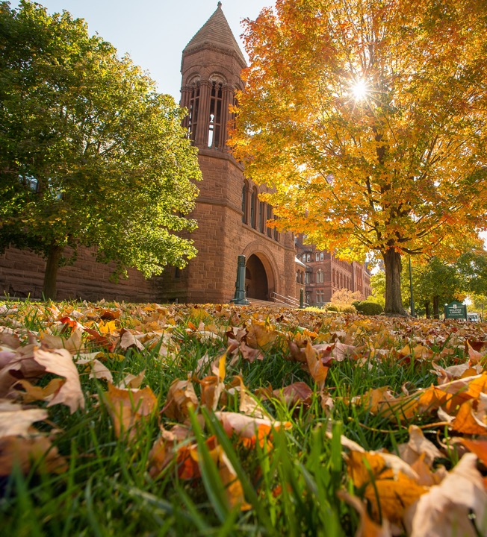
University Requirements & General Education
University Requirements
Foundational Writing & Information Literacy
SU: Sustainability
D1: Race & Racism in the U.S.
D2: Human & Societal Diversity
QR: Quantitative Reasoning
General Education Requirements
English Writing
Social Science
Natural Science (lab optional)
Humanities

Slide 11
Tech Platforms & Tools
Navigate – to schedule advising appointments (with us, and Student Support Offices like Study Abroad, Tutoring, etc.)
Blackboard – for managing homework assignments, accessing course content
MyUVM / “The Portal”
Advising (Degree Audit) - for declaring a Theme/Concentration, minor, degree audit checklist
Registrar - registering for classes
GSB CSS Website – for student handbook, transfer course evaluation, catalog year information, most up-to-date theme/concentration matrix
Suitable – for PEAKS (Professional Engagement and Knowledge System)
Microsoft Outlook – email

Slide 12
Your Degree Audit

Slide 13
Your Degree Audit
Your Degree Audit is a web‐based planning tool that shows progress toward degree completion.

Slide 14
Resources

Slide 15
Resources
GSB Center for Student Success
GSB Faculty appointment and office hours
Writing Center
Counseling and Psychiatry Services
Student Health Services
Student Accessibility Services
Tutoring Center
Tech Support

Slide 16
FERPA

Slide 17
Family Education Rights and Privacy Act
It’s federal law
We cannot discuss you or your academic record with anyone outside of UVM without your permission
Waivers are available at GSB’s Center for Student Success starting in Fall 2022
Alcohol and Drug violations are not protected by FERPA
We strongly encourage you to talk to your family members about FERPA and come up with a plan that works for you

Slide 18
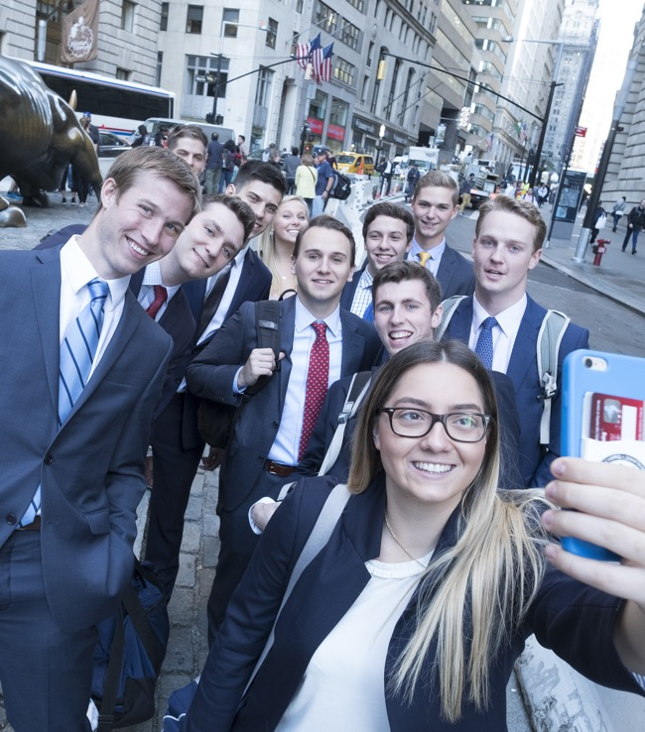
Engagement in Fall 2022
Clubs & Organizations
Women in Business, Finance and Investment Club, Diversity in Business Club, etc.
Business Pitch & Case Competitions
Study Abroad
Engage with Alumni
Investment Club trip to NYC

Slide 19
Your Fall Schedule

Slide 20
First Semester Schedule
BSAD 010: The Business Enterprise I
BSAD 015: Business Communications
BSAD 040 Information Technology or MATH 019/021
BSAD 002: Professional Development
EC 011: Macroeconomics
12-19 credits is the number of credits to be full-time

Slide 21
Mathematics Readiness Test (MRT)
A 45-minute test of basic high school math skills, including algebra and trigonometry.
Determines math placement for 2022-2023 academic year
All new first-year students must take the MRT at least 48 hrs before their one-on-one advising meeting, or risk being dropped from MATH 019
The MRT is on your New Student Checklist and info has been sent to your UVM email
Mathematics Readiness Test | Department of Mathematics & Statistics

Slide 22
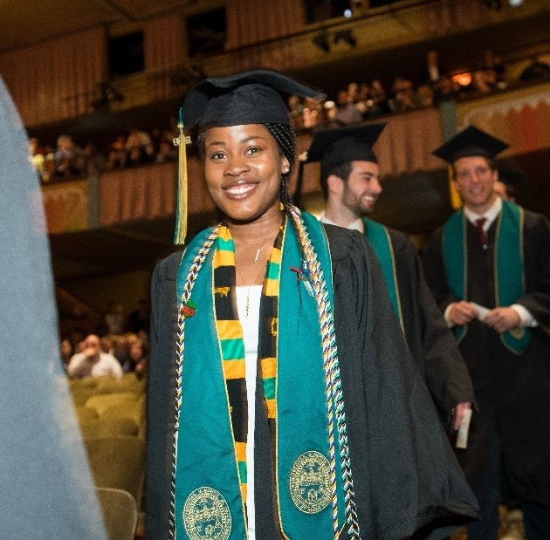
Next Steps

Slide 23
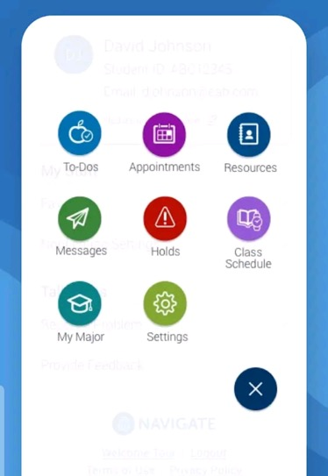
How to NAVIGATE Advising
Make appointments
Find a tutor
Find a study buddy
Remember tasks and deadlines
Access the app: go.uvm.edu/navigate*
*Also available as a desktop version

Slide 24
Next Steps: What to expect at your 1-on-1
Discuss Fall 2022 Schedule
Review Degree Audit
Explore myUVM portal
General Questions

Slide 25
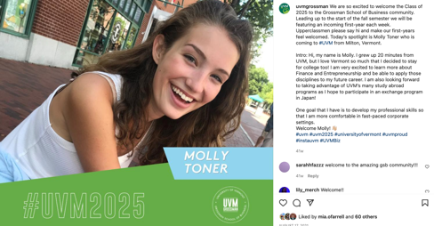
First Year
Student Spotlight!
Get to know your peers! GSB would like to celebrate our incoming First-Year cohort by creating a big presence on social media using the hashtag #UVM2026!
Be featured on @uvmgrossman Instagram by filling out the Microsoft Form.
Form: https://go.uvm.edu/gsbftfy22

Slide 26
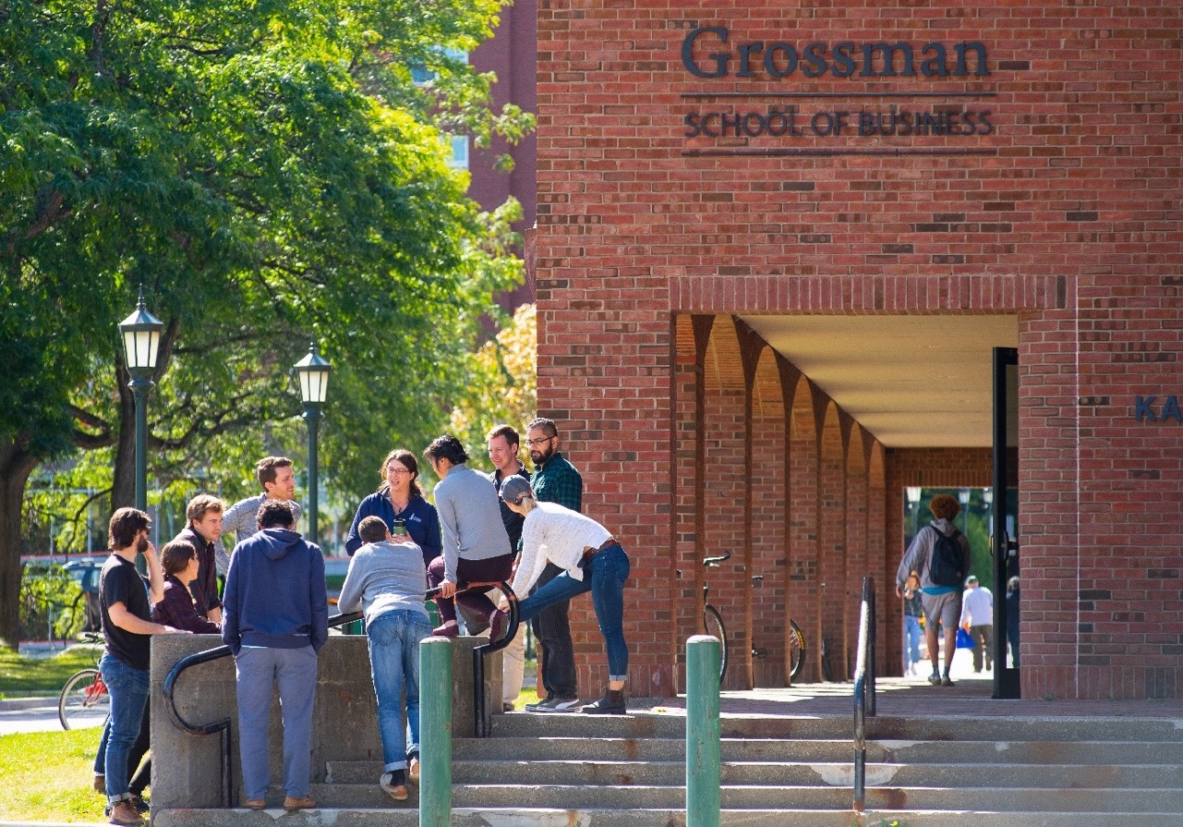
Socialize with Us!
@UVMGrossman
@UVM Grossman
School of Business
Center for Student Success
100 Kalkin Hall
gsbcss@uvm.edu
Uvm.edu/business

Slide 27
Thank you!

