Slide 1
Academic Session
Welcome to
January 14, 2022
2:30 – 4:00 pm

Slide 2
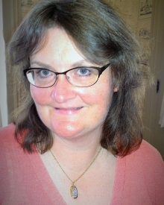
Welcome with
Professor Amy Tomas, Ph.D.
Director of Undergraduate Programs
& Senior Lecturer

Slide 3
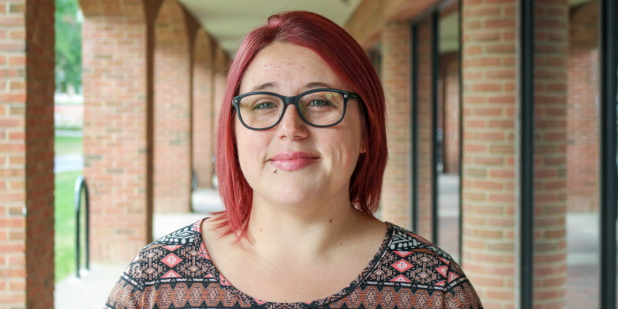
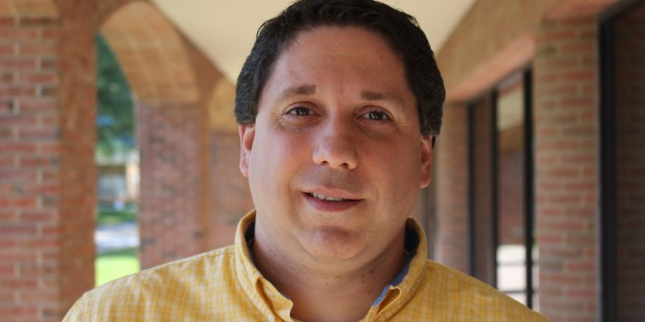
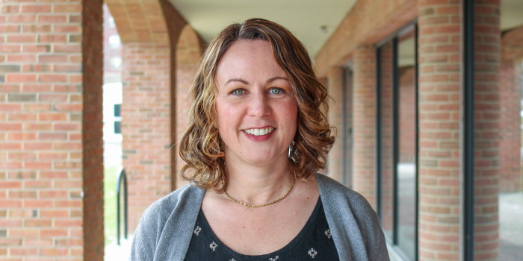
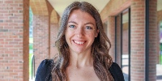
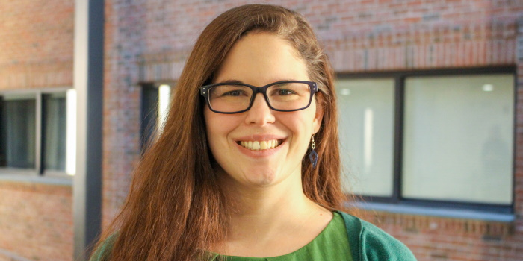
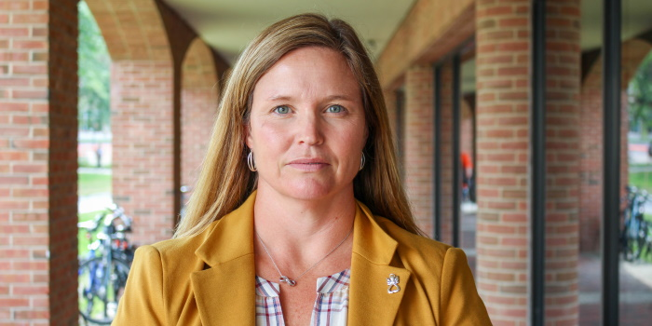
Meet the Center for Student Success Team
Samantha Williams (she/her) Director of Academic Services | Travis Perry (he/him) Student Success Advisor & Systems Liaison | Angela Erdmann (she/her) Student Success Advisor
Lindsey Bouzan (she/her) Student Success Advisor & Experiential Learning Specialist | Madison Berry (she/her) Student Success Advisor & Employer Engagement Liaison | Cyndi Dowling (she/her) Administrative Assistant

Slide 4
Agenda
Welcome
Intros & Structure Struggles Activity
Goals: Ours and Yours
Overview of the Center for Student Success
Your degree audit
Business Administration Degree Requirements
Brand Alphabet Challenge
Resources & Essential Tips
PEAKS

Slide 5
Structure Struggles

Slide 6
Structure Struggles – How to Play
You will be handed a baggie of supplies.
You have 45 seconds to create a structure using only the supplies in the baggie.
You may not ask for assistance.

Slide 7
Debrief
What are 1-2 words that describe what this activity was like for you?
Why did others receive more supplies?
Would you have been more successful if you were able to share resources?
How might this game be applied to your transition to college & GSB in particular?
How can you find out meaningful information that’s helpful to your goal in the future? What is the value in that?

Slide 8
Goals

Slide 9
Your Goals
What do you want to talk about today? Why are you here?
What makes that important?
What is your goal for this session?
How will you know we were successful?
What do we need to get started?

Slide 10
Learning Objectives – Our Goals for You
Recognize the Center for Student Success (CSS) as a resource for your academic supports
Recognize how to locate your degree audit
Recall requirements for receiving a Bachelor’s of Science in Business Administration
Classify key resources and essential tips
Explain the value of PEAKs

Slide 11
Center for Student Success
CSS

Slide 12
CSS Office
Located in Kalkin 100
Drop in hours M-F 10:30 am – 12pm or 1:00 pm – 3:00 pm
By appointment, in-person or remote
Personal academic advising meetings in the first and second year for all students
Career and professional development opportunities starting in the first year
Connections to student organizations to help with adjustment to college life
Dedicated study abroad advisor in the Center for Student Success
Faculty advisor in student's area of study assigned before junior year

Slide 13
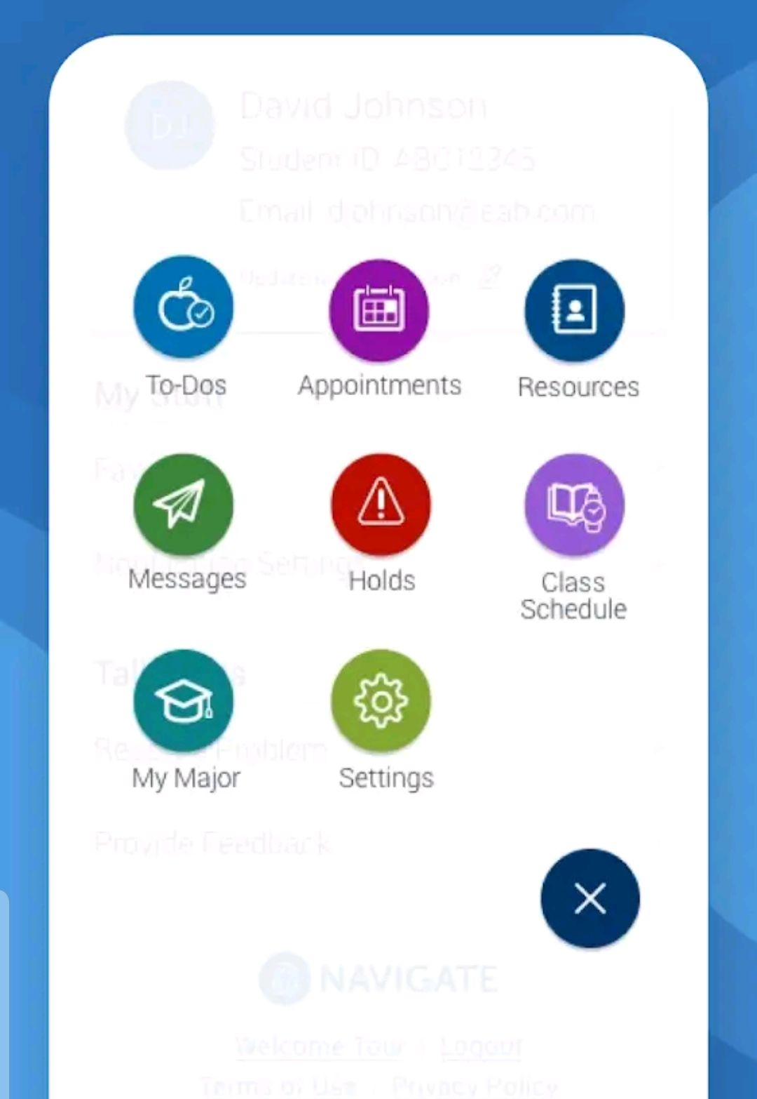
How to NAVIGATE Advising
Go.uvm.edu/navigate
Make appointments
Find a tutor
Find a study buddy
Remember tasks and deadlines
Also available in a desktop version

Slide 14
Making an Appointment
Open the Navigate app on your browser or smartphone. If you don’t have the Navigate app, you can find it here: https://www.uvm.edu/registrar/navigate-students. Note: Mobile & desktop versions are available.
Sign in with your NetID and password. Select ‘Appointments’ and ‘Schedule an Appointment’ (on the bottom of your screen).
Then, make the following selections:
  What type of appointment would you like to schedule: Advising
  Select a Reason for Appointment: Academic Advising with a GSB CSS Advisor
  Location: GSB - Grossman School of Business
  Staff: While selecting a staff member, First-Years and Sophomores should select their CSS Advisor (see your MyUVM portal or Navigate app for their name). Students advised by faculty should click ‘Next’ to be directed to all available times for all CSS staff at our location.
  How would you like to meet? Please choose In-person or Remote (MS Teams)

Slide 15
Family Education Rights and Privacy Act
It’s federal law
We cannot discuss you or your academic record with anyone outside of UVM without your permission
Waivers are available at GSBs Center for Student Success (CSS)
Alcohol and drug violations are not protected by FERPA

Slide 16
Your Degree Audit

Slide 17
What is a Degree Audit?
Web‐based planning tool that shows progress toward degree completion
It does not take the place of working with your advisor to develop a plan to reach your academic and future goals

Slide 18

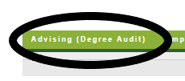



How to Find Your Degree Audit
Go to myuvm.uvm.edu
Navigate to the Advising tab
Click on the “run your degree audit” banner on the right

Slide 19
Bachelor of Science in
BUSINESS ADMINISTRATION

Slide 20
University & GSB General Education Requirements
University Requirements
Foundational Writing & Information Literacy
SU: Sustainability
D1: Race & Racism in the US
D2: Human & Social Diversity
QR: Quantitative Reasoning
GSB Gen Ed Requirements
English Writing
Social Science
Natural Science (lab optional)
Humanities

Slide 21
Themes & Concentrations
Themes
Entrepreneurship
Global Business
Sustainable Business
Concentrations
Accounting
Business Analytics
Finance
Marketing

Slide 22
Goal Check In

Slide 23
Important Information
If you feel you need to make any schedule adjustments, that’s okay… BUT you should know:
Add/Drop is the first TWO weeks of classes…
  After January 24th, you need instructor permission to ADD a new course
  You can drop a course until January 31st
  You should meet with a CSS advisor to discuss schedule changes
12 credits is the minimum number of credits to be full-time; 19 credits is the max
  There are scholarship, financial aid, housing and NCAA implications of being enrolled in less than full-time

Slide 24
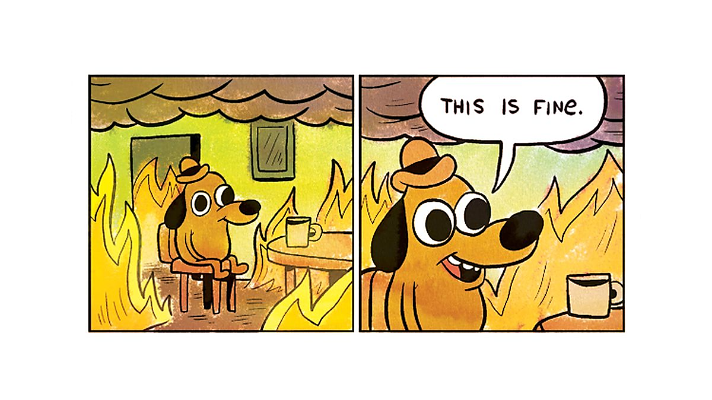

Slide 25
Brand Alphabet Challenge

Slide 26
Brand Alphabet Challenge – How to Play
Work in groups or individually. Spread out in the space so no other team can hear you.
An array of partial business logos will appear on the screen. Work to identify the business of each letter.
The fastest wins!

Slide 27

How many of these brand logos do you recognize?

Slide 28
Resources &
Essential Tips

Slide 29
Resources & Essential Tips
Programs & Services
Top Tips from GSB Advisors
PEAKS
Getting the most out of your classes

Slide 30
Programs & Services
Wellness | Academic | Identity Center | Faith-Based | Additional
Counseling & Psychiatry Services (CAPS) | Tutoring Center | PRISM | Interfaith Center | Career Center
Living Well | Writing Center | Women & Gender Equity Center (WAGE) | UVM Hillel | Student Financial Services (SFS)
Catamount Recovery | Center for Student Success (CSS) | MOSAIC Center for Students of Color | Catholic Center | UVM Dining
Student Health Services (SHS) | Student Accessibility Services (SAS) |  |  | UVM Faculty & Course Instructors
Not sure where to go? Start with your advisor!

Slide 31
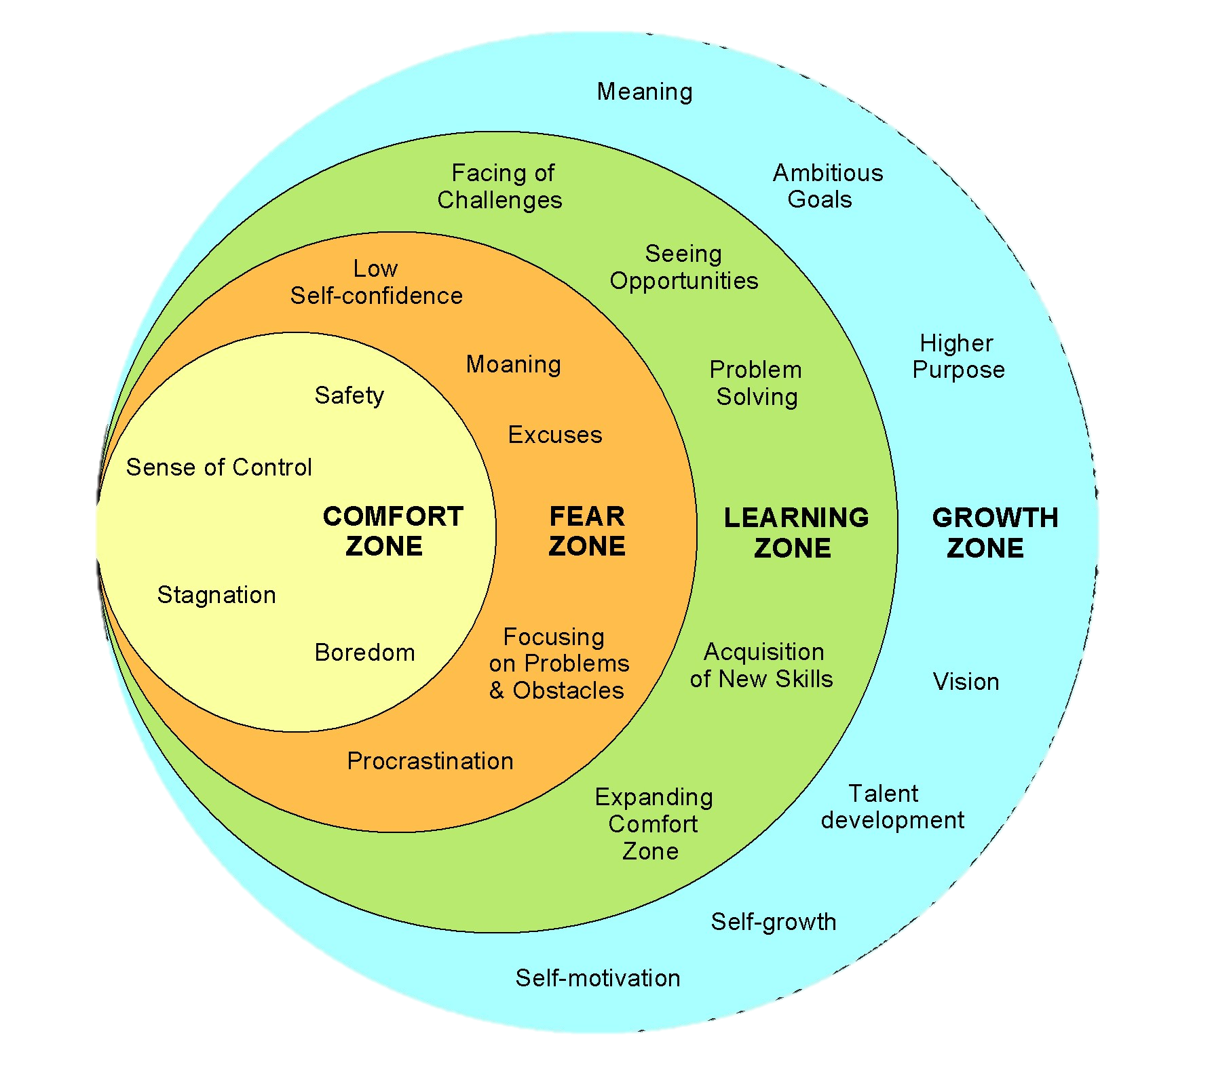

Slide 32

Go Beyond your Comfort Zone
Meet new people
Explore clubs/organizations
Take elective courses that interest you!
Attend campus events
Take initiative; be the one to start (a conversation, a new club, asking a question in class, etc.)

Slide 33

Self-Care
The practice of taking an active role in protecting our own well-being, pursuing happiness, and having the ability, tools, and resources to respond to periods of stress so that they don’t result in imbalance and lead to a health crisis. ​

Slide 34
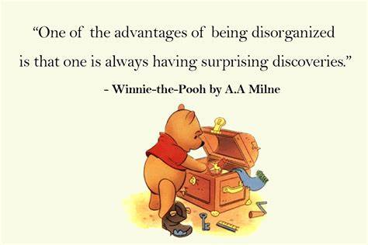
Organization = Planning
Planner?
Post-it Notes?
Who planned out their day today?
How do you
stay organized?
“Don’t be like Pooh.”
- Travis, right now

Slide 35
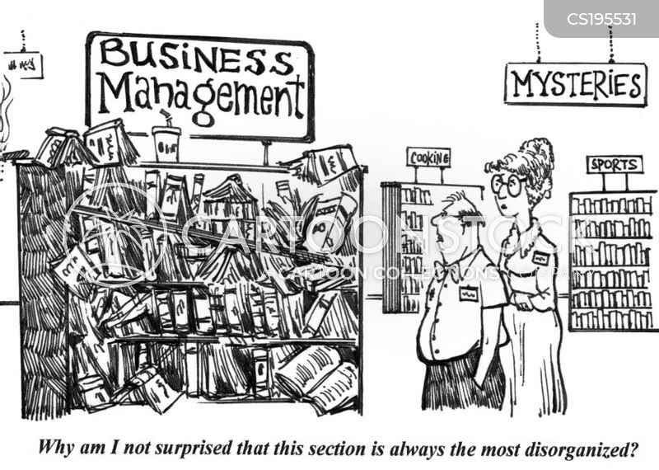
Find a system that works for you!
Use your Syllabus to help you stay organized
in every class!

Slide 36
Get the Most out of Your Classes
  Read the syllabus and track due dates
  Come to class prepared
  Schedule homework/study time
  Follow academic integrity:
  If it’s not yours, cite it. Your assignments,
  your tests… your original work.
  Be flexible

Slide 37
Final Reminders Before Classes Start
Check your UVM e-mail often (we recommend several times a day)
Make sure MS Teams is downloaded on your computer – this is how most of your courses and meetings will be held.
Your classes might require different online platforms. Never hesitate to reach out to our Tech Team for help.

Slide 38


Slide 39
What is PEAKS?
Professional development badges, based on YOUR interests.
Credentials to show employers, peers, and more.
Recognizing your involvement in Grossman, UVM, and beyond.

Slide 40
Overview: The 3-Step Process
Attend
Career Event
Internship Fair
Reflect
Written Summary
QR Code
Credit Awarded
Automatically Applied
Class
Club
Forums
Panel
Self-Report
File Upload
Assigned by PEAKS team
Student Initiated

Slide 41
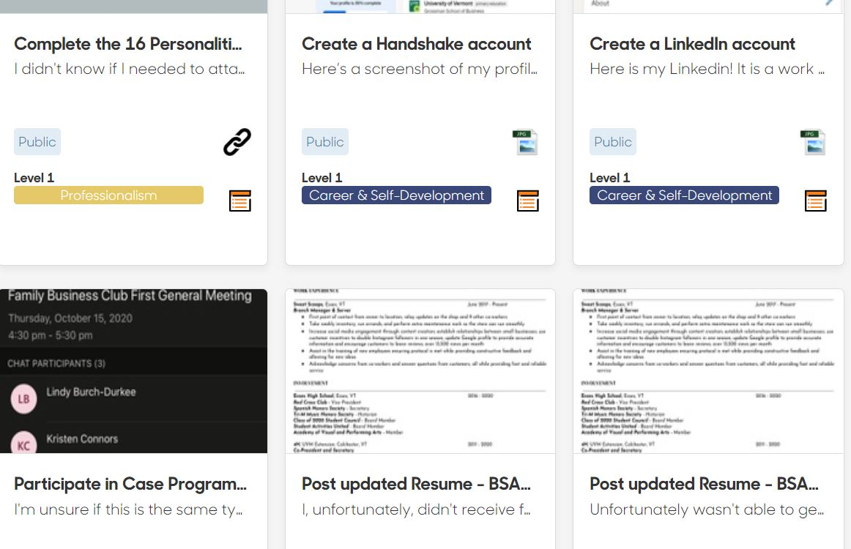
An example of a PEAKS digital portfolio:

Slide 42
Engagement Opportunities with GSB
Clubs & Organizations
Business Pitch & Case Competitions
Study Abroad
Engage with Alumni

Slide 43
Learning Objectives – Our Goals for You
Recognize the Center for Student Success (CSS) as a resource for your academic supports
Recognize how to locate your degree audit
Recall requirements for receiving a Bachelor’s of Science in Business Administration
Classify key resources and essential tips
Explain the value of PEAKs

Slide 44
Reflection
Were you able to meet your goal(s) for today’s session? Why or why not?
What helped you keep focused in obtaining your goals for today? What hindered your progress?
What do you need from CSS or GSB to help you transition smoothly?
What are your next steps? How can you get started?

Slide 45
Center for Student Success – Contact Info
100 Kalkin Hall
gsbcss@uvm.edu
uvm.edu/business

Slide 46


Socialize with Us
We’re excited to feature our incoming students!
Contact: Rachel.Narkewicz@uvm.edu
@UVMGrossman
UVMSchoolofBusiness

Slide 47
Connect with Us!
We will be stationed around the room for the duration of the session. See us if you have questions about:
Degree Audit
Spring Schedule
Tips/Tricks
Internship/experiential learning
Any other questions/concerns

Slide 48
The End

