Slide 1
UVM Graduate Writing Center All About Literature Reviews
https://www.uvm.edu/gradwriting

Slide 2
Goals of a Literature Review
Establish importance of topic
Evaluate existing research
Important trends (organize/synthesize)
Strengths/weaknesses (analyze/evaluate)
Gaps
Spotlight the contribution of your research
Tell the story that leads to the gap and the question/approach you propose
Provide context and detail that contributes to a persuasive narrative (why this gap matters, the promise of your question/approach)

Slide 3
Composing a Literature Review
Which are hardest for you?
Finding/keeping focus
Determining/communicating relevance
Organization/Synthesis vs. summary

Slide 4
Defining a Frame of Reference for Your Research Question
CONFUSION
RESEARCH & THEORY ON A SPECIFIC
PROBLEM
Create a frame of reference for your research question by telling the story of research so far that is relevant to and leads to your question
Your
?
CONCLUSION
FURTHER LINES OF INQUIRY
Adapted from Keith
Hjortshoj’s Writing from
A to B
CONFUSION

Slide 5
Activity: Finding Focus
What is the research question or gap your literature review helps to define?
Why should we study this topic?
What will your research contribute?
Briefly tell the story of what has happened in this field to led you to this research.
What do researchers already know about this?
What do they not know?
What key conversations or trends lead to the gap you’ve identified and approach you propose?

Slide 6
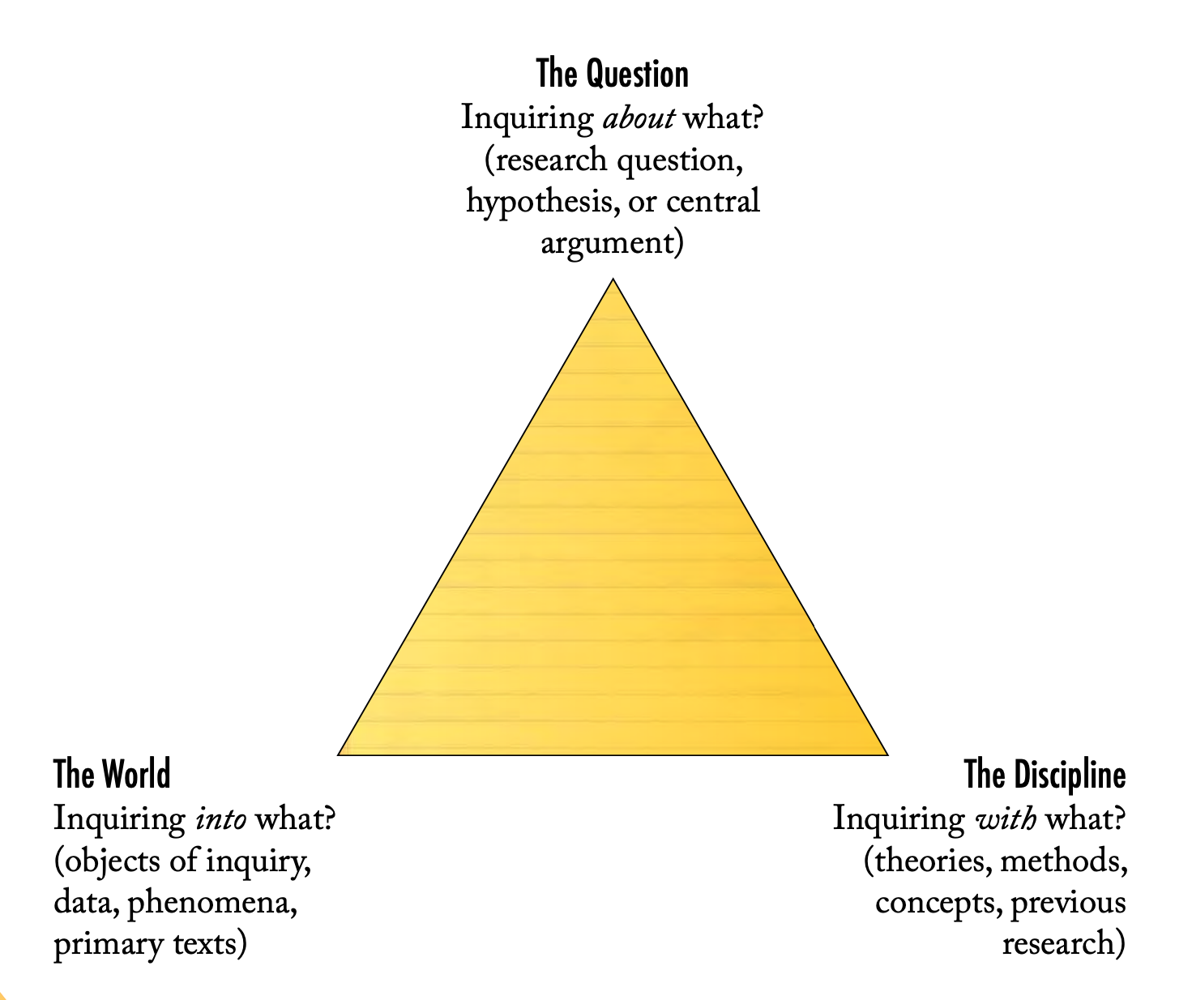
Establishing Relevance
Establish your question’s relevance by placing it within existing scholarship and theories in your field(s) and also by describing the problem or situation (“The World”) you and scholars in your field(s) are concerned with.
Adapted from Keith
Hjortshoj’s Writing from A to B

Slide 7
Activity: Establishing Relevance
If a novice (e.g., an intelligent and interested but nonacademic family member or friend) asked what you are working on and why it matters, how would you respond?
If you were are asked to give a guest lecture for first-year undergrads about your field of inquiry and its importance, what would your lecture outline look like?

Slide 8
Annotated Bib v. Literature Reviews
Annotated Bibliography
Literature Review
Source 1 Citation
Source 2 Citation
Source 3 Citation
What this source says.
What this source says.
What this source says.
Introduction (frame of reference for your research question)
Supporting paragraph 1
Supporting paragraph 2 (and 3, 4 etc.)
Source 3
Research Question
Source 1
Source 2
Source 2

Slide 9
Options for Organizing Literature Reviews
Topical:
Three important areas of this field have received attention: “A”, “B”, “C”.
“A” has been approached from two perspectives: “F” and “G”
The most important developments in terms of “B” have been…
“C” has also been an important area of study in this field.
Debate:
There have been two (three, four, etc.) distinct approaches to this problem
The first model, advanced by A and G, posits…
The second model, developed by B, C, and F, argues that the first model is wrong … Instead, the second model claims…
Trends over Time:
This subject was first studied by W, who argued…
In (date), X modified/extended/contradicted X’s work by…
Today, research by Y and Z represents the current state of the field ….

Slide 10
Activity: Organizing a Literature Review with Concept Mapping
Source 1
Source 5
Source 2
Theme
Theme
Source 4
Source 3
Source 4
Problem/Concern
Source 2
Theme
Theme
Source 5
Source 4
Source 1
Theme
Source 3
Source 5
Source 2

Slide 11
Activity: Organizing a Literature Review with Theme Buckets
Paper 1
Papers 1, 2
Theme 1
Theme 2
Theme 3

Slide 12
Talk It Out!
www.uvm.edu/gradwriting
uvm.mywconline.net

