Slide 1
Graduate Writing Center
Citation Resources

Slide 2
Table of contents
Section One: Why We Cite
Section Two: When to Cite
Section Three: Citation Styles
Section Four: Integrating Sources
Section Five: Managing Citations plus Tools to Help

Slide 3
Section One:
Why We Cite

Slide 4
We Cite for Novice or Out-of-Field Readers
Citations introduce foundational information and notable voices.
They also point to landmark studies for further reading.

Slide 5
We Cite for Expert Readers
To demonstrate that you are familiar with the current state of the field.
To build the case that you have meaningful perspective to add to the current discussion.

Slide 6
We Cite for All Readers
How does your research fit in with what’s already published?
What gap do you aim to fill?
How does your research support or challenge prior publications?
How does your research shape future research directions?

Slide 7
Citing Benefits the Audience
Demonstrates your trustworthiness—you’ve done your research!
Helps readers identify the specific conversation, issue, or problem in the field you are taking up.
Points your audience to readings of further interest or key background they can catch up with so you don’t have to discuss everything in detail.

Slide 8
Citing Benefits the Author
Bolsters your confidence as a growing authority in this subject.
Enables you to gather kindred voices/studies that support and guide your research.
Allows you to spotlight diverse and lesser-known voices in your field, not just the “big names.”
Well-cited texts in your field can become “mentor texts” for you—guides about what’s common knowledge, landmark studies etc.

Slide 9
Change Your Perspective on Citations!
Citations are not …
a mind-numbing task to get through.
Citations are …
a way to create a stage to support your argument/contribution and boost confidence in your ability to communicate your reesarch.

Slide 10
SECTION 2:
When to Cite

Slide 11
Cite When You …
quote two or more words verbatim, or even one word if it is used in a way that is unique to the source.
introduce facts or concepts that you have found in a source that are not common knowledge or may be common knowledge in one field but for the field you are writing for.
paraphrase or summarize facts, ideas, interpretations, or conclusions that you find in a source.
borrow the plan or structure of a larger section of a source’s argument (for example, using a theory from a source and analyzing the same three case studies that the source uses).
build on another’s method, program, code, or algorithm.
collaborate with others in producing knowledge.

Slide 12
When and Where to Cite
It can be tough to reach a “balance”--citing not too frequently, not too infrequently.
But where does that balance lie? How do you know what is “common” knowledge? And how are citations woven into a text without disrupting the flow of ideas?
Notes:
Image source: https://formulabotanica.com/wp-content/uploads/2015/02/Scales.jpg

Slide 13
When and Where to Cite
Use mentor texts--models from your field--to learn what/when/where they cite and what they treat as common knowledge.
Consider your purpose: What research paper trail do you want to leave that leads to your research question or argument?
Consider your audience: What is “common knowledge” in one field may not be known to your readers. Citations point readers toward further reading on a point or claim you make, so minimize the space between material from a source and its citation!
Notes:
Image source: https://formulabotanica.com/wp-content/uploads/2015/02/Scales.jpg

Slide 14
SECTION 3:
Citation Styles

Slide 15
Know Your Discipline
Citation styles vary by discipline, and subfields and journals within a discipline may use different styles.
Learn more about your discipline’s common citation styles via the Howe and Dana libraries’ research guides: https://researchguides.uvm.edu/guides-a-z/ and https://researchguides.uvm.edu/dana
Go straight to the style guide you need through Howe Library’s Citations, Style Manuals, and Information Management page: https://library.uvm.edu/research/citations_style_guides_and_information_management#specific_styles

Slide 16
Other Online Citation Resources
Visit the Purdue OWL (Online Writing Lab) for further citation guides plus sample papers, slides, and posters using each style: owl.purdue.edu/owl/research_and_citation/resources.html
For citing government and legal documents, start here and also remember to consult mentor texts for more examples: https://library.uvm.edu/research/citations_style_guides_and_information_management/additional_style_guides_and_resources

Slide 17
SECTION 4:
Integrating Material

Slide 18
What are the different ways to cite?
Use quotation when the exact wording matters.
Example: One study found that “the more dire the situation, the greater the empathy in community response” (Kumar & Jones, 2020, p. 375).
Use a paraphrase or summary when ideas and findings matter more than exact wording.
Example: Kumar and Jones (2020) found that a community’s empathetic response increases as circumstances worsen.

Slide 19
Block Quotes
Block quotes are commonly used in the humanities when a passage is important in its entirety.
If the quotation is more than four lines, use a block quote.
Indent half an inch from both sides of the block quote and do not use quotation marks. The indent signals readers that they are reading someone else’s words.
Here’s an example:
Kumar and Jones (2020) explain:
As measured by charitable donations and participation in mutual aid projects, the study demonstrated that a community’s capacity for caring increases rather than decreases in urgent circumstances. These findings intervene in and contest the commonly held view that people are genetically “hard-wired” for selfishness. Indeed, our findings suggest, the more dire the situation, the greater the empathy in community response. (p. 375)

Slide 20
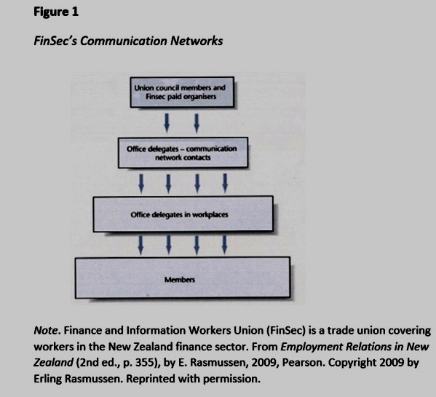
Citing Figures
When using a figure from a source, include the source in your figure note and reference list. If the figure is not in the public domain, seek permission and state that you are using it with permission.
The example at right uses APA 7th edition. Consult your field’s style guide, library research page, and mentor texts (from a target journal, for example) for more guidance.

Slide 21
Signal phrases and Reporting Verbs
Signal phrases introduce a piece of research (whether from a source or your own), whether you’re directly quoting, paraphrasing, or summarizing.
The reporting verbs you choose can help readers understand the authors’ attitude (positive, neutral, negative) about an issue and/or your attitude toward the material you are citing.

Slide 22
Signal phrases and Reporting Verbs (Examples Using APA 7th edition)
Neutral:
According to Kumar and Jones (2020), …
Kumar and Jones (2020) reported …
Positive:
A definitive study by Kumar and Jones (2020) found …
Negative:
A study by Kumar and Jones (2020) disputed the common belief that people are inherently selfish …
Based on a limited sample, the authors of one study (Kumar & Jones, 2020) claimed …
Check your field’s style guide to determine if reporting verbs should be past-tense (disputed) or present-tense (dispute)!

Slide 23
Diversify Your Verb Choices
The verbs you choose communicate the stance/attitude of the author(s) whose the material you are citing and/or your stance on cited work:
Neutral Verbs: describe, show, study, note, point out, indicate, report, observe, take into consideration, examine, state, mention
Qualified Verbs: suggest, speculate, intimate, hypothesize, imply, propose, recommend, posit, view, question the view that, postulate
Assertive Verbs: reveal, demonstrate, argue, claim, emphasize, contend, maintain, assert, deny, negate, refute, challenge, counter, strongly believe, hold

Slide 24
Positive or Negative Evaluative Adjectives
The adjectives you use also signal your stance toward the material you are citing:
Positive: useful, important, interesting, detailed, up-to-date, insightful, significant, salient, necessary, innovative, consistent, sustainable, impactful, definitive, landmark
Negative: inconsistent, restricted, misleading, poorly designed, limited, disputed, controversial

Slide 25
SECTION 5:
Managing Citations Plus Tools to Help

Slide 26
keeping track of sources
Think about your current method of keeping track of sources.
Do you use a single folder? Divide your sources by project?
How do you return to sources in future projects?
How do you take notes?
Handwritten notes? Typed notes?
Do you highlight or use sticky notes or marginal notations?

Slide 27
Information Management Systems
Information management systems can keep track of your sources.
They can create reference list citations and also help you include in-text citations.
They can help you keep track of notes and highlights.
Support is available at UVM for EndNote, Mendeley, Zotero.

Slide 28
Why Use Such a system
You have all your sources and notes in one place.
They can create the reference list citation for you.
They can create in-text citations with certain programs.
You can return to previously read sources in the future.
You can search all of your sources for a key term or author.
You are building a citation library for all future research.

Slide 29
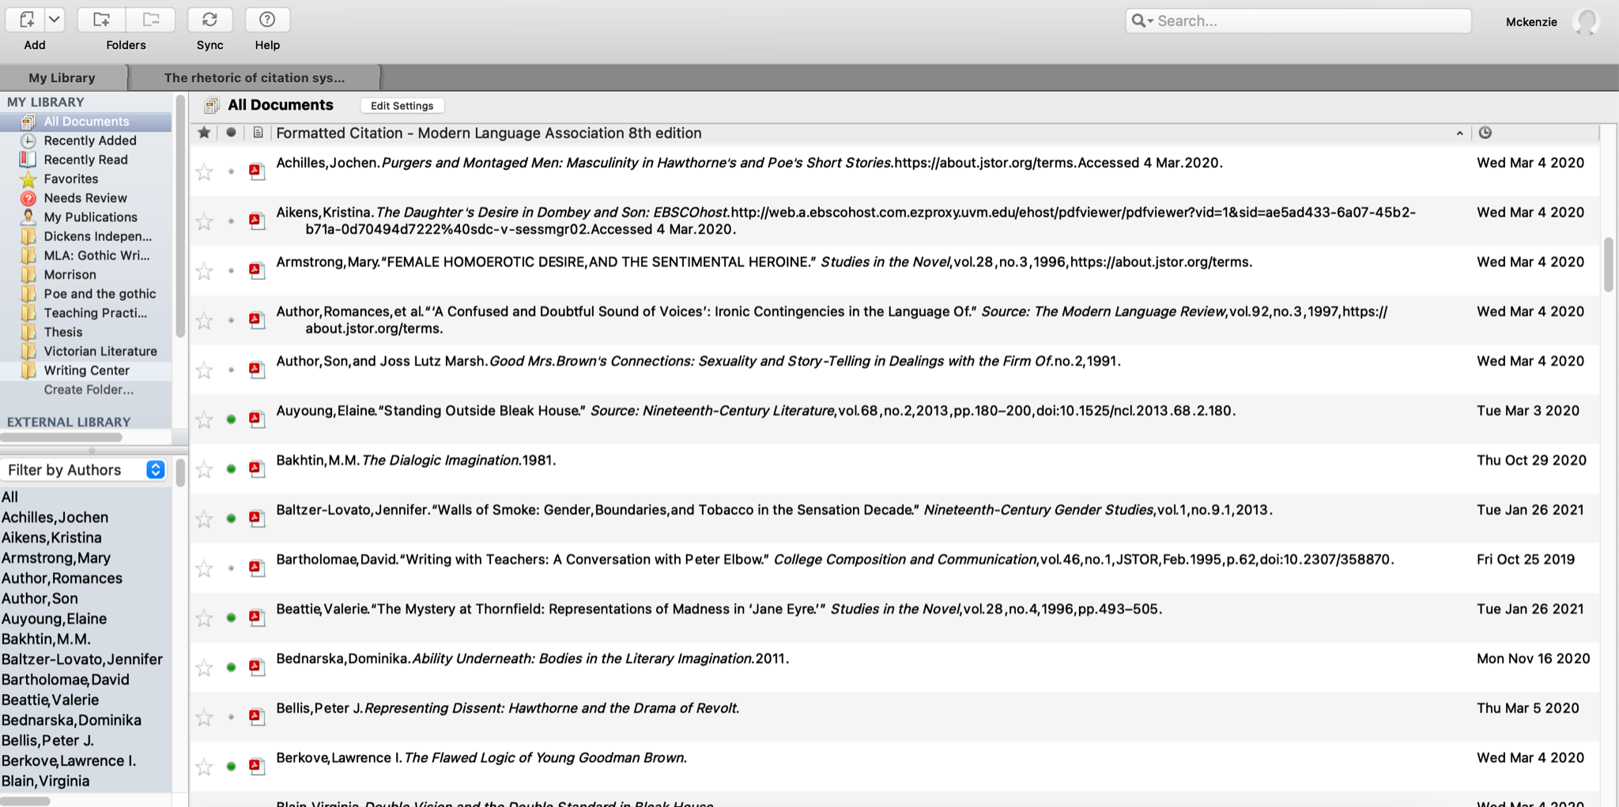
Example of a Mendeley Screen
These are folders where I can separate my sources by which class or project I’m working on
This is a list of all the authors in my library
These are my documents. If I right click, I can export the citation to put into my bibliography.

Slide 30
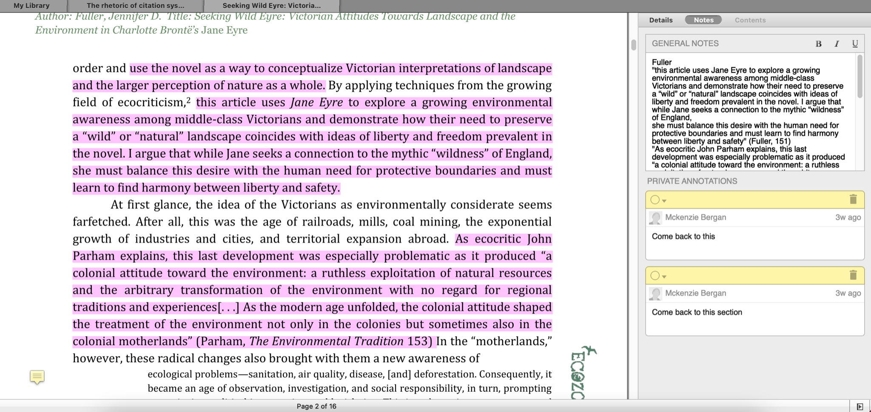
Example of a Mendeley Screen
Here is where I keep my notes on a document.
If I leave a sticky note, they are all collected here for me to come back to.
I can highlight by selecting text or by creating a rectangle, which is helpful if I get something sent to me as a picture instead of as a pdf.

Slide 31
Getting Started
Visit https://researchguides.uvm.edu/workshops to learn more about EndNote, Mendeley, and Zotero.
You’ll find there the research librarian to contact for one-on-one support in learning the system you’re interested in.
Check in with your advisor, professors, and program colleagues to learn which system is most commonly used in your discipline (a great help for co-authored papers!).

Slide 32
Don’t Want to Use These Tools . . .?
Devise a system for preserving your sources and your notes. You never know when you might need to find a source again or quickly remember what were the important ideas.
Have a Google Doc or Word Doc or Google Slides or PowerPoint where you keep track of what you’ve read (full citation) with quotations and notes.
Save all of your pdfs and notes and put them in one folder.
Have a notebook where you keep a list of sources (full citation) and any notes.
Consider using a double-entry legal notebook: full citations and quotations/summaries (with page numbers if appropriate) in one column and your notes and observations in the other.

Slide 33
Visit the Graduate Writing Center
No single consultant knows everything about citation in every discipline but can help you
Find answers to your citation questions.
Think about the bigger picture (purpose, audience, a text’s voice and flow) to make sure your citation practices support your goals.
Identify mentor texts to guide you in how, when, where, and why to cite in your field.
Visit uvm.mywconline.net for appointment options!

