Slide 1
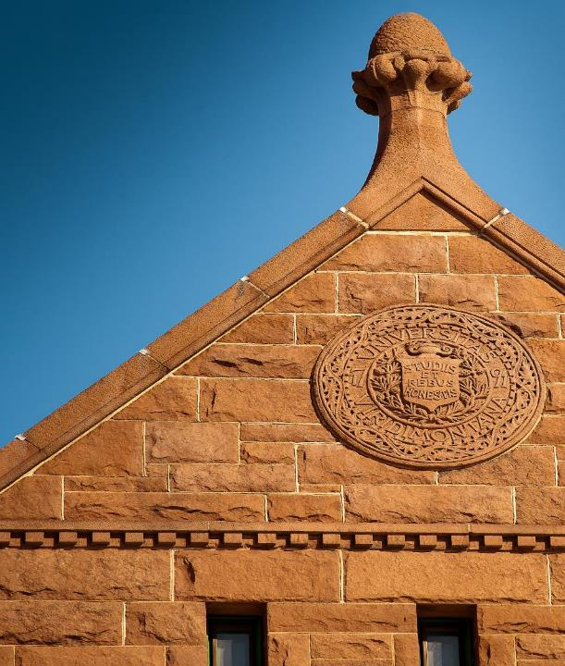
DEPARTMENT OF English
WELCOME

Slide 2
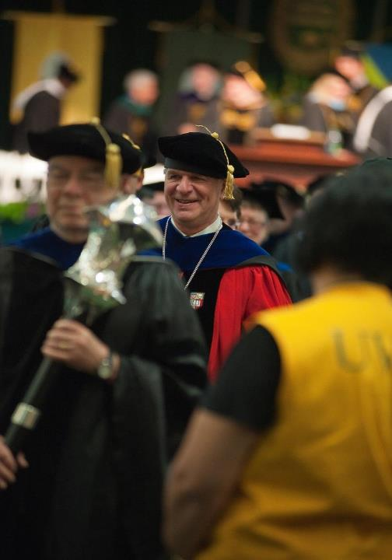
DEPARTMENT OF English

Slide 3
MAJORS
ENGLISH (Concentrations: American Literary Traditions, British and Anglophone Literary Traditions, Cultural Studies, Writing, Independently Designed)
FILM AND TELEVISION STUDIES
MINORS
ENGLISH
FILM & TELEVISION STUDIES
WRITING
REPORTING & DOCUMENTARY STORY TELLING

Slide 4
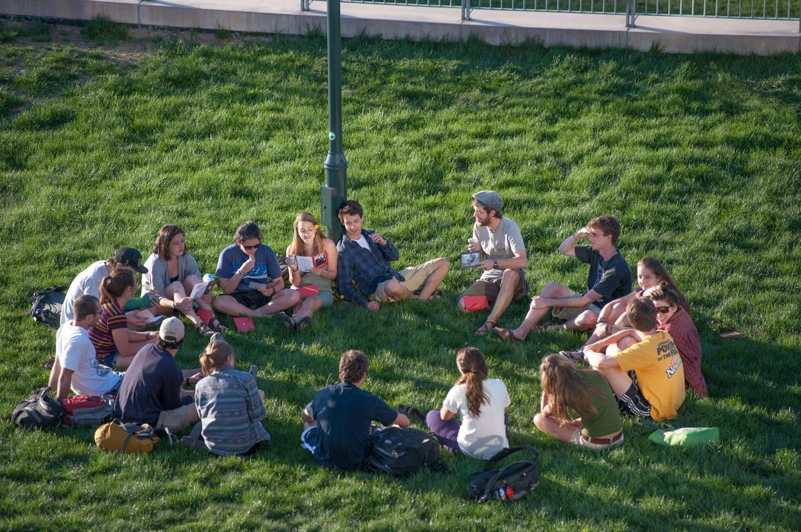
MAJORS
ENGLISH (Concentrations: American Literary Traditions, British and Anglophone Literary Traditions, Cultural Studies, Writing, Independently Designed)
FILM AND TELEVISION STUDIES
MINORS
ENGLISH
FILM & TELEVISION STUDIES
WRITING
REPORTING & DOCUMENTARY STORY TELLING
FILM AND TELEVISION STUDIES

Slide 5
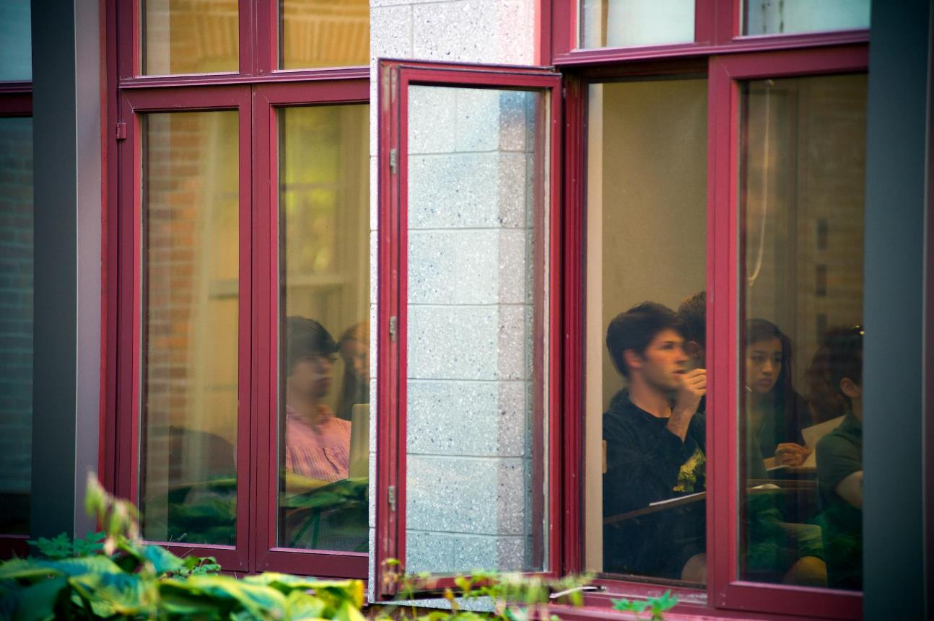

Slide 6
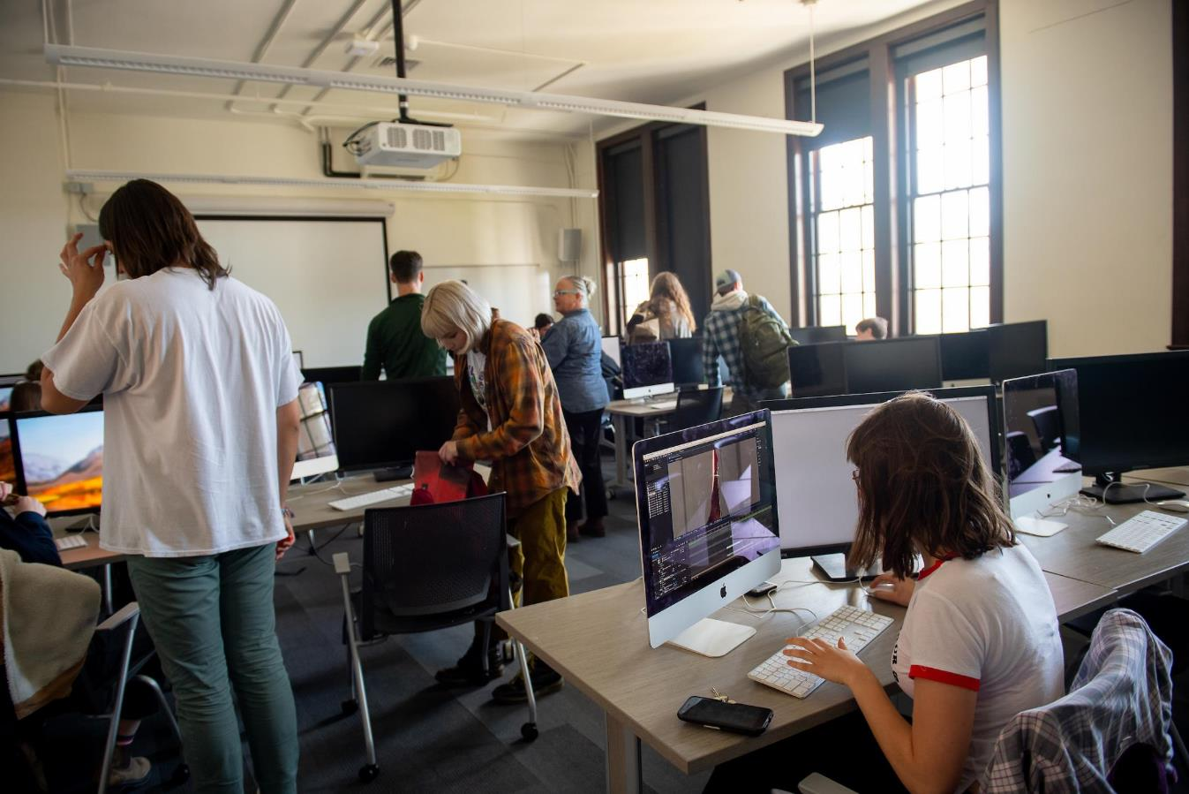
MAJORS
ENGLISH (Concentrations: American Literary Traditions, British and Anglophone Literary Traditions, Cultural Studies, Writing, Independently Designed)
FILM AND TELEVISION STUDIES
MINORS
ENGLISH
FILM & TELEVISION STUDIES
WRITING
REPORTING & DOCUMENTARY STORY TELLING
FILM AND TELEVISION STUDIES

Slide 7
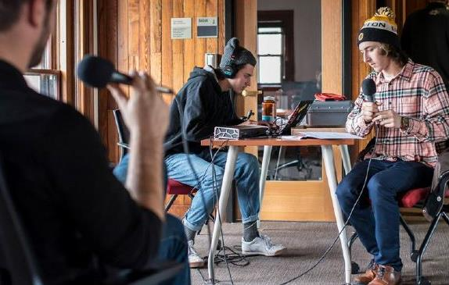

Slide 8
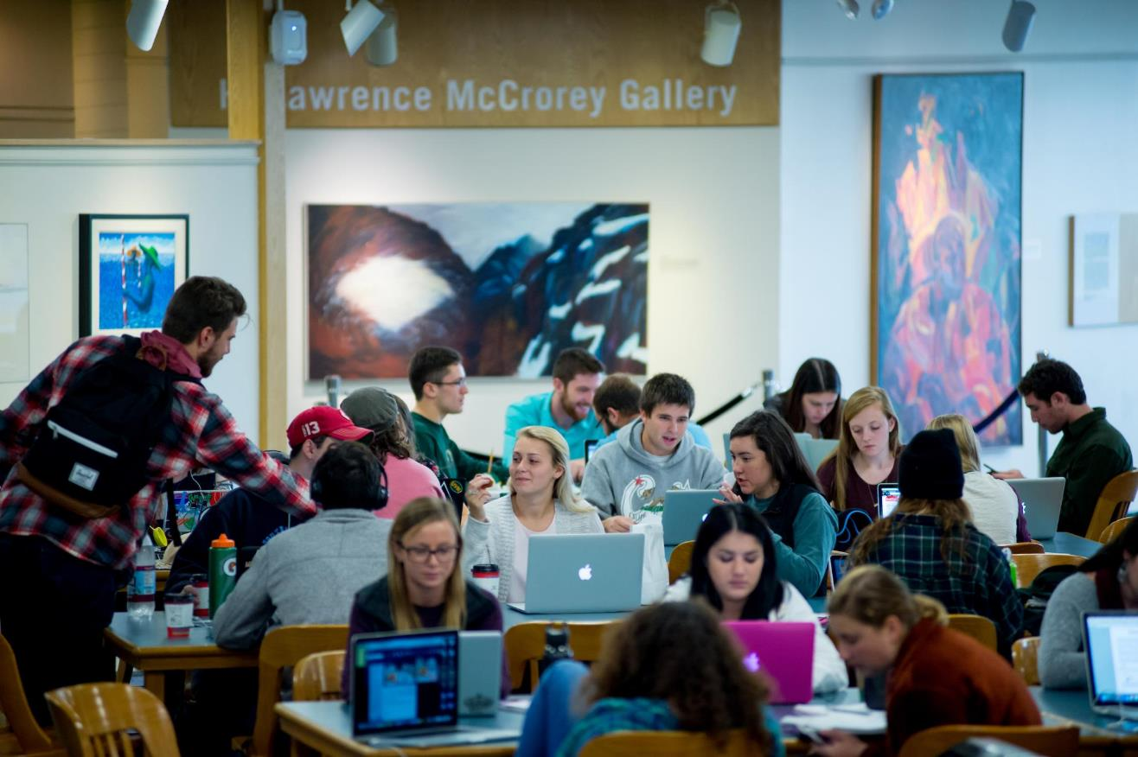
MAJORS
ENGLISH (Concentrations: American Literary Traditions, British and Anglophone Literary Traditions, Cultural Studies, Writing, Independently Designed)
FILM AND TELEVISION STUDIES
MINORS
ENGLISH
FILM & TELEVISION STUDIES
WRITING
REPORTING & DOCUMENTARY STORY TELLING
FILM AND TELEVISION STUDIES

Slide 9
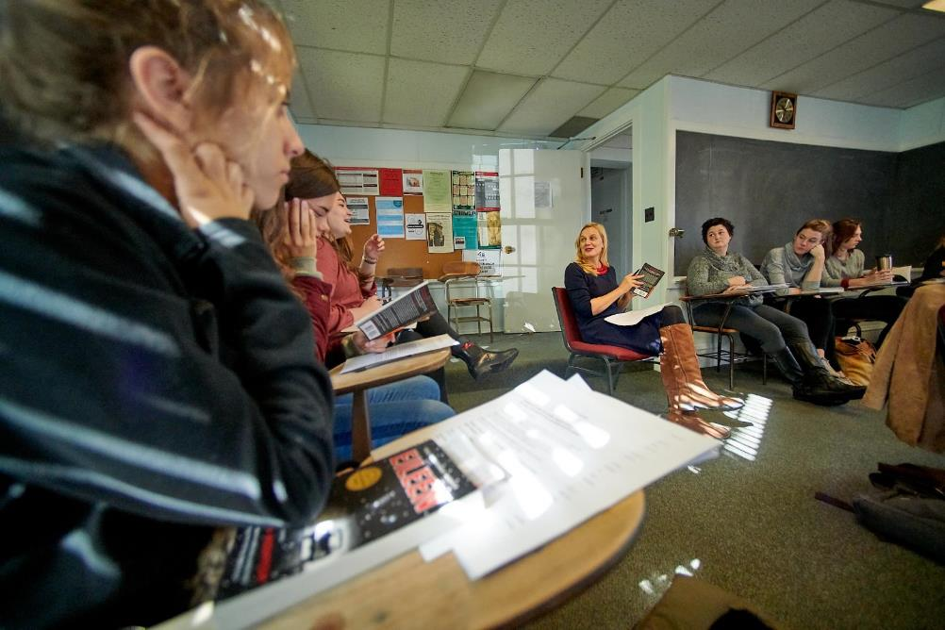

Slide 10
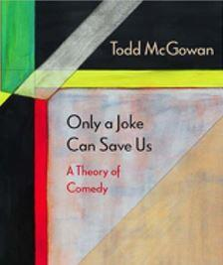
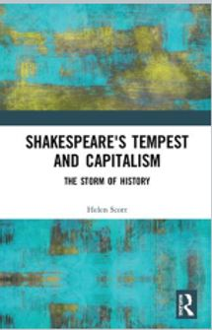
Recent Faculty Publications

Slide 11
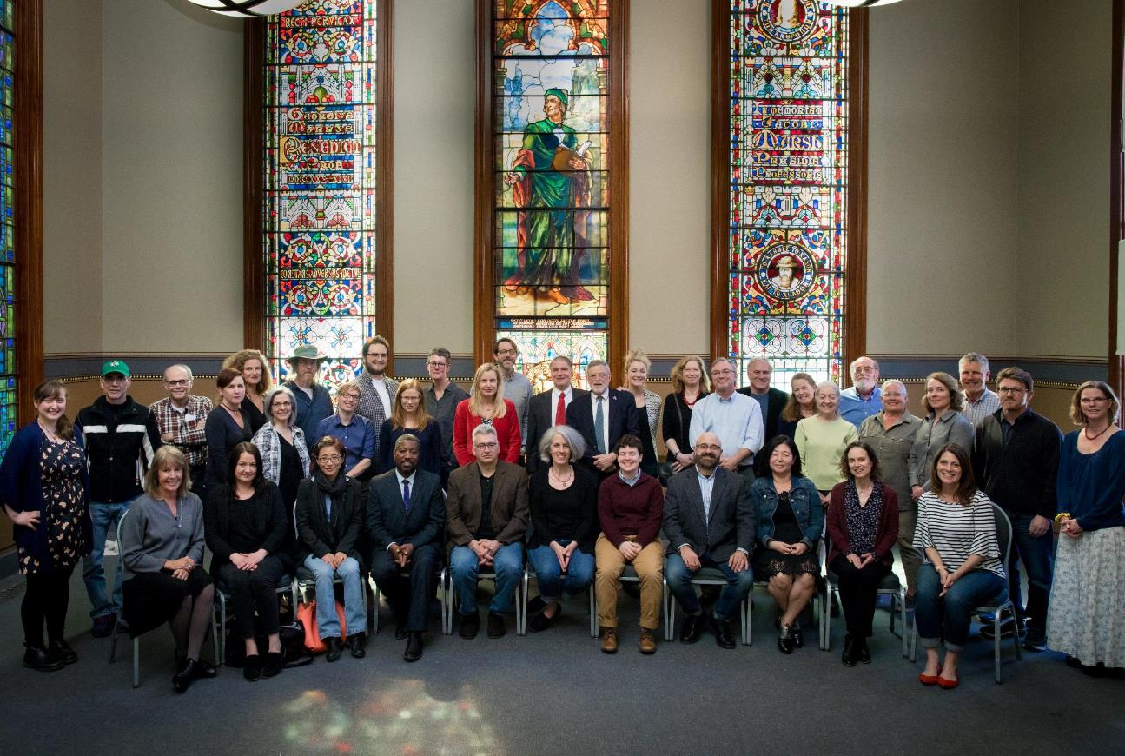
MAJORS
ENGLISH (Concentrations: American Literary Traditions, British and Anglophone Literary Traditions, Cultural Studies, Writing, Independently Designed)
FILM AND TELEVISION STUDIES
MINORS
ENGLISH
FILM & TELEVISION STUDIES
WRITING
REPORTING & DOCUMENTARY STORY TELLING
FILM AND TELEVISION STUDIES

Slide 12
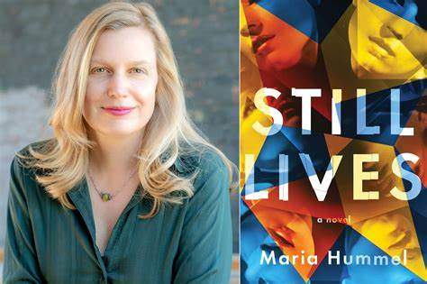

Slide 13
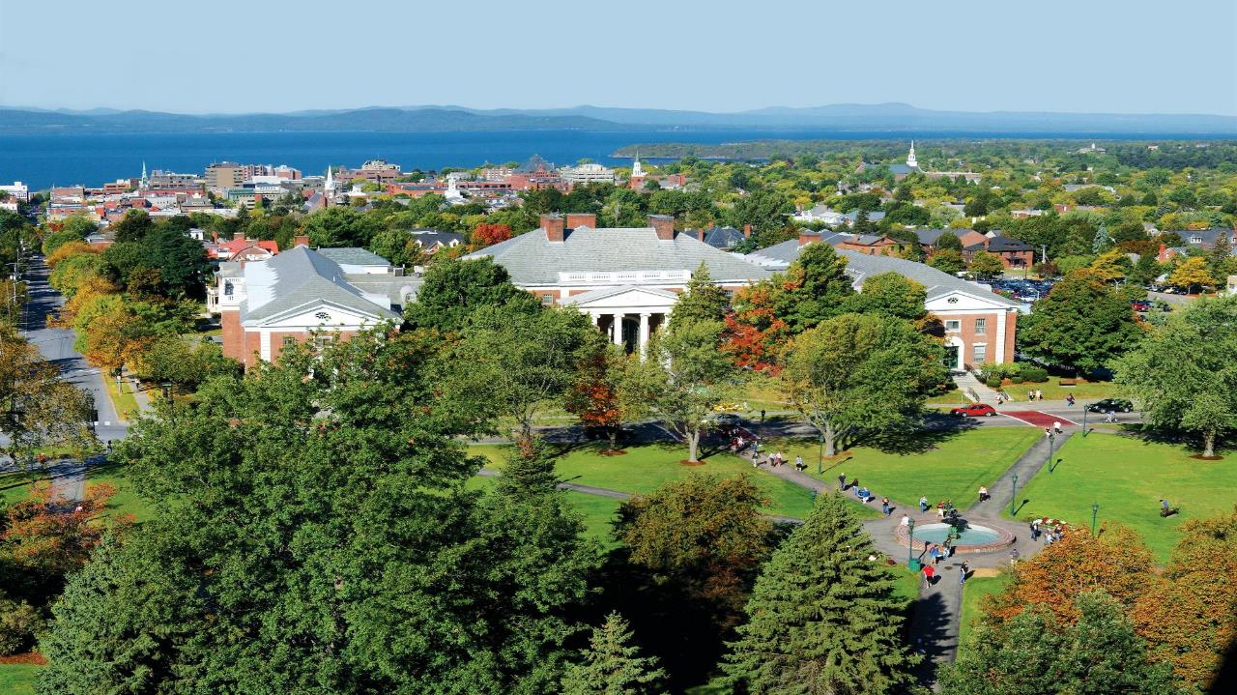

Slide 14
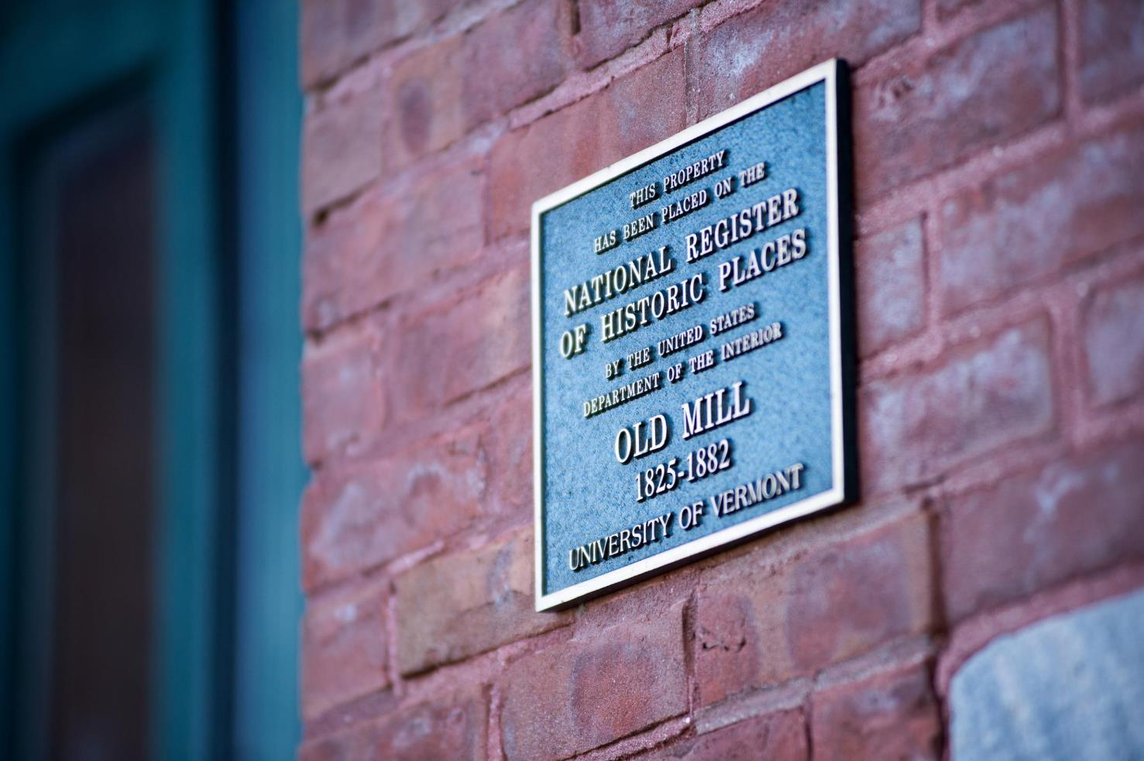
MAJORS
ENGLISH (Concentrations: American Literary Traditions, British and Anglophone Literary Traditions, Cultural Studies, Writing, Independently Designed)
FILM AND TELEVISION STUDIES
MINORS
ENGLISH
FILM & TELEVISION STUDIES
WRITING
REPORTING & DOCUMENTARY STORY TELLING
FILM AND TELEVISION STUDIES

Slide 15
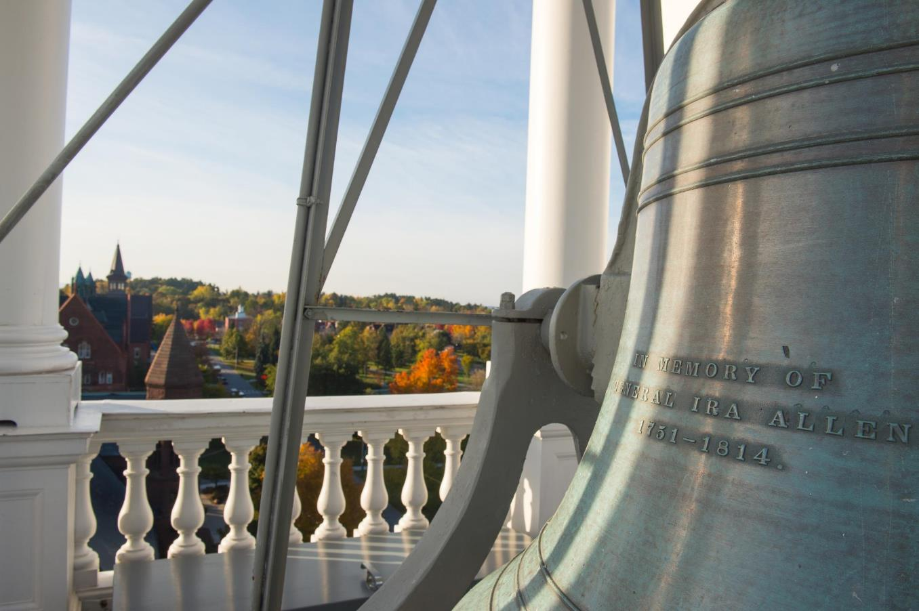
MAJORS
ENGLISH (Concentrations: American Literary Traditions, British and Anglophone Literary Traditions, Cultural Studies, Writing, Independently Designed)
FILM AND TELEVISION STUDIES
MINORS
ENGLISH
FILM & TELEVISION STUDIES
WRITING
REPORTING & DOCUMENTARY STORY TELLING
FILM AND TELEVISION STUDIES

Slide 16
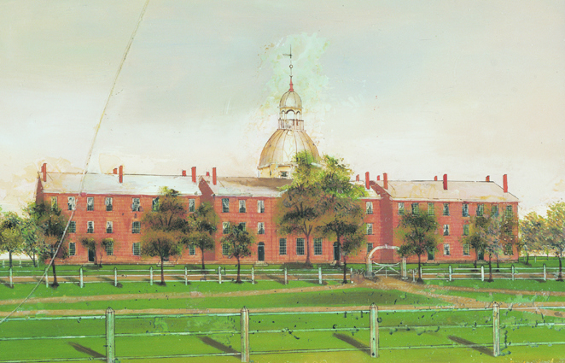
The Original Old Mill Building at The University of Vermont

Slide 17
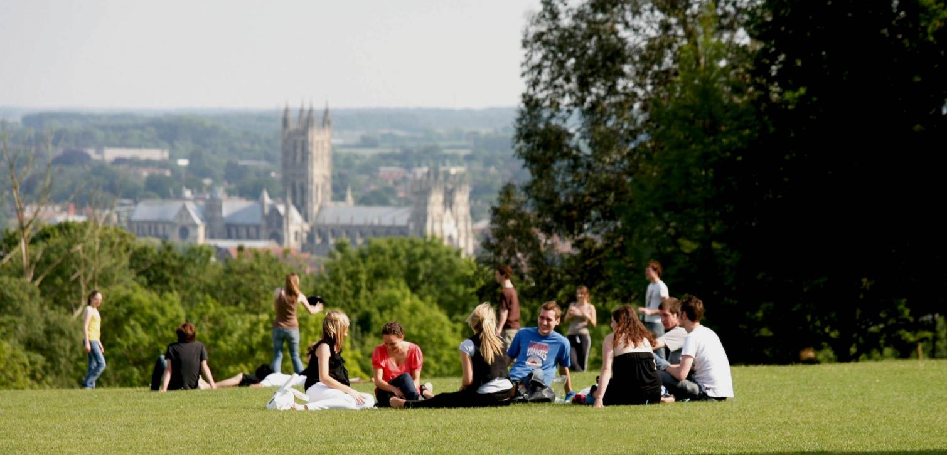
Buckham Overseas Program Canterbury, England

Slide 18
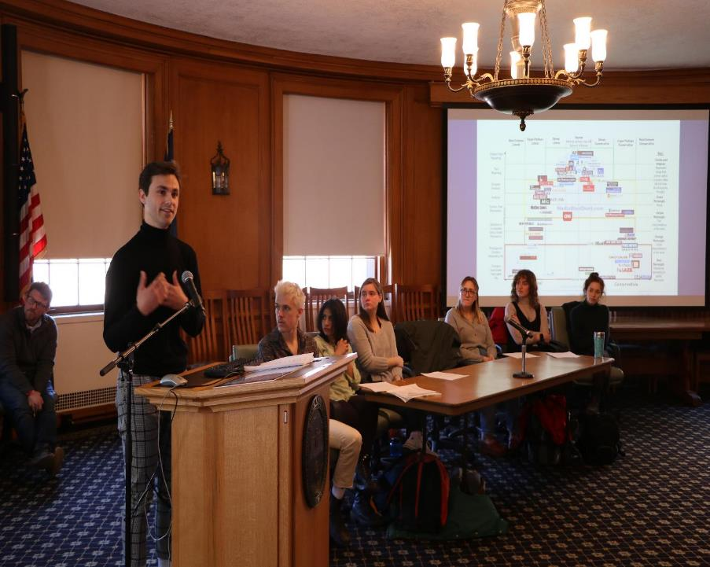
MAJORS
ENGLISH (Concentrations: American Literary Traditions, British and Anglophone Literary Traditions, Cultural Studies, Writing, Independently Designed)
FILM AND TELEVISION STUDIES
MINORS
ENGLISH
FILM & TELEVISION STUDIES
WRITING
REPORTING & DOCUMENTARY STORY TELLING
FILM AND TELEVISION STUDIES

Slide 19
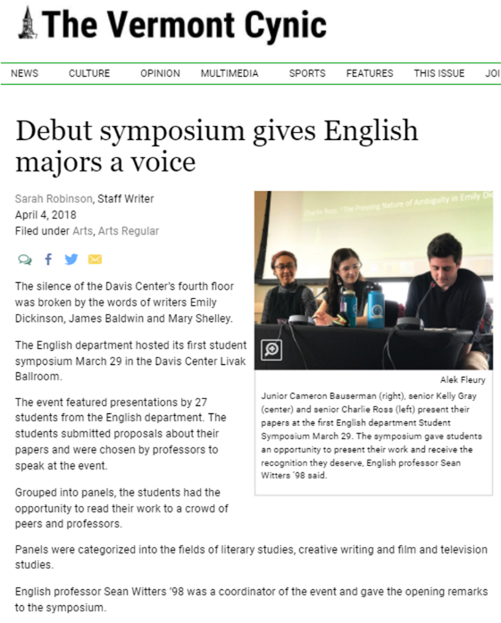

Slide 20
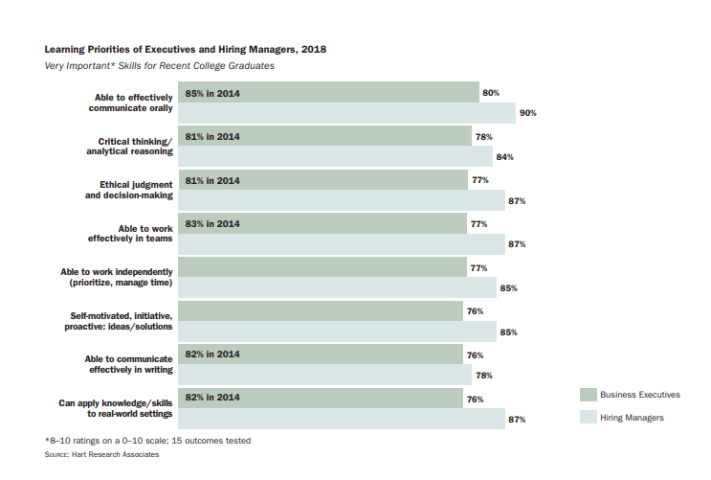

Slide 21
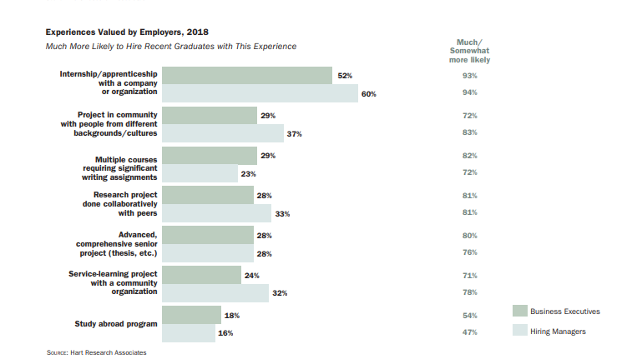

Slide 25
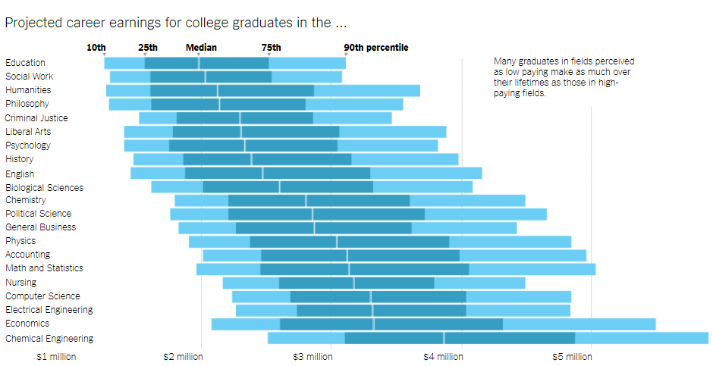
“The typical [business major] earns $2.86 million over a lifetime. When you put business graduates side by side with . . . what are considered low-paying majors, . . . those who are slightly above the median salary in their fields are not that far behind the business grads. For example, an English major in the 60th percentile makes $2.76 million in a lifetime, a major in psychology $2.57 million and a history major $2.64 million.” New York Times, “Six Myths
About Choosing a College Major” (11/03/2017)

Slide 26
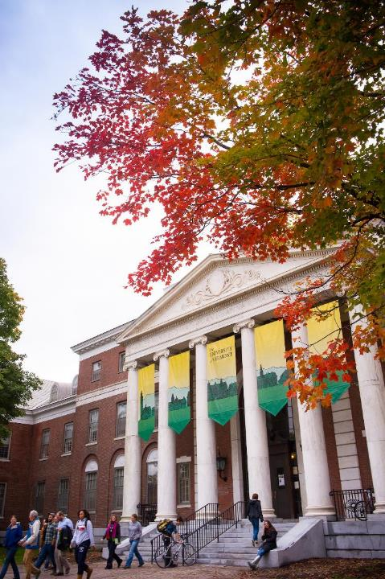
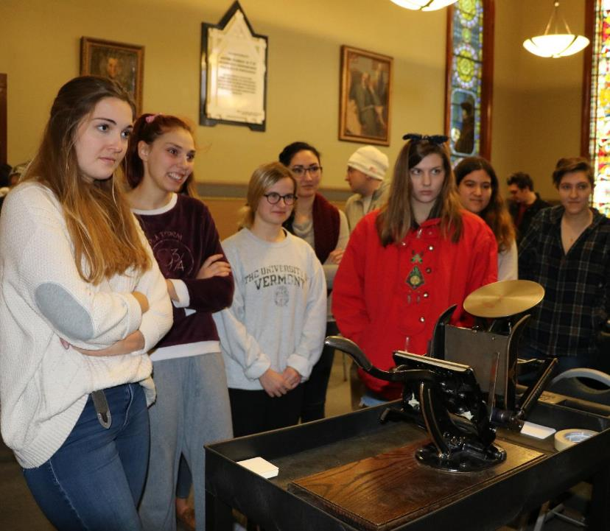

Slide 27
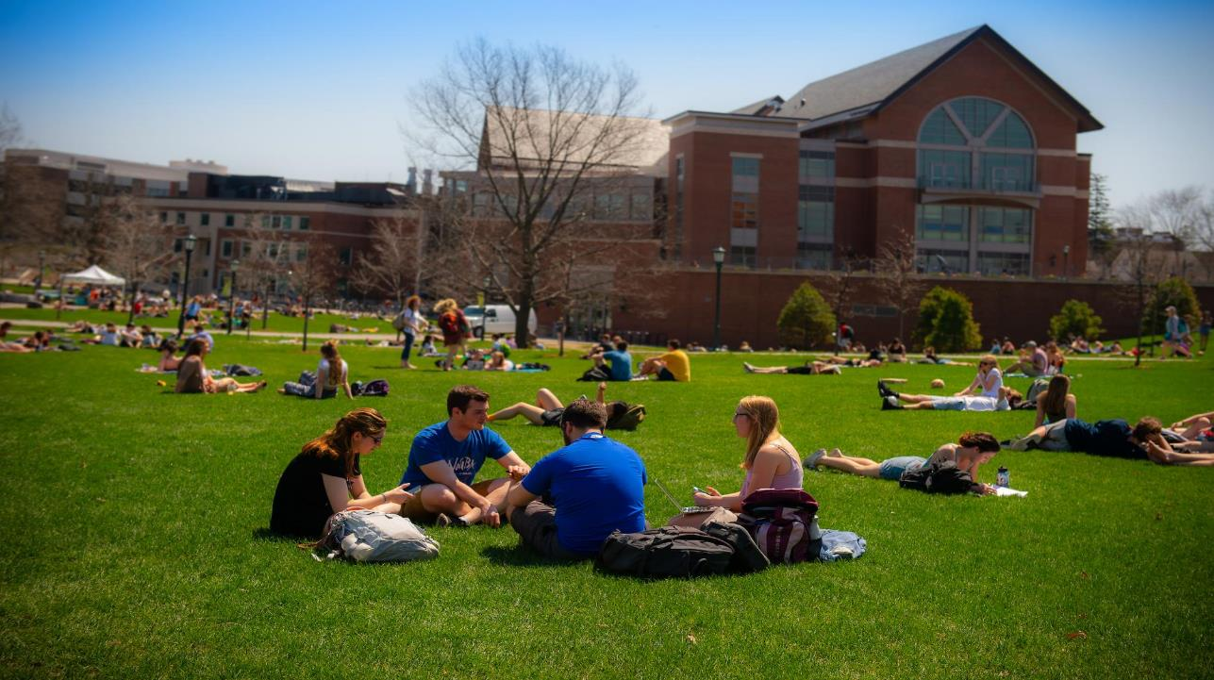

Slide 28
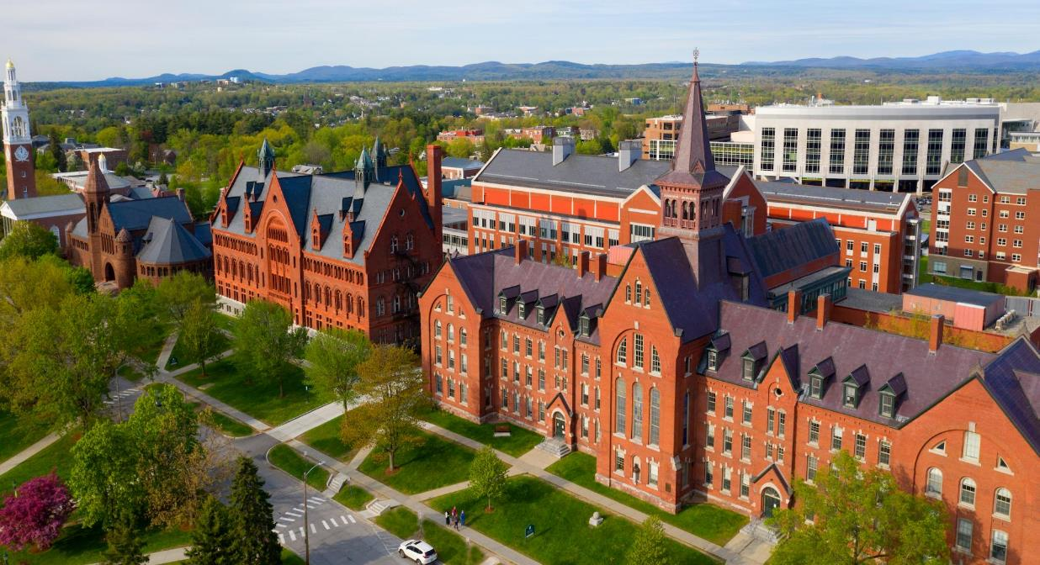

Slide 29
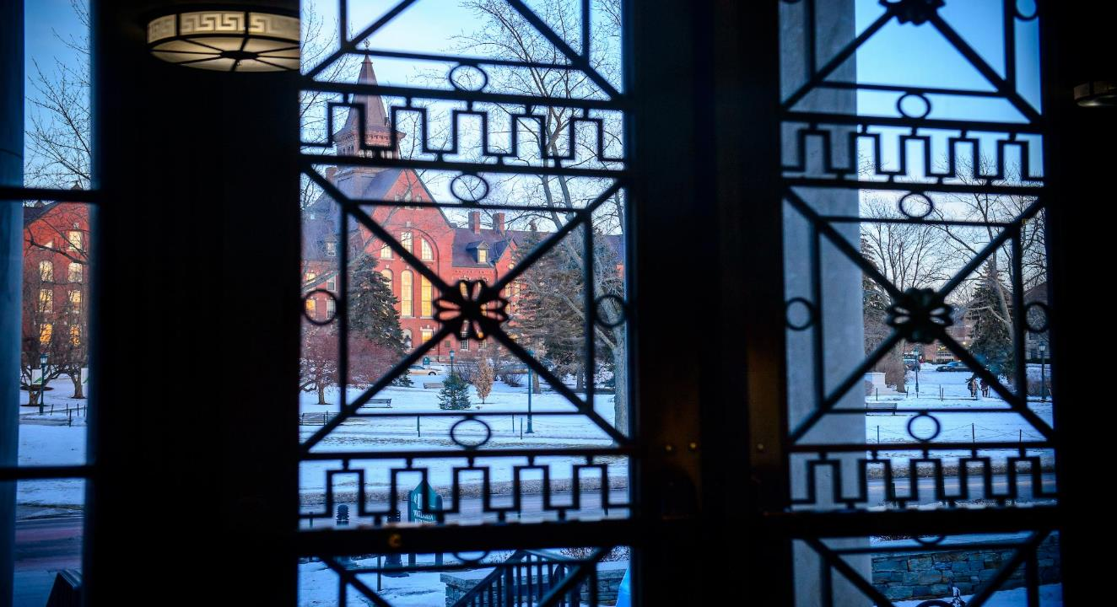

Slide 30
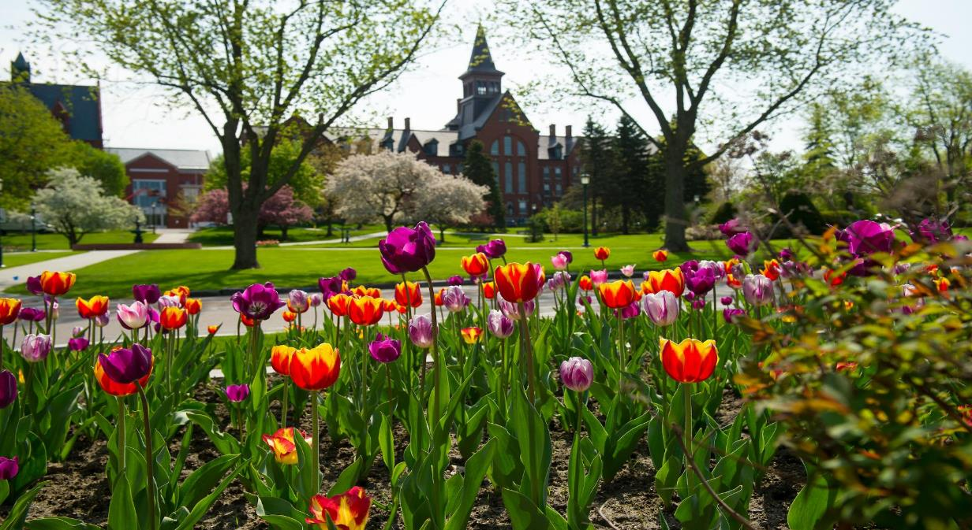

Slide 31
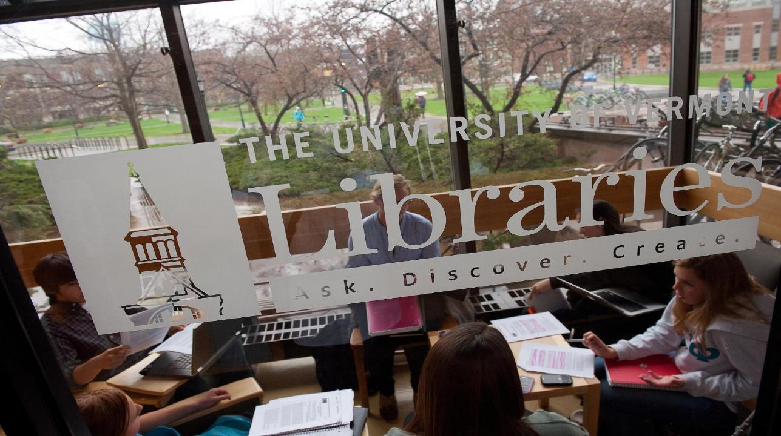

Slide 32
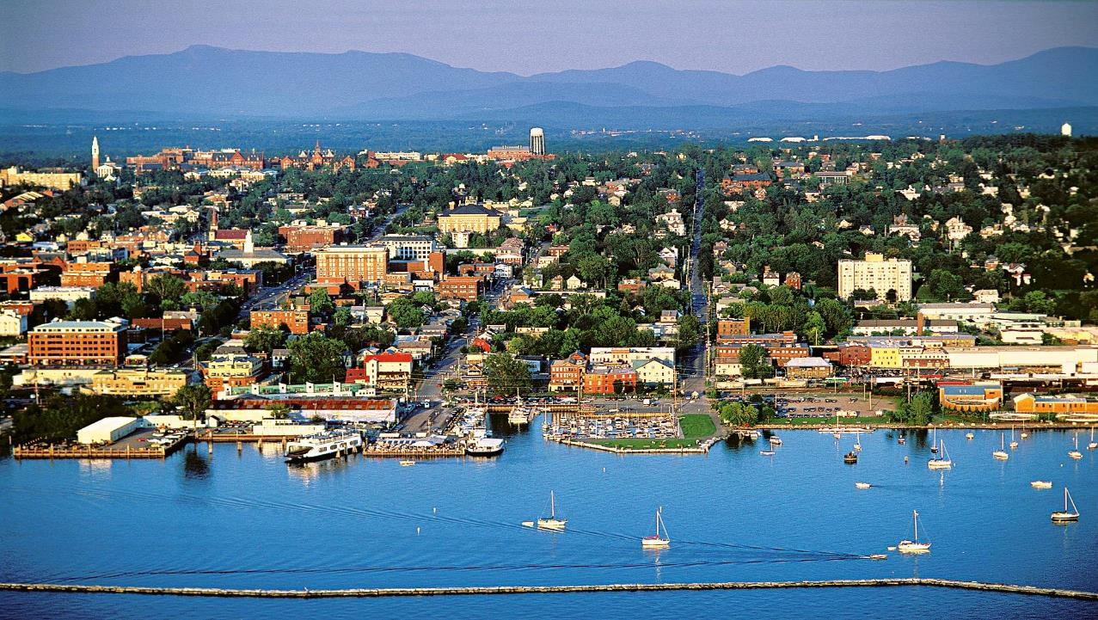

Slide 33
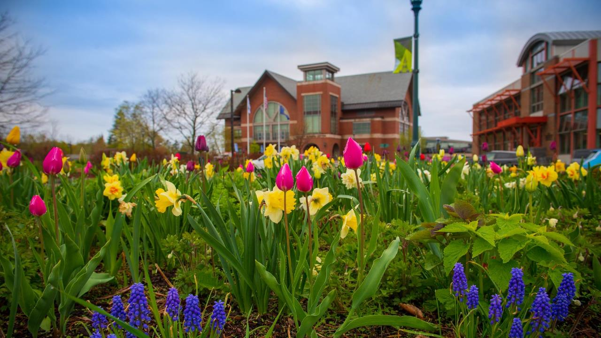

Slide 34
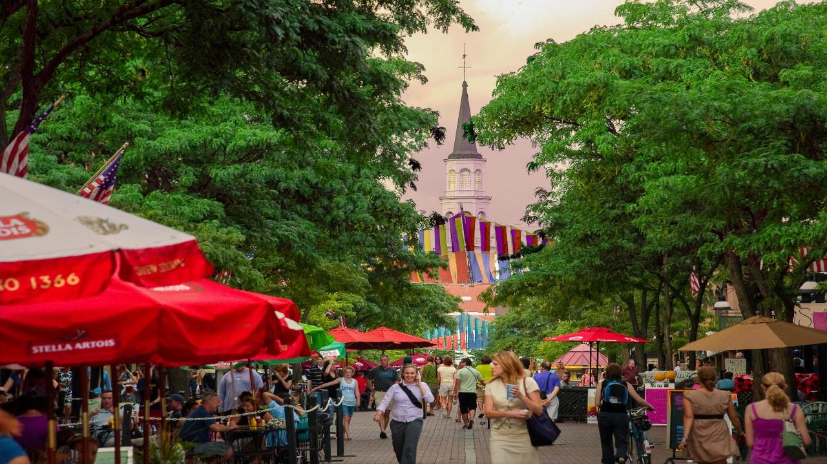

Slide 35
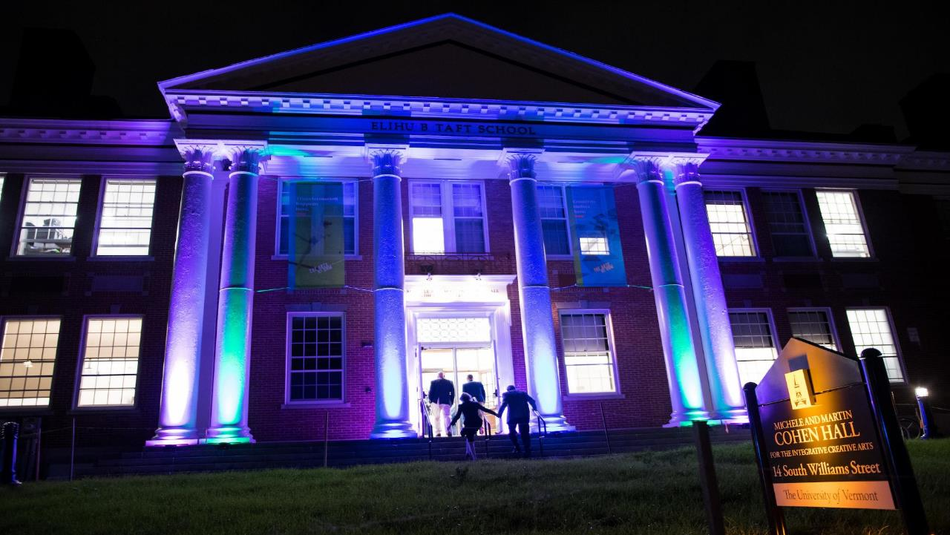

Slide 36
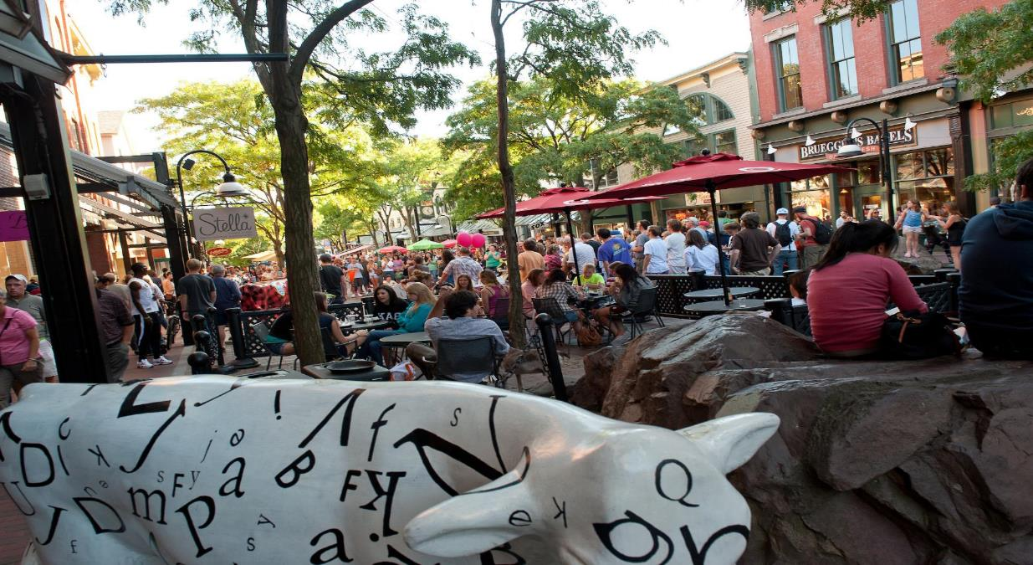

Slide 37
PLACE A NUMBER OR STAT HERE
Please be in touch.
Dan Fogel
Department Chair
daniel.fogel@uvm.edu
Helen Scott
Director of Undergraduate Studies
helen.scott@uvm.edu

Slide 38
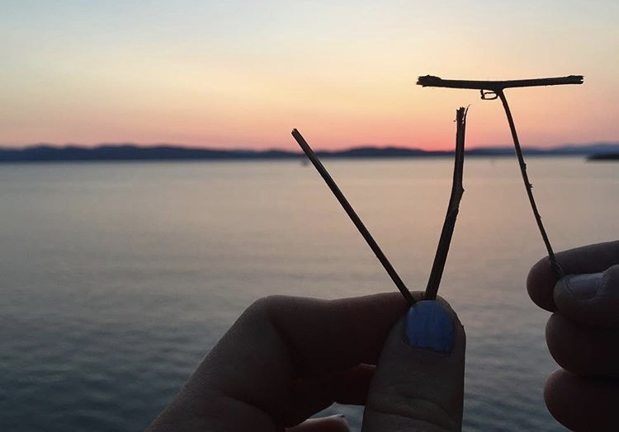
The University of Vermont

