Slide 1
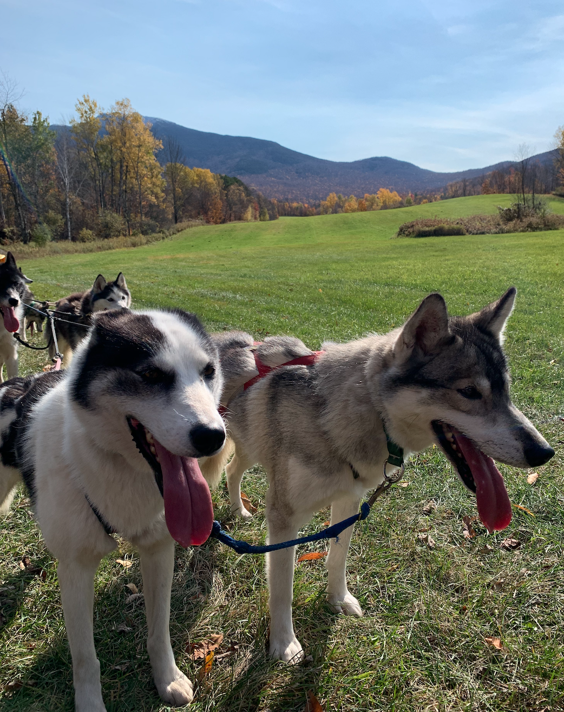
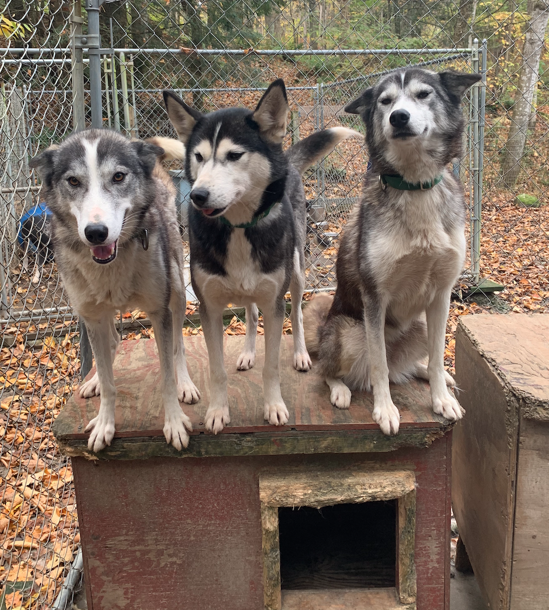
Thesewoods Kennels
Thesewoods Kennels is a privately owned Siberian husky sled dog racing kennel owned by Ingrid Bower in Underhill, VT. It is currently called home to 20+ Siberian huskies ranging from the ages of 5 months to 15 years. These talented dogs travel all over the East Coast and Canada, competing in races ranging from 30-100 miles.
Responsibilities:
While we were at the kennels, we were responsible for caring for the dogs’ health and daily needs as well as running them. We were responsible for their basic chores like pooper scooping, feeding, refilling waters after runs, and allowing the young puppies play time. On top of the basic needs, we also were responsible for running the dogs through harnessing and collaring them, attaching them to the line, fixing tangles on runs, doing road crossing, and even driving them at the end!
Experience:
Overall I had an excellent time. In fact, going to the kennels was my favorite part of the week! While I enjoyed running the dogs and caring for them, my favorite part often whole experience had to be seeing the dogs grow confident running. While most of the dogs readjusted to running quickly, not all were as easy. In fact, my favorite dog started off anxious, shaking and needing to be coddled before running and by the end, we had to hold him back as he became so confident and excited that he would have run off with the team on his own!
Contact: Ingrid.bower@uvm.edu

Slide 2
Photo 1: Team Running on Road for Practice
This is a photo of one of the two teams out on a practice run. Since it was so hot out that day, the dogs only ran a 4-mile sprint run as they overheated quickly. Therefore, we stopped to give them a quick break to cool themselves down. We usually do not do this on sprint runs; however, the heat made it hard for them to maintain the desired pace and we always prioritized their health first. The two dogs closest to us are Salty (left) and Jester (right).

Slide 3
Photo 2: Jafar Getting Ready to Run
This is a photo of me attempting to get my favorite husky, Jafar, ready to run. They were just given bated water, which is water blended with dog food, cat food, meat, fat, and whatever high calorie meat in the house. The water gave them extra energy and calories to do the 15-mile run ahead of them with minimal stops. This photo was taken right after I successfully got a collar on him and since he is an anxious dog, he got a hug as a praise right after.

Slide 4
Photo 3: Allie, Mirage, and Amour Waiting
This is a photo of two of the many racing dogs waiting to be placed on the line. They are wearing their appropriately sized harness and are begging to be let out to go. Since dogs have likes and dislikes, these two girls, Allie (right) and Mirage (left), hate this other dog named Tinkerbell. Therefore, they are let out after Tinkerbell was hooked up and individually carried over to their spot to avoid fights. Knowing that information was crucial for if they were let out and allowed to run around with the other dogs, they could have been injured. The dog in the back, Amour, is too young to be raced so she was unharnessed and forced to wait while the older girls were run.

Slide 5
Photo 4: Salty Excited After a Cage Clean
This is a photo of Salty enjoying his clean kennel. One of the responsibilities at the kennels were to clean the cages before and after running. This was taken after a run; therefore, he was more than happy to enjoy a nice, clean kennel to relax in after running multiple miles. Maintaining a clean environment was not only good for the dog’s physical health, but mental as well for they enjoyed being clean , which is a husky trait. In the winter, the dogs get straw in their dog houses and sometimes they like to wear it as seen by Salty.

Slide 6
Photo 5: Rye Being Carried to her Spot on the Line
Finally, this is a photo of me holding Rye. At 10 years old, this fearless, tiny, husky is still running all the big races and is an important part of the team. She will probably run for 3 more years, retiring at 13 like Ingrid’s other older dogs. Huskies live until they’re around 16 years old, so after she is done racing, she will get a nice 3 years of relaxing She is being carried to her spot on the team as she is known for starting small fights between the other dogs and is easier to control in my arms. While she may look unhappy, she loves to be carried and will howl at you until you do so.

