Slide 1
Proactive Crisis Planning for Students with Complex Needs
Presented by:
Judy Houde Hardy
Ken Kramberg
Tracy Harris
June, 2020
www.pbisvermont.org

Slide 2
Agenda
Components of an Effective Crisis Response
One School’s Experience (DBS)
Procedural and Regulatory Considerations

Slide 3
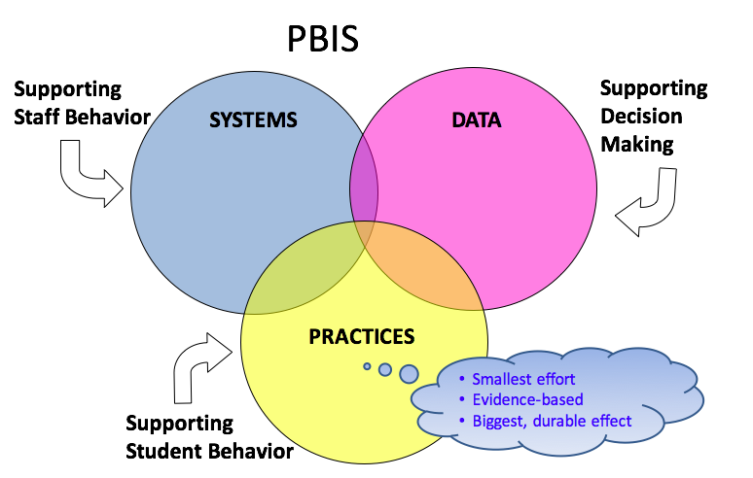
Three Things to Consider

Slide 4
Effective Crisis Intervention and Response
Establishing an effective team
and protocols.
Applying sound de-escalation practices and relationship building.

Slide 5
1 Teaming
5 Evaluation (BSP)
2 Goals
Vermont’s Planning Process for Students
Adapted from: Dunlap et al. (2010). Prevent, Teach, Reinforce
4 Intervention (BSP)
3 Assessment (FBA)
Inserst this as transition slide for each section
Notes:
We’ve focused today on systems.
We’re going to move for the rest of the week to focusing on intensive supports for students
Hand out books

Slide 6
Building a Good Response Team
Who
What
When
Where
Practice and Processing

Slide 7
Safety First
Safe persons
Safe Place
Safe Process

Slide 8
A Critical Skill for Members of a Crisis Team is the Ability to Manage Their Own Feelings
Self awareness is important
Most of us have brief periods of stress which make it challenging to take a lead role with student in crisis
How can we program for this?
f

Slide 9
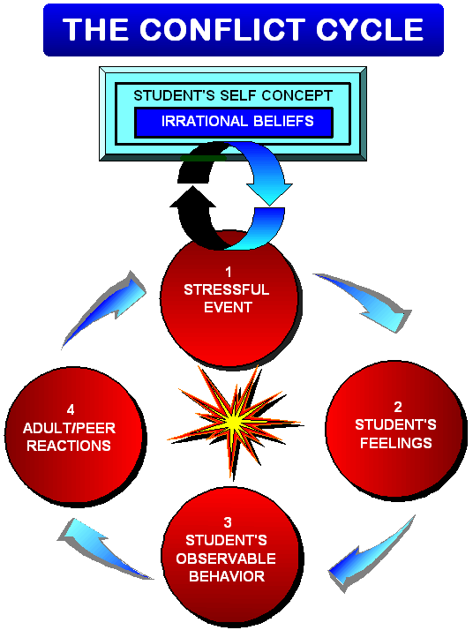
Notes:
The Conflict Cycle
Participant Manual page 24
This is simply a full page visual for participants to refer back to. Nothing new here.

Slide 10
Some things to consider
Kids who act out violently are usually most fearful of themselves. Most acts of Violence in Schools stem from fear.
Fear of the intensity of their emotions
Fear of the consequences for their actions
Fear Of Being Out of Control

Slide 11
Key Points
Before You can Fix It:
You Must the Deal With The Feelings First Before You Can Deal With The Behavior
“Kids Who Are Heard Listen” You must actively listen and get the child to share their perspective

Slide 12
Some thing to consider
Most kids in a crisis feel “cornered by their own actions” and feel they are “alone in the corner”

Slide 13
Consider Using the CPI Crisis Development Model
Anxiety -- Supports
Defensive -- Directives
Risk Behaviors -- Disengagement or Safe Physical Management
Tension Reduction -- Therapeutic Rapport
Notes:
Consider using this CPI framework for planning and designing Crisis Plan. Most VT schools use CPI training . Supportive and Directive strategies offer proactive preventative supports.

Slide 14
Unit 1: The CPI Crisis Development ModelSM
WORKBOOK PG 7
Crisis Development/Behavior Levels | Staff Attitudes/Approaches
1. Anxiety | 1. Supportive
2. Defensive | 2. Directive
3. Risk Behavior | 3. Disengagement or Physical Intervention
4. Tension Reduction | 4. Therapeutic Rapport

Slide 15
Using Data
SWIS Data
ODR / Behavior Incident reports
Written Accounts after Interventions
Staff Observations
Much of our best data comes from our processing after difficult behavioral events

Slide 16
The Power of Relationships
The Effectiveness Of An Intervention Often Hinges On The Quality Of The Relationship With The Helping Adult
Well Designed and Informed Behavior Support Plans Often Fail Because The Helping Adult Fails To Establish A Positive Helping Relationship With the Child
Sometimes A Poorly Designed Or Marginal Plan Is Successful Because Of The Quality Of The Relationship

Slide 17
When Engaged in an emotionally charged event…
Two Critical skills
Validating
Acknowledging Feelings
You must deal with the feelings first before you can focus on the behavior
Active Listening:
Children who are heard listen. Kids want to tell their story

Slide 18
School-wide Crisis Plan
Starts with prevention:
Consistent Tier 1 strategies are in place
Safety Plan posted and practiced
All staff trained in de-escalation and personal safety

Slide 19
Crisis Response
Crisis Team: Small group of 3-5 trained staff available to respond to crises
Does your school have a team?
Who needs training?
School-wide procedure established for calling crisis team in
Does your school have a procedure?

Slide 20
Crisis Response
Individualized Crisis Plan should be developed for students at risk
- Who is called
- Where they go
- What they do or say to child
- Do key support people need training?
Restraint is used as a last resort following Rule 4500 protocol – other options should be explored pro-actively & in the moment

Slide 21
Crisis Prevention/Intervention Plan
Situation (triggers/stressors)
Coping Strategies
What is needed to feel safe in crisis
Key support people to contact
What to do to manage a crisis
What not to do
Conditions for emergency room, police, hospital
^{Coordina}ted
^{Services} Plan
^{Proactive} Crisis
^{forma}t

Slide 22
Taking Care of Yourself
Recognize signs
Irritability
Difficulty planning & concentrating
Numb
Intensive feeling
Don’t go it alone
Teams
Administrators
Colleagues
Recognize as occupational hazard
“cost of caring”
NOT weakness
Seek help with own trauma
Education
Talk to professional
Attend to self care
Eat well
Exercise
Sleep
Laugh & Cry

Slide 23
Crisis Intervention Team
Dothan Brook School

Slide 24
What’s Important?
Top Four:
The Team
The Training
The Response
The Dilemas

Slide 25
Pillars of DBS CIT practices:
Relationships - building, strengthening, and maintaining relationships through crisis intervention responses
Response protocols - who does what when called
Student plans - specific responses for individual students
Tagging out - trusting team members
Debriefing - making time to review, improve, and care for each other
Monthly meetings - involve all team members; share notes

Slide 26
The Team:
Considerations:
Desire to do the work
Building-wide representation
Humor
Compassion
Calm
Trust
Flexibility
Voice
Vulnerability

Slide 27
Did we mention TRUST?
Trust that the child is doing the best they can.
Trust that everything happening is to keep the child, class community, and staff safe and maintain dignity for all.
Trust that we have your back.
Trust that everyone on the call is doing the best they can.

Slide 28
Team Activity

Slide 29
The Training:
Team Training
Crisis Prevention Intervention training
Life Space Crisis Intervention
Trauma informed practices
Restorative practices
Staff Training - when and why to call the Team
Gear and Stuff - radios, clipboards, and other info

Slide 30
The calls for Miss CIT: Nuts and Bolts
Staff places a call for Miss CIT to the office.
Office response:
Student specific, lower-scale calls channeled through team radios for response team
Urgent safety calls notified by PA for whole-team response
Available team members go to indicated place to support
Stuff: Walkie Talkie radios
Clipboard for data collection
Timers
Wipes and gloves

Slide 31
The Response:
What do you do when the call comes?
Team member tasks
Safety for all
Maintaining dignity

Slide 32
Task card:
Manage the doors/other classes
Paperwork clipboard
Time tracker
SSF - quick info from the teacher
What happened?
What’s needed for re-entry?
Notify Becky and Andrea
Notify counselor to debrief with class
Email resolution and/or invitation to debrief to team members

Slide 33
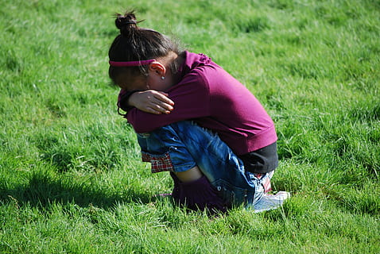
Student Plans:
Strengths
Triggers
Trusted adults
Effective interventions
Processing
Re-entry

Slide 34
What does it mean to ‘Tag Out’?
Back to that “Vulnerability” thing…
Rising emotions
Unreasonable consequences
Power struggles
Hurtful words and actions
Removing target

Slide 35
Debriefing:
Purpose of debriefing: Review, improve, and care for each other.
How is the student?
How are team members?
What went well?
What needs improvement?
Does the student response plan need updating?
What did we learn?
Is the classroom team fully informed?
Does the family have questions/concerns?
Where’s the chocolate?
Rule 4500 mandates debriefing

Slide 36
Monthly Meetings
Whole team attends one meeting each month.
Support Staff members are paid for after school meeting time.
Meeting minutes
Include the front office person who calls the team. They need the information for specific student calls.
Running record of student plans
Training notices and opportunities
Student updates and changes to individual protocols provided to team members between meetings through notes added to the minutes.
Chocolate - Did we mention the chocolates??
Building trust and care
Sharing concerns, hopes, and fears

Slide 37
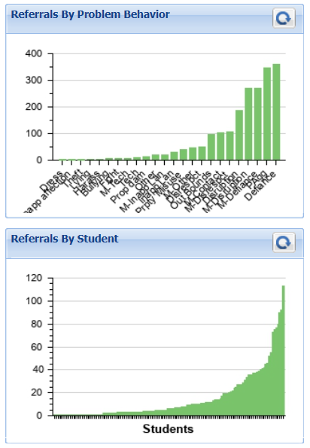
Data:
Student Support Forms
Behavior Support Plans
Individualized Education Plans
Mandatory Reporting Forms - Vermont Rule 4500
Targeted and Intensive Team data

Slide 38
The Dilemas:
When and how to leave the learning environment vs when does the class community leave to provide space and privacy to de-escalate.
Communication with student team - creating time to support re-entry and share processing information.
Debriefing meetings are NOT behavior planning meetings. Hard to resist the temptation.
Using escalating behavior to gain access to a preferred adult - finding the balance.
Connecting with local police departments - how, why, and when.

Slide 39
Considerations for Restraint and Seclusion Tracy Harris, Vermont Agency of Education

Slide 40
The “Givens”
Only Used When:
Imminent and substantial threat
Less restrictive interventions have failed
Safe, proportionate, and sensitive
Trained staff members using the procedures on which they’ve been trained
Visual monitoring at all times
School-wide safety plan

Slide 41
Also “Givens”
Physical restraint: only when no known medical, physical, psychiatric condition or trauma history that would contraindicate its use
Seclusion: prohibited unless physical restraint is contraindicated
Prone and Supine: prohibited except when less restrictive interventions have failed or would be ineffective to prevent harm

Slide 42
During a COVID-19 Pandemic
Considerations:
Physical Restraint: only when no known medical condition that may contraindicate its use ....
Seclusion: prohibited unless physical restraint is contraindicated ...
Prone and Supine: most restrictive due to risk of positional asphyxia

Slide 43
During a COVID-19 Pandemic
Considerations:
Facial Coverings
Personal Protective Equipment
Wash and moisturize hands
Change clothes
Clean & sterilize area
Dispose of gloves
Tend to the needs of child, family, and staff members!

Slide 44
Risk Assessment Matrices
2 | 3 | 3
1 | 2 | 3
1 | 1 | 2
Level of Risk
Likelihood of Happening

Slide 45
Risk Assessment Matrices
Level of Risk

Slide 46
Resources:

