Slide 1

Welcome!
Materials at: bit.ly/VTBEST2020
You will be muted during this session, except during breakouts.
Need help?
Type into the chat box
You can show or hide your video.
This session will be recorded.
If you’d like to access the recording, please email anne.dubie@uvm.edu.

Slide 2
2020 BEST/VTmtss Summer Institute
Staying Grounded:
Aligning Systems so All Students and Adults Thrive
(Wherever They Are!)
Who’s here?
366 Participants
47 Staff/ Presenters
67 Schools
28 SU/SDs

Slide 3

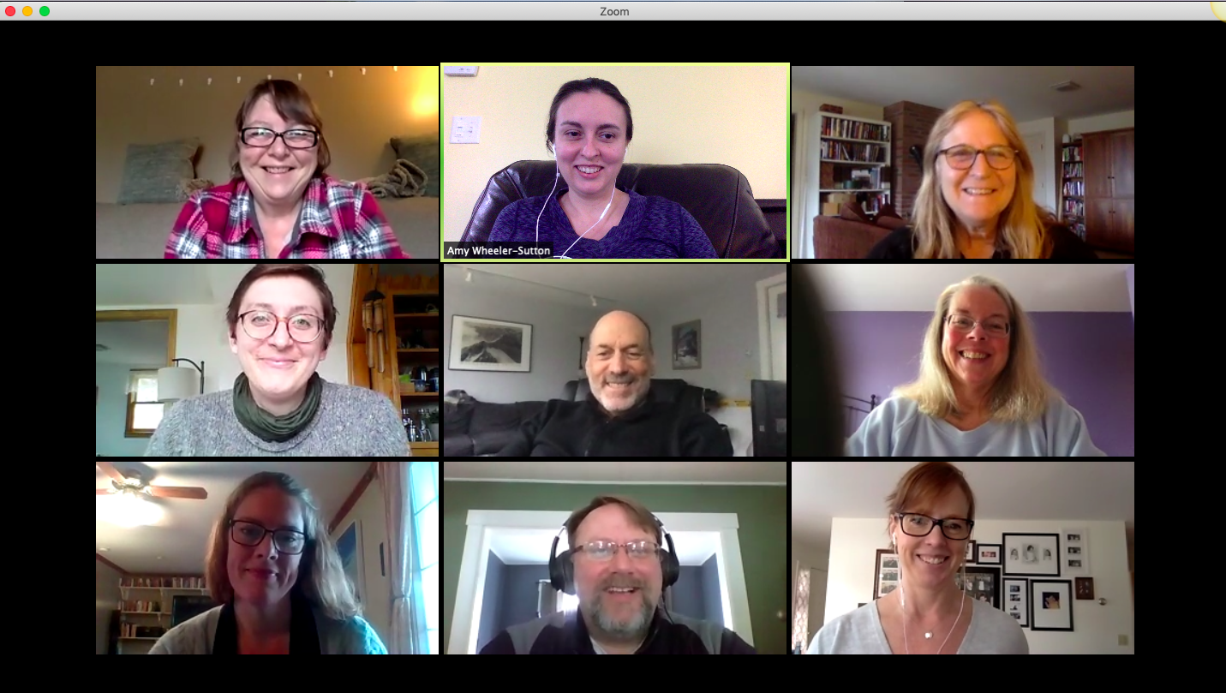
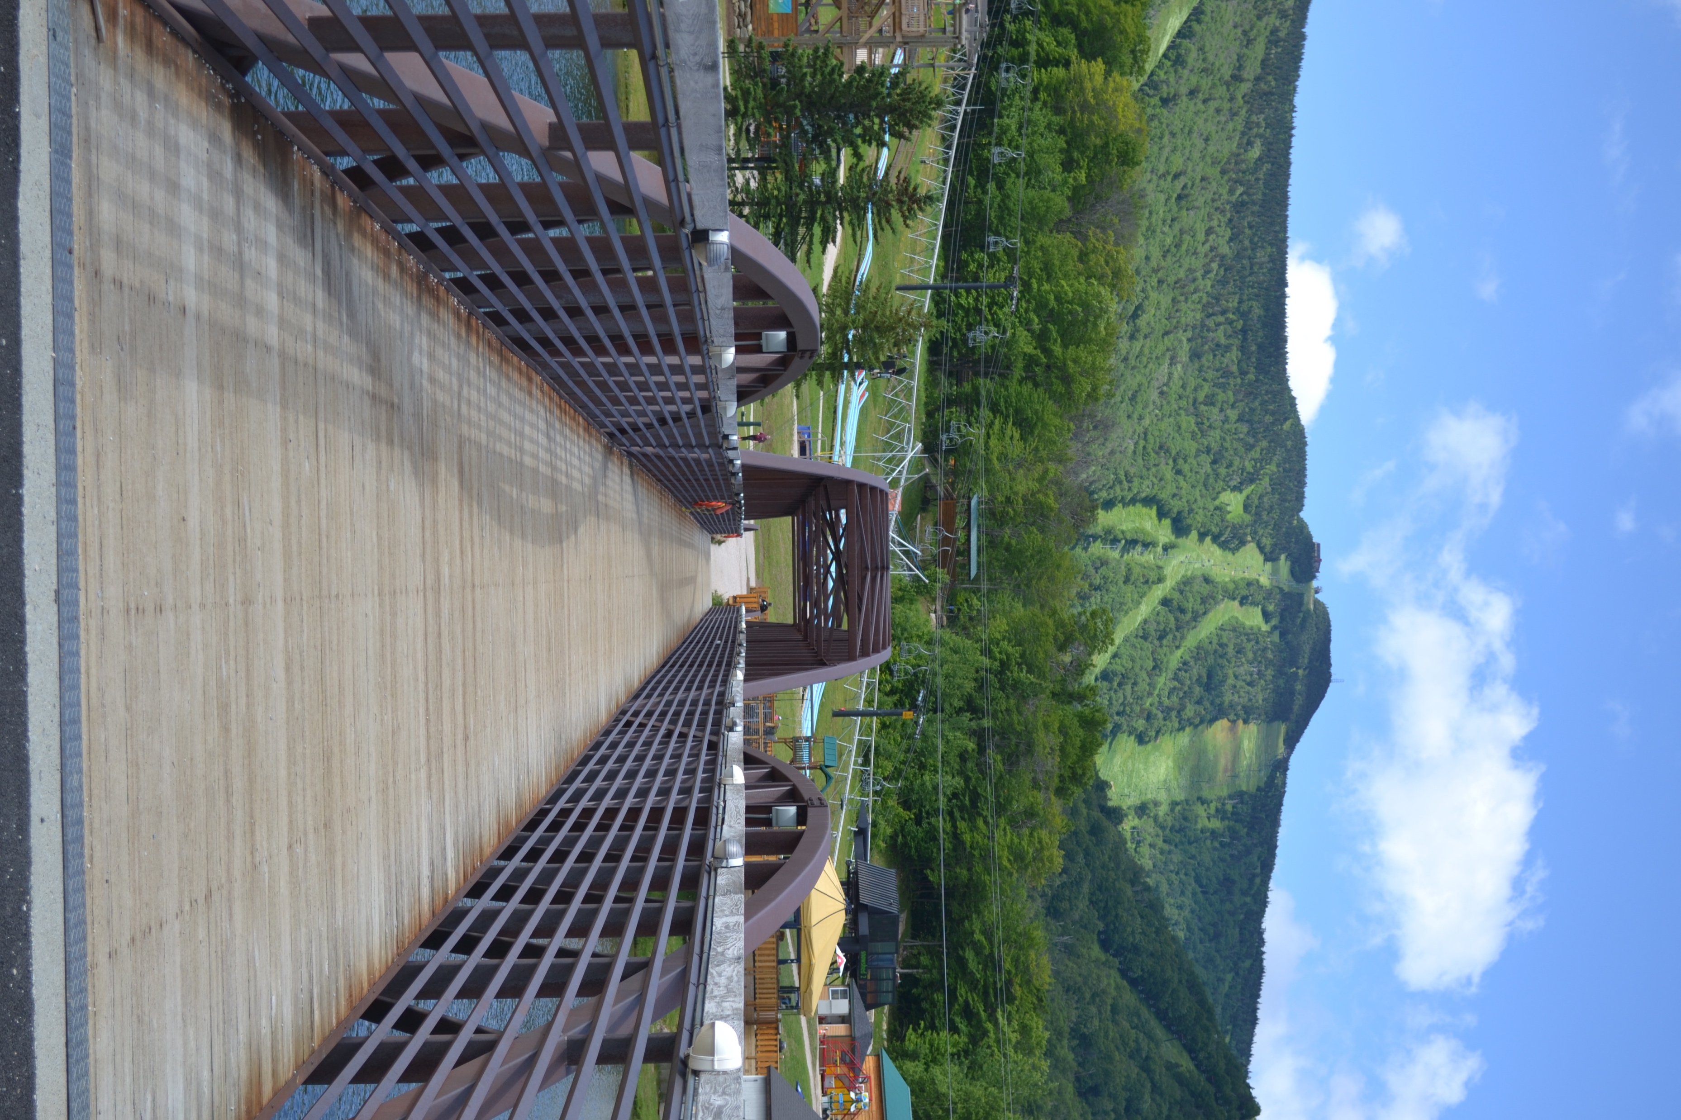
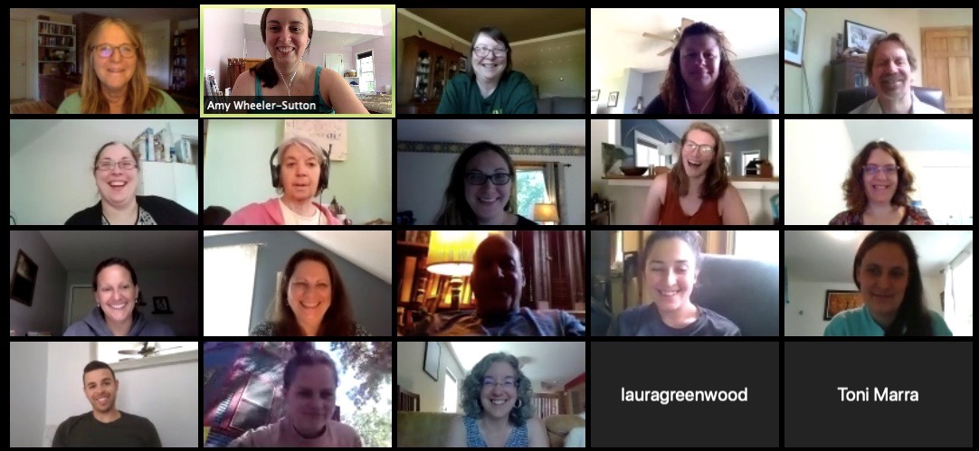
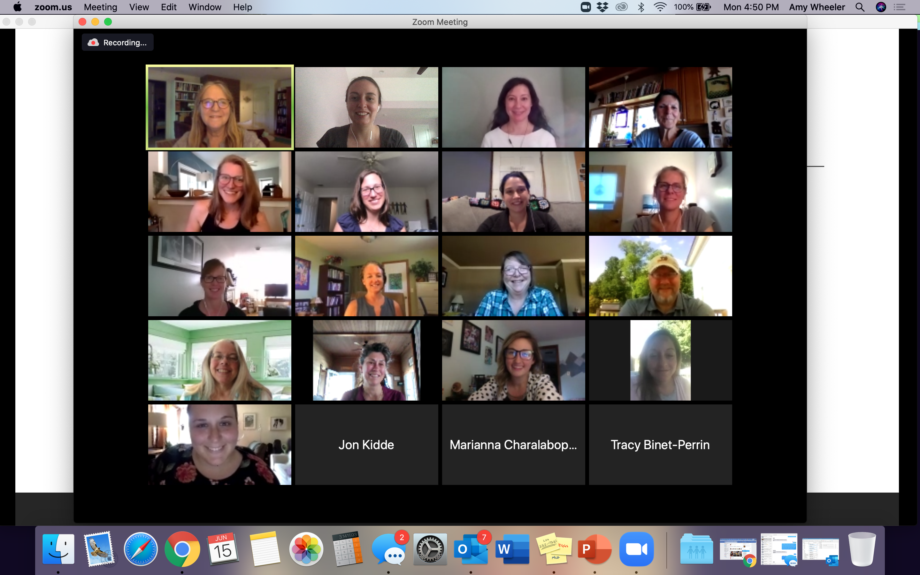

Slide 4
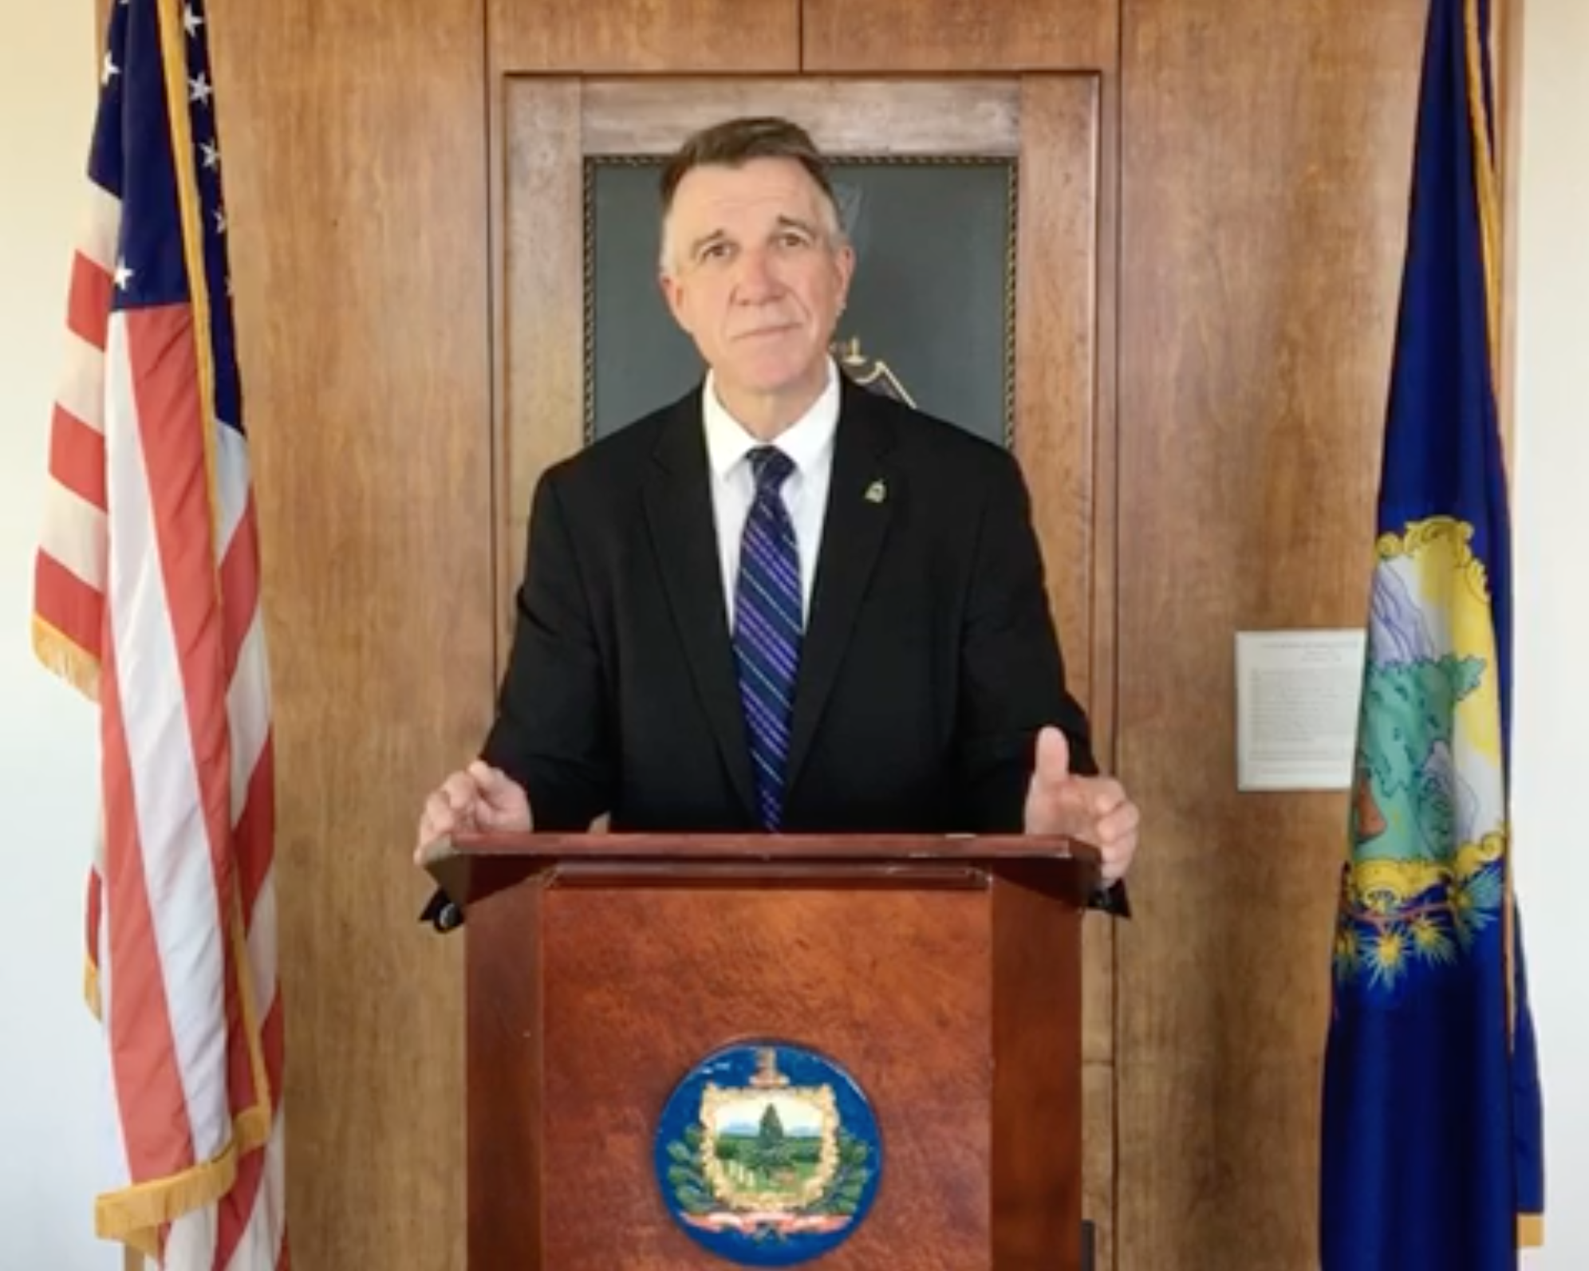

Slide 5
Making the BEST/VTmtss Institute A Success!

Slide 6
BEST Expectations:
Teaching Matrix
BEST Expectation | All Settings
Be Respectful | Be present: reduce distractions/other tabs Mute when you’re not speaking Have patience for new technology
Engage | Take a Team role Ask clarifying questions Contribute to conversations using the chat box or other means
Strengths-based | Use positive statements and re-statements Remember, four positives to one negative
Team Solutions | Establish and follow team roles and norms Consider all ideas of team members

Slide 7
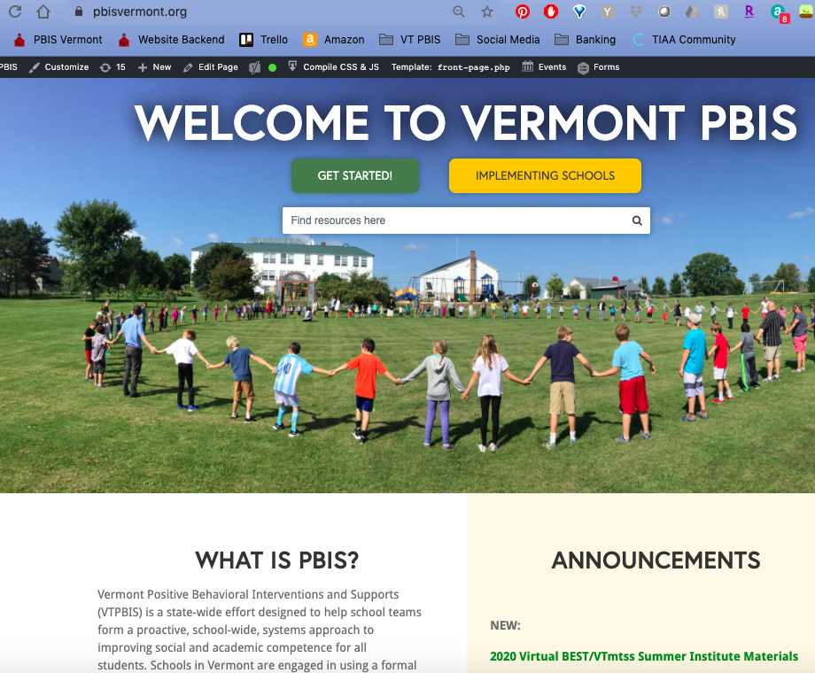

Slide 8
Interested in the 3-credit graduate course?
Email Winnie.Looby@uvm.edu
Missions on Goose Chase!
Notes:
https://www.pbisvermont.org/resource/schedule-of-the-week/

Slide 9
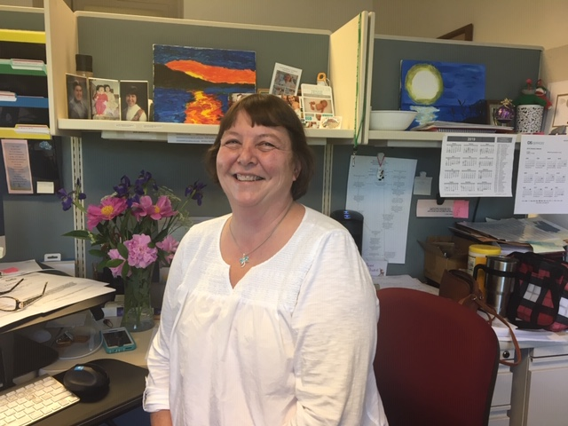
Visit Anne!
https://us02web.zoom.us/my/best2020

Slide 10
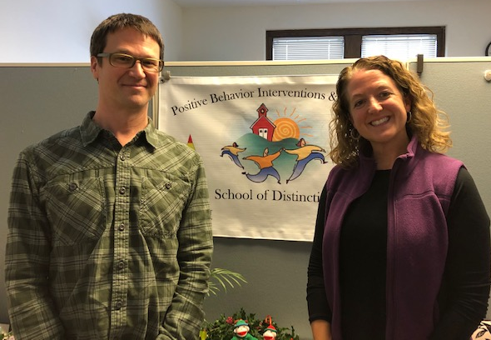
Welcome, Jon Kidde and Joelle van Lent!
Notes:
Jon Kidde has been exploring the concepts of restorative justice (RJ) for 20 years and has played a critical role in the conceptualization, application, and enhancement of restorative justice within different contexts—education, legal, and within organizations in several states. In the last 5 years he has dedicated most of his work to supporting schools in their exploration and implementation of whole-school restorative approaches.
Dr. Joelle van Lent is a clinical psychologist who has worked in Vermont for over 20 years. Joelle has worked in various mental health settings and currently focuses the majority of her efforts in public schools providing consultation, training, and evaluation. Joelle has expertise in resilience, trauma, and Autism Spectrum Disorder.

Slide 11

Building a Runway for Resilience:
Using an MTSS Framework to Align
Restorative Approaches and Trauma-Responsive Schools
2020 BEST/VTmtss Summer Institute
Jon Kidde, MSW
Joelle van Lent, Psy.D.
Type to enter a caption.

Slide 12
We are going to need a long runway
before we take off to a more typical pace & rigor
  Key considerations that we relied on to plan this keynote & will also apply for you as you approach the upcoming school year:
  Start slow and simply - less is more
  Prioritize connection at the start and throughout the flight
  Wisely let go of some traditions & hold tight to some others
  Approach with meaningful engagement - doing with vs. to/for

Slide 13
“Some people have gained downtime, holistic perspective, and family closeness, while others have lost their health, their financial security, and their loved ones.
***The pain isn’t breaking evenly***
Let’s stay mindful of others’ experiences, grateful when we are the lucky ones, and be helpful whenever we can be.”
~ Dr. Lindsey Jernigan

Slide 14
“We built the plane as we flew it.”
In 1 or 2 words, what weather did you fly through these past few months?
What kind of landing did you endure (if you have landed)?
We invite you to simply answer these questions and resist the temptation to give explanation, rationalization, or justification.

Slide 15

VTmtss can offer guidance & direction
Systemic Approach
Assessment
  Collaboration
Expertise
High-Quality Instruction/ Intervention

Slide 16

Restorative Approaches & Trauma-Responsive Schools

Slide 17


Restorative Principles & Resiliency in a Trauma-Responsive Community
Exploring
Relationship
Agency
&
Choice
Meaningful
Engagement
Responsibility/
Accountability
A sense of belonging & supportive relationships
Achieving a sense of mastery over one’s life circumstances
(taking ownership of your story & making meaning of your experiences)

Slide 18

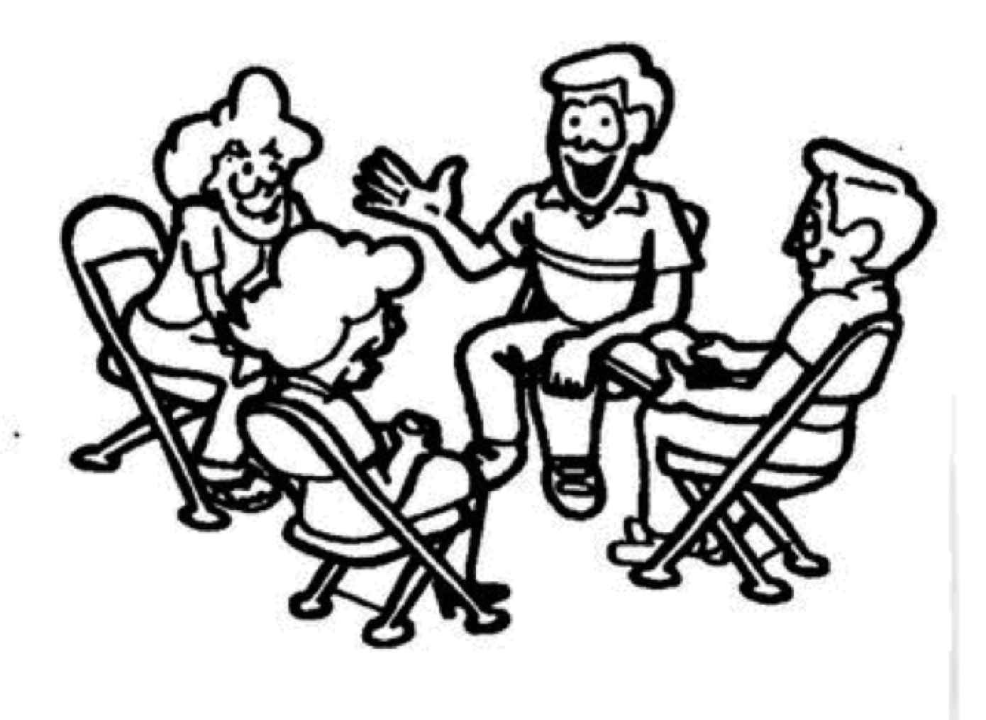
Restorative Practices & Resiliency
in a Trauma-Responsive Community
Restorative Communication &
Active Listening
Circle Processes
Check-in
Community Building
Learning
Difficult conversations
Repair
Healing
Re-engagement
Peer Mediation
Restorative Conferencing
Predictable routine, structure, & traditions that create a supportive and safe context.
Intentional skill-building for all:
Social Support/relational health/healthy attachment
Emotional regulation/Self-regulation/Access to co-regulation/Emotional literacy
Social Competency
Executive Functioning

Slide 19
How will you welcome your community back?
How will you put the principles in action of Restorative Approaches & Resilient/Trauma-Informed Schools within MTSS? How might that look?
The goal is to generate ideas & brainstorm in this discussion - we invite you to focus on listing ideas and pause on the “but”s, “how”s, & “what-if"s for now.
We invite you to focus within your sphere of influence rather than what you wish others would/could do or the unknowns.

Slide 20
Closing:
What is your group vibe?
“It is possible to prepare for the future without knowing what it will be. The primary way to prepare for the unknown is to
attend to the quality of our relationships,
to how well we know and trust one another.”
– Margaret J. Wheatley

