Slide 1
Using the relationship as a therapeutic intervention
Lance Metayer MS, LCMHC

Slide 2
Some Top Universal Relational Needs
Belonging Respect Support
Encouragement Approval
Safety
Acceptance Comfort
Affection To Be Seen Appreciation

Slide 3
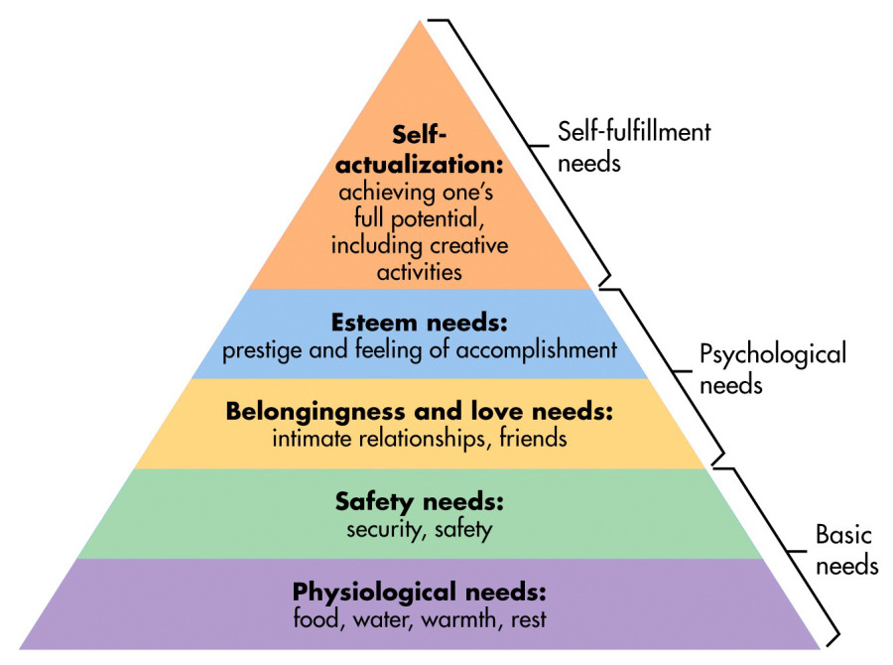
Relationships Provide the Foundation

Slide 4
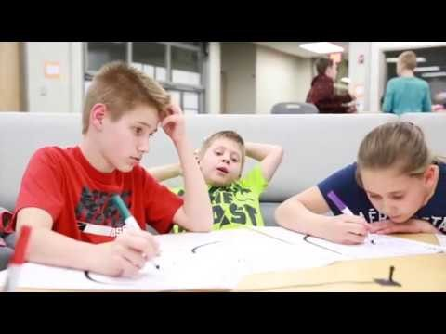
The Power of Relationships
https://www.youtube.com/watch?v=NPW3ko6GoNE

Slide 5
Building the foundation: Attachment
John Bowlby: Attachment is “ the lasting psychological connectedness between human beings.”
● Infants are biologically prepared to form attachments with others because attachments help them survive
●A fundamental part of healthy development
● Secure Attachments can help buffer us against trauma

Slide 6
Attachment Building Blocks
●Caregiver Management of Affect
● Attunement
● Routines and Rituals
● Consistent Response
Blaustein & Kinniburgh, 2010

Slide 7
Caregiver Management of Affect
Non-verbal communication can be just as or more impactful than our verbal communication
Children who are frequently “scanning” their environment tend to pay a lot of attention to non- verbal cues (facial expressions & other body language)
Sometimes our body language may be experienced differently than we intended

Slide 8
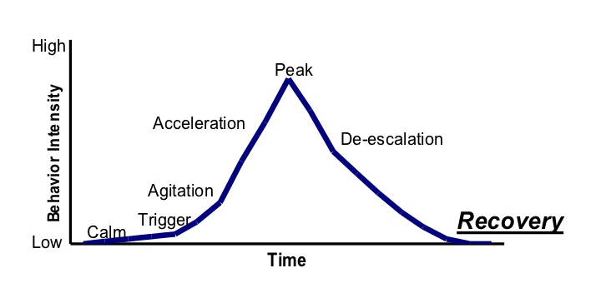
Management of Affect

Slide 9
Caregiver Management of Affect: Non-Verbal Management
Be thoughtful about proximity and individual needs for space or closeness
Control your voice (volume and tone)
Do not force eye contact
Control your body language
Be thoughtful about location
Use silence and relational distance and take a break if needed

Slide 10
Caregiver Management of Affect: Self-Regulation
Children need support with learning how to identify, understand, and safely express emotions. The relationships we provide to them can serve as practice for the real thing.
Trauma can significantly impact one’s ability to regulate emotions and can shape attachment
Secure relationships are a fundamental component of self-regulation
"There is no more effective neurobiological intervention than a safe relationship" Bruce Perry, PhD, MD

Slide 11
Measuring Compassion Satisfaction & Compassion Fatigue: The Professional Quality of Life Scale (ProQOL)
Compassion Fatigue
A 30 item self-report measure of the positive and negative aspects of caring
Measures Compassion Satisfaction and Compassion Fatigue
Compassion Fatigue has two subscales
Burnout
Secondary Trauma
Resiliency Planning
Individual, personally
The ProQOL can help you plan where to put your energy to increase our resilience
Organizational planning
Can help organizations find ways to maximize the positive aspects and reduce the negative aspects of helping
Supportive Supervision
The ProQOL can be used as information for discussions

Slide 12
Attunement
The ability to read and appropriately respond to emotional cues
A subjective experience of being “felt” by another.
Focused attention – bringing another into our internal world (Sigel, 2010)
In order to accurately attune, we must listen for the emotional experience underneath the behavior
Escalation Cycle 8,11

Slide 13
Attunement: Responsive Listening
Short, descriptive, empathic statements (we are not yet analyzing, problem solving or repairing- we are focusing on soothing and calming)
Processing statements: “I am noticing…..”
Mirroring/Paraphrasing: “I hear you saying...”
Respectful curiousity: “I am wondering if….”
Self Reflection/Modeling: “I am feeling…”
How we say this, will be just as important as the content of what we say

Slide 14
Attunement: Responsive Listening Skills
Acknowledging
Apologizing
Agreeing
Inviting criticism

Slide 15
Consistent Response
Caregivers’ responses and the environment are predictable
Rules and limits are clear
We can be consistent without being overly rigid
Children who have endured trauma may initially resist imposed structures and rules due to survival mechanisms

Slide 16
Routines and Rituals
Predictable routines increase sense of safety
Children can focus less on “survival” and more on healthy development
Repetition is an important way that all people gain skill; we gain skill more easily through predictable structures
“The invisible bookends that bracket our days”
(Blaustein & Kinniburgh, 2010)

Slide 17
De-escalation and emotional support to a youth in distress “Connect, Then Redirect” -Dan Siegel

Slide 18
Connection Strategies
Validate Emotions: We can validate emotions and not like the behavior. “Name it to tame it.”
“It makes sense to me that you feel….”
“That sounds so frustrating…”
Reflect what you hear. This communicates comfort and allows the child to feel heard
“It sounds like you were feeling overwhelmed”…. “is that right”?
“Can you help me to understand what was going on; it sounds like…”?

Slide 19
Why Connect First?
● Short-term benefit: It moves the youth from reactivity to receptivity.
● Long-term benefit: It builds a youth's brain.
● Relational benefit: It deepens your relationship with the youth.
From: CONNECT AND REDIRECT REFRIGERATOR SHEET No-Drama Discipline by Daniel J. Siegel and Tina Payne Bryson

Slide 20
Then, Redirect
When the youth is ready, we can then engage the problem solving and processing part of the brain: “the thinking brain”.
-
Inquire to increase insight and understanding:
“I wonder how you were feeling when…?”
“I wonder what was happening for you?”
Problem Solve:
“What might help next time?”
“Let’s practice these skills together.”
Redirection is our opportunity to teach skills
Relational Repair Work If Needed

