Slide 1
Accessible Graphic Design:
go.uvm.edu/accessibility
Fonts
and readability
Audrey Homan audrey.homan@uvm.edu

Slide 2
Audrey Homan
go.uvm.edu/accessibility
B.A., Linguistics
M.A., Linguistics
Graphic design
Document accessibility
Web accessibility
And they hate trapped white space.

Slide 3
Contents:
go.uvm.edu/accessibility
font type
font size
font style
white space
contrast

Slide 4
Good design = accessible design.
GENERAL GUIDELINES
And (largely) vice versa.

Slide 5
Inaccessible design = bad design.
GENERAL GUIDELINES
Always.

Slide 6
Accessibility & readability
GENERAL GUIDELINES
Accessibility = the ability to access a design
Readability =
how comfortable the design is to read and understand

Slide 7
Fonts are the basic building blocks of readability.
GENERAL GUIDELINES
That’s why browsers, .pdf readers, and assistive technology treat them differently from everything else on a page.

Slide 8
67%
GENERAL GUIDELINES
of accessibility failures come down to design choices.
Reference

Slide 9
99%
GENERAL GUIDELINES
of good design is invisible.
Reference

Slide 10
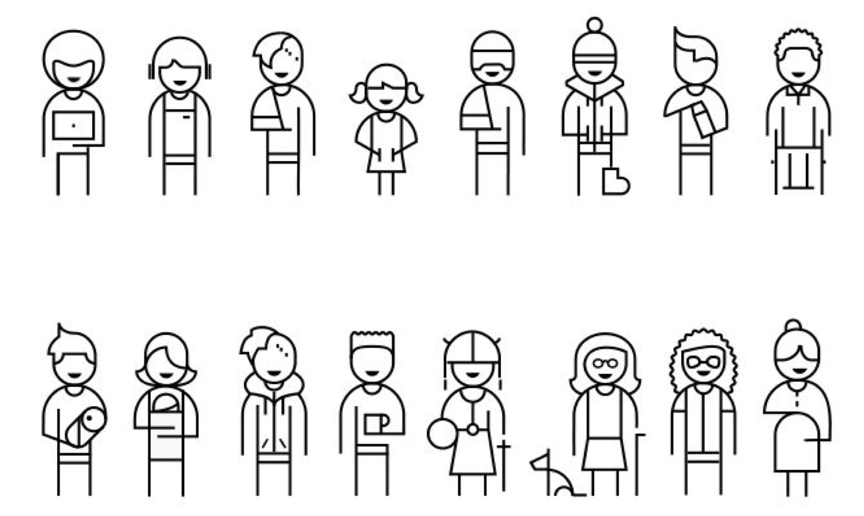
Design for everyone:
GENERAL GUIDELINES

Slide 11
A lot of people make their own accessibility.
GENERAL GUIDELINES
screen readers
screen
magnifiers
custom stylesheets
glare-blockers
dark
mode
custom browsers

Slide 12
Things to consider:
FONTS
font type
font size
font style
white space
contrast

Slide 13
FONT TYPE
Serif
Decorative
Sans Serif
Script

Slide 14
Sans Serif
FONT TYPE
In general,
fonts are easier for most people to read on a screen.
Reference

Slide 15
Start by choosing a common font:
FONT TYPE
Arial
Helvetica
Times New Roman*
Verdana

Slide 16
Save decorative and script fonts for occasional use.
FONT TYPE
Snell Roundhand
Papyrus
Modak
Brush Script
Brocade Script
HERCULANuM
Chalkduster
Party LET
Phosphate
Sign Painter
Impact
Zapfino

Slide 17
UVM’s recommended fonts:
FONT TYPE
Playfair Display (serif)
Roboto Slab (slab serif)
Raleway (sans serif)
GoBold (condensed headline)

Slide 18
Again, start by choosing a common font:
FONT TYPE
Arial
Helvetica
Times New Roman*
Verdana
Century Gothic
Calibri

Slide 19
Keep it simple: 1-2 fonts max.
FONT TYPE
Choosing different weights of the same font can keep things simple and look professional.
BrownPro Bold
BrownPro Regular

Slide 20
Use headings to organize
your text.
FONT STYLES
Heading 1
Heading 2
Heading 3
Heading 4

Slide 21
Use italics for emphasizing words, not for styling text.
FONT STYLES
Italic text is difficult to read after the first sentence. Save it for emphasizing certain words or terms you need the reader to fix in their mind.
Italic text is difficult to read after the first sentence. Save it for emphasizing certain words or terms you need the reader to fix in their mind.

Slide 22
Use ALL-CAPS sparingly.
FONT STYLES
ALL-CAPITAL TEXT IS DIFFICULT TO READ AFTER 2-3 WORDS. THIS IS BECAUSE ALL-CAPITALS MAKE EVERY WORD BASICALLY THE SAME SHAPE.
All-capital text is difficult to read after 2-3 words. This is because all-capitals make every word basically the same shape.

Slide 23
ALL CAPS vs. Camel Case
FONT STYLES
ALL-CAPS ALSO HAS BECOME ASSOCIATED WITH YELLING ON THE INTERNET.
ALL CAPITALS
Use Camel Case for Headlines
Camel Case

Slide 24
Font Size Guidelines
FONT SIZE
Minimum 14-point body text
Minimum 18-point headings
Line spacing at least 1.5 times the text height for body text (can be closer for columns)
Space following paragraphs to at least 2 times the font size;

Slide 25
Use columns to avoid eye-strain.
WHITE SPACE
This is why newspapers were originally laid out in columns, rather than long passages of text that stretched all the way across the page and back again.
Human eyes enjoy reading short column lengths.
Ideally, that’s no longer than 80 characters.

Slide 26
No columns?
WHITE SPACE
Human eyes enjoy reading short column lengths.
Ideally, that’s no longer than 80 characters.
This is why newspapers were originally laid out in columns, rather than long passages of text that stretched all the way across the page and back again.

Slide 27
Don’t trap white space
WHITE SPACE
If you create small pockets of white space in your design, it repeatedly draws the reader’s eye to the space.
Trapped white space
If you create small pockets of white space in your design,
it repeatedly draws the reader’s eye to the space.
If you create small pockets of white space in your design, it repeatedly draws the reader’s eye to the space.
If you create small pockets of white space in your design, it repeatedly draws the reader’s eye to the space.
If you create small pockets of white space in your design, it repeatedly draws the reader’s eye to the space.
In the design at left, notice how often your eyes are drawn back to the trapped white space left of the image.
If you create small pockets of white space in your design, it repeatedly draws the reader’s eye to the space. If you create small pockets of white space in your design, it repeatedly draws the reader’s eye to the space.
If you create small pockets of white space in your design, it repeatedly draws the reader’s eye to the space.

Slide 28
Left justify your text.
WHITE SPACE
deadly river of space
Left justify your text. Don’t extend it to both sides of a column. Fully justified text creates “rivers of space” that are especially difficult to read for people with dyslexia.
Left justify your text. Don’t extend it to both sides of a column. Fully justified text creates “rivers of space” that are especially difficult to read for people with dyslexia.

Slide 29
This is actually a WCAG requirement.
WHITE SPACE
Left justify your text. Don’t extend it to both sides of a column. Fully justified text creates “rivers of space” that are especially difficult to read for people with dyslexia.
Left justify your text. Don’t extend it to both sides of a column. Fully justified text creates “rivers of space” that are especially difficult to read for people with dyslexia.
Reference

Slide 30
How much contrast?
CONTRAST
 | Small text | Large text | Icons & Graphics
WCAG LEVEL AA | 4.5:1 | 4.5:1 | 3:1
AAA | 7:1 | 4.5:1 | 3:1

Slide 31
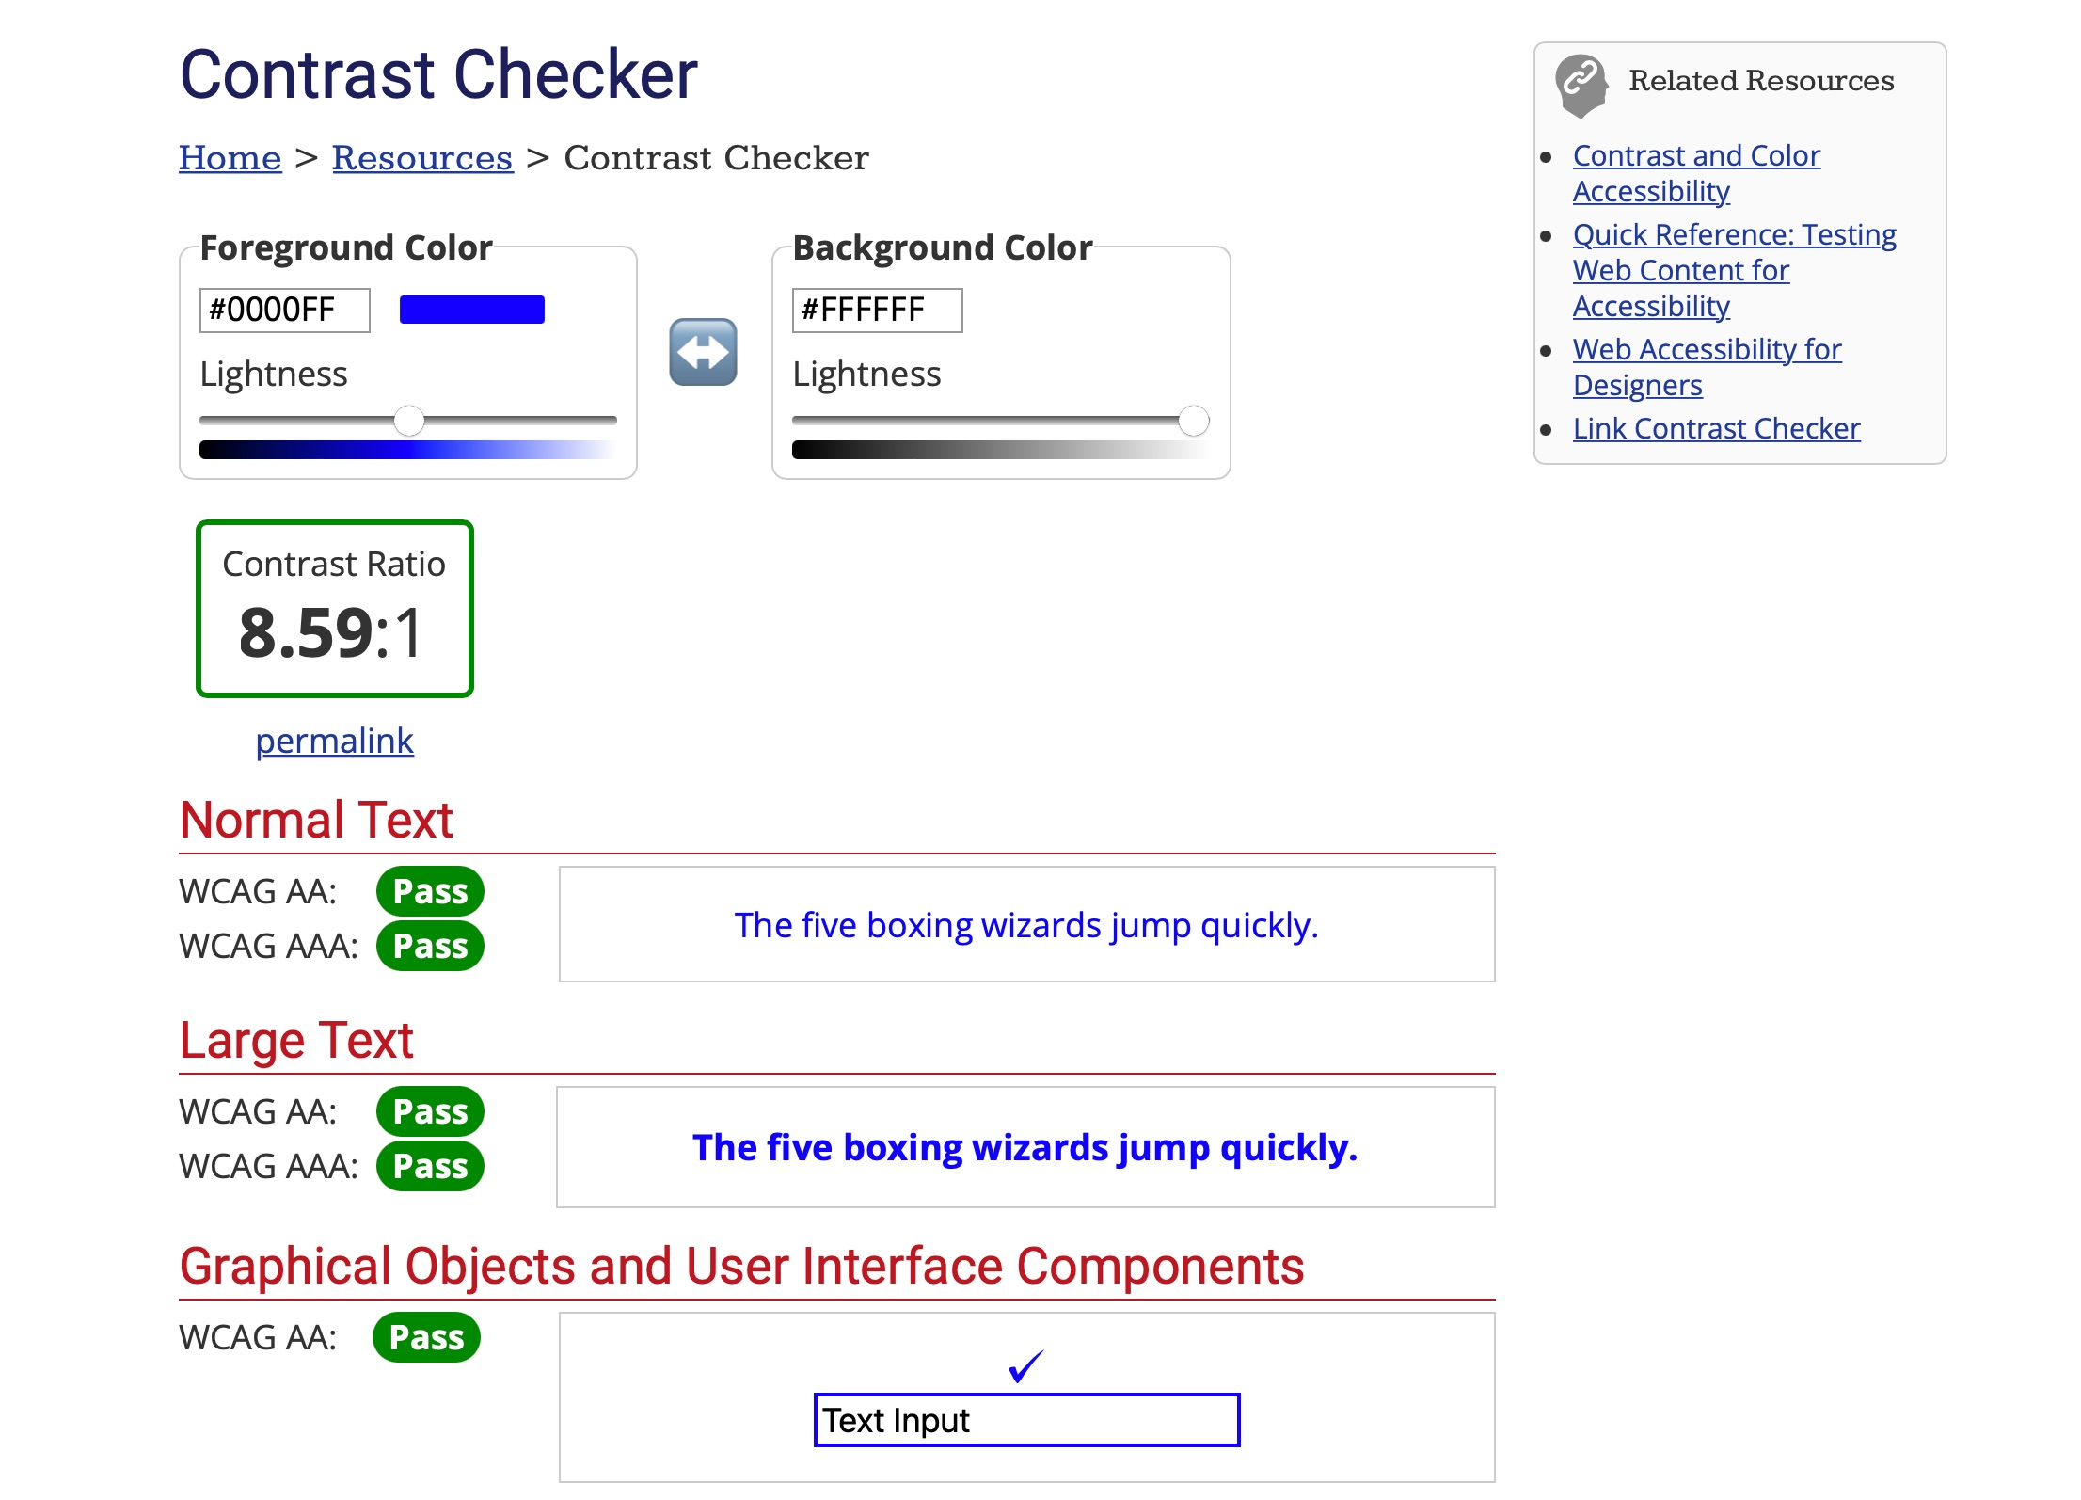
How do you measure contrast?
CONTRAST
WebAIM Contrast Checker

Slide 32
Steps for measuring contrast
CONTRAST
1. Use your browser tools to access the eyedropper.
2. Take a sample from your text.
3. Copy the hex number, and paste it into the “Text” box.
4. Repeat with your background.
5. Check your results.
WebAIM Contrast Checker

Slide 33
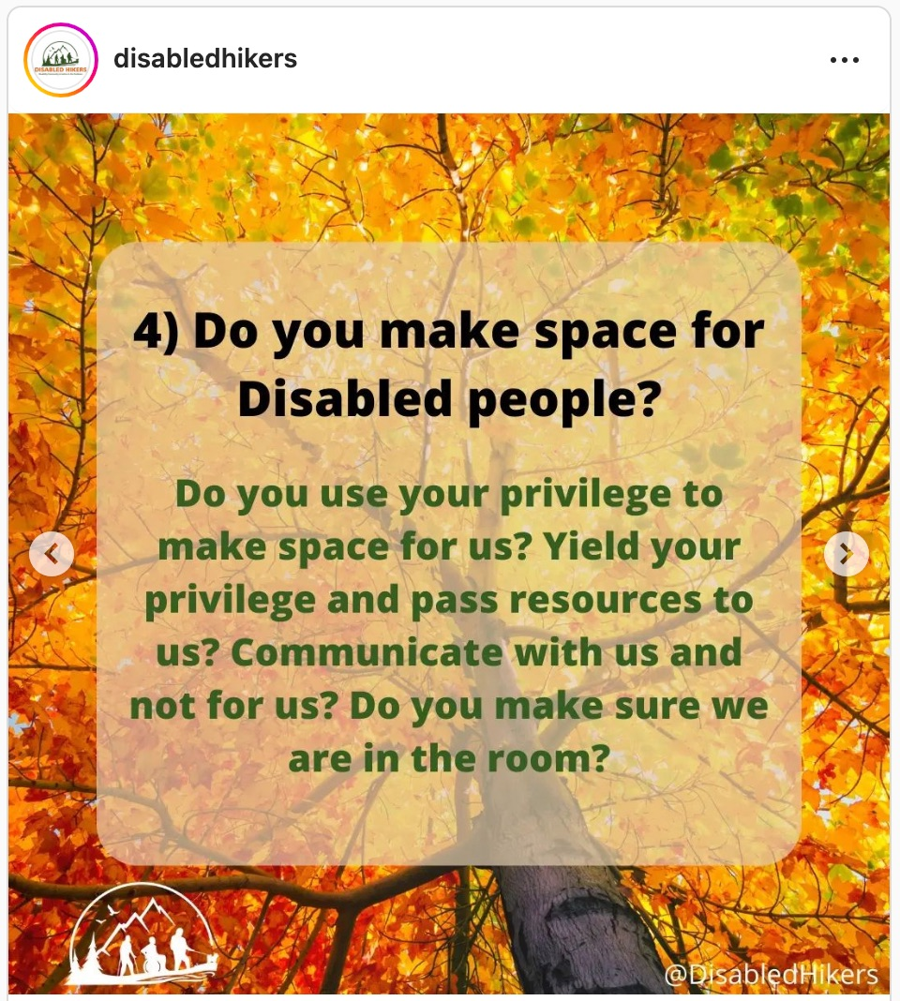
Avoid patterned backgrounds.
CONTRAST

Slide 34
Finally, realize two things:
GENERAL GUIDELINES
1. You can’t predict all the ways in which your reader might access your design.
2. Human data always beats general guidelines.

Slide 35
“What the font’s
up with that?”

Slide 36
WHAT THE FONT: WRUV

Slide 37
WHAT THE FONT: CONTINENCE

Slide 38
Thank you for your time.
go.uvm.edu/accessibility
Feel free to share it, and remix it for non-commercial use, with attribution.
This presentation is licensed under CC-BY-NC-SA.

Slide 39
FURTHER READING: FONTS
}
}
Font Accessibility & Readability: The Basics
Mobile Web Typography Guidelines
UVM Style Guide
Virtual Readability Lab
FONTS

Slide 40
FURTHER READING: COLOR
}
}
}
Color Blindness Simulator
WEBAim Color Contrast Checker
UVM Color Palette
CDCI Color & Font Quick Guide (.pdf)
COLOR

