Slide 1
go.uvm.edu/accessibility
This is a Sample Presentation
April 2022
Audrey Homan | choman@uvm.edu

Slide 2
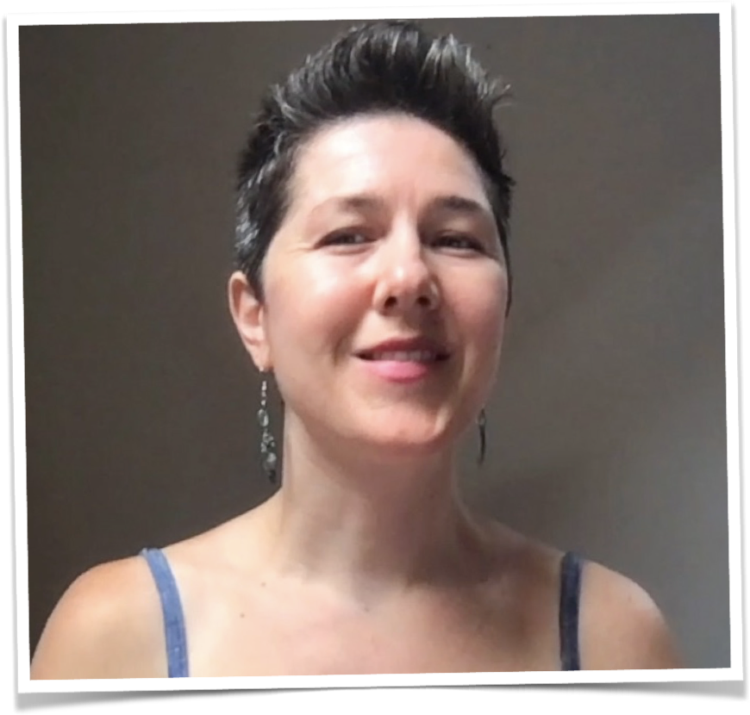
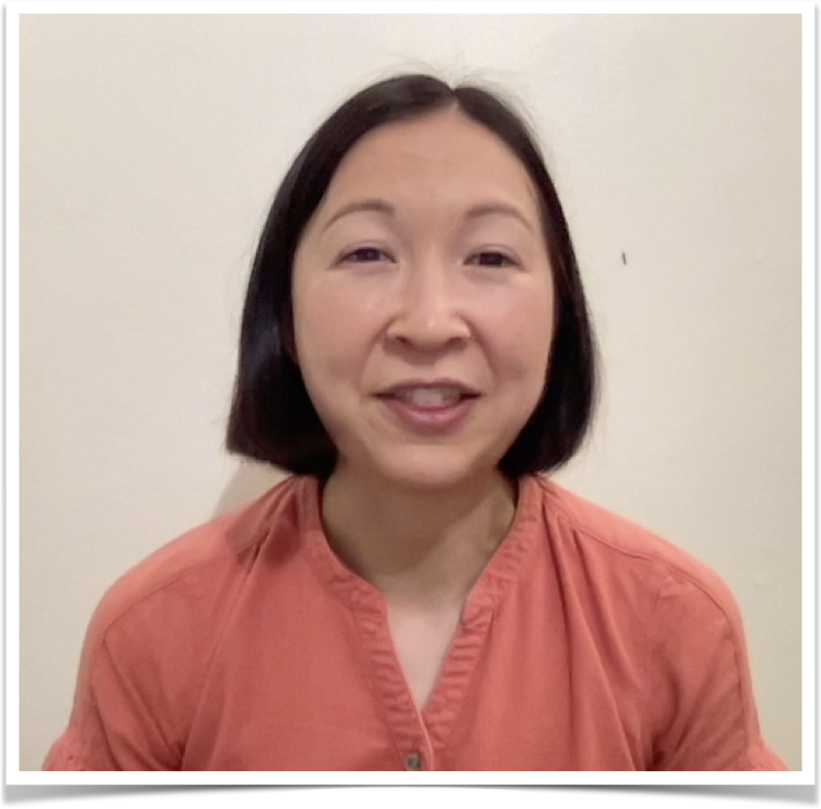
Presenters
Chayah Lichtig
Occupational Therapist
chayahlichtig@uvm.edu
Adrienne Miao, PhD
Occupational Therapist
adriennemiao@uvm.edu

Slide 3
Sample Workshop Code of Conduct
These workshop spaces are explicitly anti-racist. By being here, we are all committing to upholding that standard.
Please help to create a safe & welcoming space for learning. Refrain from posting images or language that denigrate anyone based on race, sex, gender, orientation, ability, class, caste, or immigration status.
Mute your audio when you’re not speaking.
Minimize distractions and be present. Participate as much as your circumstances -- physical, emotional, and mental -- allow.
Grant each other, and the presenters, grace in this time.

Slide 4
CHAPTER MARKER > PAGE MARKER
This is a slide.
This is body text. This is body text. This is body text. This is body text. This is body text. This is body text.
This is body text. This is body text.

Slide 5
CHAPTER MARKER > PAGE MARKER
This is a slide with a video.

Slide 6
CHAPTER MARKER > PAGE MARKER
This is a slide with a data table.
TITLE | DATE | DETAILS
Text | Text | Text goes here like this.
text | text | Text goes here like this.
text | text | Text goes here like this.
text | text | Text goes here like this.

Slide 7
go.uvm.edu/accessibility
Connect with us:
cdci@uvm.edu

Slide 8
go.uvm.edu/accessibility
Thank you for your time.
Feel free to use it and remix it for non-commercial use, with attribution.
This presentation is licensed under CC-BY-NC-SA.

