Slide 1
Accessible Multimedia:
go.uvm.edu/accessibility
captions & transcripts
Audrey Homan audrey.homan@uvm.edu

Slide 2
Multimedia =
video & audio

Slide 3
Contents:
2. CAPTIONS:
Types
How-To
ACCESSIBILITY
The Basic Bits
The Legal Bits
The CDCI Bits
3. TRANSCRIPTS:
Types
How-To

Slide 4
67%
ACCESSIBILITY: THE BASIC BITS
of accessibility failures come down to design choices.
Reference

Slide 5
“Does my multimedia need to be accessible?”
ACCESSIBILITY: THE BASIC BITS
YES.

Slide 6
We’re creating multimedia for:
ACCESSIBILITY: THE BASIC BITS
}
people with permanent disabilities
temporary disabilities, and
situational disabilities
What does that actually mean?

Slide 7
With multimedia, accessibility has two parts:
ACCESSIBILITY: THE BASIC BITS
AUTOMATED | MANUAL
Generating captions or transcripts | Ensuring your captions and transcripts are useable.

Slide 8
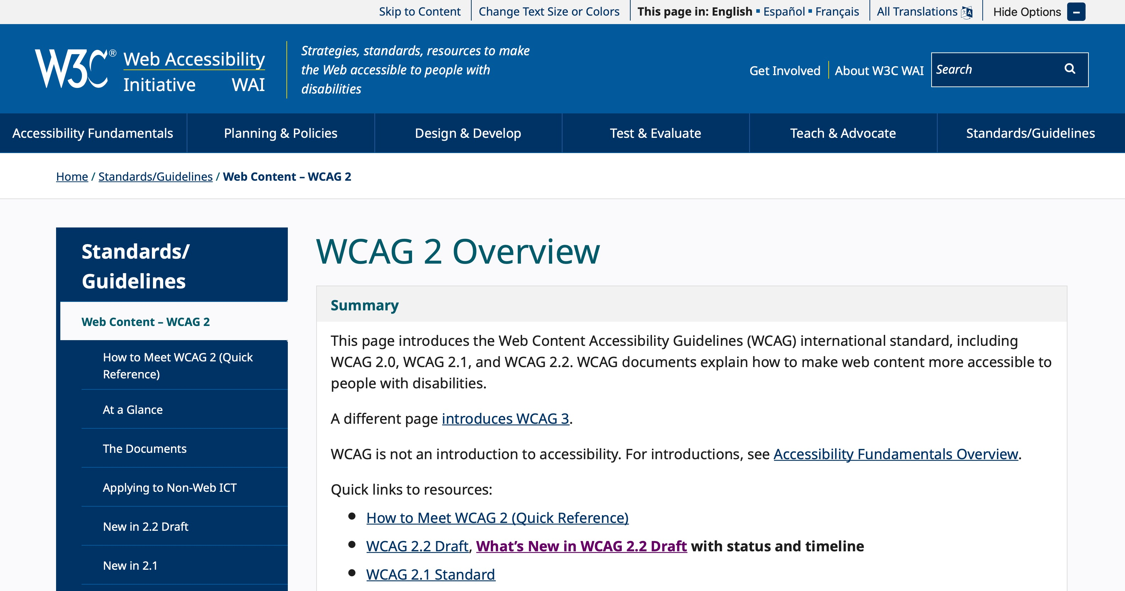
Who sets standards for accessible multimedia?
ACCESSIBILITY: THE LEGAL BITS
They’re baaaaaaaack:
it’s the WCAG.

Slide 9
WCAG 2.1 Guidelines
ACCESSIBILITY: THE LEGAL BITS
A-level: basic ACCESS
AA-level: reasonable USEABILITY
AAA-level: gold-standard HOLY CROW THAT’S INCLUSIVE

Slide 10
For videos with audio:
ACCESSIBILITY: THE LEGAL BITS
A-level: automated captions
AA-level: edited captions
AAA-level: edited captions + audio description and/or ASL interpretation

Slide 11
For videos without audio:
ACCESSIBILITY: THE LEGAL BITS
A- & AA-level: audio description
AAA-level: audio description and a descriptive transcript

Slide 12
For audio:
ACCESSIBILITY: THE LEGAL BITS
A-level: automated transcript
AA-level: edited transcript
AAA-level: edited transcript

Slide 13
But wait, there’s more:
ACCESSIBILITY: THE LEGAL BITS
“Provide text alternatives for any non-text content so that it can be changed into other forms people need, such as large print, braille, speech, symbols or simpler language.”
WCAG 1.1.1: Non-text content (A)

Slide 14
Wait, what?
ACCESSIBILITY: THE LEGAL BITS
It’s Universal Design!
All videos must have an audio track.
All audio must have a transcript.
Ergo: all videos must have a transcript.
No kidding.

Slide 15
Types of captions:
CAPTIONS: TYPES
open captions
closed captions
subtitles

Slide 16
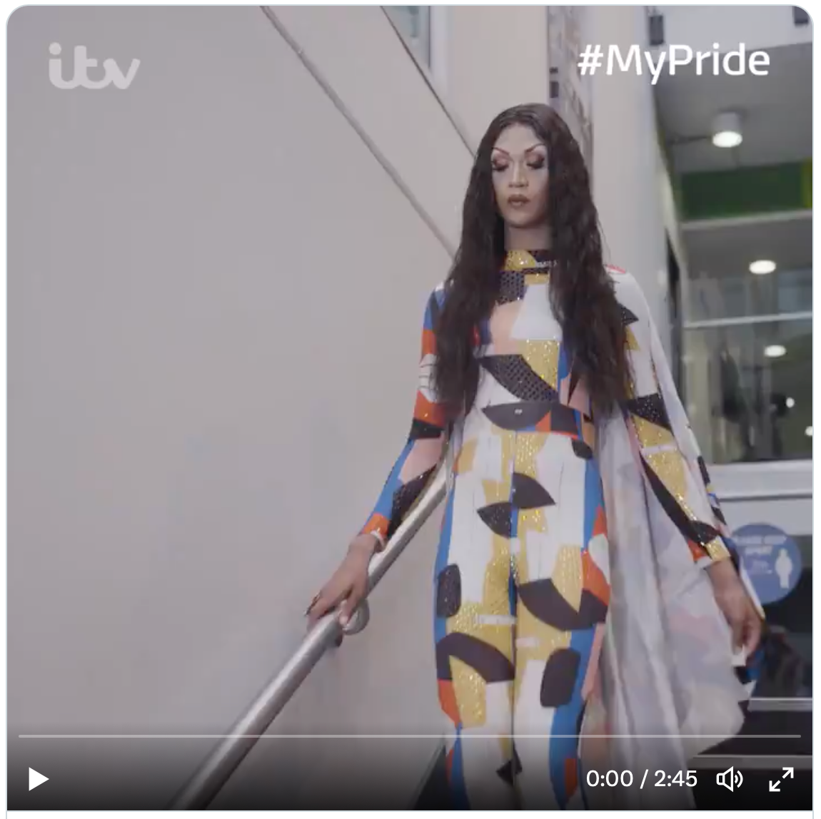
Open captions:
CAPTIONS: TYPES
An example of open captions.

Slide 17
Pros & cons of open captions:
CAPTIONS: TYPES
May be distracting for some users
Hard to create and hard to edit
Not compatible with screen readers
Users can’t customize them
AMAZING for events, but…

Slide 18
Closed captions:
CAPTIONS: TYPES

Slide 19
Pros & cons of closed captions:
CAPTIONS: TYPES
Compatible with screen readers
Users can customize
Searchable (boosts yr SEO)
Can be turned off by users with different access needs
Requires editing time to make useable

Slide 20
Subtitles
CAPTIONS: TYPES
Captions that translate one spoken language into another.

Slide 21
POP QUIZ, HOTSHOTS
OH NO
What kind of captions is this video using?
Is this a video with audio content?

Slide 22
KEANU REEVES JUST EXPLODED.
WHAT NOW
What kind of captions is this video using?
Is this a video with audio content?

Slide 23
How to get:
automated captions
CAPTIONS: HOW-TO
Upload to YouTube. YouTube provides automated captions automatically.
Use Adobe Premiere or CADET.
Send out for commercial captioning.

Slide 24
How to get:
edited captions
CAPTIONS: HOW-TO
Ask the UVM Access Center*
Edit your automated captions on YouTube or in Adobe Premiere, Camtasia, or CADET
Send out for commercial captioning

Slide 25
Caption-editing software
CAPTIONS: HOW-TO
SOFTWARE | COST | EASY TO USE?
YouTube | FREE | Somewhat
Camtasia | $ | Very
Adobe Premiere | $$$ | No
CADET | FREE | No
Subtitle Horse | FREE* | Wow no

Slide 26
Types of caption files
CAPTIONS: HOW-TO
FILE TYPE | EXTENSION | WHERE TO USE
SubRipper | .srt | YouTube, Facebook, Twitter,Snapchat
WebVideo TextTracks | .vtt | PowerPoint
Timed Text Markup Language | .ttml | Television
Plain Text | .txt | Quicktime, creating transcripts

Slide 27
Social media & captions
CAPTIONS: HOW-TO
PLATFORM | CAPTION TYPE
YouTube | .srt, .vtt, .sbv
Vimeo | .srt
Facebook | .srt
Twitter | .srt
Instagram | automatic captioning
TikTok | manual captioning

Slide 28
Why edited captions?
CAPTIONS: HOW-TO
Because:
The fresh automated baptism blight now are Sony 60% accurate.
The best automated captions right now are only 60% accurate.

Slide 29
A quick note about audio description
CAPTIONS: HOW-TO

Slide 30
And ASL:
CAPTIONS: HOW-TO

Slide 31
This is known as Language Access.
A NOTE ABOUT LANGUAGE ACCESS
A Language Access Plan spells out which materials will be offered in which different languages.
In FY24, CDCI will create our own Language Access Plan.

Slide 32
During online presentations, workshops, and events:
CAPTIONS: HOW-TO
Zoom, Teams, and Google Meet all provide automated live-captioning (A-level)
CART captioning is AA-level
The UVM Student Access Center provides ASL interpreters

Slide 33
After online presentations, workshops, and events:
CAPTIONS: HOW-TO
How to create accessible Zoom recordings

Slide 34
Types of transcripts:
TRANSCRIPTS: TYPES
automated
edited
descriptive*

Slide 35
Automated transcripts:
TRANSCRIPTS: TYPES
A copy of your captions file with timestamps, from YouTube or Zoom
A machine-automated transcript, such as from rev.com

Slide 36
Pros & cons of
automated transcripts:
TRANSCRIPTS: TYPES
Technically, they’re better than nothing, and they meet WCAG 1.1.1
In practice, they’re pretty unuseable.

Slide 37
Pros & cons of
edited transcripts:
TRANSCRIPTS: TYPES
Readable and useful
Help boost your SEO
Not everyone watches videos
Help people skim or search for relevant information
You can include extra resources
They take time to edit.

Slide 38
How to get:
edited transcripts
TRANSCRIPTS: HOW-TO
Edit your automated transcripts in Word or WordPress
Send out for commercial transcription

Slide 39
How to edit a transcript
TRANSCRIPTS: HOW-TO
Delete timestamps
Indicate different speakers by paragraph. Bold each speaker’s name.
Add in links, images, or other videos to provide context. Transcribe non-speech sounds that are important for context.

Slide 40
Best practices in graphic design apply to transcripts.
TRANSCRIPTS: HOW-TO
slides
video
transcript

Slide 41
Edited transcripts should read like print interviews.
TRANSCRIPTS: HOW-TO
Chayah: So I would like to start with an introduction, and I don’t know you at all, we’re meeting for the first time — but I’m introducing you based on having read your book, followed you online, and also read a bit about you from different content on the internet.
Hannah: Sounds good.
Chayah: So, Hannah Setzer is a self-described joyful rebel. Some of the many hats she wears are homesteader, business owner, foster and adoptive parent, community activitst and organizer social worker, and disability rights advocate.

Slide 42
Descriptive transcripts:
TRANSCRIPTS: TYPES
Usually for video, these transcripts include written text of the audio content paired with written visual descriptions.

Slide 43
This is an example of a descriptive transcript:
TRANSCRIPTS: TYPES
AUDIO
VISUAL
Video isn't just about pictures, it's also about sound. Without the audio, you would have to guess what this film is about.
Video isn't just about pictures, it's also about sound. Without the audio, you would have to guess what this film is about.
[no sound]
The video on his computer shows a person speaking to the camera. It is playing with no audio.
Frustrating isn't it? Not knowing what's going on. That's the situation for everyone who can't hear.
The man watching the video has a hearing aid.

Slide 44
Screencast narration
TRANSCRIPTS: HOW-TO
Narrated screencasts are a great way to share information.
And they need edited captions.

Slide 45
A word about presentations:
TRANSCRIPTS: HOW-TO
NEW: PowerPoint supports closed captions!
You can absolutely embed audio and video in presentations.
And they always need edited captions.

Slide 46
How to create captions for PowerPoint:
TRANSCRIPTS: HOW-TO
Narrated PowerPoints can be a great way to share information.
And they need edited captions.

Slide 47
How to create captions for video in PowerPoint:
TRANSCRIPTS: HOW-TO
Embed a YouTube video that you know has edited captions available.
Upload a video file that you’ve added captions to.

Slide 48
How to create captions for audio in PowerPoint:
TRANSCRIPTS: HOW-TO
First: go to Insert > Audio, and upload an audio file.
Next, upload a .vtt captions file.

Slide 49
Four for the door:
YOU’RE DOING AMAZING
Resist the freakout: Accessibility is hard, and it’s a process. Choose one thing to work on at a time.
You are always always always encouraged to ask for help. All questions rock.
3. Get feedback from people with disabilities
4. Don’t be afraid to advocate for what you need.

Slide 50
Captioning Resources
RESOURCES
rev.com: automated captions @ $.25 / minute, edited captions @ 1.50/minute
DCMP.org: Described & Captioned Media Program
CADET (Caption and Description Editing Tool): free downloadable tool with a steep learning curve
How to add captions to PowerPoint

Slide 51
Transcript Resources
RESOURCES
Rev.com: edited transcripts @ $1.50/minute
WCAG Best Practices for Transcription
descript.com: Unlimited transcriptions starting at $12/month

Slide 52
Language Access Resources
RESOURCES
AUCD Language Access Plan (.pdf)
Language and Coloniality: Non-Dominant Languages in the Digital Landscape (Kupfer, Muyumba)
Requesting an ASL interpreter from UVM Access Center

Slide 53
Thank you for your time.
go.uvm.edu/accessibility
Feel free to share it, and remix it for non-commercial use, with attribution.
This presentation is licensed under CC-BY-NC-SA.

