Slide 1
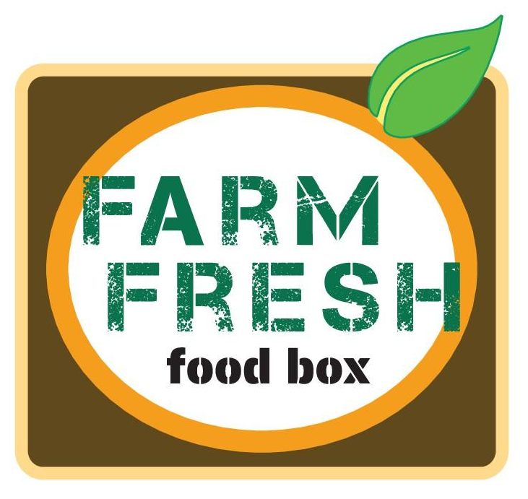




Farm Fresh Food Boxes: an Entrepreneurial Partnership between Farmers & Retailers
Jane Kolodinsky, The University of Vermont
Marilyn Sitaker, The Evergreen State College
Lisa Chase, Weiwei Wang, Hans Estrin, and
Lauren Greco, University of Vermont;
Diane Smith, Washington State University Extension,
Julia E Van Soelen Kim, University of California, Cooperative Extension
Notes:
National Institute of Food And Agriculture-USDA: AFRI (2015-68001-23230; Seguin, PI)

Slide 2
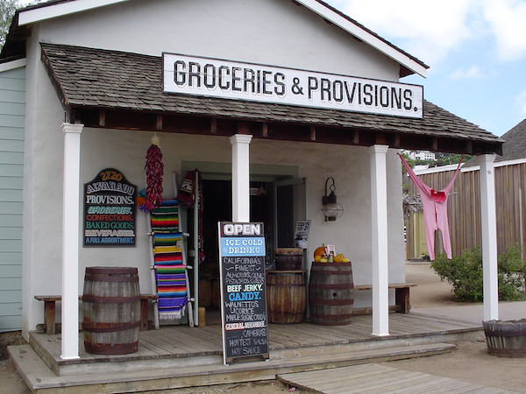
Current Trends in Rural Areas
Competition for small farms, from large, centralized farms that farmers face-- as well as DTC market saturation
Declining business for rural retailers, as rural consumers switch to shopping in larger urban centers.
Lack of access to healthful, locally grown food for rural residents, many of whom have lower incomes
Notes:
Recent farming and marketing trends have placed rural communities at a disadvantage:
Small-to-medium sized farms are at a business disadvantage compared to large, centralized farming operations that can offer a large volume at lower price to wholesale distributors (1).
The concurrent growth of large national retail chains has forced smaller retailers out of business, particularly in rural areas.
These parallel trends have contributed to weakened rural agricultural economies (2), and made it harder for local residents to access fresh, affordable healthy produce (3,4). This has implications for the health of rural adults and children, who tend to have higher levels of obesity and nutrition related chronic diseases like diabetes.
The F3B model was designed to address three problems facing rural communities.
First, it addresses market saturation, a potential contributor to the flattened growth in direct-market sales (DTC) ^{i} by opening new market channels for producers of locally grown foods.
Secondly it addresses declining business for rural retailers, as rural populations fall and consumers switch to shopping in larger urban centers. According to Kansas State University (KSU), 50% of Iowa grocery stores have closed since 1998, and over 40% of Kansas rural grocery stores have closed since 2007. These losses have negative economic impacts on rural communities, as each rural grocery store employs 14 people on average, and cumulatively account for over 2.5 million jobs nationwide. When local grocery stores close, they are not replaced; thus dollars once spent locally are now spent elsewhere, further eroding the economic vitality of rural communities.
Finally, F3B addresses lack of access to healthful, locally grown food for rural residents—many of whom have lower incomes. It’s estimated that a third of rural residents lack access to healthy foods, putting them at higher risk of obesity and weight-related chronic diseases than their urban or suburban counterparts.
Befort, C. A., Nazir, N., & Perri, M. G. (2012). Prevalence of obesity among adults from rural and urban areas of the United States: findings from NHANES (2005‐2008). The Journal of Rural Health, 28(4), 392-397.

Slide 3
Farm Fresh Food Boxes
Farm Fresh Food Boxes (F3B) is a concept-tested entrepreneurial food system innovation aiming to:
Expand markets for fruit and vegetable producers
Increase sales in small rural convenience stores,
Help rural residents access & consume more locally grown produce
Build community social capital
F3B is a hybrid of a direct-to-consumer (CSA) and intermediated approach

Slide 4
https://www.youtube.com/watch?v=Qi8t2gHvIMk

Slide 5
A hybrid DTC/Intermediated approach
Farmers offer weekly F3B at participating retail sites that consumers can easily access. Box contents change throughout the season
Retailers provide a drop-off point, in exchange for a nominal transaction fee. F3B is advertised via sandwich boards and flyers. In-store white boards detail the cost and weekly contents of the box.
Customers pre-order a weekly F3B at the retail site or on-line on a week-to-week basis for later pick-up. Customers can use SNAP/EBT.
Notes:
Farm Fresh Food Box (F3B): is a DTC approach that is an alternative to farmers’ markets and CSAs
Farmers offer weekly F3B at participating retail sites that consumers can easily access. Box contents (and flyers) change throughout the season, to move product that is most abundant.
Small, rural retailers provide a drop-off point for the F3B, in exchange for a nominal transaction fee. Participating retailers advertise via attractive sandwich boards and flyers, and in-store whiteboards that detail the cost and weekly content of the F3B from the local farms.
Customers pre-order a weekly F3B at the retail site or on-line on a week-to-week basis for later pick-up. No long term commitment, no up front payment!
Some customers can use SNAP/EBT.

Slide 6
Consumer, Retailer & Farmer Benefits
Notes:
Farmers’ markets require transportation and staffing time; at days’ end, unsold produce may be wasted (15).
An upfront CSA subscription lowers farmer’s risk, with relatively little time spent transporting shares to the drop-off site. However, while CSAs help farmers cover operating expenses they may not adequately cover labor costs (16).
In some areas, farmers’ markets and CSAs may have reached market saturation (5). Overall the economic returns from DTC sales are not well understood (11).
Smaller farms trying to supply food hubs or sell directly to institutions may find it challenging to meet the demand for a large volume of fresh produce year-round at a specific price point (17).

Slide 7
F3B: a multi-state collaboration between Cooperative Extension and Research
Total DTC Sales by County, 2012
Washington
Vermont
California
v
In each state, 3 farms each partner with 1-2 retailers
Notes:
For this 30-month project,
We have chosen, as performance sites, 3 states with a good proportion of DTC sales in a number of counties.
In each site, there will be 1-2 retailers associated with 2-3 participating farms in each state. This works out to between 6-9 farms overall. For retailers, this could be 2-6 in each state, or 12-18 overall.

Slide 8
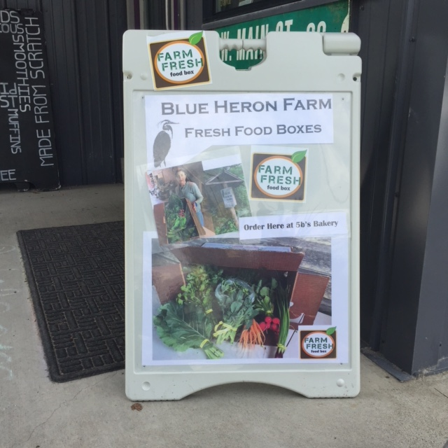
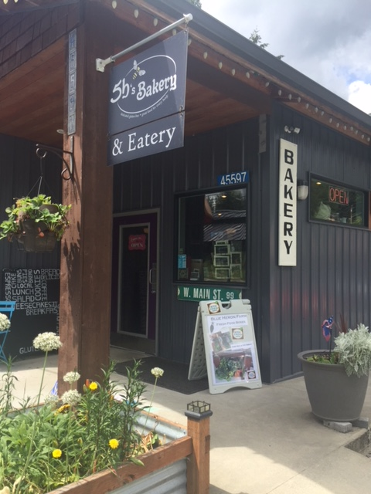
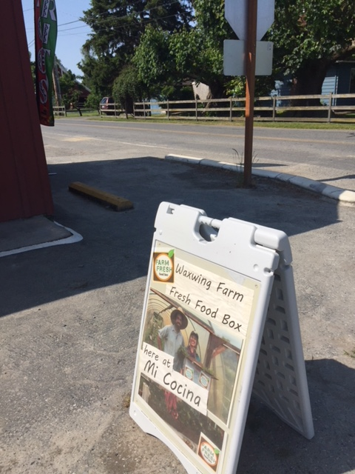
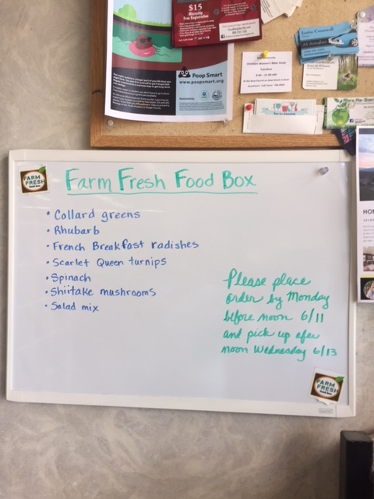
Washington State

Slide 9
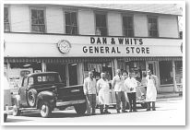
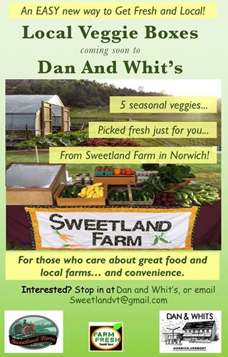
Vermont

Slide 10
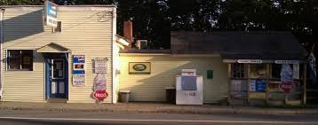
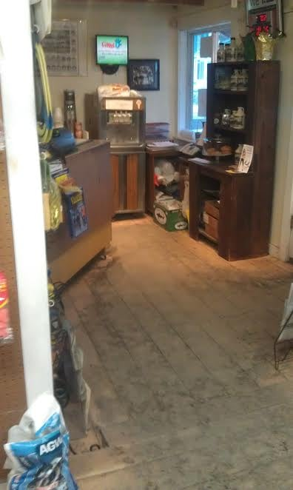


Slide 11
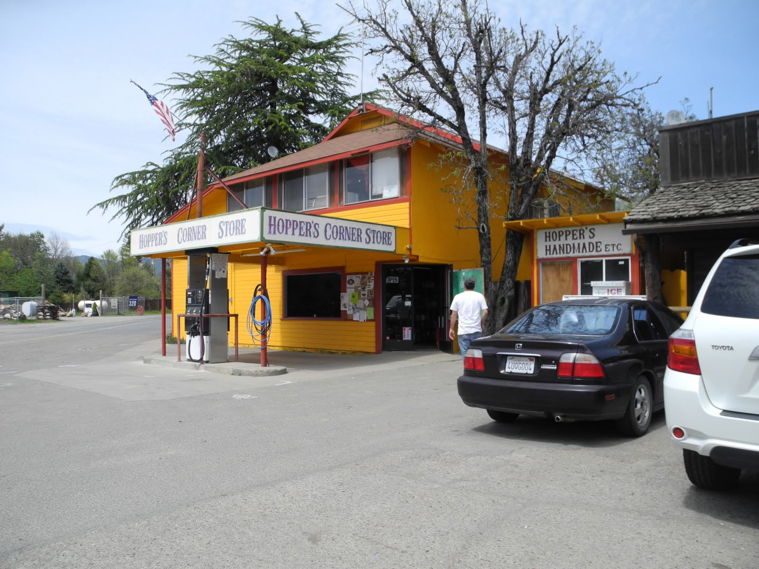
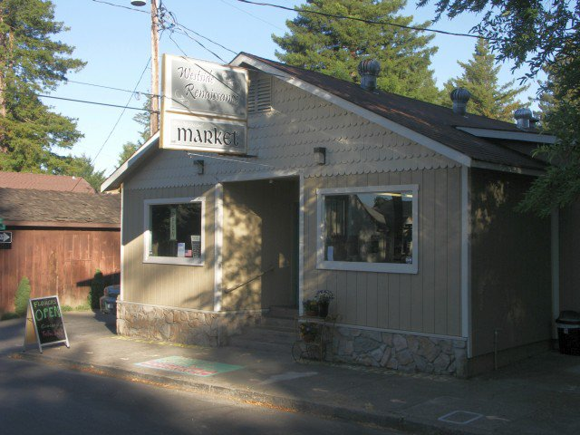
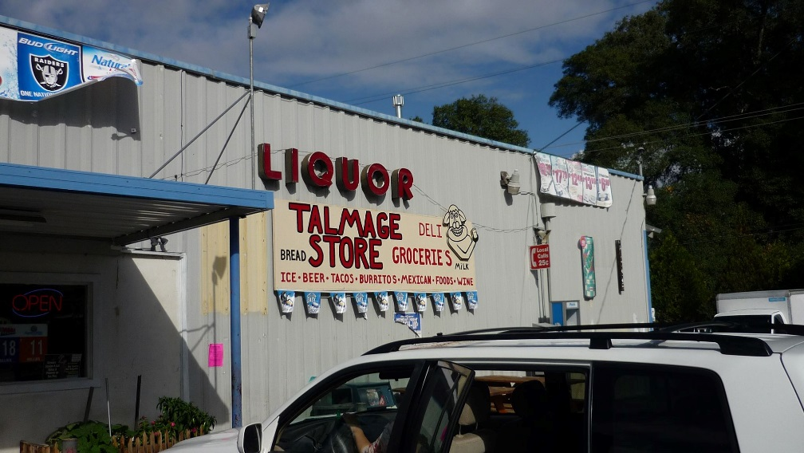
Westside Renaissance (Ukiah)
Hopper’s Corner Store (Potter Valley)
Talmage Store (Ukiah)

Slide 12
Roles throughout the season
Notes:
Providing an orientation and overview of the F3B model to each farmer and retailer
Helping each farmer set pricing, box size, and plan box contents for each week throughout the season and
Coach each farmer-retailer pair to create a F3B operations logistical plan that includes
date/time by which farmer will provide retailer with the list of weekly box contents;
date/time by which retailer will relay final order list to farmer;
date/time of weekly F3B deliveries to retail site by the farmer; and
mechanism by which retailer will transfer revenue to farmer (payment on delivery or invoice).

Slide 13
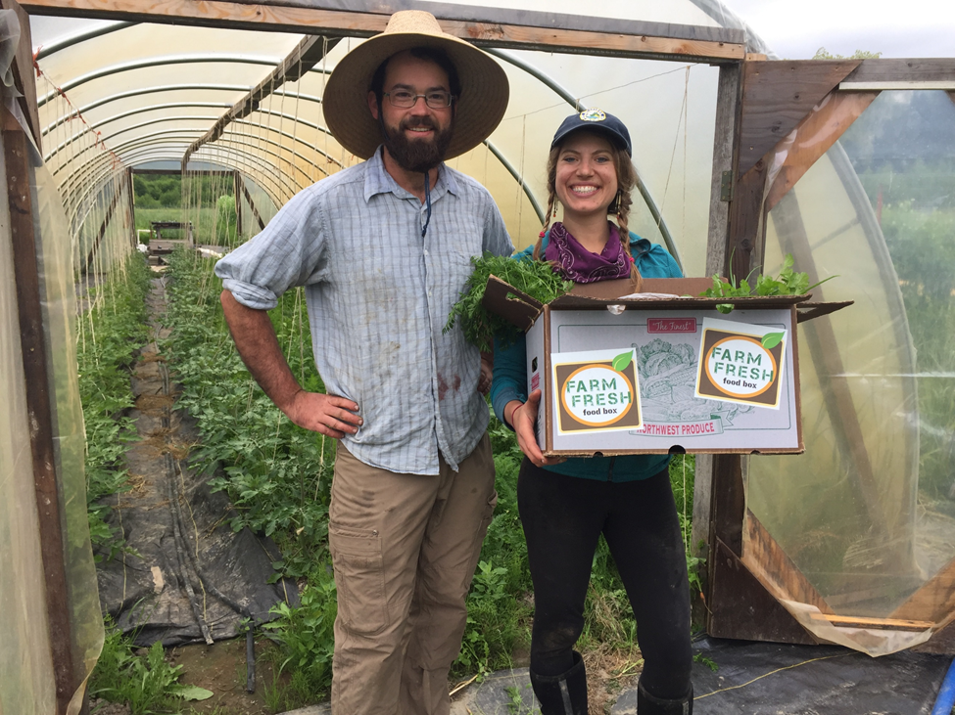
Extension Activities
Orient farmers & retailers to the F3B model
Help each farmer set pricing, box size, and plan box contents for each week throughout the season
Provide sales tracker & marketing materials to the retailer
Coach each farmer-retailer pair to create a F3B operations & logistics
Notes:
Providing an orientation and overview of the F3B model to each farmer and retailer
Helping each farmer set pricing, box size, and plan box contents for each week throughout the season and
Coach each farmer-retailer pair to create a F3B operations logistical plan that includes
date/time by which farmer will provide retailer with the list of weekly box contents;
date/time by which retailer will relay final order list to farmer;
date/time of weekly F3B deliveries to retail site by the farmer; and
mechanism by which retailer will transfer revenue to farmer (payment on delivery or invoice).

Slide 14
Research Activities
Assess the F3B market potential via consumer intercept surveys;
Measure economic impact of F3B project returns to farmers & retailers via sales tracker
Measure acceptability and use of F3B by consumers via purchaser surveys in each box
Compare benefits/challenges of F3B to other DTC approaches via farmer & retailer interviews and baseline demographic survey

Slide 15
Consumer Response in 2017

Slide 16
F3B Sales, 2017
ID | Boxes sold | F3B Duration | Box Price | Total Sales
1 | 5 | 1 month | $20 | $150
2 | 15 | 2 months | $20-$25 | $545
3 | 12 | 1.5 months | $30 | $360
4 | 136 | 6 months | $20 | $2,720
5 | 10 | 4 months | $20 | $200
6 | 11 | 1 month | $11-$18 | $402
Notes:
In 2017 there were 3 WA farms that partnered with 4 retailer (one retailer was subsequently dropped due to lack of sales).
In VT, there were 4 farms partnering with 4 retailers
Box prices ranged from $11 to $30 (median, $22.50).
There was a large variation both in how long the program was in operation for each farm-retail pair, as well as in the number of boxes sold.
F3B implementation in Vermont was of relatively short duration, averaging six weeks. Vermont retailers sold a combined total of 32 boxes for a gross revenue of $1,055.
F3B implementation in Washington occurred over a longer period (14.6 weeks on average); and retailers sold a combined total of 157 boxes for a gross revenue of $3,922. In total, 199 F3B were sold, on average 33 per store, which is on par with the 35 boxes sold in the single pilot location.
While market penetration is difficult to estimate, reported F3B sales could represent as much as 2% of local households on average (assuming no repeat purchases or out-of-area buyers).

Slide 17
Purchaser Surveys
A 20-item paper survey with questions about demographics, previous F3B purchases, frequency of store use, satisfaction
Included diffusion of innovation questions about relative advantage, simplicity/complexity, observability, compatibility and trialability.
12 Farm Fresh Food Box (F3B) customers completed consumer surveys between October 28 and December 13, 2017.
Notes:
Participating farmers included a consumer survey when packing each F3B.
Twelve responses were received, mostly from older, white, middle-income women living with a 15-minute drive to the store, who habitually shop other DTC venues.
Five respondents were frequent shoppers at the rural store and learned of F3B through store posters and handbills.
A majority expressed satisfaction with the quality and variety of produce in the F3B, as well as the value, ease of ordering, and interactions with retailers.
About half made additional purchases when picking up their box.
Two respondents felt F3B was not as convenient as shopping at a grocery store, due to inconsistent pick-up times.
Yet most felt the advantages made F3B worth trying, and stated that they would purchase F3B again next season.
While this sample was too small to be representative of all F3B customers, the results are promising. Researchers have shortened the customer survey to increase response rate next season.

Slide 18
Respondent Characteristics
All respondents identified themselves as white & non-Hispanic.
Most were females & aged 65 or older
Half reported household income between $25,000 - $75,000
4 had children under age 18 living with them
Most live within a 15-minute drive & visit the store frequently
Most respondents were first-time purchasers of F3B who had learned of F3B from in-store advertising.
Notes:
Participating farmers included a consumer survey when packing each F3B.
Twelve responses were received, mostly from older, white, middle-income women living with a 15-minute drive to the store, who habitually shop other DTC venues.
Five respondents were frequent shoppers at the rural store and learned of F3B through store posters and handbills.
About half made additional purchases when picking up their box.
Five customers shopped regularly at the store where they purchased their F3B, visiting once or more per week. Three visited the store between 1 and 3 times per month, and 3 said they shopped less than once a month at the store. Six customers said they made additional purchases while picking up their box, such as soda, cheese, sour cream, eggs, milk, cookie, beer, burritos, and smoothies.
A majority expressed satisfaction with the quality and variety of produce in the F3B, as well as the value, ease of ordering, and interactions with retailers.
Two respondents felt F3B was not as convenient as shopping at a grocery store, due to inconsistent pick-up times.
Yet most felt the advantages made F3B worth trying, and stated that they would purchase F3B again next season.
While this sample was too small to be representative of all F3B customers, the results are promising. Researchers have shortened the customer survey to increase response rate next season.

Slide 19
Places F3B customers get fresh produce
Number of responses
Notes:
When asked where they usually get their fresh produce, customers most frequently said it was at either a grocery store or supermarket, with two people saying they shopped both places (n=10). Local DTC sources, like farmers’ markets (n=9) and farm stands (n=8) were also frequently cited, as were gardens (n=8). The two respondents who did not mention grocery stores or supermarkets as sources of fresh produce said they shopped farmers’ markets, farm stands and food co-ops instead. Only one person mentioned the food bank as a source of fresh produce. No one said they left a CSA program to try F3B.

Slide 20
Initial Reactions to F3B
Freshness, quality & variety were the most-liked features
Customers were satisfied with the ease of ordering & interactions with the retailer
11 said F3B cost less than buying at the farmers’ market; 8 said it was less expensive than other places they shopped for fresh produce
Overall, respondents felt F3B was a good value for the money (n=11)
Notes:
Participating farmers included a consumer survey when packing each F3B.
Twelve responses were received, mostly from older, white, middle-income women living with a 15-minute drive to the store, who habitually shop other DTC venues. The demographic profile is similar to the customer demographic profile for other DTC venues, described previously in the published literature.
Five respondents were frequent shoppers at the rural store and learned of F3B through store posters and handbills.
A majority expressed satisfaction with the quality and variety of produce in the F3B, as well as the value, ease of ordering, and interactions with retailers.
Most customers were very satisfied with aspects of the F3B, most frequently with the quality and variety of the produce. Customers also frequently were very satisfied with the ease of ordering, the value for the cost of the box, and interactions with the retailers.
11 said F3B was less expensive than buying at the farmers’ market & 8 said it cost less other places they shopped for fresh produce
Two respondents felt F3B was not as convenient as shopping at a grocery store, due to inconsistent pick-up times.
Yet most felt the advantages made F3B worth trying, and stated that they would purchase F3B again next season.
While this sample was too small to be representative of all F3B customers, the results are promising. Researchers have shortened the customer survey to increase response rate next season.

Slide 21
Notes:
F3B seemed a good fit with consumers’ lifestyle habits.
For example, it was a good fit with family preference, the way consumers usually eat, and with meal preparation and shopping habits.

Slide 22
Notes:
Most respondents strongly agreed that the F3B model allowed them to put their food dollars towards support for local agricultural producers; that it is a good way for people to get food from local farmers, and a way to potentially increase fresh produce consumption. More than half felt it could increase store purchases and also bring more local shoppers into the store.

Slide 23
Insights from consumers
“I've been waiting for this in Skagit County since my daughter did it in St. Paul, MN and Bethel, AK 4+ years ago!!”
“I normally don't buy so much veggies at the same time, but I've found that it's convenient to have them on hand”
“I hope it is in this store next year” (9 strongly agreed).
Consumers Suggest:
Include recipes in the box
Find way to recycle empty boxes to the farm

Slide 24
Value Chain Insights
Many consumers want familiar staple items like salad, potatoes, green beans, corn & carrots. While they’re willing to pay slightly more than supermarket prices, they’re still sensitive to the F3B cost.
A marketing strategy is needed that goes beyond the in-store posters, handbills, and sandwich boards
Consumers may need an on-line ordering option if they find in-store ordering for subsequent pick-up inconvenient
Notes:
Post season interviews with farmers and retailers provided additional insight into consumer response to this DTC innovation:
Though some will purchase the more typical CSA-type box, retailers report that many consumers want familiar staple items like salad greens, onions, potatoes, green beans, corn and carrots. And, while they are willing to pay slightly more than supermarket prices for produce, they are still sensitive to the F3B cost.
A marketing strategy is needed that goes beyond the in-store posters, handbills, and sandwich boards currently being used.
In-store ordering for pick-up later in the week is inconvenient for some consumers; this could be addressed by instituting an online ordering system.

Slide 25
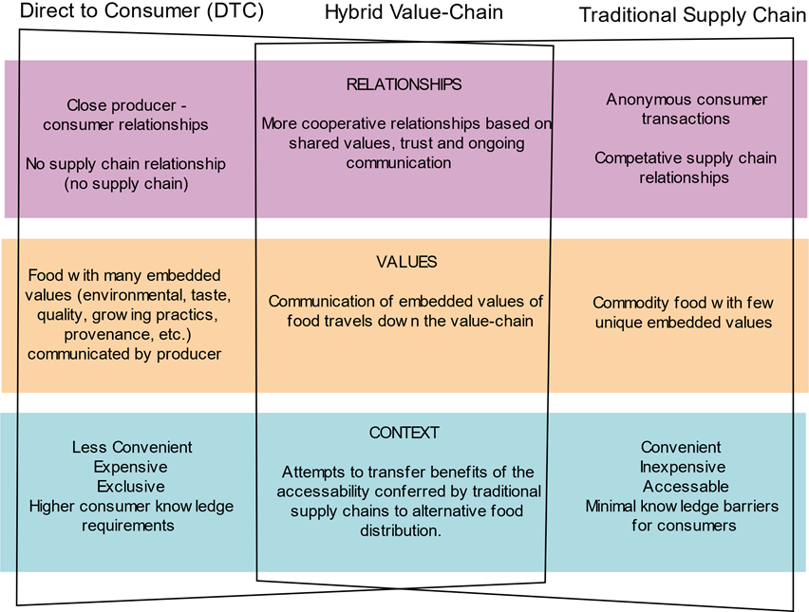

Slide 27
National Survey:
Spring 2018: National Consumer Survey regarding perceptions & use of DTC markets with a focus on F3B
401 respondents
We just started analyzing data
Notes:
While this sample was too small to be representative of all 2017 F3B customers, the results are promising.
To better understand consumer demand for the F3B, the team conducted marketing research with a national consumer panel in the spring of 2018. The survey, administered via telephone interviews, asked adult respondents about their perceptions and use of DTC venues. Preliminary findings suggest that, similar to other DTC approaches, consumers would be attracted to the superior quality and freshness of F3B produce when compared to supermarket choices, but in addition would be more likely to buy it since no season-long commitment is required.
Additionally, researchers developed an in-store consumer intercept survey to assess local consumer interest in F3B. The survey, currently being implemented, will ascertain consumer preferences regarding pricing, amount and variety of produce in the box, and mechanisms for ordering and picking up weekly boxes. The information will help farmer-retailer pairs tailor the F3B model

Slide 33
Next Steps
Pre-season 2018: In-Store consumer intercept surveys to assess interest in F3B, and preferences regarding pricing and desired amount/ variety of produce
Currently in the field for the 2018 season
Linked up with another AFRI (Cost-Offset CSA to prevent childhood obesity) to conduct a spatial analysis of direct to consumer food channels.

Slide 34
Publications and Presentations
Greco, L., Sitaker, M., Roche, E., Becot, F., Chase, L., Estrin, H., Smith, D., Van Soelen, J., & Kolodinsky, J. (2017, April). Farm Fresh Food Boxes. Poster session at the UVM Student Research Conference, Burlington, VT.
Sitaker, M., Roche, E., Becot, F., Chase, L., Estrin, H., Greco, L., Smith, D., Van Soelen, J., & Kolodinsky, J. (2017, June). Farm fresh food boxes open new markets for farmers and retailers, and benefit rural economies. Presentation session at the annual meeting of the Agriculture, Food and Human Values Society (AFHVS) /Association for the Study of Food and Society (ASFS), Los Angeles, CA.
Chase, L., Becot, F., Estrin, H., Greco, L., Kolodinsky, J., Roche, E., Sitaker, M., Smith, D., & Van Soelen Kim, J. (2017, June). Farm fresh food boxes: Expanding rural economies through new markets for farmers and retailers. Presentation session at the meeting of the National Association of Community Development Extension Professionals (NACDEP), Big Sky, MT.
Smith, D. K., Roche, E., Becot, F., Chase, L., Estrin, H. Greco, L., Sitaker, M. Van Soelen Kim, J., Wang, W.W., Kolodinsky, K. (2017, July). Farm Fresh Food Boxes: Increasing food access in rural communities through new markets for farmers and retailers. Poster session at the annual conference of the Society for Nutrition Education and Behavior, Washington D.C.
Smith, D. K., Roche, E., Becot, F., Chase, L., Estrin, H. Greco, L., Sitaker, M. Van Soelen Kim, J., Wang, W.W., Kolodinsky, K. (2017, November). Farm Fresh Food Boxes: Direct to consumer strategy for increasing food access and economic vitality. Poster session at the annual conference of the Tilth Alliance, Vancouver, WA.
Wang, W., Sitaker, M., Chase, L., Estrin, H., Becot, F., Greco, L., Roche, E., Smith, D. Van Soelen Kim, J., & Kolodinsky, J. (2017, August). Innovations in rural development: Farm fresh food boxes. Panel session presentation at the annual meeting of the Agriculture and Applied Economic Association (AAEA), Chicago, IL.
Smith, D.K., Greco, L., Van Soelen Kim, J.E., Sitaker, M., & Kolodinsky, J. (2018) Farm Fresh Food Box: An innovative new business model in rural communities, Rural Connections.
Sitaker, M., Kolodinsky, J., Estrin, H., Greco, L., Chase, L., Wang, W., Smith, D., Van Soelen Kim, J. (2018, June). Consumer response to Farm Fresh Food Boxes, an entrepreneurial partnership between farmers and retailers. Presentation session at the annual meeting of the Agriculture, Food and Human Values (AFHVS)/Association for the study of Food and Society (ASFS), Madison, WI.
Greco, Kolodinsky, Sitaker, Chase, Wang, Kim, Smith and Estrin (under review) Farm Fresh Food Boxes: Pilot Study Findings of Farmer – Rural Retailer Partners. Journal of Extension.
Greco et al. (in development). Hybridizing direct to consumer and value chain models: Farm Fresh Food Boxes (F3B). Agriculture and Human Values.

Slide 35






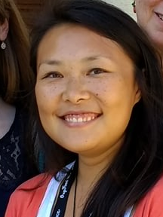

Project team: Investigators
Jane Kolodinsky Principal Investigator University of Vermont Center for Rural Studies Lisa Chase Co-Investigator University of Vermont Cooperative Extension | Marilyn Sitaker Co-Project Director The Evergreen State College Ecological Agriculture and Food Systems Julia E. Van Soelen Co-Investigator University of California Cooperative Extension
Hans Estrin University of Vermont Cooperative Extension | Diane Smith Washington State University Extension, Skagit and Whatcom Counties
Weiwei Wang University of Vermont Center for Rural Studies | Lauren Greco University of Vermont Center for Rural Studies
10

