Slide 1
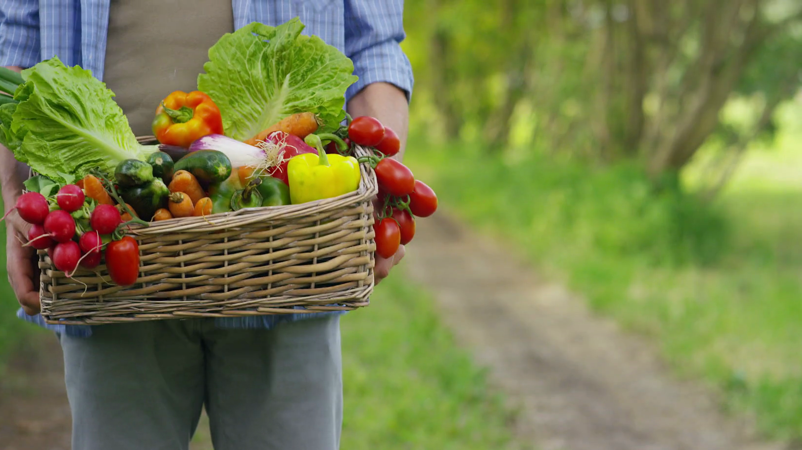
Growing the Local Food PIE:
Increasing Access and Creating New Markets for Farm Fresh Produce
Farm Fresh Food Boxes
USDA Grant 2016-67023-24853
June 10, 2019
NACDEP Conference

Slide 2

Farmers have difficulty making a living.
Consumers can’t access fresh, healthy, affordable food.
Notes:
Double bind: Small, diversified farms focused on selling to local markets struggle with profitability, while consumers lack access to local food for a variety of reasons.

Slide 3
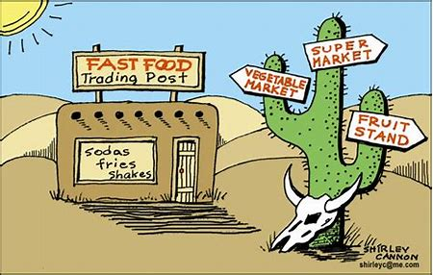
Food Desert
Notes:
Food deserts exist in every state throughout the US.

Slide 4
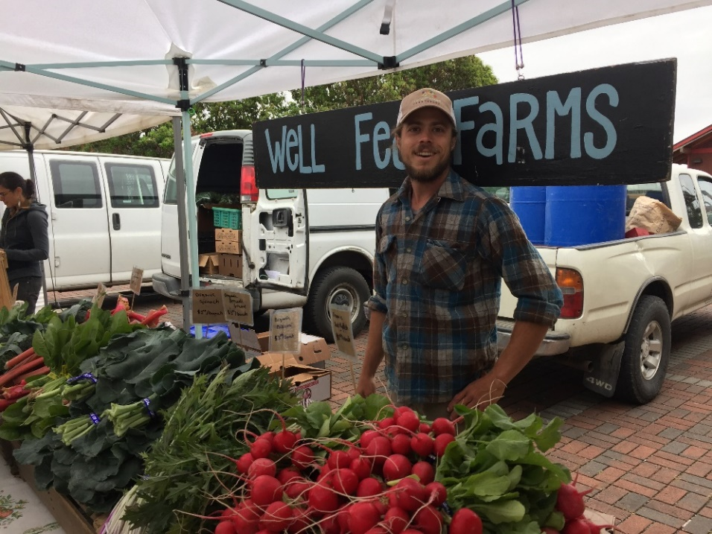
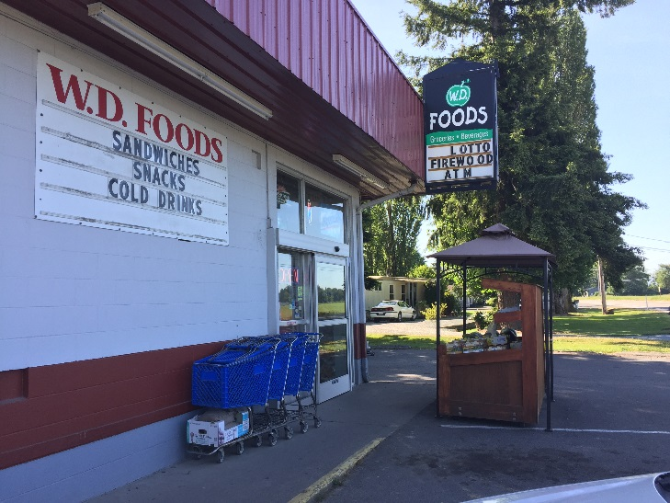
Well Fed Farms, WA
Notes:
Eric from Well Fed Farms in Skagit Valley, WA. Farm philosophy of taking care of the land and selling local, feeding his community. He regularly drove by a local store, WD Foods in Bow. The only fresh produce was bananas and apples.

Slide 5
HiGH MeadOws Farm, VT
Notes:
Across the country, Howard Prussack was experimenting with winter survival boxes from High Meadows Farm.

Slide 6

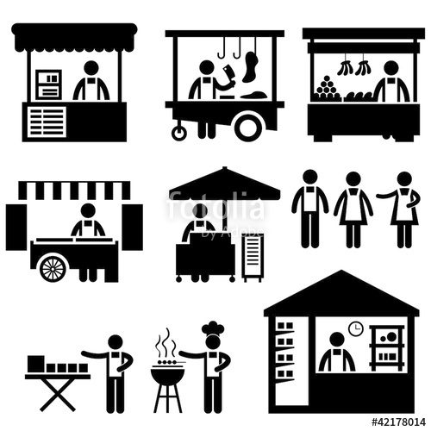

Three Target Groups
Farmers
Retailers
Consumers
Notes:
Three target groups we are focused on: Farmers, Retailers, Consumers
Specifically:
Small farms,
Small, independently-owned stores
Low income consumers with limited access to fresh produce

Slide 7
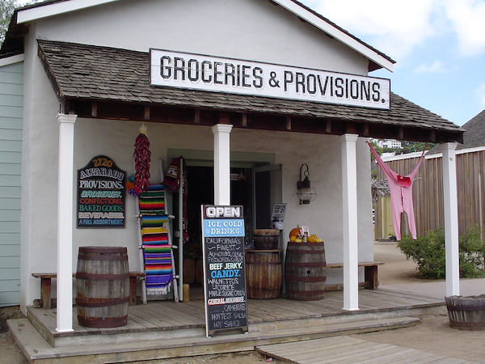
Farming and Marketing Trends
Large, centralized farms sell a large volume at low prices
National retail chains have forced small retailers out of business
Hard for consumers to access fresh, affordable produce in some areas
Notes:
Segments of the three target groups have been adversely affected by farming and marketing trends: Farms are getting bigger, stores are consolidating, consumers have less access to fresh, local produce.
Small-to-medium sized farms are at a business disadvantage compared to large, centralized farming operations that can offer a large volume at lower price to wholesale distributors (1).
The concurrent growth of large national retail chains has forced smaller retailers out of business, particularly in rural areas.
These parallel trends have weakened rural agricultural economies (2), and made it harder for local residents to access fresh, affordable healthy produce (3,4).

Slide 8
Rising demand for local food
According to the 2015 Local Food Marketing Practices Survey (USDA):
167,000 U.S. farms sold local food in 2015, generating $8.7 billion in revenue
Nearly two-thirds of locally produced foods marketed via wholesale channels
Direct-to-institution sales were the biggest revenue generator at $3.4 billion
Notes:
Largest revenue generator ($3.4 billion): Farms selling food directly to institutions and intermediaries, such as wholesalers who locally branded the product or food hubs
Direct-to-consumer sales amounted to $3 billion from approximately 115,000 operations
Up from approximately $1.2 billion in 2007, 136K farms
Sales directly to retailers were $2.3 billion from more than 23,000 operations
Consumers (35 percent of direct sales in 2015)
Includes sales through farmers markets, onsite farm stores, roadside stands, CSA (Community Supported Agriculture) arrangements, online sales, pick-your-own operations, mobile markets, and other means.
Retailers (27 percent of direct sales in 2015)
Includes supermarkets, supercenters, restaurants, caterers, independent grocery stores, and food cooperatives.
Institutions and Intermediary Businesses (39 percent of direct sales in 2015)
Includes institutions such as schools, colleges, universities, and hospitals as well as intermediary businesses such as wholesalers, distributors, processors, etc., that market locally or regionally branded products.

Slide 9
How many shop local?
Few national studies of shopping habits ask about direct-to- consumer venues or local foods
Blanck et al. (2011), analyzing NCI's Food Attitudes and Behaviors Survey (n= 1194), found that 27% of shoppers purchase food from direct-to-consumer venues weekly
A National Grocery Association 2014 Consumer Panel found 75% eat local foods regularly; only 27.0% consume them once a month or less.
Packaged Facts (2014) found U.S. food shoppers will intentionally seek out local foods, even at higher price points
  33% of consumers consciously buy locally produced foods weekly.
  ~50% are willing to pay up to 10% more for local foods
Notes:
Few research studies using a general population at the national level have been done on consumer attitudes towards local foods and the specific venues they use.
Blanck represents one of the few national studies of the general population, based on analysis of data from NCI’s Food Attitudes and Behaviors Survey (n= 1194). They found 27% of shoppers said they purchase food from DTC venues weekly [note: they only used data from respondents who said they were the primary grocery shopper for the HH. Analysis based on responses to “Where does the primary food shopper go grocery shopping?”, and “In the summer, how often does the primary food shopper get fruits and vegetables from a farmers’ market, roadside stand, pick-your-own produce farm, or community-supported agriculture program?”)
Blanck et al. (2011), used NCI's Food Attitudes and Behaviors Survey (n= 1194) and found 27% of shoppers said they purchase food from DTC venues weekly
Older adults & those in N.E. were most likely to shop DTC
No differences by sex, race/ethnicity, education, or HH income
National survey by Packaged Facts (2014) found U.S. food shoppers will intentionally seek out local foods, even at higher price points
33% of consumers consciously buy locally produced foods weekly.
~50% are willing to pay up to 10% more for local foods
Nearly 33% said they would pay up to 25% more.

Slide 10

Methods
National stratified random sample
Phone-based survey conducted by UVM Center for Rural Studies
Data collected March 1st-30th, 2018 (n=399)
Sample skewed slightly towards Males (63.8%), Whites (90%), Educated (53% with BS or more) and Older adults (median, 67)
Prior to analysis, data were adjusted (weighted) to reflect % each state contributes to the US population overall

Slide 11
Notes:
Overall, 79.5% of respondents said they had purchased F&V from one or more DTC venues in their lifetime (ie, Farmers Market, Farm Stand, U- Pick, CSA, farm box). NOTE: This includes ANY kind of fruit or vegetables, not just locally grown or organic. [Note: respondents were asked to check as many reasons as apply to them]
Farmers markets were the most frequently cited DTC market venues shopped either in the past month (73%), or some time in the past. This is followed by Farm stands, (55%) U pick (45%), Farm boxes (14%) and CSAs (6%).
Note: “farm box” was defined as…. A bulk box of fresh produce purchased directly from a local farm

Slide 12
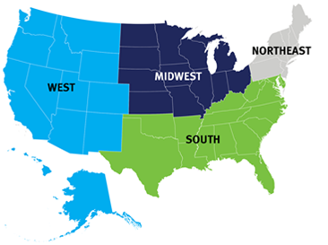
How does direct-to-consumer (DTC) food shopping vary by region?
Overall, 79.5% said they have bought produce at a direct-to-consumer venue, but this varies by region (below).
Additionally:
Farm Stand use: is significantly lower in the West than the South
Farmer's Market use: lower in the West than the Midwest or Northeast
CSA use: no significant regional variation
Lifetime prevalence of shopping any DTC venue
89.7%
64%
86.6%
81.5%

Slide 13
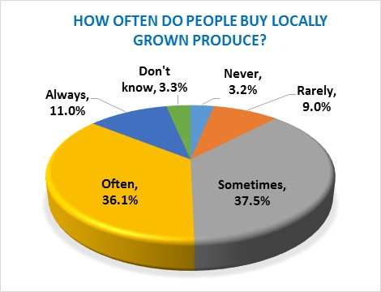
Shopping Direct-to-consumer venues & Buying local produce
29% of respondents said they had purchased fresh produce from just one direct venue; 45% from two different venues, and 5% from three or more venues.
Regarding locally grown produce, about 75% said they buy it ‘sometimes’ or ‘often’

Slide 14
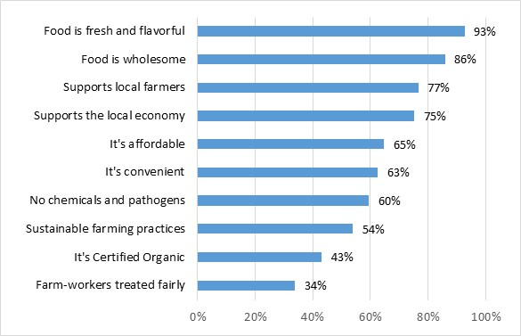
Why people say they buy local produce (n=350)
Notes:
For those who purchased locally grown produce, we asked what why they buy it. [Note: respondents were asked to check as many reasons as apply to them]

Slide 15
What’s Challenging for local food shoppers? (n=373)
Notes:
For those who do purchase locally grown produce, we asked what makes it harder for them to buy it. [Note: respondents were asked to check as many reasons as apply to them]

Slide 16
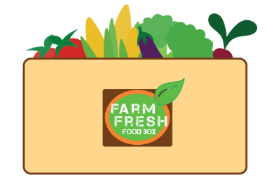
Farm Fresh Food Box (FFFB) Model
Notes:
To address these concerns, we developed the FFFB alternative. Here’s how it works…

Slide 17
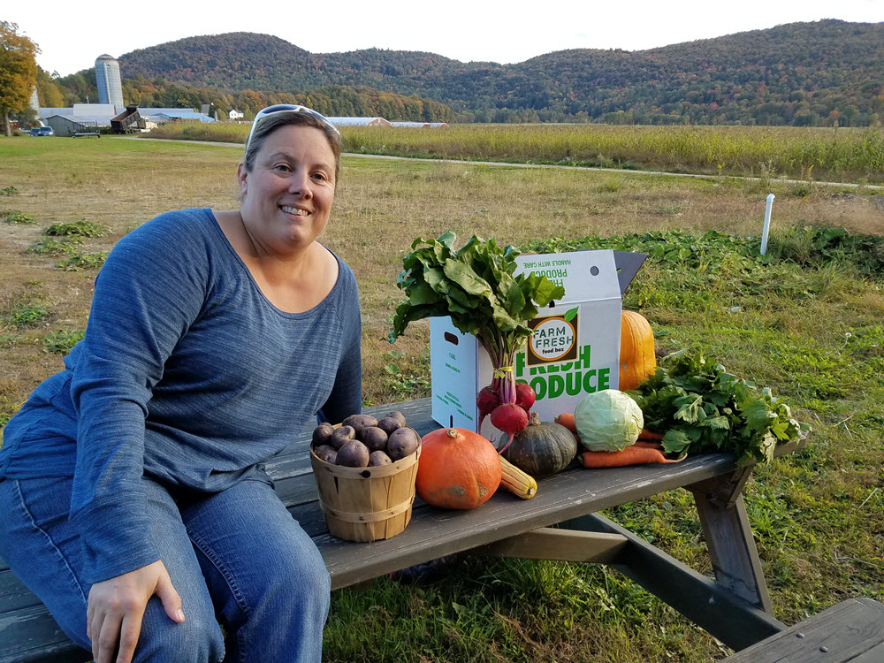
Farmer Role
Farmers offer weekly FFFB at participating retail sites that consumers can easily access. Box contents (and flyers) change throughout the season, to move product that is most abundant.
Notes:
Photo: Foote Brook Farm. By Hans Estrin.

Slide 18
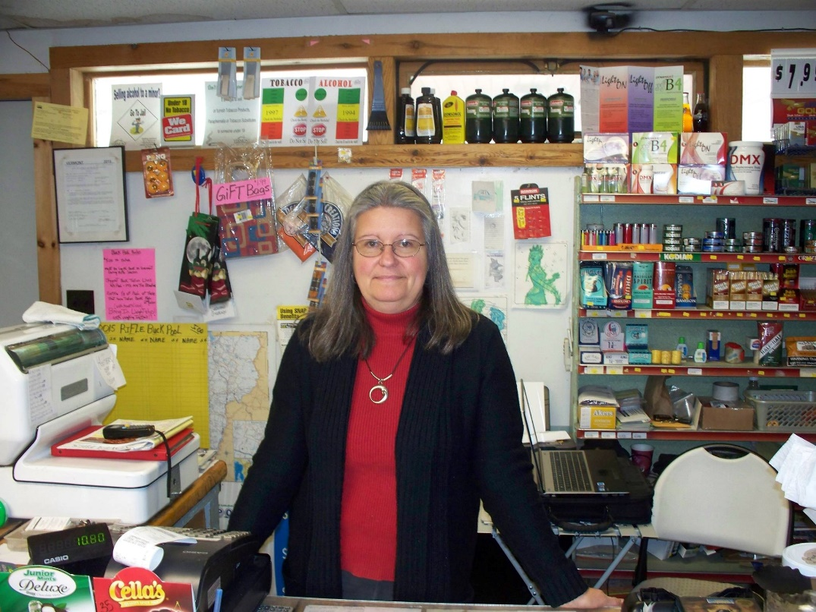
Retailer Role
Retailers provide a drop-off point for the FFFB, in exchange for a nominal transaction fee. Retailers advertise via sandwich boards, flyers, social media, and whiteboards detailing the cost and weekly content of the FFFB.
Notes:
Photo: Sheila Lord of Waterville Market. By Hans Estrin.

Slide 19
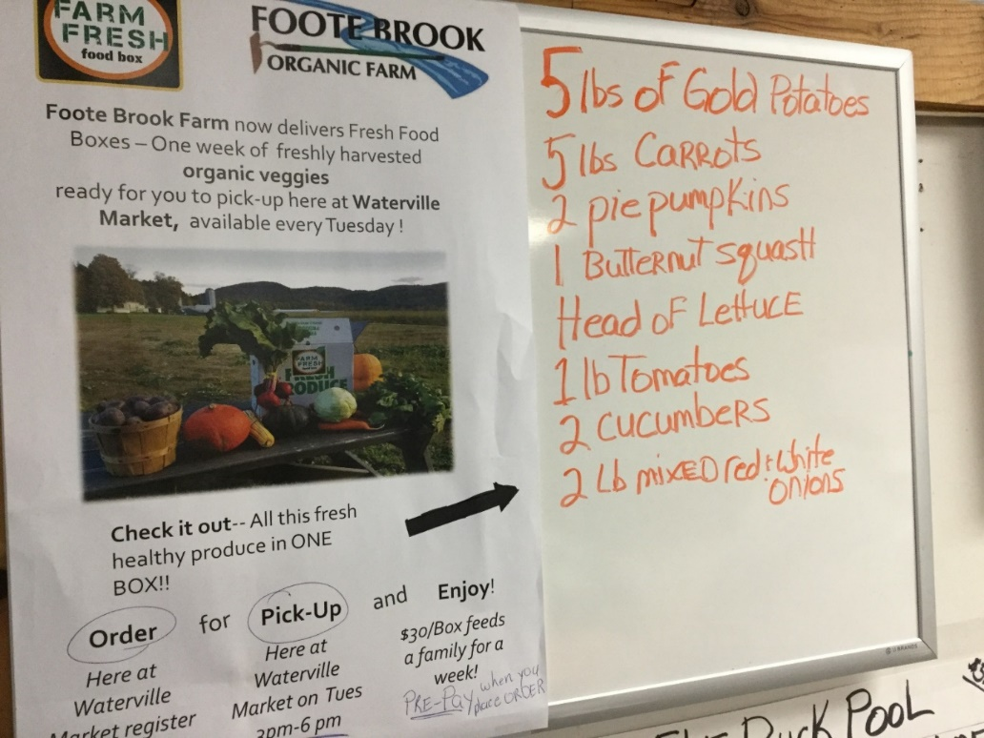
Consumer Role
Customers pre-order a weekly FFFB at the retail site or on-line on a week-to-week basis for later pick-up.
Notes:
Photo: Waterville Market and Foote Brook Farm White Board. By Hans Estrin.

Slide 20
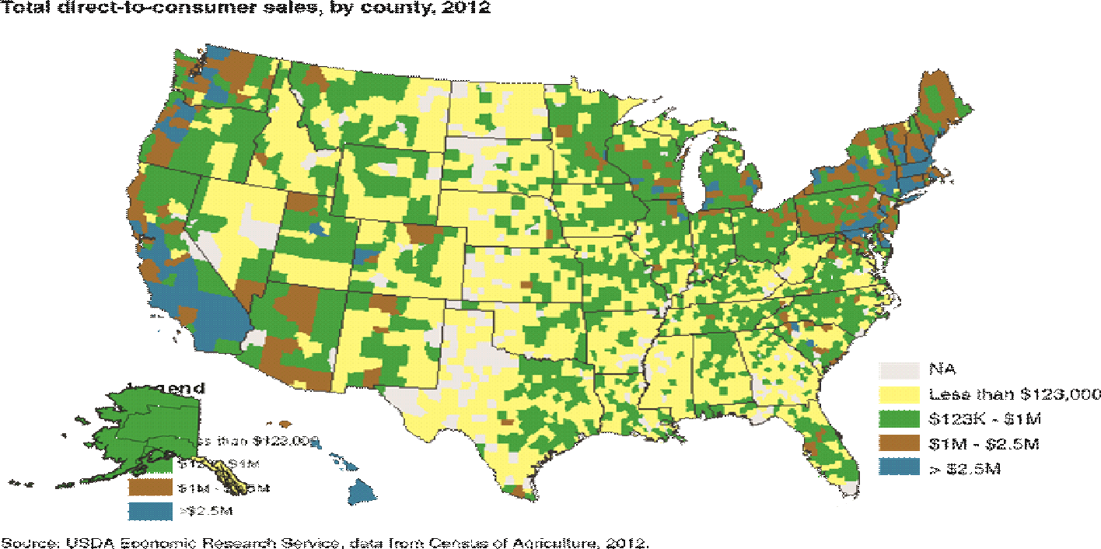
Pilot Sites in CA, VT, and WA
Direct to Consumer Sales by County, 2012
Washington
Vermont
California
v
v
v
Notes:
For this 30 month project,
We have chosen, as performance sites, 3 states with a good proportion of DTC sales in a number of counties.
In each site, there were 1-2 retailers associated with 2-3 participating farms in each state. This works out to between 6-9 farms overall. For retailers, this could be 2-6 in each state, or 12-18 overall.

Slide 21
Findings
Notes:
We have tested the FFFB model in an integrated research and extension project.

Slide 22
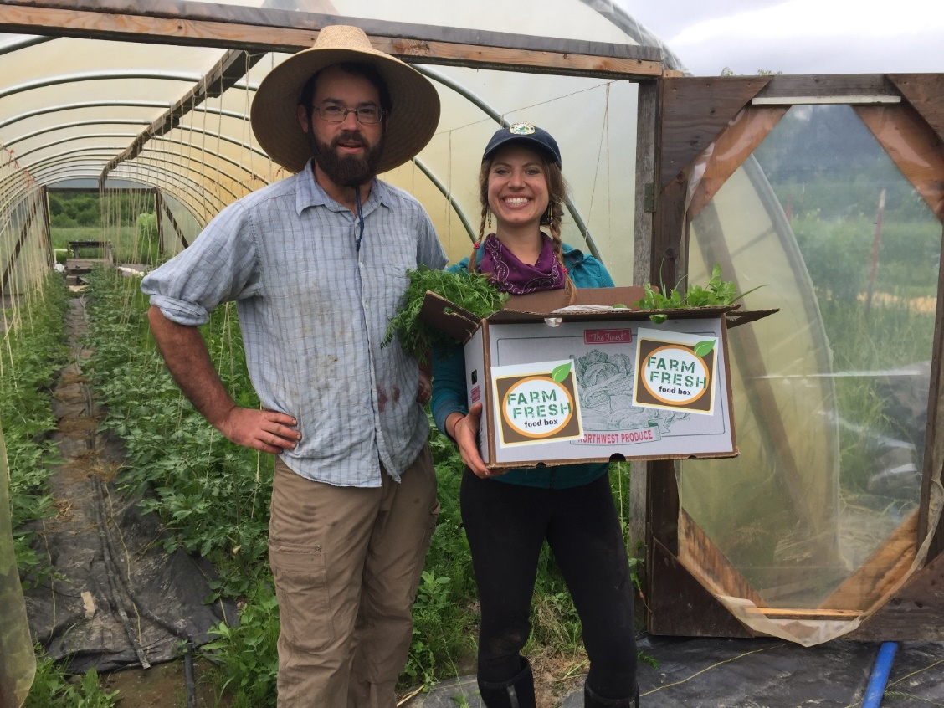
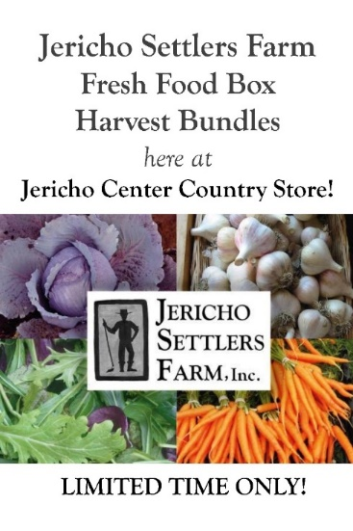
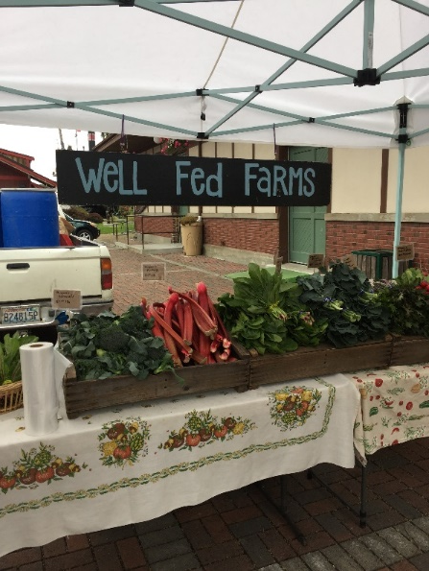
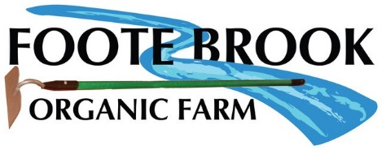
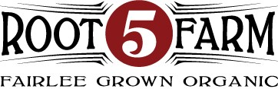
Farmer Recruitment
Notes:
Farmer recruitment has been going well in VT and WA and CA. Farms saw old CSA customers return (those who could not keep up with a CSA for financial or time reasons) as well as new customers who had always wanted to try farm products. The new model made it easier for customers to try the product. Some F3B members eventually became CSA members.
Photos: Diane Smith and Hans Estrin

Slide 23

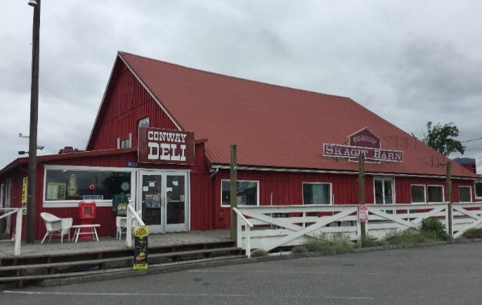
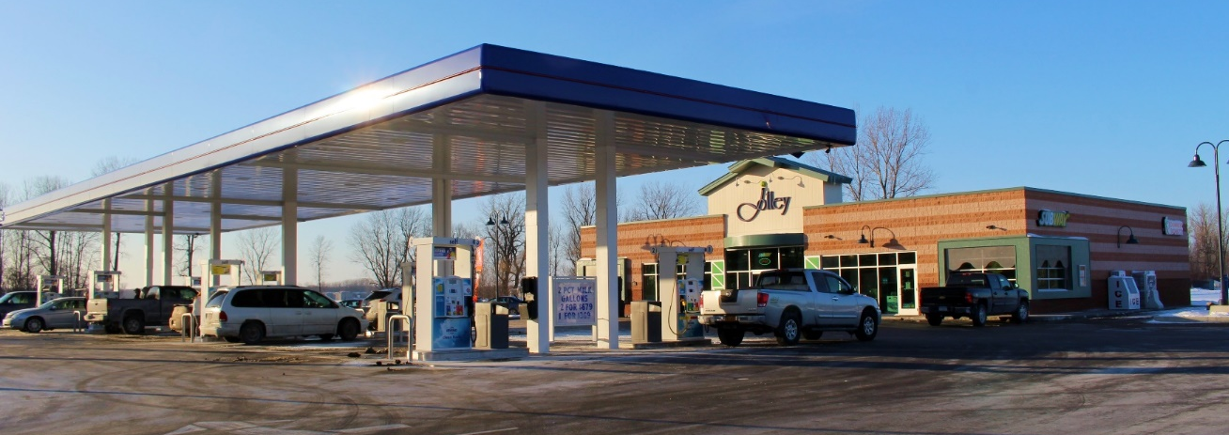
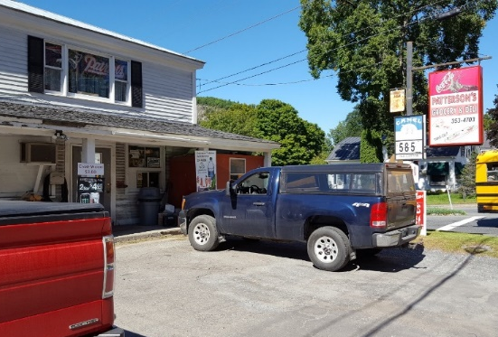
Retail Site Recruitment
Notes:
WD Foods in WA participated! Store recruitment has ranged from country stores to convenience stores and a variety in between. Goal is to supply fresh produce in places that don’t normally have it, to connect with new customers. A farm store probably does not reach new customers. We are focusing on other types of stores, such as country markets and convenient stores/gas stations. Stores did see an increase of people who had never purchased from the store come inside and purchase the boxes. That said, we were not able to measure whether those same customers increased their purchase of store items outside of the box purchase and whether they continued to purchase from the store outside of the box season.
Photos: Hans Estrin and Diane Smith

Slide 24
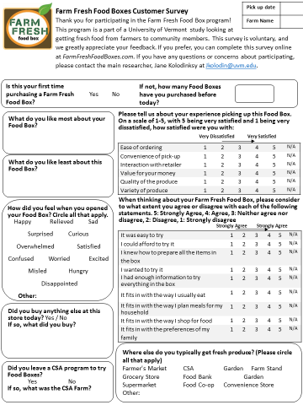
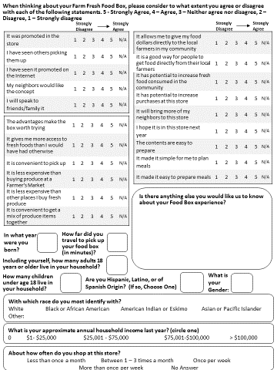
Consumer Survey
Notes:
Low response rate on the consumer survey. Low sales overall for most farms. The average number of boxes per week was about 3-5. Not every customer bought on a consistent basis; some would purchase every other week. Farms would have liked at least 8-10 boxes per week minimum but all said that they were willing to try again because they realize that new models take time to catch on.

Slide 25
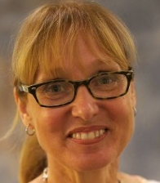

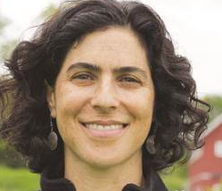



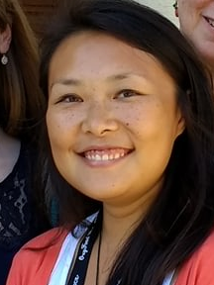
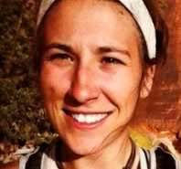
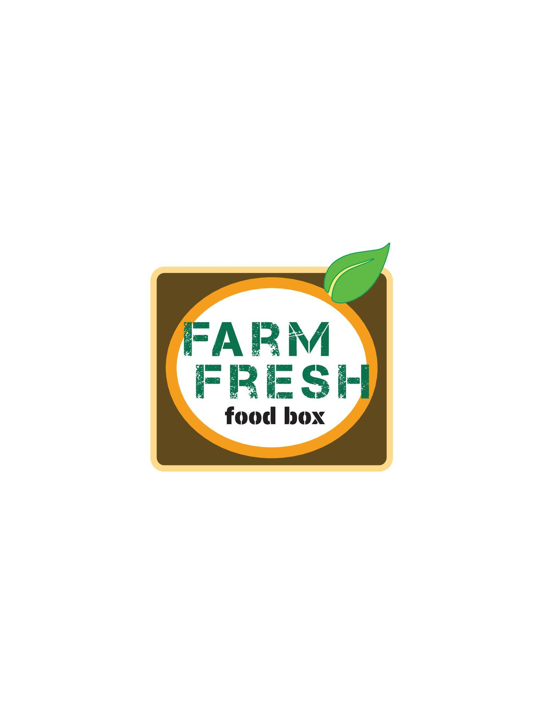
Project team: Investigators
Jane Kolodinsky Principal Investigator University of Vermont Center for Rural Studies Lisa Chase Co-Investigator University of Vermont Cooperative Extension | Marilyn Sitaker Co-Project Director The Evergreen State College Ecological Agriculture and Food Systems Julia E. Van Soelen University of California Cooperative Extension
Hans Estrin University of Vermont Cooperative Extension | Diane Smith Washington State University Extension, Skagit and Whatcom Counties
Weiwei Wang University of Vermont Center for Rural Studies | Lauren Greco University of Vermont Center for Rural Studies
10
Notes:
The team continues to explore possibilities and best practices for FFFB.

Slide 26

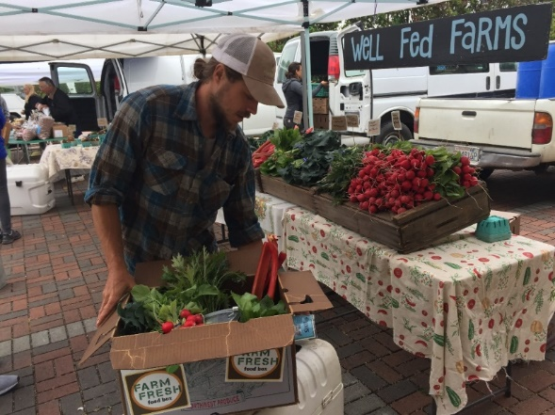
Acknowledgements
This work is supported by the United States Department of Agriculture (USDA), Agriculture and Food Research Initiative (AFRI) award number: 2016-67023-24853
Notes:
During the final year of the grant, we are sharing findings and will have a webinar and short course.
Photo by Diane Smith

Slide 27
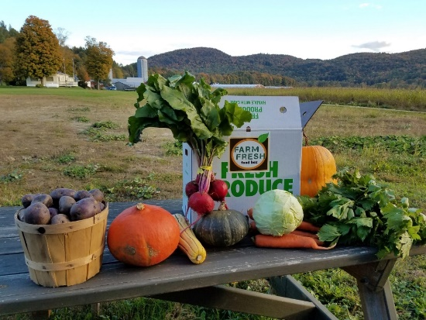
Questions
What models have worked in your communities that help with profitability for small, diversified farms?
What has been most successful in your communities for increasing access to local food?
Do you see the F3B model working in your communities? Why or why not?
Notes:
Questions for discussion.

