Slide 1
Preparing an Annual Assessment Report
Emily Manetta, Provost’s Faculty Fellow for APR/Assessment and Chair of the Department of Anthropology

Slide 2
Today’s workshop
A step-by-step overview of how to complete the assessment report
Time to ask questions about the report, plan, or assessment activities
Tips to make the process easier, more efficient, and at the same time more useful
But why: NECHE requires that the quality, integrity, and effectiveness of its academic programs be measured through “systematic assessment” to show that they are “demonstrably effective in the improvement of academic offerings, student learning, and the student experience” and that the institution have a record of “evaluation activities to inform planning, changes in programs and services, and resource allocation” (2.6-2.8)
This is the internal mechanism/process UVM has set up to meet this accreditation requirement for academic programs that do not undergo external review

Slide 3
What you will need
Your multi-year program/department assessment plan, focusing on the cycle you were in for AY 19-20
Whatever outputs your assessment activities produced
The annual assessment report for AY 19-20, due Feb 1, 2021 (delayed from Sept.)

Slide 4
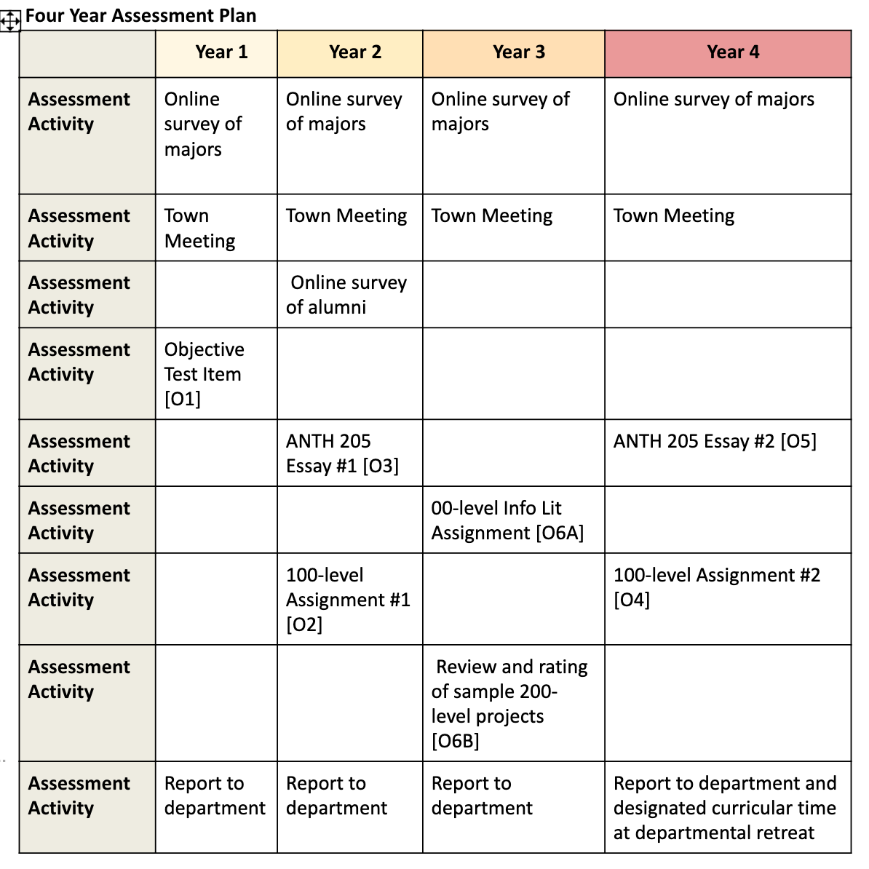
Your assessment plan
A short document to be found/filed at the sharepoint here if you don’t have a copy, and which should feature your learning outcomes, assessment activities you will undertake to evaluate whether you are meeting these outcomes, and (hopefully) a multi-year plan to do this in a reasonable way
Mine looks like this:

Slide 5
Your assessment plan – troubles and tips
TROUBLES
You might find that your assessment plan is incomplete or out of date, or no longer reflects the current state of your program/offerings
You might find that there are so many learning outcomes or assessment activities, or that your program did not stagger assessments over multiple/enough years
You might find that the plan was fine but some or all of the activities weren’t assigned to faculty, staff, teaching assistants or the appropriate coordinator
TIPS
Reasonable # of outcomes
A 4-5 year plan, spreading out the work (and targeting different levels/parts of the curriculum)
A designated person to keep the system running who is on top of things
Assessment activities that target outcomes directly and are reasonable in effort to perform

Slide 6
Your outputs from AY 19-20 activities
These can be quite diverse and should match the outcomes assessed:
Activity | Output
MC question on intro class exams | Chart plus brief breakdown/interpretation
Essay in advanced course | Ratings day chart plus brief interpretation
In-class discussion activity on ethical research practices | Brief faculty summary and qualitative evaluation
Alumni/major survey | Survey results plus brief interpretation

Slide 7
Your activity outcomes – troubles and tips
TROUBLES
While the assessment activities happened, no reports were generated – you have raw data
The activities didn’t happen (because of COVID disruption or because the process was neglected)
The activities you assigned yourselves are too complicated and can’t be done easily
TIPS
Spread the love! Figure out at the beginning of the year who will be performing what activity and whom they will report to, then follow up
Consider simpler activities for the first year or two, to get warmed up
Be curious about outcomes – are there things you really want to know?

Slide 8
The assessment form – getting it done
For the well-organized program, a combination of central storage and spreading the work out over teams will mean this annual exercise is about 15 minutes of cut-and-paste work
For the rest of us, the idea is to do the best you can and be honest about what you want to improve and how you will make that happen (if only to make next Sept. 1 even easier)
Put in what info you do have, however raw it may be, and try to provide the interpretation yourself as best you can if it is absent. What can be learned even from partial data?
If there were COVID-related disruptions, say so and talk about whether you will skip or make-up assessments.
If you feel that the assessment plan you attach to the form is inadequate or needs work, say so, and indicate when you will get that done and who will be responsible

Slide 9
just do it

