Slide 1
Data and its use in assessment and program review: program-level metrics
Alex Yin, Executive Director, OIR
Emily Manetta, Provost’s Fellow for APR/Assessment

Slide 2
Familiarizing yourself with available data
Chairs and program directors typically seek data in order to conduct periodic program reviews, prepare reports for external accreditors, and to justify staffing proposals
This type of data can also be used to evaluate curricular design, curricular flow, and form the basis for direct and indirect assessment of and best matching assessment to certain outcomes
Many program-level metrics at UVM are made available through dashboards via the Office for Institutional Research (OIR)
This presentation gives you an up-to-date overview of the kinds of data easily available to you through the dashboards, and ideas for how it can be used
The goal is to encourage frequent and proactive use of this data alongside annual assessment work as a comprehensive review, not only when an APR or accreditation review rolls around

Slide 3
Student retention and graduation
How well does your program, department, or major retain students? How long do they take to graduate?
Consider reviewing the adjusted retention and graduation rates, which look at retention and graduation rates based on a student’s major in their third fall semester
What is happening in the 3rd and 4th year of your curriculum, and how well are students meeting your stated learning goals in those years?
https://www.uvm.edu/oir/retention/graduation-planning - go to the section on Retention and Graduation Rates by Adjusted Cohorts

Slide 4
Student flow
How do students flow into or out of your program?
The Student Flow Dashboard shows you what programs are receiving your students when they leave your program. The Student Flow, Semester-to-Semester and Student Flow, Fall Term-to-Fall Term examines student pipeline (what majors your students are coming from) and student pathway (where do your students go).
You can use Retention and Graduation Rates by Adjusted Cohorts alongside this data to build a comprehensive picture of how program and curricular structure and program-internal advising may influence student flow.
Are there targeted changes at key points that could aid in earlier recruitment and greater retention? How does this data interact with your assessment of outcomes at various levels to indicate, for instance, where students may be underprepared for advancement?
https://www.uvm.edu/oir/retention/graduation-planning, go to the Student Flow Dashboard.

Slide 5
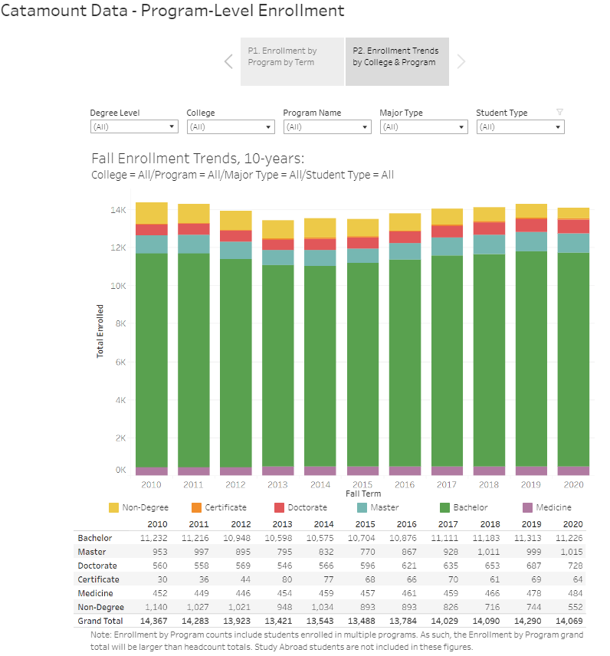
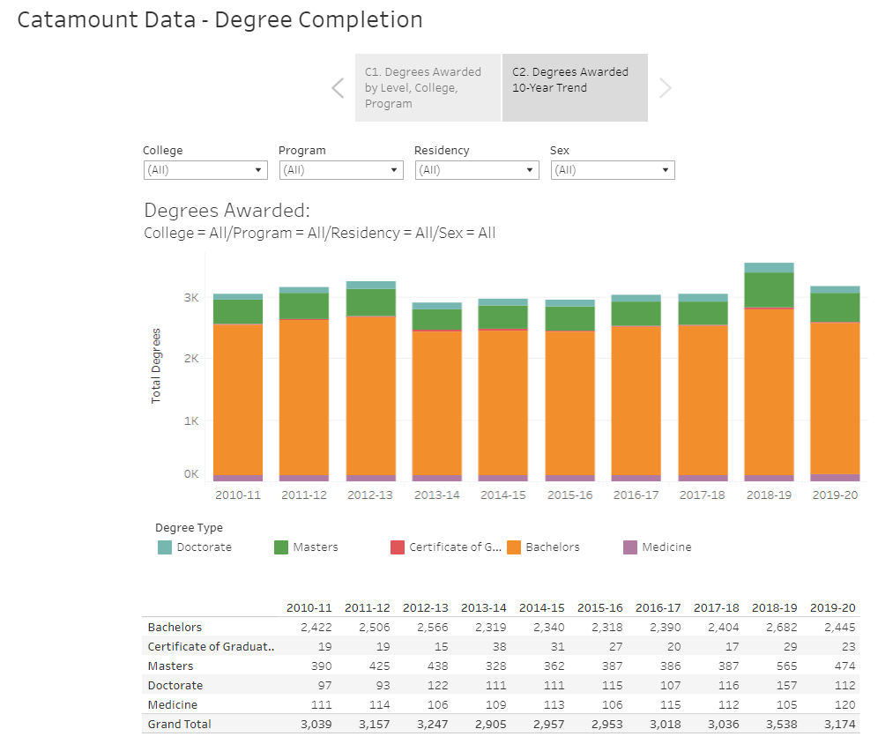
Program growth (1 of 2)
https://www.uvm.edu/oir/program-level-enrollment and https://www.uvm.edu/oir/degrees-awarded

Slide 6
Program growth (2 of 2)
How has our program changed in size over time?
There are two ways you might measure size: Program Enrollment and Degrees Awarded
FYI: The program enrollment dashboard shows students with multiple majors and those studying abroad in a given semester, and can be viewed over 10 years
If your program has changed in important ways (e.g. credits or degrees) have you considered revision to your 3/5-year assessment plan? If you plan to change something, how might that impact outcomes and levels at which you assess student learning?
https://www.uvm.edu/oir/program-level-enrollment and https://www.uvm.edu/oir/degrees-awarded

Slide 7
Post-graduation and career outcomes
Where do students go when they complete their degree in your program?
The Career Center and OIR produce annual reports on students’ post-graduation outcomes six-months out. Due to small numbers, the reports do not disaggregate by major.
The methodology in collecting this information aligns with the National Association of Colleges and Employers (NACE), which provides national benchmarks by programs (https://www.naceweb.org/job-market/graduate-outcomes/first-destination/).
OIR encourages programs to conduct periodic surveys of their alumni and can help you to design an effective survey instrument; we are currently working to set up a resource hub for this purpose with best practices, tools, and templates available for programs
Alumni and major surveys can form a key component of indirect assessment efforts for your program
https://www.uvm.edu/oir/career-outcomes

Slide 8
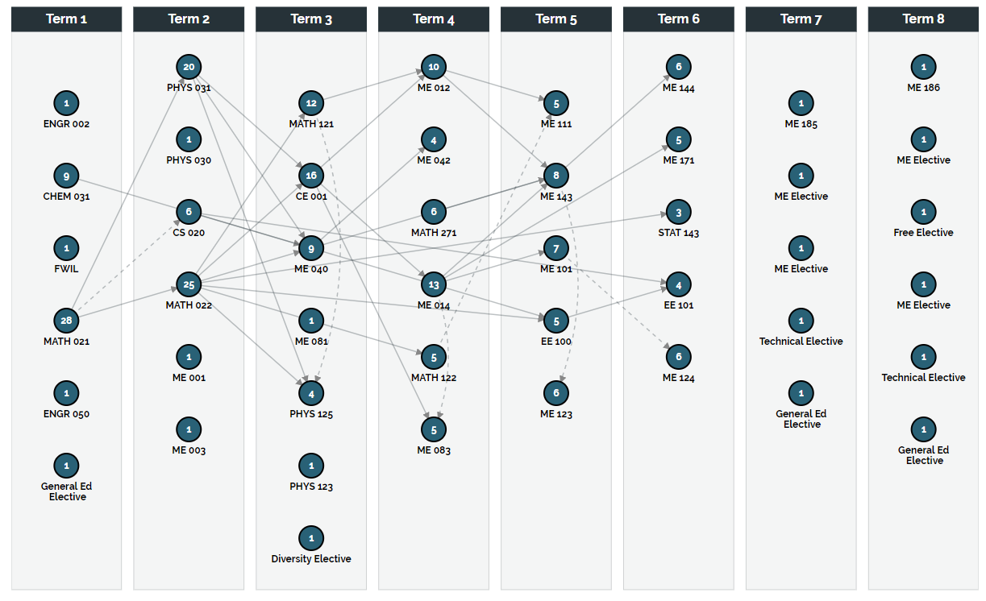
Curricular design (1 of 2)
What are quantitative approaches to evaluating curricular design?
Curricular Analytics, a free program, allows you to visualize the complexity of your curricula and degrees plans (https://curricularanalytics.org/) -- reach out to OIR for support in creating the files for the visualizations.
https://www.uvm.edu/oir/career-outcomes

Slide 9
Curricular design (2 of 2)
What are quantitative approaches to evaluating curricular design?
The Student Curriculum Matrix (https://www.uvm.edu/oir/university-department-planning -> go to the section on Student Credit Hours & Matrix Dashboards) allows you to examine who (e.g., by major and class level) is taking your courses and what courses your students are taking.
This can be helpful in identifying how effectively students progress through your program and whether there are bottlenecks. It can also suggest patterns in the ways in which your program’s students fulfill other requirements throughout the university.
This resource can be used alongside assessment in determining how well the design is meeting program goals and can inform the curriculum mapping portion of your assessment planning or plan revision.
https://www.uvm.edu/oir/university-department-planning

Slide 10
Wrap-up
Data concerning student pathways through your program, program size, and curricular design work together with what you learn from your assessment to inform a range of decision-making at the program level
Familiarity with this data and how it changes over time can also allow you to actively manage and evaluate the impact of any changes
Ideally integrating this kind of data-based program-level evaluation with assessment as an annual practice will also make program review and/or accreditation simpler
Upcoming assessment workshops: Jan 20 – DEI in Assessment: Designing DEI-focused Learning Outcomes; Jan 27 – Preparing an Annual Assessment Report

Slide 11
Questions

