Slide 1
UVM Legislative Policy Summit Building Vermont’s Advanced Manufacturing Infrastructure: Opportunities and Best Practices
Christopher Koliba Ph.D. Professor, Community Development & Applied Economics, University of Vermont
Janette Bombardier Senior Location Executive, Global Foundries
Brenan Riehl President , GW Plastics
Joan Goldstein Commissioner, Department of Economic Development
UVM – Legislative Research Summit on Economic Development
November 17, 2015
University of Vermont
Notes:
CHRIS

Slide 2
Manufacturing of the Past:

Slide 3
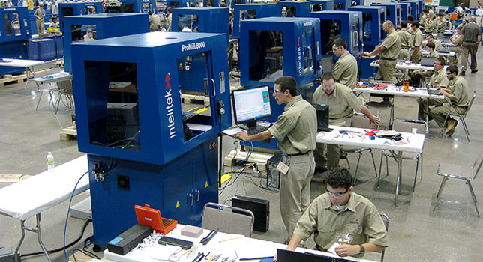
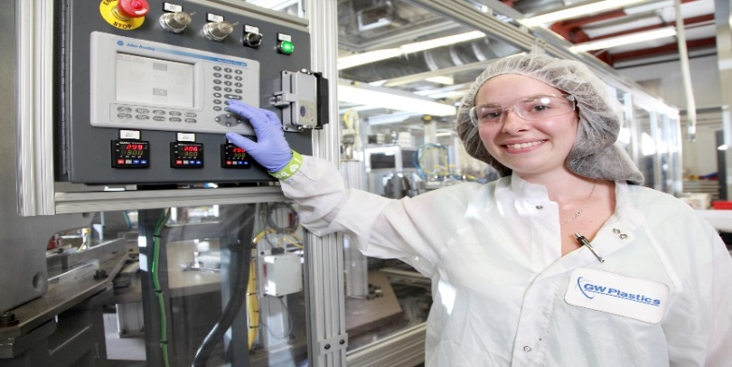
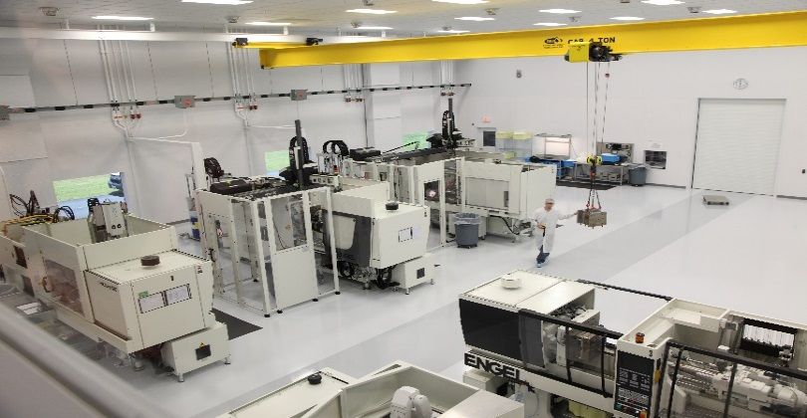
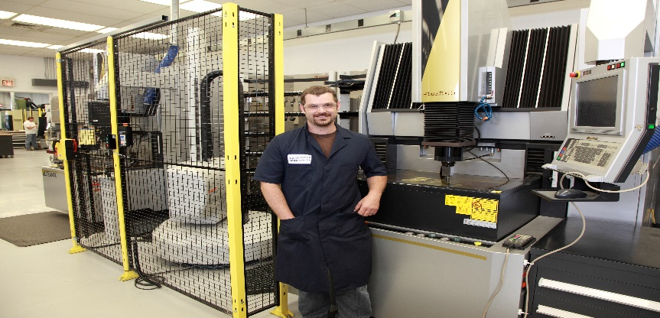
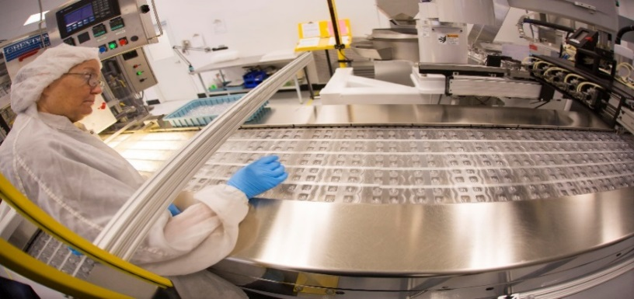
Manufacturing: Now and Future?
Notes:
CHRIS

Slide 4
Importance of Manufacturing to Vermont: Labor statistics
Statewide employs:
30,000 persons as of September 2015
At year end 2014: 31,000 contracting slightly
In US:
12,317,000 September 2015
12,301,000 December 2014 nationwide slight increase
Manufacturing Employment:
During the last 5 years has grown in the US from 10mm to 12.3mm
During the last 5 years has slightly contracted in VT: 30,747 to 30,200.
As of first quarter 2015:
1,049 establishments in the manufacturing: super sector: includes durable and non durable
13.9 per hour average wage and > 14 per hour for durable sub sector
$427mm total payroll for first quarter 2015 Annualized : $1.6 billion
We do not want this sector to contract: we want to retain and grow it!
Source: BLS and VTDOL.

Slide 5
Relative Importance of Manufacturing
Natural Resources + Mining

Slide 6
Impediments to retention and growth:
Availability of Suitable Housing
Developable Land
Skilled
Workforce
Adequate Infrastructure
Capex Investment:
Equip and C & I Facilities

Slide 7
Department of Economic Development Programs
VEPC / VEGI
Business Revenue Enhancement
Vermont Training Program Funds
Workforce development Assistance
EB-5/Captive
Financing
Government Procurement Assistance, Export Assistance
Growth in employment

Slide 8
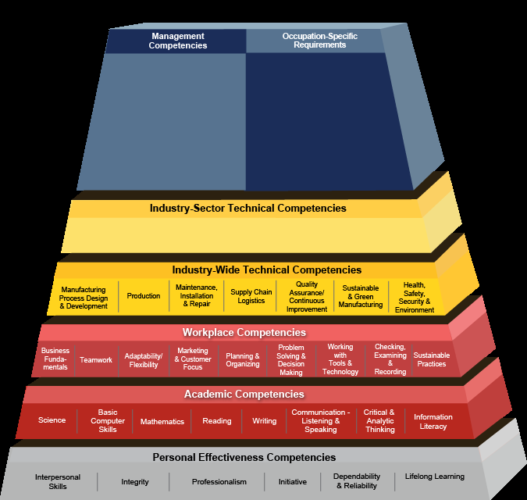
Learning and Skills Competencies
Competency is a cluster of related knowledge, skills, and abilities that affects a major part of one’s job (a role or responsibility), that correlates with performance on the job, that can be measured against well-accepted standards, and that can be improved via training and development.
Notes:
CHRIS

Slide 9
Solutions

Slide 10
Workforce Needs

Slide 11
GW Plastics: examples of best practices in action

Slide 12
Best Practice examples in VT
Current:
VAST program: Senior year in HS is the first year of College paid for. Then one more year for an associates degree.
VTC apprenticeship program: GW Plastics, GE Aviation, GS Precision
School of Tech: Randolph HS students attend class at GW for credit.
CCV: Program with Global Foundries
Future:
Required PLPs: Personalized learning program for each HS student: an opportunity to team up with secondary schools and employers for programming that will make students notice what it takes to be employed in 21st century.
Pre-pipeline development: 8th grade math mastery

Slide 13
Career Literacy Cycle: Start early to influence outcomes and achieve competency.
Awareness
Preparedness
Hope: within the realm of the possible
Achievement of Competency
Hard Work
Job opportunity with capability to fill

Slide 14
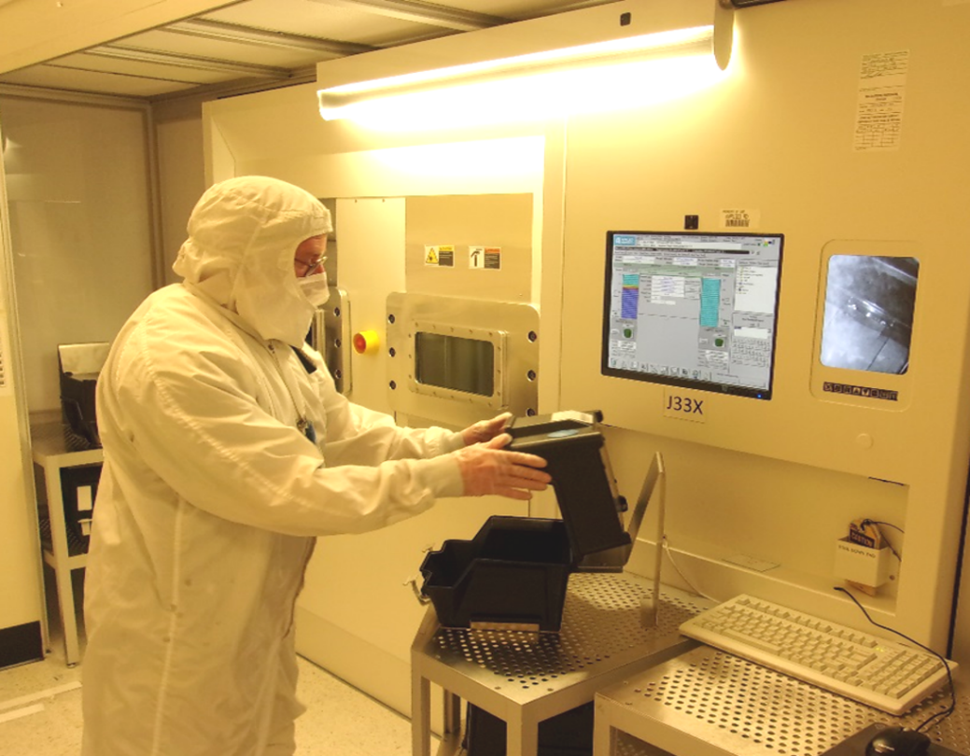
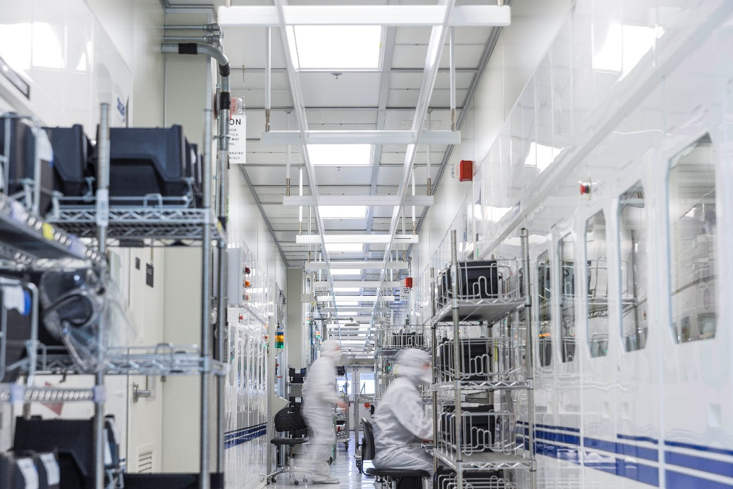
Global Foundries

Slide 15
Gaps and Challenges Differences in Vermont in regards to support of the Manufacturing Sector
Advanced Manufacturing Competes Globally
Transportation Network
Needs improvement – Roadway construction and improvement based on the needs of moving raw materials and finished goods for economic sustainment and growth. Truck safety needs to be considered
At risk – Increasing the cost for employees to get to and from work.
Energy
An asset – The power quality and reliability in Vermont and responsiveness of our energy utilities
A negative – Prescribed spending for energy efficiency via power bill or other programs which competes with spending for operation growth
At risk – Increasing those costs with additional fees and with policy that increases costs
Compared to others – No subsidy or power grants of any form

Slide 16
Gaps and Challenges Differences in Vermont in regards to support of the Manufacturing Sector
Economic Development Policy and Practice
Compared to others: No programs to support state “ anchor tenants”
Enterprise Fund is not sustained at this time
No programs/policies to support the R&D at manufacturing facilities
Taxes
Compared to others – No subsidy or tax elimination programs for Property Tax
Government
An asset – Vermont State government is approachable
A negative – Vermont regulation that is duplicative of Federal issues
At risk – Regulation on material content that drives manufacturing cost and compliance cost

Slide 17
What else do we need?
How to best move forward to plant the seeds for growth?
Legislation
Policy
Practice
Public/ Private Partnerships

