Slide 1
The Intersection of Transportation Resilience and Economic Opportunity
University of Vermont Legislative summit
Nov 17, 2015
Secretary Chris Cole
Vermont Agency of Transportation

Slide 2
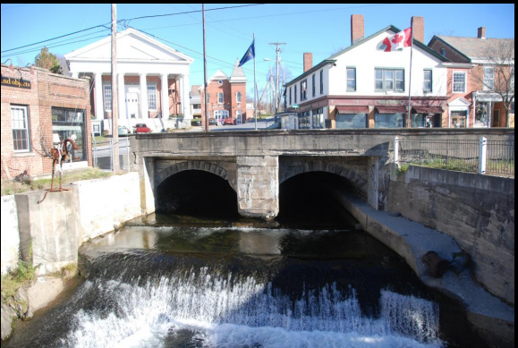
Premise
90% of VT employees work for small businesses
Downtowns consist mostly of small businesses
Downtowns grew-up around rivers and are vulnerable to flood damage
Improving infrastructure resilience to flooding will improve economic resilience

Slide 3
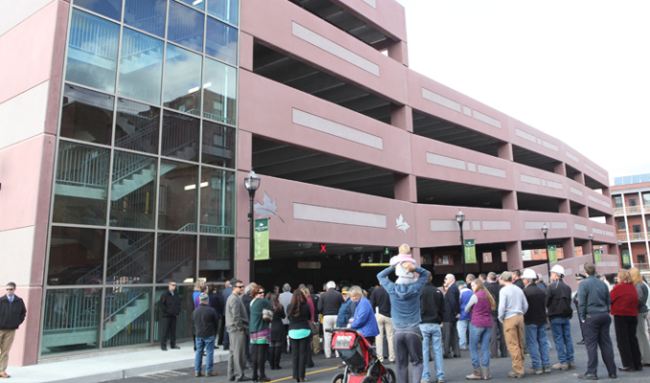
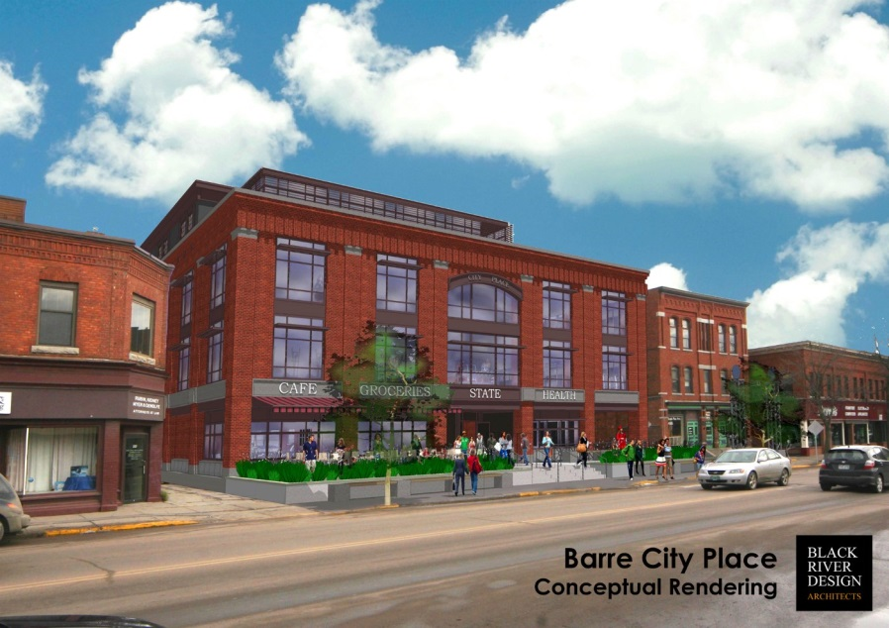
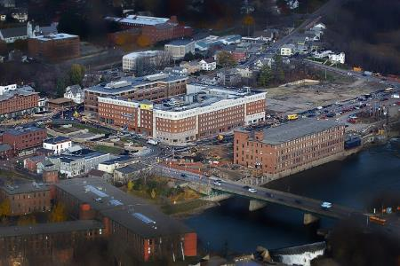
Investing for the Future Growing Our Downtown Economies
St. Albans
Barre
Winooski
3

Slide 4
Downtown Investments Pay-Off
Barre
2011-2014
Public $$ = $19,936,230
Private $$ = $45,122,000
Net Change in Businesses = +24
Net Jobs Added Since 2011 = +263
St. Albans
2011-2014
Public $$ = $12,848,171
Private $$ = $33,783,030
Net Change in Businesses = +37
Net Jobs Added Since 2011 = +288
4

Slide 5
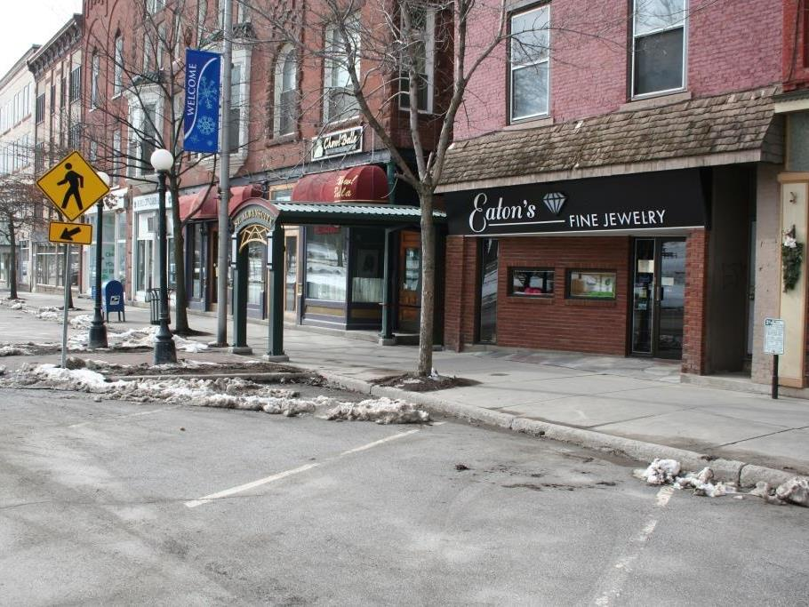
St. Albans BEFORE
Notes:
Before – could be more inviting…

Slide 6
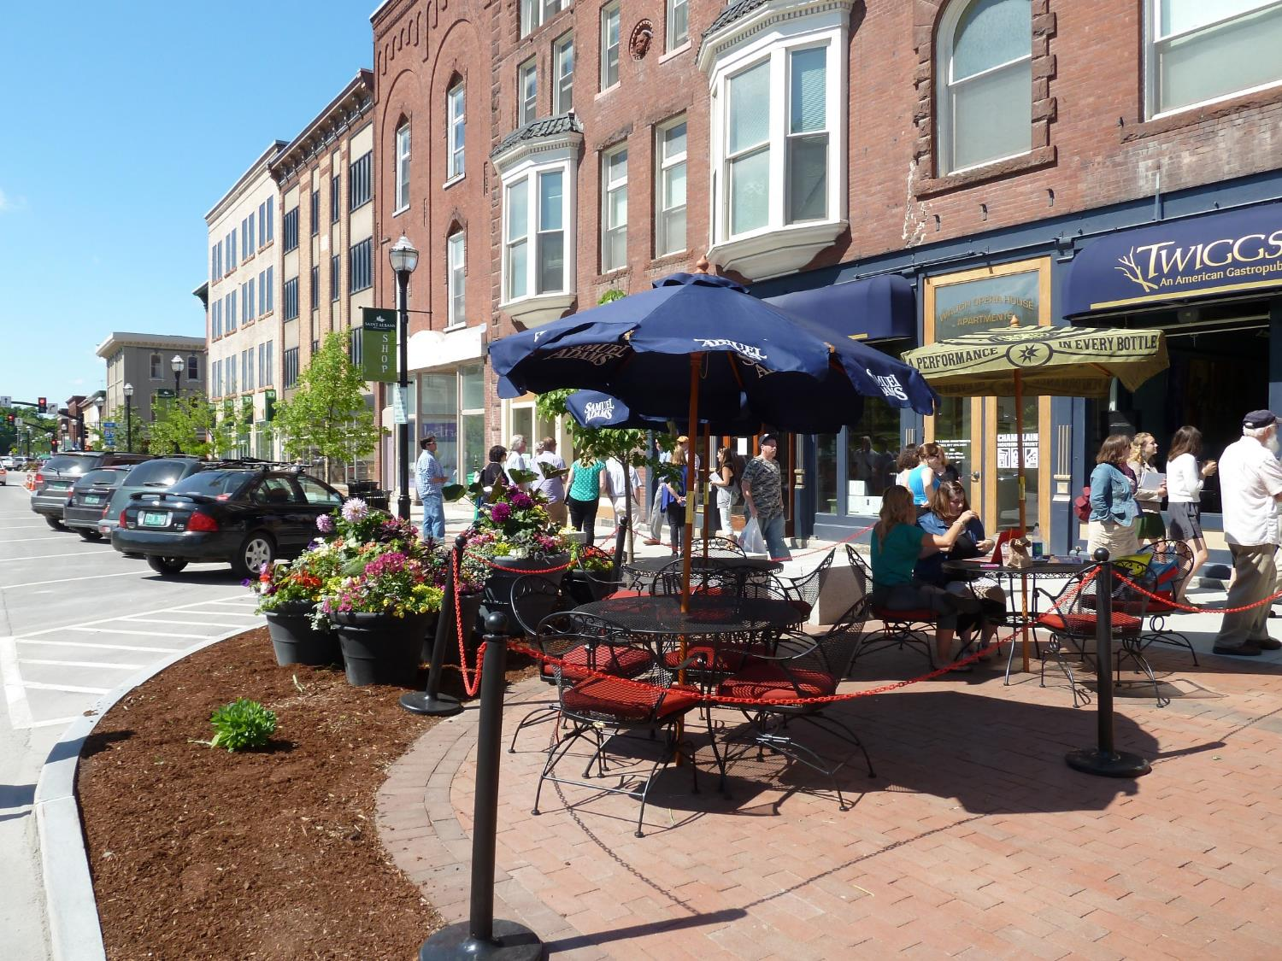
St. Albans AFTER
Notes:
After – creating new activity and opportunities for the streets to support more users and local business

Slide 7
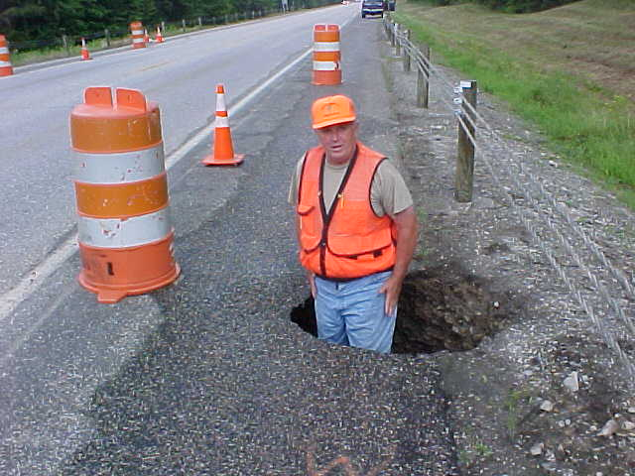
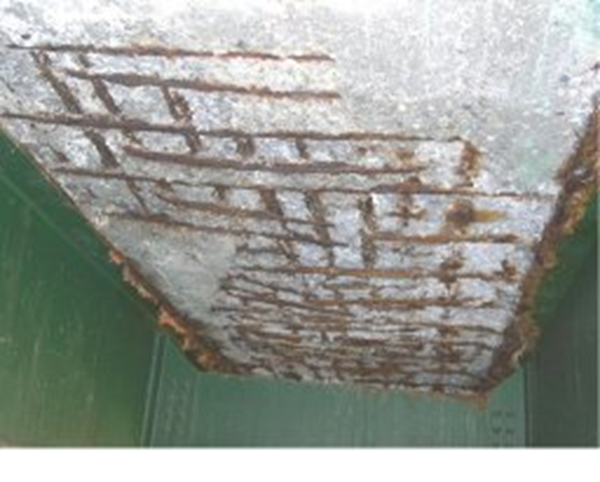
Challenges
Huge needs and constrained resources
Public expects a State of Good Repair for all roads and bridges
Cost to fix infrastructure damaged by floods results in Lost Opportunity
Limited resources remaining to address economic development – must be coordinated and strategic
Impact of current funding programs is minimized because it is dispersed

Slide 8
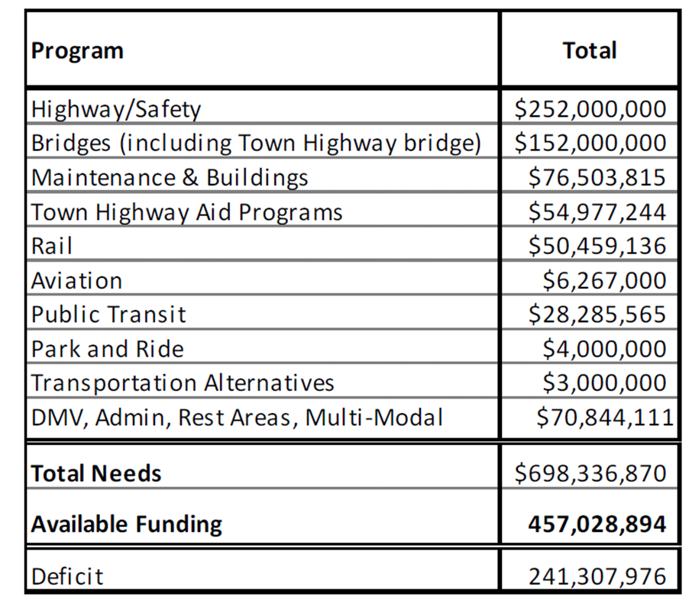
VTrans Funding Gap 2014 - 2018
Source: Section 40 Funding Study - http://vtransplanning.vermont.gov/reports
Funding Needs versus Review
5-Year Average 2014-2018

Slide 9
Rise in alternate modes of transit = Decline in gas tax revenue

Slide 10
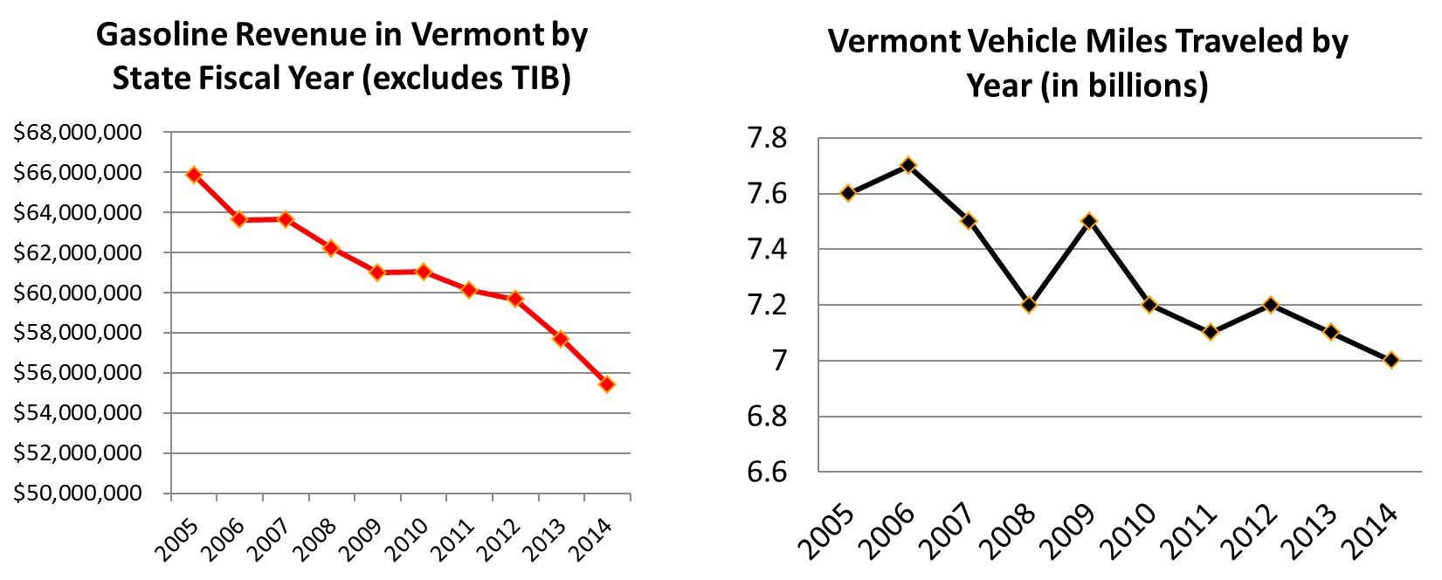
Vermont Gasoline Revenues and Vehicle Miles Traveled Trends

Slide 11
The Opportunity
Reduce risk to floods and support the economy
Focus state resources in downtowns that:
Are at an economic renaissance tipping point
Have critical infrastructure that is vulnerable to flood damage
Incorporate flood resilience and economic development in transportation project priorities
Create synergy with other state agency funding programs for downtowns

Slide 12
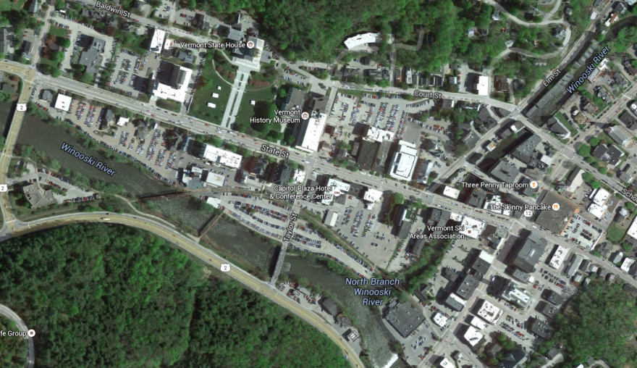
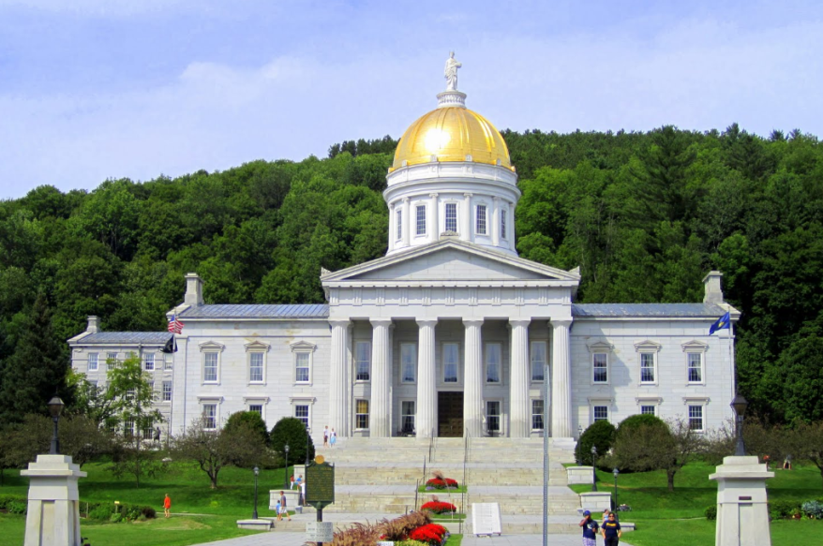
2015 UVM Legislative Summit Objective Measurement of Resilience & Economic Development
Jim Sullivan, UVM CEMS-TRC
Other Principal Investigators: Jarlath O’Neill-Dunne, UVM RSENR-SAL David Novak, UVM BSAD Lisa Aultman-Hall, UVM CEMS With: Chris Cole, Vermont Secretary of Transportation Joe Segale, Director of VTrans Policy, Planning and Research Bureau Glenn McRae, UVM CEMS-TRC

Slide 13
Objective Measurement of Resilience & Economic Development
UVM Research for VTrans
The Vermont Travel Model and the Network Robustness Index (Sullivan, Novak, Aultman-Hall)
Using Remote Data Collection to Identify Bridges and Culverts Susceptible to Blockage During Flooding Events (Sullivan, O’Neil-Dunne)
Incorporating Economic Impact and Benefit Criteria in Project Prioritization (Dowds, Novak, Sullivan)

Slide 14
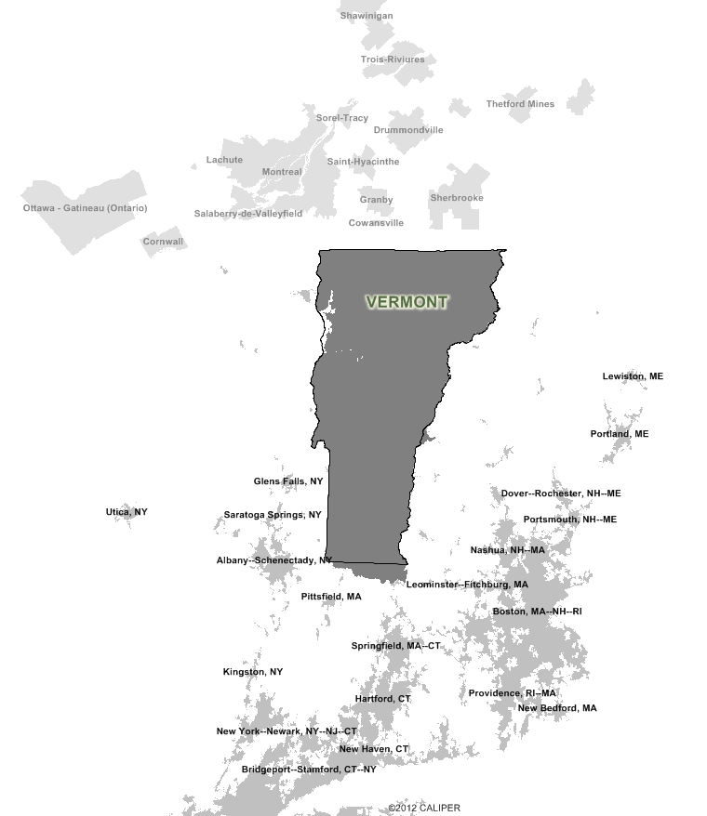
The Vermont Travel Model
Simulates a typical day of travel within, into, out of, and through Vermont
Resiliency assessments using the Model include
Select-link analysis
Immediate effects of capacity disruption or closure of a highway

Slide 15
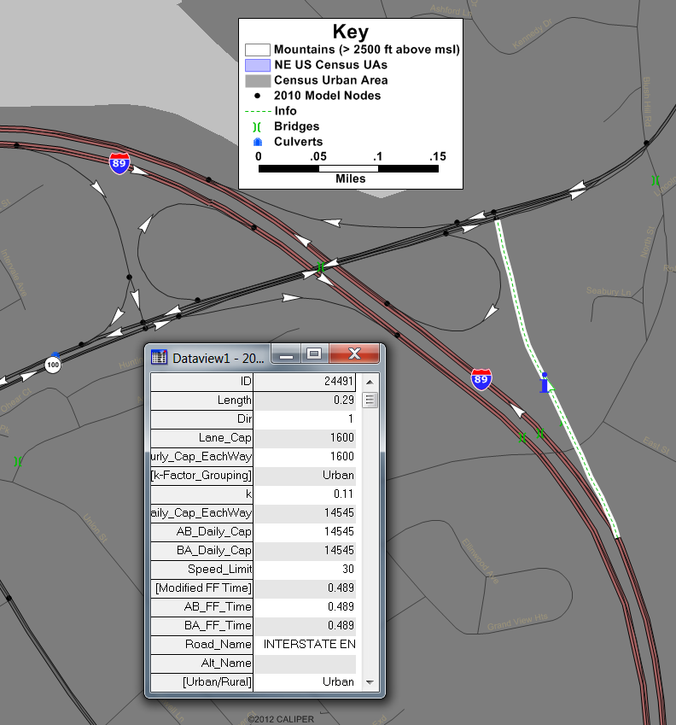
The Vermont Travel Model
Simulates a typical day of travel within, into, out of, and through Vermont
Resiliency assessments using the Model include
Select-link analysis
Immediate effects of capacity disruption or closure of a highway

Slide 16
The Network Robustness Index
The Network Robustness Index
Evaluating and ranking links in a road network using connectivity-based performance measures:
Link criticality
Trip importance
Critical closeness
Useful for:
Project prioritization
Project selection
Asset management
Strategic re-investment

Slide 17
The Network Robustness Index
Link criticality (NRI)
Trip importance
Critical closeness

Slide 18
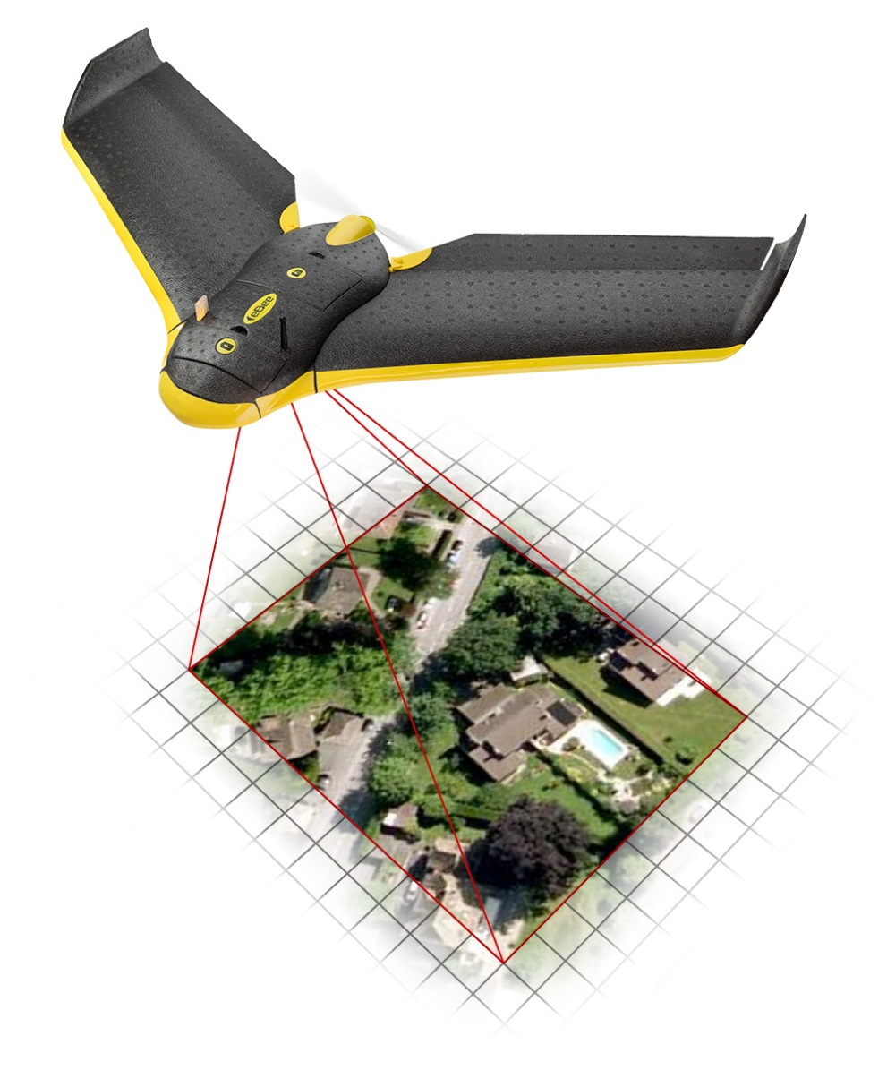
Using Remote Data Collection to Identify Bridges and Culverts Susceptible to Blockage During Flooding Events
Best Uses of the UAV:
Rapid, high-quality 3D imagery acquisition
Imagery acquisition for places that can’t be accessed on the ground

Slide 19
Using Remote Data Collection to Identify Bridges and Culverts Susceptible to Blockage During Flooding Events
Inaccessible Test Sites Selected for Imagery Acquisition:
Gunners Brook in Barre
Money Brook in Plymouth
West Branch Deerfield River in Readsboro
Honey Brook in Barre
Great Brook in Plainfield

Slide 20
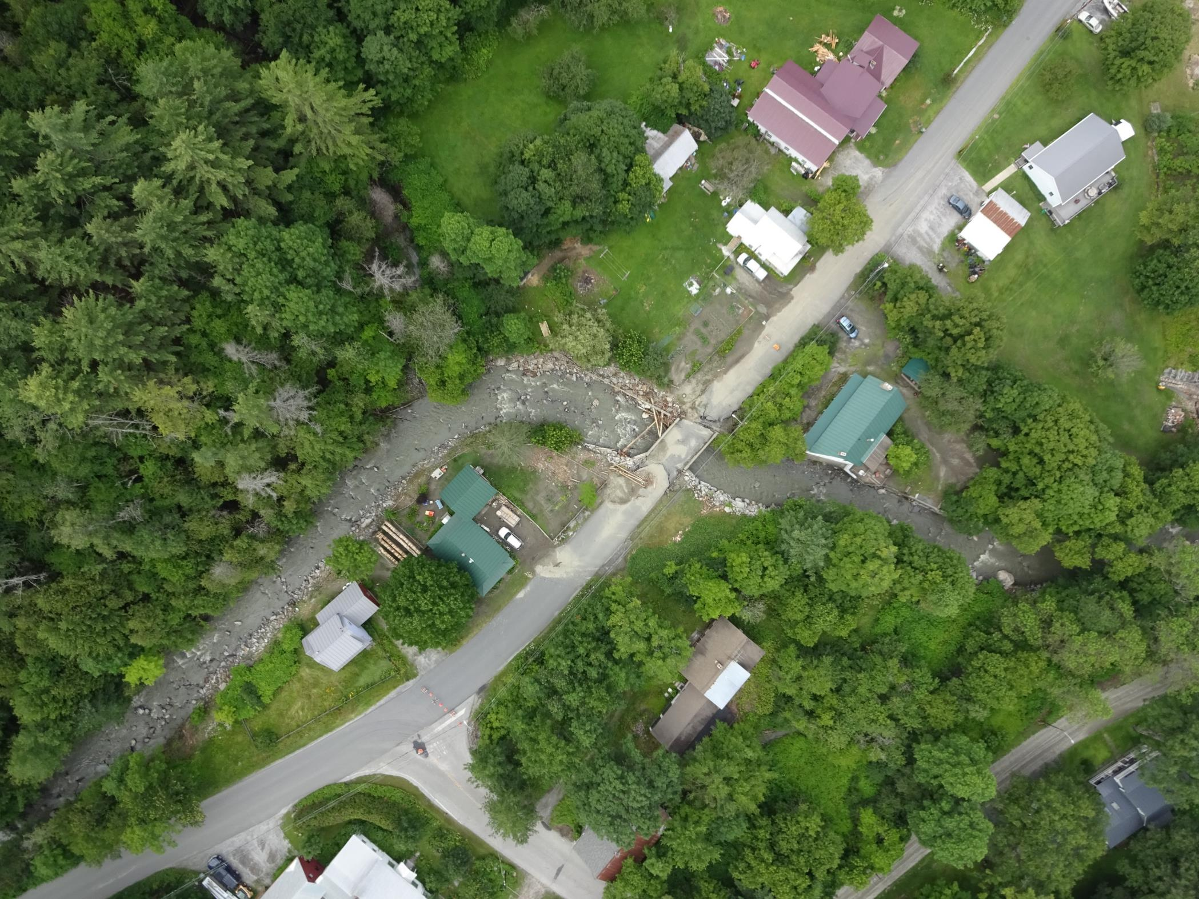
Using Remote Data Collection to Identify Bridges and Culverts Susceptible to Blockage During Flooding Events
Rapid response:
UAS imagery helped the Town of Plainfield respond to the July 2015 storm, providing detailed imagery within 24 hours

Slide 21
Using Remote Data Collection to Identify Bridges and Culverts Susceptible to Blockage During Flooding Events
Rapid response:
UAS imagery helped the Town of Plainfield respond to the July 2015 storm, providing detailed imagery within 24 hours

Slide 22
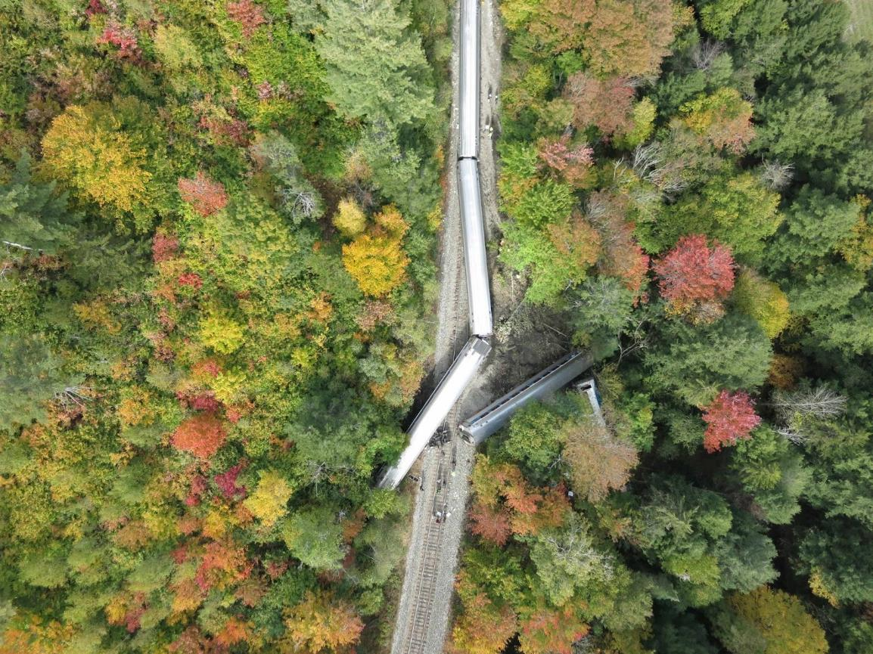
Using Remote Data Collection to Identify Bridges and Culverts Susceptible to Blockage During Flooding Events
Rapid Response:
Amtrak derailment on Oct 5th in Northfield:
11:50am - Assistance request received
12:15 - Airspace coordination
13:30 - Arrival in Northfield
13:50 – UAS flight commences
14:15 – UAS flight completed
14:35 - KML delivered to incident commanders
19:35 - Orthophoto mosaic completed

Slide 23
Incorporating Economic Impact and Benefit Criteria in Project Prioritization
Framework for measuring travel “benefits” and economic “impacts”
Travel benefits from transportation investment: Decreased travel times More route and mode options Reduced congestion Improved safety | Economic impacts from transportation investment: Better business access to markets Better employee access to employment centers Better consumer access to goods and services

Slide 24
Incorporating Economic Impact and Benefit Criteria in Project Prioritization
Review existing evaluation criteria in the Project Prioritization process
Revise or generate additional new evaluation criteria in consultation with VTrans, ACCD, the RPCs, and non-government organizations with an interest in economic development in Vermont
Generate guidance on possible supplements to the existing Project Prioritization criteria

