Slide 1
Setting Up a Business for Success: Entrepreneurial Teaching - Education Presenters: Dr. Kathleen Liang Laurel Butler

Slide 2
Other State-wide Entrepreneurial Initiatives
Secondary – Post Secondary
Programs – Competitions – Events
Laurel Butler
VtSBDC Business Advisor | Young Entrepreneurship Specialist

Slide 3
Why The Purpose – the Passion and the Motivation
It just doesn’t happen in most schools today!
Relevance of math, reading, writing, communication, the arts, collaboration, problem solving within the motivating context of starting and operating a small business
Encouragement of an Entrepreneurial Mindset – to succeed whether pursuing higher education, becoming an entrepreneur or entering the workforce– understand how/why companies/organizations make some decisions
Financial Literacy! – learn to save and invest to achieve goals like home ownership and retirement – or quite frankly just read a paycheck!

Slide 4
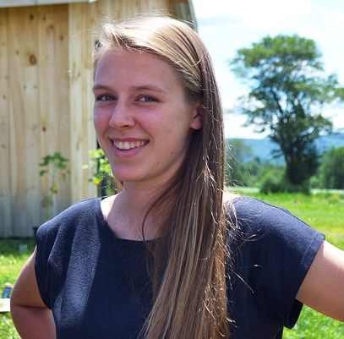
REAL experiential learning curriculum
VtSBDC (Vermont Small Business Development Center) In partnership with Vermont Business Education Corporation (VBEC), is committed to the students of Vermont becoming entrepreneurs invested in the growth of our state; has worked with many teachers (over 150) in Vermont to train them/certify them to facilitate the use of:
REAL – (Rural Entrepreneurship Through Action Learning)- an experiential learning curriculum that develops entrepreneurial knowledge and skills, and guides participants through the process of planning, creating, and operating small businesses of their own design; develops Knowledge, skills, and abilities in three recognized 21st century disciplines:
Entrepreneurship
Personal finance
Economics

Slide 5
Statewide Entrepreneurship Visual Media Competition
During the fall semester VT secondary students are invited to create posters and/or short videos depicting the many possibilities that Vermont Entrepreneurship has to share.
Students work in teams and /or as part of class project (50 – 85 entries)
Student winners are recognized and awarded cash prizes at the February Vermont Entrepreneurship Day Celebration in Montpelier.
This year’s competition will feature short video clips and/or bumper stickers with theme:
“ Vermont Entrepreneurship…. Find it Everywhere!”

Slide 6
https://vimeo.com/111747456

Slide 7
Vermont Entrepreneurship Day Celebration at the Statehouse – 225+
7th Annual – February 4, 2016 – in recognition of the heritage of entrepreneurial leadership in America, and encourages support for the growth of entrepreneurship education as a lifelong learning process, reminding everyone that our economy GROWS because of our entrepreneurs and their creative thinking.
Sponsored and supported by the SBA, VtSBDC, VTREAL & VBEC, Career/Tech Center School Clubs, VT Economic Development, post secondary institutions and many organizations.
Legislature’s Breakfast - Mini-workshops (Rooms 10 & 11) – Award presentations – Governor’s Proclamation

Slide 8
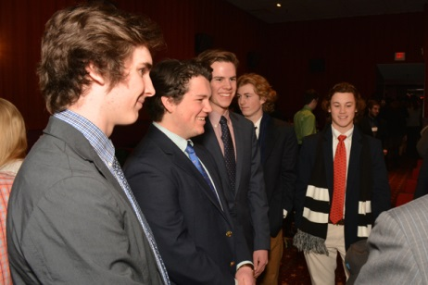
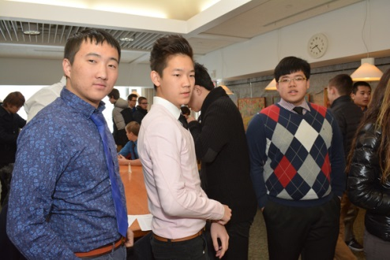
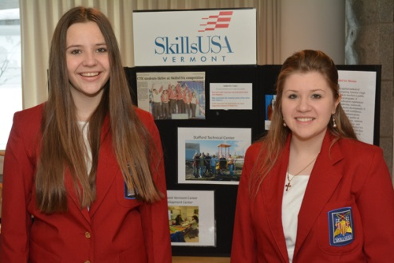
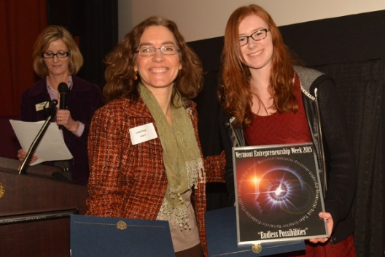
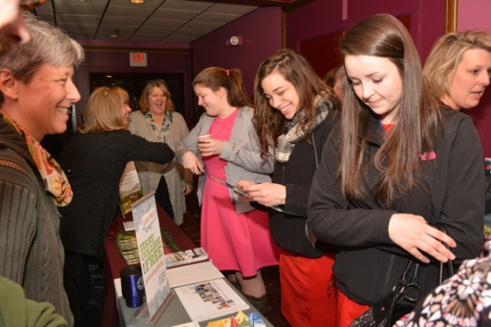
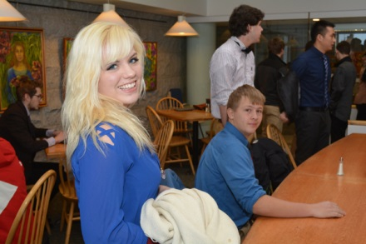
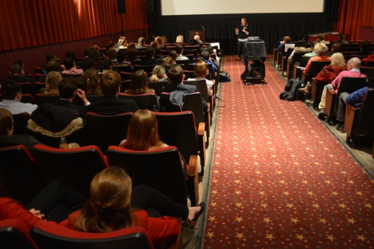
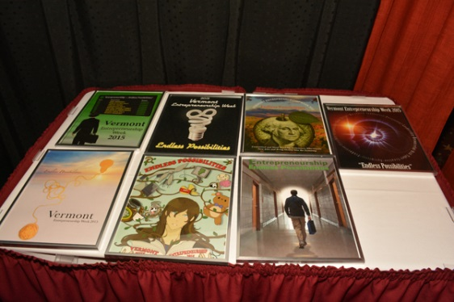
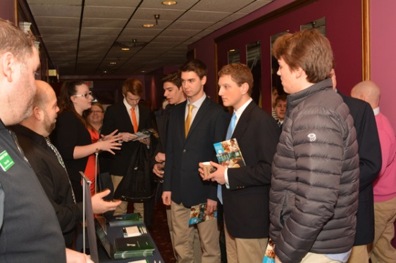
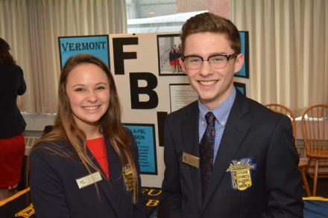
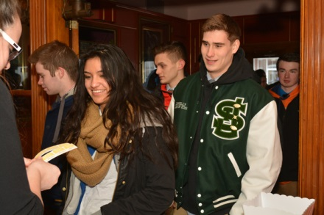
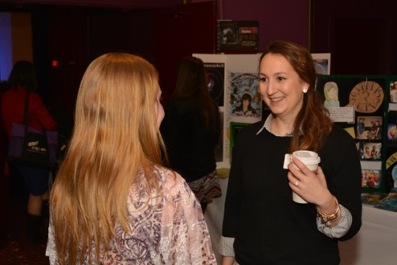

Slide 9
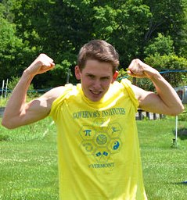
Business Plan Competition VT REAL – annual
A teaching tool for business, marketing, financial literacy, problem solving, creativity and citizenship topics; designed to give students a real life experience within an educational setting.
VT REAL advocates that educating our youth about entrepreneurship is vital to the success of Vermont and its overall economy
Over 40 plans submitted annually from several VT secondary schools
Plans reviewed by VtSBDC advisors and business leaders
Winners awarded cash prizes - either recognized at a special award’s reception or personally visited at their schools by VtSBDC State Director and presented at their school award’s ceremonies.

Slide 10
What does this mean?
“We want to encourage young people to adopt an entrepreneurial mindset, to view problems as opportunities, to explore the creative process of new venture creation…It is our hope that these skills will lay the foundation to help the students academically, personally and professionally long after they matriculate from secondary education.”
Laurel Butler, VtSBDC Business Advisor | Young Entrepreneurship Specialist
“This is a unique opportunity for young people to practice business planning, critical thinking and financial management skills in a real-life setting. Our workforce depends on the entrepreneurial mindset of Vermont’s future small business owners and it’s amazing to see the creativity and hard work these students have demonstrated.”
Linda Rossi, VtSBDC State Director

Slide 11
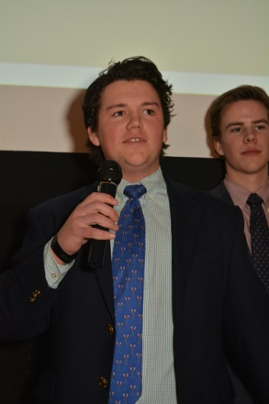
Vermont Career/Technical Center Student Organizations/Clubs (VtCTSO)
FBLA & DECA
FBLA to bring business and education together in a positive working relationship through innovative leadership and career development programs.
DECA to prepare emerging leaders and entrepreneurs for careers in marketing, finance, hospitality and management
Also- Skills USA & FFA

Slide 12
Schools Participating (over past 8 years – Career & Tech Centers have students from sending schools participating)
Bellows Free Academy – St. Albans
Central VT Career/Tech-Spaulding
Champlain Valley UHS
Cold Hollow Career/Tech
Essex Technical Center
Green Mountain Career/Tech
Hannaford Career/Tech
Hartford Career/Tech
Lakes Region – Orleans
Lyndon Institute
Mt. Mansfield Union HS
Missisquoi Valley Union HS/Career
North Country Career/Tech
Northwest Career/Tech
Randolph Career/Tech
River Bend Career/Tech
River Valley Career/Tech
South Burlington HS
Southwest Career/Tech
St. Johnsbury Academy
Stafford Career/Tech
Windham Career/Tech
Winooski HS

Slide 13
GIV – Entrepreneurship (GIV-E) Governor’s Institutes of Vermont
A “hands-on” week long summer crash course on all things entrepreneurial; students immersed in every aspect of launching a business, from idea creation (ideation) and market research through product development, promotion, finance, operations to a 7-minute “pitch-deck” presentation of a viable business created by each team – up to 28 students yearly.
Led by experienced, professional business leaders and educators passionate about entrepreneurship who genuinely believe that developing an “Entrepreneurial Mindset” has the power to transform lives, communities and the world.
Students interact with visiting entrepreneurs, VtSBDC Advisors, VTC faculty and insider tours of businesses which showcase principles in action and allow students to network and learn about career choices and business decisions.

Slide 14
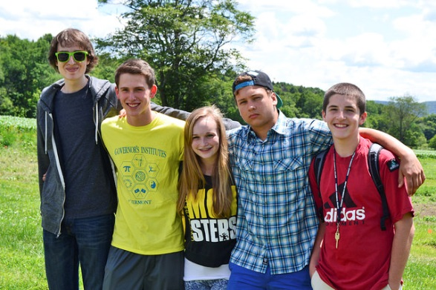
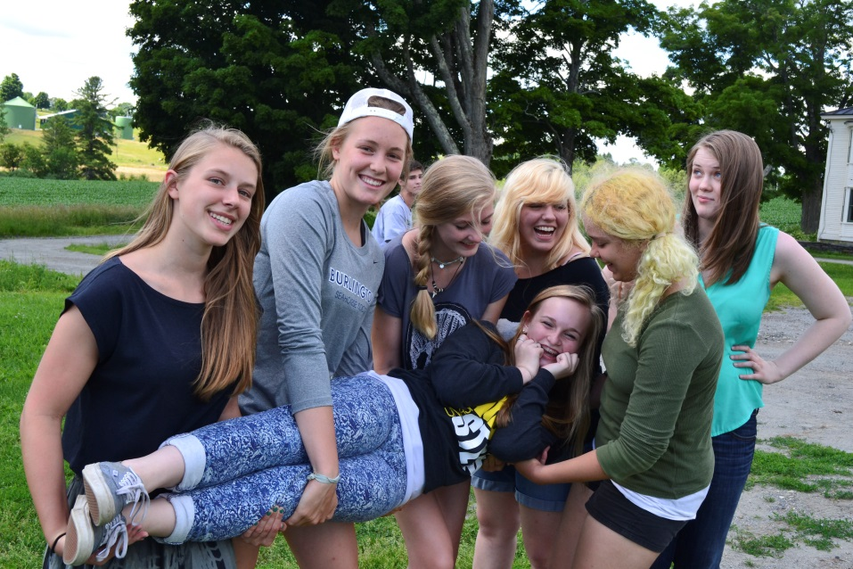
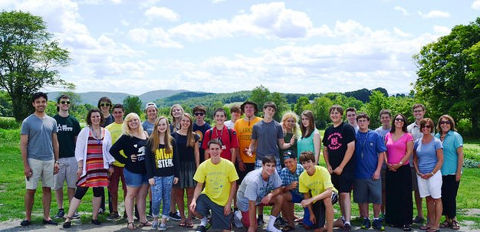
Said one student:
“I loved getting a chance to be around kids just like me, who share the same passion for business and entrepreneurship. Everyone was able to bring their individual skills and intelligence to the table and it was amazing to see a vision turn into a product.”

Slide 15
GIV – Entrepreneurship (36 secondary)
Bellows Free Academy - St. Albans
Berkshire School
Brattleboro Union High School
Burr and Burton Academy
Cabot School
Champlain Valley Union HS
Cold Hollow Career Center - Enosburg
Compass School
Essex Ctr. For Technology
Green Mountain Technical Center
Hannaford Career Tech
Hartford Area Career & Tech Center
Lake Region - Orleans
Lyndon Institute
Middlebury Union High School
Missisquoi Union HS/Career Center
Mt. St. Joseph Academy
North Country Career & Tech
Northwest Technical Center
Oxbow High School
Peoples Academy
Randolph Technical Career Center
Rice Memorial High School
Rivendell Academy
River Bend Technical Center
River Valley Technical Center
South Burlington High School
South West Career Center
Spaulding High School
St. Johnsbury Academy
Stafford Technical Center
Stowe High School
Thetford Academy
U-32 High School
Windham Regional Tech/Career Center
Winooski HS
Note: highlighted schools represent Career/Tech Centers

Slide 16
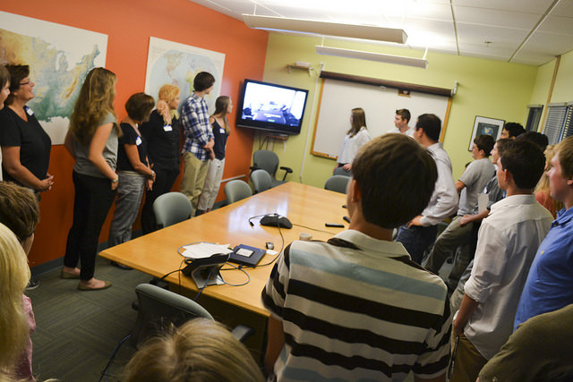
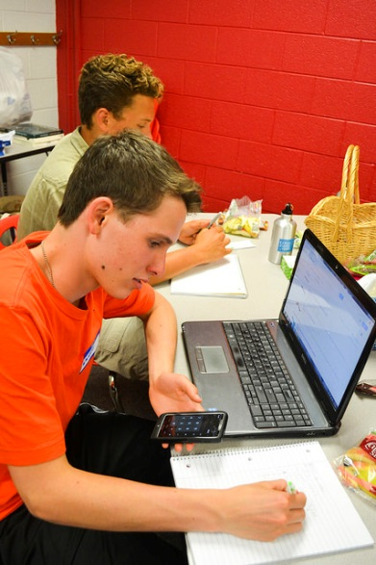
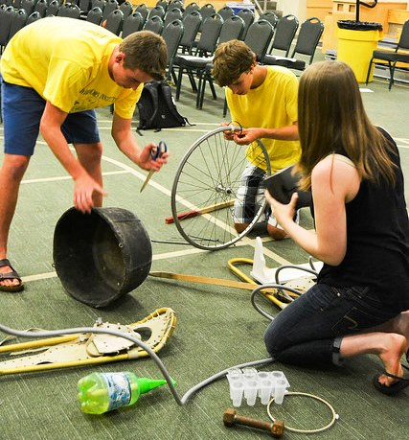
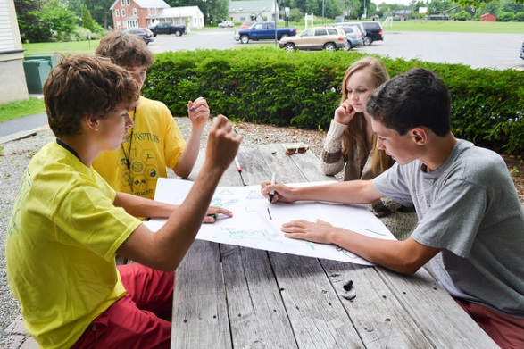
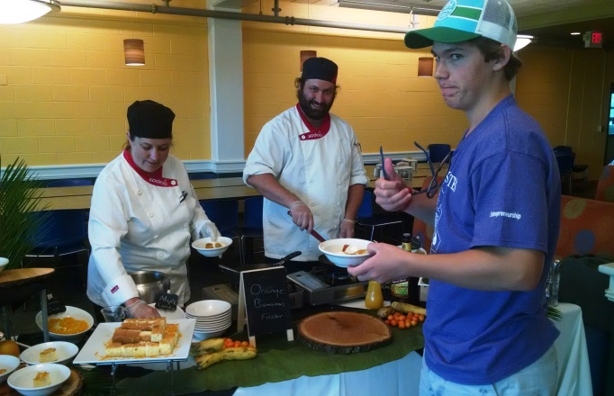

Slide 17
Experiential Learning
Students actively participate in exercises, reflect, and apply it to real life
Project Based Learning is accomplished by "doing" while having fun
Students learn to plan, set goals, and manage their time
Students address ethical issues as they build their plans and model ethical behavior in their teams
Students connect with communities and work with people outside the classroom
Enhanced opportunities for service learning & social responsibility
Note: Aligned with Vermont and National Standards: Math | Economics |English Language Arts |Science |Entrepreneurship Education

Slide 18
Transformation & 21st Century Skills
Financial literacy | Life skills | Civic engagement
Problem solving | Critical thinking
Communication |Teamwork and Collaboration
Flexible learning environment
Etiquette – Integrity and Ethics
Innovation – Creativity – Ideation - Engagement
Next Generation & Workforce Readiness
Feeds pipeline of future entrepreneurs
Helps keep youth in Vermont
Increases student interaction with local community
Helps with adapting new learning ands skills in other settings
Increases readiness for successful self or workforce employment
Motivates and prepares students for post secondary study

Slide 19
LaunchVT Collegiate
Inaugural competition to bring the spirit of excellence and innovation to campuses across the state. Participating institutions seek out the best startup team to head in a pitch competition on February 19, 2016; team with the winning pitch will be awarded at least $6,000.
University of Vermont | Middlebury College |Lyndon Institute
Johnson State College |Champlain College |Vermont Tech
Castleton College | St. Michael’s College |Norwich
Teams have 10 minutes to present pitch w/ Q&A. Judges determine if plan is viable and offers a likelihood of meaningful growth and successful business using the following criteria:
Industry & Target Market (What problem/need is the business solving/addressing? )
Product/Service Design (What is the product/service? What’s the unique value?)
Business Model and Operations (Who is on the team & value they provide? Does the business have a likelihood for success?)
Presentation (Was effective storytelling used? Were there adequate answers for Q&A?)
Use of funds (What are the team's financial resources & how would prize money be used?)
Sponsors: VCET | VtSBDC |Lake Champlain Chamber of Commerce

Slide 20
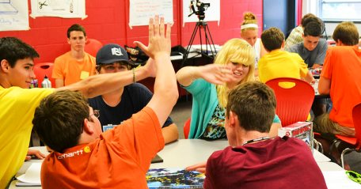
Tomorrow’s Entrepreneurs are in our Vermont Schools Today!
https://drive.google.com/folderview?id=0B8IhraBeb8NNfnFQVHBRY19GT2pfR2w4c1hFQlkwZEljQmNuNUJFNEUyTFkzcjBROU55U1E&usp=drive_web

Slide 21
Thank You We welcome your comments and questions
Chyi-Lyi (Kathleen) Liang, PhD Professor
University of Vermont
Email: Chyi-Lyi.Liang@uvm.edu
Laurel Butler, Business Advisor |Young Entrepreneurship Specialist
Vermont Small Business Development Center (VtSBDC)
www.vtsbdc.org | Email: lbutler@vtsbdc.org

