Slide 1
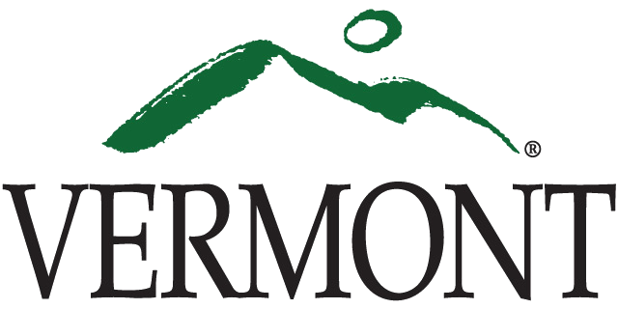
Vermont’s Economic & Workforce Incentives

Slide 2
Vermont Training Program (VTP)
Background
Starting over 30 years ago, VTP has been partnering with employers and training providers to train Vermont’s employees for the jobs of tomorrow
VTP provides performance based workforce grants for:
Pre-employment training
Training for new hires and incumbent workers
On-site training or through a training provider/vendor
Grants may cover up to 50% of the training cost
Recent Data
FY 2014: Served over 2,000 Vermonters
Median quarterly wage increase of 11.2% after training completed
FY 2013: Those served by the VTP saw a median quarterly wage increase of 10.6% post training – statewide average only 0.1%

Slide 3
Workforce Education & Training Fund (WETF)
WETF was created to:
Increase career opportunities for workers
Strengthen workplace experiences for students about to enter the workforce in Vermont
Increase number of workers with skills that meet the needs of VT employers
WETF promotes…
Creation and retention of high quality jobs
Growth of a highly skilled workforce
…by funding occupational skills training
Goal of WETF programs:
Train or re-train workers who are unemployed, underemployed, or at risk of losing their jobs

Slide 4
Vermont Economic Growth Incentive (VEGI)
What is VEGI?
Created by the State of Vermont, VEGI offers economic incentive for business recruitment, growth and expansion
Provides cash payments to qualified businesses based on revenue return to the State of VT
Revenue return in the form of prospective job and payroll creation and capital investments
How to become authorized:
Company applies to the Vermont Economic Progress Council, who will then determine if the company and project meets statutory approval requirements
How incentives are allocated:
Based on a cost-benefit model analysis that calculates revenue benefits and costs to the State for up to 5 years following approval
Vermont Department of Economic Development

Slide 6
Harnessing the Power of Public Investment to Attract Private Investment
Dominic Cloud, City Manager
St. Albans, Vermont

Slide 7
The Situation
2010, City experiencing decades of decline and divestment
Grand List flat
60 Percent vacancy rate on Main Street
Very high crime rates
Our trajectory was not great …

Slide 8
Our Strengths
Public was eager to transform City and see action
Unified City Council; willing to take reasonable risks
City had about $500,000 in “catalyst capital”
Previous administrations made strategic land acquisitions
Core belief: private investment will follow public investment
Reality: City needed to lead revitalization

Slide 9
St. Albans House 2010

Slide 10
St. Albans House 2010

Slide 11
St. Albans House 2014

Slide 12
St. Albans House Summary
$50,000 Grant; $100,000 Loan
State and Federal Historic Tax Credits
Two community banks
City backstop loan until fully leased
Since 2013 fully leased
Two floors office, two floors market rate residential

Slide 14
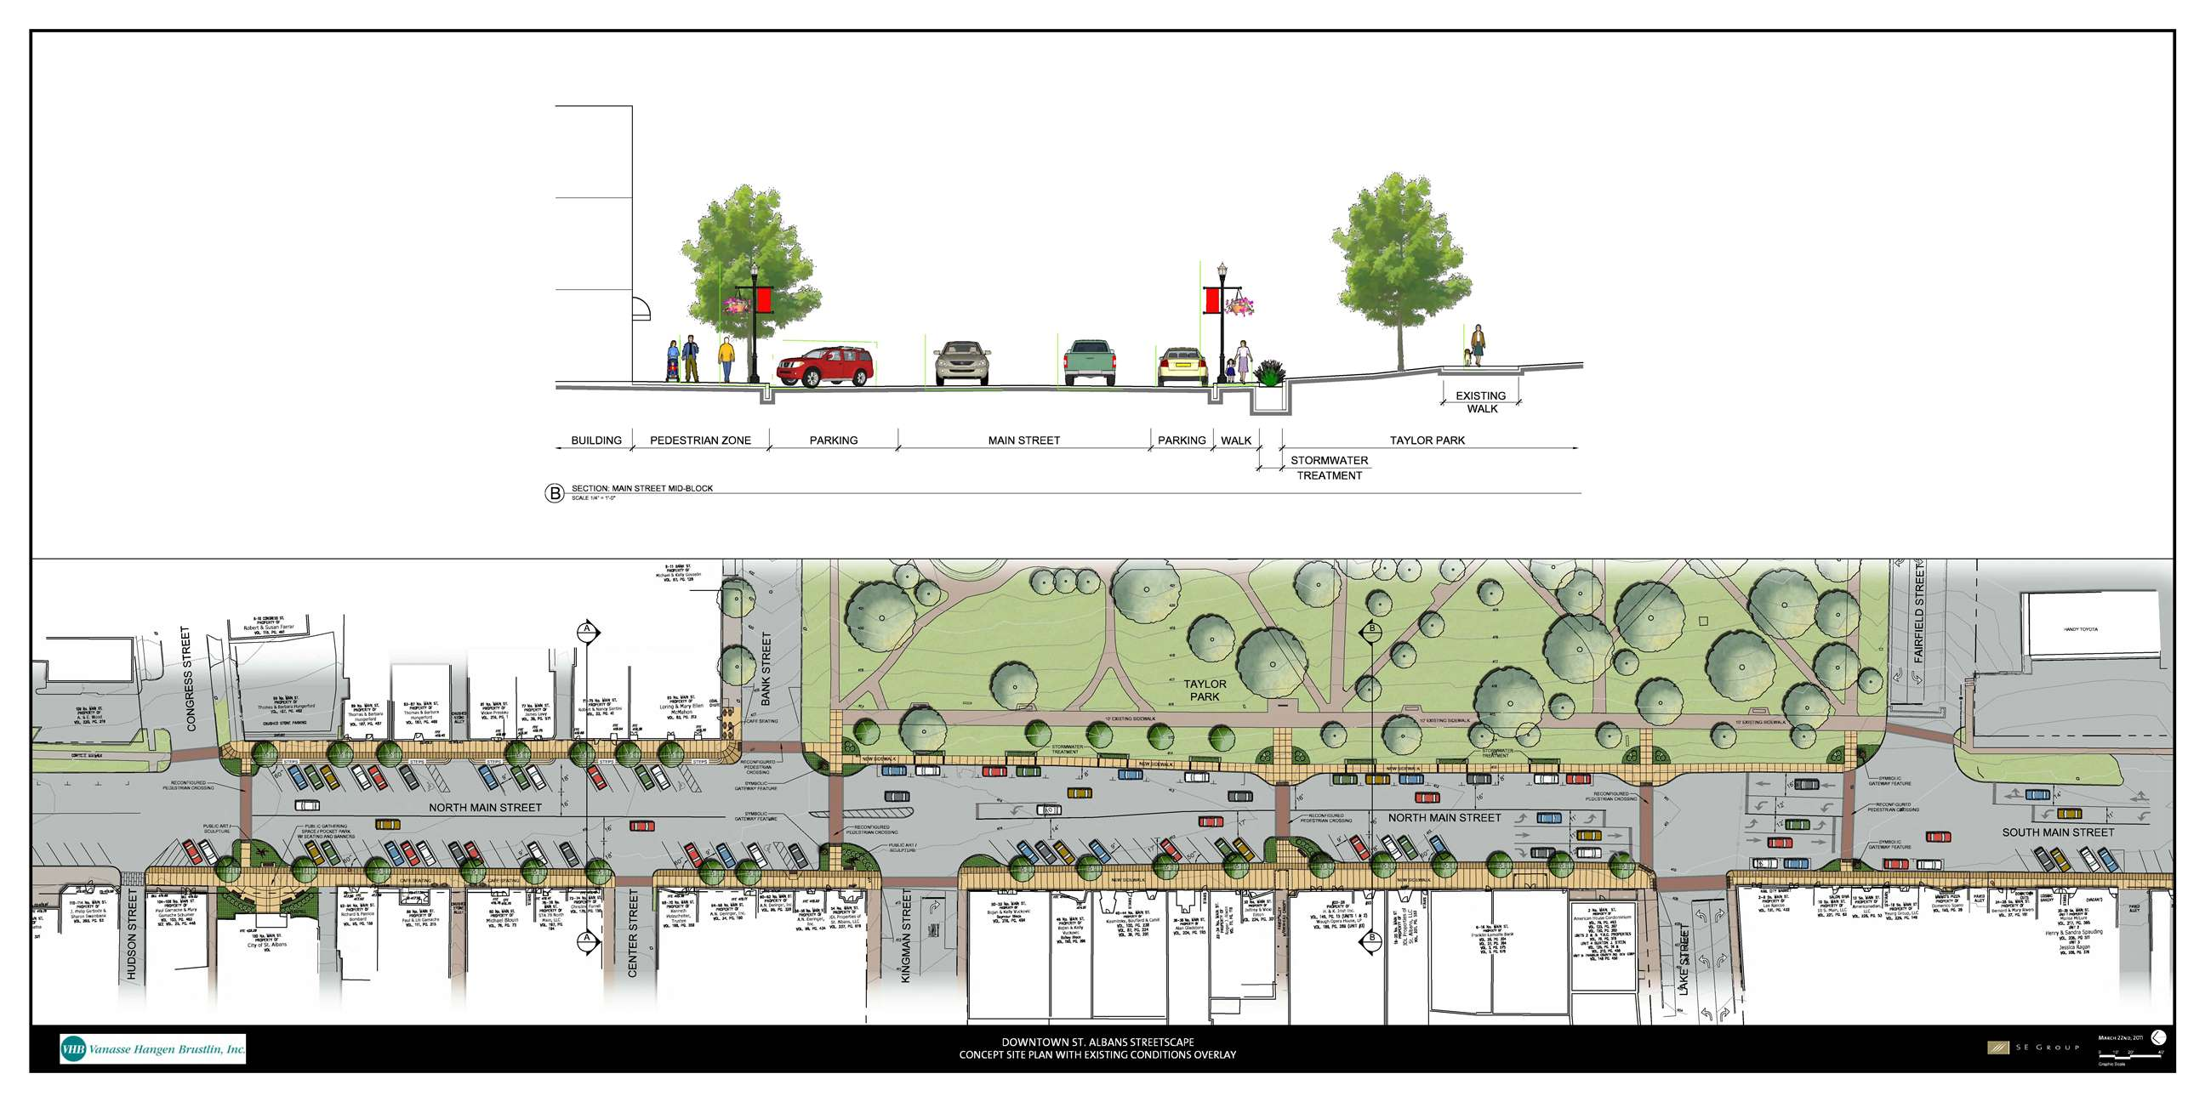

Slide 15
$3 Million Main Street Makeover Before

Slide 16
$3 Million Main Street Makeover After

Slide 17
Main Street Makeover (Streetscape)
$3 million project – federal, state, and local
$500,000 water and wastewater portion serves as local match

Slide 18
Ace Brownfield Redevelopment

Slide 19
Ace Brownfield Redevelopment

Slide 20
Ace Redevelopment

Slide 21
Ace Brownfield Redevelopment

Slide 22
Ace Brownfield Redevelopment
Developer / owner pays same for urban site as suburban
City role: acquisition, demolition, and remediation
Create flagship redevelopment site, integrated with Streetscape
Serves as anchor tenant for rest of downtown

Slide 23
Downtown Core: The Opportunity

Slide 24
The Opportunity

Slide 25
The Vision
Convince the State to sell their building to Mylan or USCIS
Relocate state offices to new building downtown
Construct a City owned parking garage on an adjacent parcel
Attract a national hotel franchise to another adjacent parcel
Do it all without raising local property taxes

Slide 26
The Vision

Slide 27
Existing Conditions

Slide 28
The Hurdles
Governor and Legislature would need to be fully on board
Local voters would need to approve $14.5 million bond
New state building would need to be leased, not owned
Lease couldn’t expire before bonds were paid off
Sale price needed to be high enough to cover transition costs
Hotel indicated they would need some incentives

Slide 29
Phase 1
Mylan buy existing property from state for $8 million
ReArch buy land and parking rights from City for $2.5 million
Federal NMTC covered land and parking costs
State and ReArch signed 20 year lease with 10 year buyout
Voters approved $14.5 million TIF bond by 2 to 1 margin

Slide 30
January 2014

Slide 31
January 2015

Slide 32
January 2015

Slide 33
State Office Site Before

Slide 34
State Office Site After

Slide 35
Phase 2: Downtown Hotel
City hospitality consultant recommended 88 room hotel
City facilitated RFP for hotel developer
Free land (assembly, demolition and remediation complete)
100 deeded parking spaces in garage
Streetscape completed in front
Selected PeakCM and American Resort Management
84 Room Hampton Inn with pool and meeting space

Slide 36
Hotel Agreement
City to invest $1M over five years as preferred equity
City to provide $500,000 in Brownfield Cleanup
City to complete Streetscape project on Lake Street
City to provide $180,000 façade grant
PeakCM to invest $11 million and construct a downtown hotel

Slide 37
April 2016

Slide 38
The Power of Tax Increment Finance
Increment = Difference in Grand List
With State approval, 75 percent of Ed. Fund increment retained for 20 years; must be matched by municipal side
Proceeds can only be used for debt service on authorized public projects

Slide 39
St. Albans TIF District
City has issued $16 million in debt
Produced over $32 million in grand list growth
Without TIF, would not have happened
Economic Study of TIF: 21-year cumulative total increase of $734.5 million in the Vermont economy.

Slide 40
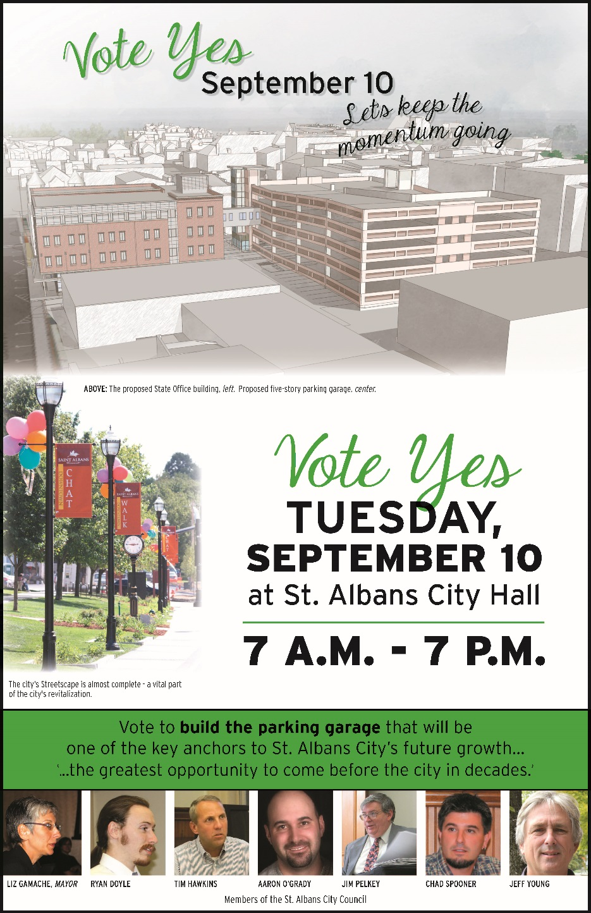

Slide 41
Investing in Vermont
UVM Legislative Summit
November 17, 2015
Michael S. Pieciak, Deputy Commissioner of Securities | Vermont Department of Financial Regulation| michael.pieciak@state.vt.us
This information provided herein is for your convenience only, is illustrative and is not intended as legal advice.

Slide 42
Crowdfunding
Non-Equity Crowdfunding
Kickstarter –
Potato Salad - Zach "Danger" Brown wanted to raise $10 on Kickstarter to make a potato salad
Oculus Rift – one and a half years later . . . 145x return
Equity Crowdfunding
Federal Crowdfunding: Jobs Act of 2012
Critiques of federal crowdfunding (i) too expensive; (ii) Individual investment amounts too low (Main Street and accredited investors are capped under federal crowdfunding).
State Based Crowdfunding: Vermont Small Business offering Exemption; 29 other states plus the District of Columbia have enacted state based crowdfunding; plus some form of state based crowdfunding is under consideration in 6 other states.
Accredited Investor Crowdfunding: CircleUp
* Main investor concern – diversification and liquidity.
* Main entrepreneurial concern - finding and then managing shareholders (time and money) / complications associated with future acquisition or merger.

Slide 43
Overview of State and Federal Securities Laws
State Based Regulation of Investment
Kansas enacted the first investment regulatory regime in 1911
All fifty states followed suit by the late 1920’s and the first version of the uniform securities act was promulgated in 1930
Federal Regulation of Investment
Securities Act of 1933
Exchange Act of 1934
Registration of investments at both the state and federal level was the default for the first 40+ years of dual system

Slide 44
Overview of State and Federal Securities Laws
Most popular exemptions available only to accredited investors:
Accredited Investor is:
Either $1,000,0000 in assets excluding one’s home; or
$200,000 of income for the last two years and anticipate the same for the current year

Slide 45
Overview of State and Federal Securities Laws
Federal Rule 147
Federal Rule 504
Federal Requirements:
Offers and Sales only to the residents of the state the investment is being offered
Company raising money must comply with the 80% tests
Must be incorporated in the state where offering is being conducted
Federal Requirements:
Notice filed with the SEC (Form D)
Must be registered with a state to take advantage of general solicitation
Aggregate cap limited to $1,000,000
States can coordinate

Slide 46
Overview of State and Federal Securities Laws
Federal Rule 147
Federal Rule 504
Focus on the on the sale not on the offer to allow the free use of social media and the Internet generally
Create a more simplified location based test instead of the 80% tests
Don’t focus on place of incorporation but whether the company is authorized to do business in the state
Working with the other five New England State to develop a regional approach to capital raising that would allow Vermont businesses to more easily access capital in those states
Held two regional meeting this past summer and the state are working on a proposed uniform rule

Slide 47
What is intrastate crowdfunding? An overview of its evolution
An Evolution:
1984
1991
1996
2000
2005
2009
2011
2012
2014
2015
First State-Only Public Offering
Advent of Non-Equity Crowdfunding
Kickstarter
State Based Crowd-funding in 30 states
World Wide Web
VSBOE
50 person/500K
JOBS ACT
Advent of Peer to Peer Lending
Zopa (United Kingdom)
NASAA Statement of Policy on Internet Offerings
Kansas – Invest in Kansas Exemption (IKE)
Title III Final Rules???

Slide 48
Intrastate Investing in Vermont
In 1984 Ben & Jerry’s conducted the first direct public offering available only to residents of Vermont
State Registration – Vermont
Federal Exemption - Rule 147
Looked to raise $750,000 in order to expand into a larger plant to expand their distribution
Shares priced at $10.50 and minimum purchase of 12 shares
1,800 Vermonters purchasing shares
Ben & Jerry’s conduct national public offering in 1985 for $5,800,000.
“If you can’t afford to lose it, don’t do it”
“Get a Scoop of the Action!”

Slide 49
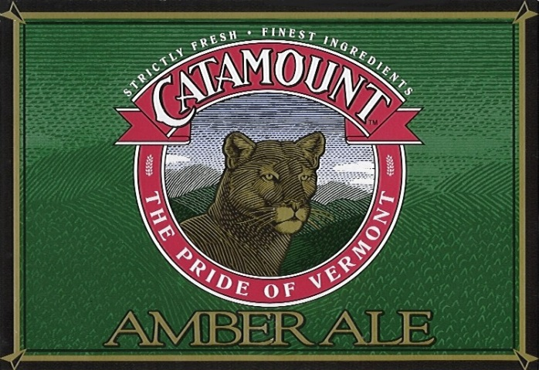
Intrastate Investing in Vermont
1985 Earth’s Best Baby Food – first nationally distributed organic food product company in the country
1996, purchased by H.J. Heinz Company
2000, purchased by the Hain Celestial Group
1986 Catamount Brewery – Vermont’s First Brewery
2000 Closed– but cited as an inspiration for many participants in Vermont’s current craft brewery industry
Vermont: more breweries per capita then any other state, including the #1 Hill Farmstead Brewery was named the 2013 Best Brewery in the World craft beer in the world, that employees 2,200 individuals

Slide 50
Vermont Small Business Offering Exemption (VSBOE)
Old
$500,000 aggregate offering cap
50 Vermont Investor Limit
No individual investment limit
Based on Federal Rule 147 Only
14 year period: 14 offerings
New
$1,000,000/$2,000,000 aggregate offering cap
No Vermont Investor Limit
10,000 / 25,000 / unlimited
Based on Federal Rules 147 or 504
1 year period: 7 offerings

Slide 51
Vermont Small Business Offering Exemption (VSBOE)
Old
14 offerings during the last 14 years
New
7 offering in the last 14 months
1 offering currently under review

Slide 52
State-Based Crowdfunding Nationwide As of September 16, 2015
State | Effective Date
1. Kansas | 8/12/2011
2. Georgia | 12/8/2011
3. Idaho | 1/20/2012
4. Michigan | 12/26/2013
5. Alabama | 4/8/2014
6. Wisconsin | 6/1/2014
7. Washington | 6/12/2014
8. Vermont | 6/16/2014
9. Indiana | 7/1/2014
10. Maryland | 10/1/2014
11. District of Columbia | 10/24/2015
12. Texas | 11/17/2014
13. Maine | 1/1/2015
14. Massachusetts | 1/15/2015
15. Oregon | 1/15/2015
16. Mississippi | 5/26/2015
17. Kentucky | 6/24/2015
18. South Carolina | 6/26/2015
19. Virginia | 7/1/2015
20. Montana | 7/1/2015
21. Arizona | 7/3/2015
22. Colorado | 8/5/2015
23. Nebraska | 9/1/2015
24. Florida | 10/1/2015
25. Iowa | 12/30/2015
26. Illinois | 1/1/2016
State | Effective Date
27. New Jersey | Awaiting Governor’s Signature
28. New Mexico | Awaiting Governor’s Signature
29. Minnesota | Pending Final Rulemaking
30. Tennessee | Pending Final Rulemaking
Total Number of Offerings Filed: 119
Total Number of Filings Approved/Cleared: 102
* Filings may not be currently approved/cleared if the notice filing is incomplete, and filings may have been withdrawn by the issuer for reasons including the availability of other limited offering exemptions or a voluntary business decision. States continue to receive several inquiries about the new exemptions.

