Slide 1
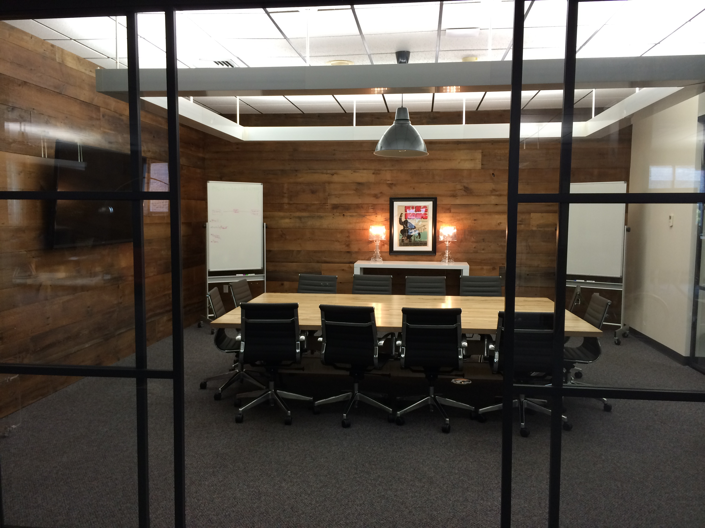
STARTUPS WANTED
PEOPLE : PLACES : CAPITAL

Slide 2

@VCET
Next Generation Jobs for
This Generation of Vermonters
Opened 2005 : 501 (c)3 : UVM cofounded
Startups and Entrepreneurs
Innovation Ecosystem
Entrepreneurship = Wealth Creation

Slide 3
PEOPLE
Professionals
VCET Staff, Board of Directors, Venture Capitalists, Entrepreneurs, Executives, and Professionals
Colleges & Universities
Students, Parents, Researchers and Alumni
Corporations
Ecosystem Partners

Slide 4
PLACES
It’s about Here and There
  Create Density & Lower Barriers
@VCET operates 3 places, +/- 100 Members
Programs and Events
Who’s Next?
Notes:
Don’t get hung up on what its called…its what it accomplishes….Maker space, Accelerators, Incubators, working spaces, etc.
VCET Spaces: > 152 in BTV first year…now about 100 across sites at any one time…
Who’s there? Remotes, students, teams from companies in other states and parts of VT, etc
Programs & Events: Investor Office Hours, HackVT, Meetups/Jams for Gamers, Healthcare, GDI, Corporates, Office Hours, etc
Assisting 4 other communities! Brattleboro, Rutland, Manchester, Northfield and ????

Slide 5
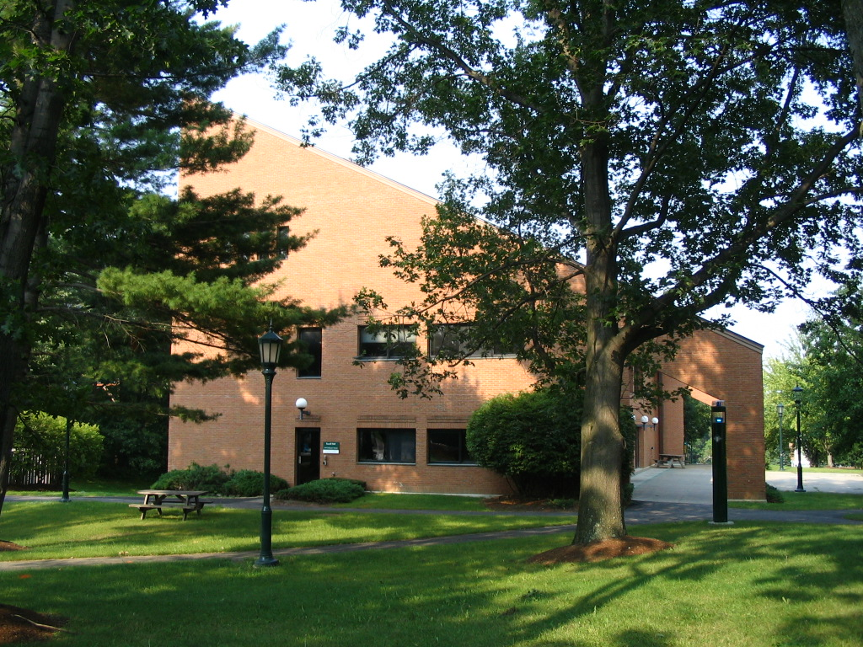
@UVM

Slide 6
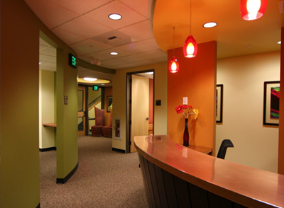
@UVM

Slide 7
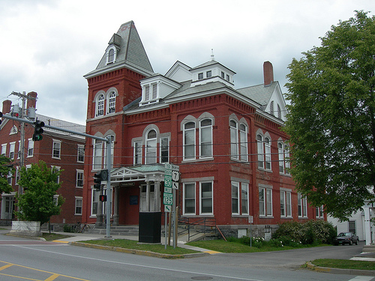
@MIDD

Slide 8
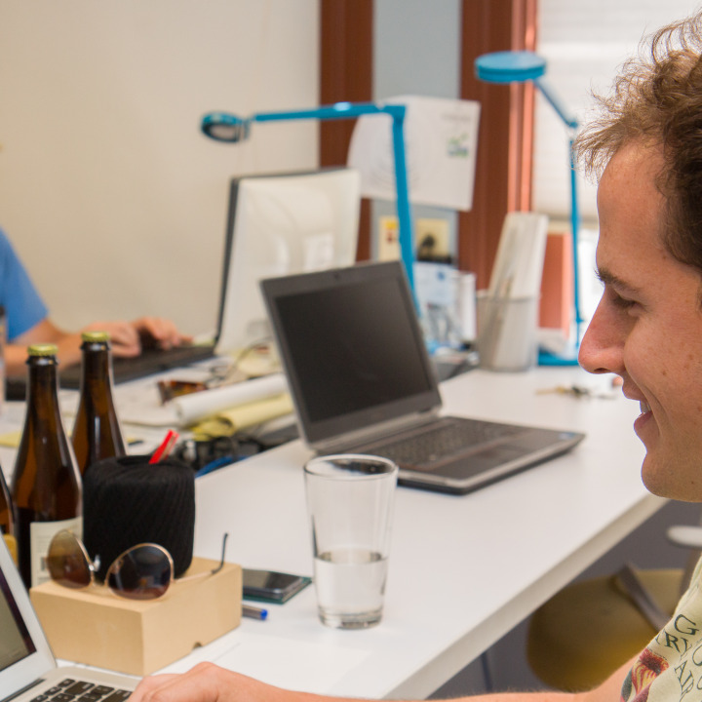
@MIDD

Slide 9
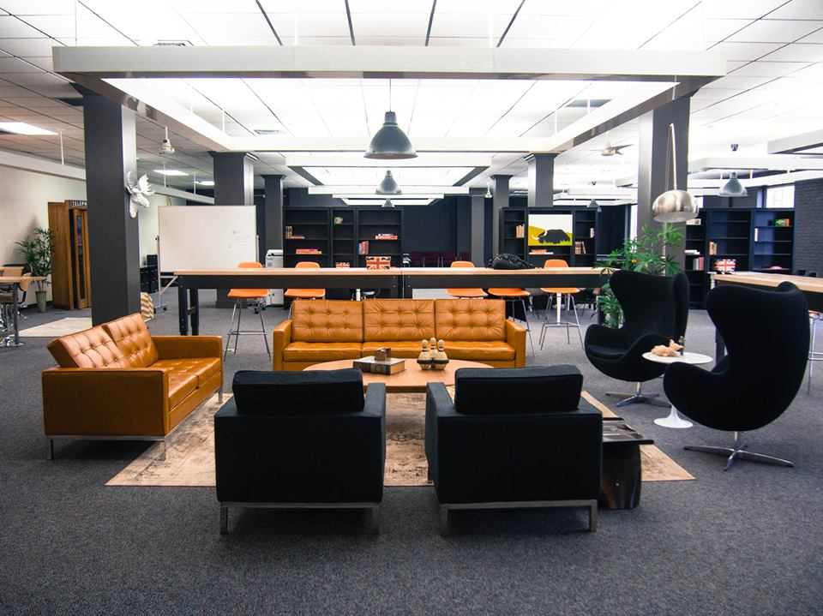
@BTV

Slide 10
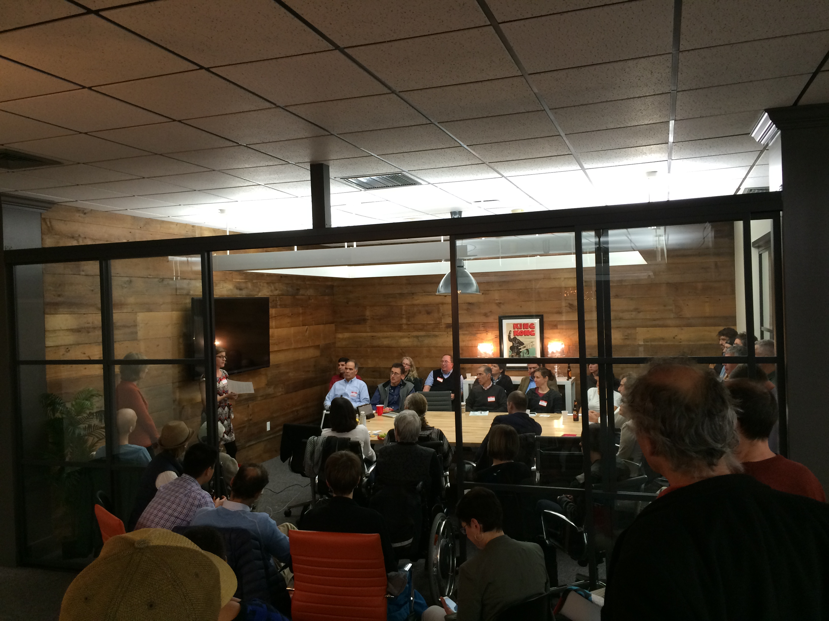
@BTV

Slide 11
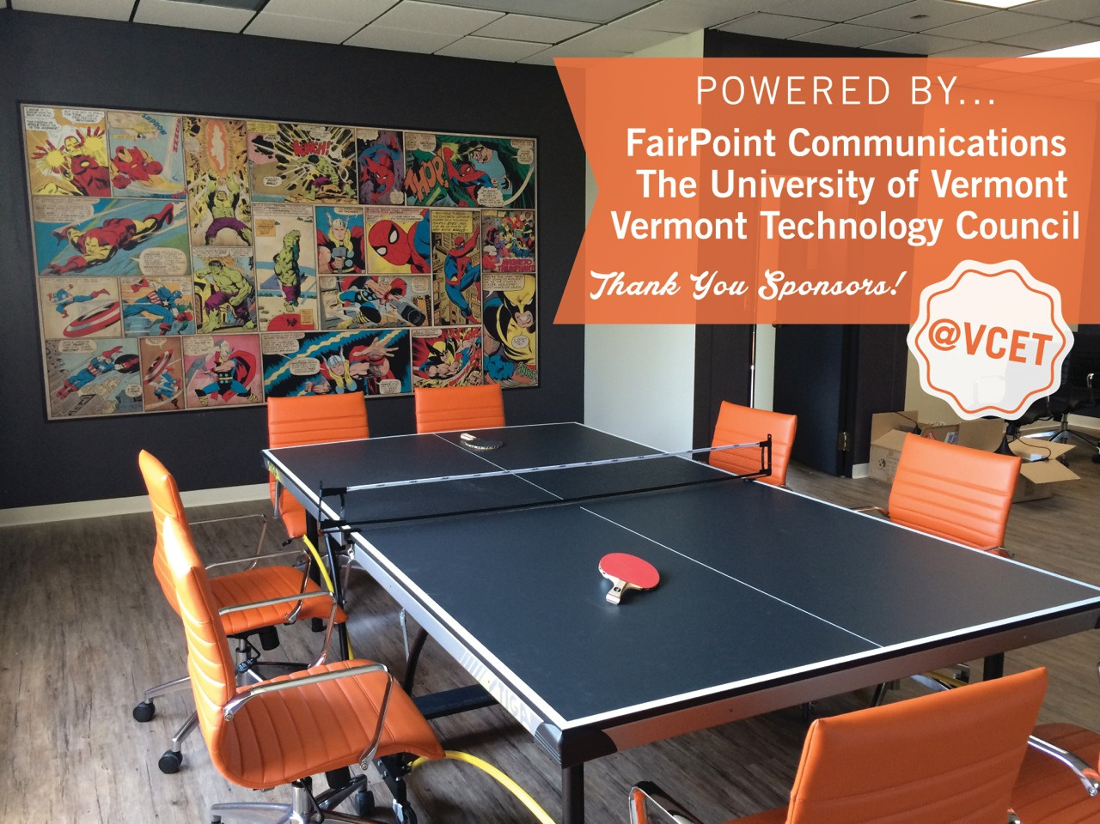
@BTV

Slide 12
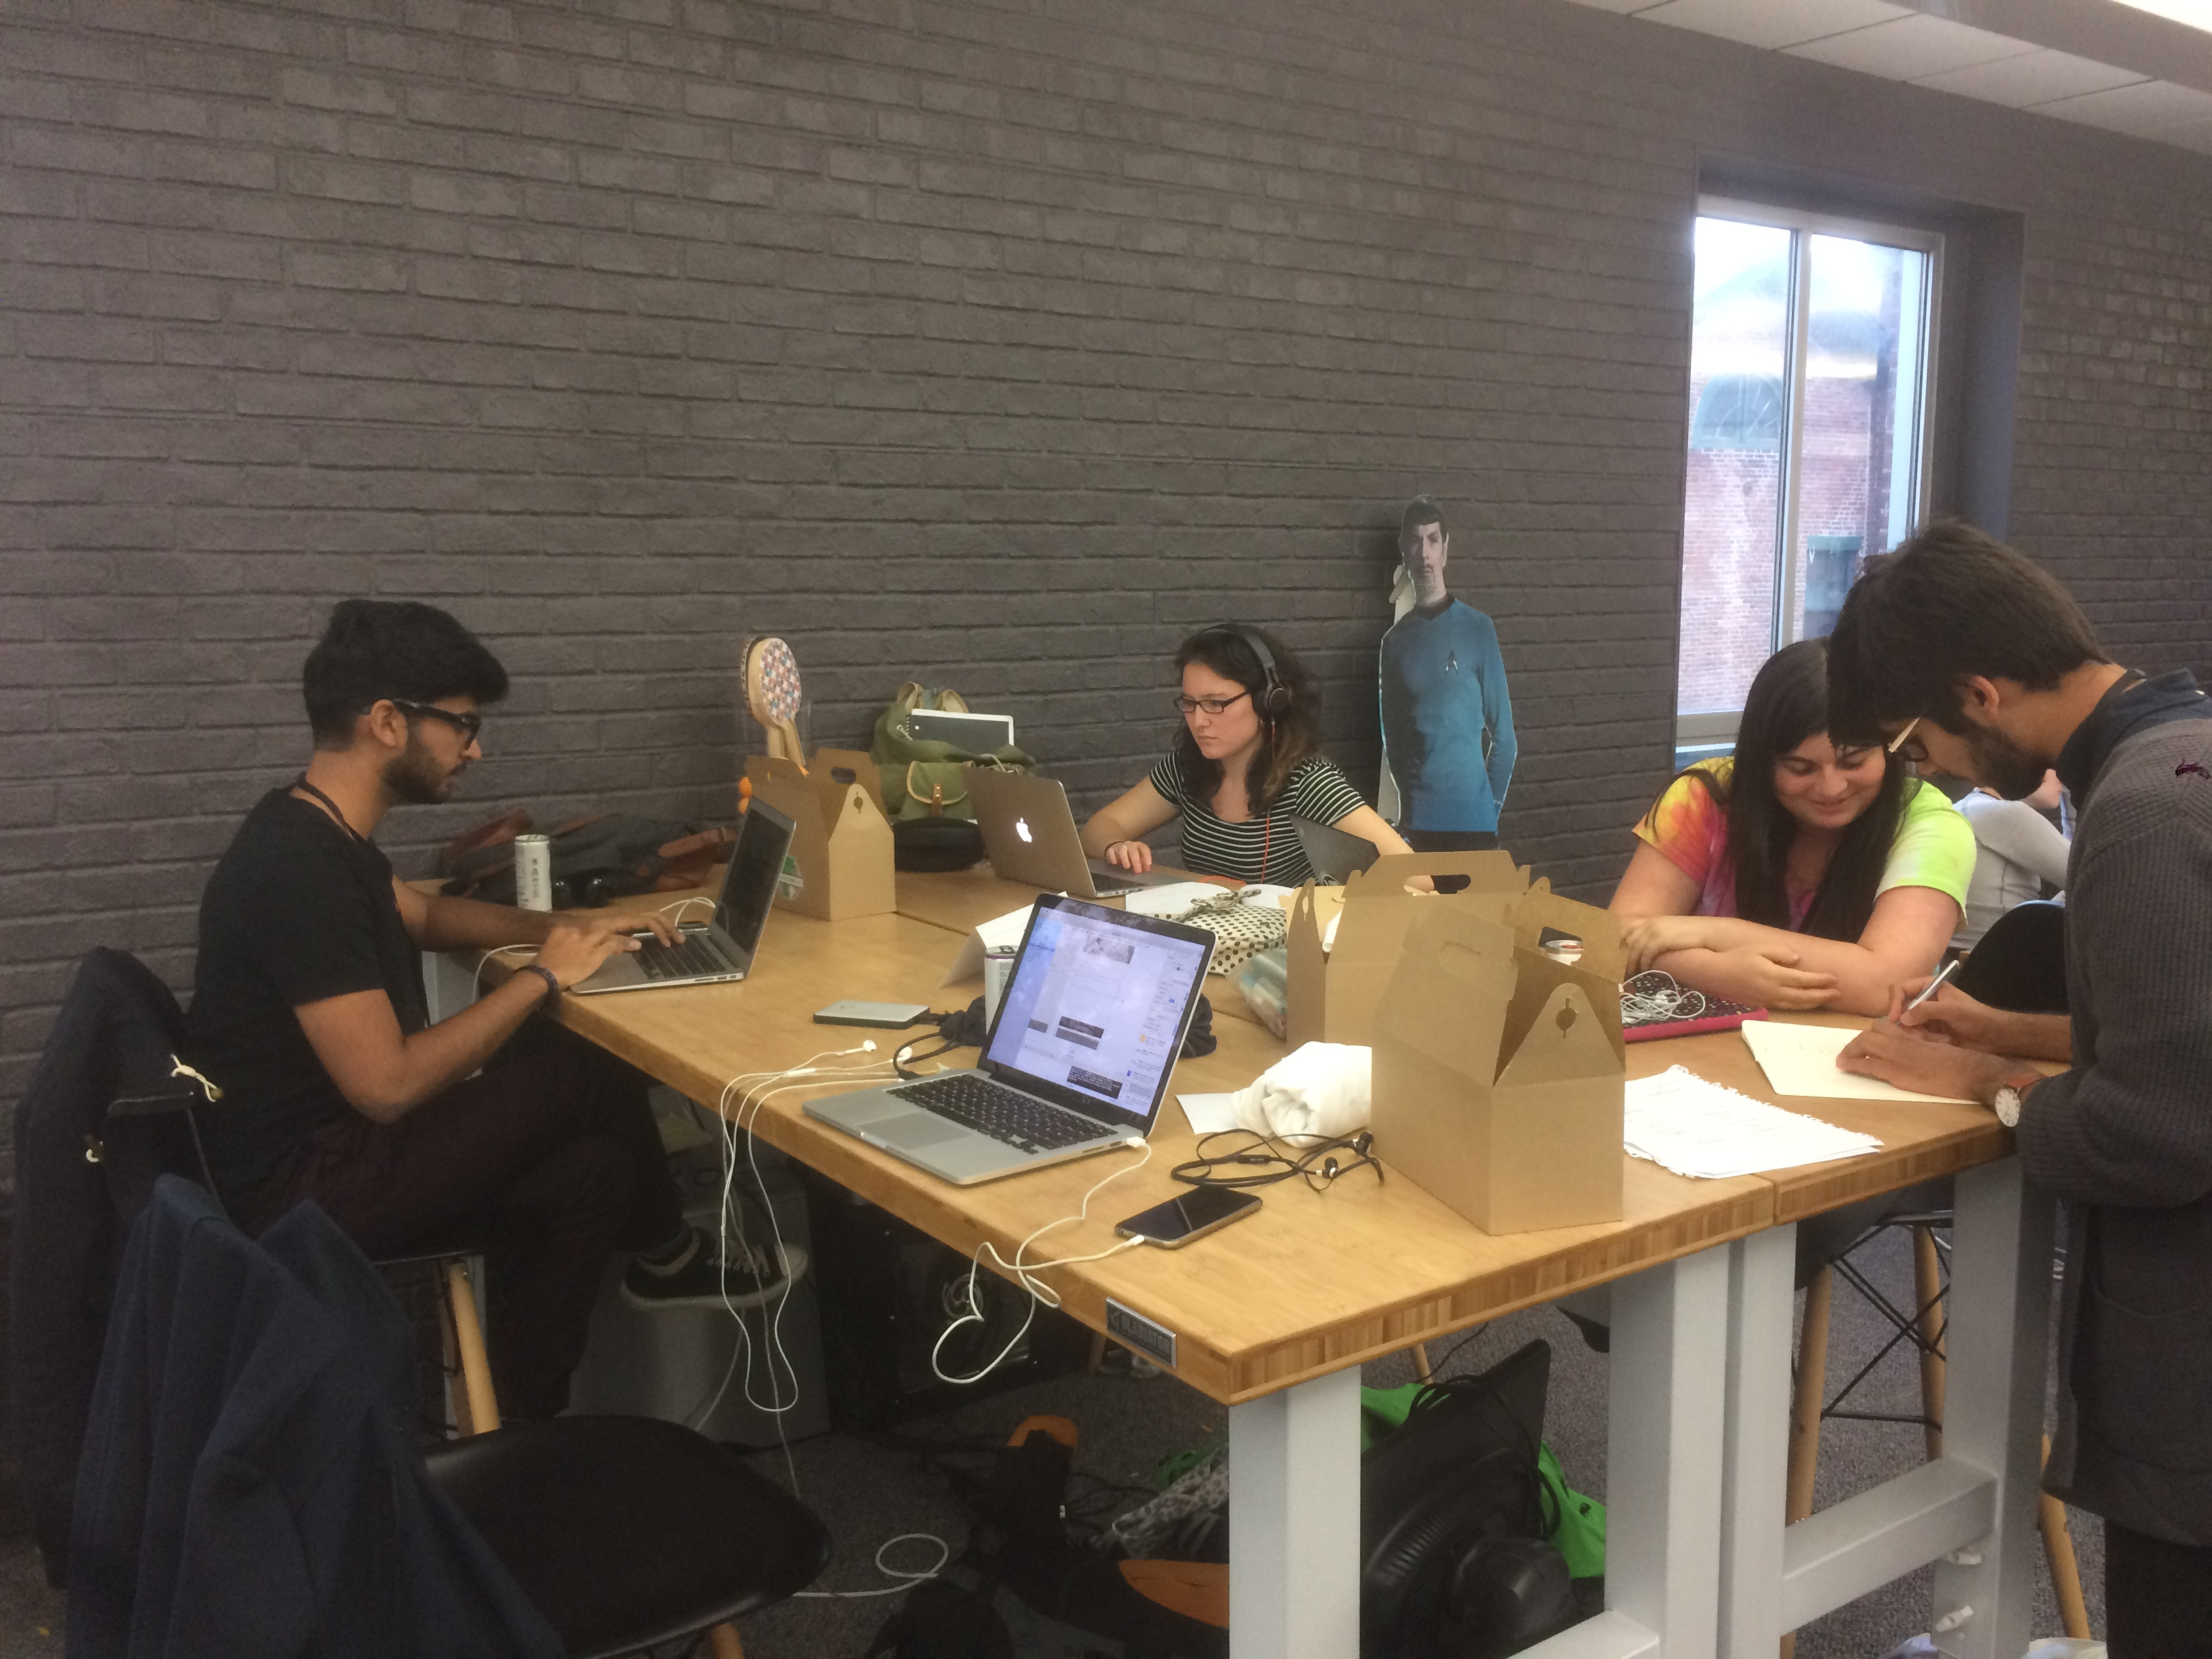
CAPITAL
More Investment but more seeking too
Fewer and smaller regional institutional funds
Startups better prepared than ever
VT crowd funding regulations aligned
BUT ….
Per Capital VC Investment (2014)
$152 = US
$252 = NH/MA/NY*
$ 63 = VT
Notes:
VT is 41% of US……25% of Neighbors ….
Increase in VT to National Average: $55M per year
Increase VT to neighbors: $118M per year
Funds: Borealis, Harborlight, Smaller Fund III,
Angesl are great but institutionally managed funds help shape, organize and syndicate deals.

Slide 13
CAPITAL
Vermont Seed Capital Fund so far…
19 companies, 2 pending, 1 exit (3x), 4 write-offs
$3.6M invested
Totals So far
  $68M capital
  $30M payroll
  $36M revenues
New investments ending?
More capital to shape, fund and syndicate

Slide 14
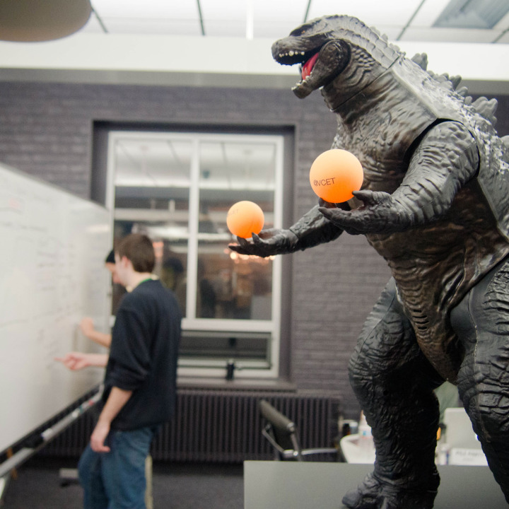
IMPACTS
Over 1,300 startups assisted
Rated #11 in World in 2013
>100 members
        FY15 Survey
          268 Jobs, $21M Payroll
          $21M Revenues, $37M Capital
        FY08-15 Cumulative Survey
          $75M Payroll, $93M Revenues
          $113M Capital

Slide 15
IMPACTS
New Coworking Spaces
Tech @ Office Hours
@Campus initiatives
InnovateHER VT $10k Pitch
Lean Entrepreneurship Course

Slide 16
@VCET
Thank you for support
Follow @ VCET
Come Visit
VermontTechnologies.com
david@vermonttechnologies.com

