Slide 1
UVM Legislative Summit November 17, 2015 Vermont’s 21st Century Economy
Mathew Barewicz
Economic & Labor Market Information Division
Vermont Department of Labor
802.828.4153
www.vtlmi.info

Slide 2
E&LMI?
The Economic & Labor Market Information Division
housed in the Vermont Department of Labor
state partner to the federal government
100% federally funded
Purpose:
- to produce, explain and disseminate economic data for the benefit of the State of Vermont to elected officials, educational institutes, employers, students, job-seekers, researchers, and the general public.
Thank you Employment & Training Administration!
www.vtlmi.info

Slide 3
Task
to create an opportunity for Vermont policy makers to learn from researchers, business owners and government leaders about current initiatives, successes, challenges, and future opportunities in our effort to move forward toward our goal of economic prosperity for all Vermonters.
PLEASE:
Ask questions or make comments as you see fit
Look to adopt standard definitions of “common” words
Unemployment, Labor Force, Discouraged Worker etc…
Challenge the data!
Contact us to have discussions or get additional information
www.vtlmi.info

Slide 4
“The Great Recession”…
www.vtlmi.info

Slide 5
www.vtlmi.info

Slide 6
www.vtlmi.info

Slide 7
Leading & Lagging
Leading the Way:
Non-Durable Manufacturing
Professional & Business Services
Health Care
Leisure & Hospitality
Looking to Recover:
Construction
Retail
Durable Manufacturing
Financial Activities
www.vtlmi.info

Slide 8
Current Status
Total employment above pre-recessionary levels with regional variations
Metro driven recovery nationwide
Low levels of unemployment
Vermont currently 8th lowest
Burlington NECTA currently 36th lowest (out of 387)
The economy is looking for the next big thing…
www.vtlmi.info

Slide 9
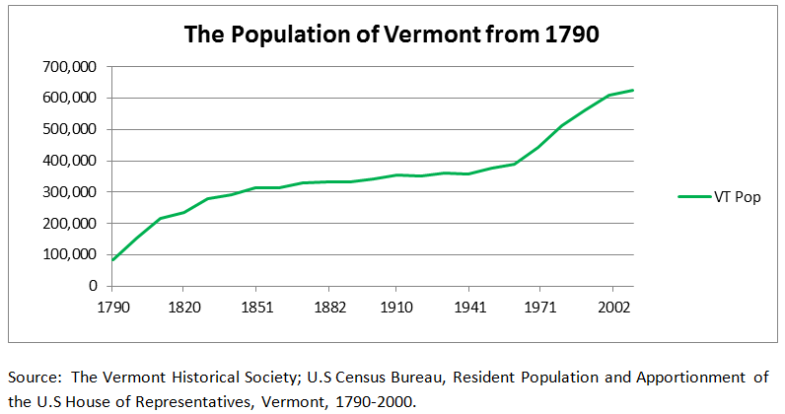
Labor Supply

Slide 10
www.vtlmi.info

Slide 11
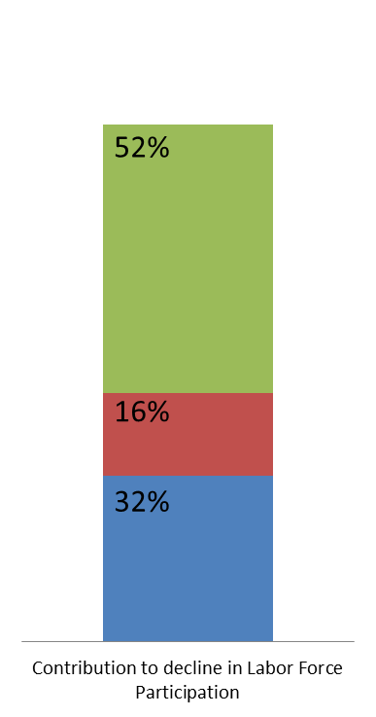
Explaining the U.S. Decline in Labor Force Participation Council of Economic Advisors¹
Three Primary Factors:
Aging of the Population
Cyclical declines in line with past
recessions.
Other factors
Significant increase in Long-Term unemployment.
Other demographic factors
www.vtlmi.info

Slide 12
The Start or the End of a Trend? Changes in the Labor Force Participation Rate
www.vtlmi.info

Slide 13
BLS Forecast of US Labor Force Participation
www.vtlmi.info

Slide 14
BLS Forecast of US Labor Force Participation (cont.)
www.vtlmi.info

Slide 15
Labor Demand

Slide 16
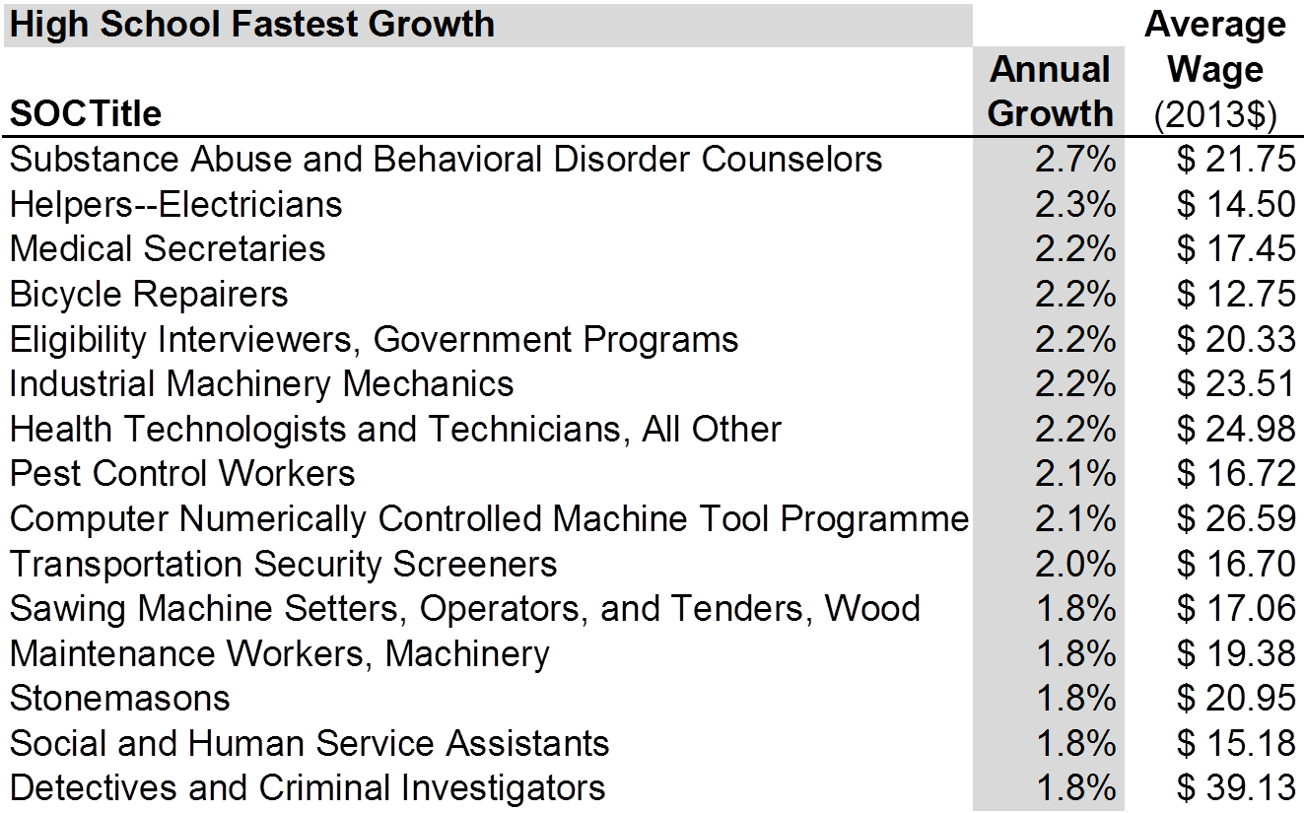
VT Occupational Projections 2012-22
www.vtlmi.info

Slide 17
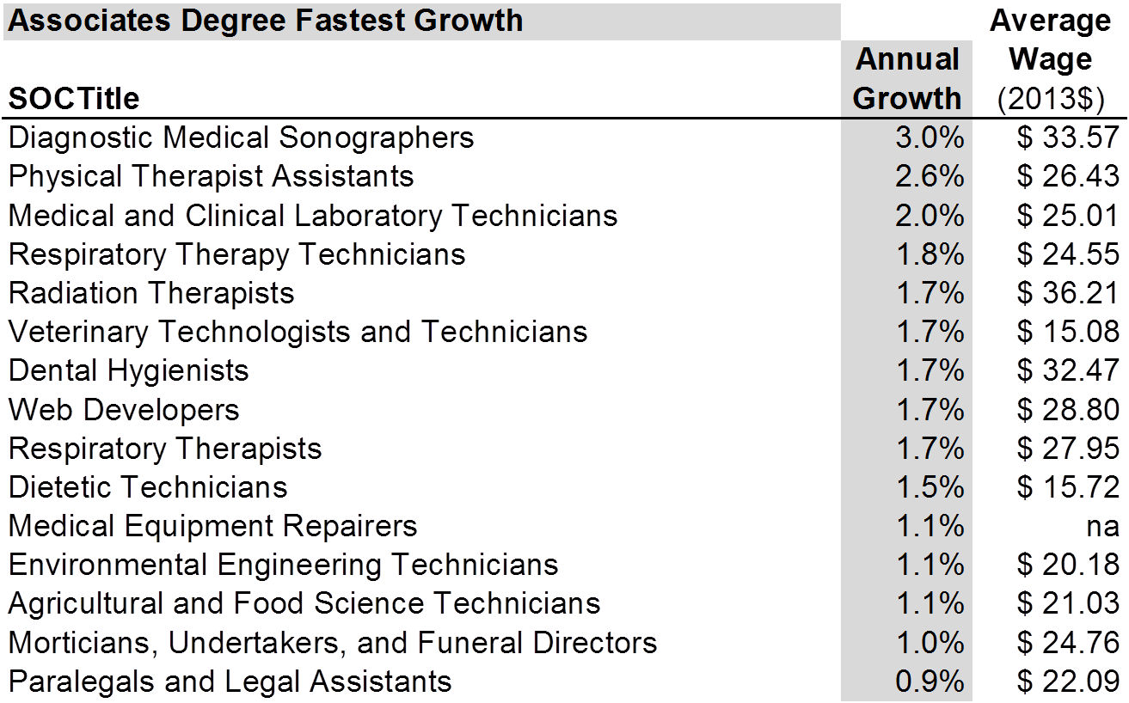
VT Occupational Projections 2012-22
www.vtlmi.info

Slide 18
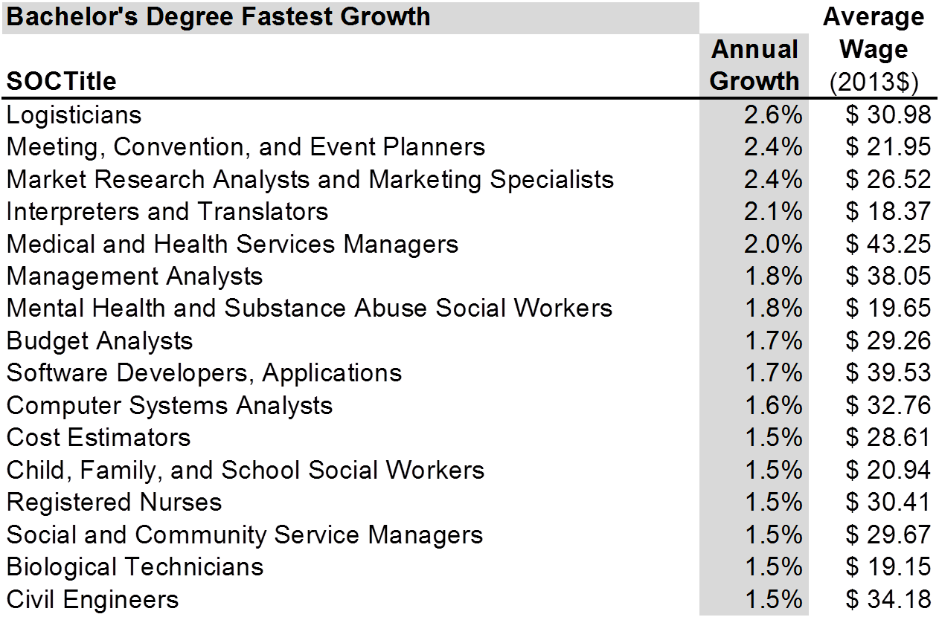
VT Occupational Projections 2012-22
www.vtlmi.info

Slide 19
Summary of Labor Demand
www.vtlmi.info

Slide 20
Educational Attainment of Vermont Adults

Slide 21
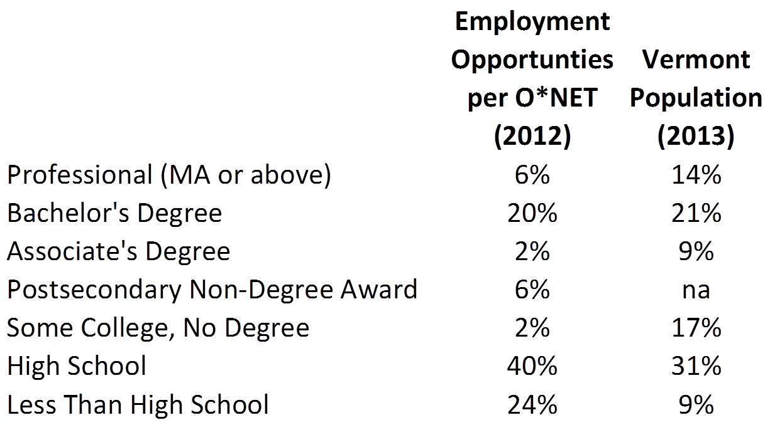
Challenges of Assessing Workforce Needs
www.vtlmi.info

Slide 22
Conclusions
Data is not “Good” or “Bad”; data is.
Focused participation in the labor force
Internships, apprenticeships, job-shadows, etc.
Meaningful access to all levels of education and training
www.vtlmi.info

Slide 23
Thank you!
Mathew Barewicz
Economic & Labor Market Information Division
Vermont Department of Labor
802.828.4153
mathew.barewicz@vermont.gov
www.vtlmi.info

