Slide 1
Forest Health Monitoring Network

Slide 2
Spatial Expansion

Slide 3
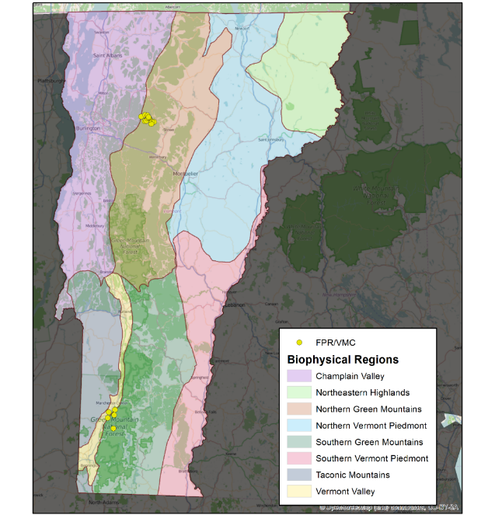
Initial network

Slide 4
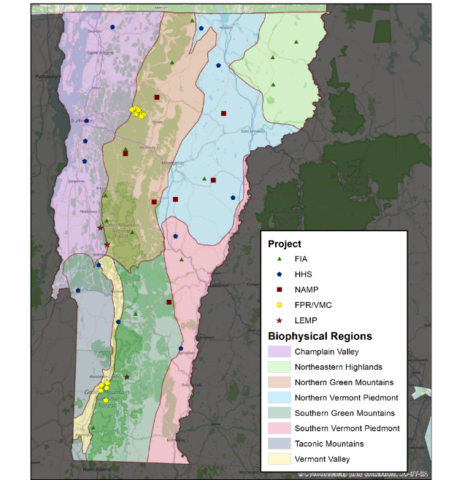
Proposed Expansion

Slide 5
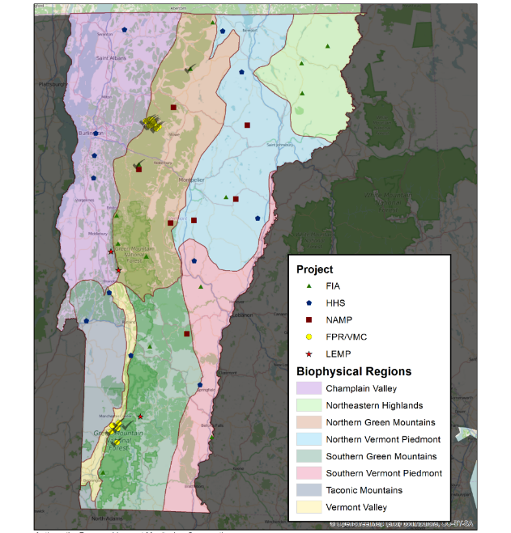
2014 Survey
Not as many as we hoped…
Slow establishment
Expanded protocol
Development of methodology

Slide 6
Bioregion Coverage

Slide 7
Bioregion Coverage

Slide 8
Forest Type Coverage

Slide 9
Additional Methods

Slide 10
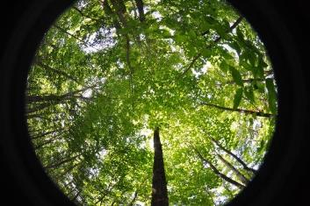
New measurements
Hemispherical Photos
Digital photos of transparency
Tree painting for DBH remeasurement
Prism
Discoloration

