Slide 1
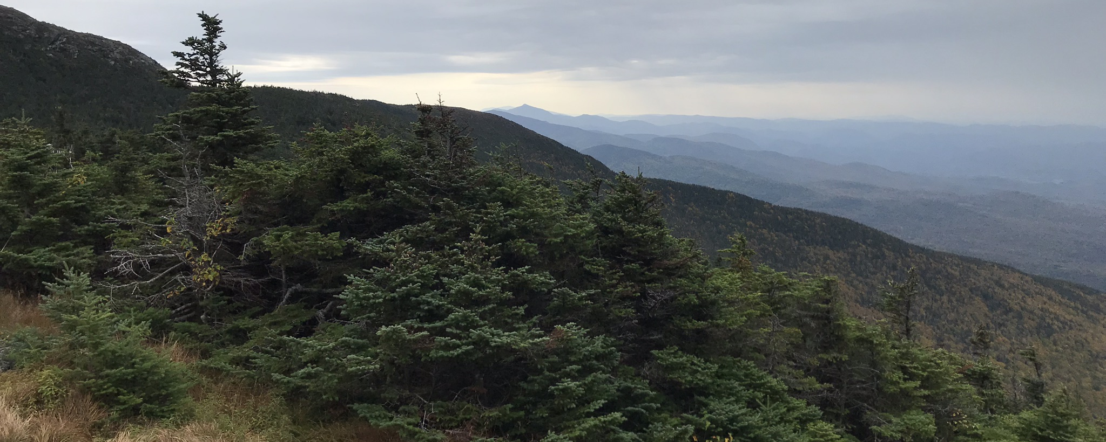
2020 Forest Ecosystem Monitoring Cooperative Conference
Revealing a changing forested landscape
Notes:
Thank you Pete. We have benefited so much from your leadership and guidance over the past two years, thank you for your service to the FEMC.
And thank you all for being here and participating when it is less than ideal.
We know from past feedback on the conference how important networking, making connections and physically being together is in our conference, and we appreciate you all being here in spite of all that.
But with this challenge comes an opportunity – the opportunity to engage more easily with speakers during the presentations, connect in new ways during our networking break, and sample content across a range of disciplines. I hope you can take advantage of them today, and thank you to our presenters, invited speakers and all of you for making this conference work.
I would like to recognize the awesome work of our Conference Planning Committee in helping us pull this together. Laura Kenefic, Lesley-Ann Dupigny-Giroux, Brittany Mosher and Alexej Siren were invaluable supports for us as we developed the theme and plenaries, so thank you to each of you for your time and energy
Before we get into the plenary session, I’m going to use organizer’s privilege to share a little bit about FEMC’s activities over the past year and what is coming up in the year ahead

Slide 2
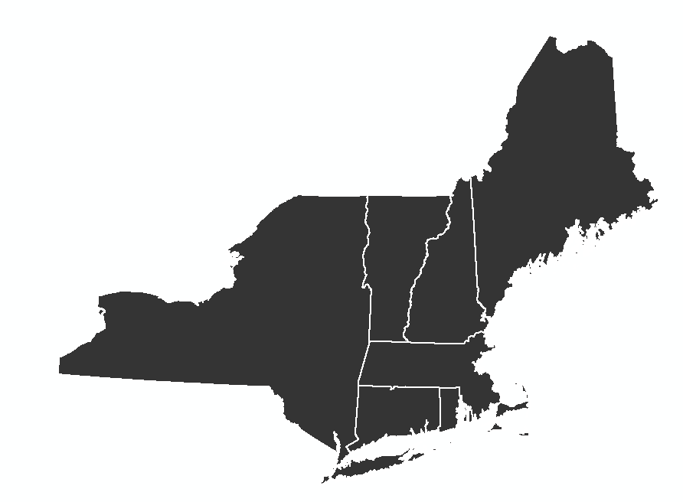


FEMC Continues to Grow
New State Coordinators
To better connect and integrate the Cooperative
Notes:
As we close out a strange year, FEMC has continued to grow. I am excited to welcome formal participation by Connecticut, Maine and Rhode Island in the FEMC, this rounds out a strong and cohesive unit for thinking about forests in our region as a system unto themselves a part of what knits us together as a human community
I am excited that we will be starting a new type of engagement at the state level in State Coordinators. These professionals will be based in each participating state forestry agencies and will coordinate with FEMC staff on state and regional project work. This opens up a wealth of new opportunity for the depth and breadth of work we can accomplish as a Cooperative. Please keep up with our newsletter, as we will be introducing them in batches over the coming months.

Slide 3
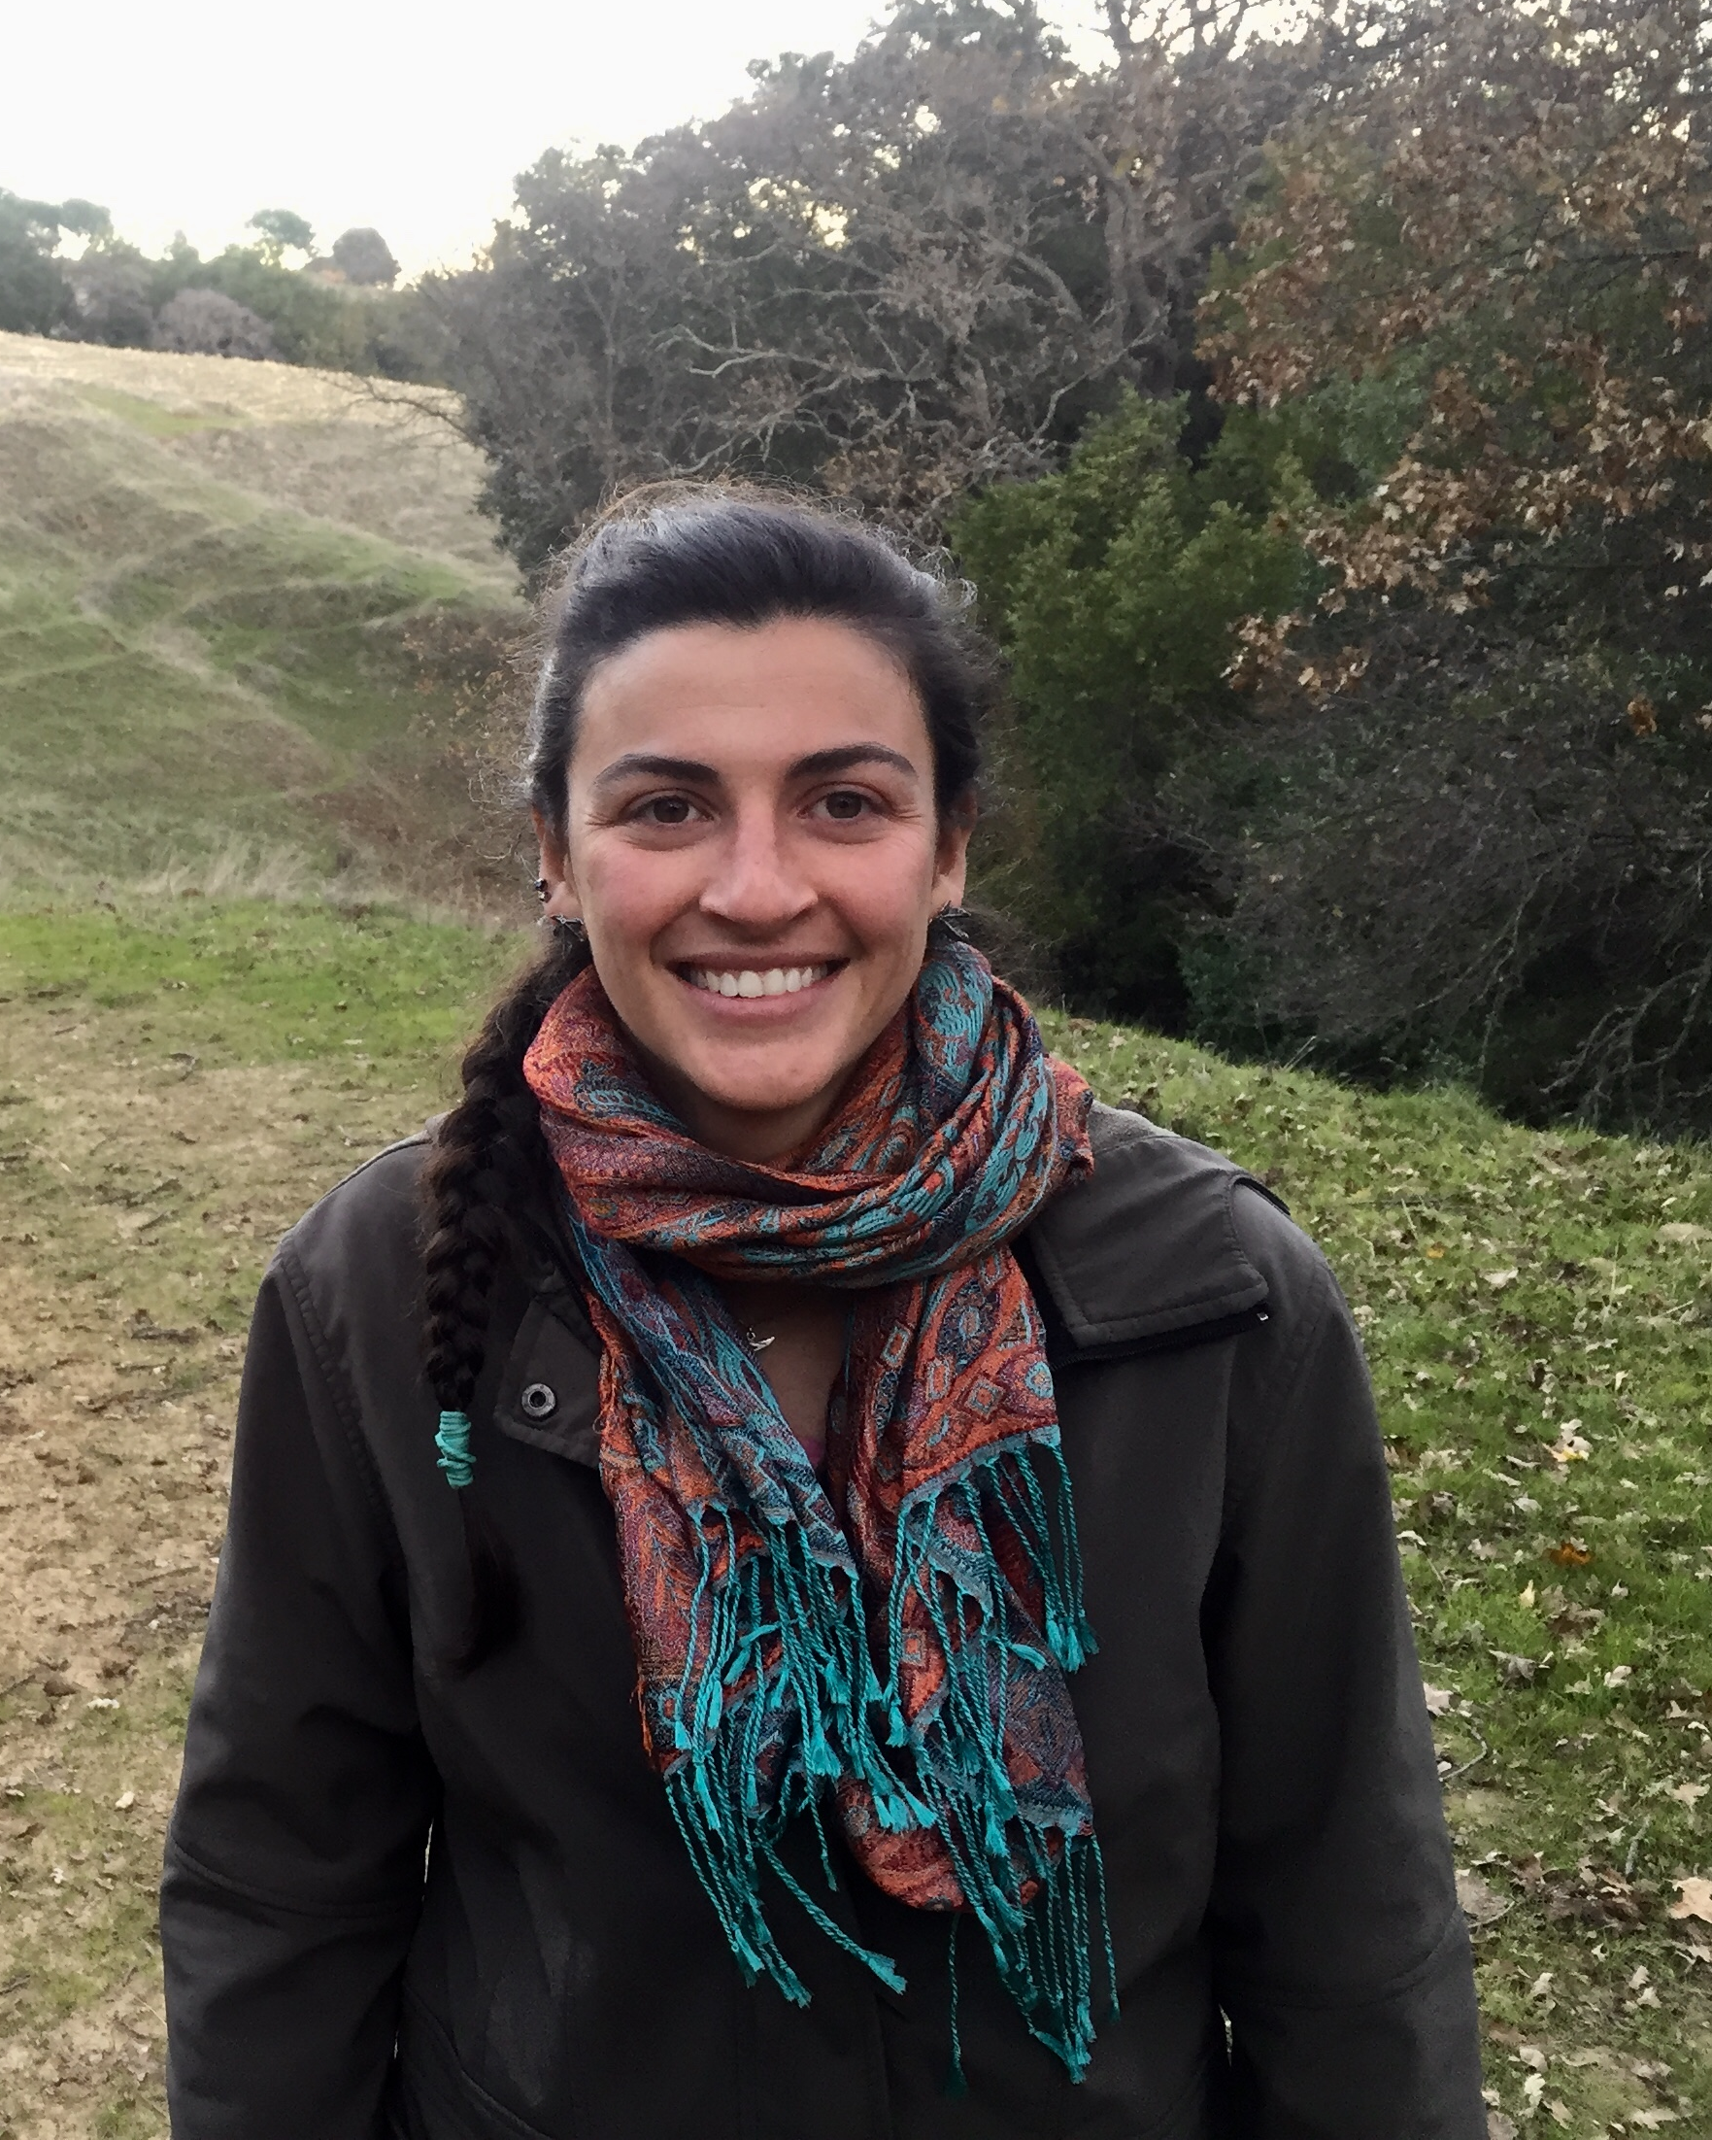
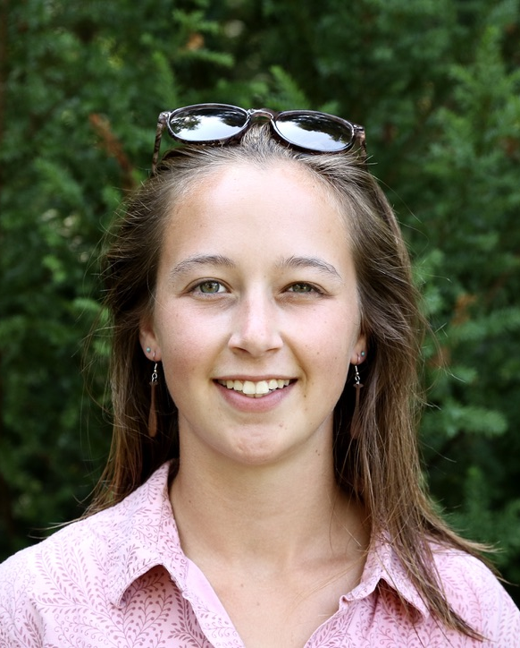
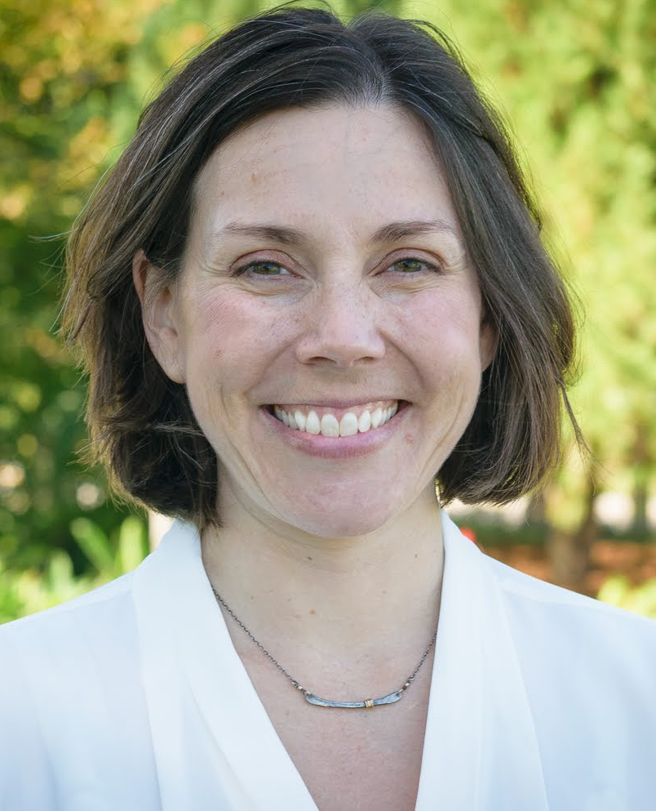
Director:
James Duncan
Project Manager:
Pia Ruisi-Besares
Monitoring/Services
Coordinator: John Truong
Web and Database Developer: Nancy Voorhis
GIS Analyst
Emma Tait
Data Specialist:
Matthias Sirch
ECO AmeriCorps Member:
Emma Gwyn
Data Archivist:
Alyx Belisle
Outreach Professional:
Elissa Schuett
Notes:
Our team continues to grow as well, and the faces here form the core of our staff but we are lucky to have even more folks involved, including Clarke Cooper, Xana Wolf and Jo Robertson, all bringing their expertise and insight to the work.
As we bid Ali Kosiba goodbye this year, we were fortunate to be able to bring Pia Ruisi-Besares on as our new project manager, Elissa Schuett as our outreach professional and Emma Gwyn as part of the Vermont ECO AmeriCorps program. Each of them has done a great job jumping into our program fully remote, please take the time to connect with them during the Conference if you can.

Slide 4
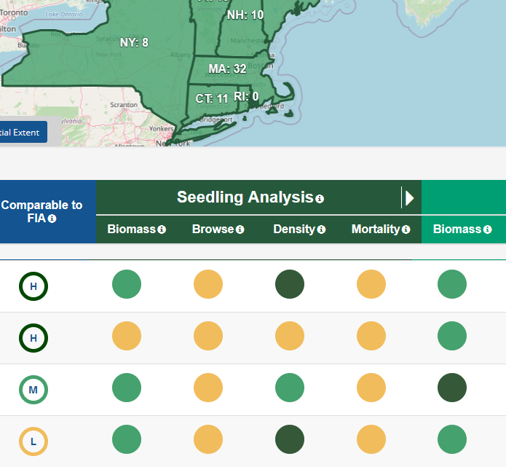
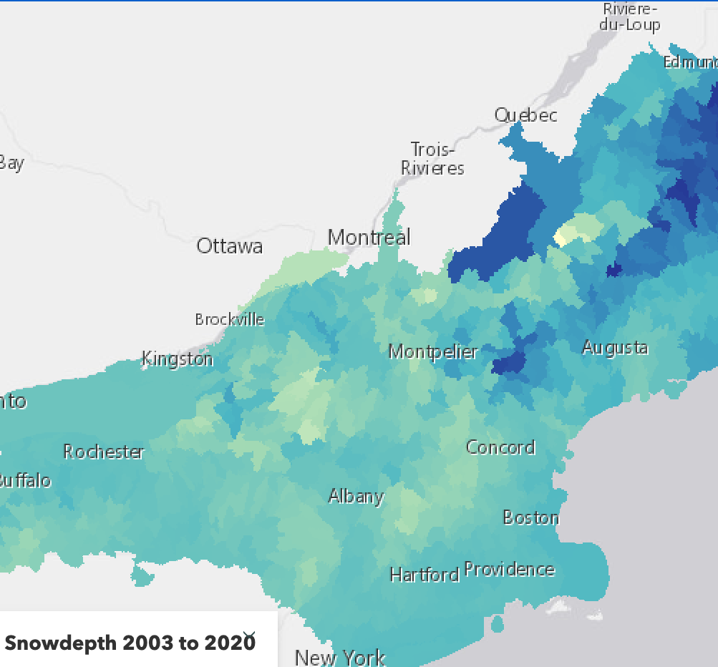
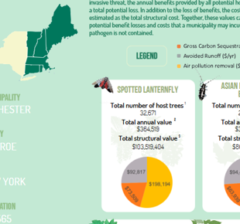
New Regional Tools and Data Resources
88 Urban Inventories
Analyzed for economic impacts
65 Programs
Northeastern Forest Regeneration Data Network
30 Key Forest-Water Datasets
Processed for and ready for analysis
Notes:
Several new tools are available since the last time we gathered. We have collated dozens of key forest regeneration studies and methods to support assessments of regeneration in our forests. We have brought together urban tree inventory data to explain the economic costs of invasive insects, and provided ready-to-use spatial data and trend analyses to support those investigating the connection between forest cover and water quality. If you haven’t already, take some time to explore these tools and let us know how we could make them stronger.

Slide 5
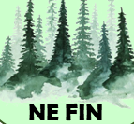
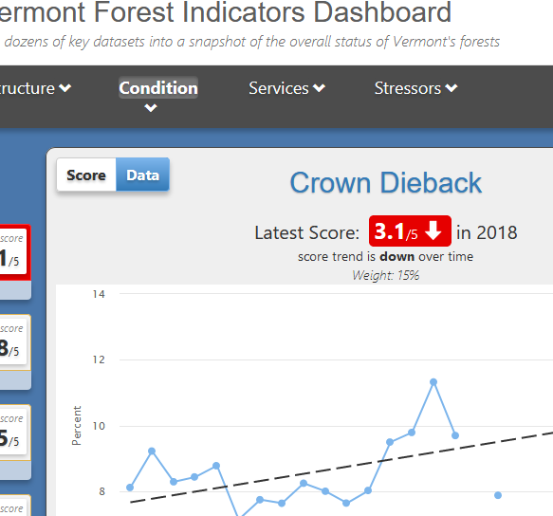
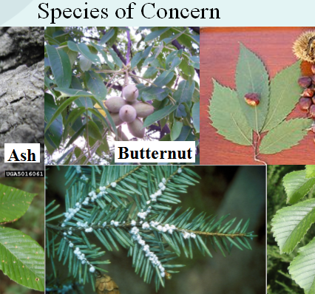
Growing Initiatives and Updated Looks
Tree Rescue Workshop
Held on key northeastern species
Forest Inventory Data Integration
Bringing together dozens of inventory programs
Updated and Expanded
Indicators Dashboard for NH, NY and VT
Notes:
We are in the midst of some exciting efforts, from aggregating data across inventory programs to coordinating monitoring of restoration efforts. And FEMC is excited about the release of a fully redone forest indicator dashboard for Vermont and similar dashboards for New Hampshire and New York that will be launched soon.

Slide 6
FEMC Regional Projects Continue
Notes:
The regional project work of the FEMC continues, and we’re in the middle of several great projects as we speak

Slide 7
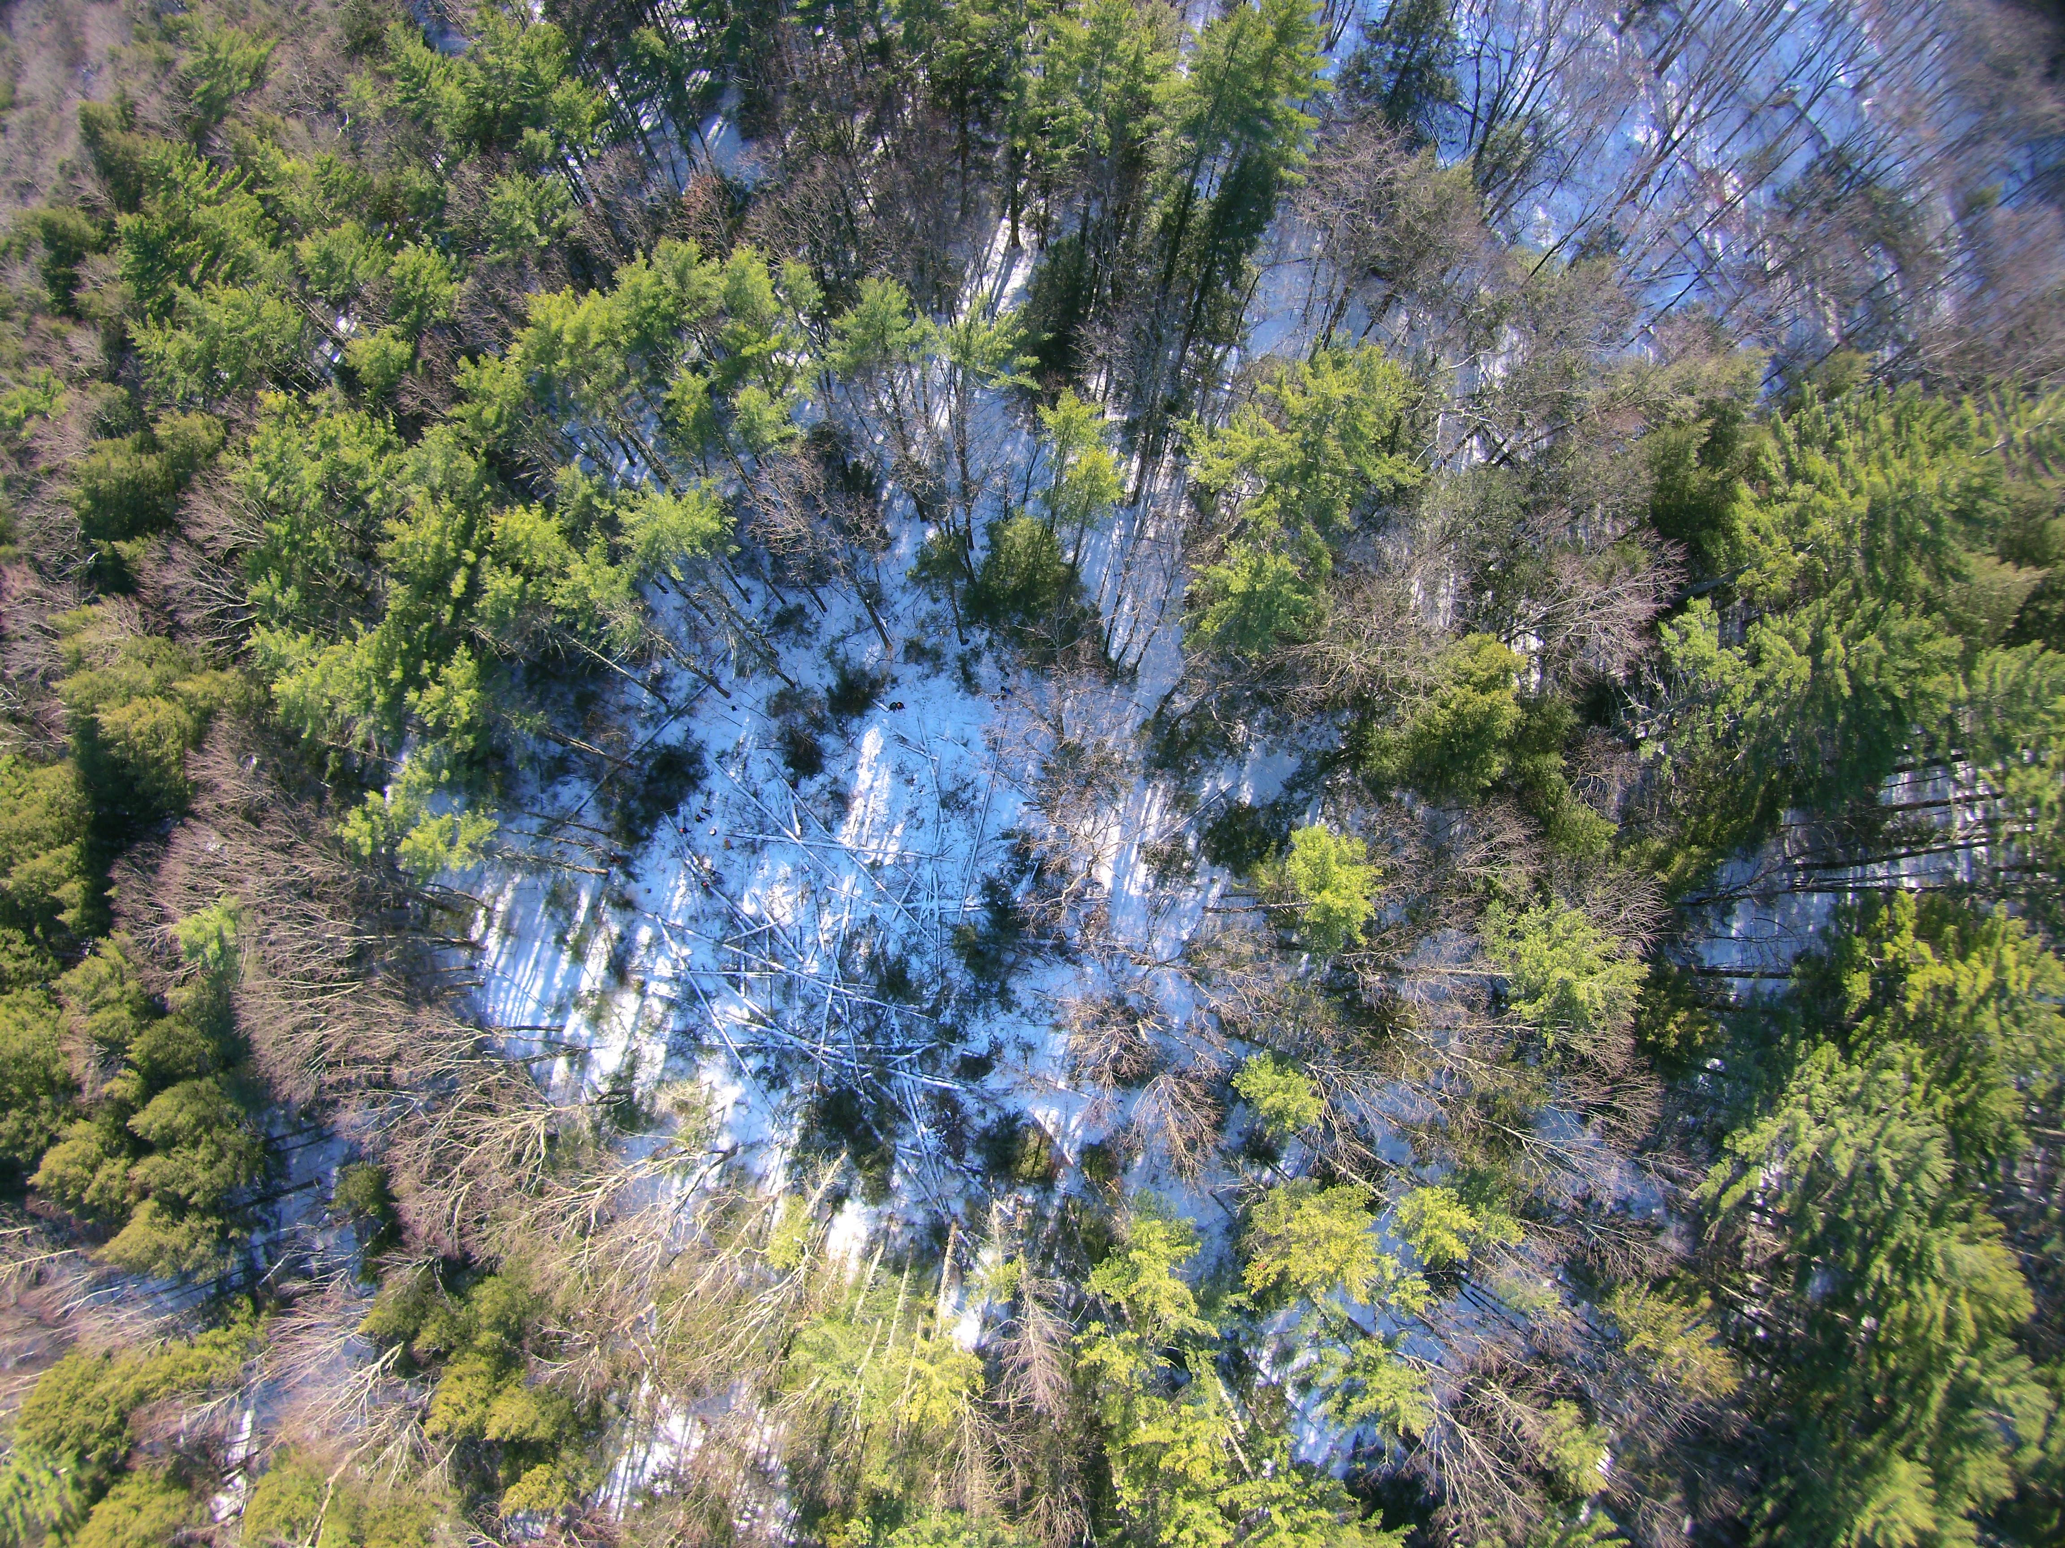
Tracking Changes in Disturbance Regimes
Data on Disturbance Events and Responses
Change and Trend Analysis
Natural and anthropogenic disturbance regimes in historical and modern contexts.
First release expected in early 2021
LM Kopacki
Altered Disturbance Regimes
Altered Disturbance Regimes
Notes:
One of this is focused on identifying and reporting on changes in disturbance regimes, and making information about disturbance in our region easier to access and work with. This involves not only looking at the key disturbances of today, but bringing back historical data from reports, old files and other sources of at-risk data

Slide 8
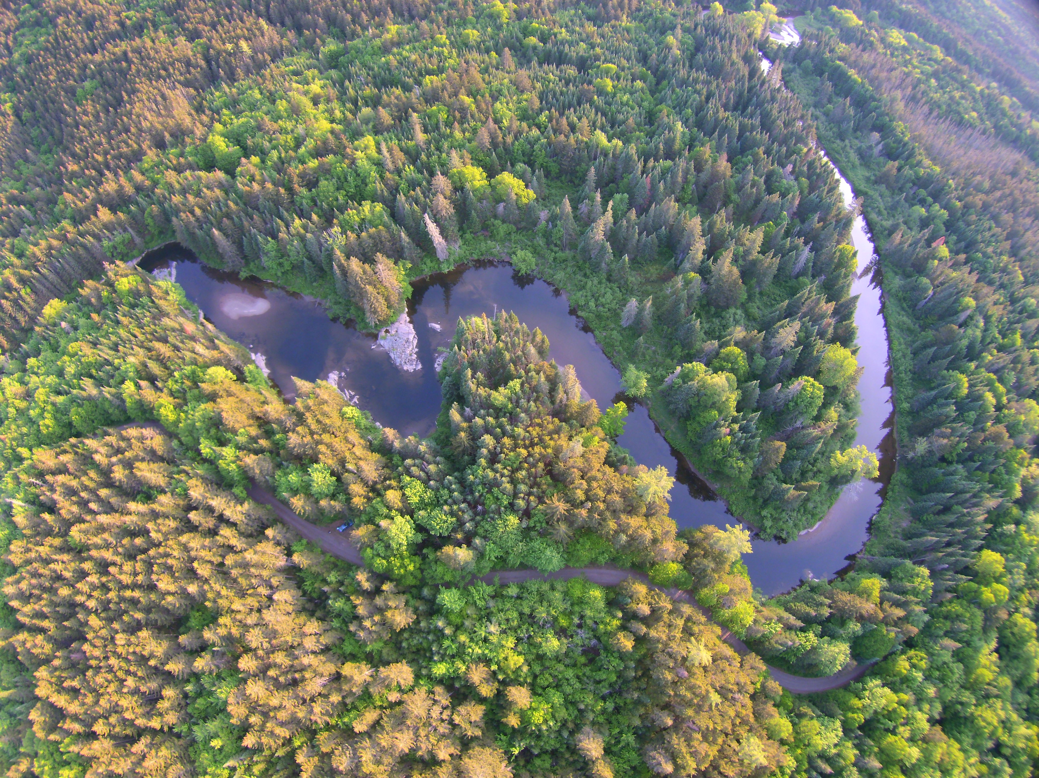
Monitoring for Signs of Climate Change Impacts
How and where indicators of the impacts of climate change are being monitored in northeastern forests
Monitoring methods and locations for 14 key indicators
Access to data for assessing impacts
First release expected in early 2021
LM Kopacki
Altered Disturbance Regimes
Altered Disturbance Regimes
Notes:
Our other large undertaking is to provide a summary of where and how we are monitoring forests for signs that climate change may be starting to have an impact. Working with a great team in the region, we aare identifying where these indicators are being monitored now and where there are gaps, and bringing together information on the ways we monitor?

Slide 9
Regional Projects Starting Up in 2021
Regional assessment of browse and its impacts on forest vegetation
Monitoring the impacts of recreation on forest ecosystems
Forest Health Monitoring expansion

Slide 10
The FEMC Ecosystem Monitoring and Assessment Fund
Novel analysis of monitoring data
Expand existing monitoring
Pilot monitoring program
Upgrade monitoring for comparability
New support for maintaining critical monitoring in the region
Bridge funding
Infrequent monitoring
Data logging equipment
Expecting launch in Spring 2021

Slide 11


Charting a path forward as a Cooperative
30 years
5 years
Join today’s listening session at 12:35
This is your cooperative, help us make it work for you
Notes:
2021 marks the 30th year since the inception of the Vermont Monitoring Cooperative, and five years since the launch of the FEMC.
FEMC begins a strategic planning process to envision what the next 5 years of the Cooperative should look like in January – please get involved in this process, share your input and help us build something that will serve us all and last another 30 years.

Slide 12










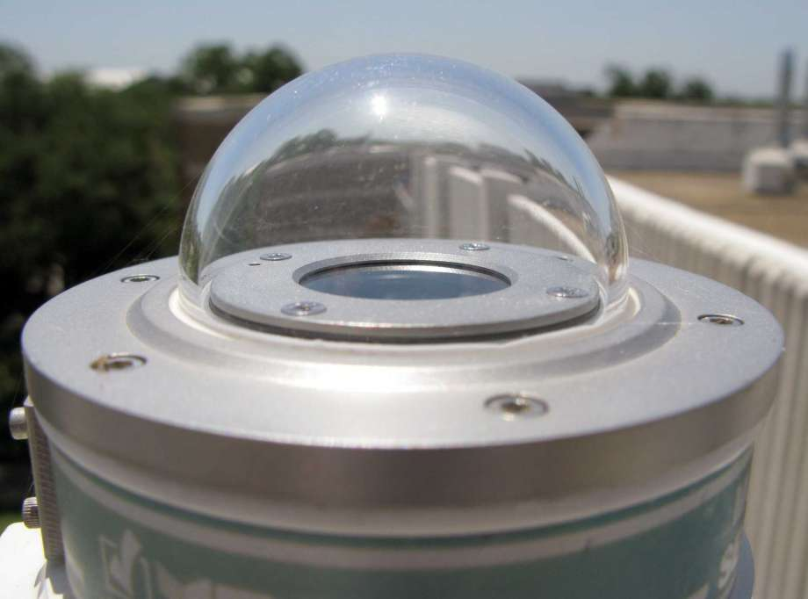


Funding and Support
Green Mountain and Finger Lakes National Forests
Notes:
I also want to extend a sincere thanks to Senator Leahy for his continued support for the Cooperative, as well as his larger commitments to protecting, preserving and understanding our natural world.

Slide 13
Conference logistics
Problems?
Elissa Schuett (eschuett@uvm.edu)
John Truong (jtruong@uvm.edu)
Today
Tomorrow
Plenary
Networking break on Wonder.me
Contributed talks
Networking/lunch break, including Wonder.me
FEMC Listening Session
Plenary
Networking break on Wonder.me
Poster session with flash talks
Contributed talks
Closing remarks
Notes:
Each morning will begin with a plenary session. On Thursday, a networking break will occur immediately after the plenary session. During this break, people are welcome to network and connect with others in a casual setting using the online platform, Wonder.me. FEMC staff will be available in the room to answer any questions, or you are welcome to mingle with others. Before moving into this space, be sure to turn off your camera and microphone in Zoom (or simply close Zoom).
Following this break, contributed talks will be held in three sessions: Forest Pests & Disease, Disturbance & Stressors, and Tools & Technology.
There will be another break for lunch, but the Wonder rooms will be available for further networking. After the break we will hold a listening session as we prepare for upcoming strategic planning. This will complete day 1.
Friday will follow a similar schedule, with a plenary session followed by a break. After the break will be a poster session in which presenters will give flash talks and then be available for Q&A discussion in a Wonder room. Contributed talks in three tracks will follow the posters with the topics: Wildlife, Long-Term Monitoring, and Forest Ecosystems.
To finish the conference will be a brief closing remarks session by FEMC Principal Investigator Jen Pontius.
If you run into any trouble, contact Elissa or John, and their phone numbers are in the agenda you received over e-mail.
For those of you seeking SAF credits, please refer to Elissa’s e-mail and be sure to sign into sessions with your name and collect the unique codes as you go. A note on the change to SAF credits, today is worth 4 credits for full attendance, and tomorrow is worth 2 credits,

Slide 14
2020 Forest Ecosystem Monitoring Cooperative Conference
Revealing a changing forested landscape
Notes:
With that, I would like to turn to our plenary. As Pete noted….
I am pleased to welcome Dr. Kate Miller to our virtual stage this year. Kate, if your bandwidth permits, perhaps you can briefly turn on your video and wave to the crowds.
Kate is a Quantitative Ecologist with the National Park Service's Inventory and Monitoring Program, where she leads long-term forest monitoring in 20 national parks from Virginia to Maine and freshwater wetland monitoring in Acadia National Park. With an extensive experience in developing tools for analysis and visualization of data, her familiarity with both the production of long-term data and making it usable to those of us who need it is invaluable. Kate received her BS in Natural Resources from Northland College, and MS and PhD from the University of Maine's School of Biology and Ecology. Today she will be sharing insight with us from a large scale monitoring effort her talk titled Forest health monitoring in eastern national parks: lessons learned and future concerns. Kate, I will play your prerecorded talk and then welcome you back to answer questions at the end. Thank you for being here today!

