Slide 1

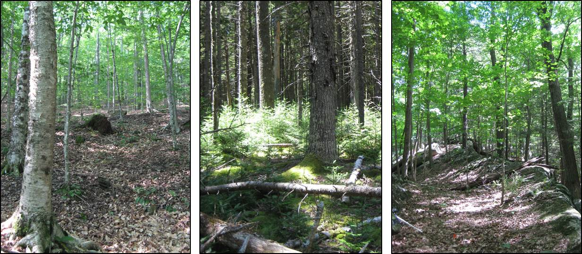
Trends in invasive plants in eastern National Park forests
National Park Service
Inventory and Monitoring Program
Northeast Temperate Network
Kate Miller and Camilla Seirup, Acadia National Park, Bar Harbor, ME
Aaron Weed, Marsh-Billings-Rockefeller NHP, Woodstock, VT

Slide 2
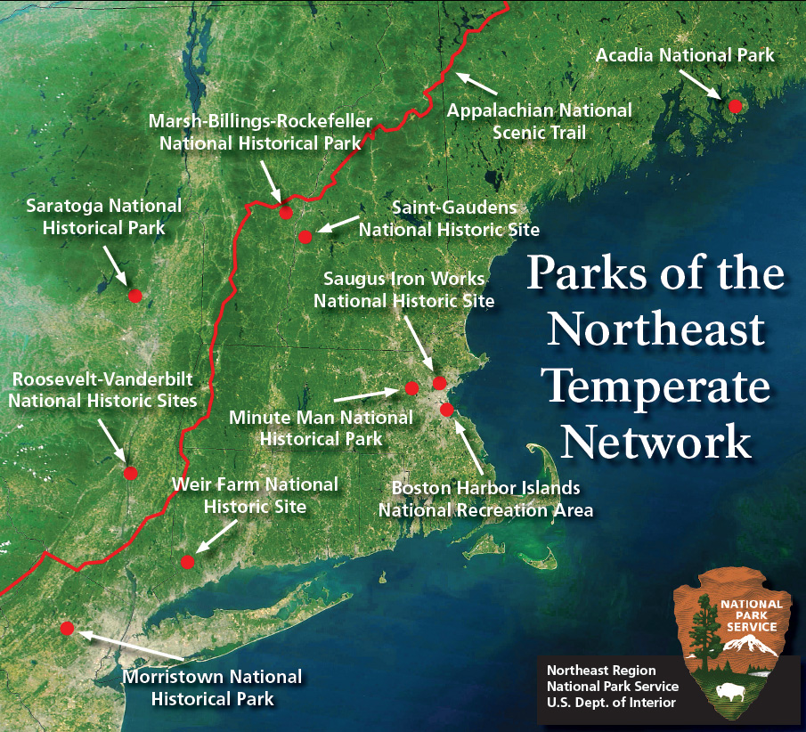
National Park Service
U.S. Department of the Interior
Northeast Temperate I&M Network
Coordinate annual monitoring of natural resources in 13 parks
Data used for evaluating status and trends in key attributes of natural resources
  Forest Health
  Breeding landbirds
  Water quality and quantity, etc
For adivising park management decisions
Data and prdocuts publicly available on our website
http://go.nps.gov/netn

Slide 3
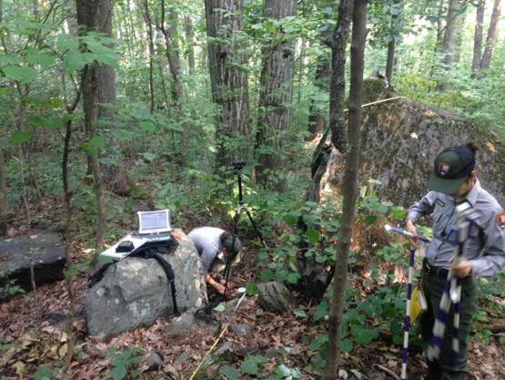
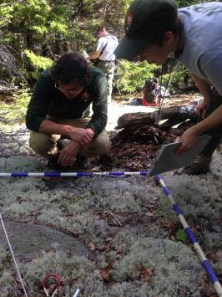
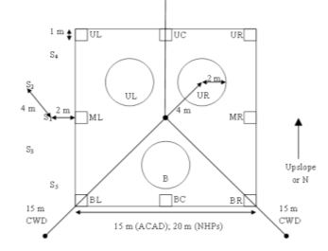
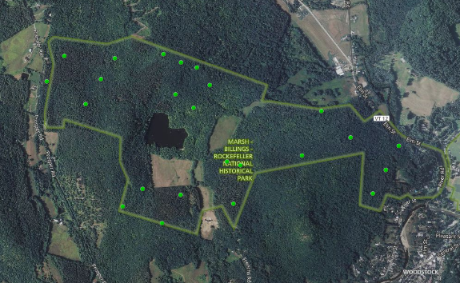
Forest Vegetation and Health monitoring
Objectives:
  Estimate changes in the abundance and composition of tree, shrub, and understory strata.
  Estimate effects from deer, diseases, and insects on tree and forest condition.
  Link results in context of other monitoring
Design and Data:
  annual monitoring since 2006 in 9 parks
  random, spatially balanced sampling within a park
  numerous data from all veg strata
    Regeneration and forest structure
  Soils data, tree cores, deer browse, etc
Program contact and data requests:
  Kate Miller
  kathryn_miller@nps.gov
  (207) 288-8736
  https://www.nps.gov/im/netn/forest-health.htm
Plot dist’n in a park
Plot Design

Slide 4
NPS I&M Eastern Forest Monitoring programs
4 letter acronyms refer to park units – 39 parks, ~2K plots, most monitored annually since 2007
Notes:
There are 50 parks that are monitoring forest health in the eastern US using similar protocols.
This has allowed us to start pooling our data to look at broader regional patterns.

Slide 5
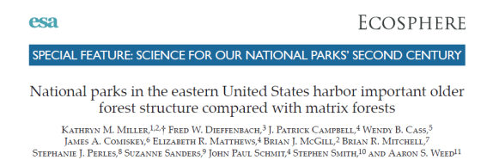
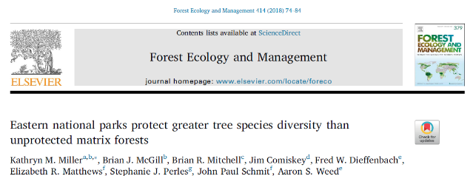
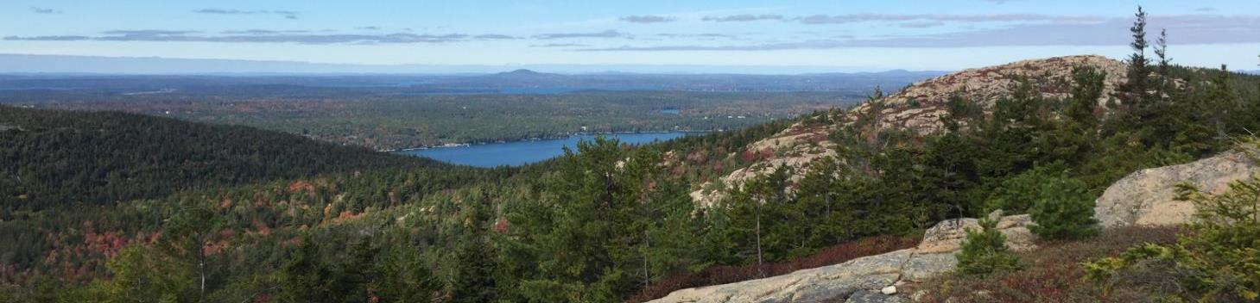
Forest monitoring in eastern parks –recent studies
Park forests harbor more complex older-forest structure than surrounding matrix forests (Miller et al. 2016)
Park forests protect greater tree diversity than surrounding matrix forests (Miller et al. 2018)
Notes:
This was significant finding to our parks. It helped us to see the importance of the forest habitat that we’re protecting.

Slide 6
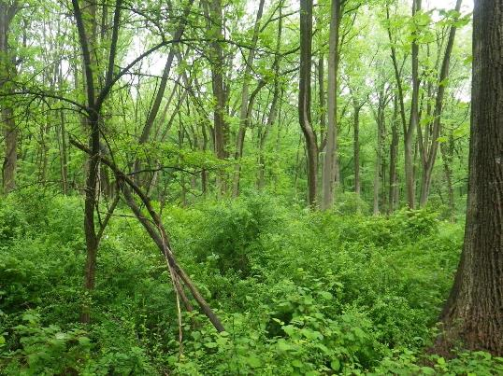
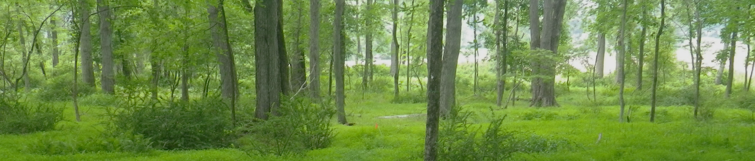
Park forest condition and threats
Main threats to park forests
Invasive plants and pests
Deer overabundance
Lacking and/or suboptimal regeneration
Climate change

Slide 7
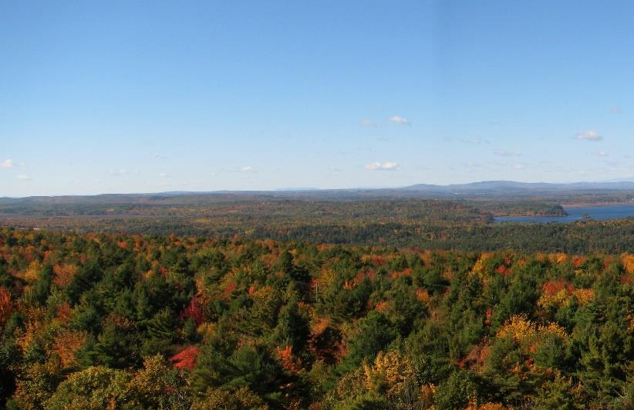
Trends in invasive plants in eastern NPS forests
Background:
Invasive plants are persistent in NPS units
Millions of $$ are spent annually managing invasive plants
Resource managers need a better understanding of which species to focus management and the drivers
Invasive plant distributions are relatively well known in the eastern US, but temporal changes in invasive species abundance and distribution have received little attention
Examining trends will help inform important drivers (e.g., climatic vs land use)
Notes:
Today I’m going to give an overview of the NPS mission and how management objectives have shifted over the last decade or so.
Then I’ll highlight some of the lessons we’ve learned through monitoring on status and trends in forest condition;
I’ll talk about some future concerns, along with their management implications.

Slide 8
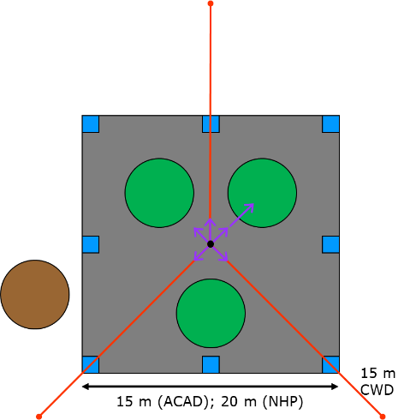
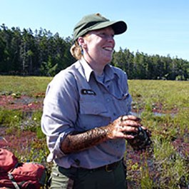
Trends in invasive plants in eastern NPS forests
Study objectives:
Examine temporal trends at 3 scales of plant invasion
  plot frequency, quadrat frequency and average quadrat cover
Grouping: all invasives, by guild, and by species
Database:
invasive species (U.S. Executive Office 1999)
1,470 permanent forest plots (225m² to 706m²)
Panel design, ~ 12 years (2006 - 2018) over 3 cycles
39 eastern national parks across 12 states (1-176 plots per +park)
NETN Forest Plot
Kate Miller, Ph.D. – plant ecologist
Miller et al. in review
Notes:
We defined invasive species similar to the U.S. Executive Order 13112, which defines invasive species as those that are non-native and whose introduction causes or is likely to cause native ecosystem impacts (U.S. Executive Office 1999). We primarily relied on three popular regional reference guides to develop our invasive species list (Mehroff et al. 2003, Miller 2003, Swearingen et al. 2010), although we only included species in our analysis that are invasive in forest habitats (e.g., shade tolerant), and/or that are capable of preventing old fields from succeeding to forest (e.g., exotic shrubs). We also added several species that were not included in the above resources but that we considered invasive or potentially invasive based on collective field experience and park management priorities, including jetbead (Rhodotypos scandens), moneywort (Lysimachia nummularia), and oriental lady's thumb (Persicaria longiseta).
Plot frequency is the percent of plots with at least one invasive species, and roughly captures the broader spread of invasive species across a park.
Quadrat frequency is the percent of 1 m² quadrats per plot containing at least one invasive species, and tracks the local spread of invasive species within a plot.
Average cover most closely tracks changes in abundance of invasive species over time.

Slide 9
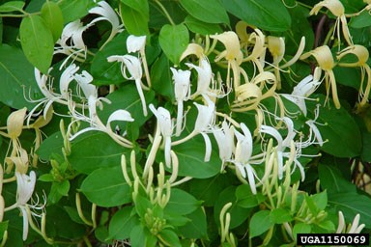
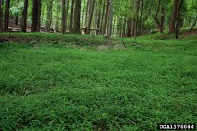
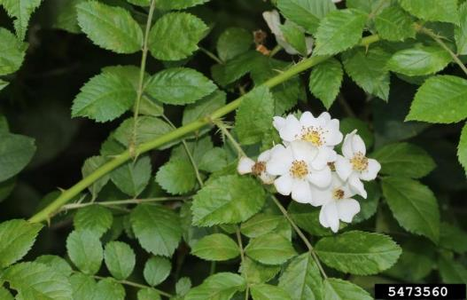
Regional trends in invasive plants
Invasive plants are everywhere! >50% of plots had at least one invasive.
80% of the parks in our study had at least one significant increasing trend in invasive abundance over time.
Highest invader abundance near densely populated areas (DC, Boston, NY, NJ)
Notes:
Today I’m going to give an overview of the NPS mission and how management objectives have shifted over the last decade or so.
Then I’ll highlight some of the lessons we’ve learned through monitoring on status and trends in forest condition;
I’ll talk about some future concerns, along with their management implications.

Slide 10
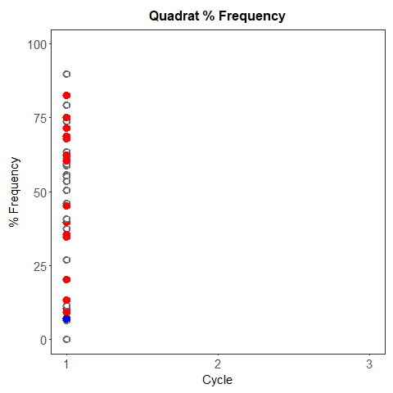
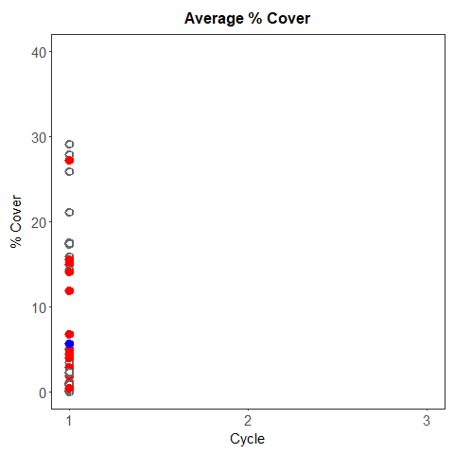
Regional Trends: Total Invasives
Cycles:
1= 2007-2010
2= 2011-2014
3= 2015-2018
Sign. Increase
Sign. Decline
No Sign. Trend
Miller et al. in review
Notes:
Results were pretty consistent across metrics and grouping levels.
In the figures I’m going to show, each park is represented by a line. Red is a significant increase, blue is sign. decrease, and grey is no trend.
Decline quad: PRWI in VA
Decline Ave Cover: ROVA

Slide 11
Trends in the Northeast park units
Results from these parks
ACAD: Acadia NP – ME
SAGA: Saint Gaudens NHS- NH
MABI: Marsh-Billings- Rock. NHP – VT
MIMA: Minute Man NHP- MA
SARA: Saratoga NHP- NY
Roosevelt-Vanderbilt NHS - NY
WEFA: Weir Farm NHS – CT
MORR: Morristown NHP- NJ
Notes:
Average % cover per quadrat patterns are similar- shrubs are most abundant, and tend to increase.

Slide 12
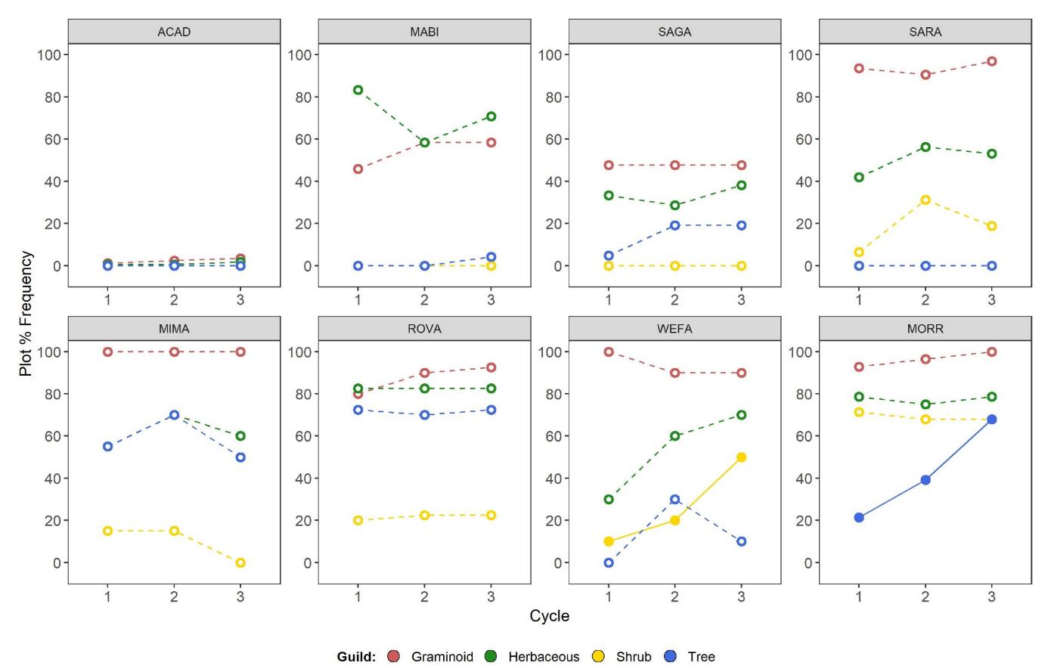
Trends in the Northeast -- Plot frequency
Bar Harbor, ME
Woodstock, VT
Cornish, NH
Stillwater, NY
Concord, MA
Hyde Park, NY
Wilton, CT
Morristown, NJ
Cycles: 1= 2007-10; 2= 2011-14; 3= 2015-18
Miller et al. in review
Notes:
Average % cover per quadrat patterns are similar- shrubs are most abundant, and tend to increase.

Slide 13
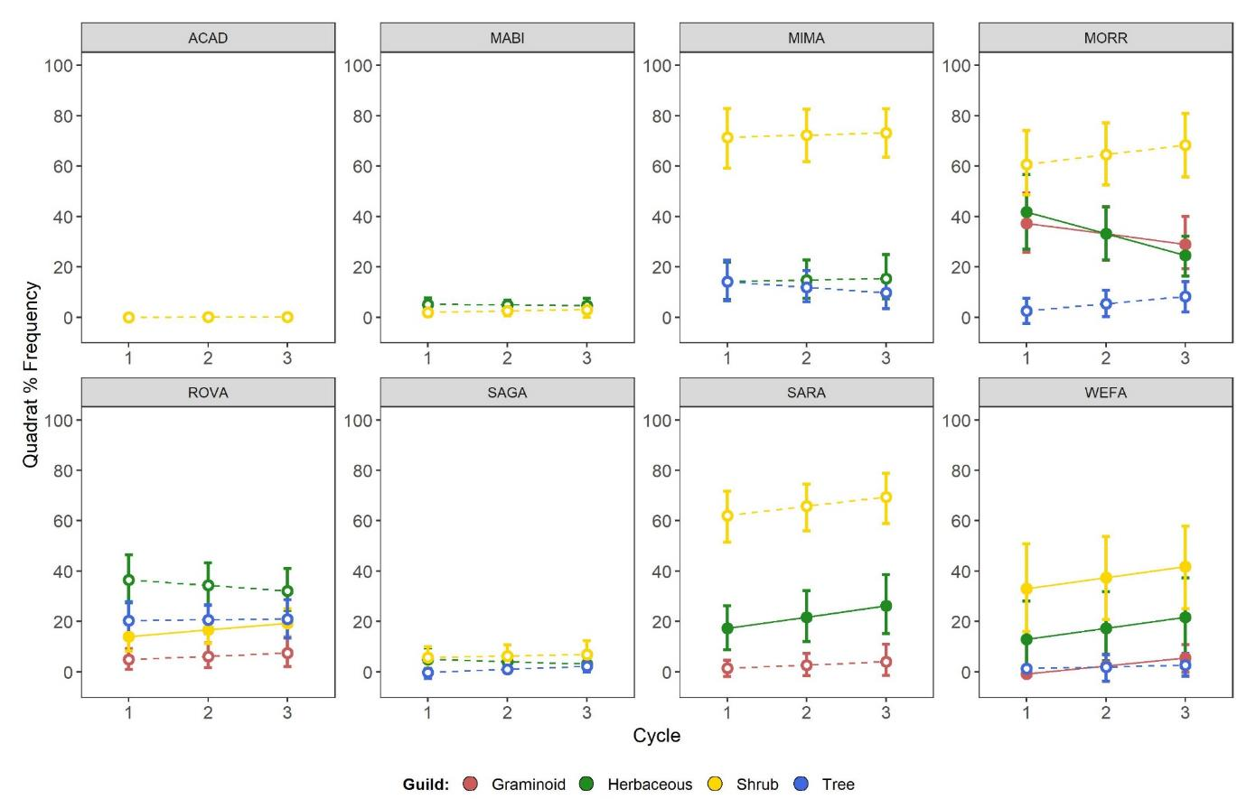
Trends in the Northeast -- Quadrat frequency
Bar Harbor, ME
Woodstock, VT
Concord, MA
Morristown, NJ
Hyde Park, NY
Cornish, NH
Stillwater, NY
Wilton, CT
8 quadrats per plot
Cycles: 1= 2007-10; 2= 2011-14; 3= 2015-18
Miller et al. in review
Notes:
Average % cover per quadrat patterns are similar- shrubs are most abundant, and tend to increase.

Slide 14
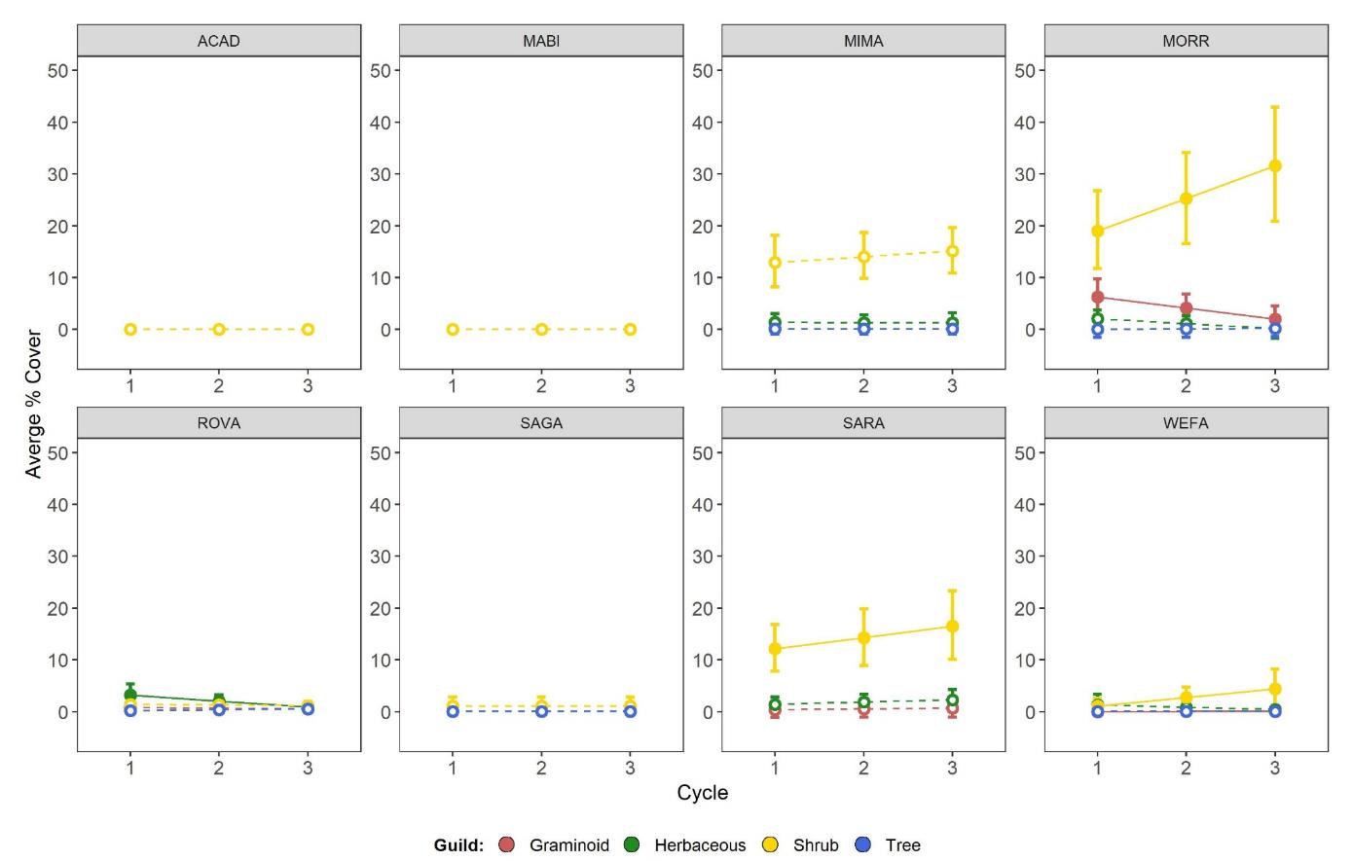
Trends in the Northeast -- Avg. % Cover
Bar Harbor, ME
Woodstock, VT
Concord, MA
Morristown, NJ
Hyde Park, NY
Cornish, NH
Stillwater, NY
Wilton, CT
Cycles: 1= 2007-10; 2= 2011-14; 3= 2015-18
Miller et al. in review
Notes:
Average % cover per quadrat patterns are similar- shrubs are most abundant, and tend to increase.

Slide 15
Most common Northeast invaders encountered
Species | Common | Guild | Ave. plot freq. (%) park⁻¹ | Range (%) | Absent from plots in State of:
Rosa multiflora | multiflora rose | Shrub | 39 | 0-91 | VT
Celastrus orbiculatus | Asian bittersweet | Shrub | 37 | 1-80 | None
Lonicera spp. | exotic bush honeysuckle | Shrub | 36 | 0-91 | ME, CT
Berberis thunbergii | Japanese barberry | Shrub | 34 | 1-90 | None
Alliaria petiolata | garlic mustard | Herbaceous | 30 | 0-73 | ME and NH
Euonymus alatus | winged burningbush | Shrub | 27 | 0-80 | ME
Rhamnus cathartica | European buckthorn | Shrub | 24 | 0-94 | ME, CT
Epipactis helleborine | broadleaf helleborine | Herbaceous | 20 | 2-58 | None
Acer platanoides | Norway maple | Tree | 19 | 0-55 | ME, NH
Rhamnus frangula | glossy buckthorn | Shrub | 15 | 0-95 | VT
Cardamine impatiens | narrowleaf bittercress | Herbaceous | 11 | 0-40 | ME, VT, NH
Microstegium vimineum | Japanese stiltgrass | Graminoid | 10 | 0-50 | ME, VT, NH, MA
Ligustrum | privet | Shrub | 7 | 0-20 | ME, VT, NH
Ailanthus altissima | tree-of-heaven | Tree | 7 | 0-48 | ME, VT, NH, MA
Lonicera japonica | Japanese honeysuckle | Shrub | 7 | 0-40 | ME, VT, NH
Notes:
Our most frequently encountered species are in our southern parks (NY and NJ)

Slide 16
Trends in the Northeast -- Summary
Invasive species are widespread and consistently increasing in abundance across eastern parks
  Low levels of invasion at: Acadia NP (ME), Marsh-Billings-Rock. (VT) and Saint-Gaudens (NH)
  Sig. decrease in invasive abundance at Marsh-Billings-Rock. (VT)
Most aggressive invaders
  Japanese stiltgrass (Microstegium vimineum)
  Shrubs and woody vines
Miller et al. in review
Notes:
Average % cover per quadrat patterns are similar- shrubs are most abundant, and tend to increase.

Slide 17
Implications for management
Likely drivers
  Overabundant deer
  Canopy disturbances
  Exotic earthworms
  Fragmentation
  Land use history
Fisichelli and Miller 2017 Biol. Invasions
HOWEVER…..

Slide 18
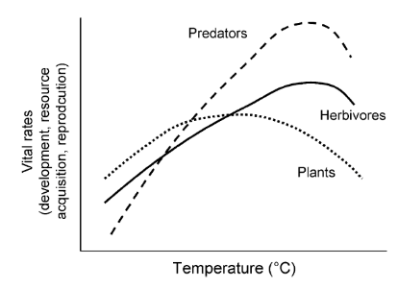
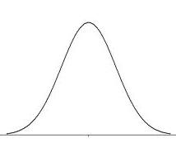
What about climate?
Local and regional plant growth and reproduction is directly affected by atmospheric CO₂ and climate
  CO₂ enrichment and ↑ water = ↑ growth
  Warming temperatures = ↑ growth, expand geographical distributions
Physiological predictions suggest that climate change could (is?) increase invasion plant abundance in the NE (just like we predict for invasive pests)
Latitude
Notes:
We need to understand ED species and beware but climate change may already and could continue to exacerbate our already persistent issue of well know invaders.

Slide 19

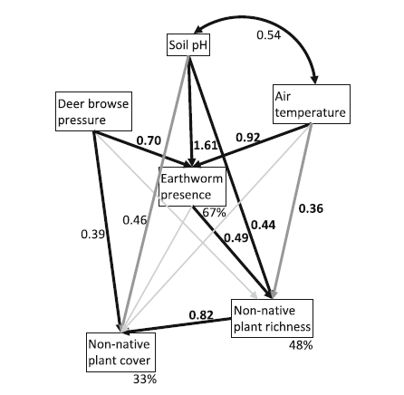
What about climate?
Park forest have warmed since monitoring began
Common forest understory stressors (worms and deer) and warming conditions promote non-native plants in park forests (Fisichelli and Miller 2017 Biol. Invasions)
Evidence for direct and indirect effects of summer air temperature on non-native plant richness
Structural equation model illustrating supported relationships among biotic global change stressors and environmental variables.
Notes:
We need to understand ED species and beware but climate change may already and could continue to exacerbate our already persistent issue of well know invaders.

Slide 20
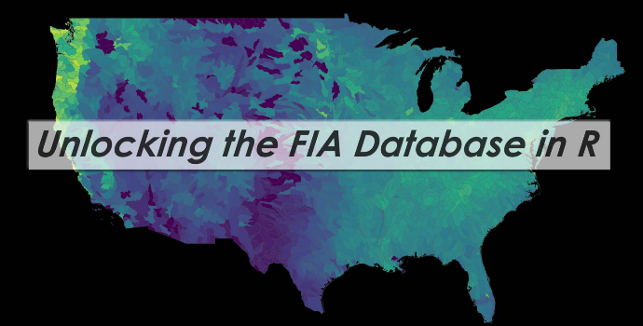

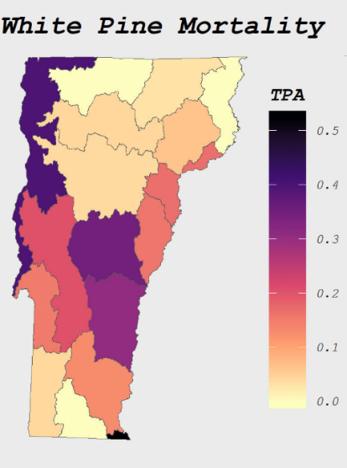



A new tool for forest analysis! -- rFIA
What is rFIA?
R package that connects, compiles and summaries USFS FIA data
Produces space-time indexed summaries of forest variables within user-defined population boundaries
Implements design-based estimation procedures (Bechtold & Patterson 2005), and has been validated against FIA’S EVALIDator
Visit: https://rfia.netlify.com/ for more details
Package authors:
Dr. Andrew Finley
Hunter Stanke

