Slide 1
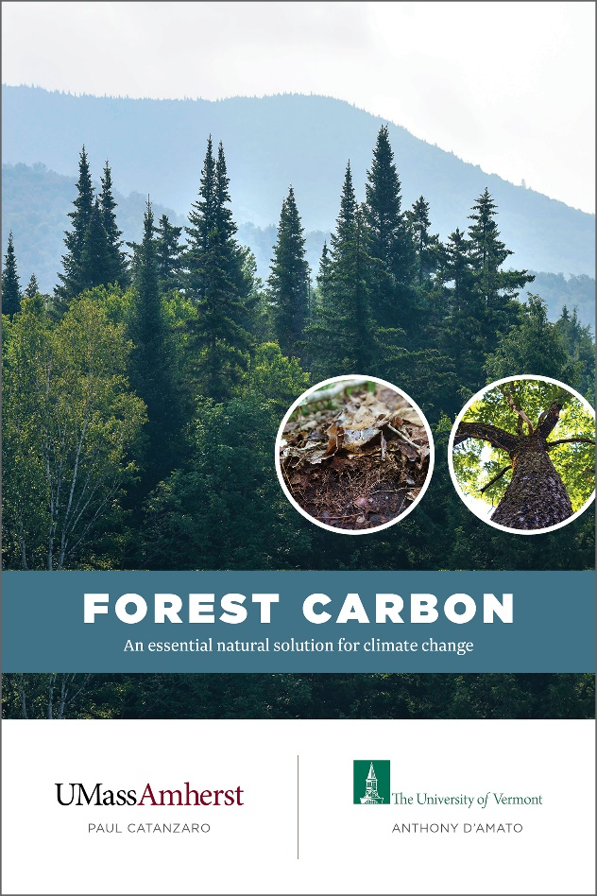
Forest Carbon
Paul Catanzaro Tony D’Amato

Slide 2
Acknowledgements
Thank you to our partners for additional support
Funding for the printing of this publication was provided by the Renewable Resources Extension Act

Slide 3
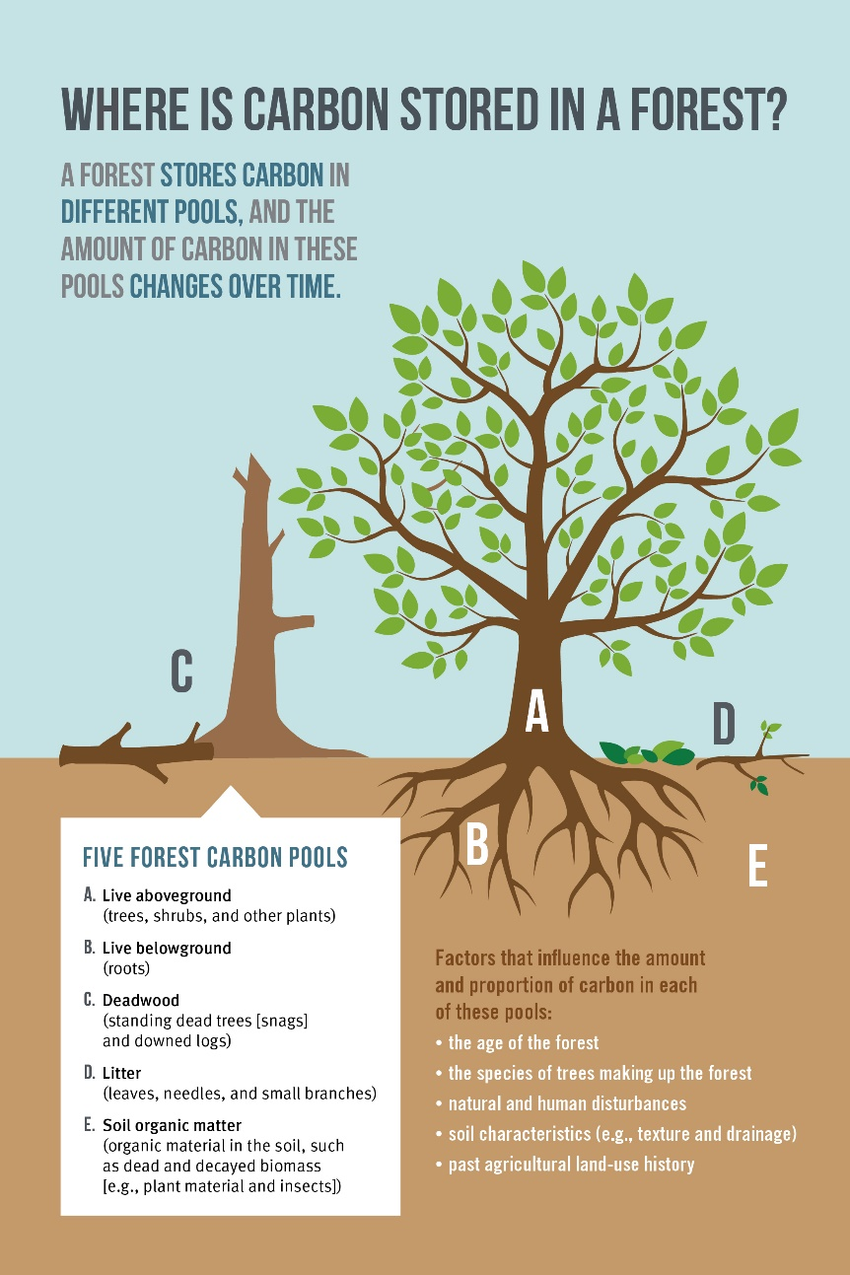
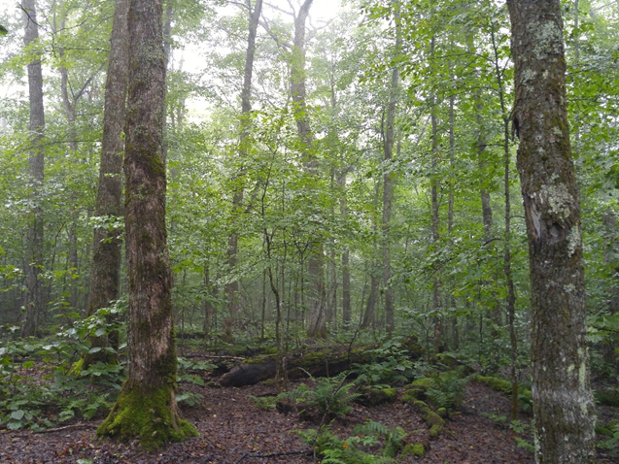
Carbon Pools

Slide 4
Carbon Terms
Carbon Storage : The amount of carbon that is retained in a carbon pool within the forest.
Carbon Sequestration : The process of removing carbon from the atmosphere for use in photosynthesis, resulting in the maintenance and growth of plants and trees.

Slide 5
Take home: Soil organic and Live aboveground pools are very important

Slide 6
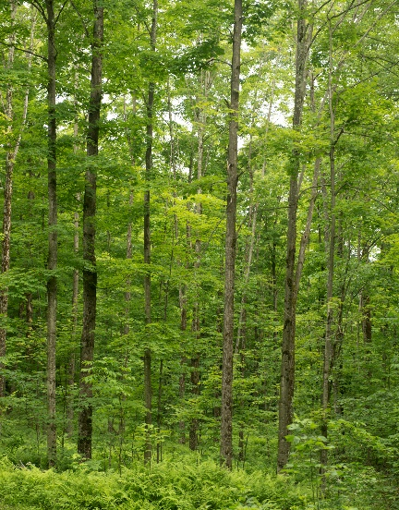
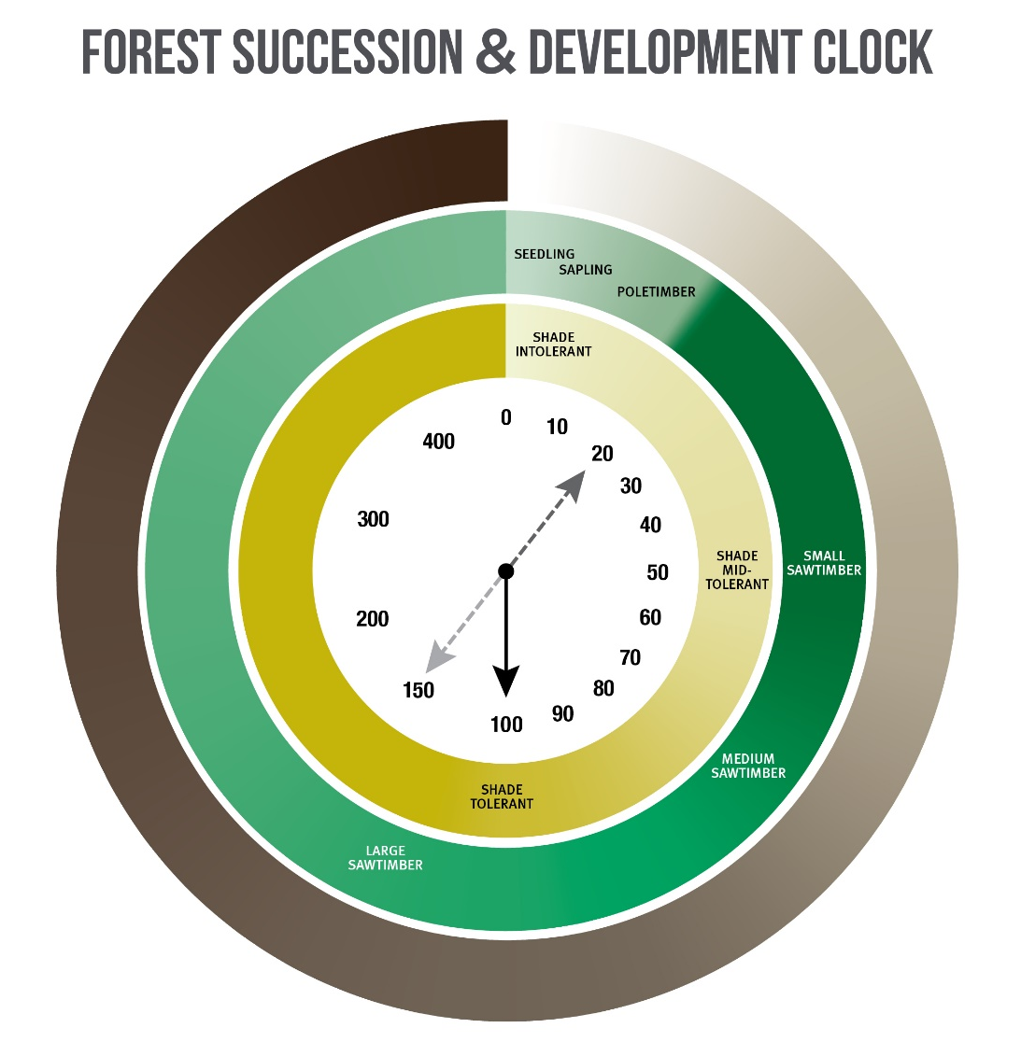

Slide 7
Land Use Decisions Impacting Forest Carbon
Future use of the land
Forest management

Slide 8
Decision 1: Future Use of the Land

Slide 9
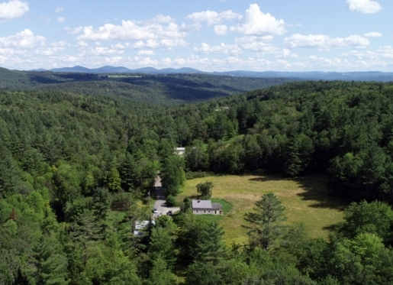
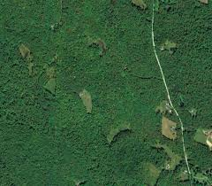
Forest Conversion
Forest conversion is the biggest loss of forest carbon benefit
Removes live aboveground, deadwood, and litter
Stumping, grading, and plowing decrease soil carbon
Losses often permanent…or at least long-term
It is also the loss of many other forest benefits

Slide 10
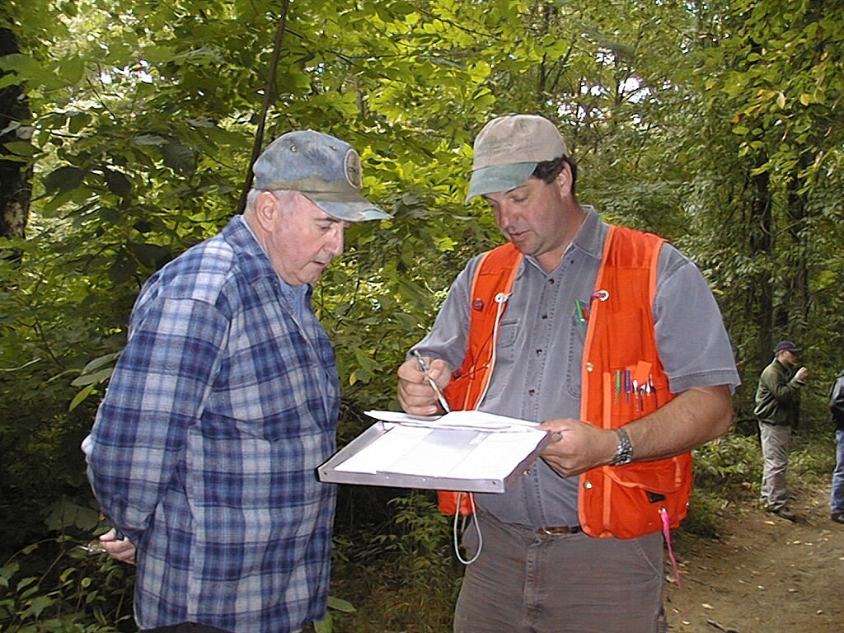
Decision 2: Forest Management
Passive
Active

Slide 11
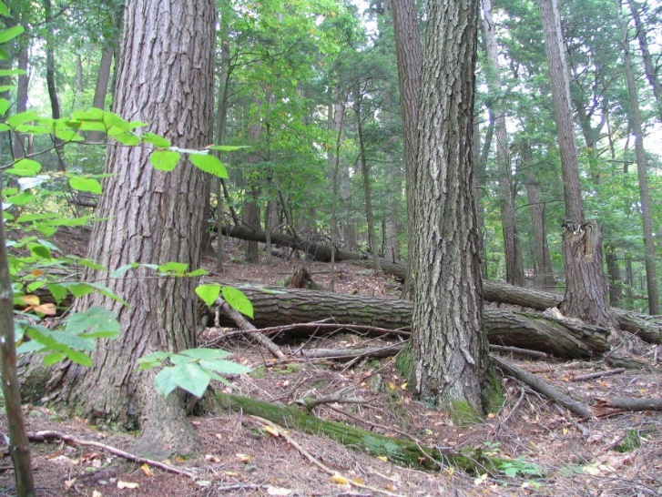
Passive Approach
Let nature take its course. No timber harvesting.
Implement strategies to help resiliency (e.g., invasive plant control)
Maximize carbon storage & continue sequestration
Prioritize rich, productive, protected sites embedded within landscapes with low fragmentation

Slide 12
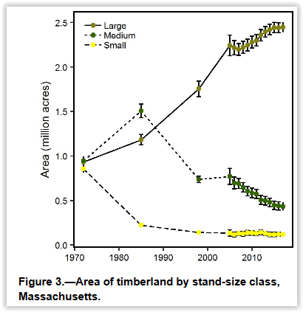
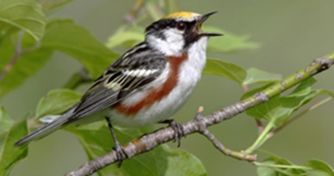
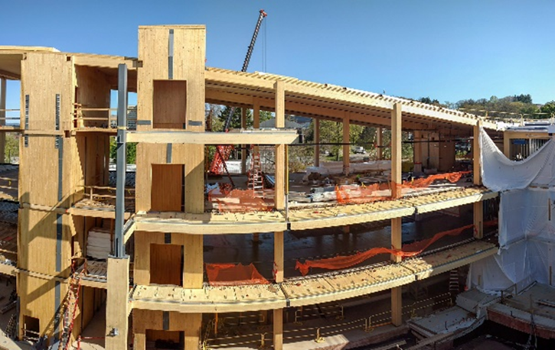
Passive Trade-Offs
Forest Resiliency
Site (e.g., slope position)
Tree species (e.g., ash, hemlock)
Forest structure (e.g., even-aged)
Species in decline
Wood products
If not here, then where?
Substitution

Slide 13
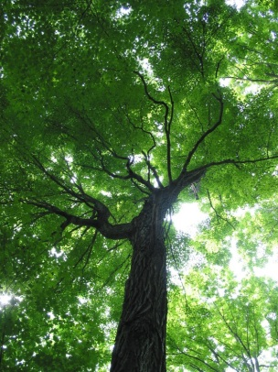
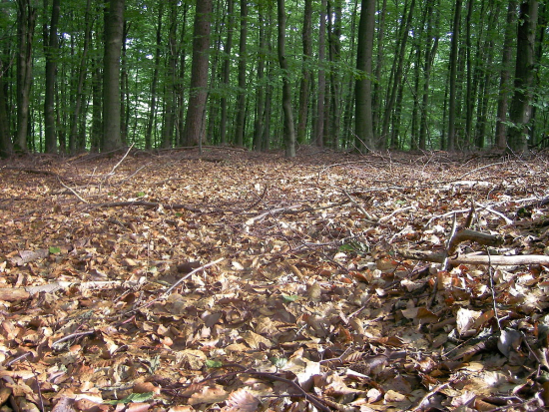
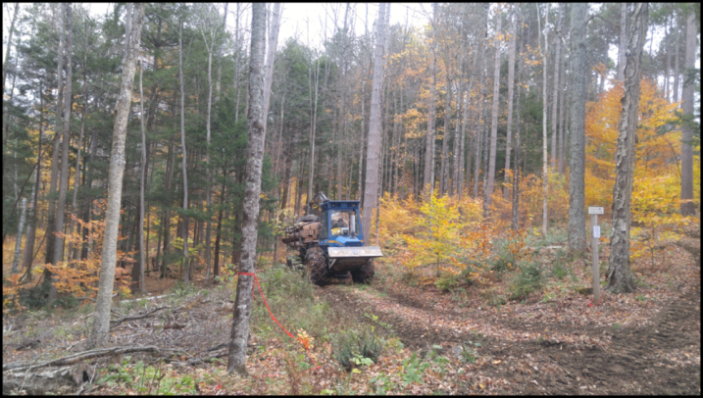
Land Use Decision 2: Active Forest Management
Impacted Pools
Live aboveground (AGC) (it depends on how much you remove!)
Litter pools (20% -36% reduction)
BMPs are effective at protection of soil carbon

Slide 14
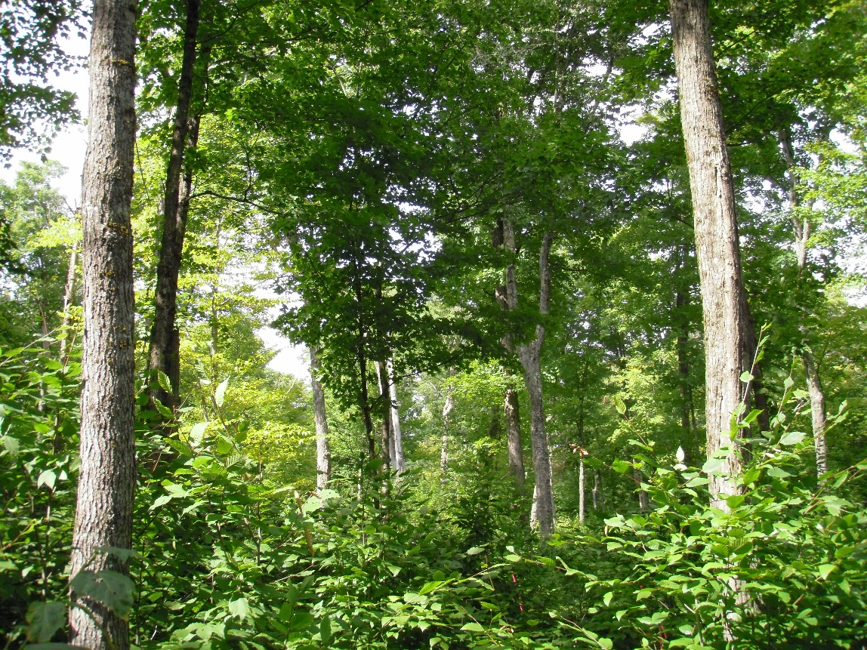
Carbon-Informed Forest Management
Strategies to reduce the loss of carbon storage during active forest management.

Slide 15
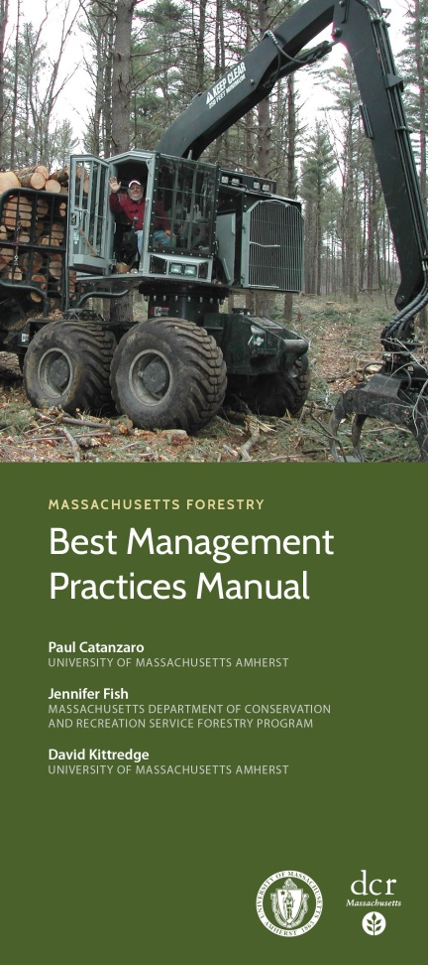
Forest Management Considerations Soil
Implement Forestry BMPs
Strong contract
Remember … soil is one of the biggest carbon pools!!!

Slide 16
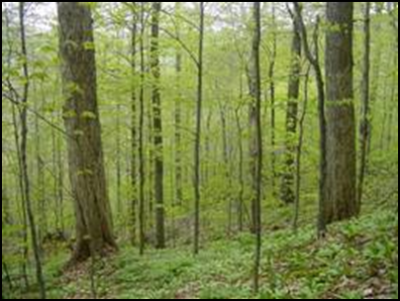
Forest Management Considerations AGC – Stand Structure
Large trees have a big influence on stored carbon:
Extend harvest cycles/recovery time 15-20 years or 1-2” DBH
Use regeneration methods that retain mature trees across the site (e.g. selection, irregular shelterwood, Variable Density Thinning)
Maintain retention trees > single and/or patch
Maintain multiple-age classes that balance:
large/older trees > storage
young fast growing trees > sequestration

Slide 17
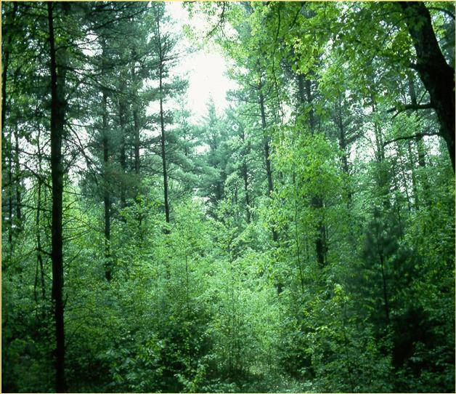
Forest Management Considerations AGC – Stand Stocking
High live-tree stocking > high levels of carbon storage
However…..low enough for healthy crowns, vigorous trees

Slide 18
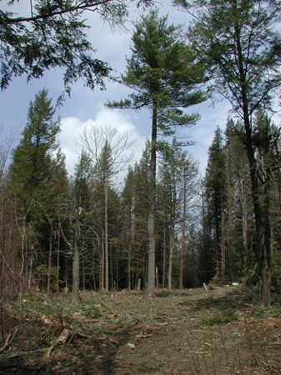
Forest Management Considerations AGC – Species Composition
Encourage species predicted to be competitive in the future.
Species that can become large dominant canopy trees store more carbon (e.g., red oak, white pine)
Dense trees store more carbon
hardwood > softwood
sugar maple > red maple

Slide 19
Active Trade-Off: Carbon Storage
Removal of logs from the forest temporarily reduces the carbon storage of a forest.

Slide 20
Removal to Growth Ratio

Slide 21
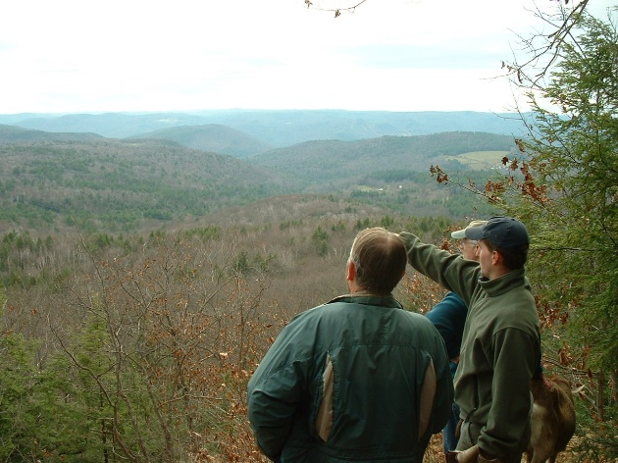
Taking Both a Passive & Active Approach
It doesn’t have to be all of one or the other!! We need both approaches !!
Multiple scales
Entire property
Stands within a property
Retention trees within a stand
Review each parcel individually and determine its characteristics (Species, structure, site quality, landscape position)

Slide 22
Take-homes
Encourage landowners to engage in conservation-based estate planning!
Protect soil & above ground carbon pools > BMPs and silvicultural strategies
Balance carbon tradeoffs

Slide 23
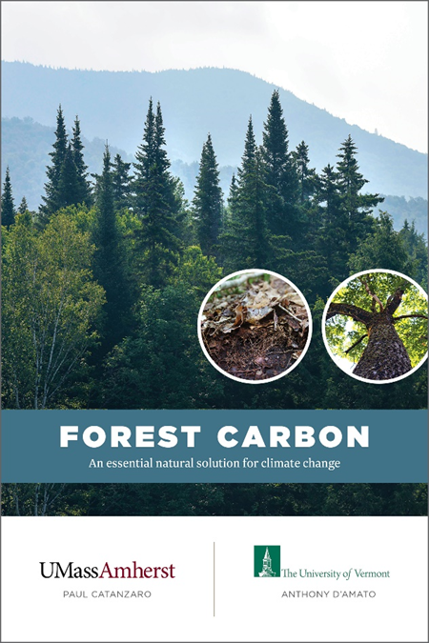
Thank you!
For a free copy(ies): paulcat@umass.edu
Download a PDF: masswoods.org/carbon

