Slide 1
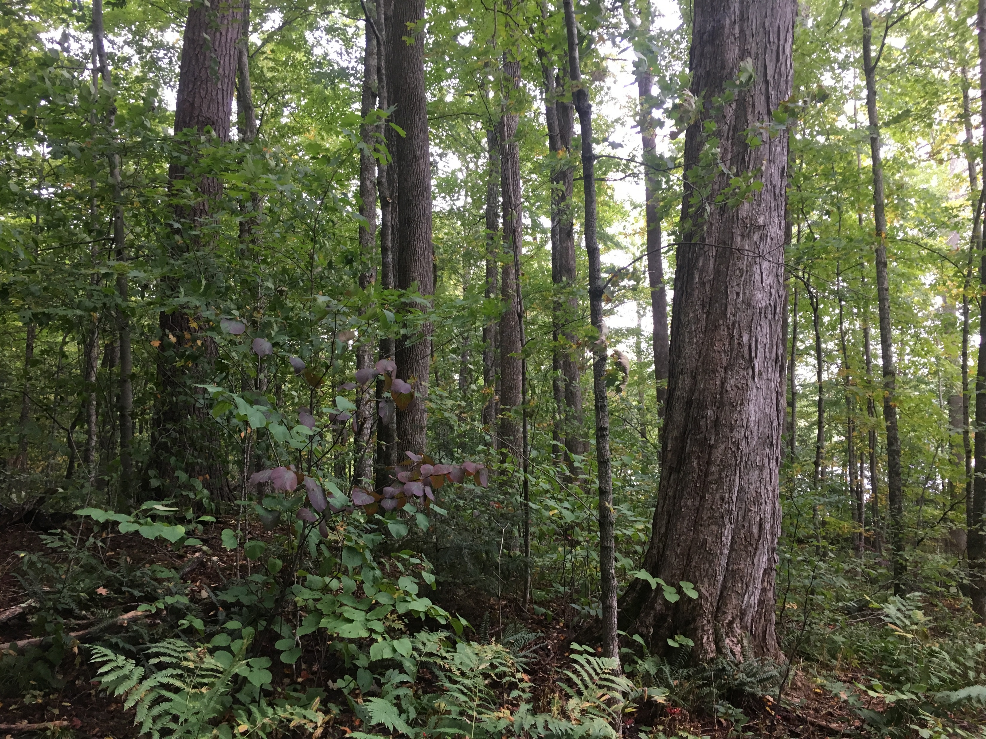
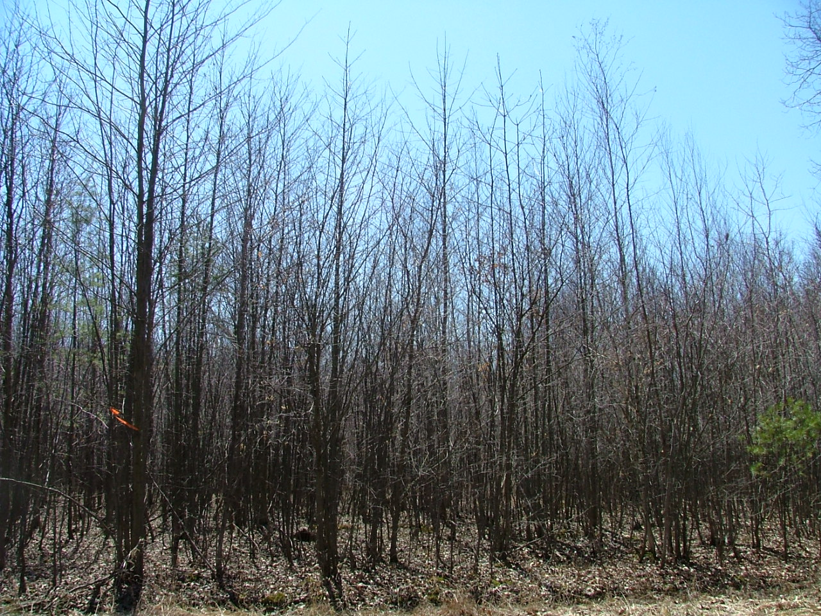
Young and Old Forest Targets
for an Ecologically Functional Landscape

Slide 2
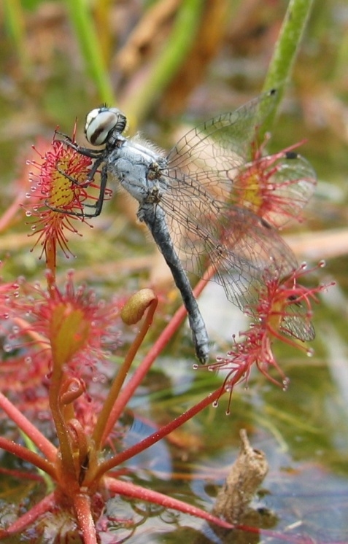
An estimated 24,000 to 43,500 species in Vermont!
How do we protect them all?
Elfin Skimmer

Slide 3
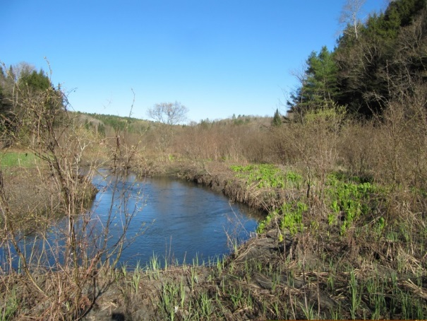
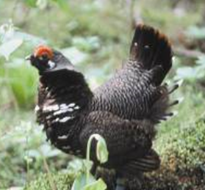
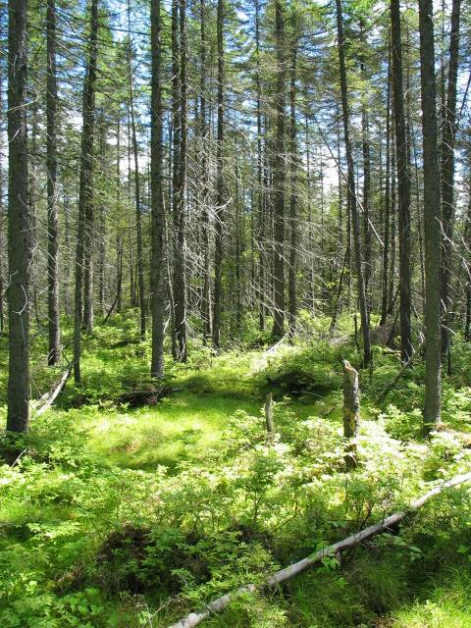
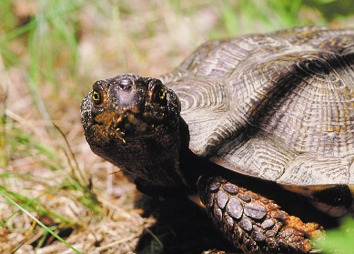
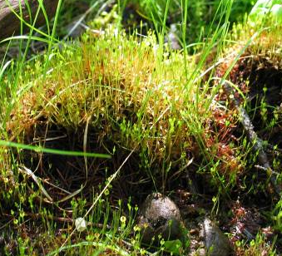
Coarse filter/fine filter approach to conservation
Well-recognized approach to conservation
“Coarse” features protect many species
Some species need individual attention (fine filter)

Slide 4
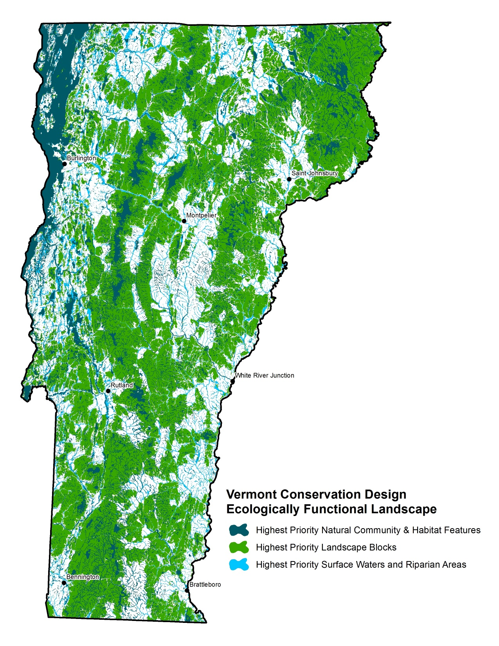
Vermont Conservation Design
Scientific vision for an ecologically functional landscape
Uses the coarse/fine filter approach
Intact, connected and diverse

Slide 5
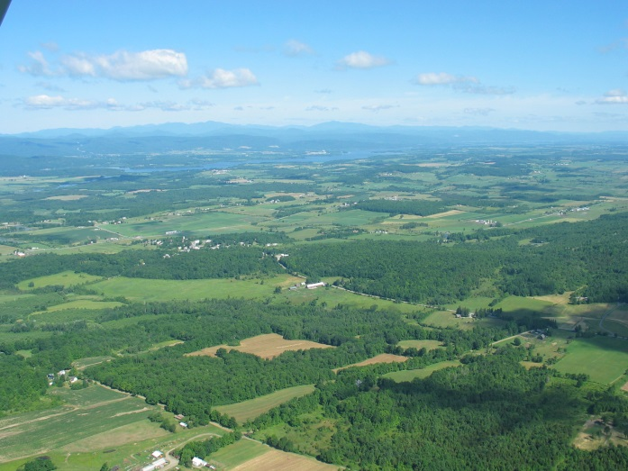
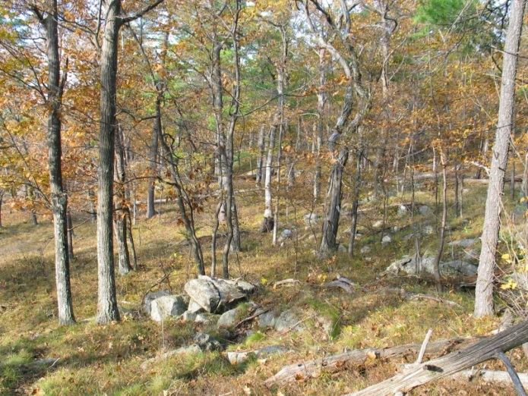
Conservation Design at Multiple Scales
Landscapes
Natural Communities
Species
Interior Forest Blocks
Connectivity Blocks
Surface Waters and Riparian Areas
Riparian Areas for Connectivity
Physical Landscapes
Wildlife Road Crossings
Natural Communities
Young and Old Forest
Aquatic Habitats
Wetlands
Grasslands/Shrublands
Underground Habitats
Species with very specific biological needs that will likely always require individual attention
Notes:
Review use of table to identify which species and natural communities are “captured” by each landscape element – refining the elements

Slide 6
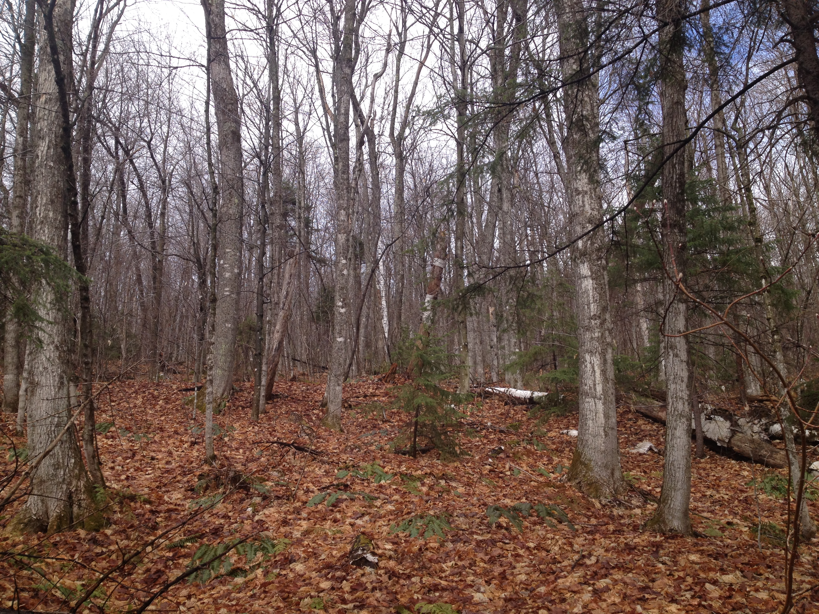
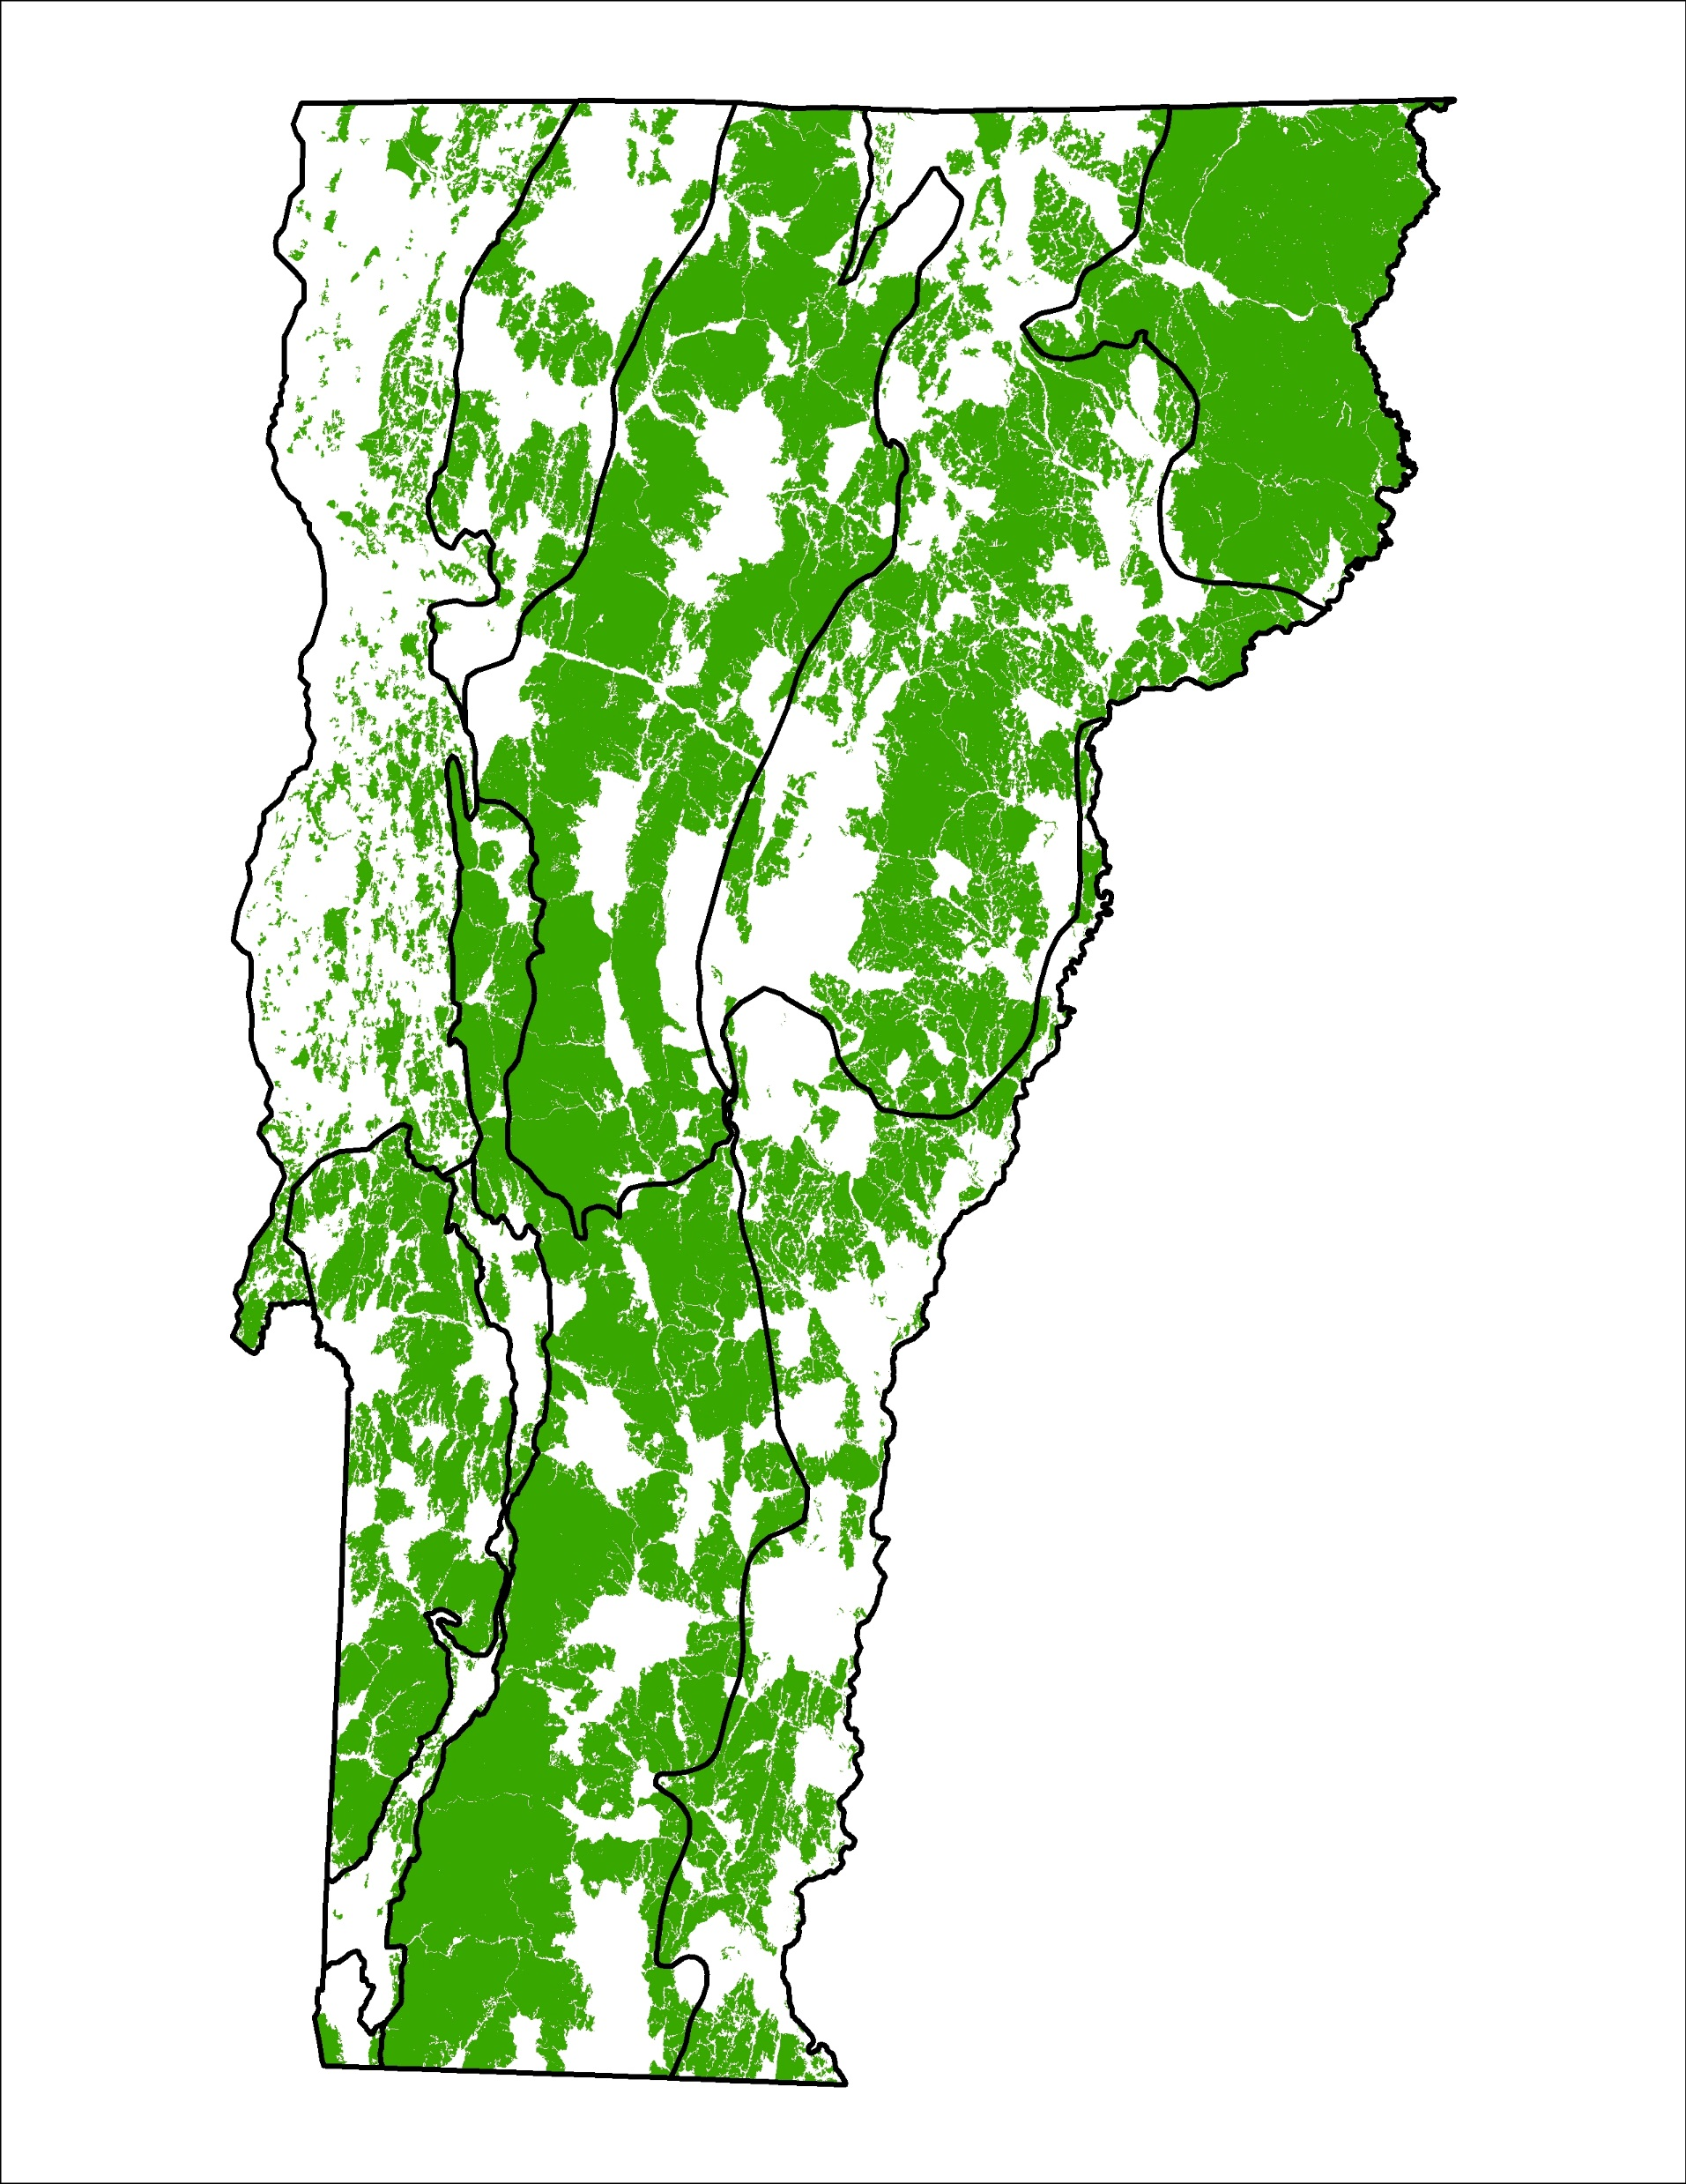

Slide 8
Vermont Conservation Design -
Forest Structure Targets
Establish targets for a balance of forest ages as part of an ecologically functional landscape

Slide 9
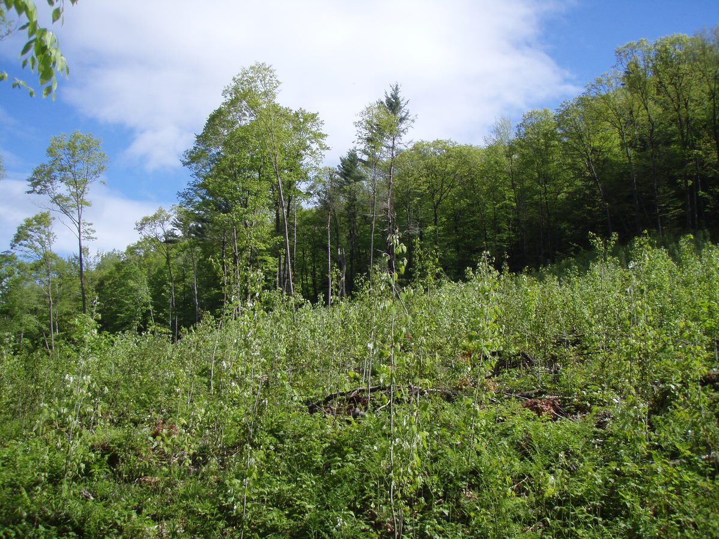
Young Forest
Forest regenerating from natural or human disturbance
Dense seedlings/saplings
Shade intolerant and tolerant tree species
Generally comprises trees less than 15-20 years old

Slide 10
Why Young Forests?
Young forests are a natural part of our landscape
Support a suite of species, particularly birds
Young forest species are declining
Valued for hunting and wildlife watching
Creating young forest is something we can do, and the process can generate income

Slide 11
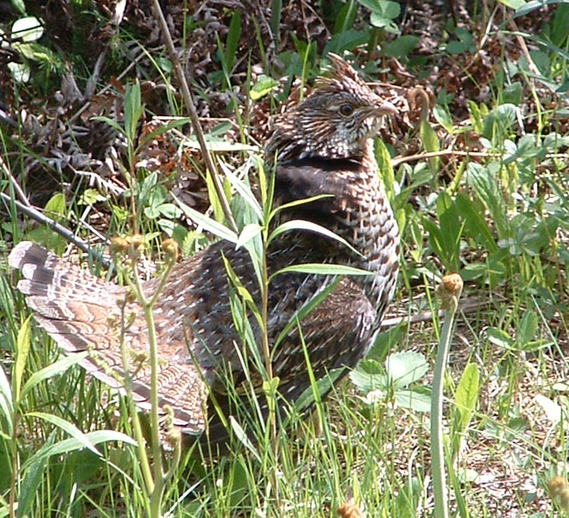
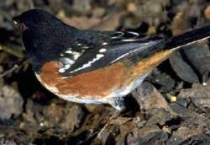
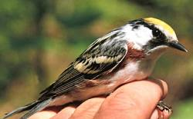
54
Species of Greatest Conservation Need

Slide 12
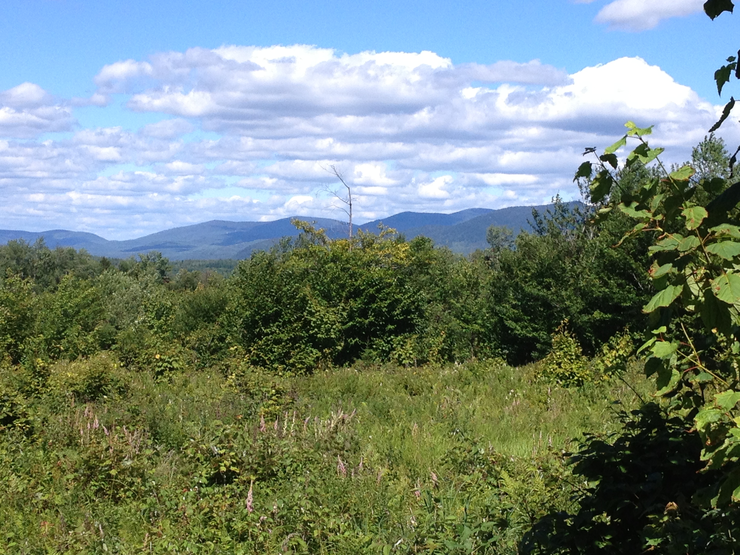
Young Forest Target: 3-5% of VT Forests

Slide 13
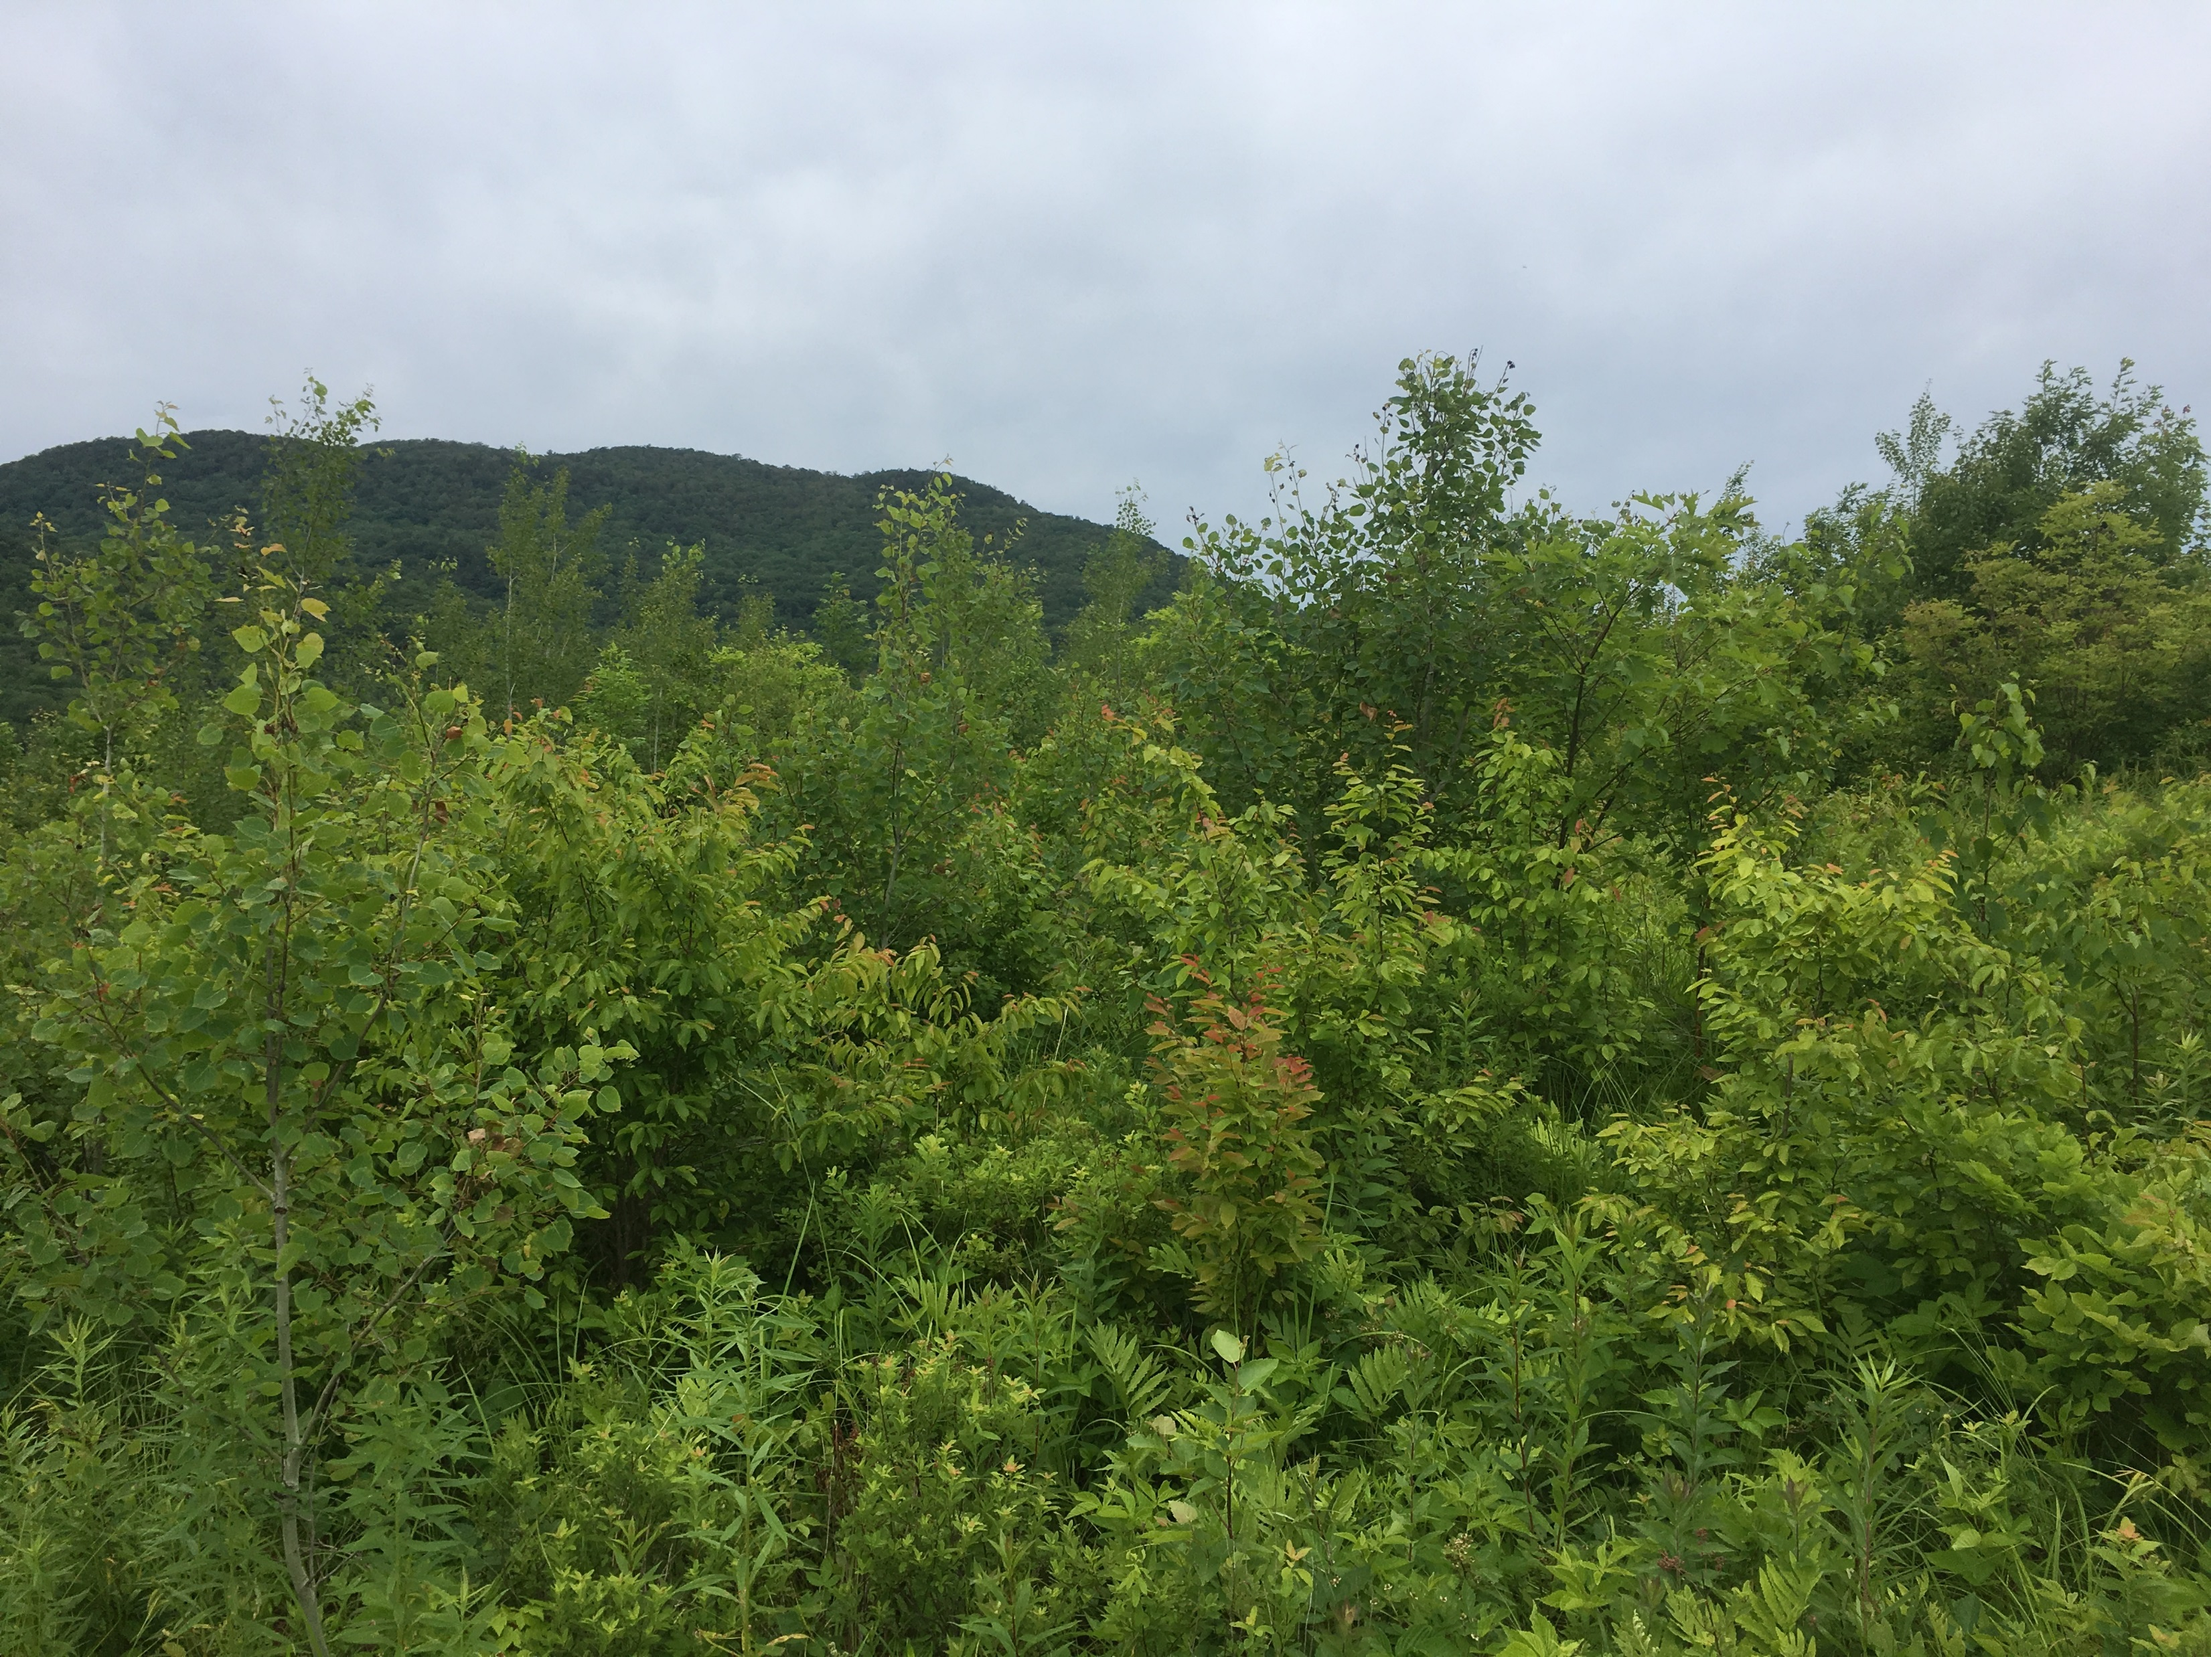
Young Forest Target: 3-5% of VT Forests
Informed by the estimated abundance of young forest prior to European settlement (Lorimer and White 2003)
A percentage that at one time supported all of Vermont’s native species that require young forest
Reverses a declining trend

Slide 14
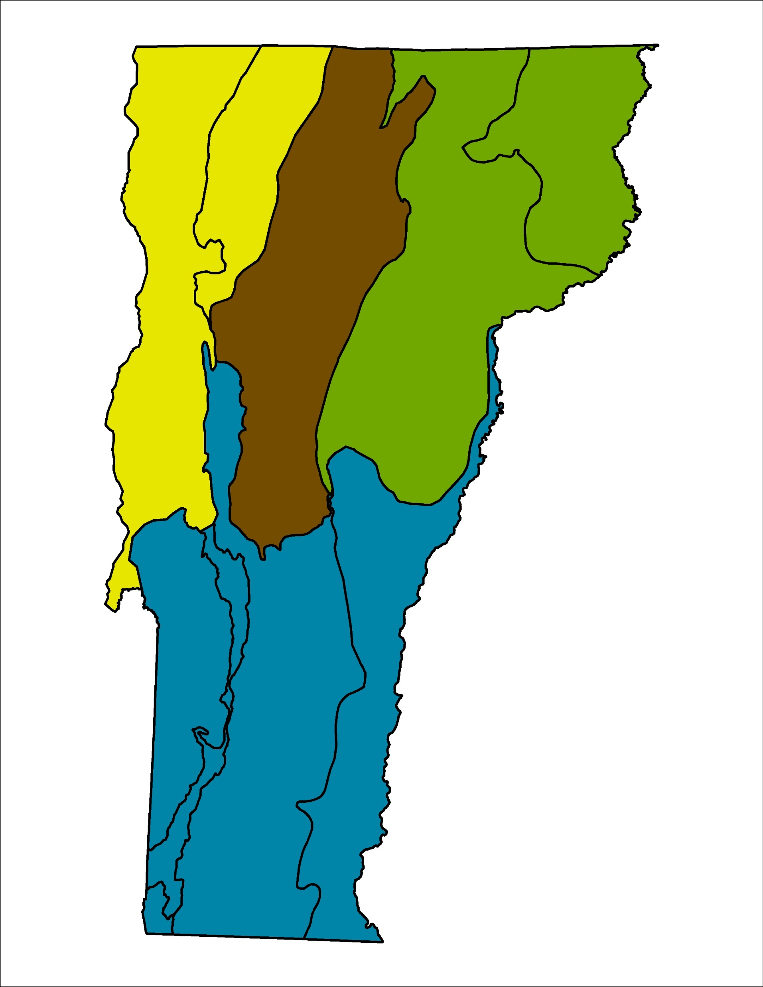
Target: 3-4%
Estimated Current: 2%
Target: 5%
Estimated Current: 4%
Target: 5%
Estimated Current: 1%
Target: 3-4%
Estimated Current: 0%
Young forest

Slide 15
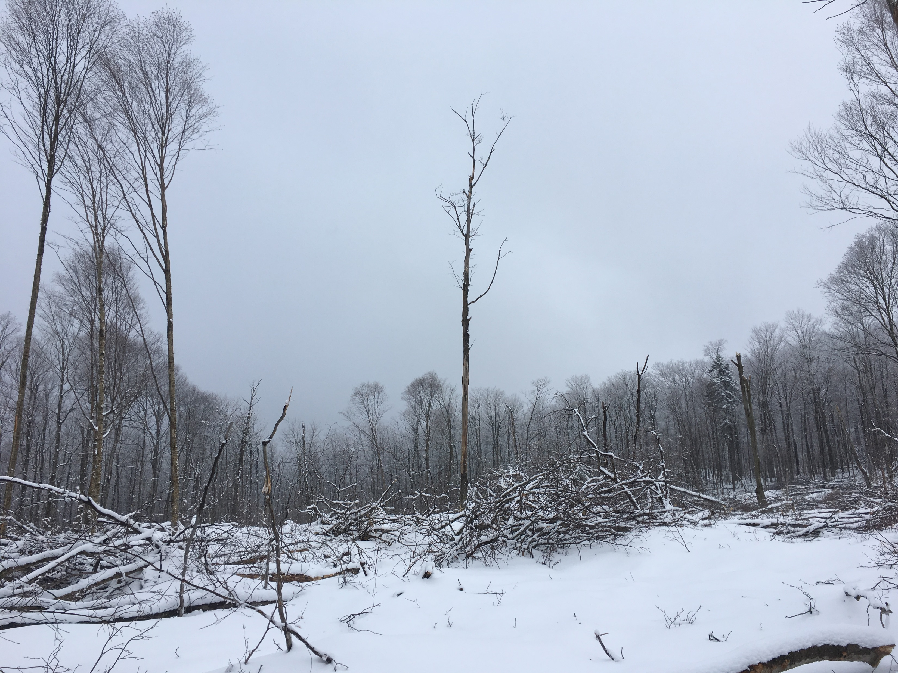
Young Forest Target: 3-5% of VT Forests
Created by forest management and natural disturbance
Patches ideally >5 acres in size
Distributed in each biophysical region
138,000 - 155,000 acres in highest priority forest blocks

Slide 16
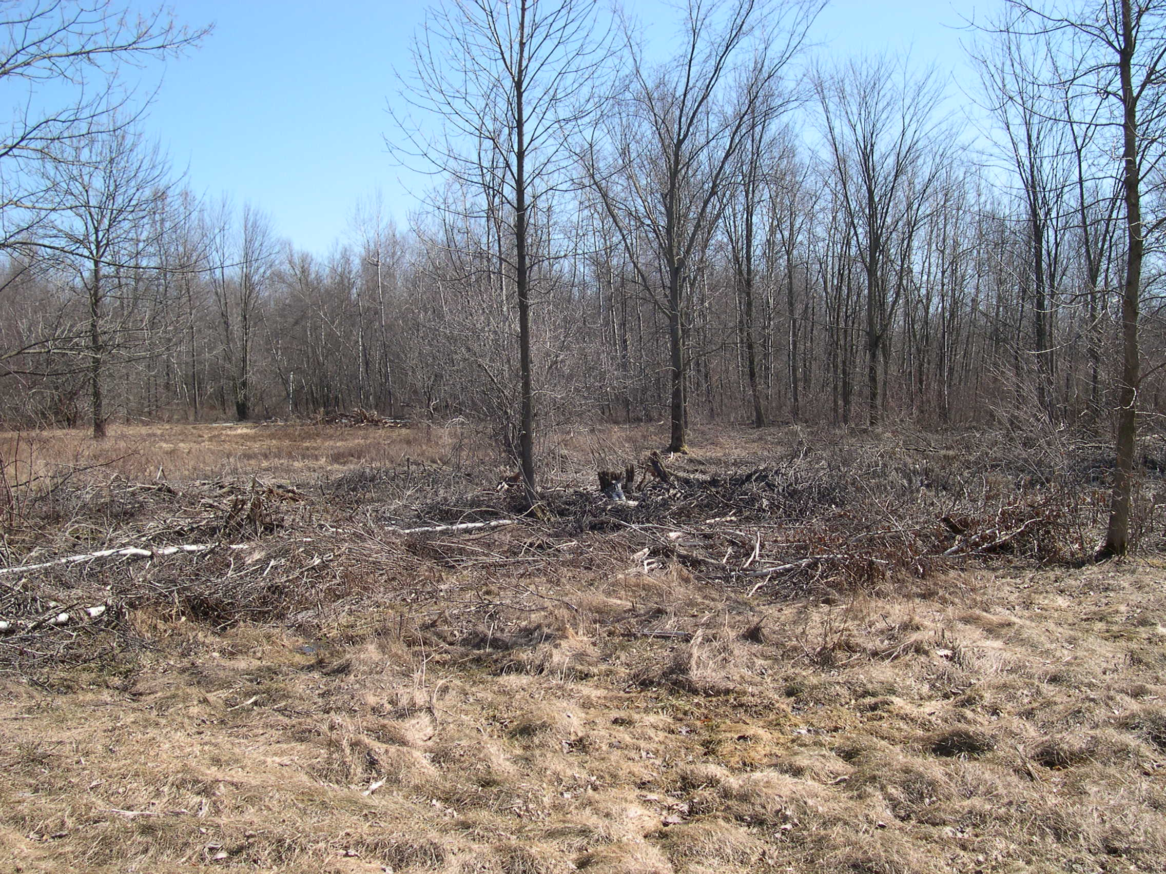
Young Forest Target: 3-5% of VT Forests
Need 6,900 – 10,300 new acres of young forest each year to meet this target

Slide 17
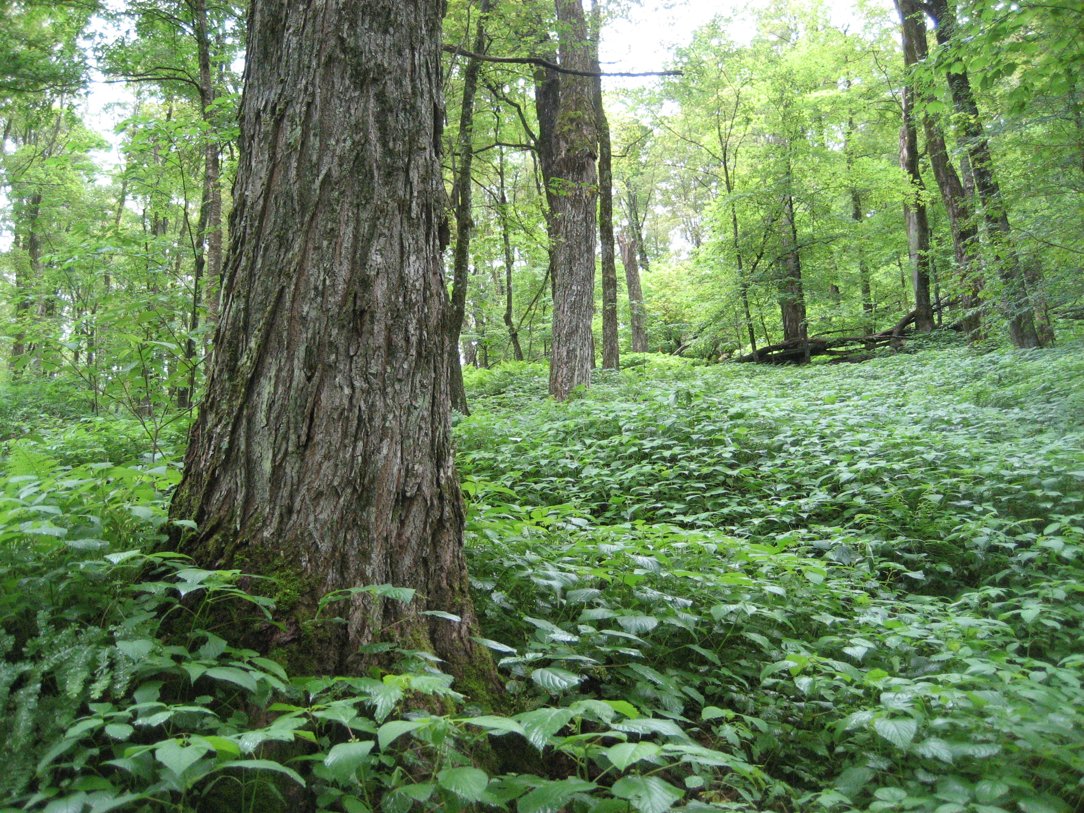
Old Forest
Biologically mature forests with minimal human disturbance
Natural disturbances prevail
Some trees exceeding 150 years (for most forest types)
Native tree species present in multiple ages
Complex stand structure (tree diameters, vertical layers, natural canopy gaps, dead and downed wood in all sizes and decay stages)

Slide 18
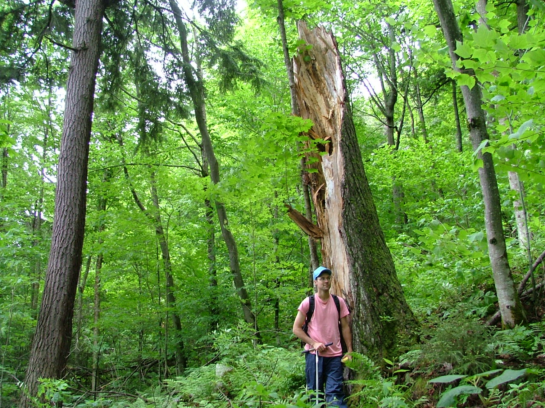
Why Old Forests?
Structural complexity creates unique habitats
Native plants and animals evolved with old forests
Resilient to change and disturbance
Carbon storage
Water quality and flood protection
Ecological benchmark
Connect people to untrammeled nature

Slide 19
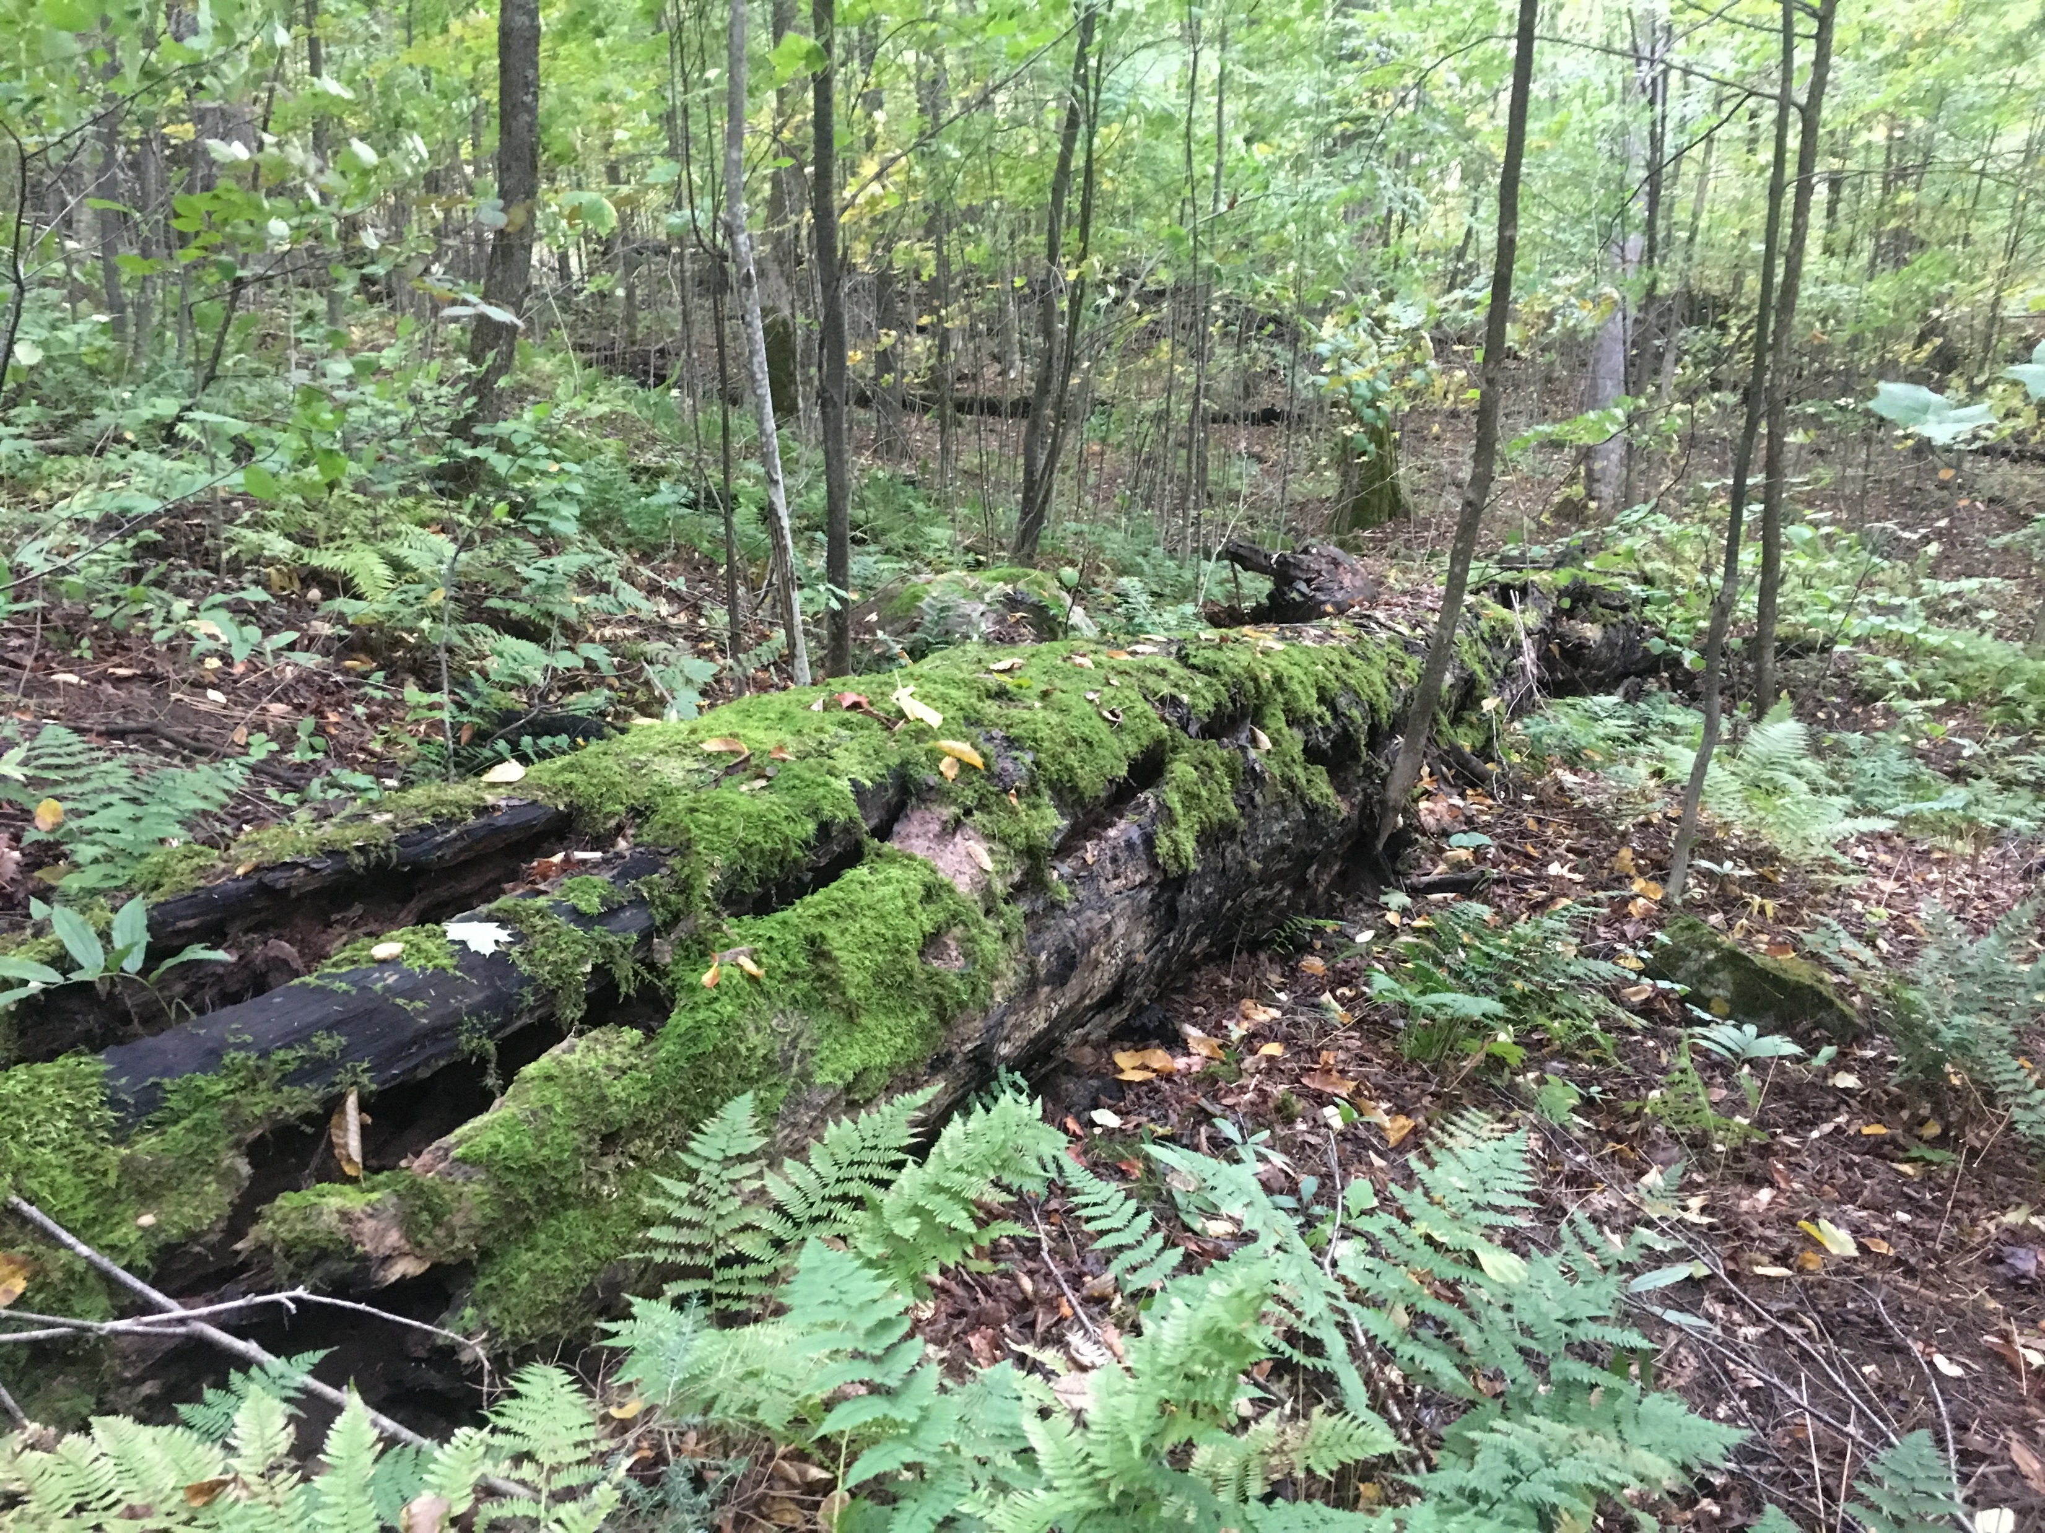
Old Forest Target: 10 % of Vermont’s Forest

Slide 20
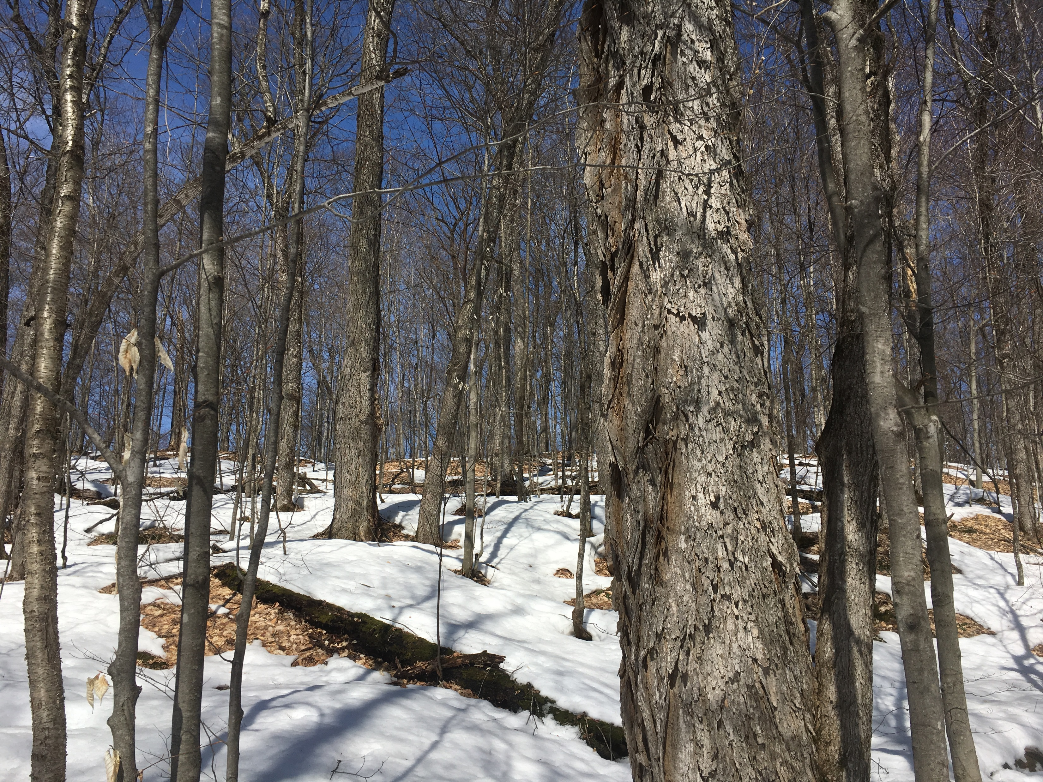
Old Forest Target
15% of matrix forest in highest priority forest blocks
9.1% of Vermont’s forest
419,000 acres
Distributed in each biophysical region
Professional judgement: an amount that will reintroduce the ecological functions of old forests

Slide 21
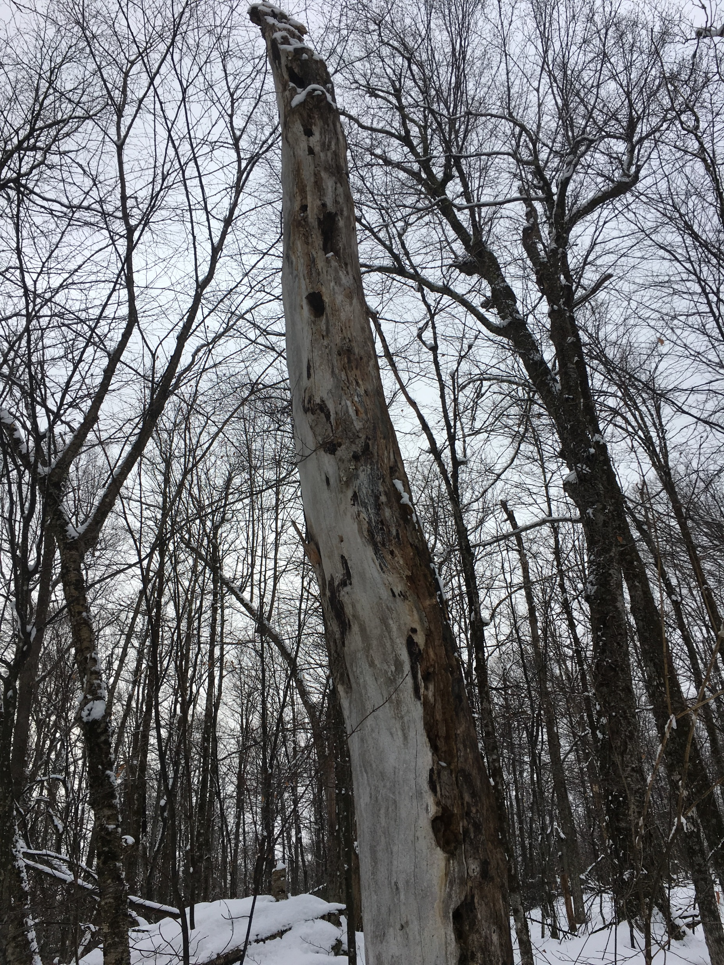
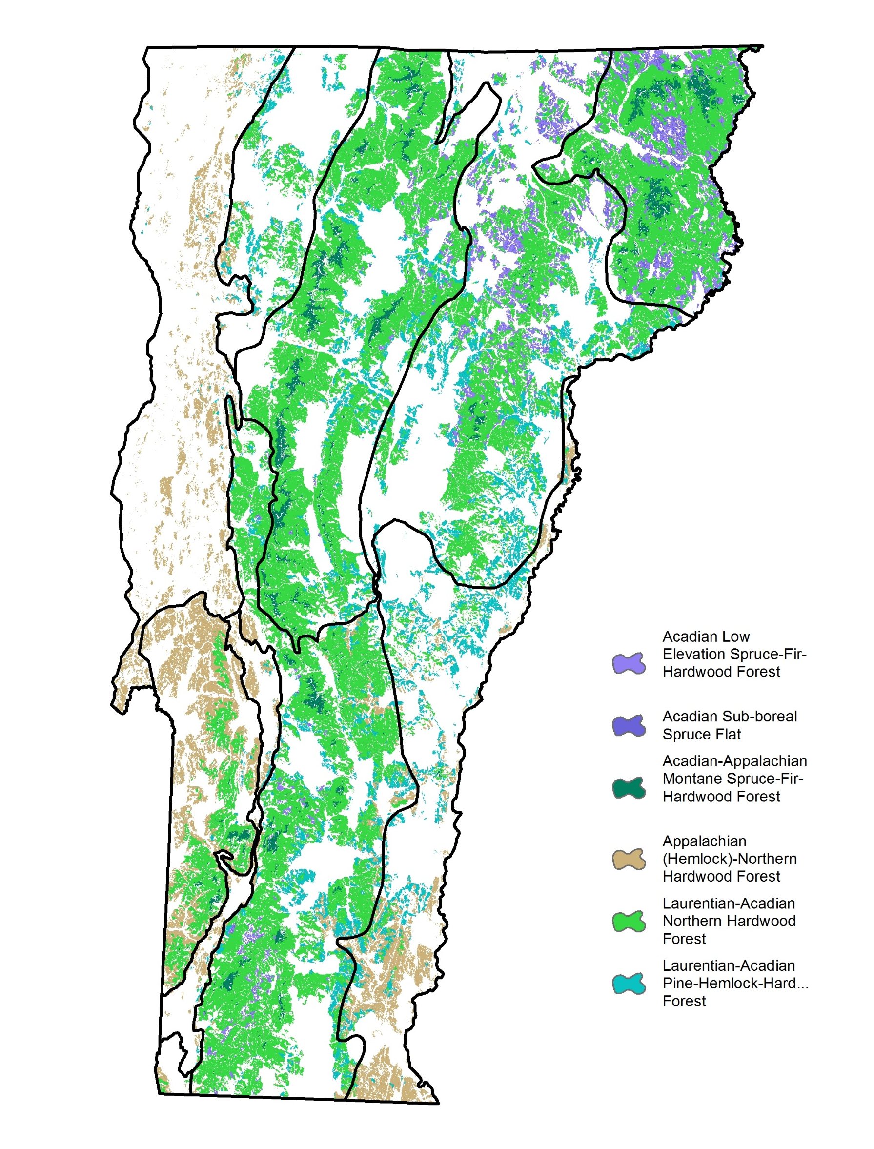
Matrix forests:
Vermont’s most widespread forested natural communities
Northern Hardwood Forest
Red Spruce-NHF
Red Oak-NHF
Montane Spruce-Fir Forest

Slide 22
Estimated future old forest acres by ecosystem type
 | Northeastern Highlands | Taconic Mountains | Champlain Valley | Champlain Hills | Vermont Valley | Northern Green Mountains | Northern Vermont Piedmont | Southern Vermont Piedmont | Southern Green Mountains
Acadian Low Elevation Spruce-Fir-Hardwood Forest (Montane Spruce-Fir Forest) | 1,256 | 0 | - - | - - | - - | 59 | 396 | 0 | 3,403
Acadian Sub-boreal Spruce Flat (Lowland Spruce-Fir Forest) | 236 | 0 | - - | - - | - - | 23 | 124 | 0 | 636
Acadian-Appalachian Montane Spruce-Fir-Hardwood Forest (Montane Yellow Birch-Red Spruce Forest) | 596 | 1,139 | - - | 0 | 0 | 27,424 | 1,161 | 74 | 12,964
Appalachian (Hemlock)-Northern Hardwood Forest (Hemlock-Northern Hardwood Forest) | - - | 4,061 | 2,950 | 0 | 113 | 0 | 0 | 806 | 1,458
Laurentian-Acadian Northern Hardwood Forest (Northern Hardwood Forest) | 9,482 | 4,003 | - - | 0 | 82 | 41,973 | 2,136 | 462 | 92,431
Laurentian-Acadian Pine-Hemlock-Hardwood Forest (Hemlock Northern Hardwood Forest) | 0 | 8 | 40 | 0 | 0 | 122 | 245 | 1,128 | 2,135
TOTAL by BPR | 11,569 | 9,211 | 2,990 | 0 | 195 | 69,601 | 4,062 | 2,470 | 113,027

Slide 23
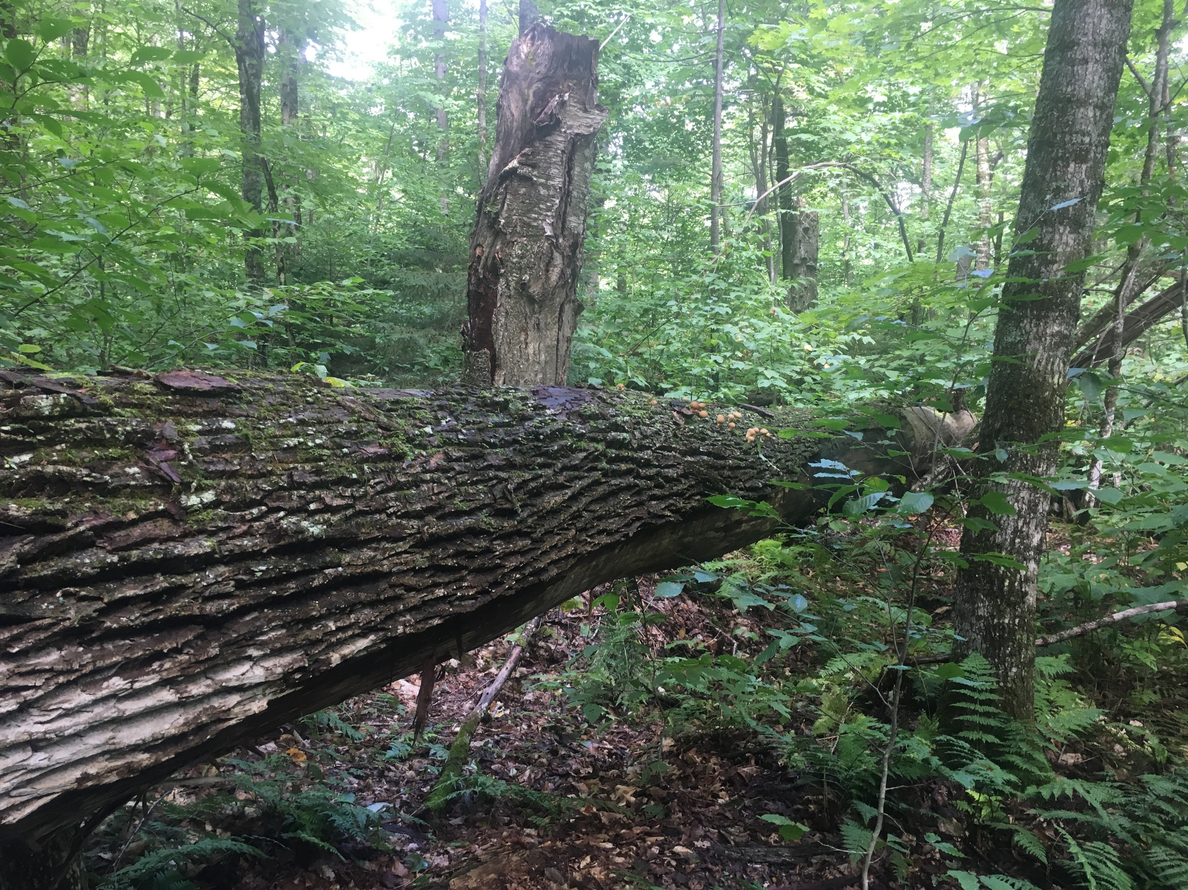
Old Forest Target
213,000 acres expected to become old forest
Need an additional 206,000 acres for the target
= approximately 5-6% of Vermont’s operable forest
Pursue these acres thoughtfully and strategically

Slide 24
Vermont Conservation Design -
Forest Structure Targets
Establish targets for a balance of forest ages as part of an ecologically functional landscape

Slide 25
Forest Age Classes | Young Forest Targets as Landscape %
 | 4% (VCD Avg) | 5% | 10% | 15% | 20%
0-15 | 4 | 5 | 10 | 15 | 20
15-30 | 4 | 5 | 10 | 15 | 20
30-45 | 4 | 5 | 10 | 15 | 20
45-60 | 4 | 5 | 10 | 15 | 20
60-75 | 4 | 5 | 10 | 15 | 20
75-90 | 4 | 5 | 10 | 15 | - -
 | 24% | 30% | 60% | 90% | 100%

Slide 26
~25%
~65%
~10%

Slide 27
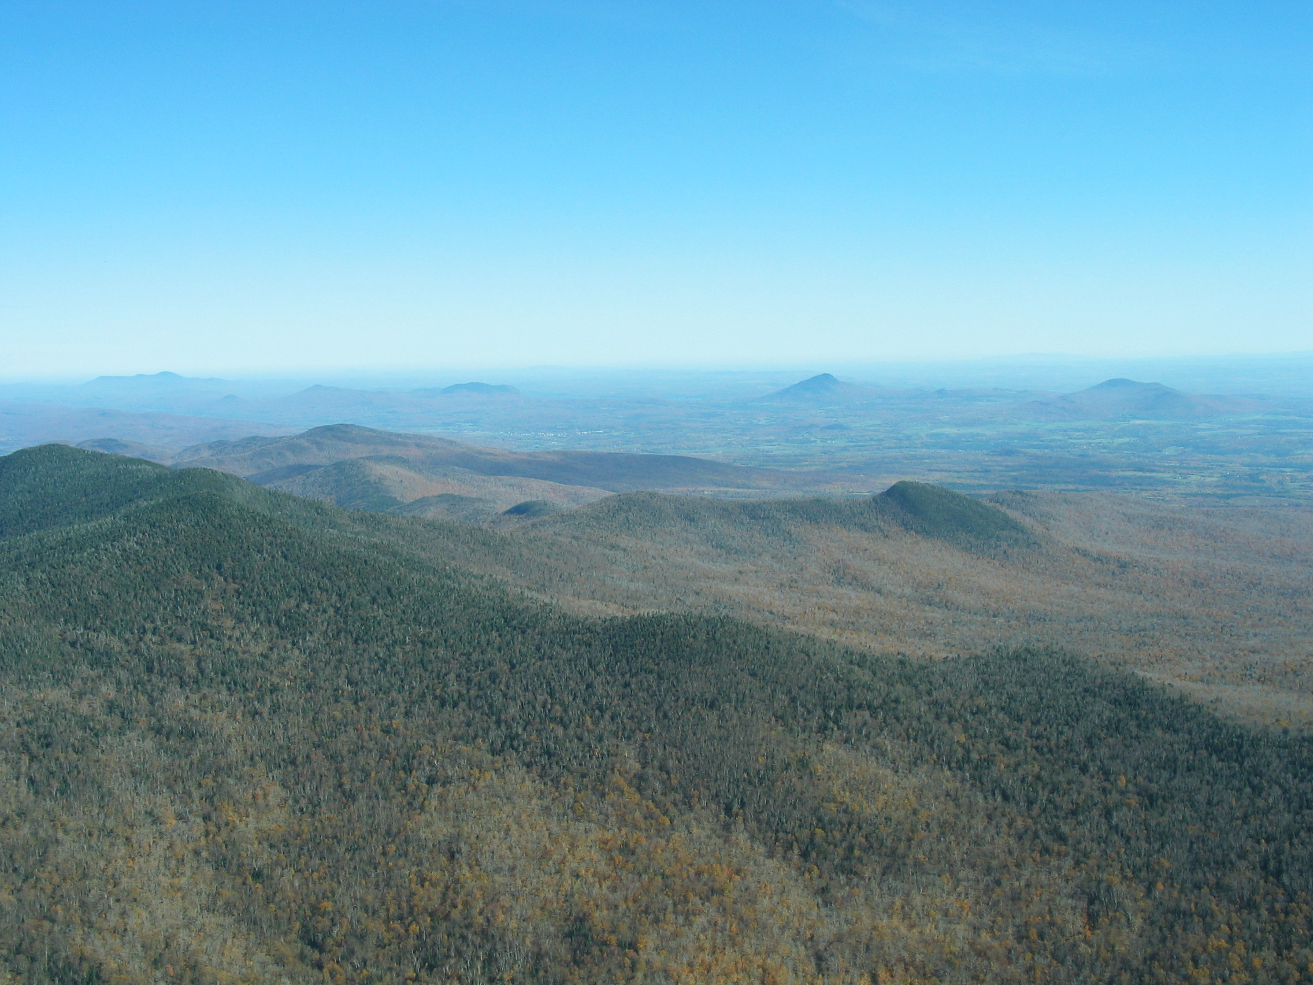
Forest Structure Targets
Restores young and old forest functions and habitats
Within an intact, connected, and diverse landscape
Conservation vision – not a mandate
Success depends on landowner choices
Supports Vermont’s social and economic values

Slide 28
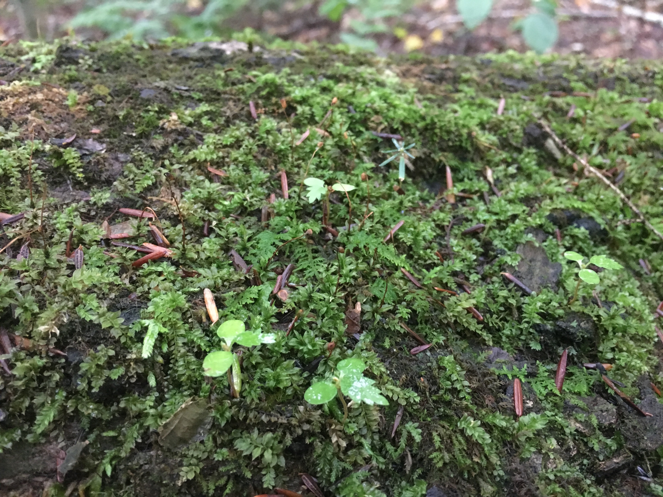
Thanks … Questions?
Vermont Conservation Design Collaborators:
VT Fish and Wildlife Dept.
Vermont Land Trust
VT Dept. of Forests, Parks and Recreation
VT Dept. of Environmental Conservation
The Nature Conservancy
USDA NRCS

