Slide 1

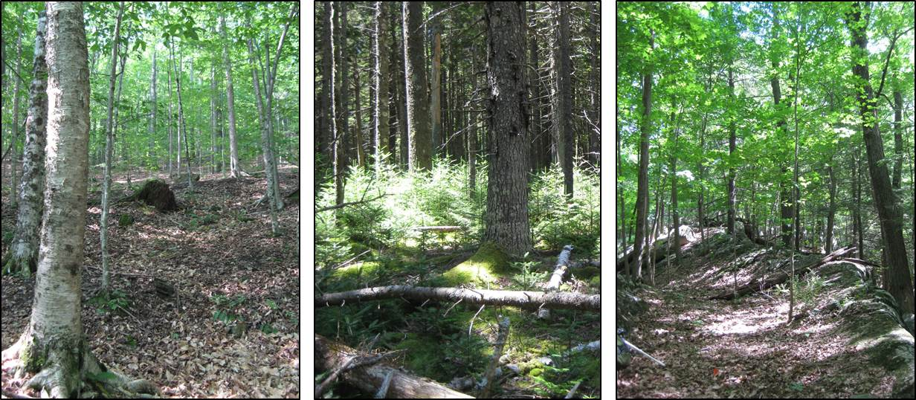
Long-Term Forest Health Monitoring in Eastern National Parks
National Park Service
Inventory and Monitoring Program
Northeast Temperate Network
Kate Miller and Camilla Seirup, Acadia National Park, Bar Harbor, ME
Aaron Weed, Marsh-Billings-Rockefeller NHP, Woodstock, VT

Slide 2
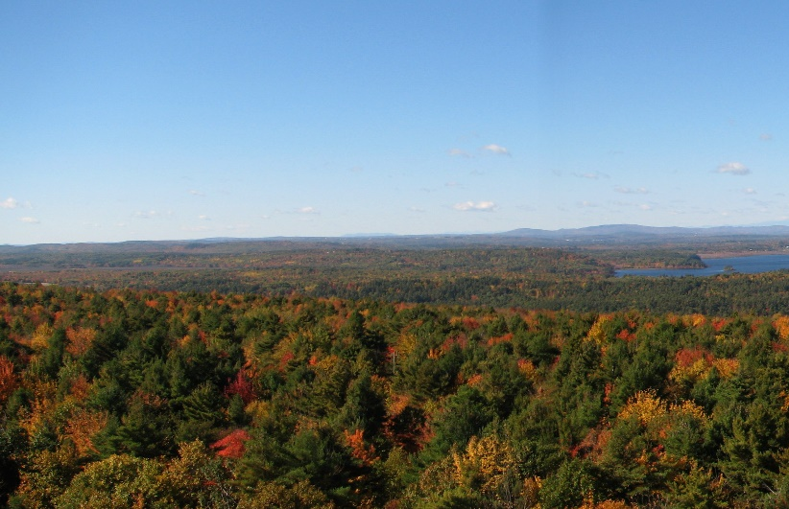
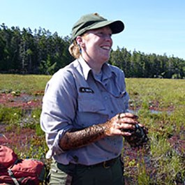
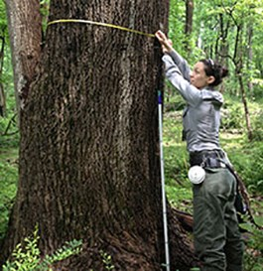
Outline
NPS Mission and Management
Monitoring forest condition
Translating results of forest monitoring
Kate Miller, Ph.D. – plant ecologist
Camilla Seirup – forest crew leader
Notes:
Today I’m going to give an overview of the NPS mission and how management objectives have shifted over the last decade or so.
Then I’ll highlight some of the lessons we’ve learned through monitoring on status and trends in forest condition;
I’ll talk about some future concerns, along with their management implications.

Slide 3
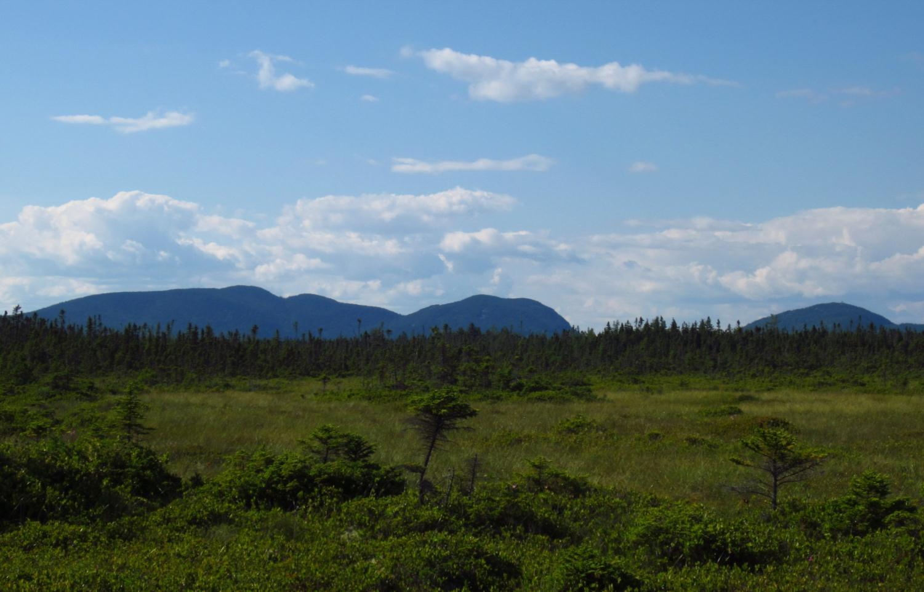
National Park Service— 1916 Organic Act
  “…to conserve the scenery and the natural and historic objects and the wild life therein and to provide for the enjoyment of the same in such manner and by such means as will leave them unimpaired for the enjoyment of future generations.”
Notes:
The mission of the NPS is to preserve natural and cultural resources unimpaired for future generations.
This is different than many land management agencies, where resource extraction is part of the mission.
Parks have the highest level of protection of any federal land management agency, and so have different management approaches and objectives.

Slide 4
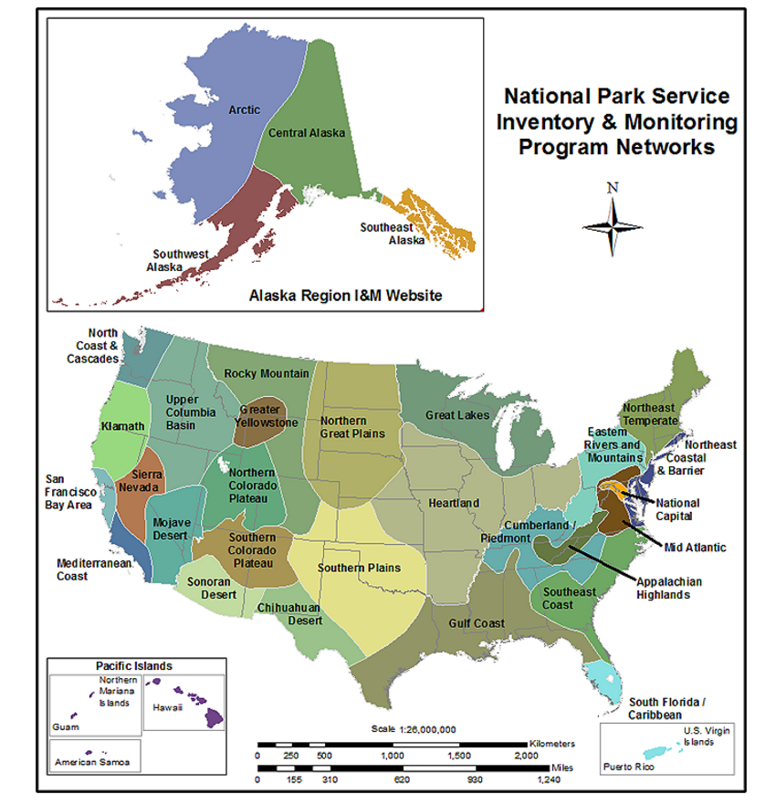
National Park Service
U.S. Department of the Interior
Inventory and Monitoring
Inventory & Monitoring (I&M) Program created by Congressional mandate in 1998
Appropriated funding to conduct baseline inventories (early 2000s) and long term monitoring of physical, biological, and ecological attributes and processes (2006 to present).
Program goals:
  Monitor natural resources to better understand their dynamic nature
  Integrate data into management and planning
  Public education
Monitoring in ~270 units (parks, monuments, preserves, and scenic rivers) organized into 32 ecoregional networks

Slide 5
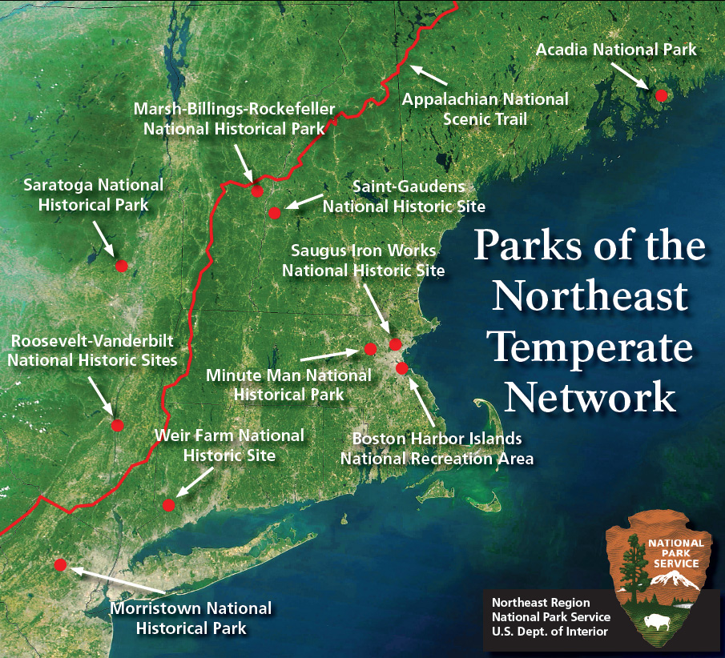
National Park Service
U.S. Department of the Interior
Northeast Temperate Network
Coordinate annual monitoring of natural resources in 13 parks
5 full-time scientists, a data manger, technicians, and science communicator
Goals:
  Collect high quality physical, ecological, and biological data
  Integrate natural resource data to decision-making
  Support opportunities in education, research, and management
  Public outreach

Slide 6
Outline
NPS Mission and Management
Monitoring forest condition
Translating results of forest monitoring
Notes:
Today I’m going to give an overview of the NPS mission and how management objectives have shifted over the last decade or so.
Then I’ll highlight some of the lessons we’ve learned through monitoring on status and trends in forest condition;
I’ll talk about some future concerns, along with their management implications.

Slide 7
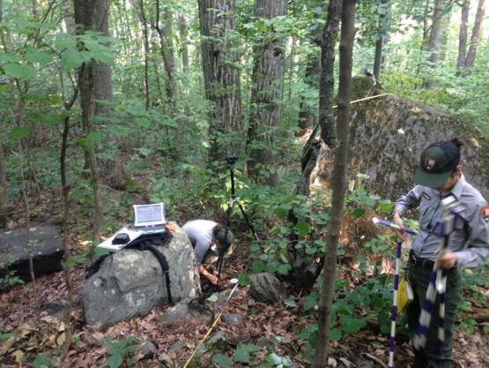
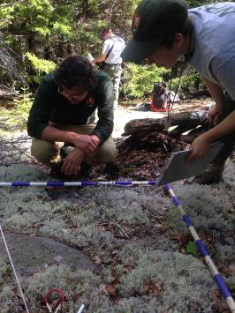
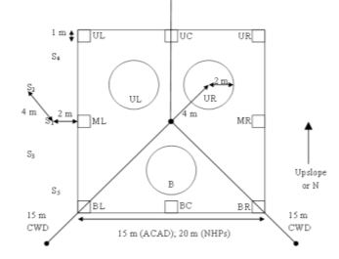
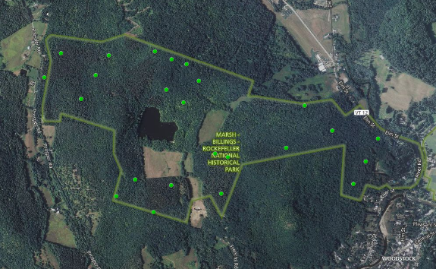
Forest Vegetation and Health monitoring
Objectives:
  Estimate changes in the abundance and composition of tree, shrub, and understory strata.
  Estimate effects from deer, diseases, and insects on tree and forest condition.
  Link results in context of other monitoring
Design and Data:
  annual monitoring since 2007 in 9 parks
  random, spatially balanced sampling within a park
  numerous data from all veg strata
    Regeneration and forest structure
  Soils data, tree cores, deer browse, etc
Program contact and data requests:
  Kate Miller
  kathryn_miller@nps.gov
  (207) 288-8736
  https://www.nps.gov/im/netn/forest-health.htm
Plot dist’n in a park
Plot Design

Slide 8

Forest Health monitoring – Appalachian NST
Objectives:
  Estimate changes in forest composition, invasive species presence, and regeneration within ecoregions over time.
  Support park and partner management and planning (conservation, large landscape)
Data:
  USFS FIA data queried and summarized per ecoregional subsection (20)
  Acquired and summarized as new data becomes available.
  Currently building new data processing workflow
Program contact and data requests:
  Fred Dieffenbach
  Fred_Dieffenbach@nps.gov
  802-457-3368 x 236
  https://www.nps.gov/im/netn/forest-health.htm
HUC10 Shell (black outline) and AT footpath (gray).

Slide 9
NPS I&M Eastern Forest Monitoring programs
4 letter acronyms refer to park units – 39 parks, ~2K plots, most monitored annually since 2007
Notes:
There are 50 parks that are monitoring forest health in the eastern US using similar protocols.
This has allowed us to start pooling our data to look at broader regional patterns.

Slide 10
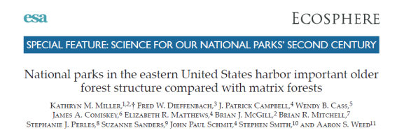
Outline
NPS Mission and Management
Monitoring forest condition
Translating results of forest monitoring
Notes:
Today I’m going to give an overview of the NPS mission and how management objectives have shifted over the last decade or so.
Then I’ll highlight some of the lessons we’ve learned through monitoring on status and trends in forest condition;
I’ll talk about some future concerns, along with their management implications.

Slide 11
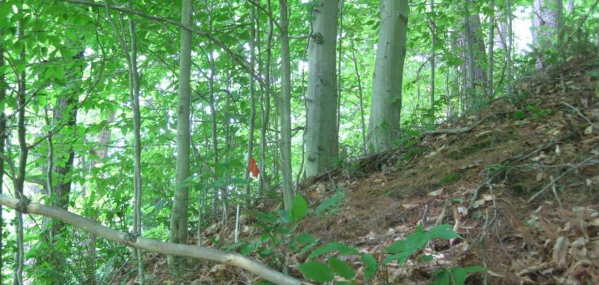
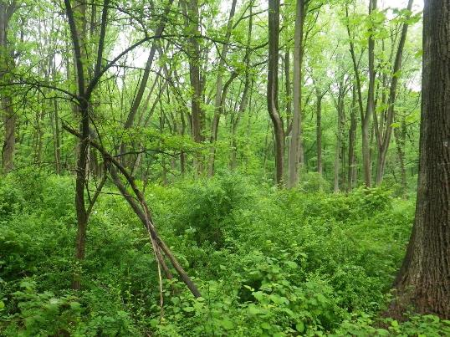
Park forest condition and threats
Main threats to park forests
Invasive plants and pests
Deer overabundance
Lacking and/or suboptimal regeneration
Results from these parks
Acadia NP – ME
Saint Gaudens NHS- NH
Marsh-Billings- Rock. NHP – VT
Minute Man NHP- MA
Saratoga NHP- NY
Roosevelt-Vanderbilt NHS - NY
Weir Farm NHS – CT
Morristown NHP- NJ
Morristown NHP Plot 21: 5/23/2017

Slide 12
Invasive Average % Cover by Guild
Cycles: 1= 2007-10; 2= 2011-14; 3= 2015-18
Miller et al. in prep
Notes:
Average % cover per quadrat patterns are similar- shrubs are most abundant, and tend to increase.

Slide 13
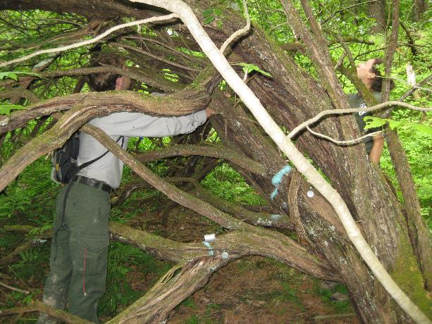
Invasive shrub cover in Saratoga NHP

Slide 14
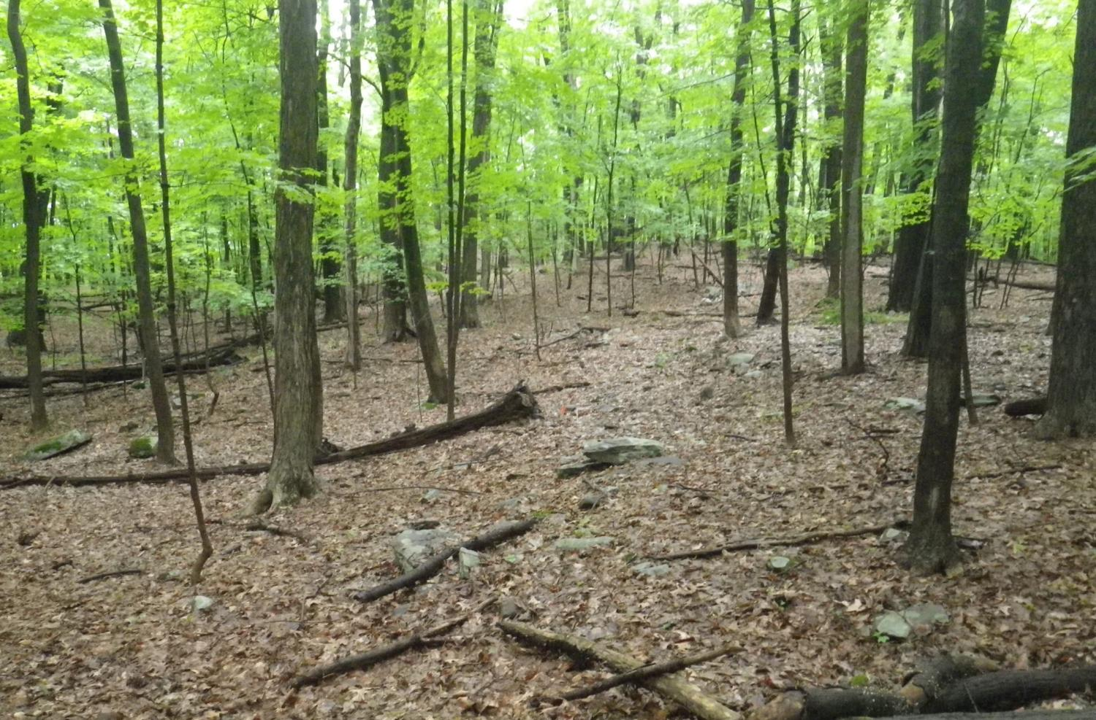
Lack of Regeneration Layer
Home of Franklin D. Roosevelt NHS
Cycles: 1= 2007-10; 2= 2011-14; 3= 2015-18
Suff. Stocked in high deer dens.
Severely Understocked
Notes:
Kate: HOFR in ROVA (plot 022)

Slide 15
Regeneration Composition in Saratoga NHP
In general we are seeing regeneration debts in southern NE, NJ, and NY.
In some park stands, regen is sufficient but we are seeing a lot of ash in the regenerating layer.
Raises questions about the resilence of the future forest.

Slide 16
Regional monitoring and science in park forests
4 letter acronyms refer to park units – 39 parks, ~2K plots, most monitored annually since 2007
Notes:
There are 50 parks that are monitoring forest health in the eastern US using similar protocols.
This has allowed us to start pooling our data to look at broader regional patterns.

Slide 17
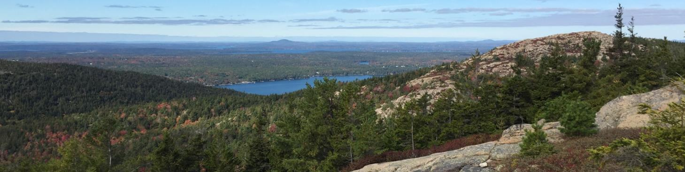
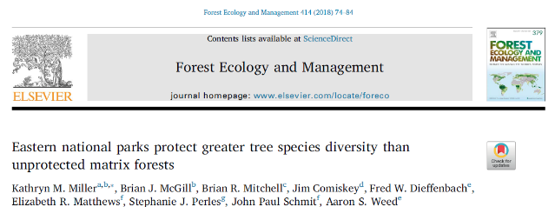
Regional monitoring in park forests –recent studies
Park forests harbor more complex older-forest structure than surrounding matrix forests (Miller et al. 2016 Ecosphere)
Park forests had greater tree diversity than surrounding matrix forests (Miller et al. 2018 Forest Ecol. and Man.)
Common forest understory stressors (worms and deer) and warming conditions promote non-native plants in park forests (Fisichelli and Miller 2017 Biol. Invasions)
Notes:
This was significant finding to our parks. It helped us to see the importance of the forest habitat that we’re protecting.

Slide 18
Implications for Parks
Non-climate stressors are impacting resilience and adaptive capacity of park forests
More proactive management may be needed to meet park objectives
  Managing deer and invasive plants high priority
  Direct planting/seeding
  Assisted migration
Forests in parks may respond differently to climate change and stressors than surrounding matrix forests
Park forests may be more resilient than matrix forests into the future
Climate change may require shift to more active management
Notes:
New paradigm of managing in parks. Typically has been very hands off- allow natural processes to occur and only intervene if stressor disrupting natural process.
Depending on park management objectives, which haven’t been fully considered in light of climate change, there may be a shift towards more active management approaches.
In some ways, it’s an exciting time to be in the park service and be a part of these discussions and decisions.

Slide 19
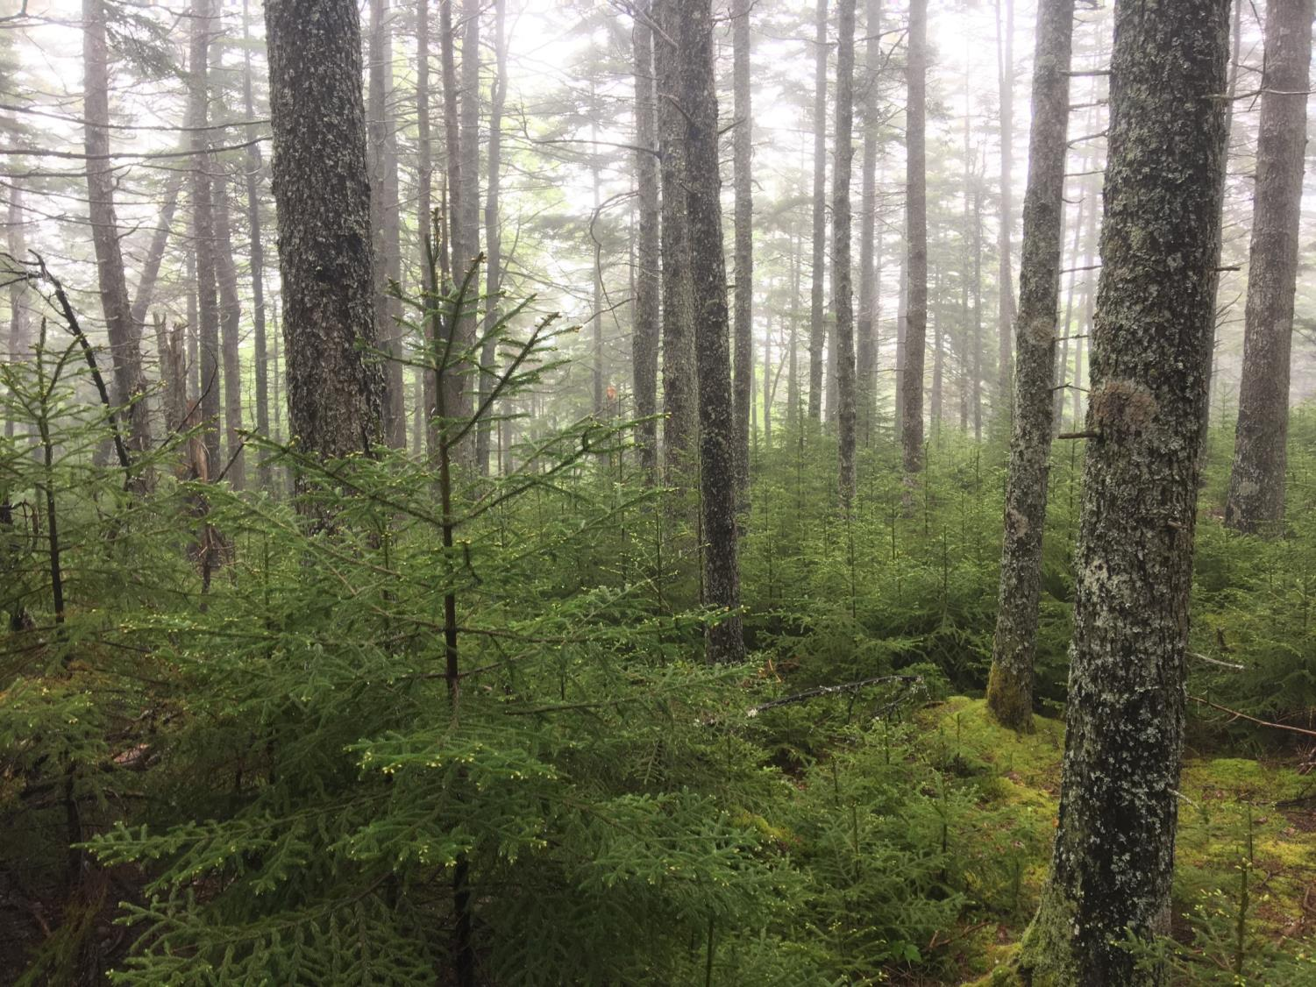

Northeast Temperate Network
54 Elm Street, Woodstock, VT 05091
Web: http://go.nps.gov/netn
Facebook: facebook.com/NPS.NETN
Aaron_Weed@nps.gov
802-359-3896
Please check out our poster!
12-year forest trends in Acadia National Park
National Park Service
U.S. Department of the Interior

