Slide 1
Using motion-triggered camera traps to describe patterns of mammal species richness and abundance in relation to anthropogenic and ecological factors
Presentation by Alyssa Valentyn ’19
Co-Authors: Declan McCabe, Jade Jarvis ’18, Schyler Schewe ’18,
Olivia Richards ’18, Ethan Brookner ’20

Slide 2
Saint Michael’s College Vice President of Academic Affairs
Saint Michael’s College Board of Trustees

Slide 3
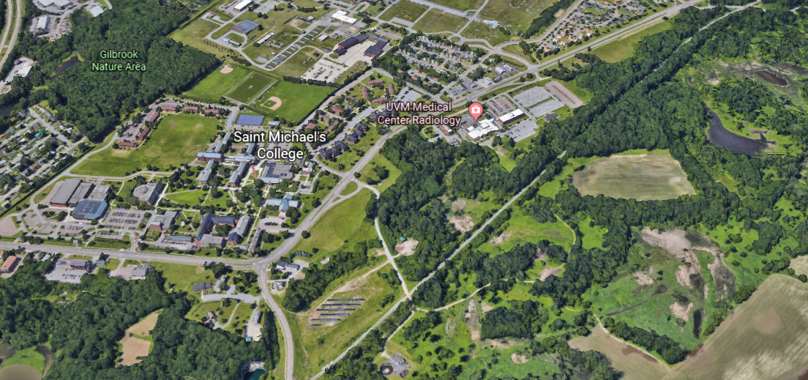
Map from Google Earth

Slide 4
Human Activity

Slide 5
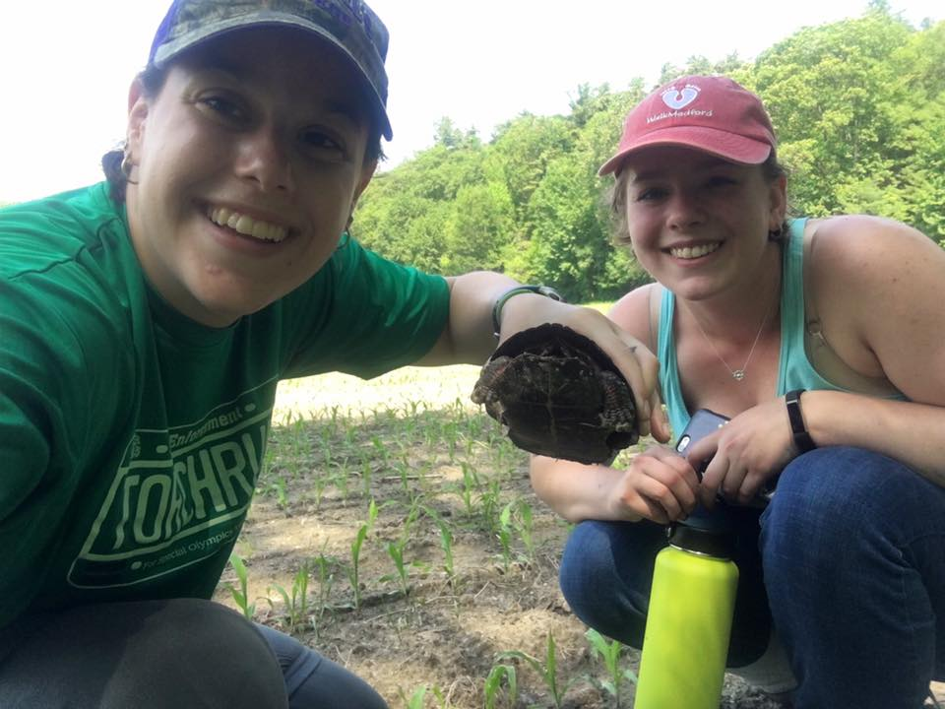
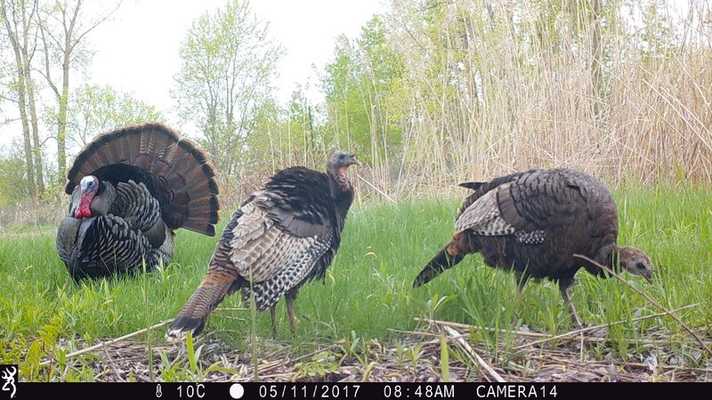
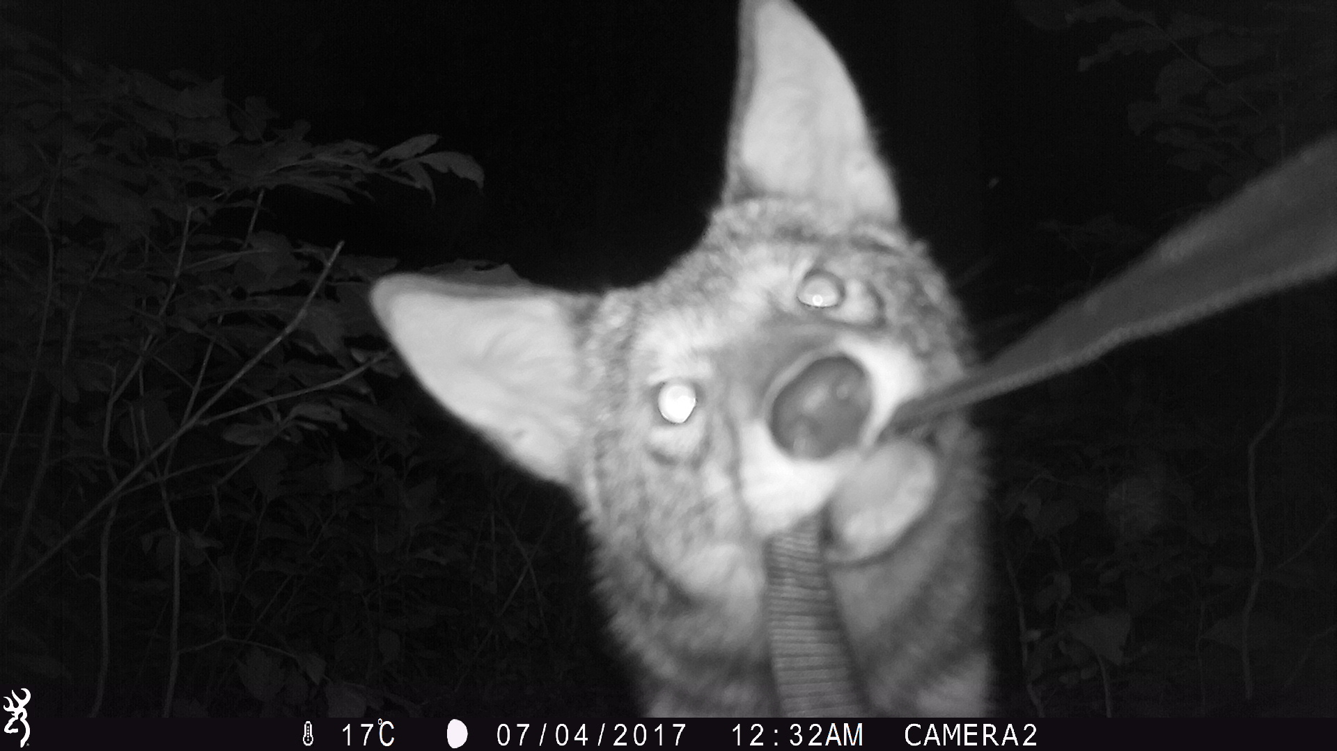
Jade Jarvis ’18: Human Visitation

Slide 6
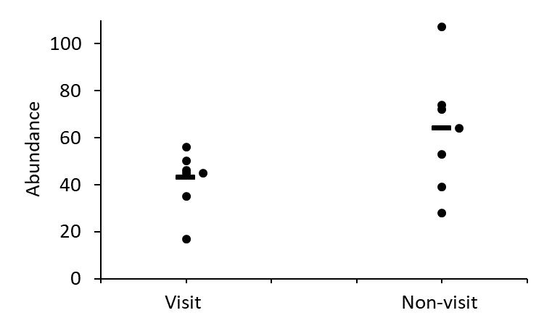
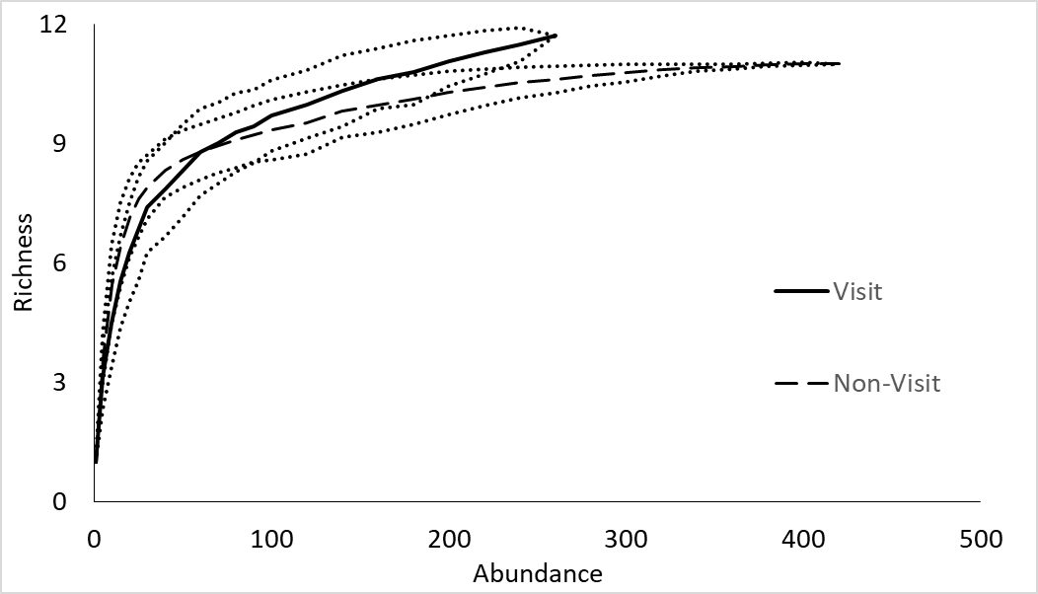
Lower abundance at visited sites
Richness not different

Slide 7
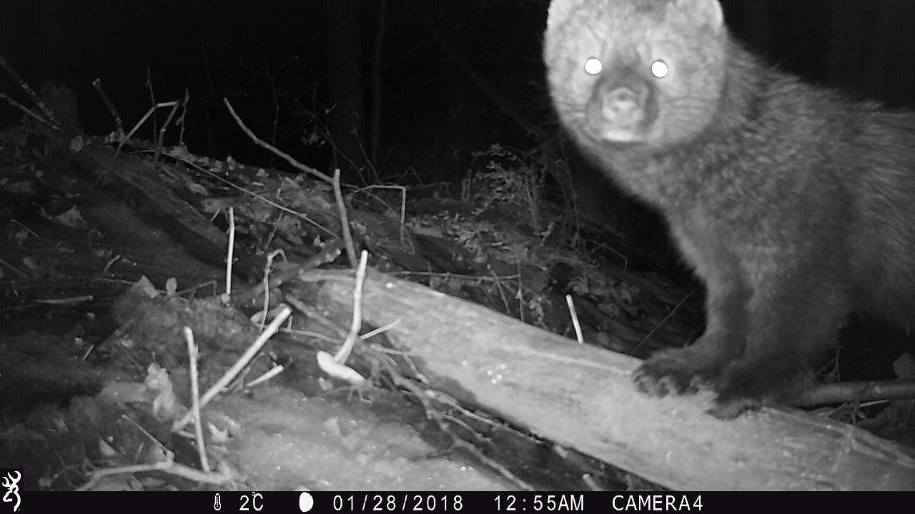
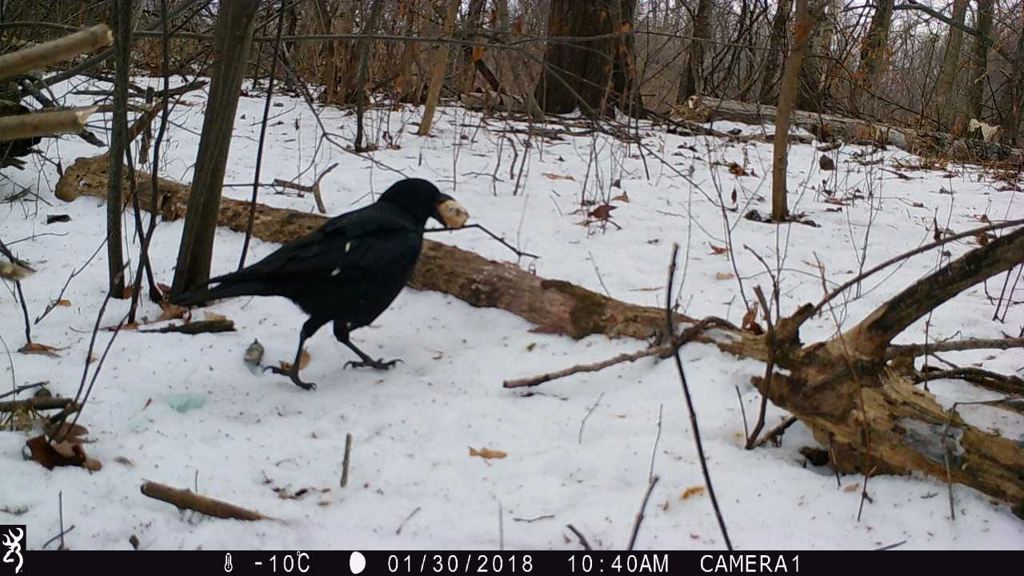
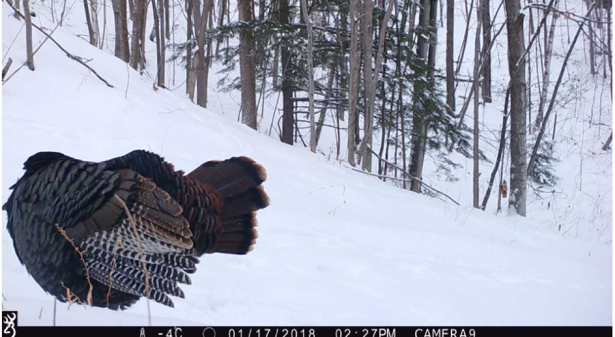
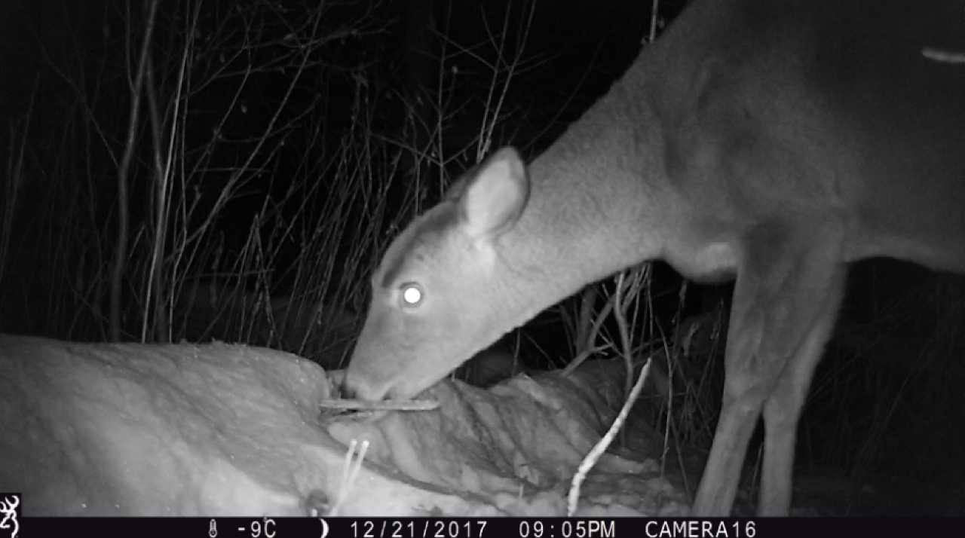
Olivia Richards ’18 & Schyler Schewe ’18: Compost

Slide 8
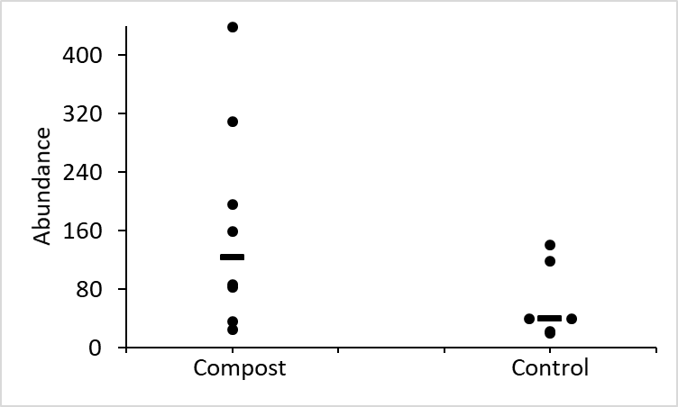
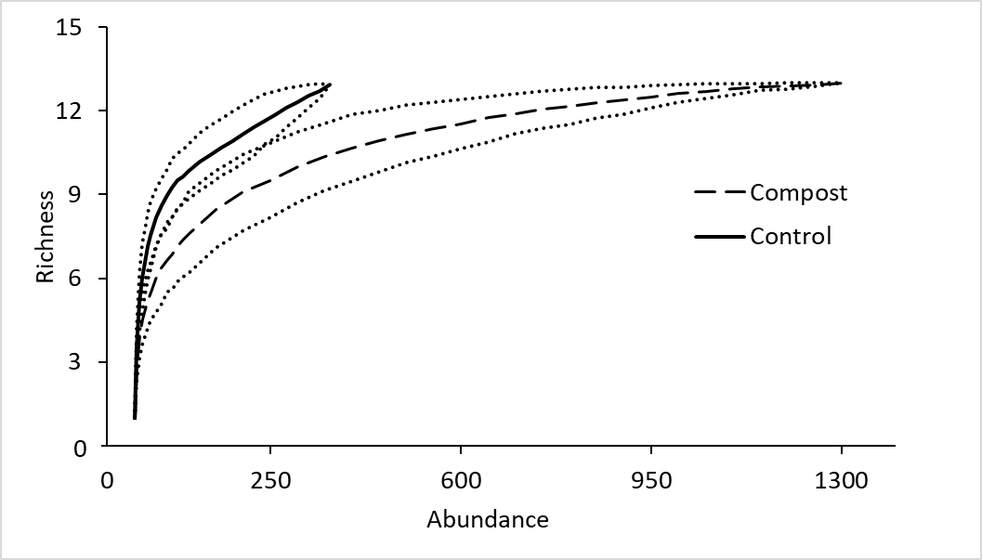
Greater abundance at compost sites
Fewer species at compost sites

Slide 9
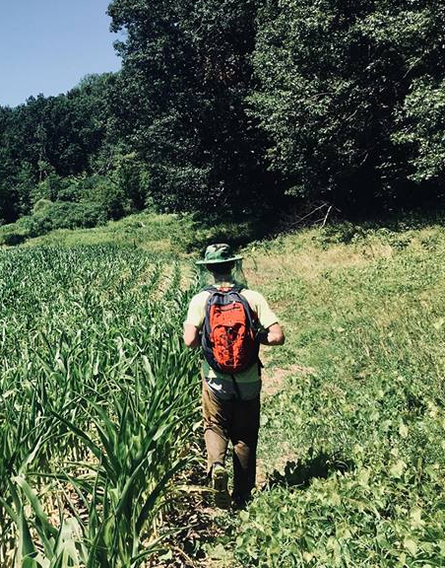
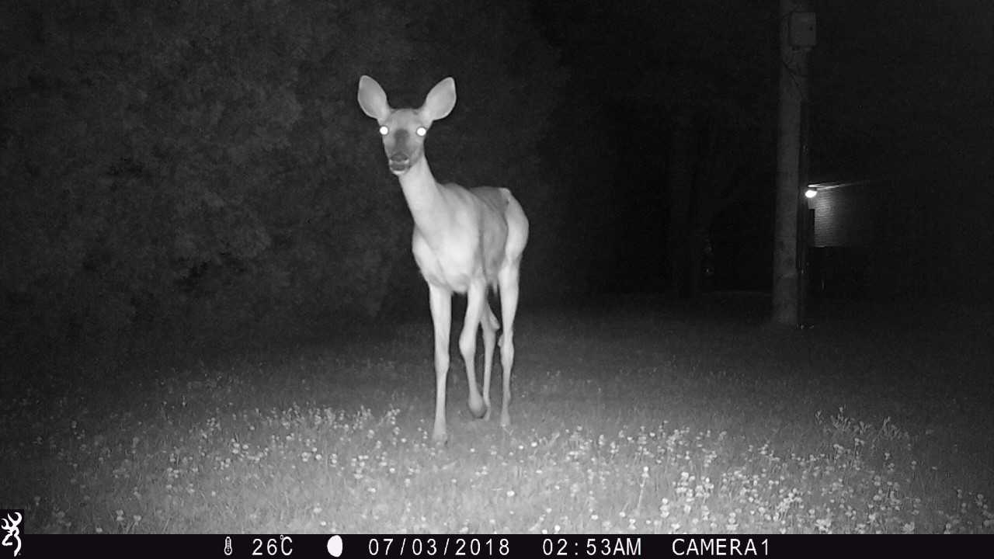
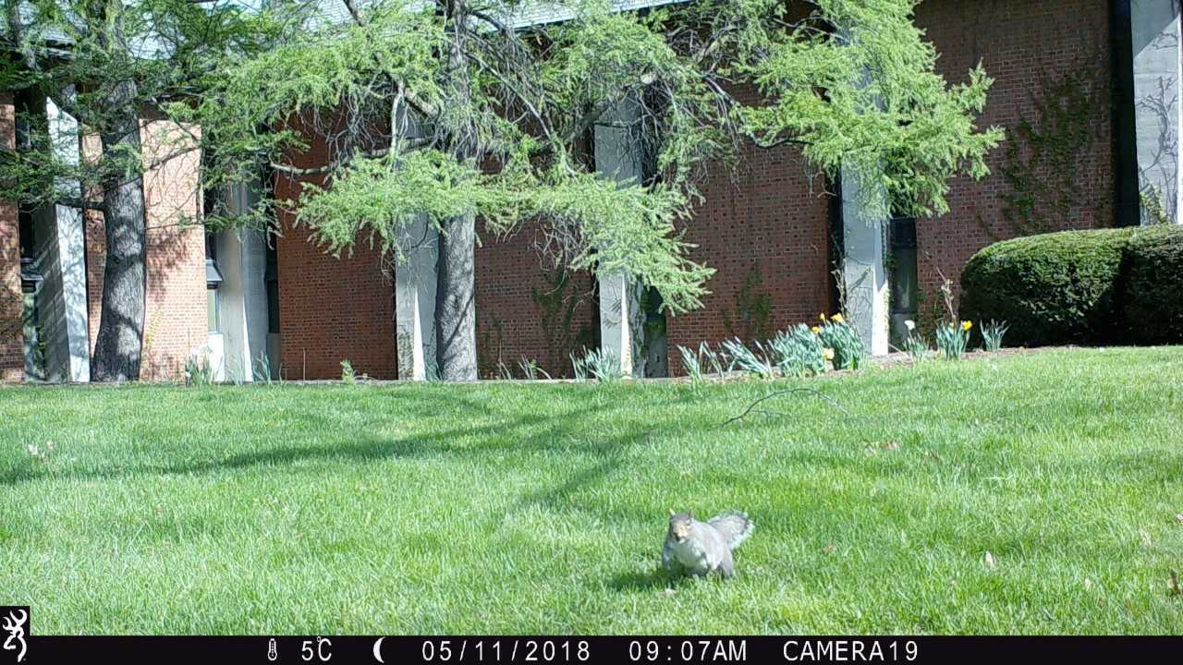
Ethan Brookner ’20: Campus

Slide 10
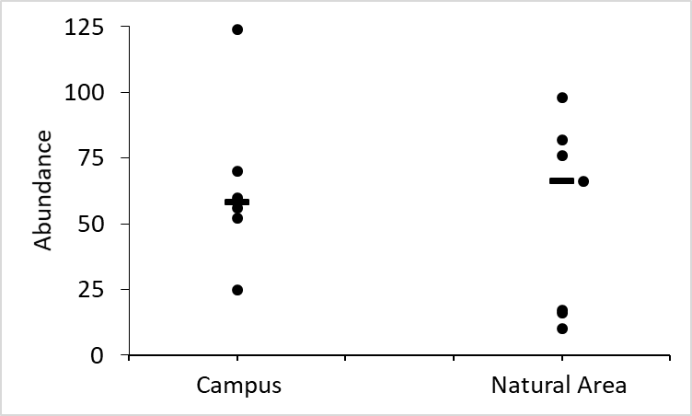
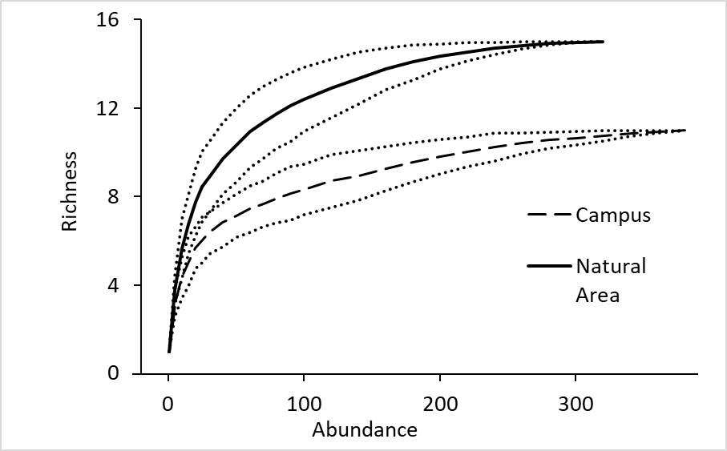
No difference in abundance
Greater species richness in Natural Area than on campus

Slide 11
Ecological Factors

Slide 12
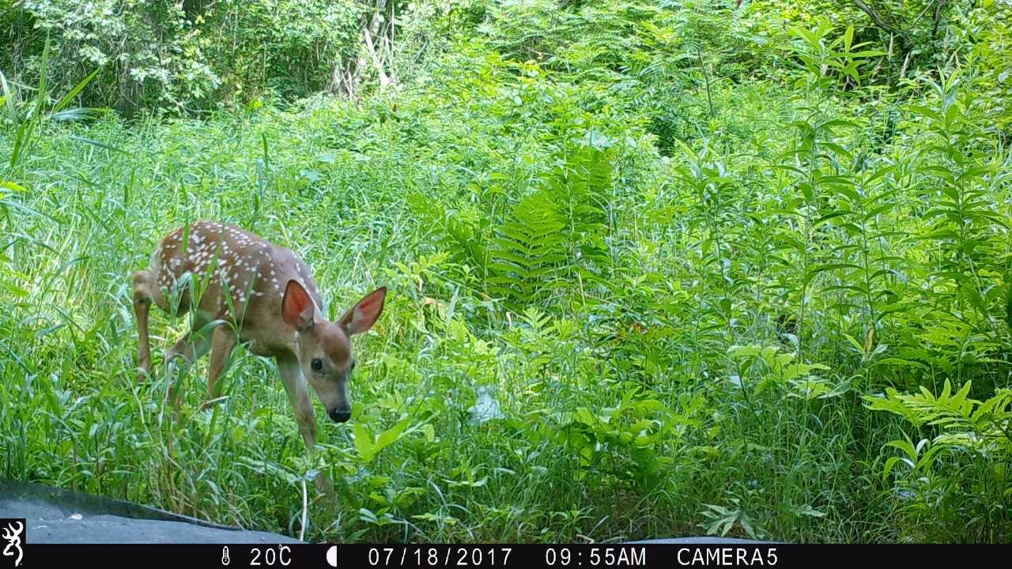
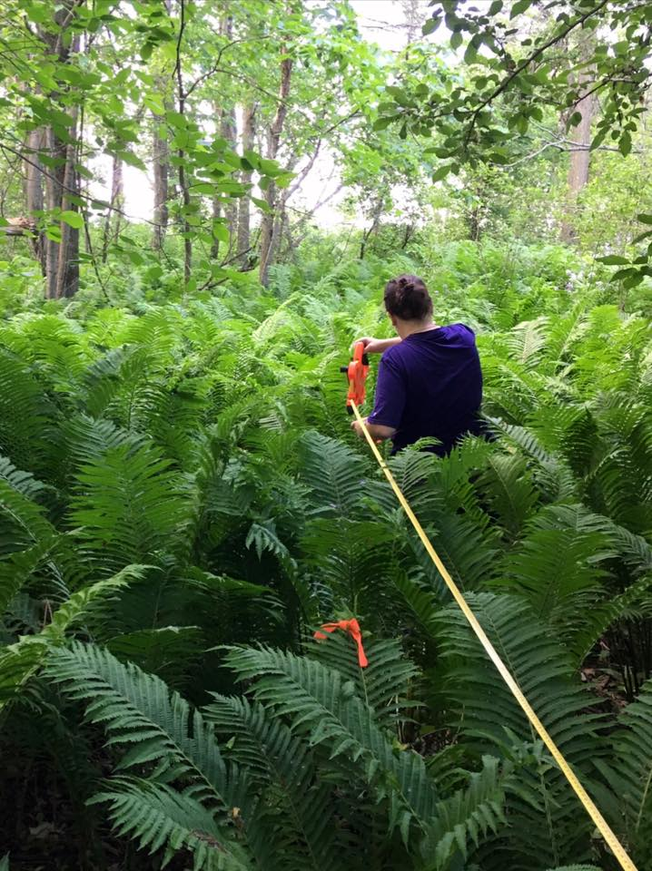
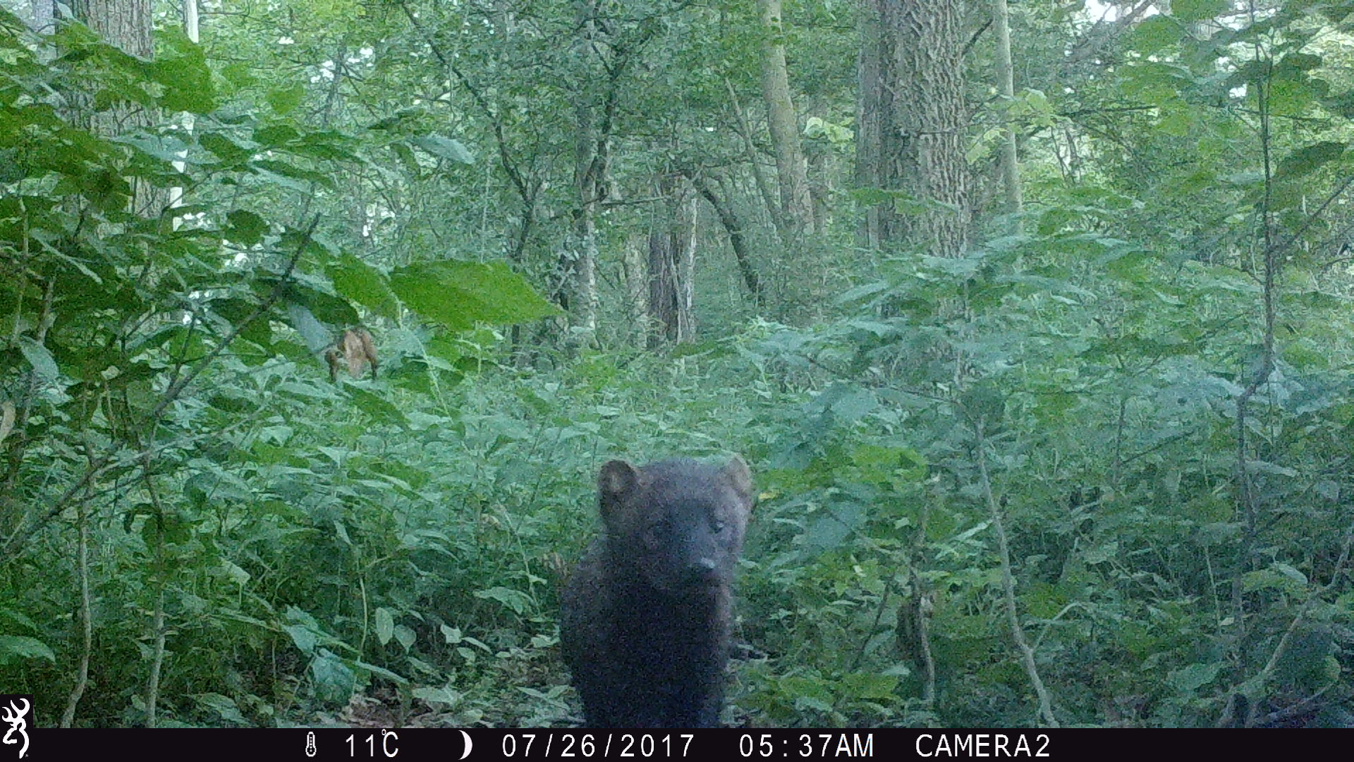
Tree and Shrub Density

Slide 13
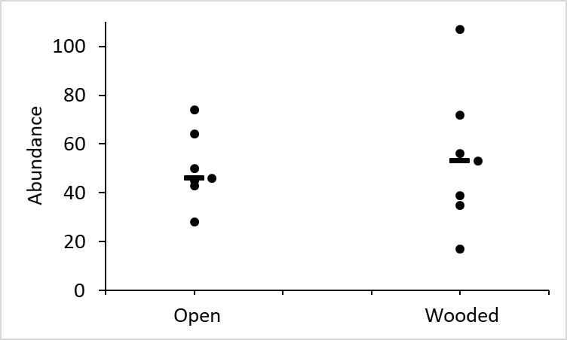
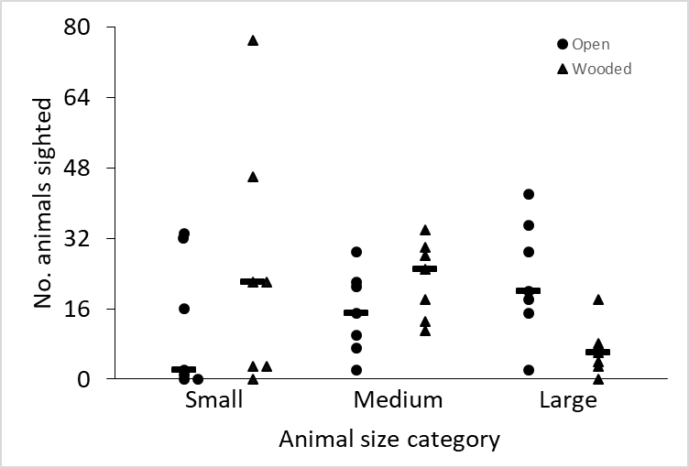
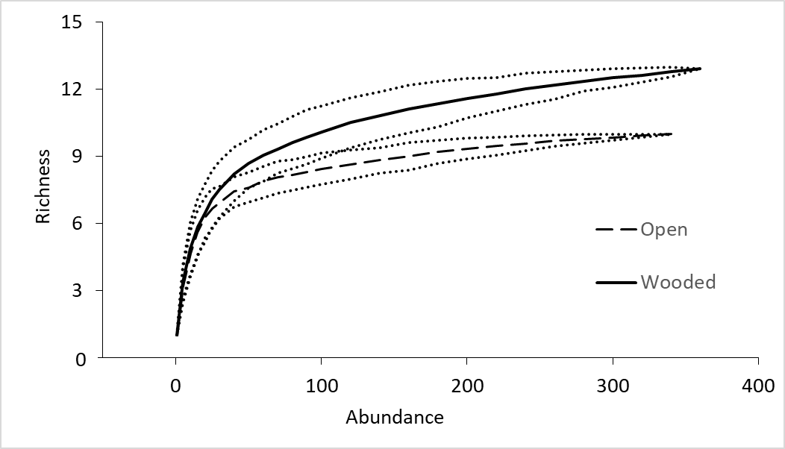
No difference in abundance
Greater number of species in wooded sites
Small animals more abundant in forest; large animals more abundant in fields

Slide 14
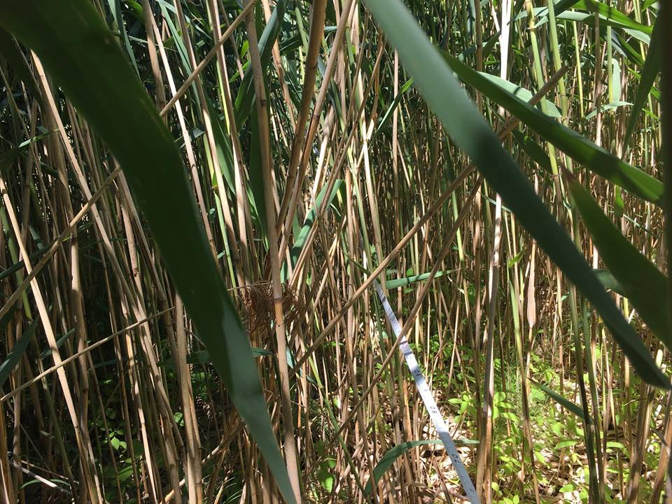
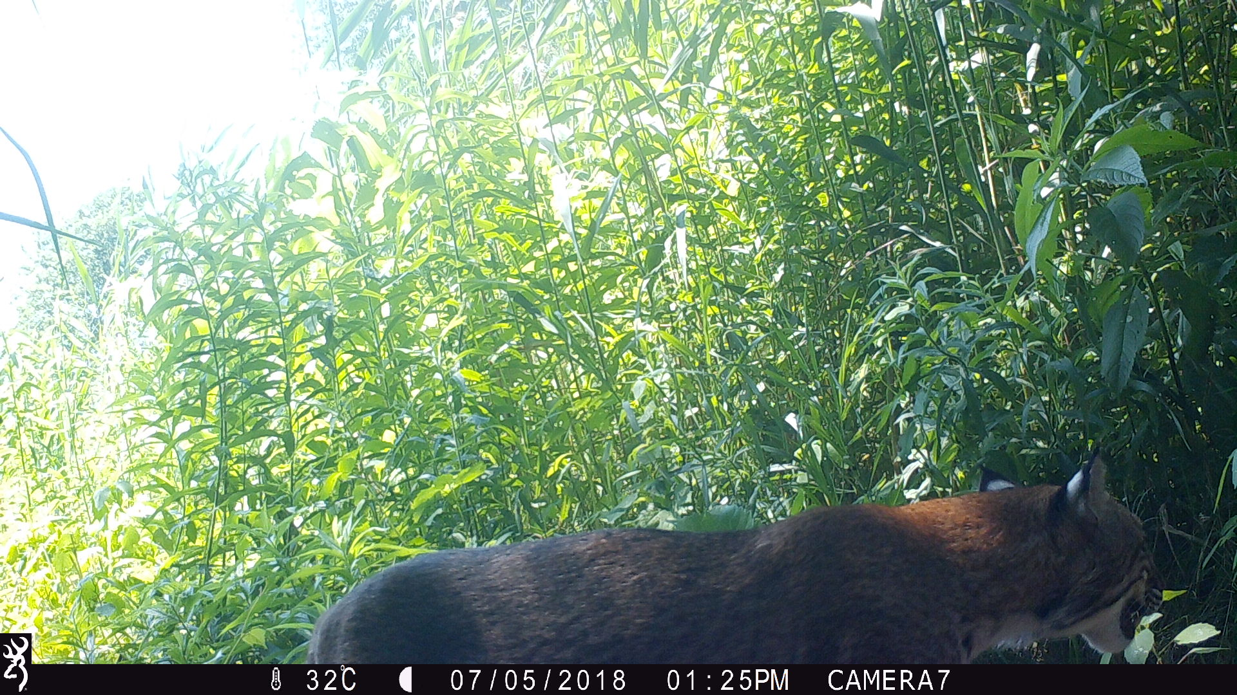
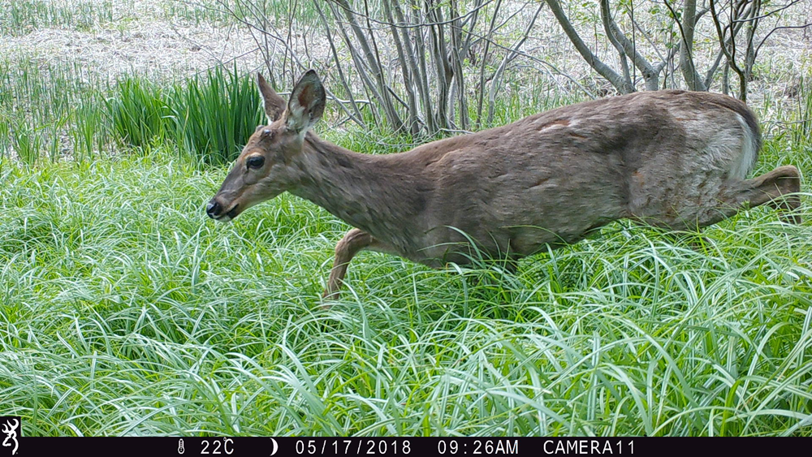
Wetlands

Slide 15
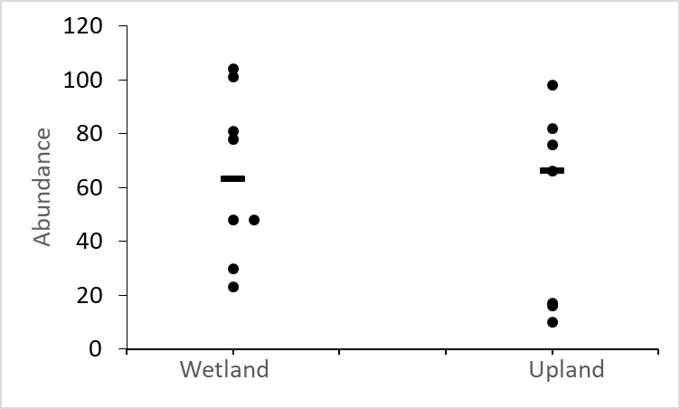
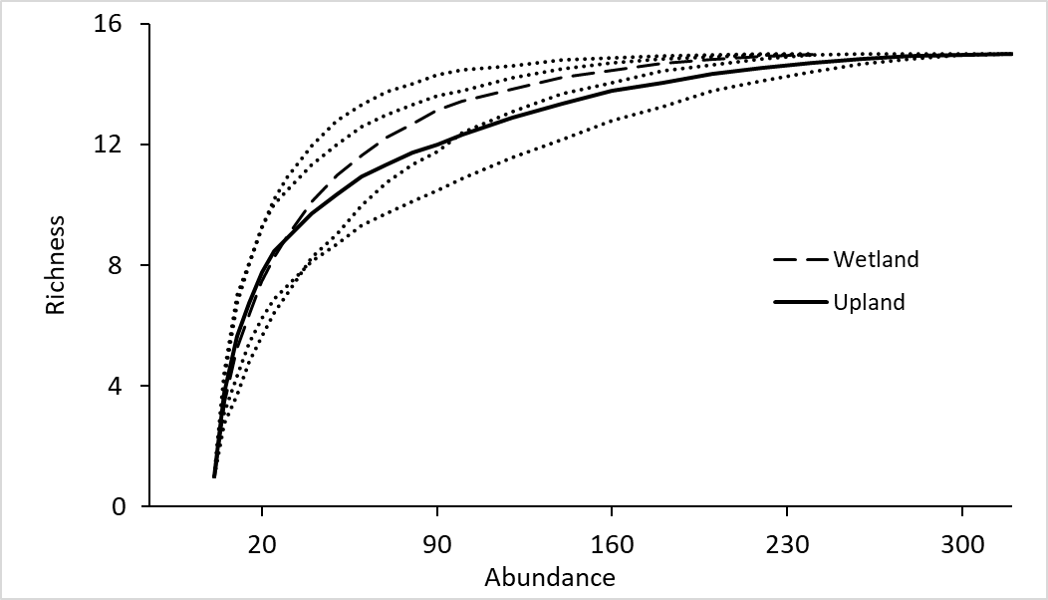
No difference in abundance
No difference in richness

Slide 16
Conclusions
Mammals respond to human visitation with wariness, likely corresponding with high levels of vehicle activity
Both compost and human development draw in certain species but exclude others
Patterns at compost sites are complicated by predation
Mammal distribution is linked with size and mobility
Large mammals are mobile and therefore not great indicators of wetland species richness

Slide 17
